Slide 1
Summary of IAC meeting
Aharon Levy
Tel Aviv University
DIS2016, DESY, April 15, 2016
XXIV International Workshop on
Deep-Inelastic Scattering and
Related Subjects (DIS 2016)

Slide 2
N(DIS) as function of time
DIS 15, Dallas
DIS 16, DESY
20 plenary talks
268 parallel talks
Total of 288 talks
>327 participants
(participants from 33 countries,
33% from Germany)
24 plenary talks
229 parallel talks
Total of 253 talks
263 participants
(participants from 28 countries,
58% from the US)

Slide 3
N(DIS) as function of time
JLAB
Madrid
Marseille
DESY
Zeuthen
St.Petersburg
Madison
Waesaw
Bologna
MPI
UCL
Bonn
Kosice
Dallas
Chicago
Cracow
KEK
Liverpool
Brussels
Firenze
Paris
Rome
Eilat
durham

Slide 4
Countries
Countries (33)
Argentina, Austria(2), Belgium(7), Brazil(2), Canada, China(8), Croatia, Czech(4), Denmark, Finland, France(14), Germany (109), Greece(3), Hungary, India(10), Iran(6), Ireland, Israel(5) , Italy(16), Japan(6), Netherland(5), Poland(14), Portugal(4), Russia(8), Spain(4), Sweden(6), Switzerland(10), Taiwan, Thailand, Turkey(2), Ukraine, UK (26), USA (45).

Slide 5
Altarelli Award
“From here to Eternity”
1951 novel James Jones
1953 8 Oscars

Slide 6

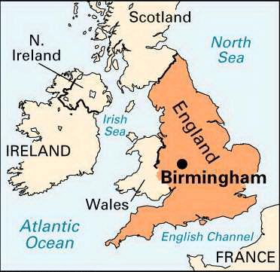

Proposal to Host DIS’17 in Birmingham
Paul Newman
DIS’16 IAC Meeting
DESY Hamburg
13 April 2016
Dates:
3-7 April 2017

Slide 7
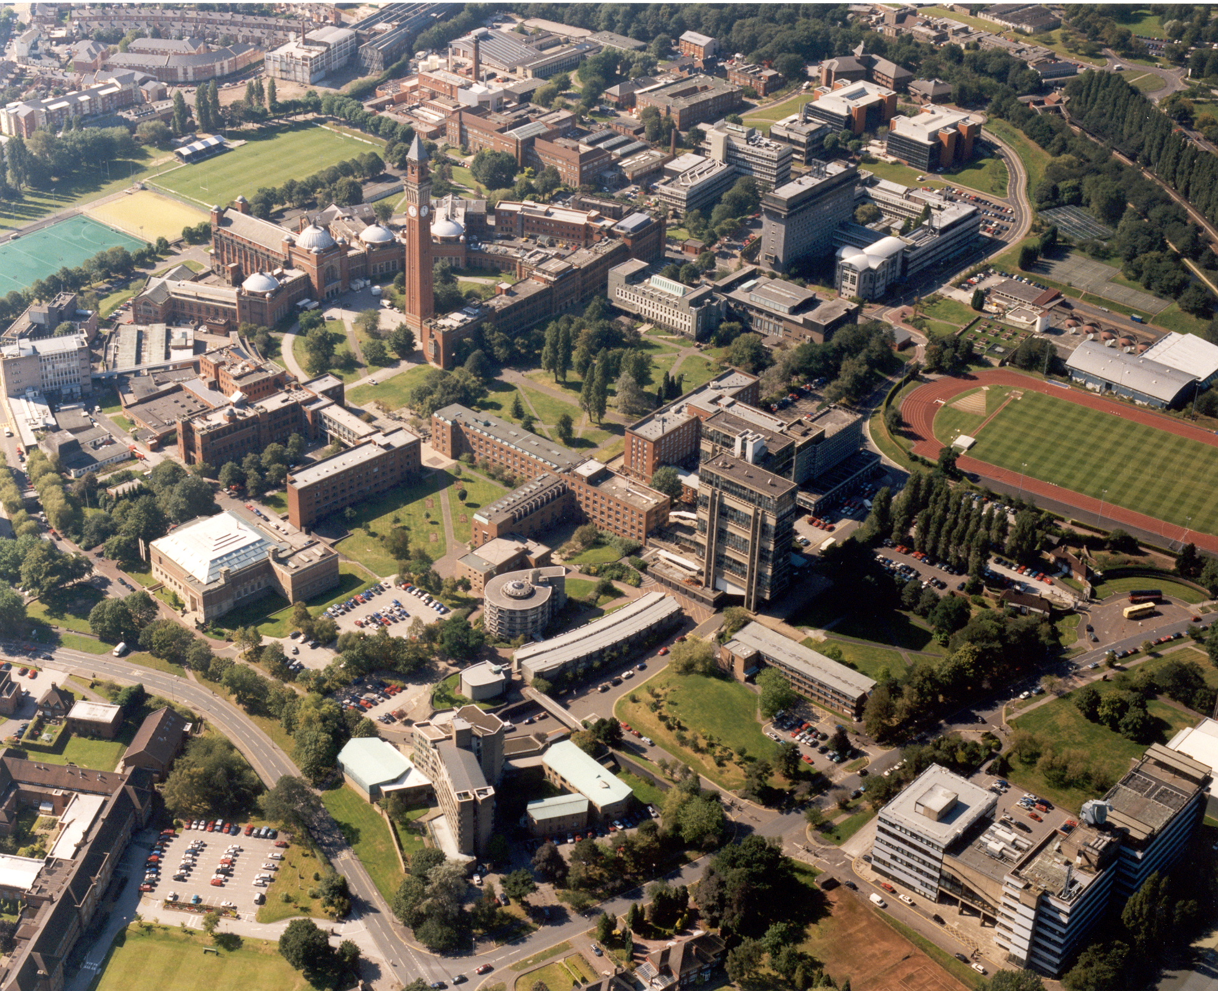
Conference Location @ University
Large ‘redbrick’ campus university with ~30,000 students and on-site facilities typical of a small town (shops, cafes, bars, new sports centre …)
Physics spread
over several
buildings near
the centre “old
Joe” clock tower
1
2
3
Plenaries
Parallels
Lunches

Slide 8
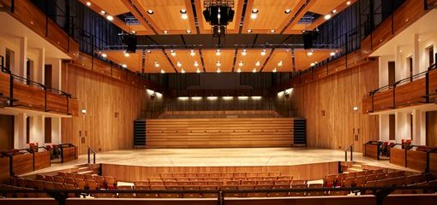
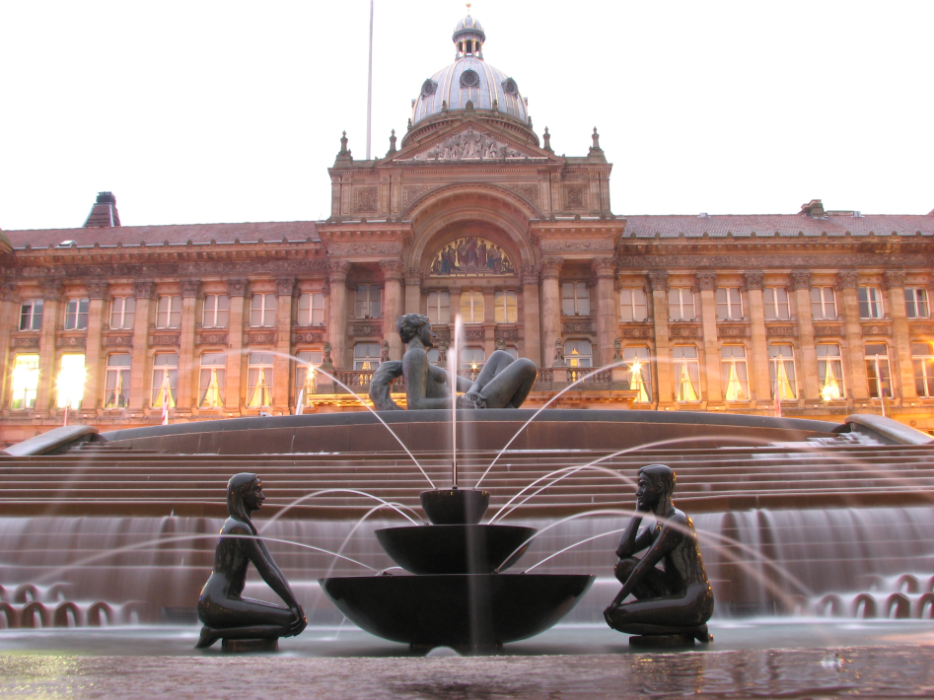
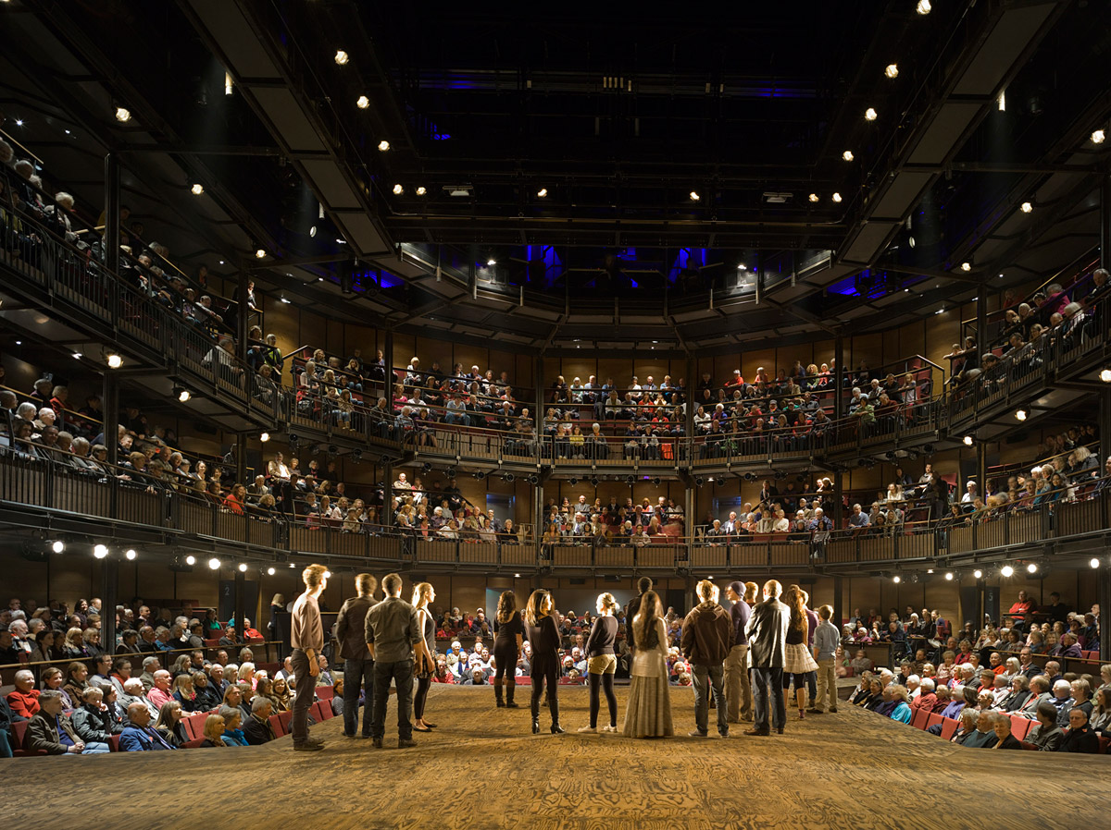
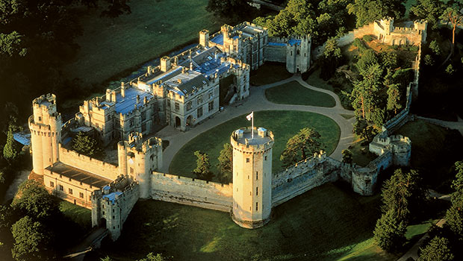
Plenaries: Elgar
Concert Hall
Dinner: Birmingham Town Hall
Excursion: Stratford-upon-Avon

Slide 9
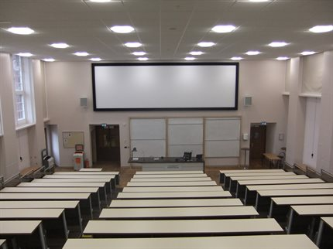
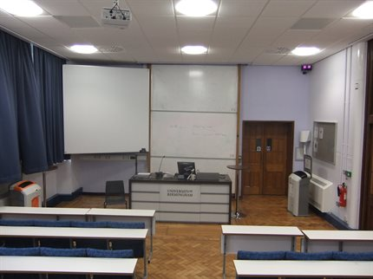
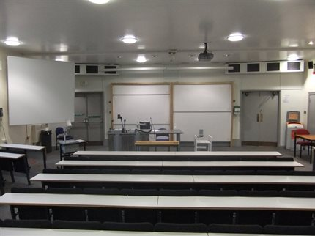
Location for Meetings
Elgar Concert Hall reserved for Mon & Fri plenaries
(built in 2012, holds 420 people orchestra, next door to physics)
Parallel sessions in physics department (tbc):
3 x 100+ lecture theatres,3 x 40+ seminar rooms

Slide 10
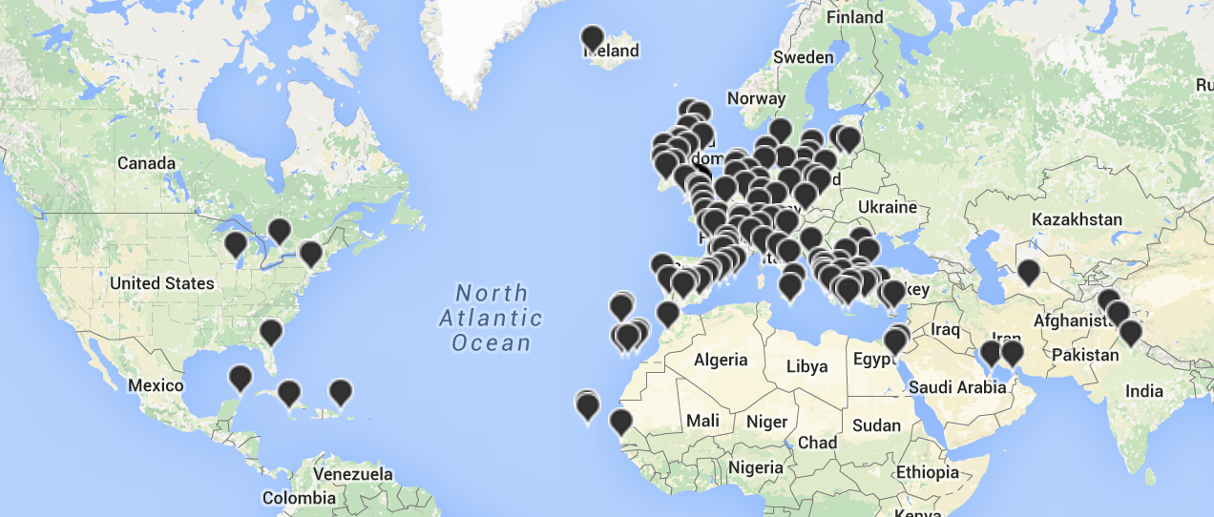
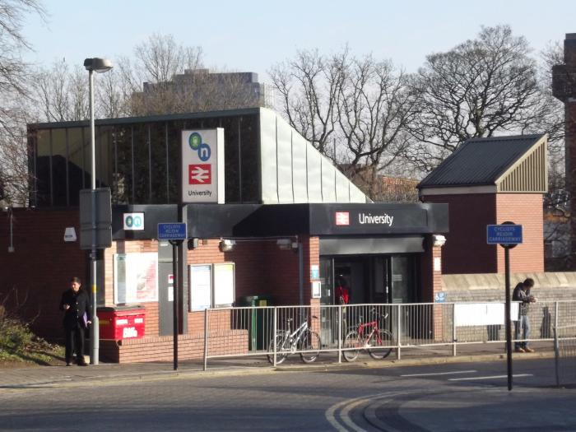
Travel
Birmingham
International
Airport is 15 mins to
city centre or 40 mins
to University by train
(or ~€35 taxi to University)
Connections to many European cities + daily flights to USA +
Asian / Pacific destinations via Gulf airports.
Good connections to other UK
cities / airports (e.g. about 2.5
hours To Heathrow
University campus has its own
Railway Station (2 stops from
City centre, trains every 10 mins)

Slide 11

Accommodation
- Wide range of hotels in city centre within easy reach
- Significantly cheaper than e.g. London (from ~ €60)
Very well organised hotel booking site run by regional
tourist board

Slide 12
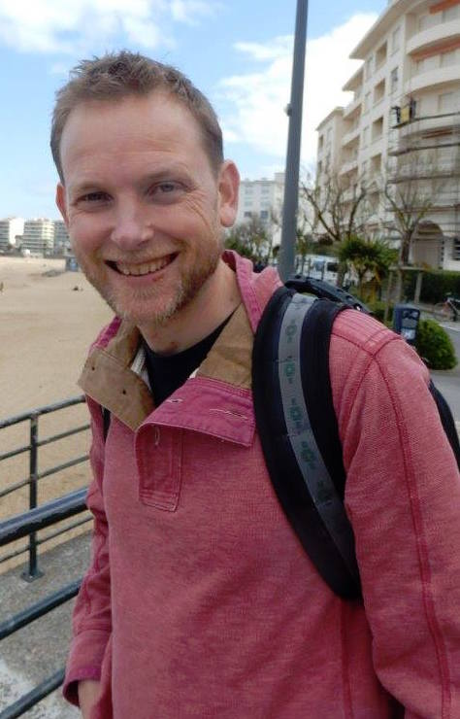
DIS2017, Birmingham, UK
April 3 – 7, 2017

Slide 13
Kabalah (Gematria)
From Wikipedia, the free encyclopedia
Gematria is an Assyro-Babylonian system of numerology later adopted by Jews which assigns numerical value to a word or phrase, in the belief that words or phrases with identical numerical values bear some relation to each other, or bear some relation to the number itself as it may apply to a person's age, the calendar year, or the like.

Slide 14
Kabalah (Gematria)
Olaf Behnke
אולף בהנקה
279
Energy
Calm
Trust

Slide 15
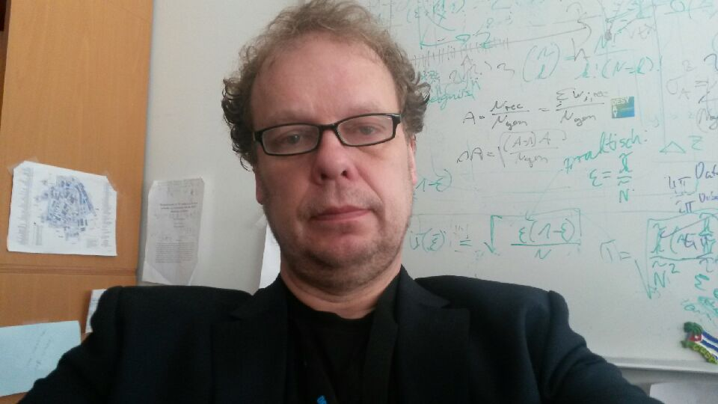
Thank you, Olaf!

Slide 16
Thank you DIS 2016
See you at DIS 2017

