Slide 1
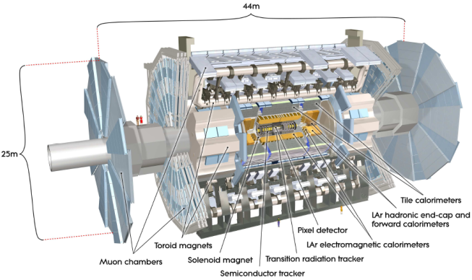


Future upgrades of the ATLAS detector for the High Luminosity -LHC (mostly ITk)
Sergio Díez Cornell
DESY
DESY LHC discussions, Hamburg, 08 June 2015

Slide 2
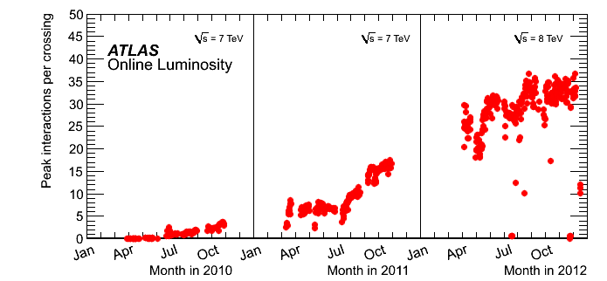
ATLAS
ATLAS detector
  General purpose detector of the LHC
  Sub-components:
    Magnets
    Muon chambers
    Hadronic and EM calorimeters
    Inner detector
      TRT, SCT, pixel
Outstanding performance so far!

Slide 3
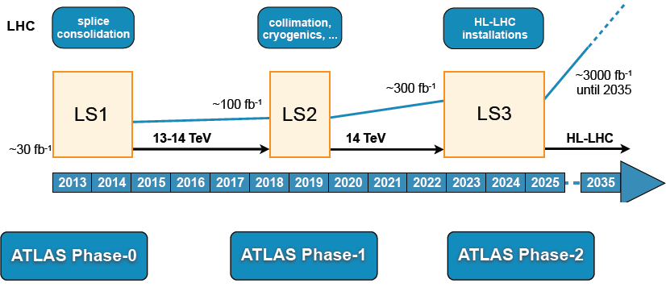
The LHC schedule and future ATLAS upgrades
L= 1x10³⁴ cm⁻²s⁻¹
<µ > ~ 30
L= 2x10³⁴ cm⁻²s⁻¹
<µ > ~ 60
L= 7.5x10³⁴ cm⁻²s⁻¹
<µ > ~ 160-200, leveling

Slide 4
The LHC schedule and future ATLAS upgrades
L= 1x10³⁴ cm⁻²s⁻¹
<µ > ~ 30
Phase-0 upgrades
New Insertable pixel b-layer (IBL) and pixel services
New Al/Be beam pipe
New Inner Detector cooling
Upgrades to Level-1 Central Trigger
Detector consolidation (e.g. calorimeter power supplies)
Add specific neutron shielding
Finish installation of EE muon chambers staged in 2003
Upgrade magnet cryogenics
L= 2x10³⁴ cm⁻²s⁻¹
<µ > ~ 60
L= 7.5x10³⁴ cm⁻²s⁻¹
<µ > ~ 160-200, leveling

Slide 5
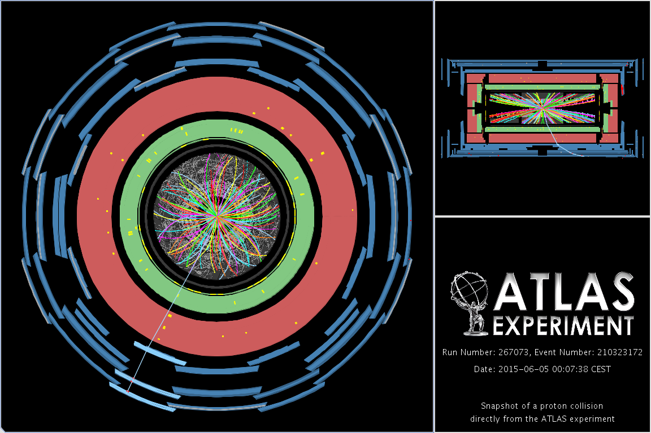
The LHC schedule and future ATLAS upgrades
http://atlas-live.cern.ch/

Slide 6
The LHC schedule and future ATLAS upgrades
L= 1x10³⁴ cm⁻²s⁻¹
<µ > ~ 30
L= 2x10³⁴ cm⁻²s⁻¹
<µ > ~ 60
L= 7.5x10³⁴ cm⁻²s⁻¹
<µ > ~ 160-200, leveling
Phase-1 upgrades
New Small Wheel (NSW) for the forward muon Spectrometer
High Precision Calorimeter Trigger at Level-1
Fast TracKing (FTK) for the Level-2 trigger
Topological Level-1 trigger processors
Other Trigger and DAQ upgrades
ATLAS Forward Physics (AFP), proton det. at ±210 m

Slide 7
The LHC schedule and future ATLAS upgrades
L= 1x10³⁴ cm⁻²s⁻¹
<µ > ~ 30
L= 2x10³⁴ cm⁻²s⁻¹
<µ > ~ 60
L= 7.5x10³⁴ cm⁻²s⁻¹
<µ > ~ 160-200, leveling
HL-LHC

Slide 8

Motivation for HL-LHC
Motivation:
  Measurements on the 126 GeV Higgs boson
    Improved precision of Higgs couplings measurements
    Access couplings with new final states through rare channels (such as H→μμ)
    Higgs-like self-coupling studied on new channels (such as HH →γγbb)
  Probe for signatures of new physics (SUSY, extra dimensions) well into TeV region
    Weak production of new particles potentially more important
  Weak-boson scattering as another probe for EWSB beyond SM
Physics Letters B (716), 17th Sept 2012
Major upgrades on all detectors to maintain their excellent performances

Slide 9
Goals for HL-LHC
Physics
Study EWSB Mechanism | precision meas's of Higgs couplings (5-30%), Higgs self-coupling
Probe for signatures of New Physics | SUSY, Extra Dimensions, ....
Measure rare decay modes | Higgs, B, top, ....
Detector Requirements
Example Physics/Detector Motivation | Requirement
complex SUSY cascades | Trigger & reconstruct low pT e/μ
H → ττ | Trigger on τ's
High-mass gauge bosons | Good lepton e/μ momentum resolution at high pT
Complex SUSY cascades | Identify Heavy Flavors
Resonances in top pairs, W, Z, H | Reconstruct leptons & b's in boosted topologies
VBF, Missing ET | Preserve acceptance in forward region
Efficient tracking with small fake rates | Radiation Tolerance and Granularity
Impacts Front End electronics | Compatibility with new trigger system
Hal Evans

Slide 10

The ATLAS Phase-II upgrade
Upgrades on ATLAS sub-detectors
  Tracking
    Major revision, new Inner tracker including LVL1 trigger capability + new services
  Calorimetry
    New Front and back-end electronics, including trigger, new forward calo if proven necessary, fix LAr hadronic cold electronics if necessary
  Muon system
    Increase trigger capability in the big wheels, add additional trigger inner layers in the barrel. New FE electronics
  Trigger/DAQ
    Major revision
  Common systems
    New TAS (collimator) and forward shielding, major infrastructure consolidation, including safety systems
http://cds.cern.ch/record/1502664?ln=en
ATLAS Phase-II LoI released on Jan 2013

Slide 11
The ATLAS Phase-II upgrade
Upgrades on ATLAS sub-detectors
  Tracking
    Major revision, new Inner tracker including LVL1 trigger capability + new services
  Calorimetry
    New Front and back-end electronics, including trigger, new forward calo if proven necessary, fix LAr hadronic cold electronics if necessary
  Muon system
    Increase trigger capability in the big wheels, add additional trigger inner layers in the barrel. New FE electronics
  Trigger/DAQ
    Major revision
  Common systems
    New TAS (collimator) and forward shielding, major infrastructure consolidation, including safety systems
http://cds.cern.ch/record/1502664?ln=en
ATLAS Phase-II LoI released on Jan 2013

Slide 12
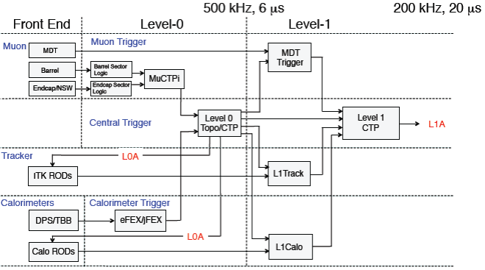
New Phase-II L0 and L1 trigger
1MHz, ~ 10 µs
400kHz, ~ 30 µs
2-level system at Phase II
Phase-I L1 becomes Phase-II L0, new L1 includes tracking
Make use of improvements made in Phase 1 (NSW, L1Calo) in L0
Introduce precision muon and inner tracking information in L1 (better muon p_{T} resolution, track matching for electrons,...)
Move part of the “offline” High Level Trigger (HLT) reconstruction into the early stage of trigger (additional p_{T} info on triggering leptons, reduce L1 rates)
Requires changes to detector FE electronics feeding trigger system
Drives ITk bandwidth requirements.

Slide 13
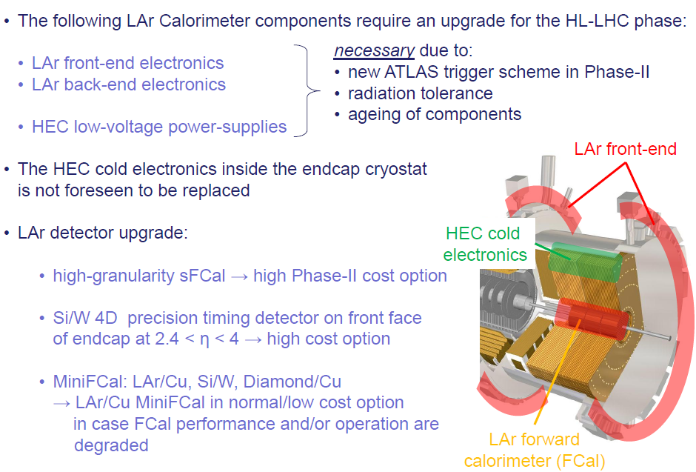
LAr Calorimetry upgrades
A. Strässner, AUW Apr 2015

Slide 14
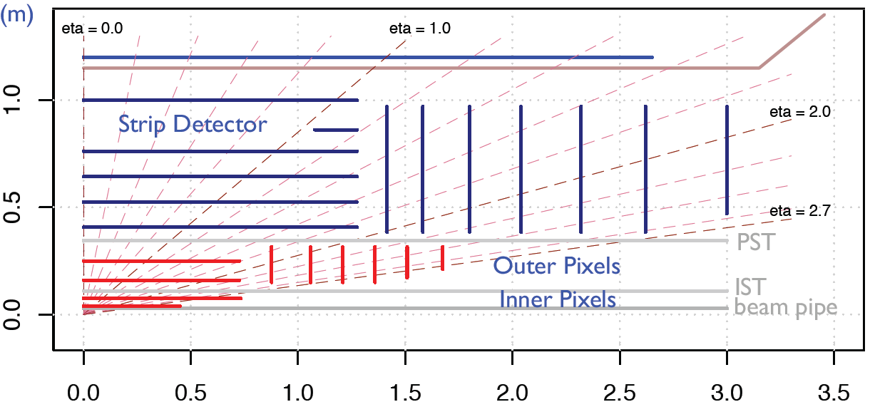
A new ATLAS silicon tracker
Challenges for silicon sensors
  Higher granularity to keep same low occupancy
  Higher radiation tolerance to deal with increased radiation environment
  Novel powering solutions to power efficiently x7.5 more channels
  Reduce material and cable count in the tracking volume to keep detector performance
  Reduce pitch to improve performance at high p_{T}
  Reduce cost per sensor to cover larger area (~ 200 m²)
Replacement of ATLAS Inner detector by an all-silicon tracker
“LoI layout” for the Phase-II Silicon tracker (Jan 2013)
Strip detector “Staves” in the barrel
“Petals” in the endcaps
R (m)
 | Silicon Area | Channels [10⁶]
Pixel | 8.2m² | 638
Strip | 193m² | 74
Z (m)

Slide 15
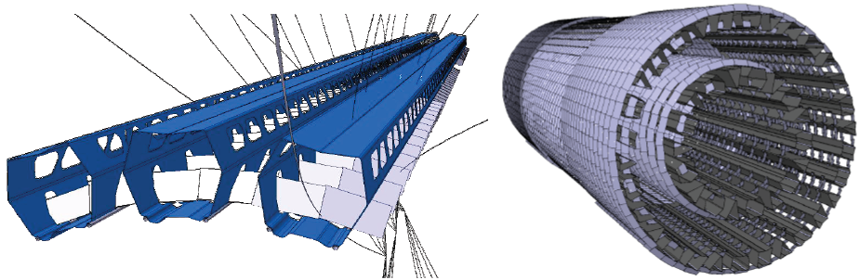
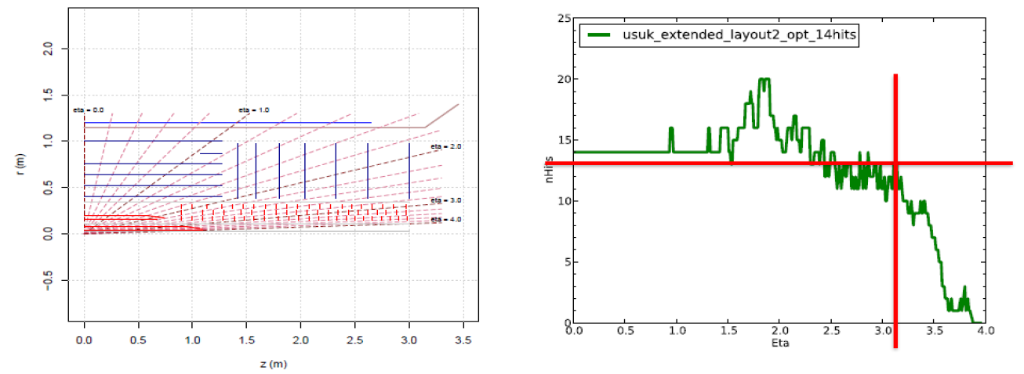
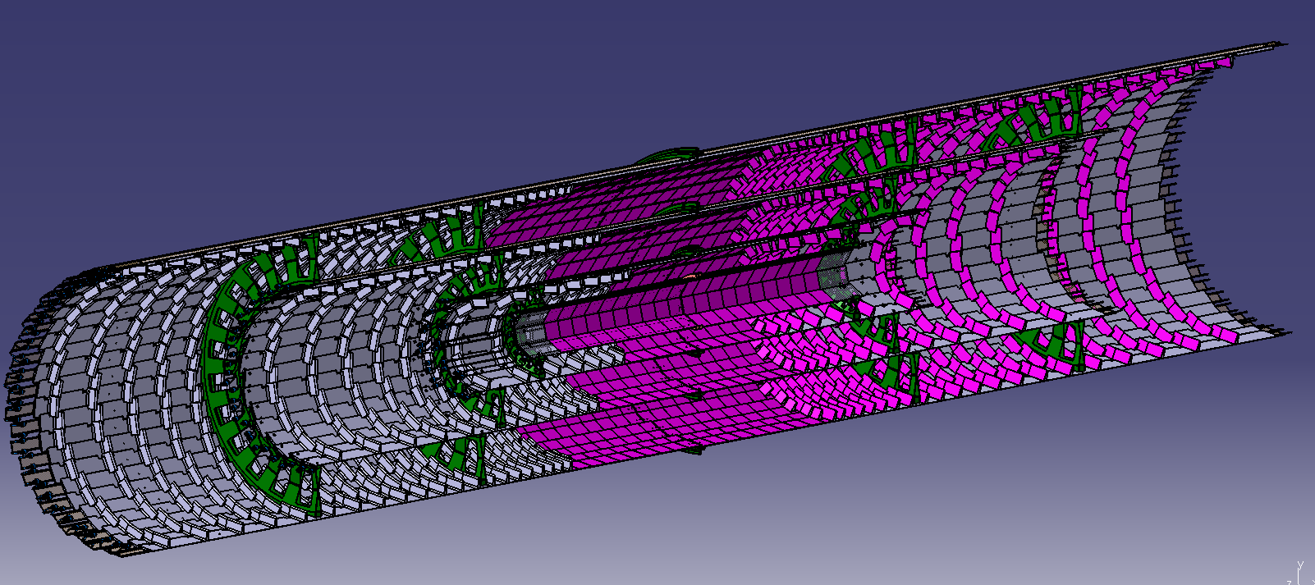
ITk pixel layouts
MANY different pixel layouts under consideration:
  LoI, LoIVF
  Rings, ringsVF
  Extended Inner barrel
  Unity
  SLIM
  Alpine
  HV-MAPS
SLIM: Stiff Longeron for ITk Modules
Unity: extended IBL + rings
Alpine: rings not included

Slide 16
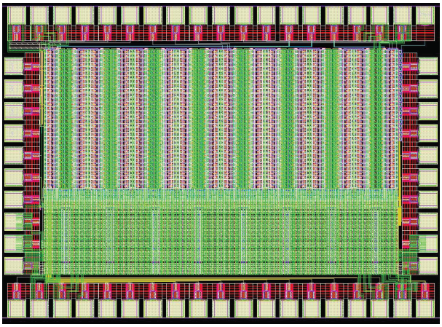
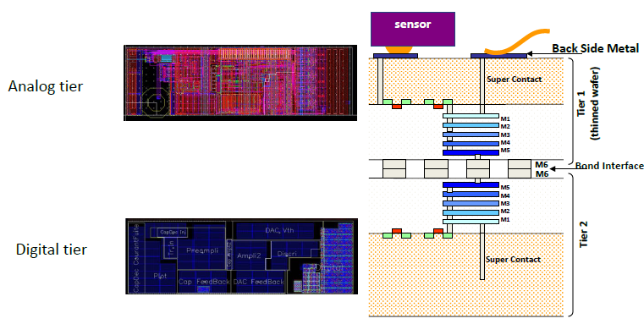
Pixel sensors and FEE
Pixel sensors:
  Two outer layers: planar n-in-n, n-in-p pixels (150 μm thick)
    Operational at the expected fluences, cheap, large number of vendors
    HV CMOS another alternative, especially for outer 5th layer
  Several options still open for the sensor technology on the 2 innermost layers (<150μm thick to take advantage of increased granularity)
    Planar n-in-n: lower cost, high yield, multiple vendors
    3D: Low depletion V even after irradiation, extremely rad-hard, more expensive
    Diamond: Promise lower capacitance, rad-hard, low dark current (no cooling?), expensive
Front-End Electronics:
  Outer layers: FE-I4-C (50x250 μm² pixel size)
  Inner layers (25x150 μm² pixel size)
    65 nm CMOS: RD65 to develop the next generation of chips
    3D integration (Trough Silicon Vias, TSV)
    Prototype ASICs fabricated on both technologies with good performances
    Extensive R&D in progress, wait for appropriate time to make decisions, cost is a driver
65 nm test chip with 16 x 32 pixels (pixel size 25x 150 μm²)
TSV ASIC for 50x166 μm² pixels

Slide 17
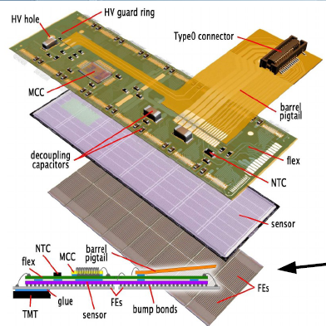
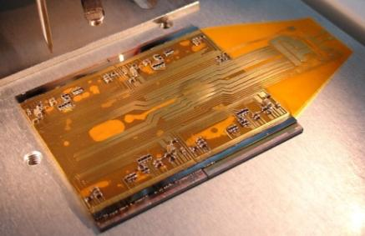
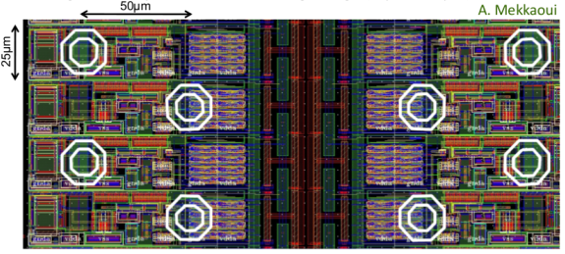
Pixel modules, interconnects, powering
Current baseline pixel module layout based on existing solutions
  Hybrid pixel approach with planar or 3D sensors under investigation.
  CMOS monolithic approaches emerging and interesting for larger radii
3 different flavors of modules:
  2-chips modules (4 x 2cm²) for the 2 innermost layers
  4-chip modules “quads” (4 x 4cm²) for the 2 outer layers and disks
  Hex modules (6 x 4cm²) for the disks
  Shared COM and CLK line for all chips in the module, but several dedicated data outputs
  Strong prototyping effort with FE-I4-B ASICs
Interconnections: flip chip bump bonding
  Bump pitch 50 μm, staggering of bump pads for 25 x 125 μm² pixels
  Many alternatives, widely demonstrated with FE-I4-B and 65 nm CMOS for 25 x 125 μm²
Powering: Serial power baseline, on-chip DC-DC under investigation
Quad pixel module prototype
65 nm CMOS prototype ASIC with staggered bump pads

Slide 18
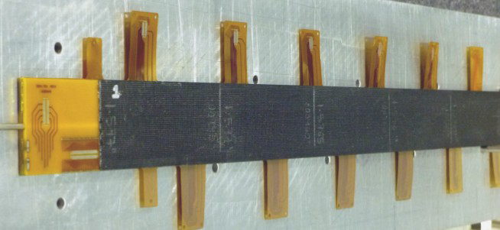
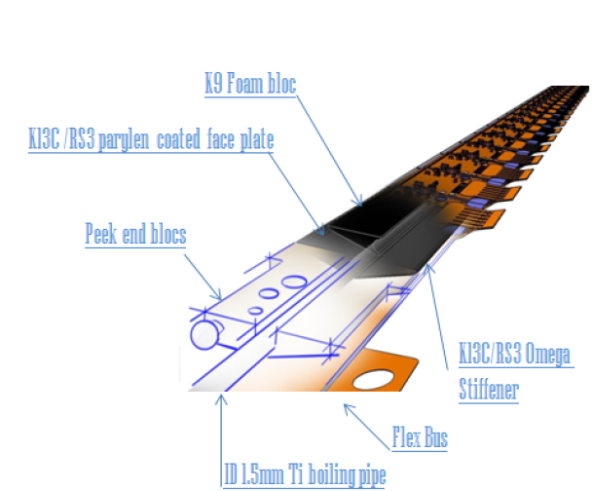
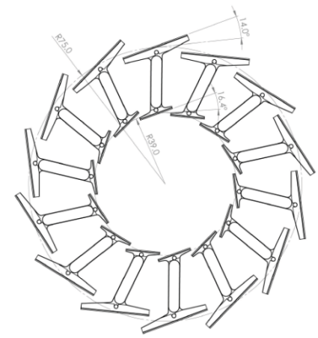
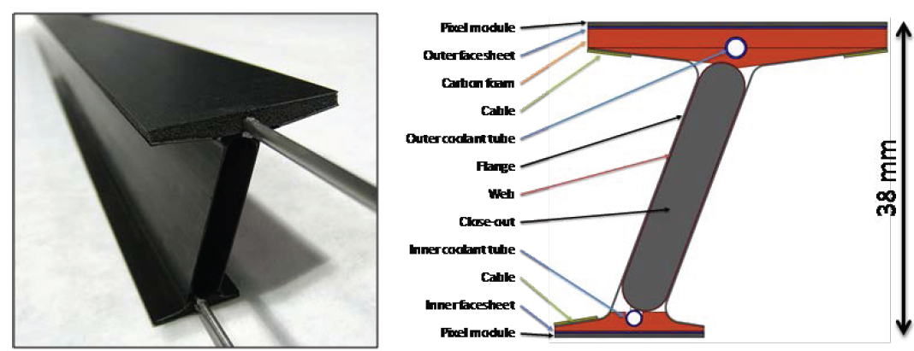
Pixel support structures
Many alternatives driven by different layouts
Improved IBL stave for outer layers
  Alternative: flat stave
    1.4 m stave with embedded tapes recently fabricated
  Other approaches for different layouts (SLIM, Alpine)
I-beam staves for 2 innermost layers
  Carbon composites and thin Ti cooling pipes
  Accommodates both layers in the same structure, stiff, low material budget, fast replacement
  1000 mm I-beam TM prototype already fabricated with excellent performance
1.4m flat stave
IBL stave
I-beam stave concept and prototype

Slide 19
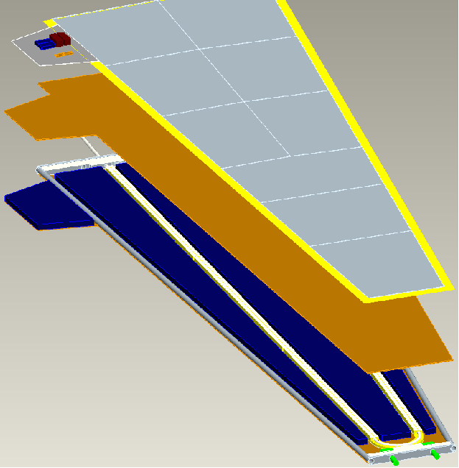
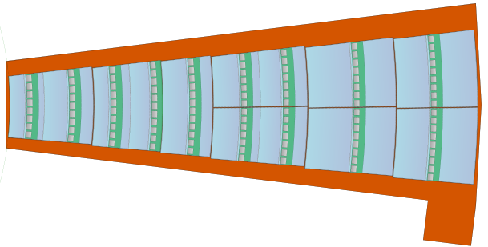
The strips tracker: stave and petal concept
Barrel stave (short strip version):
1.4 m
DCS
12 cm
Designed to minimize material
  Shortened cooling paths
  Module glued to stave core with embedded pipes
  No substrate or connectors, hybrids glued to sensors
  Minimizes cable count
Designed for large scale assembly
  Simplified build procedure
All components testable independently
Aimed to be low-cost
Stave cross-section:
Kapton flex hybrid
Readout ICs
Cu bus tape
Ti coolant tube
Carbon fiber facing
Si Strip sensor
High T conductivity foam
Carbon honeycomb
Endcap petal:
62.5 cm
Follows barrel design
9 sensor modules per side (6 flavors of modules, 13 flavors of hybrids)
10 cm
30 cm

Slide 20
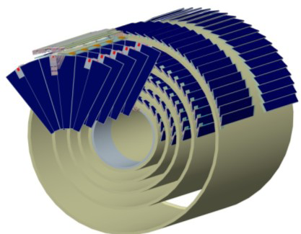
The strips tracker: stave and petal concept
Barrel stave (short strip version):
1.4 m
DCS
12 cm
Designed to minimize material
  Shortened cooling paths
  Module glued to stave core with embedded pipes
  No substrate or connectors, hybrids glued to sensors
  Minimizes cable count
Designed for large scale assembly
  Simplified build procedure
All components testable independently
Aimed to be low-cost
Stave cross-section:
Kapton flex hybrid
Readout ICs
Cu bus tape
Ti coolant tube
Carbon fiber facing
Si Strip sensor
High T conductivity foam
Carbon honeycomb
Endcap petal:
62.5 cm
Follow barrel design
9 sensor modules per side (6 flavors of modules, 13 flavors of hybrids)
10 cm
30 cm

Slide 21
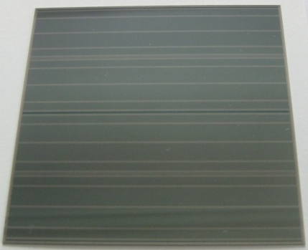
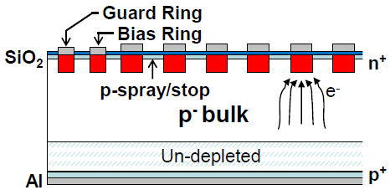
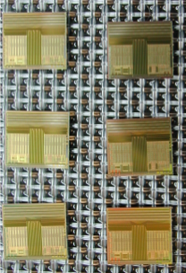
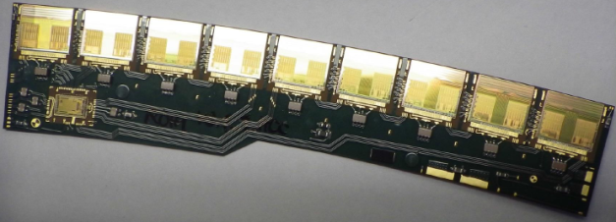
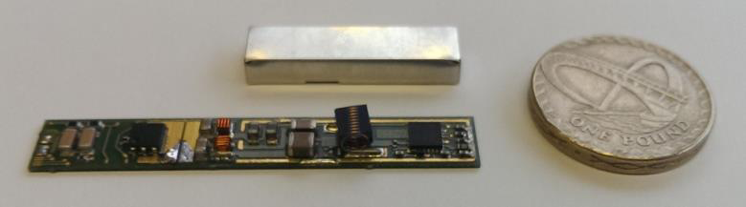
Strip module prototypes
Silicon sensors: n⁺ strips in p-type substrate (n-in-p)
  Collects electrons (as opposed to current p-in-n), depletes from segmented side, single-sided process
  9.75x9.75 cm² sensors fabricated on 6” wafers in collaboration with Hamamatsu Photonics
  Barrel: rows of 1280 strips, 74.5 μm pitch, 2.5 cm long (short strips), 5 cm long (long strips)
  Meet electrical specifications, also after irradiation
Readout and control electronics: ABCN130 and HCCs (130 nm CMOS from IBM)
  ABCN130: 256 binary readout channels per ASIC, connected to sensor strips via wirebonds, mounted on low-mass flex hybrids (substrate-less, no connectors)
  “Star” versions of ABCN130 and HCCs on preparation in order to cope with 1 MHz L0 trigger rate
Power and protection circuitry: DC-DC converters (DC-DC)
  Buck DC-DC converters: custom low-mass inductor and shield + FEAST ASIC (0.35μm LDMOS)
54x8x4.5 mm

Slide 22
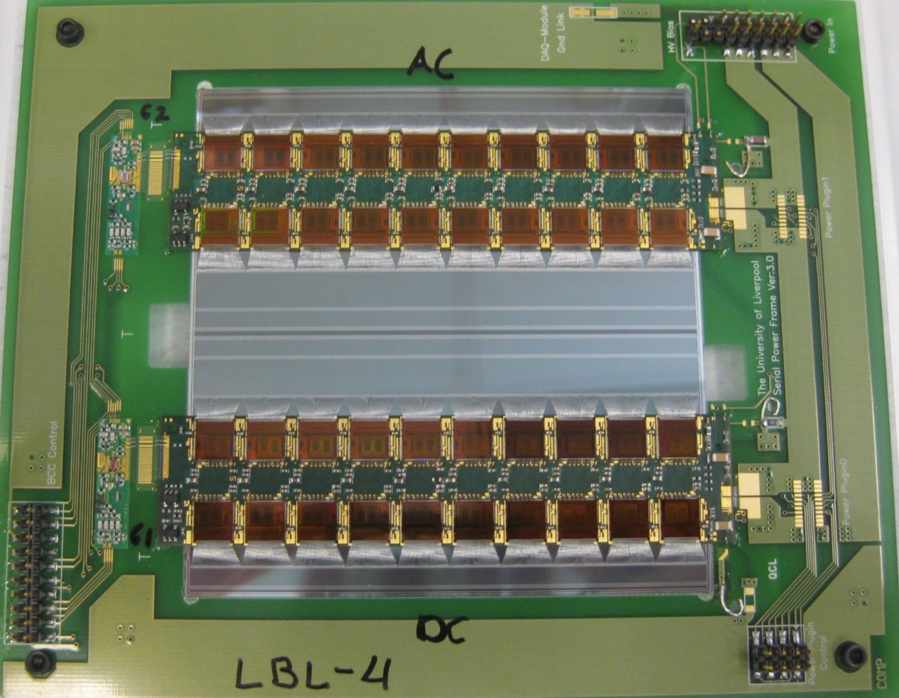
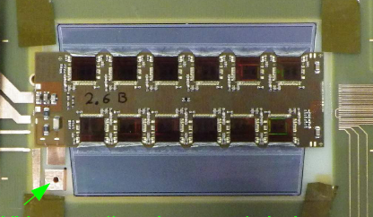
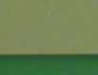
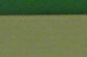
Silicon microstrips modules
Barrel short strips modules:
9.75 x 9.75 cm sensors
4 x 1280 strips (2.45 cm long, 74.5μm pitch)
Former prototypes use ABCN25 (128 channels each)
Endcap modules:
Different sizes along r dimension
(this one: 2 x 768 strips (2.45 cm long, max. 75 μm pitch))
Short strips hybrid
BCCs and data lines
Power line
Short strips sensor
Fully testable modules, ready for stave assembly
Module construction designed for large scale production even at prototyping stage
More than 100 modules produced so far by the stave community ( > 20 institutes worldwide)
ABCN25 ASICs connected to strips via wire bonds (128 per ASIC)
~21000 strip modules required for the tracker

Slide 23
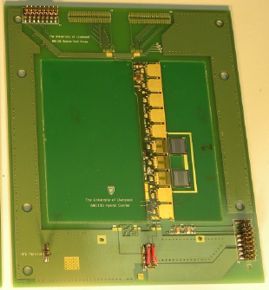
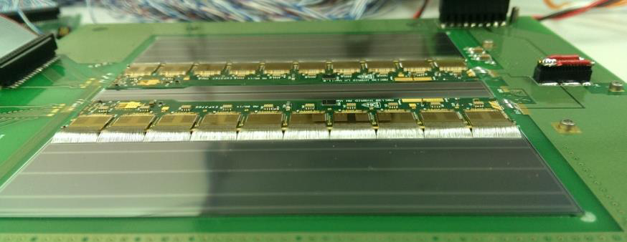

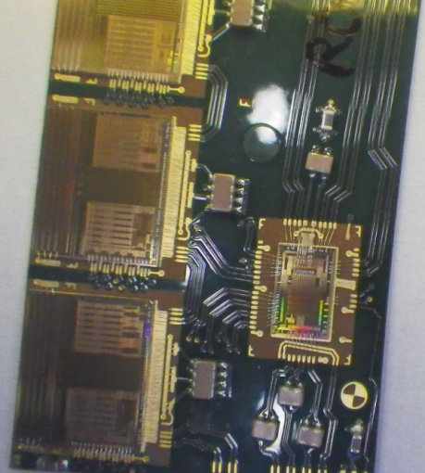
Silicon microstrips modules
First ABCN130 barrel and endcap prototypes being produced

Slide 24
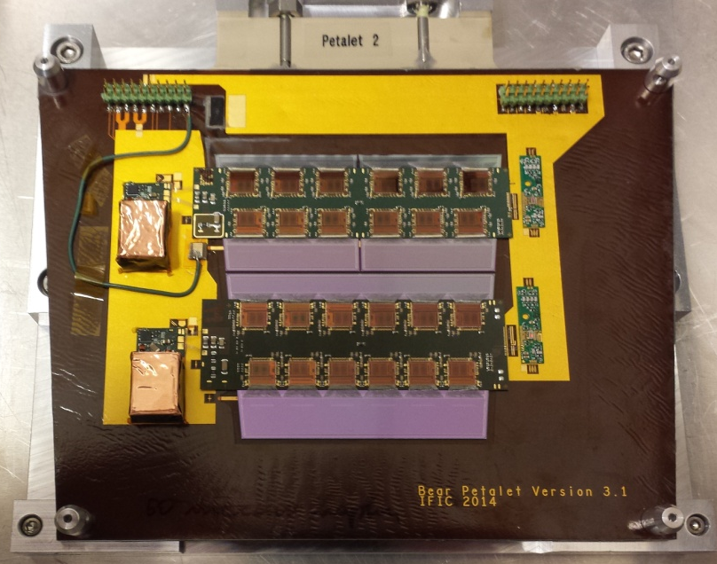
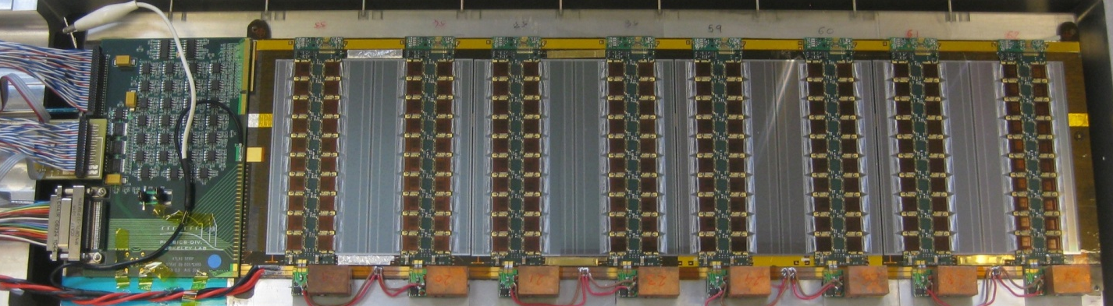
Staves and petal structures
“Stavelets” and “petalets”: shortened short strip prototypes
  Key test bed for electrical testing, powering, protection, G&S, understanding complexity of building and handling procedure,…
  Single- and double-sided serial and DC-DC powered prototypes built and tested so far, each with unique features
  DC-DC powering selected as a LV power, serial power backup option
Berkeley stavelet (DC-DC power side)

Slide 25
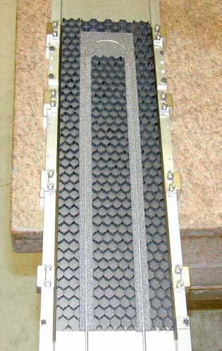
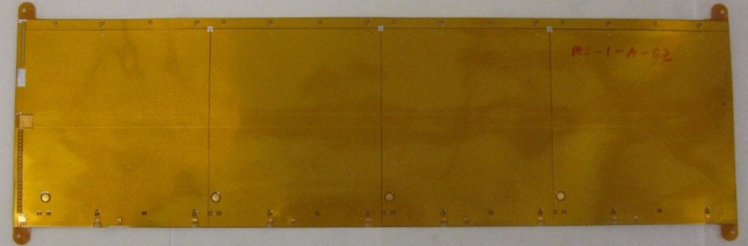
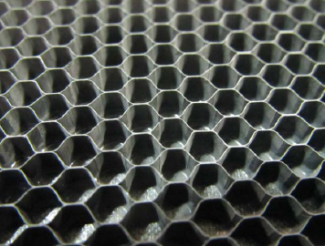
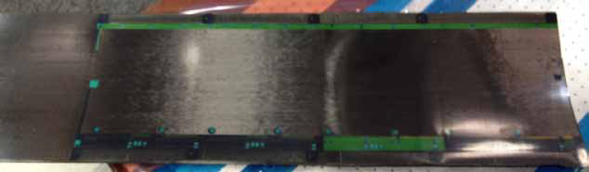
Support structures for strip modules
Support structures (cores): low mass, embedded cooling pipes, optimized for thermal performance, resistance to deformations, flat structure
  Carbon composites: very flexible class of materials, reasonable Xo, good thermal properties, variable CTE
Bus tapes: Flexible circuits with power, data, and control traces along the staves and petals
  Kapton-Cu-Kapton-Cu-Kapton (+adhesives) layers, 150 µm thick total
  Co-cured with carbon fiber facings
Stave cross-section
Cu bus tape (co-cured with facings)
Carbon fiber facing (3 lay-ups) 0-90-0
Carbon honeycomb
Ti coolant tube
High T conductivity foam
Kapton flex hybrid
Readout ICs
Si Strip sensor

Slide 26
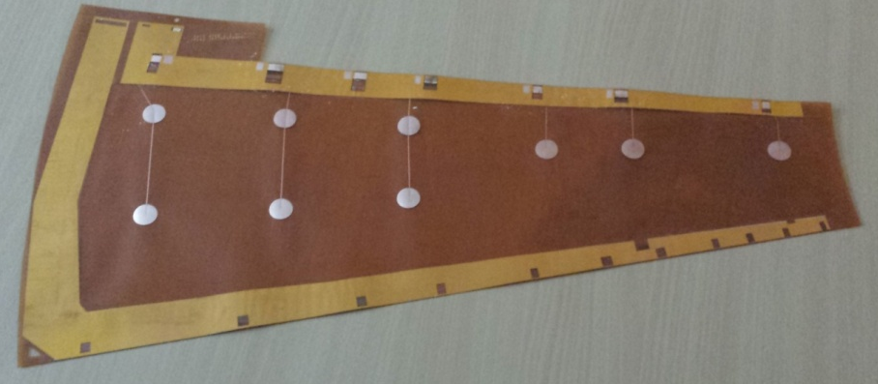
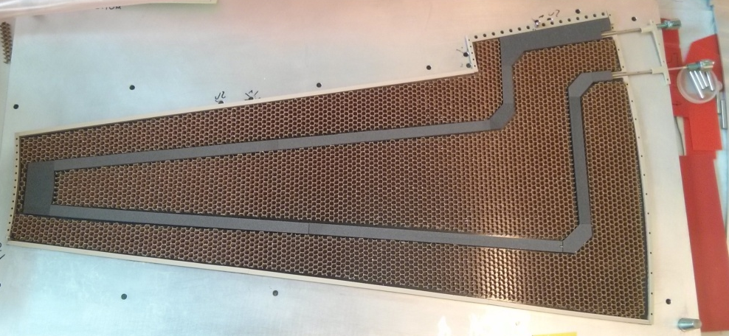
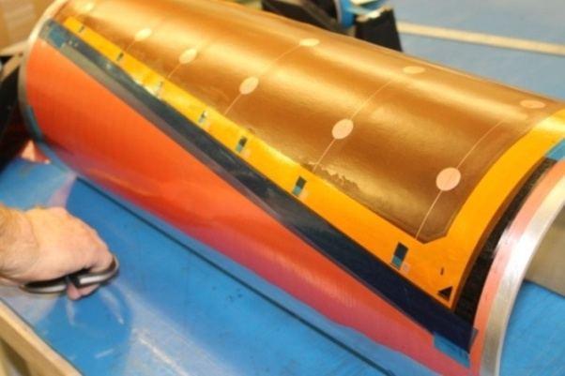
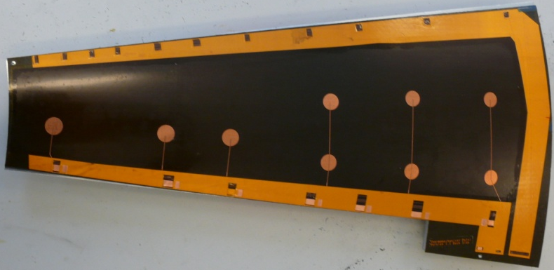
Support structures for strip modules
Support structures (cores): low mass, embedded cooling pipes, optimized for thermal performance, resistance to deformations, flat structure
  Carbon composites: very flexible class of materials, reasonable Xo, good thermal properties, variable CTE
Bus tapes: Flexible circuits with power, data, and control traces along the staves and petals
  Kapton-Cu-Kapton-Cu-Kapton (+adhesives) layers, 150 µm thick total
  Co-cured with carbon fiber facings

Slide 27
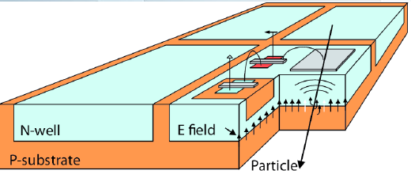
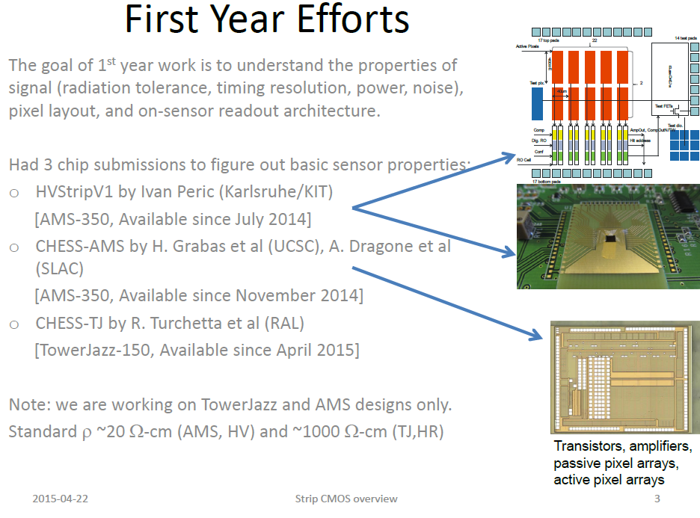
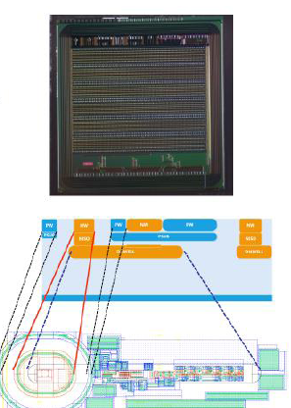
HV/HR CMOS alternative
HV/HR CMOS technologies are an attractive alternative to classical Si pixel and strips particle detectors
  System-on-a-chip: integrated FEE (or sections of it)
  Very few interconnections
  Lower material
  Potentially big cost savings
  Less cooling, lower operating voltages
  Radiation tolerance may be an issue, among others (schedule, re-design tasks,...)
Pixel and strips are investigating the feasibility of their use on the Phase-II upgrade
  In principle, easier to implement on the pixel region
    Outer 5th layer?
  Extensive design and radiation hardness programs ongoing
    Several prototypes already in hand
    Dedicated AUW sessions, a lot of information there
HV CMOS device
LF 150nm prototype for pixel detector
HVStripV1 prototype for strip detector

Slide 28
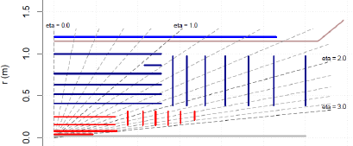
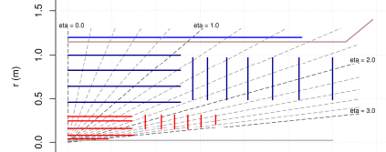

ITk layout task force: 5th pixel layer
The ITk collaboration established as a top priority for 2015 to come with a final layout for the ITk
  One of the biggest changes in LoI under discussion is the increase of pixel volume to allow a 5th pixel layer
  Increase to ~25m² of pixels (LoI layout 8 m²)
  The savings in the strip detector may make up for the extra cost in the pixels
  Strip layout options are obviously strongly coupled to the pixel layout and requirement task force outputs
    Increase of pixel radius: removal of stub + 1 strip barrel layer, reduction of EC petal strips size
LoI layout
5th pixel layer + strips rearrangement

Slide 29


DESY strips activities in the phase-II upgrade
Endcap module assembly and testing
Module mounting on petalets and petals
Petalet and petal core manufacture
Electrical design of stave/petal GBT PCBs
Electrical testing of petalets/petals
CAD layout of strip petals
ITk layout task force
Leadership role in recent and future strips test beams
CMOS activities for strips
Overall project planning
  Strips project leader and 2 activity coordinators
Ultimately, one of the strip endcaps will be assembled at DESY
  Petal core manufacture
  Module assembly and test
  Module mounting and test
  Petal assembly and test
  QA and QC

Slide 30
Outlook
Despite being still far in time, ATLAS (phase-II) upgrade is a vibrant community covering a very wide range of activities
ITk is the most expensive element of the ATLAS upgrade
  Heavy involvement of DESY ATLAS group, in particular in the strips endcaps
    The goal is to produce a full endcap here!
  ITk layout is rapidly evolving, planning to converge on a final layout by the end of 2015
    Re-assessment of proposed technologies once this decision is taken
  Not so much time!
    Strips TDR: end 2016
    Pixel TDR: end 2017

Slide 31
Backup
Backup slides:
  Phase-I NMW project
  Phase-I FTK
  ITk radiation fluences
  Alpine layout
  SLIM layout
  High η coverage for ATLAS and “rings” layout
  Pixel sensor technologies
  CMOS for strips and pixels
  DESY ATLAS group
  CERN’s particle accelerator chain

Slide 32
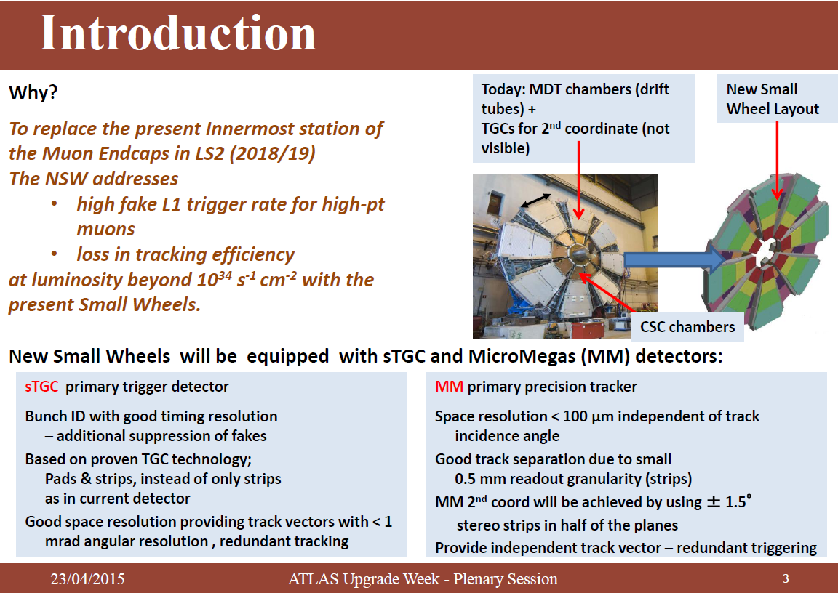
NSW for Phase-I
M. Bianco, Apr 2015 AUW

Slide 33

FTK phase-I

Slide 34

ITk radiation environment (LoI layout)

Slide 35

ITk pixel layouts: Alpine layout
Alpine + rings:

Slide 36


ITk pixel layouts: SLIM layout
Stiff Longeron for ITk Modules (SLIM)
Initially developed for 5th Pixel Barrel layer (CMOS)
Evolved to be compatible with other sensor technologies

Slide 37

High η coverage for ATLAS
Potential benefits from an extension to large η:
  VBF Higgs production
  Vector Boson Scattering
  Double Higgs production
  Top background rejection (in ttH, H →WW)
  At object level: MET reconstruction
  Pile up jets rejection
Possible scenarios considered by high-η task force

Slide 38




ITk pixel layouts: EC pixel “rings” layout
Higher η coverage possible to be implemented in most layouts by adopting the “rings” pixel layout for the EC: single rows of quad modules placed on rings at different radii
Baseline “rings” layout: η < 2.7
Very-Forward (VF) rings layout: η < 4

Slide 39


Pixel sensor technologies
Several candidate technologies for pixel detector
  Oxygenated n-on-n, 3D, diamond, HV/HR CMOS for outer pixel layers
Planar pixel sensors (PPS)
“Classic” sensor design
Oxygenated n-in-n
200μm thick
Minimize inactive edge by shifting guard-ring underneath pixels (215 μm)
Radiation hardness proven up to 2.4x10¹⁶ p/cm²
HV might need to exceed 1000V
3D silicon
Both electrode types are processed inside the detector bulk
Max. drift and depletion distance set by electrode spacing
Reduced collection time and depletion voltage
Low charge sharing
Diamond sensors
Good radiation tolerance Low capacitance (noise) no cooling
BUT expensive
Used in ATLAS beam monitoring, current and replacement in 2014

Slide 40

CMOS pixels

Slide 41

CMOS pixels

Slide 42
CMOS strips
Vitaliy Fadeyev, Apr 2015 AUW

Slide 43

DESY ATLAS group

Slide 44



CERN’s particle accelerator chain

