Slide 1
“The Challenge of Big Data in Science”
Opening
Achim Streit
The 4th International LSDMA Symposium

Slide 2
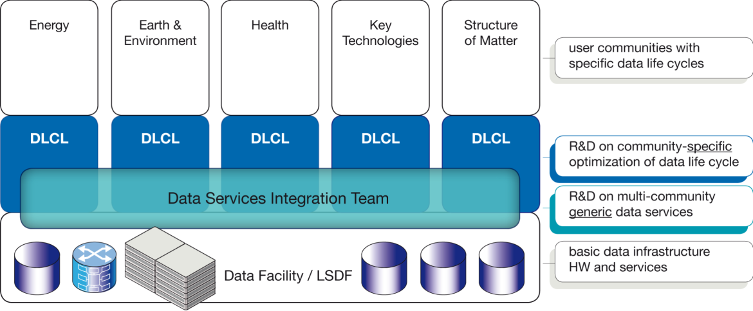
Structure and Aims of LSDMA
R&D
Data Life Cycle Labs
Joint R&D with communities
Optimizing the data life cycle
Specific data analysis tools and services
Data Services Integration Team
Generic, multi-community R&D
Interface between federated data infra-structures and DLCLs resp. Communities
Integration of data services in scientific working process

Slide 3
Facts and Figures
Helmholtz portfolio extension
Initial project duration: 2012-2016
Partners:
Continuation as cross-programme initiative from 2015-2019
Build a research bridge on data-intensive science in Helmholtz and beyond
7 programmes in 3 research fields, coordinated by
Connected to many projects and initiatives

Slide 4
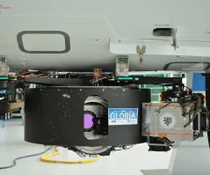
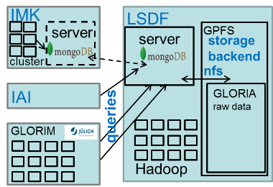
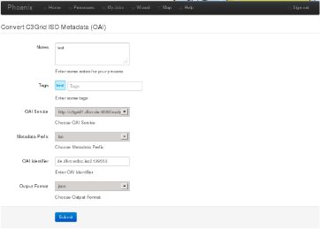
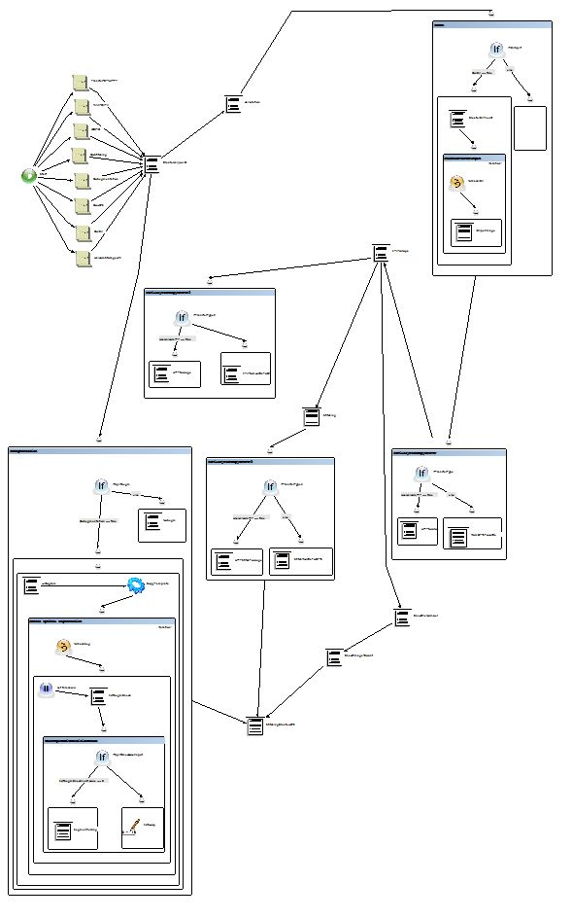
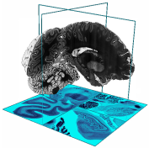
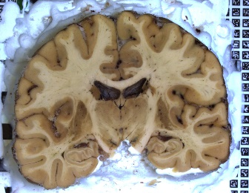
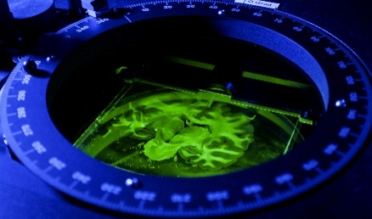
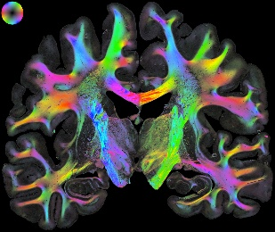
Selected Research Activities
DLCL Climatology
Data management for sensor data (GLORIA, MIPAS)
Geospatial data life cycle portal
Federating sensor and simulation data of the atmosphere at European scale
DLCL Neuroscience
Virtual long-term database of the human brain atlas including metadata management
Optimize PLI (polarized light imaging) data workflows
Big
Brain
3k sections
1.2 PB

Slide 5
Agenda for Today
9:00 – 9:30 | Welcome, Introduction | Michael Decker Achim Streit
9:30 – 10:30 | Data and software preservation for open science - connecting publications with Cyberinfrastructure | Jarek Nabryzski (U-Notre Dame)
10:30 – 11:00 | Coffee break
11:00 – 11:30 | Computational Requirements for Climate Science | Peter Bräsicke (KIT)
11:30 – 12:00 | From seismic stations to integrated data centers and computational facilities | Javier Quinteros (GFZ Potsdam)
12:00 – 12:30 | Indigo Data Cloud | Isabel Campus (CISC)

Slide 6
Agenda for Today – cont‘d
12:30 – 14:00 | Lunch break
14:00 – 14:30 | Data management challenges in Astronomy and Astroparticle Physics | Giovanni Lamanna (LAPP/IN2P3)
14:30 – 15:00 | Science SQL: Advancing from Data to Service Stewardship | Peter Baumann (Jacobs U-Bremen)
15:00 – 15:30 | Coffee break
15:30 – 16:00 | How astronomy shares and reuses big and small data | Francoise Genova (Strasbourg Astronomical Data Centre CDS)
16:00 – 17:00 | Data Management and Data Analysis in CLARIN-D | Erhard Hinrichs (U-Tübingen)
We plan to collect the slides and provide them on the Symposium webpage: http://www.helmholtz-lsdma.de/Symposium2015

Slide 7
Logistics
Breaks
Two coffee breaks at 10:30 and 15:00 with coffee, tea, water, apple spritzer, fruits, cookies is available in front of the lecture hall
Lunch break from 12:30-14:00 with buffet in front of the lecture hall
WIFI
eduroam
Guest account info in your conference bag

Slide 8
Thanks
To the organising team
Parinaz Ameri
Ugur Cayoglu
Melanie Ernst
Frank Tristram
Verena Geisselmann
Christopher Jung
Jörg Meyer
Felix Riese
Ingrid Schäffner
Gabriel Zachmann

