Slide 1
02 Juni 2015
L1 Inbetriebnahme
Notes:
Before you start editing the slides of your talk change to the Master Slide view: Menu button “View”, Master, Slide Master:
Edit the following 2 items in the 1st slide: 1) 1st row in the violet header: Delete the existent text and write the title of your talk into this text field 2) The 2 rows in the footer area: Delete the text and write the information regarding your talk (same as on the Title Slide) into this text field.
If you want to use more partner logos position them left beside the DESY logo in the footer area Close Master View

Slide 2
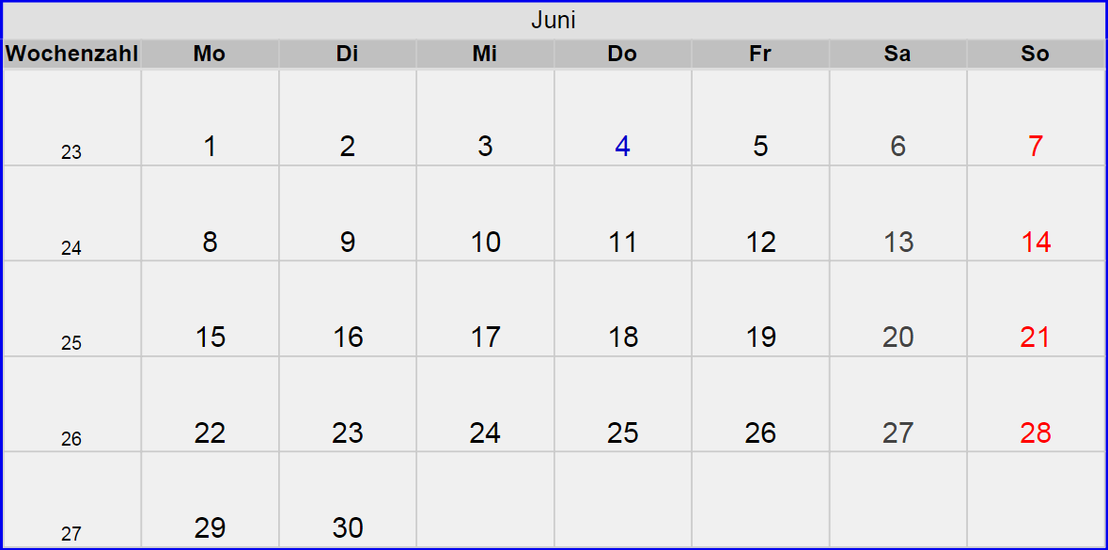
MSK Workshop ( Poland, Warschau )
RF: Hochfrequenz setzen 04.06.15, 10-15 Uhr
LLRF Kallibrieren
State mashine
Coupler warm conditioning
(Netzwerk + Timing)
KW24 BKR aktiv

Slide 3
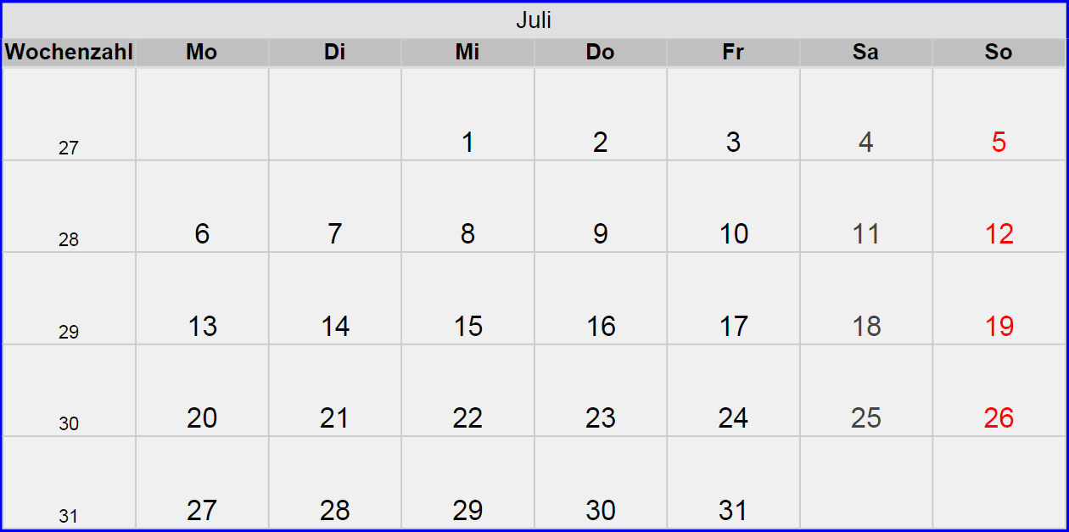

Slide 4
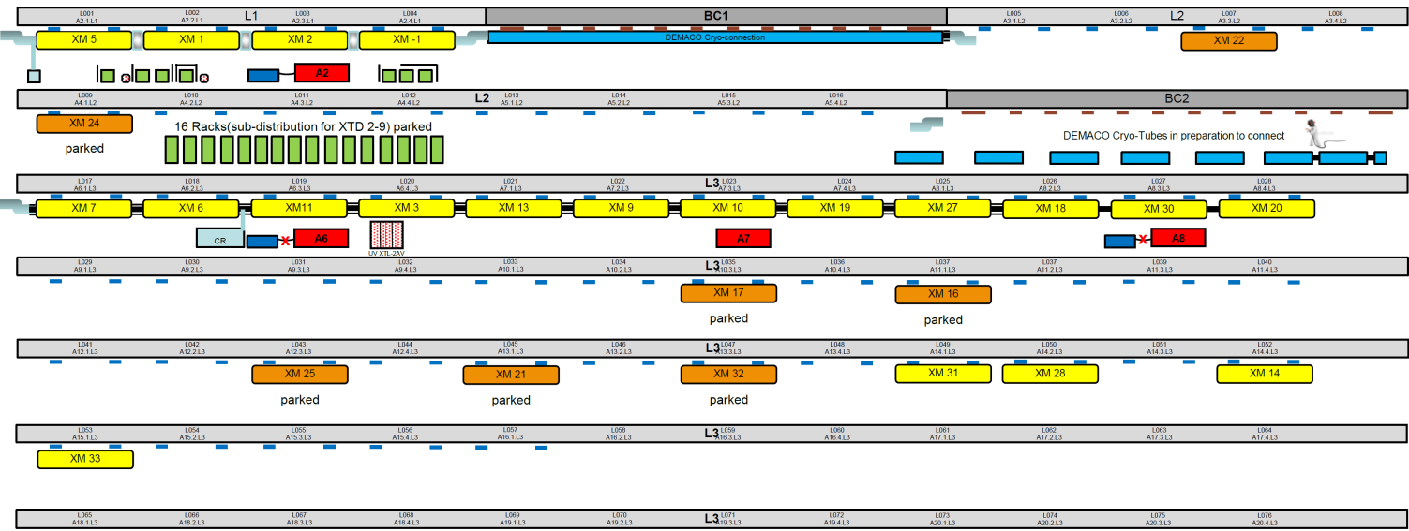
Status Montage: Modul- und RF-Stationen

Slide 5
