Slide 1
SNS Fundamental Power Coupler History
J. Mammosser
(material from S-H Kim, M. Champion)

Slide 2
The SNS Linac cavities are powered by four unique types of fundamental power couplers
Type | Configuration | Couplers per cavity | Frequency (MHz) | Peak Power (kW) | Pulse Width (ms) | Duty Factor (%) | Average Power (kW)
RFQ | Coaxial | 2 | 402.5 | 650/2 | 1 | 6 | 19.5
DTL | Waveguide | 1 | 402.5 | 2000 | 1.1 | 6.6 | 133
CCL | Waveguide | 2 | 805 | 3700/2 | 1.1 | 6.6 | 122
SCL | Coaxial with transition to waveguide | 1 | 805 | 500 | 1.3 | 7.8 | 39
Notes:
All couplers feature a single Alumina ceramic window.
SCL couplers also feature a gas barrier at the waveguide flange.
Power numbers are typical maximum operating parameters at this time and do not indicate maximum capabilities of the couplers.

Slide 3
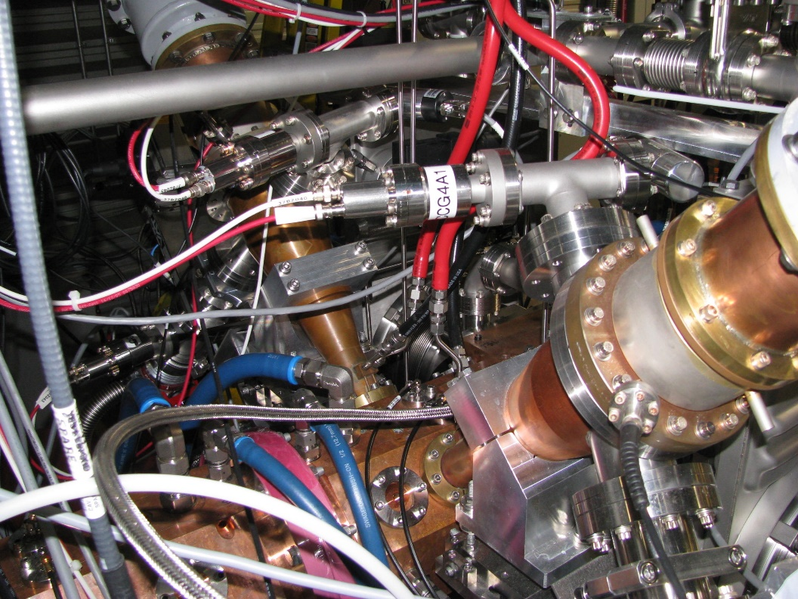
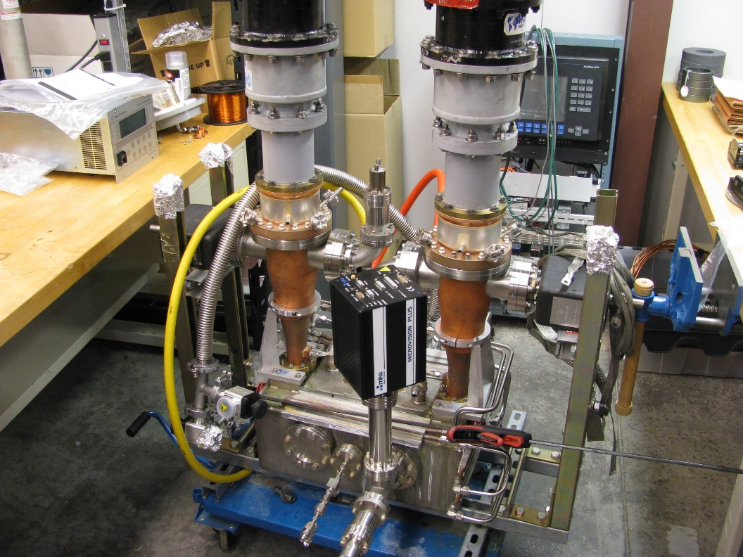
The RFQ is powered by two coaxial couplers
402.5 MHz, 325 kW peak, 19.5 kW average per coupler
Based on the SCL coupler design; window assembly by Toshiba.
Loop coupling with water-cooled loop
Water cooling at outer diameter surface of ceramic
Power split at waveguide magic tee above RFQ structure
Operating RFQ featured eight couplers originally (of a different design)
Coupler pair mounted on the new spare RFQ presently under test.
Coupler pair mounted on a bridge waveguide for testing, conditioning, and storage.

Slide 4
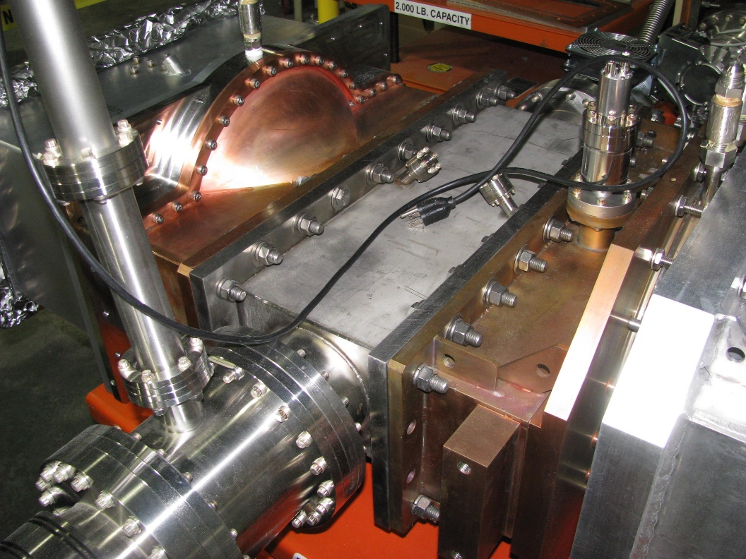
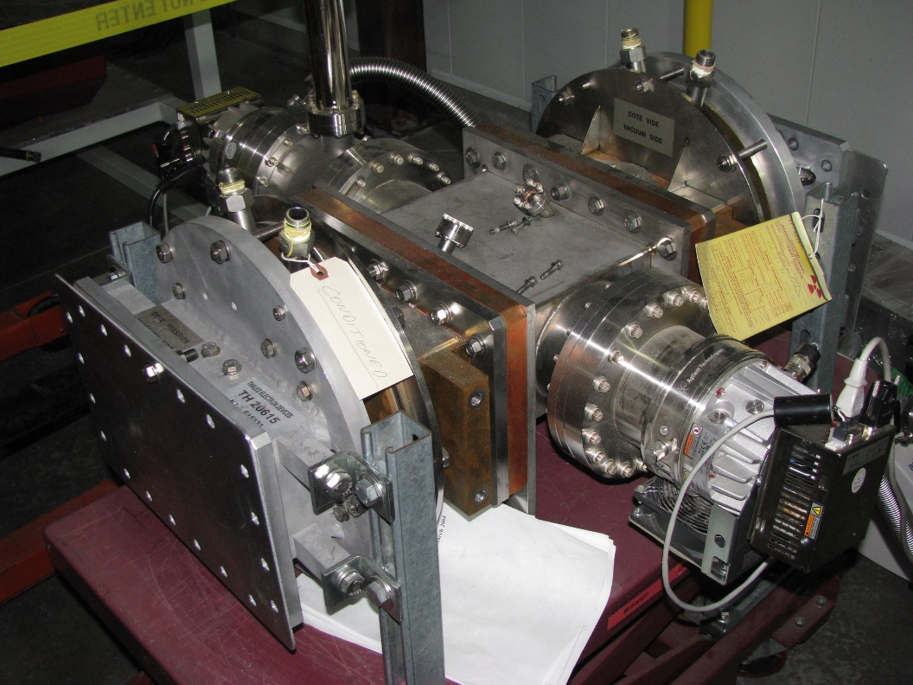
The DTL and CCL are powered by coupling irises, evacuated waveguides, and waveguide windows
DTL: 402.5 MHz, 2000 kW peak, 133 kW average per coupler
CCL: 805 MHz, 1850 kW peak, 122 kW average per coupler
Water cooling at outer diameter surface of ceramic
DTL windows mounted on bridge waveguide for testing, conditioning, and storage. Window to left is prototype of new design (Mega). Window on right is standard Thales window used in the Linac.
CCL windows mounted on bridge waveguide for testing, conditioning, and storage. Both are standard Thales windows used in the Linac.

Slide 5
Recent RFQ History at SNS
Oct 2012: Vacuum degradation during power outage. Impact uncertain.
Jun 2013: RFQ retuned; transmission increased ~15%.
Replaced B coupler due to flow restriction in the loop cooling circuit.
Oct 2013: Replaced B coupler due to heating.
Jan 2014: Replaced A coupler due to heating.
The RFQ performance was adequate for sustained 1.3-1.4 MW beam power on target through Jun 2014.
Jul 2014: RFQ accidently vented and exposed to water vapor.
Aug 2014: RFQ accidently vented and exposed to water vapor again.
➔ RFQ performance degraded as result of these events.
Oct 2014: Removed and inspected B coupler.
No damage observed ➔ reinstalled coupler.

Slide 6
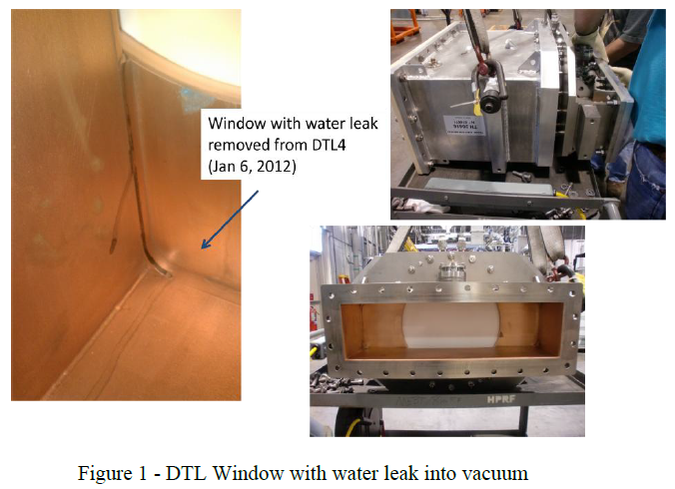
Four DTL RF Vacuum Windows Replaced to Date
DTL6 window replaced 1/21/10 because of suspected flange or O-ring vacuum leak
DTL4 window replaced 4/26/11 because of arcing
DTL4 window replaced 12/26/11 because of water leak to vacuum
DTL5 window replaced 4/15 because of ceramic break
DTL5 window to be replaced 7/15 because of vacuum leak

Slide 7
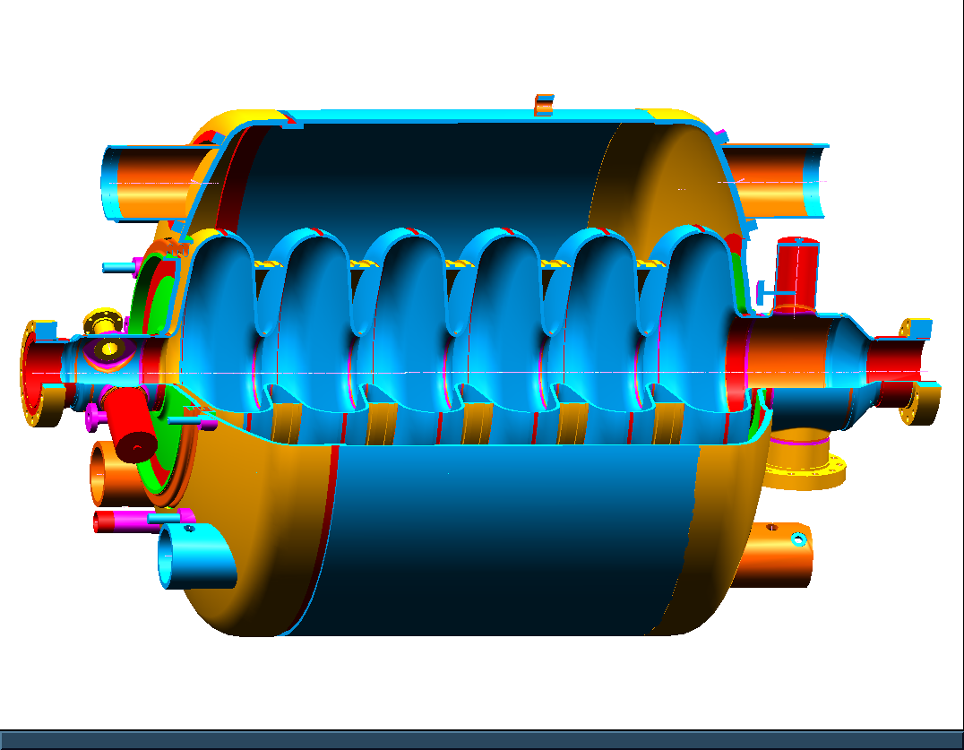
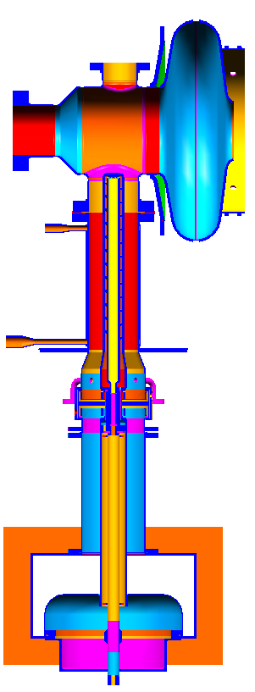
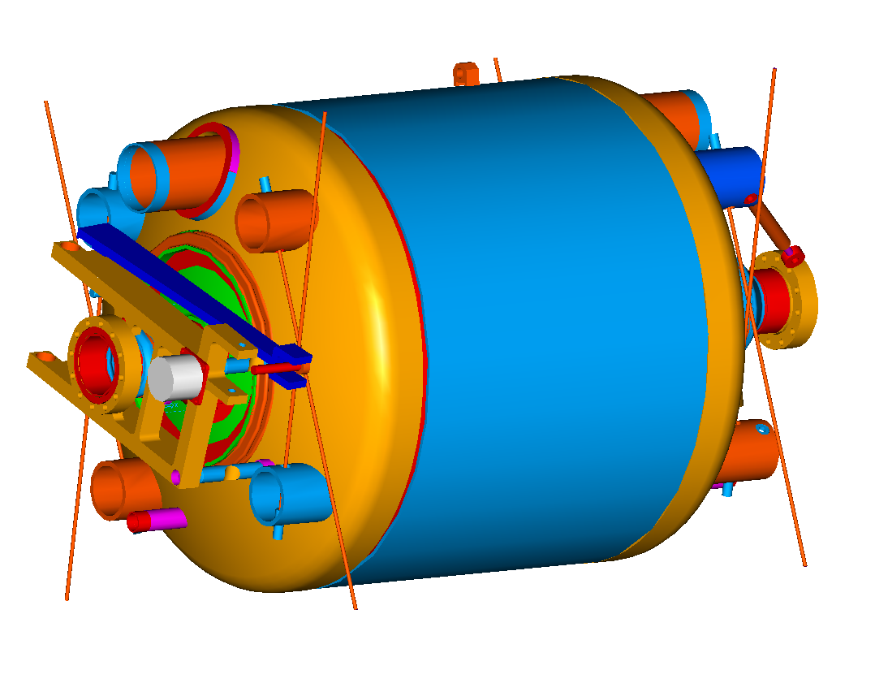
SNS SRF cavity assembly
Field
probe
HOM coupler
HOMB
HOM coupler
HOMA
5K
supercritical
helium
Fundamental power coupler
Helium vessel
CCG
CCG
Arc detector
(vacuum side)
Electron
probe
Arc detector
(air side)
Tuner
DC break

Slide 8
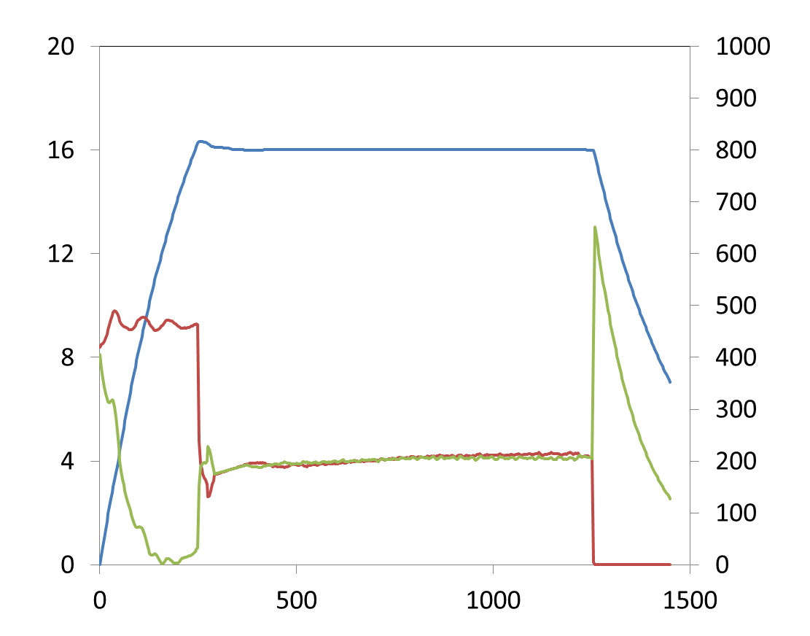
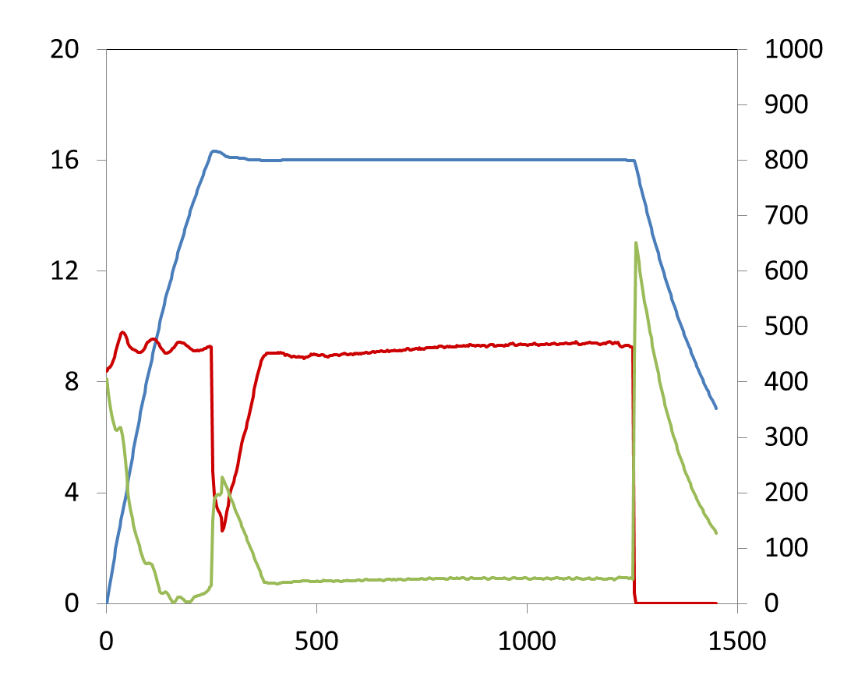
SNS SRF cavity RF operation
RF only
23 cryomodules in operation
60 Hz: 5.2 M pulses/day
Filling: 250 us, feed forward
  Forward power: ~3 times higher than power during the flattop without beam loading
Flattop: 1 ms, feedback
E_{acc} (MV/m)
RF power (kW)
Time (μs)
  With beam: Uses adaptive feed forward
  Forward power at full beam loading (26mA): 2.5-3.5 times higher than power for RF only
With full beam loading
E_{acc} (MV/m)
RF power (kW)
Time (μs)

Slide 9
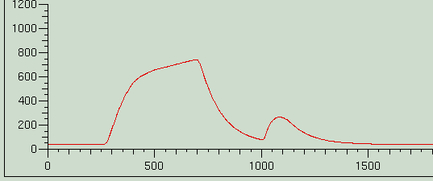
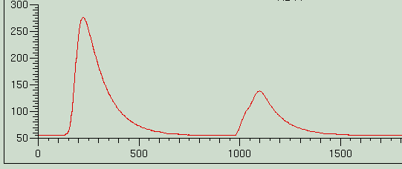
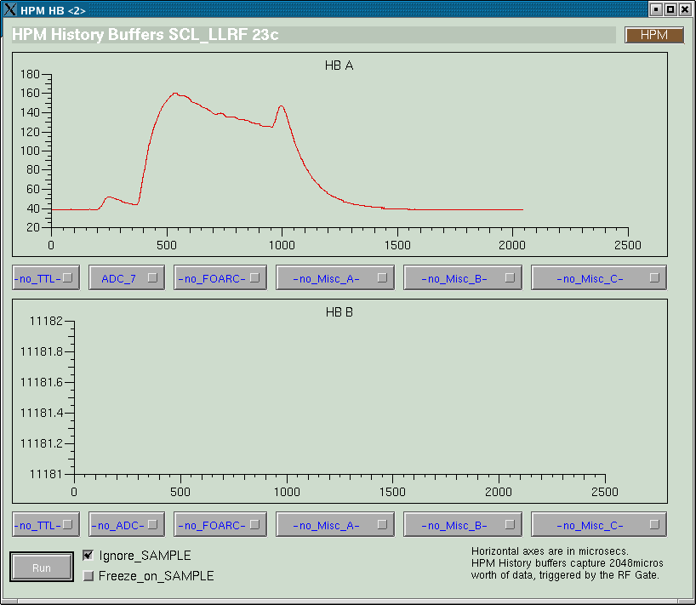
Electron probe
Good diagnostics for electron activities around FPC
Multipacting during conditioning.
us
Multipacting during fill time and decay only. Some cavities show same radiation pattern.
us
Strong MP appears at 350-400 kW at FPC (with beam loading), only depends on RF power and SWR
us

Slide 10
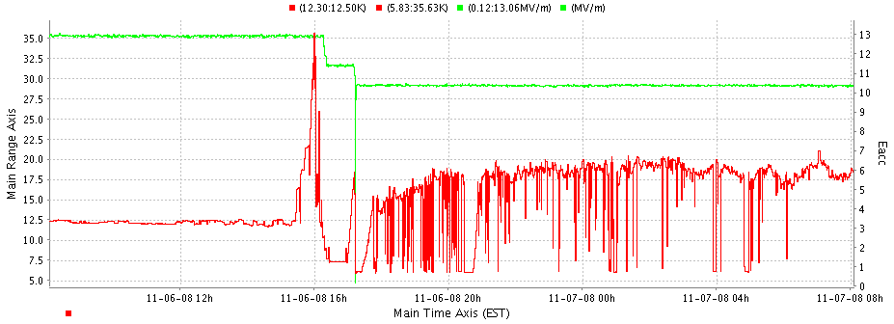
Multipacting at Fundamental power coupler
Strong MP appears at 350-400kW in about 20 cavities
Those are MP at FPC only
  Only depends on Power and SWR
Prepared DC biasing for higher intensity run
25 couplers have DC biasing
Electron probe signal
us
Eacc
Coupler temperature

Slide 11
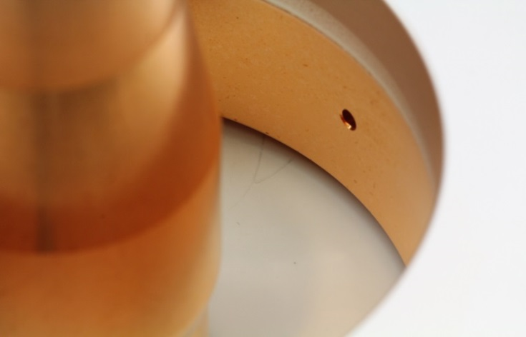
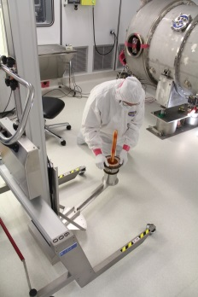
Coupler window leak
So far two cavities had leak at the coupler window (6c, 20d)
  Presumably from errant beam event in 2009 (arcing accompanied)
Did not results in catastrophic failures
  Vacuum at the coupler window: between 1e-10 torr 1e-8 torr and after 2 years it had stayed 1e-8 torr
  Leak rate: about mid 10^-6 torr l/s
Out of service in the tunnel during operation and took out both CMs in 2012 and repaired in the SNS test facility

Slide 12
Coupler design was successful and will be used for the STS project
FPC; reasonably stable/robust. had two mild leaks at about 10⁻⁶ torr l/s from errant beam/discharge events (very slowly developed~ Over year). Not catastrophic failure
For second target station one modification was identified
  Thicker inner conductor wall

Slide 13
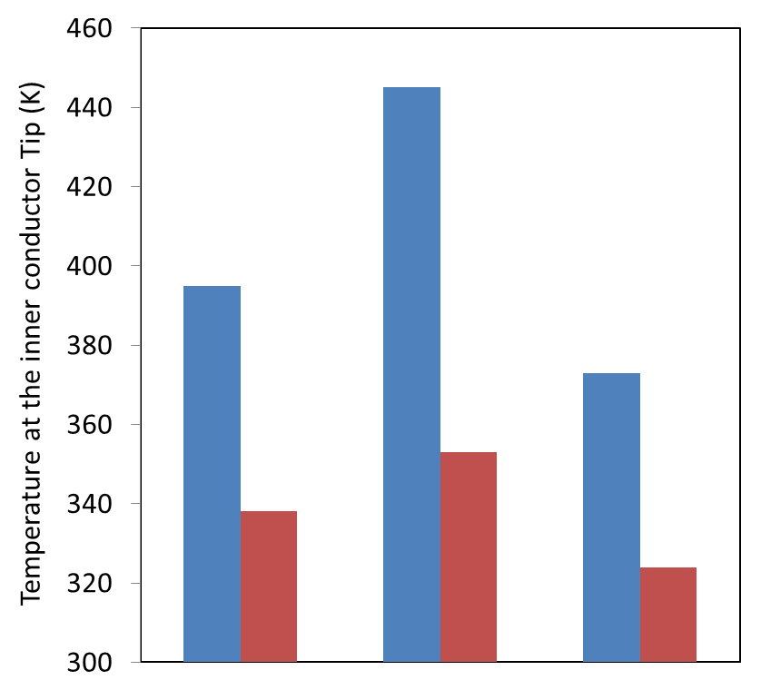
Existing cavities:
  No upgrade for FPC & HPRF system (550 kW, 8% duty).
STS cavities
  RF performance of the original FPC satisfies the STS requirement (700kW, 8% duty):
    Original coupler were tested up to 2-MW in the full travelling wave condition and up to 550 kW in real cavity operation at various standing wave ratios.
    However, antenna tip temperature will go higher, thus thermal radiation to the end group.
  Thicker inner conductor (from 3.5 mm to 7 mm) will be used for the STS. Prototyping is completed.
: full standing wave
: full travelling wave
Original design
500 kW
Original design
700 kW
STS design
700 kW

Slide 14
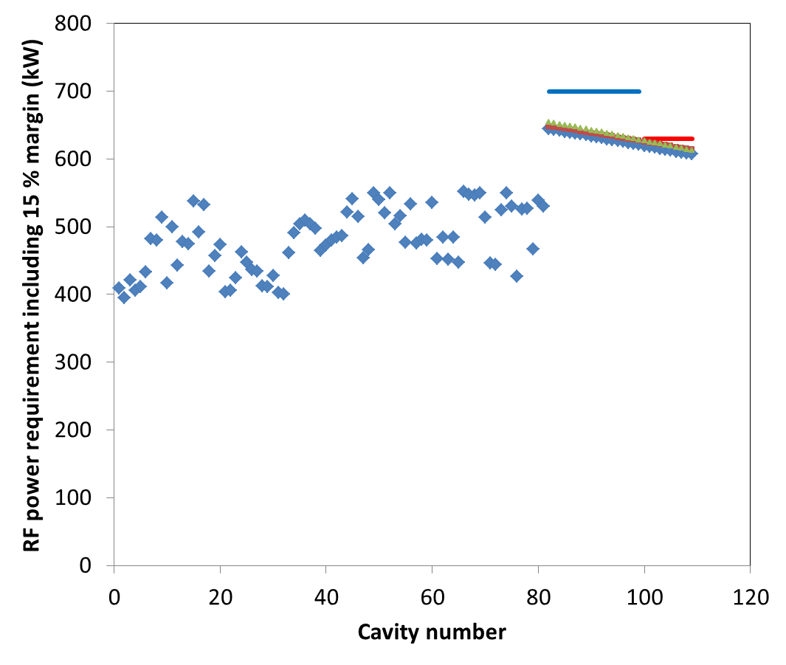
STS power requirement
STS klystron power limit
(8-pack klystrons per HVCM)
Existing klystron power limit
STS klystron power limit
(9-pack klystrons per HVCM)
For STS cavities
Blue Qex, ref =8x10⁵
Red Qext, ref -20 %
Green Qex, ref +20 %

