Slide 1
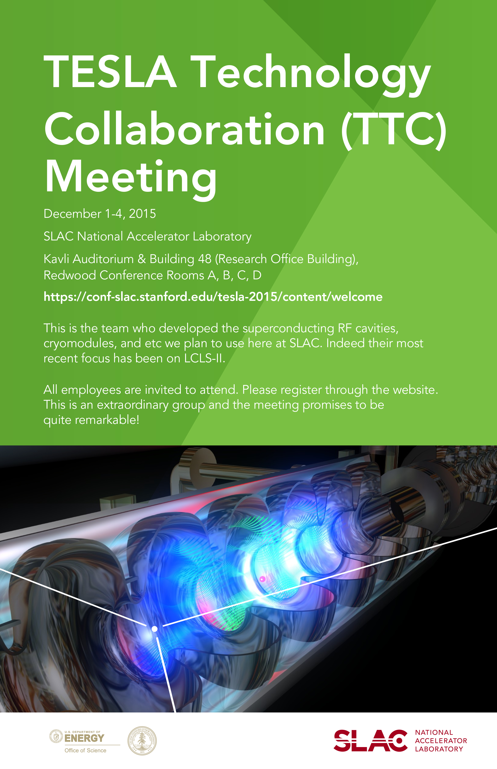
WG-3 Summary
S. Berry, E. Harms, H. Nakai, J. Preble

Slide 2

Overview
Find the ‘true picture’
Learn from each other/share experiences
Four main topics
  Cryomodule Development & Integration Experience
  Cryomodule Performance including Degradation
  Materials Issues
  Installation & Rework/Remediation Issues
7 hours allotted
  13 (15-minute) Presentations
    7 pertaining to EuXFEL
  Discussions

Slide 3
WG-3 Agenda

Slide 4
Take-Aways
Cleanliness of CM interconnects/beam pipe
QA/QC – everyone has this issue
  Different approaches
    embed someone at the vendor
    a traveling inspector
    very detailed incoming inspections
  Feeds into testing
    how thorough (test every single cavity) vs. how many times to interrupt assembly to test components/subassemblies
  A manifestation of balancing the goals of minimizing risk (lots of tests) and meeting the schedule (fewer tests).
Dealing with nonconformities
  attack the source (get vendor to make better product)
  make the best of the situation (grind down thick weld to install washer when assembling cold mass)
  make a work around, or
  reject the piece.
  Feedback from the tunnel installation folks to the QA and assembly folks is critical
Not sufficiently addressed
  Alignment
  Ancillary components (e.g. 3rd harmonic)
  Transport & Installation

Slide 5
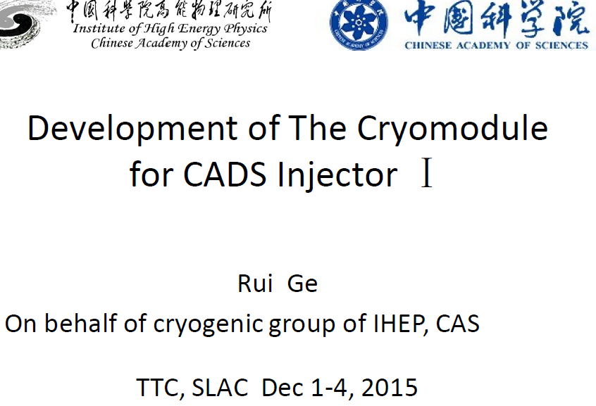
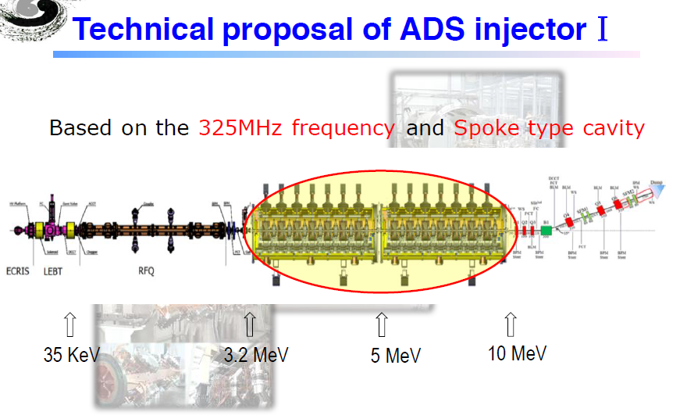
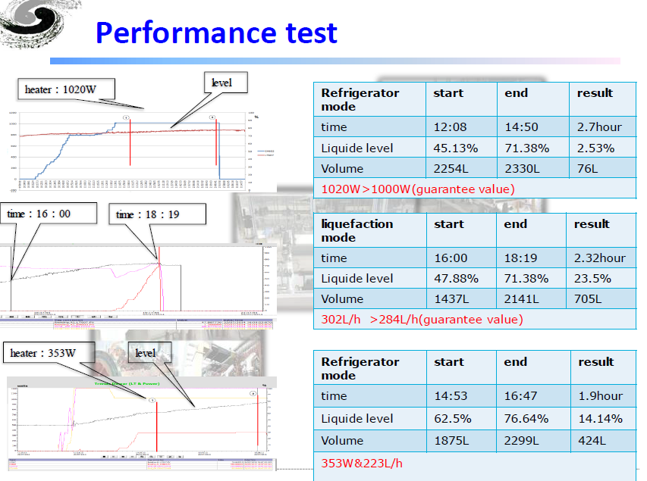
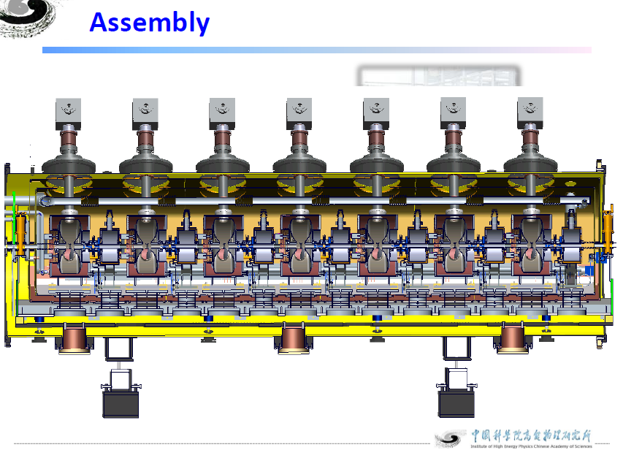

Slide 6
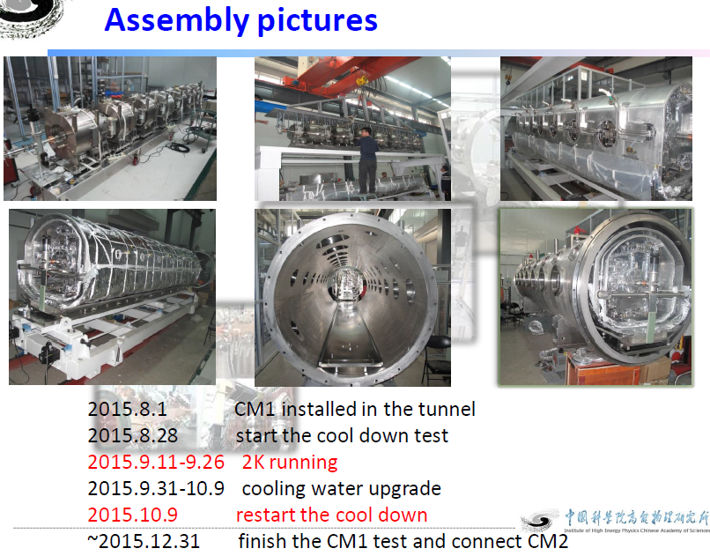
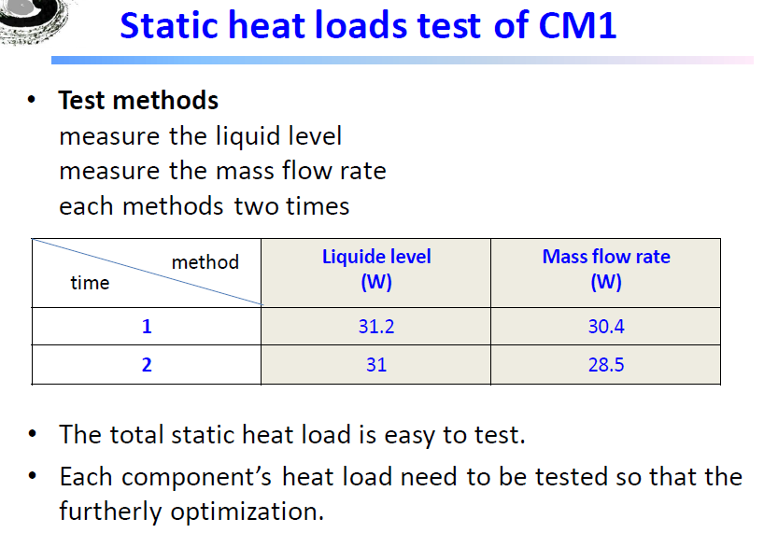
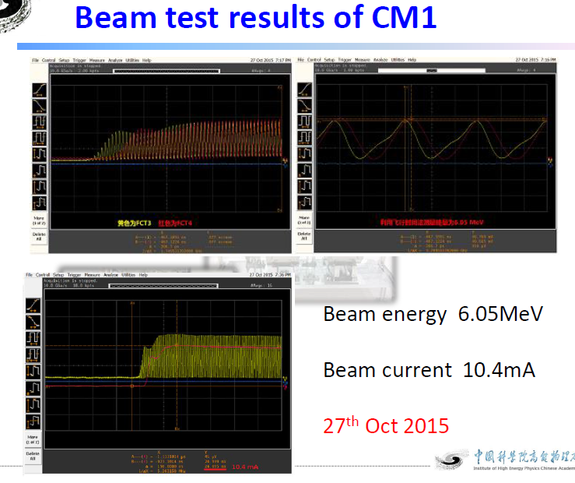
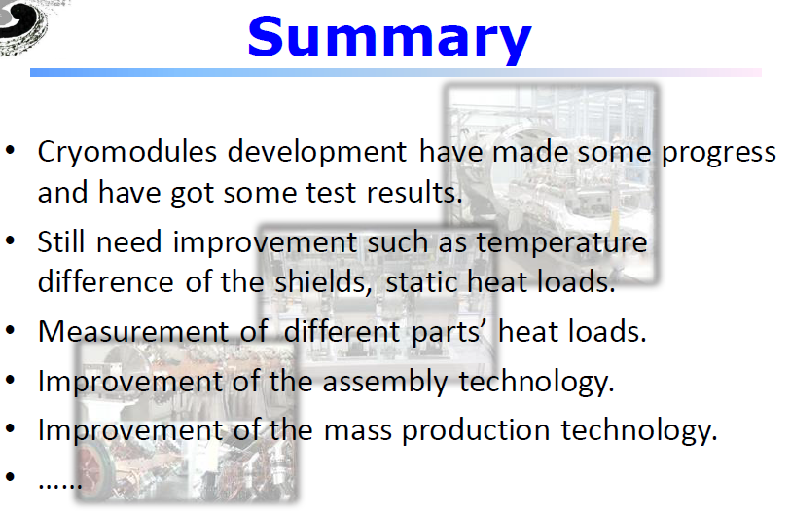

Slide 7
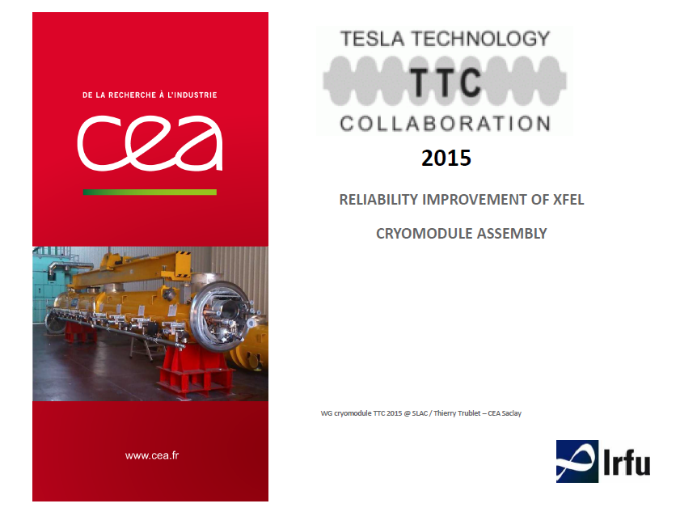
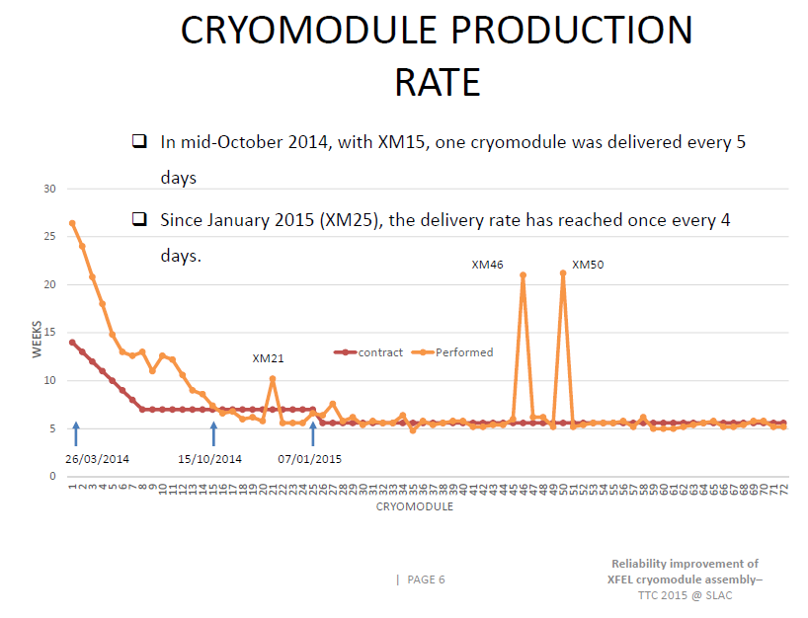
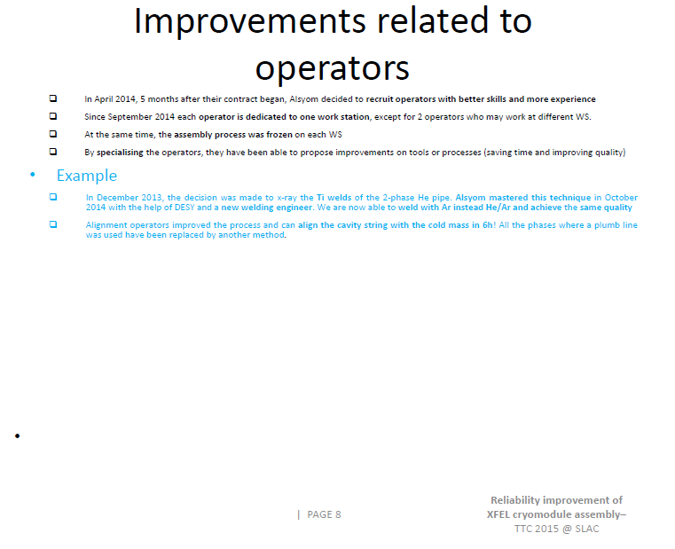
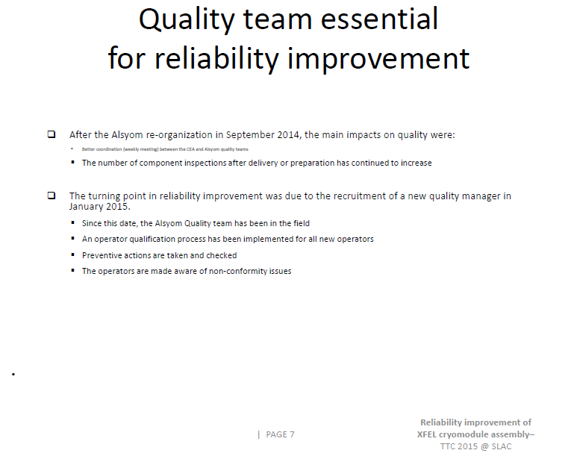
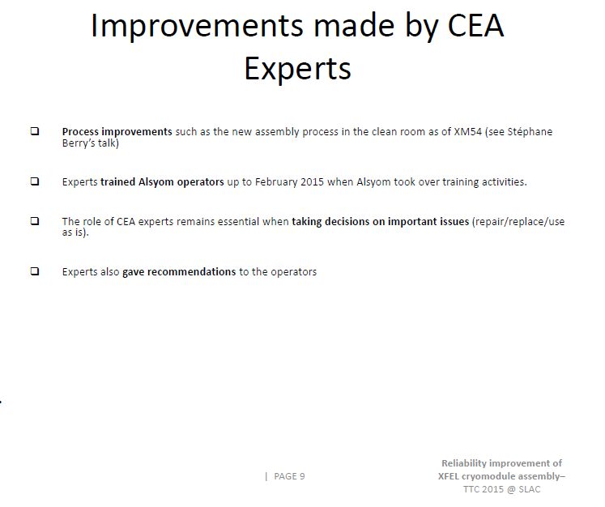

Slide 8
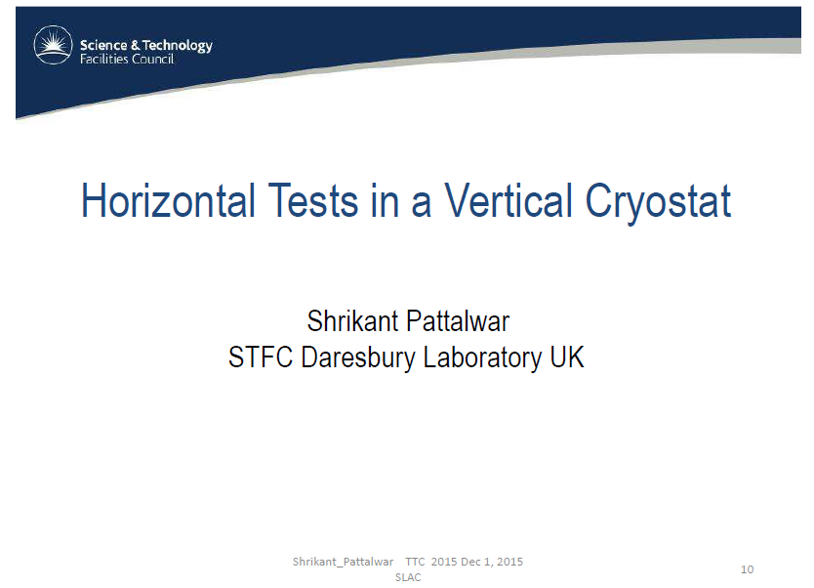
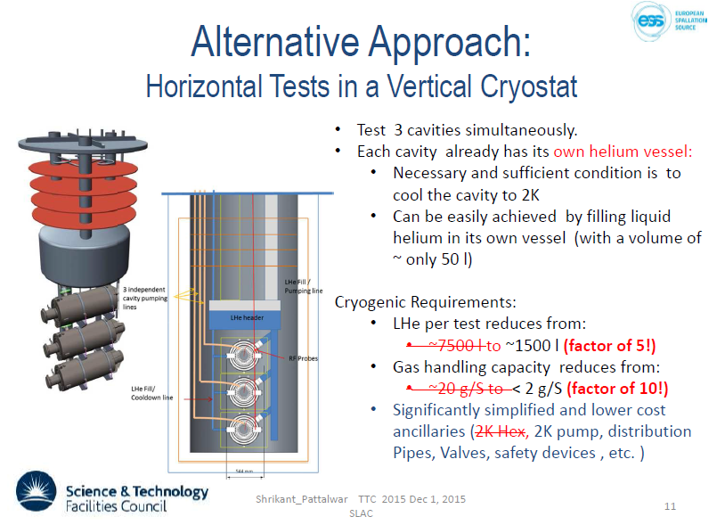
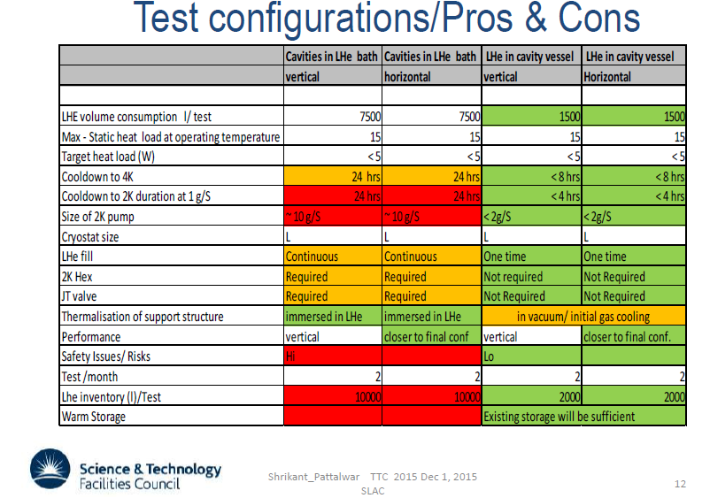
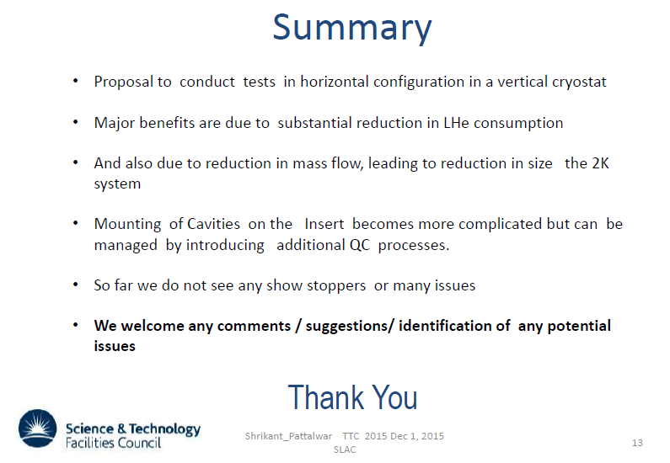

Slide 9
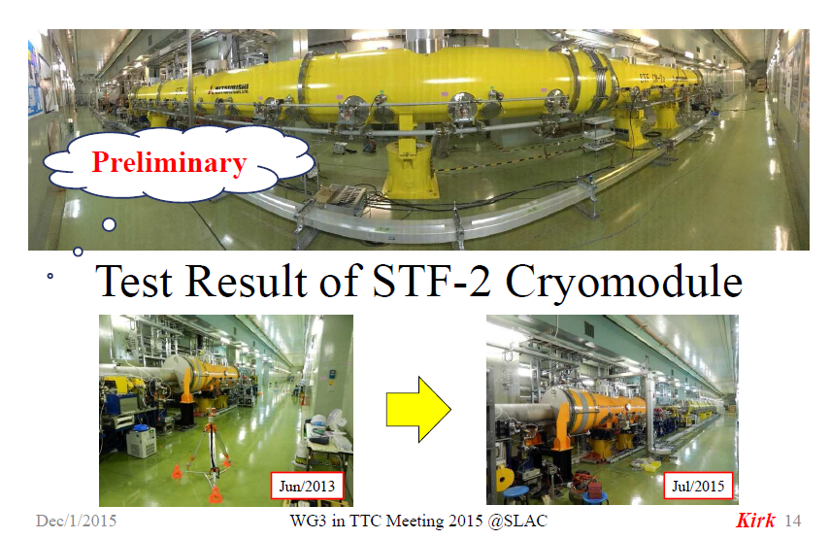
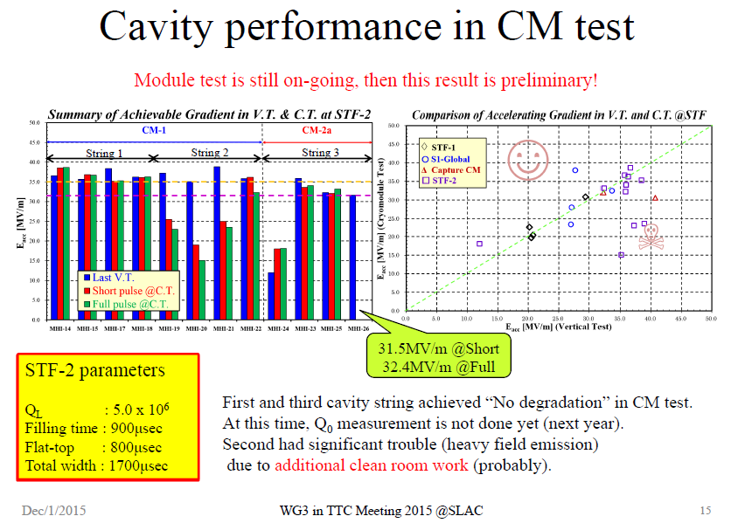
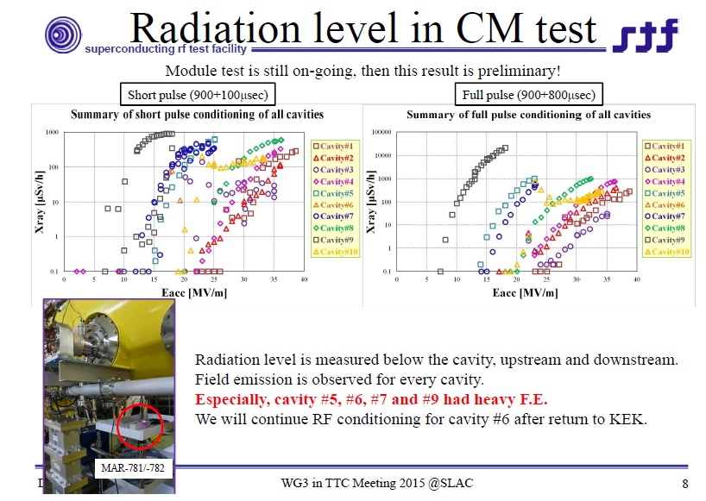
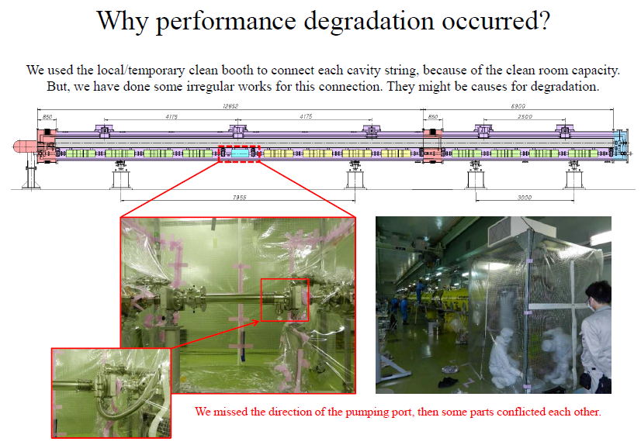

Slide 10
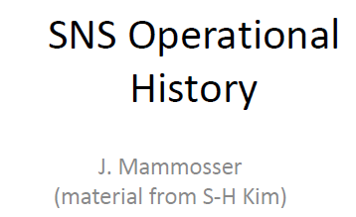
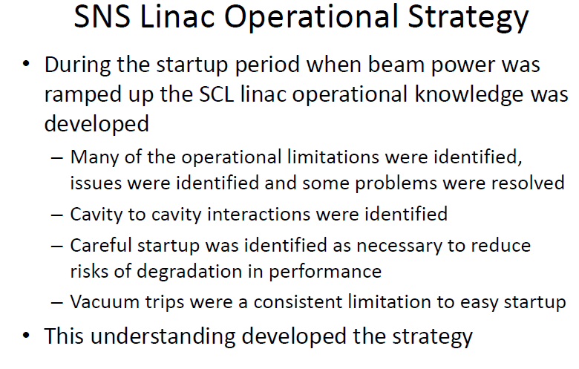
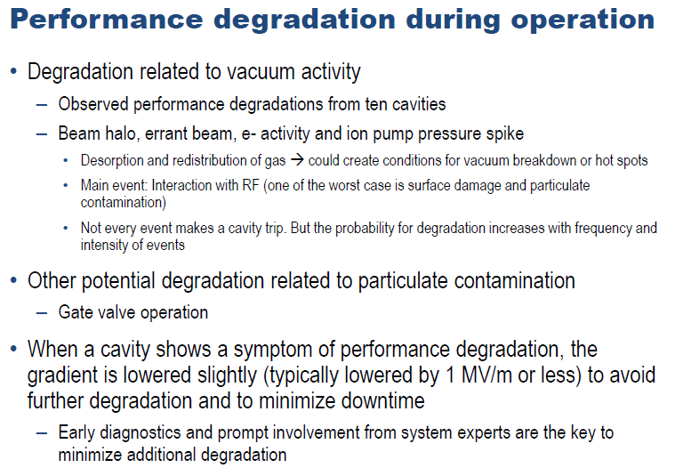
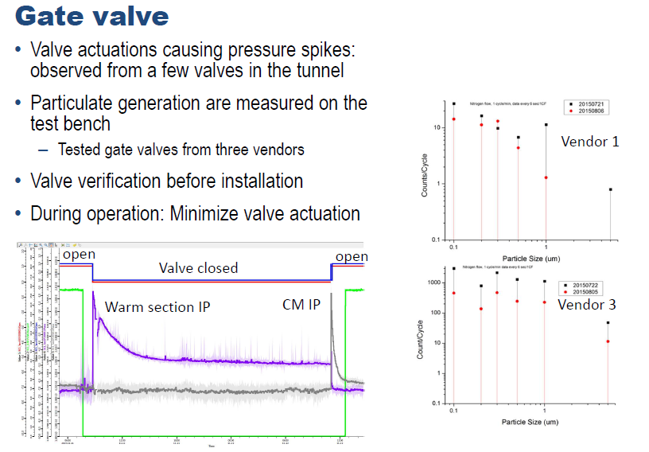

Slide 11
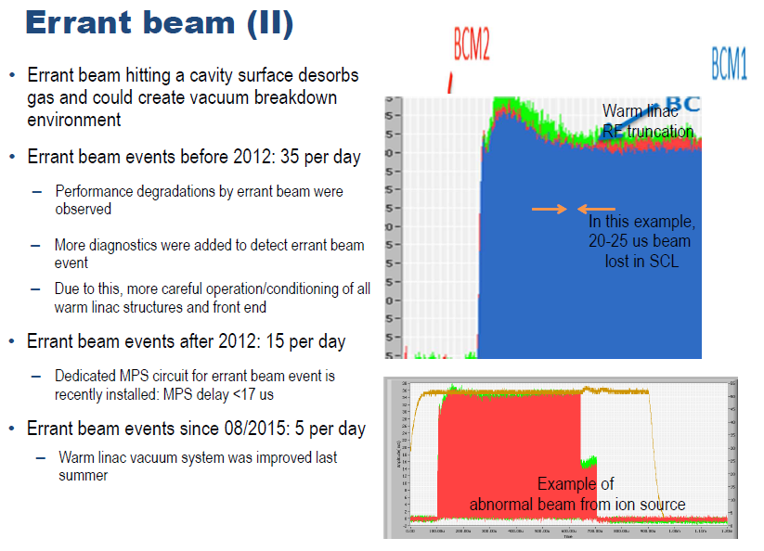
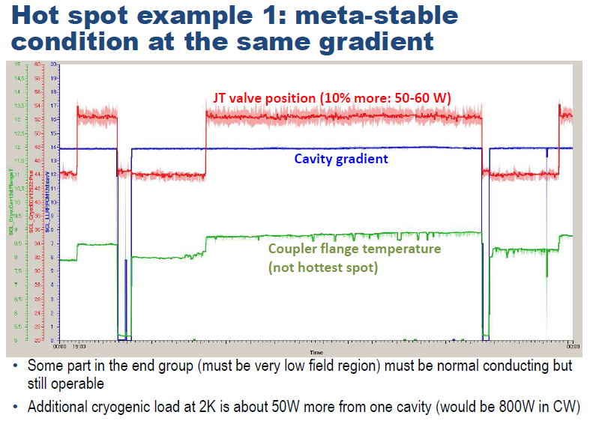
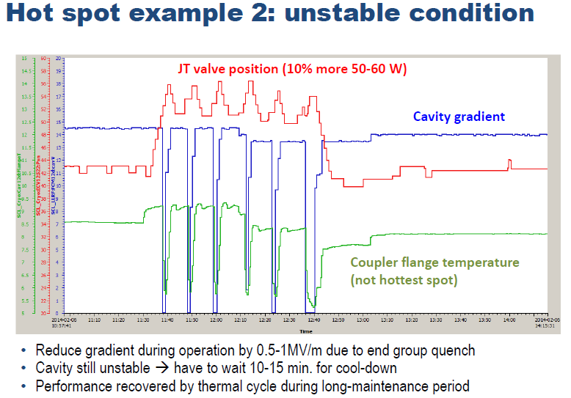
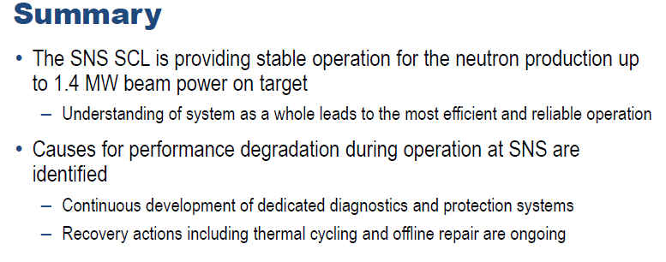

Slide 12
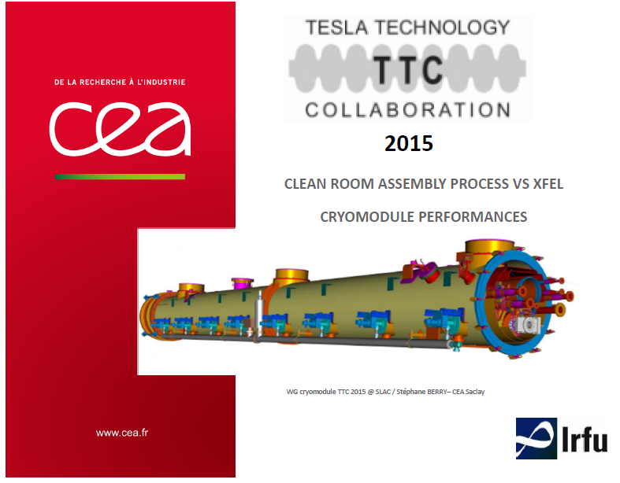
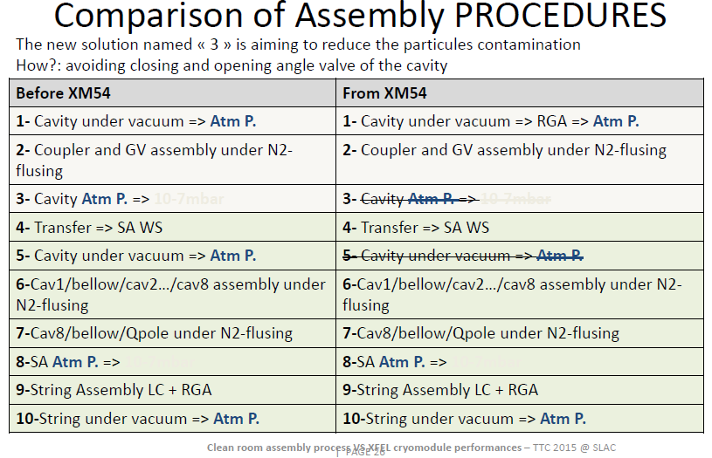
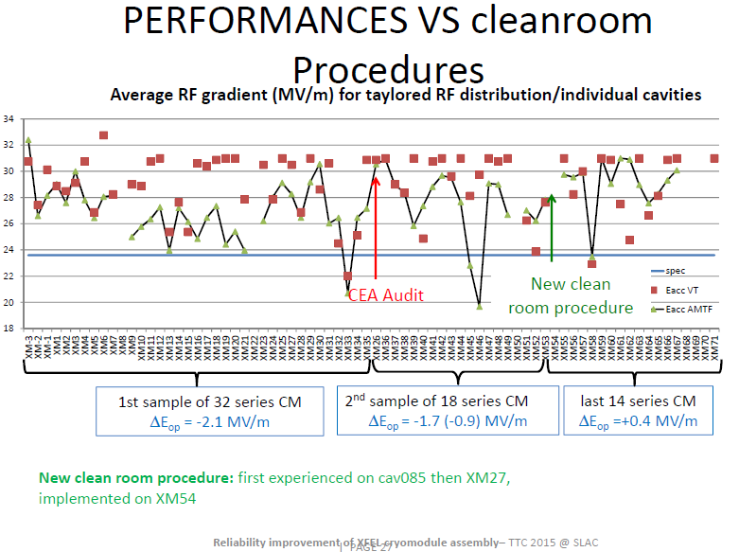
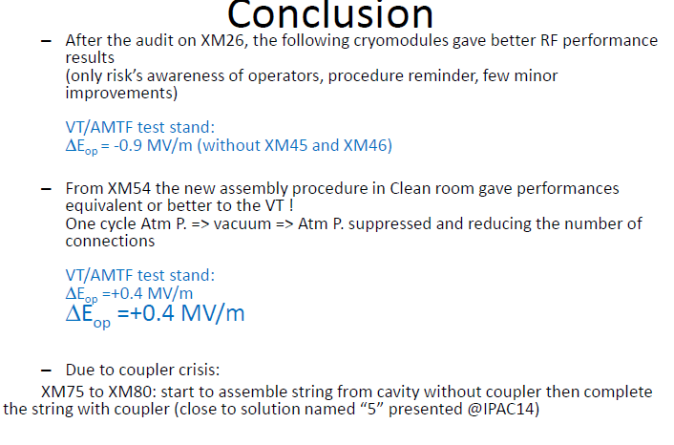

Slide 13
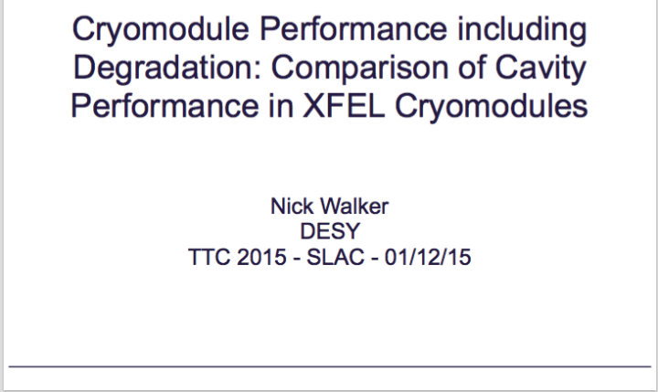
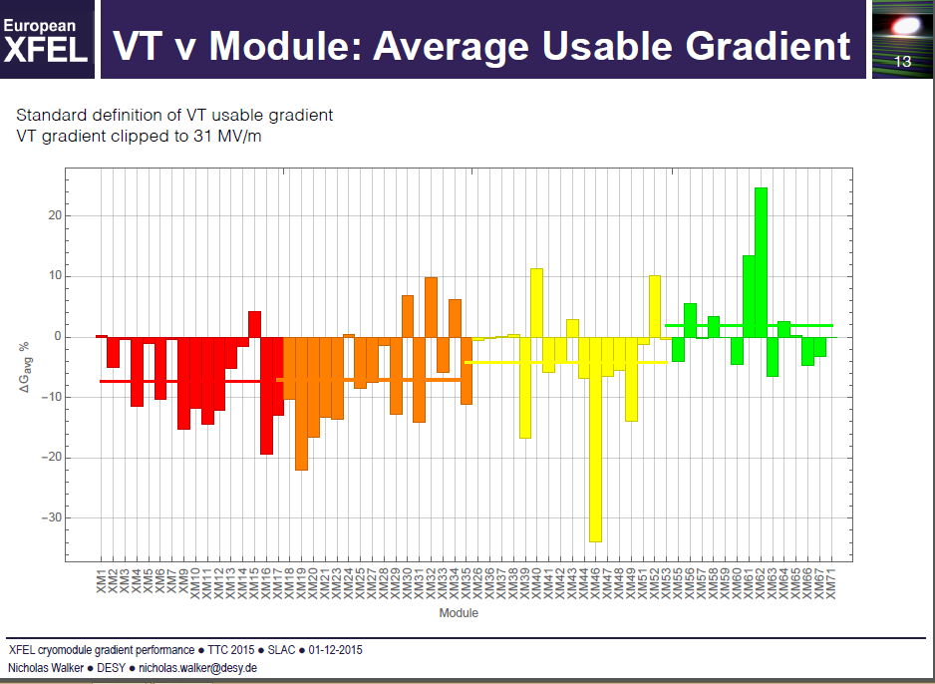
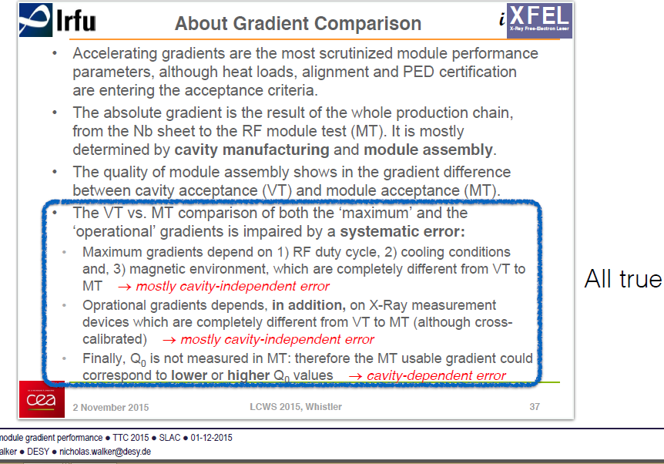
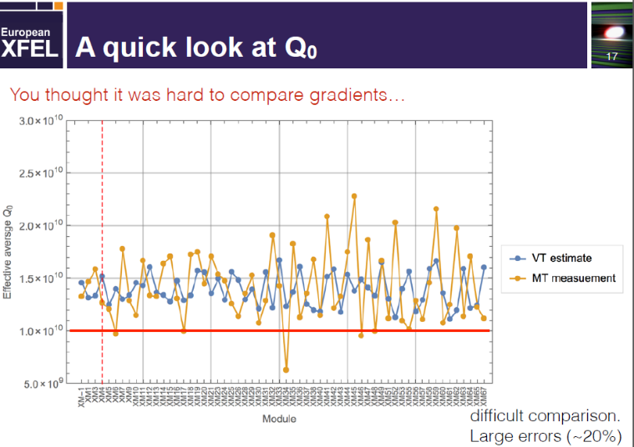
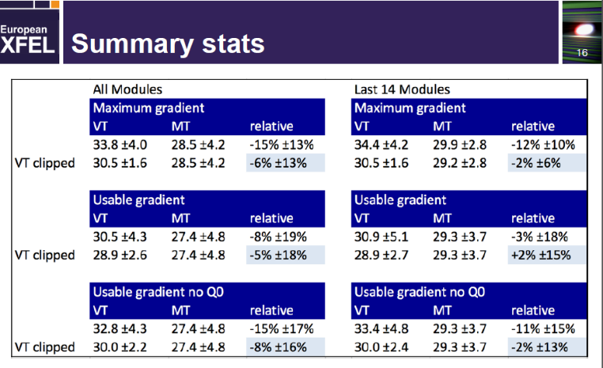
Nick Walker / DESY
TTC 2015 - SLAC - 01/12/15

Slide 14

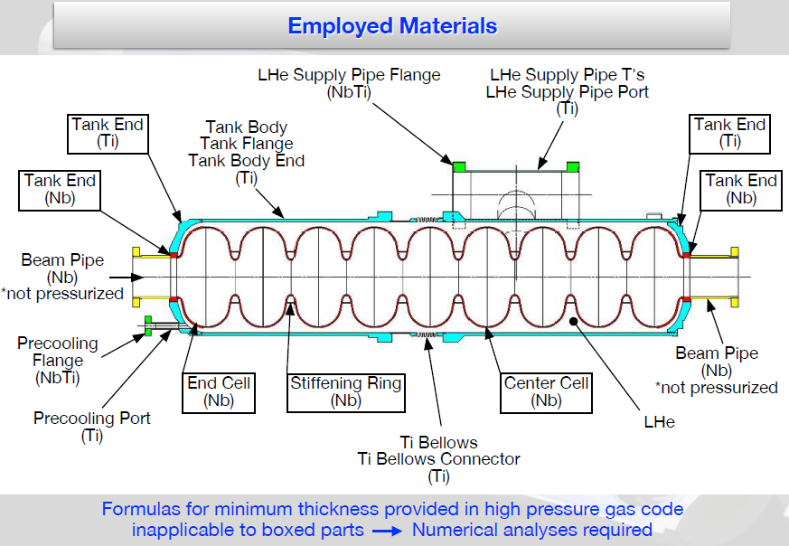
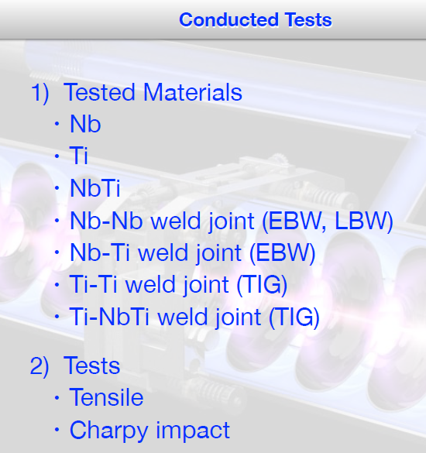
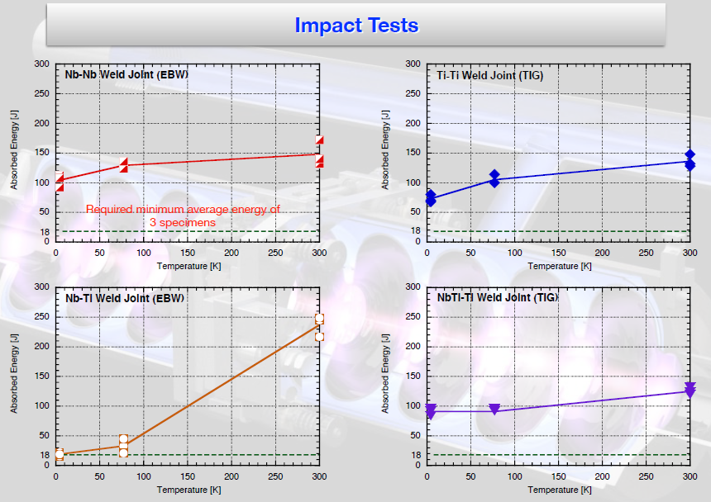

Slide 15
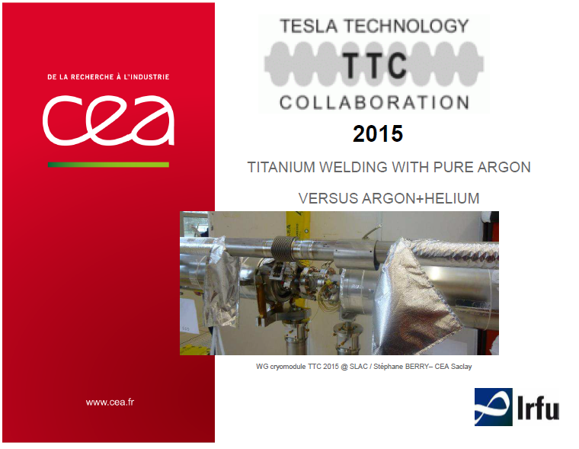
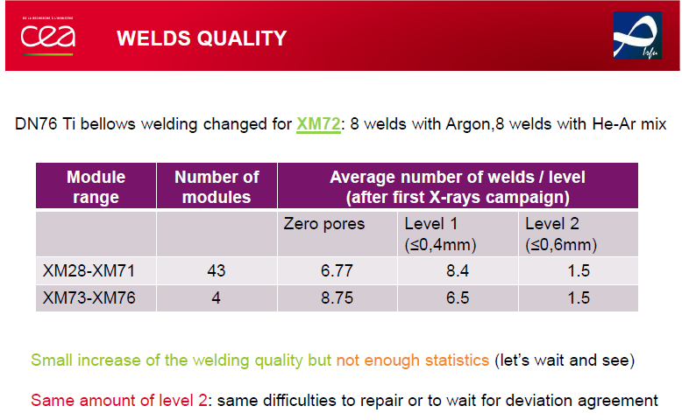
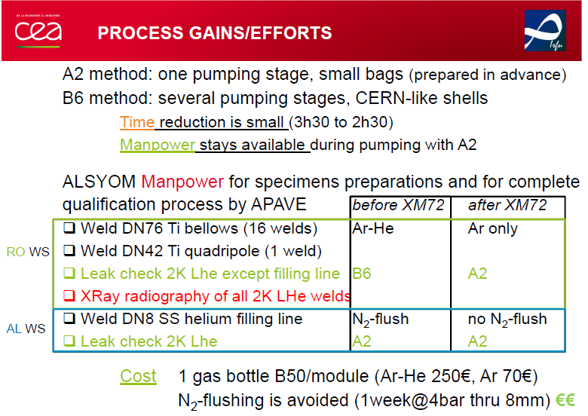
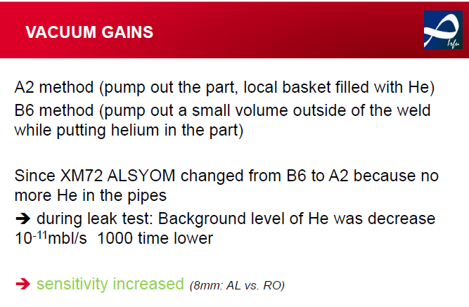

Slide 16
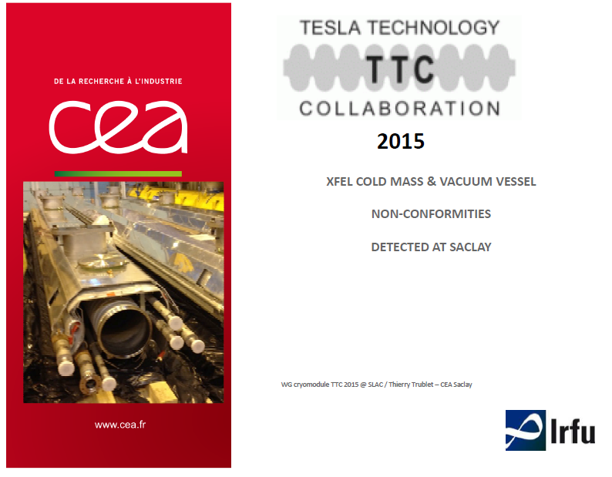
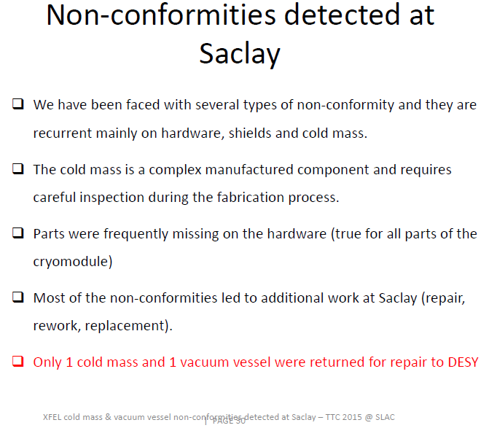
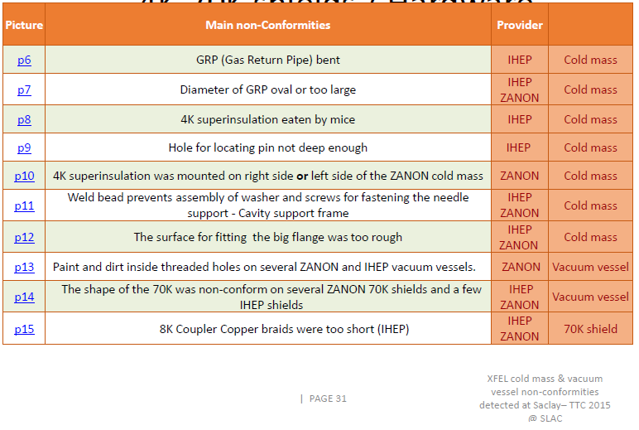
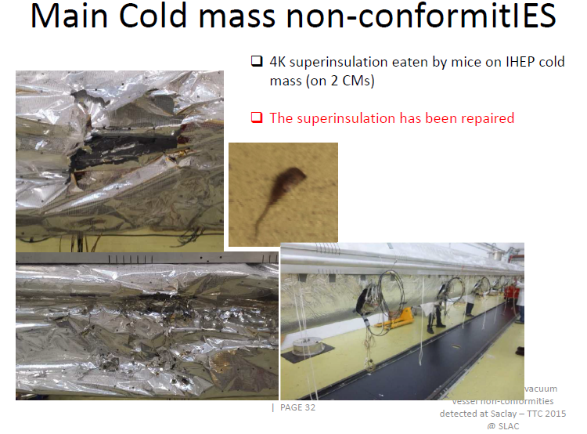

Slide 17



Slide 18





Slide 19





Slide 20





Slide 21
Summary
Minimize beam/gate valve manipulations
QC/QA cannot be under-estimated
Likewise pre-planning
Installation has its own challenges
Performance Degradation debunked?
Thank you to all participants, especially presenters

Slide 22





We’ve tried to find the “true picture” through the fog
<= We saw blanket
<= We saw a snake
We saw a rope =>
The picture we got is a…..

Slide 23
Thank you for your attention!

