Slide 1

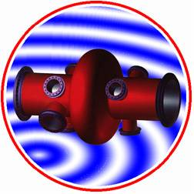
WG2 Cavities: Radiation and field emission in vertical and horizontal tests at CERN
P. Maesen for CERN BE/RF-SRF team

Slide 2
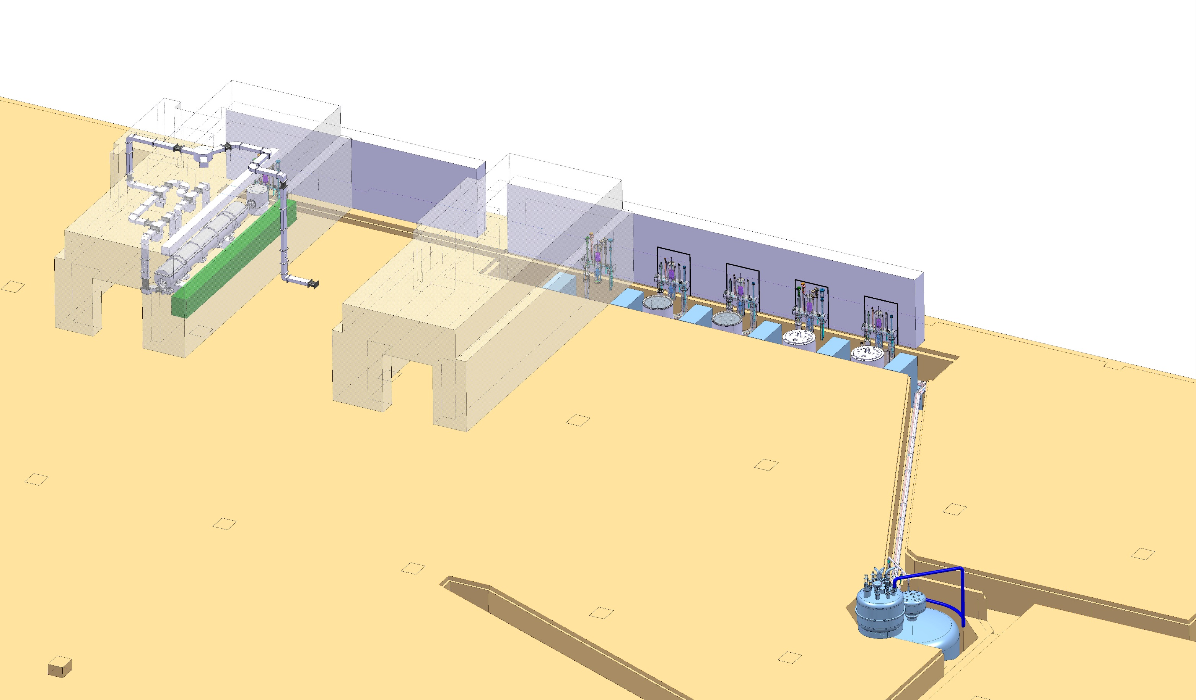
  Horizontal & Vertical Bunkers at CERN
V3
M7
V4
V5
V6
M9

Slide 3
Nb/Cu HIE-ISOLDE

Slide 4
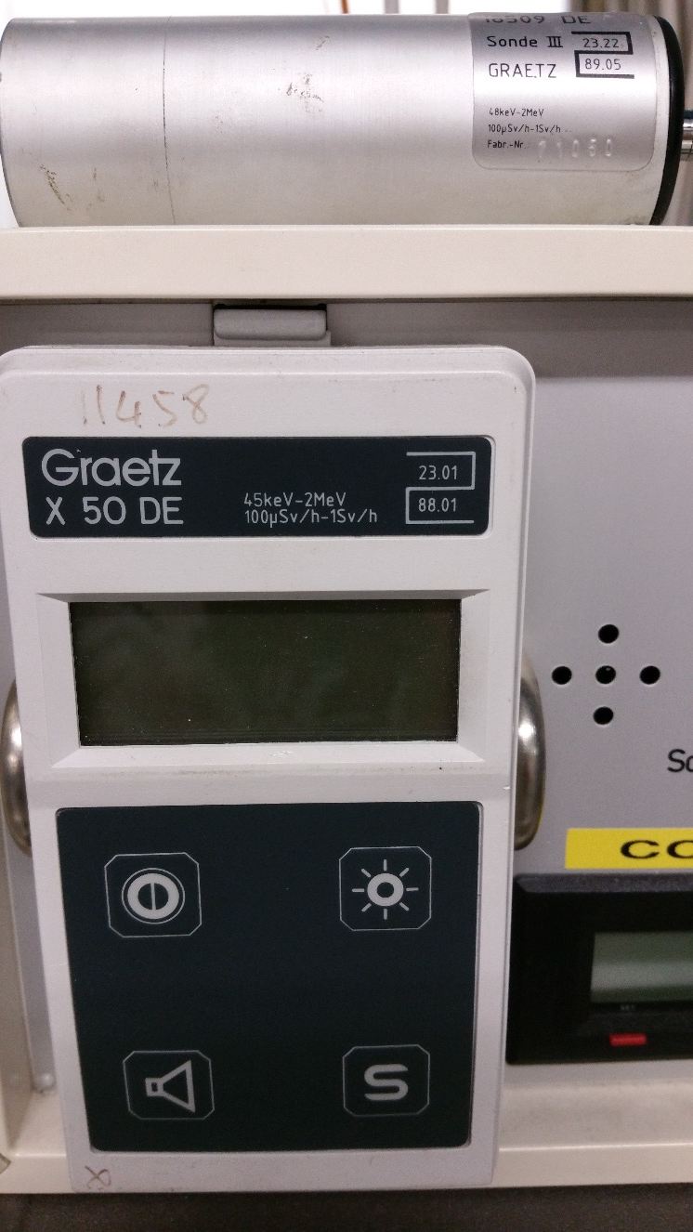
1) Which diagnostic techniques wrt. radiation are applied?
Please distinguish between "R&D" and "production", if necessary
  In vertical : Graetz probe 45keV-2MeV 100 uSv/h – 1 Sv/h on top plate of the insert : +- 3 meters above the cavity in the cryostat
    On top plate without any insert layers abortion compensation
    Tried some energy spectrum measurements but still needs weighting to de-convolute the detector.
    Some thermometers can show beam port flange heating specially with multicells cavities
    OSTs without localized spot could confirm general
    global equator quench at 2K
  In horizontal : same Graetz probe 45keV-2MeV
  100 uSv/h – 1 Sv/h at 1.5 meter on the side
  of the cavity in its cryo-module

Slide 5
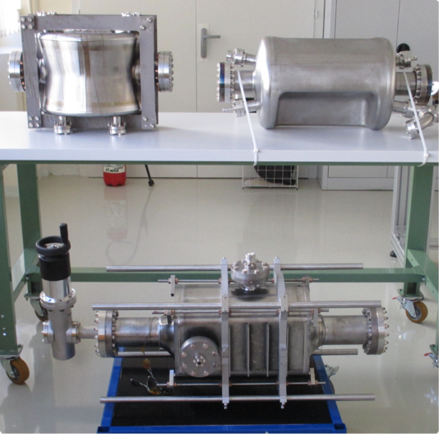
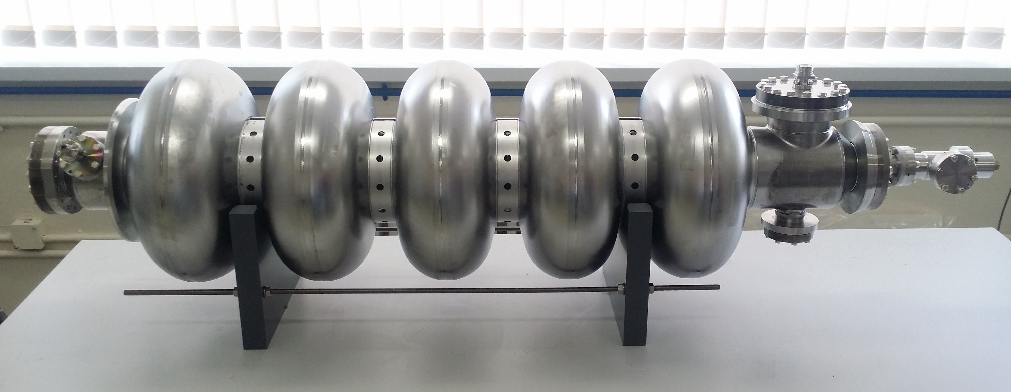
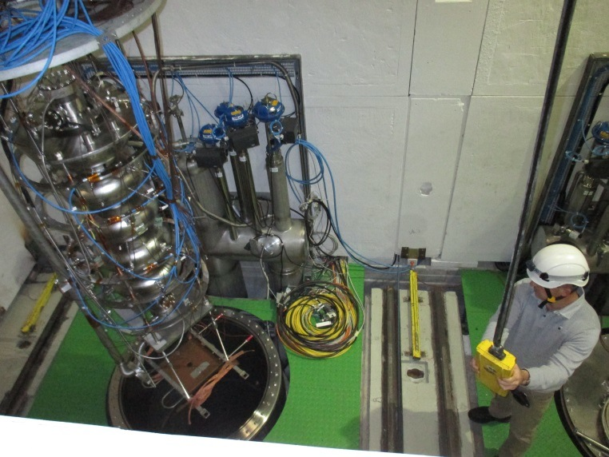
Bulk Niobium CRAB & Multi-cells at CERN
DQW
RFD
UK4R

Slide 6
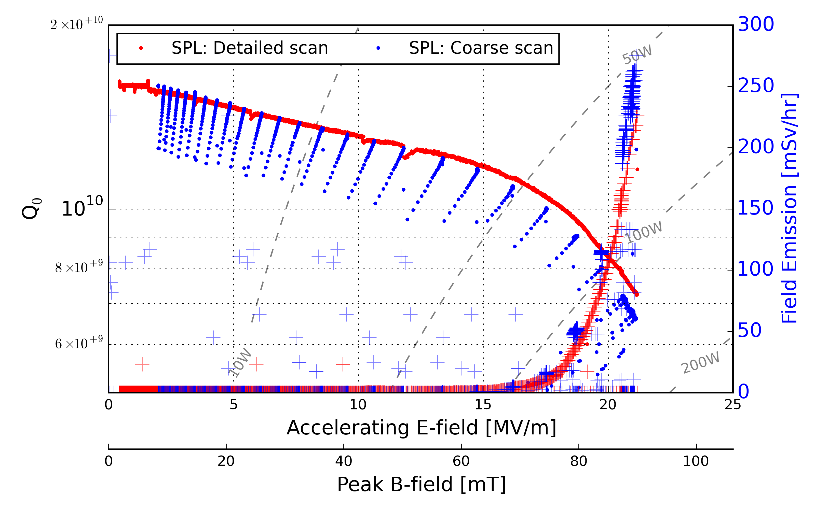
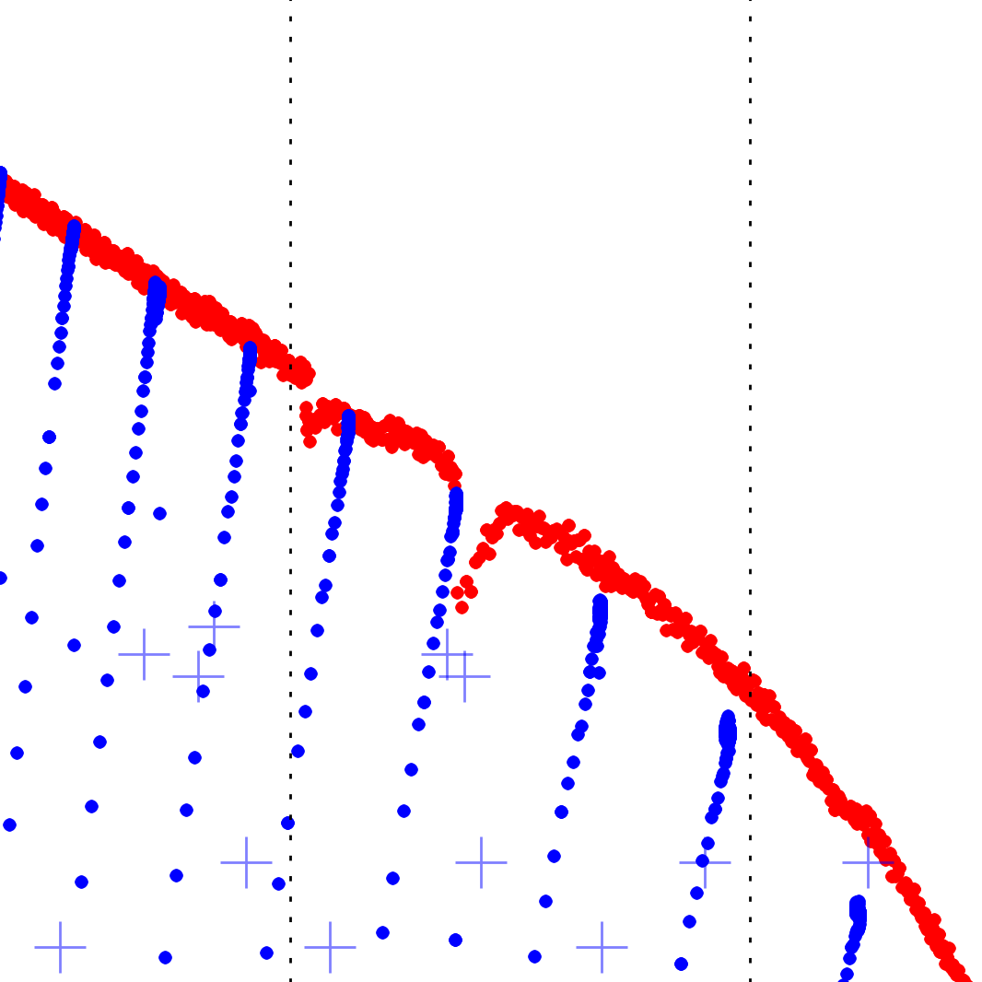
Detailed scan to identify multipactor/FE sites
Once multipacting/field emission regions identified, we apply focused amplitude modulation at entered on the region of interest
  Focused amplitude modulation => Sinusoidal variation of power at the 10%-20% level,with period of 10 seconds

Slide 7
2) What is your criteria for "field emission" in the test? What is your criteria for counting a cavity as FE loaded/limited/relevant?
  In vertical : No matter assuming above nominal Q/Eacc meaning low He consumption and acceptable FE
  In horizontal : For LHC module we considered 300 uSv/h as being acceptable at 5.3 MV/m nominal acceleration field per cavity
3) What is your guideline for the vertical test in case of field emission present?
(e.g. try processing; abort the test; administrative limits,...)
  In vertical : Try processing but difficult due to high Q, long filling time..
    Push high radiations with RP compensatory measures up to the max Helium consumption…Finish the test
    Mobile coupler will help for critical matching conditioning from mid to high field multipacting…
  In horizontal : Try processing at loaded Q around 150 000 with 500 us pulse/ 20 ms.
    Giving good result burning emitters. See LHC spare module recovery

Slide 8
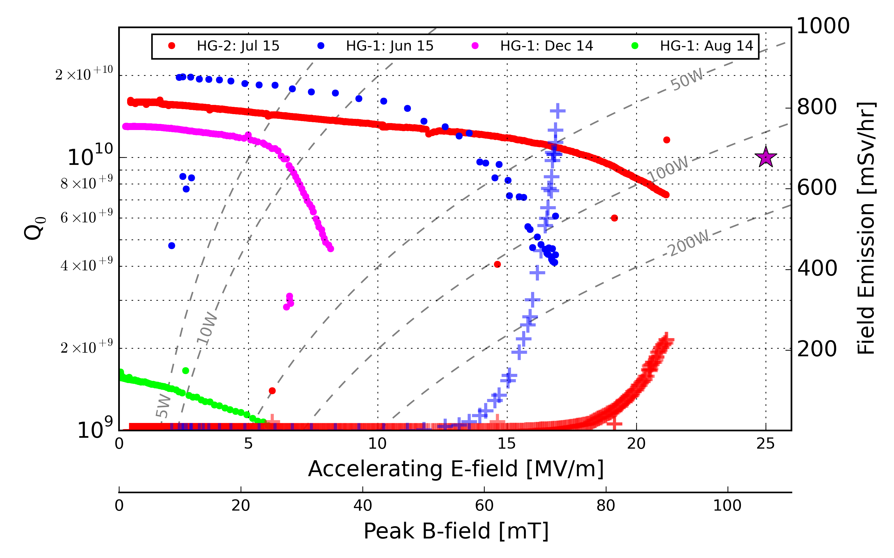
Improved HPR made the biggest improvement
Evolution of performance due to improved quality control of HPR
  HPR is now ~8 - 12 hrs duration for a 5-cell cavity (depends on outflow water quality ; Resistivity, 0.2 μm particle count, TOC, pH )
Field Emission

Slide 9
4a) Which processing techniques are applied? What is the success rate?
  AM modulation help the conditioning
  Assuming conditioning finished, He processing usually helped on LHC cavities, HIE-ISOLDE cavities and CRAB with its special geometry.
4b) How often is a spontaneous degradation observed (Q-value, radiation, gradient)?
  Q drop, radiation, unreached nominal field are linked
  Bulk Nb : Mid and high field Q switches observed with CRAB with FE peaks
5) Percentage of cavities showing field emission?
  Nb on Cu : Very low, 5 % for HIE-ISOLDE production well above nominal field
  For R&D, we push up to the maximum drive unless Cryo cannot compensate the He level drop usually with high FE

Slide 10
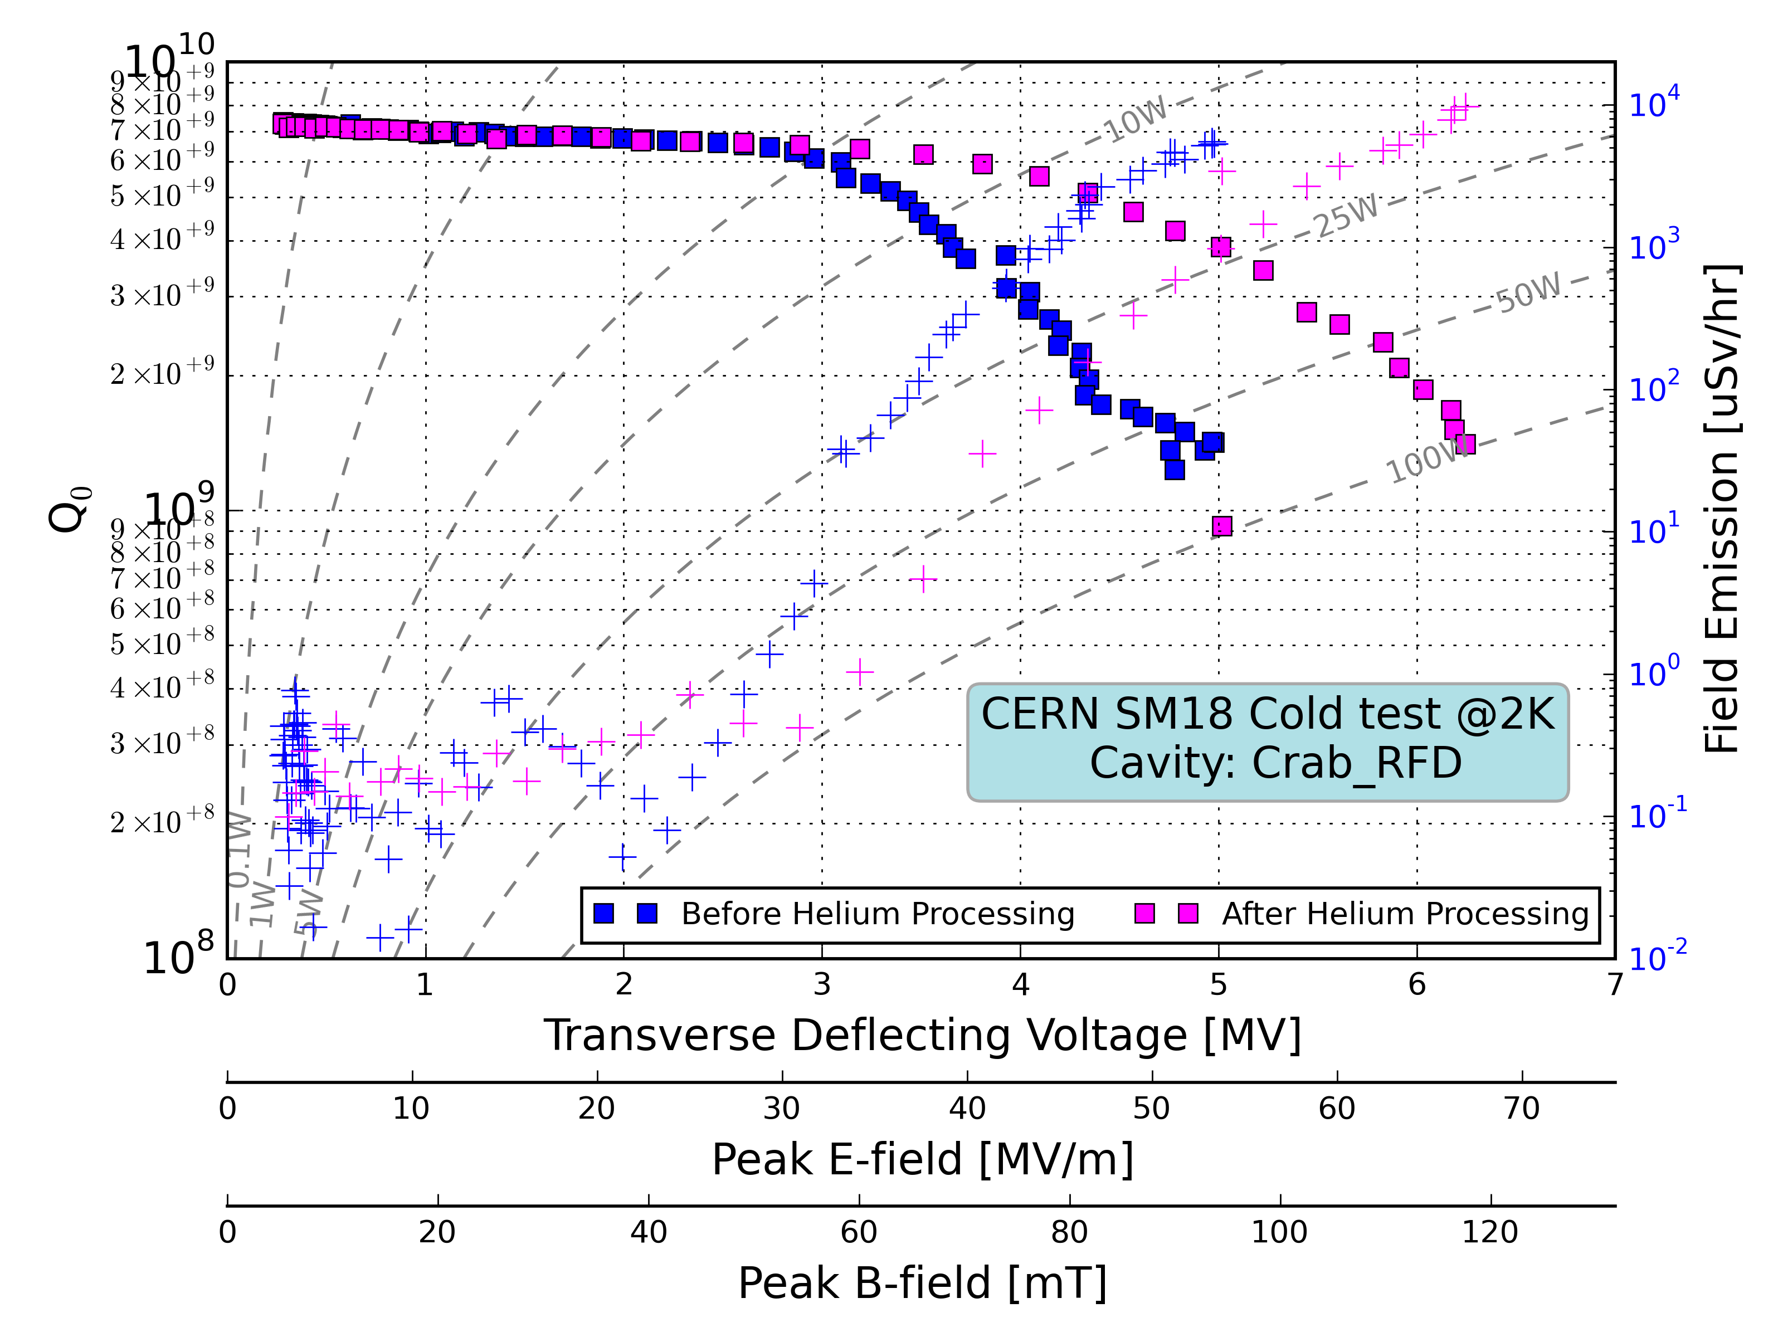
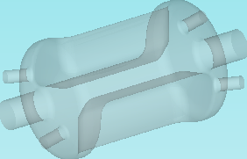
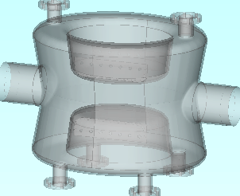
Crab Cavity: Vertical testing observations
Mid-field multipactor in High B-field region
Difficult to process
Effect Of Helium processing
Ambient B-field ~3μT
Ambient B-field <50nT
F=403.82 MHZ
Q-switch at high field: Radiation follows

Slide 11
6) Reprocessing strategy?
  Nb on Cu : Rinsing 10 bars
  Bulk Nb : Long High Pressure Rinsing or Light BCP & HPR or Light EP & HPR
7) If available: Comparability between horizontal/module and vertical test wrt. radiation/dark current?
This includes both diagnostic techniques and cavity results!
  Nb on Cu : To be extracted for LHC modules…
8) is there any relation between Multipacting and FE observed
  Yes if enough field reached > 3 MV/m

Slide 12
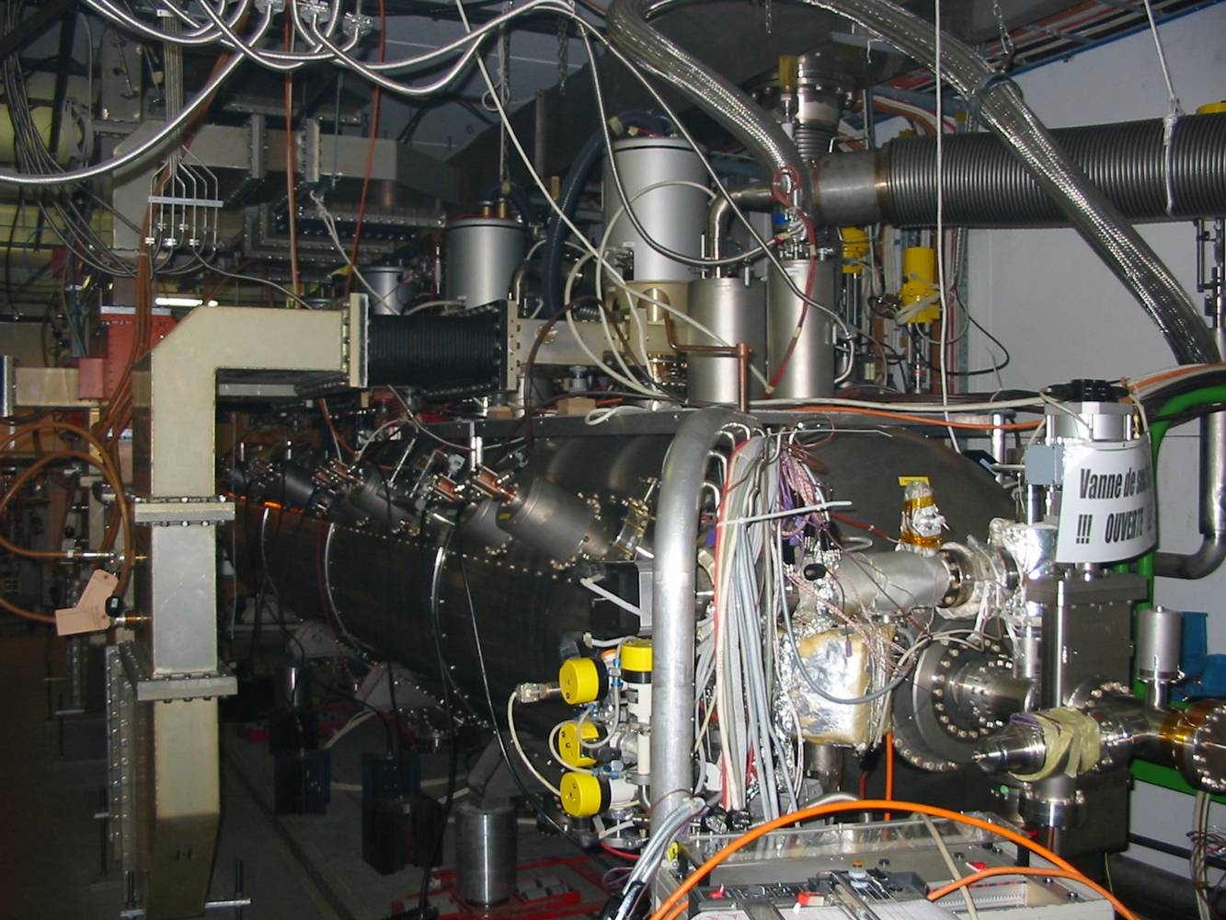
LHC 400 MHz Cryo module

