Slide 1
WG2; Lab Contributions about
A) Instrumentation; Limits;
Procedures incl. Discussion
Fumio Furuta
Cornell University
TTC Meeting WG2, 3Dec2015, SLAC

Slide 2
1) Which diagnostic techniques wrt. radiation are applied? -> gamma proves
Cavity VT area at Newman lab basement.
VT area | probe | Interlocked | location | Notes
Inside of rad. shielding block | 3 Gamma | No | Semi-fixed in pit
Outside of rad. shielding block | 3 Gamma | Yes | Fixed on wall | 2mR/h limit.
 | 2 Gamma | No | Flexible
MLC test area at Wilson L0E.
MLC | Probe | Interlocked | location | Notes
Inside of rad. shielding block | 3 Gamma | No | Semi-fixed on MLC (coupler, end plates)
Outside of rad. shielding block | 3 Neutron | No | Fixed on wall
 | 6 Gamma | Yes | Fixed on wall | 2mR/h limit.
 | 1 Gamma | No | Handy for survey

Slide 3
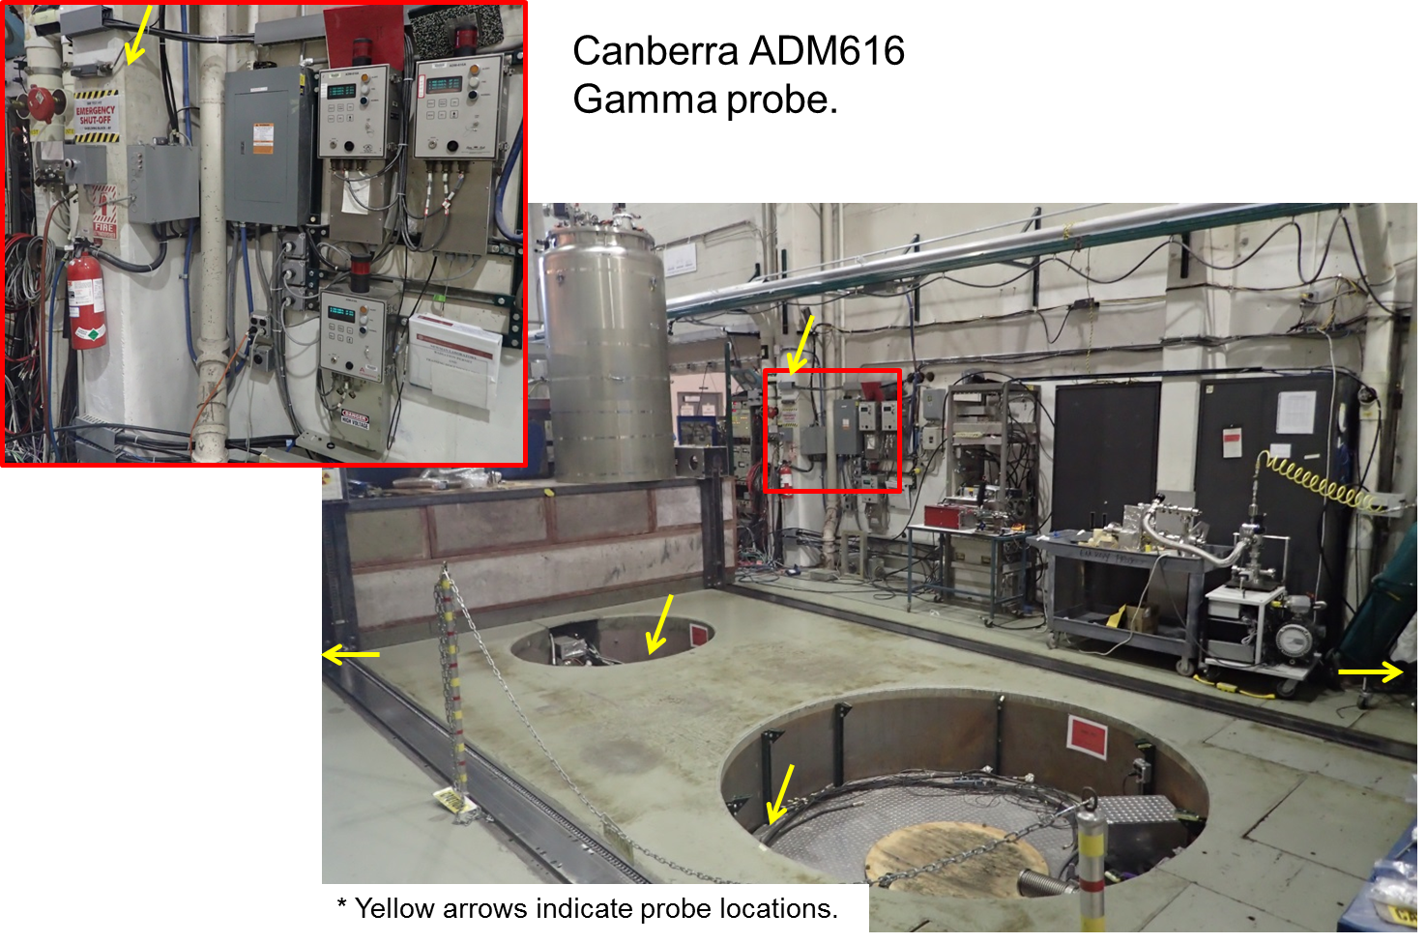
Cavity VT area in Newman lab. basement

Slide 4
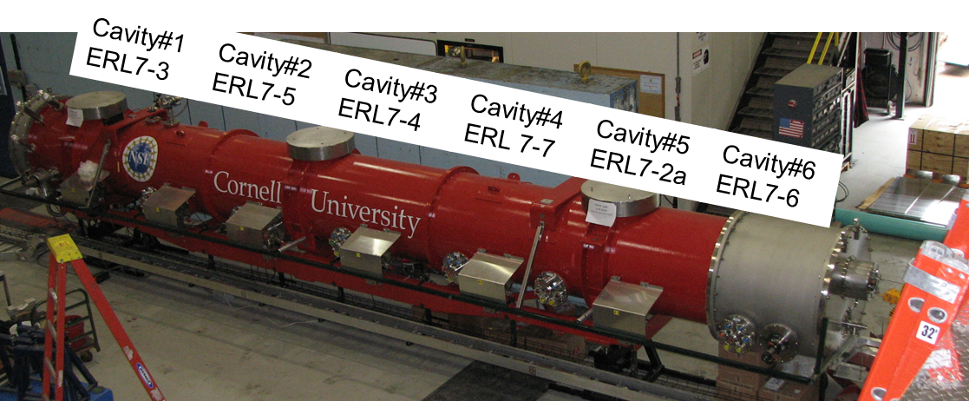
MLC String and Rad monitors
#1
#2
#3
Gamma probe #1, #2, and #3 on MLC.
#2 was put on the coupler of measured cavity.

Slide 5
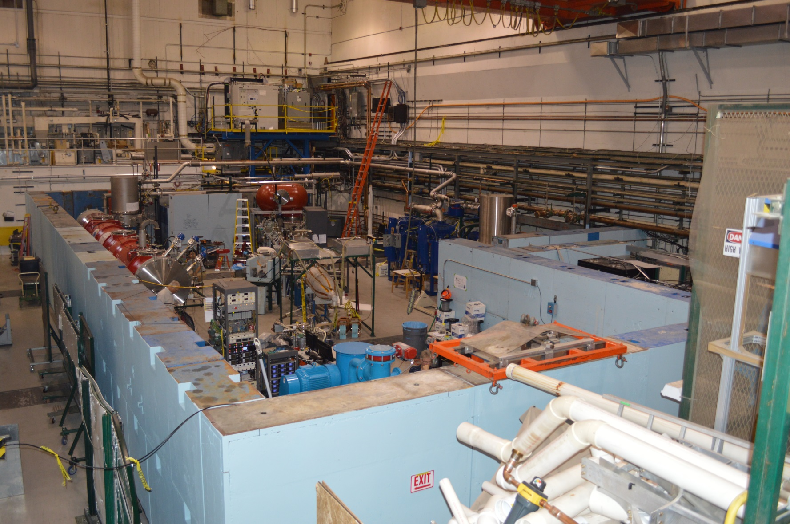
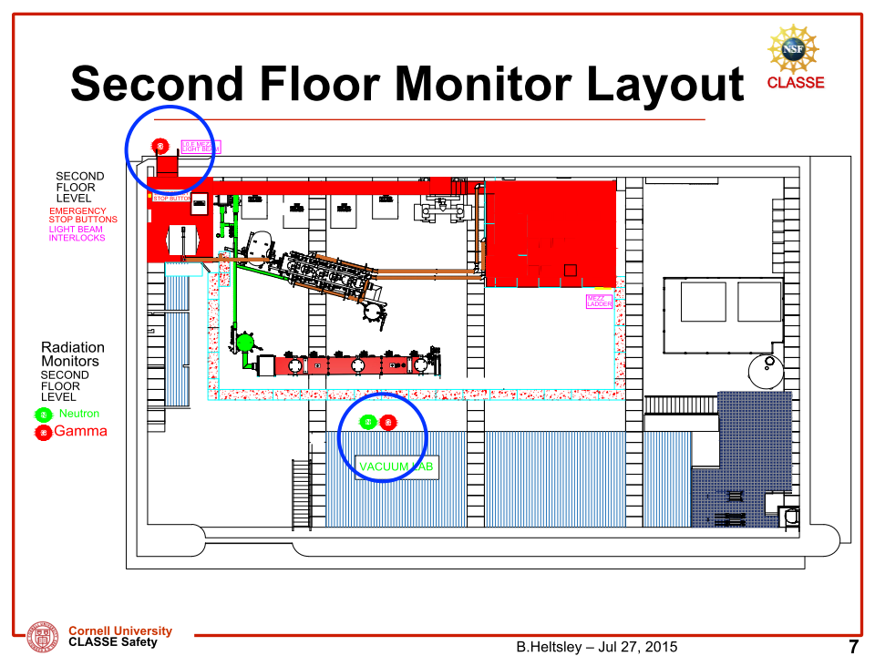
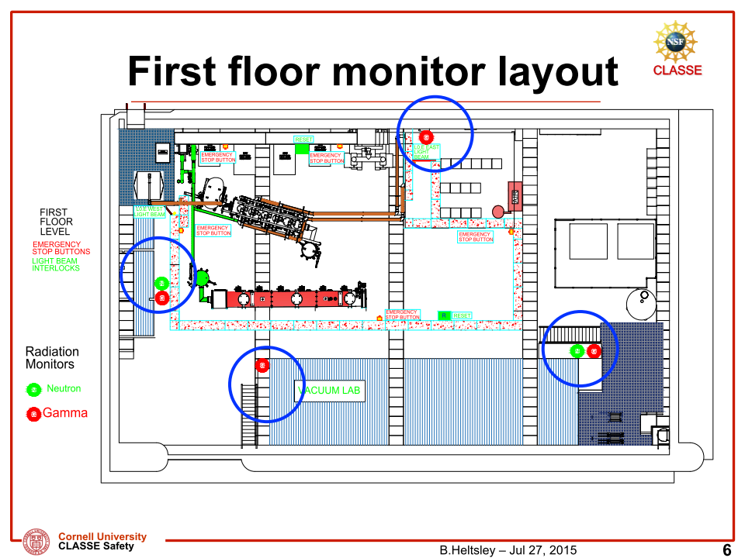
Wilson L0E for MLC test

Slide 6
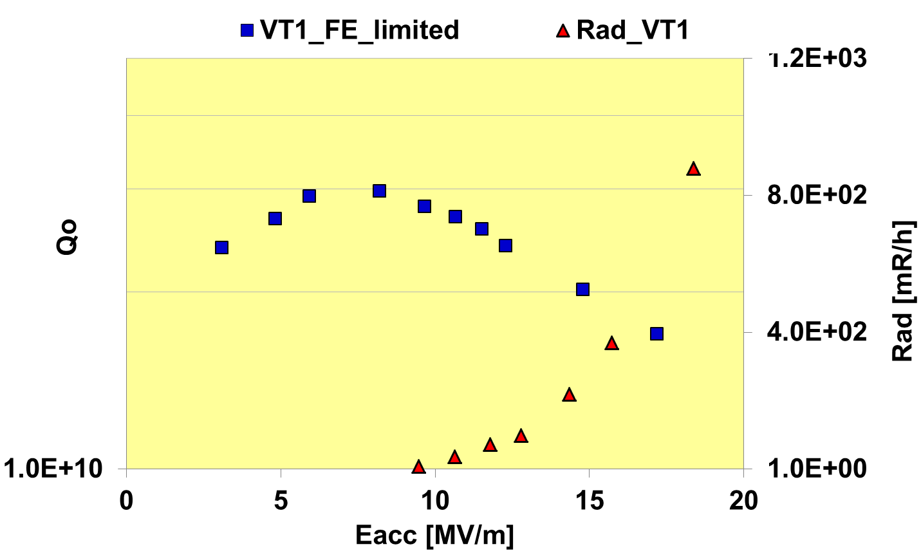
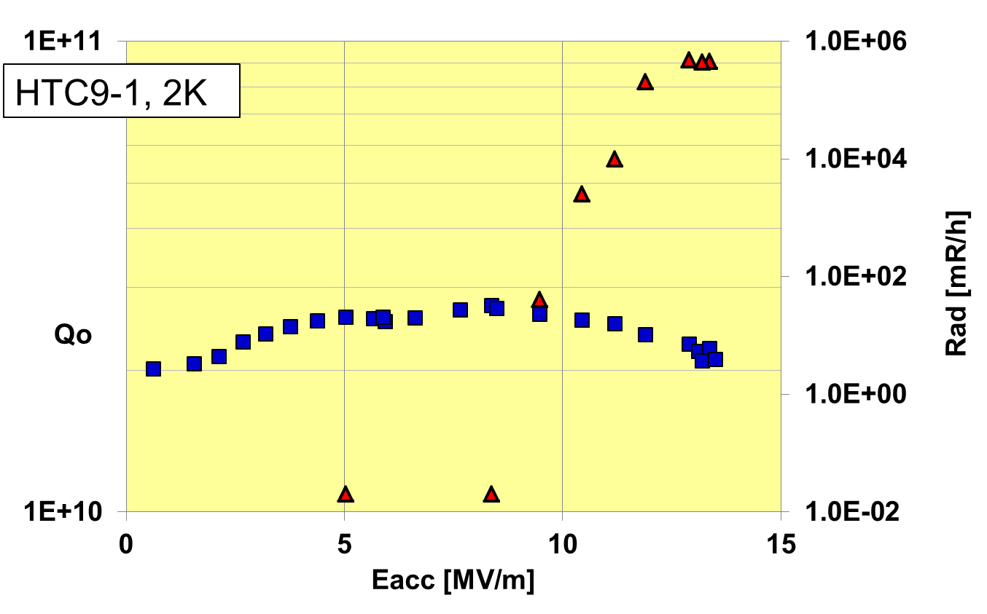
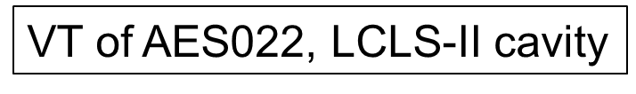
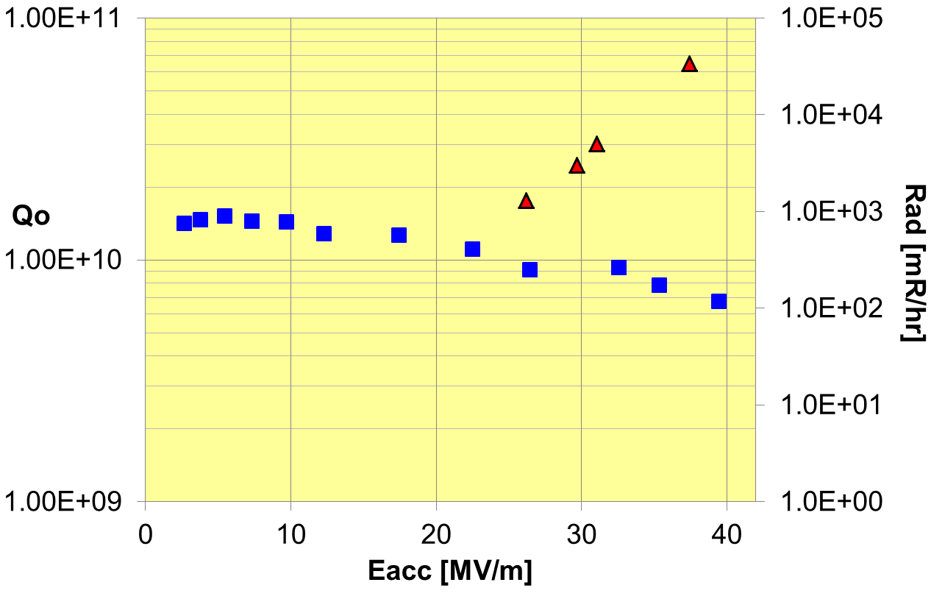
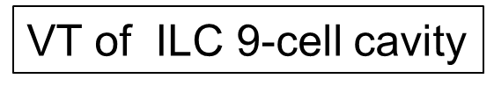
2) What is your criteria for "field emission" in the test?
What is your criteria for counting a cavity as FE loaded/limited/relevant?
FE onset
FE onset
VTs limited by FE
Cavities were counted as FE limited when
Qo dropped with rad increasing,
Showed high Rad (>1~10R/h) w/, or w/o, quench.

Slide 7
3) What is your guideline for the vertical test in case of field emission present?
If cavity achieved design specs, stop as admin. limit.
If not, keep rising RF power .
If Cavity had quench, try processing by keep quenching,,
in Pi-mode (single-cell, multi-cell)
in Pass-band (multi-cell)
Abort test when
input power was too high, need to prevent burn RF cable.
cavity heating was too high to maintain temp.
Rad at outside shielding > 2mR/h, safety limit.

Slide 8
4a) Which processing techniques are applied? -> quenching.
What is the success rate? -> table
4b) How often is a spontaneous degradation observed (Q-value, radiation, gradient)? -> table
 | VT | HTC7-cell | HTC-9cell | MLC
# of test | 53 | 3 | 5 | 6
# of FE limited | 10 | 1 | 1 | 2
Eacc degradation | 2 | 1 | 0 | 1
Qo degradation | 8 | 1 | 1 | 2
Applied processing | 10 | 0 | 1 | 2
success | 0* | 0* | 1 | 1
Total success rate [%] | ~15% (2/13)
* Some improvements were seen, but not fully processed out

Slide 9
5) Percentage of cavities showing field emission? 6) Reprocessing strategy?
Re-chem.
FE limit ~19% of VT (multi-cells)
Reprocessing strategy
Optical Inspection
based on T-map, OST data if available.
Reprocess will depend on R&D goal, schedules, or budget.
Re-HPR ; if schedules were not tight
Re-Chemistry ; BCP or VEP, depends on R&D target.
Re-HPR
FE limited
 | # of Cavity | # of VT | # of FE | cured by
 |  |  |  | re-HPR | re-chem.
total | 17 | 53 | 10 | 3 | 7

Slide 10
7) If available: Comparability between horizontal/module and vertical test wrt. radiation/dark current?
FE limit during VT / HTC
Ratio of test limited by FE (# of FE limited / # of toal tests)
VT | HTC | MLC
15% (5/33) | 25% (2/8)* | 3% (2/6)**
*, ** One cavity processed out by quenching

Slide 11
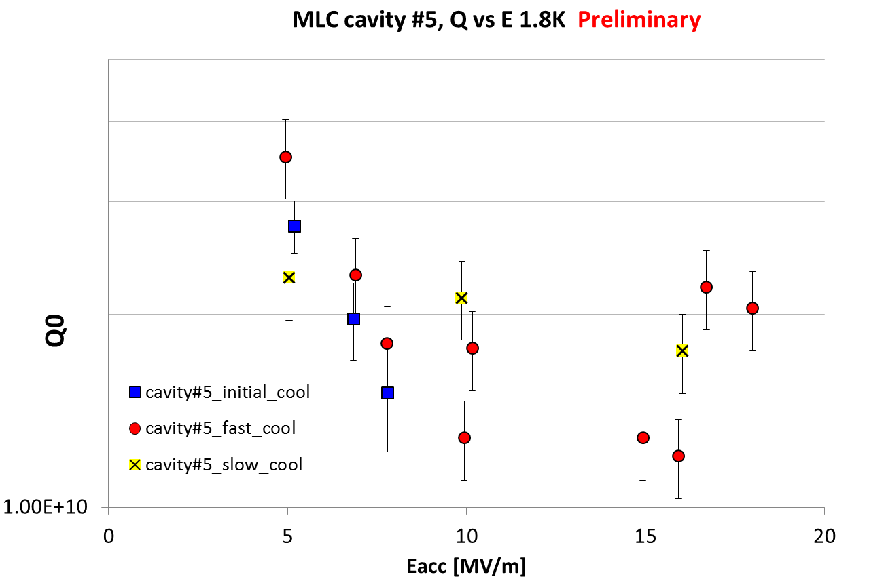
Example of FE processed out
Quenching processed out FE.
1st process
2nd process

Slide 12
8) is there any relation between Multipacting and FE observed
Histogram of gradient with FE, analysis on 11 test limited by FE.
Histogram of FE onset, analysis on 11 test limited by FE.

