Slide 1
Radiation / Field Emission measurements at DESY
Detlef Reschke
SLAC, Dec 1-4, 2015
TTC2015 WG2 Cavities

Slide 2
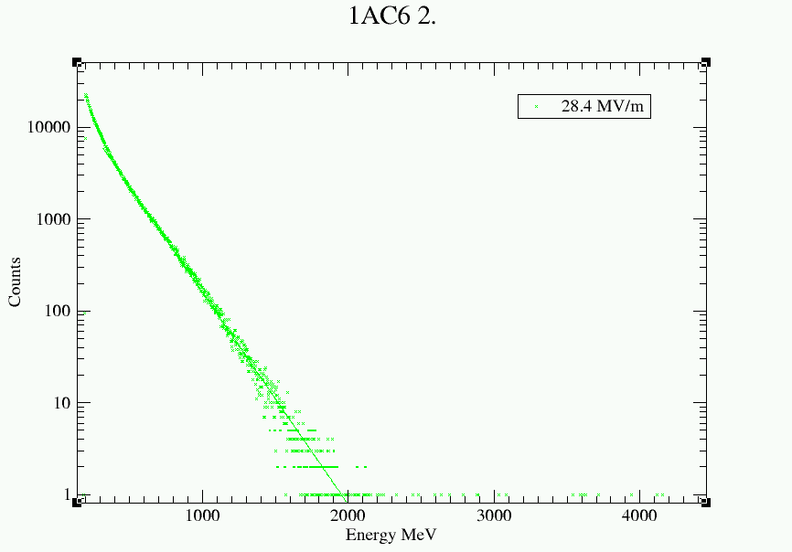
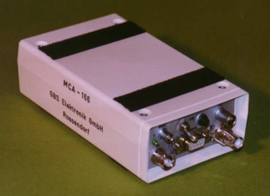
X-ray detection in vertical test
Radiation detectors (inside of shielding):
Ionization chamber: Unidos T10001 with chamber TM32002; PTW Freiburg; Germany lower detection limit 10⁻⁶ mGy/min in sensitive range - „hall 3“: on top of cryostat - „AMTF“ for XFEL series: top + bottom of cryostat
Scintillator with Multi-Channel Analyzer => energy spectrum (few R&D tests) MCA 166; GBS electronic, Germany
+

Slide 3
Field emission / Radiation in vertical test
XFEL series cavities: - Detection limit ~ (1-2) x 10⁻⁴ mGy/min (“medium” range of detector) - “x-ray limit”: - upper detector: 10⁻² mGy/min - lower detector: 0.12 mGy/min => usable/operational gradient limited by radiation Comment 1: Historical empirical limit based on FLASH experience Comment 2: Maybe to conservative looking at present XFEL module results ???
“Old” R&D radiation onset: 4 x 10⁻⁴ mGy/min
No administrative limit (except of personal safety interlock) => test the cavity until max available rf power or quench of cavity

Slide 4
Field emission / Radiation in vertical test II
Allowing + active rf processing with risk of degradation accepted
Processing techniques: - RF processing, only - often some/good success, but degradations observed => quantitative analysis of degradations on the way
MP vs. FE: No correlation (preliminary)
More results + test examples by Nick Walker

