Slide 1
Introduction and Update from last Collaboration Meeting
Hasan Padamsee
Cornell

Slide 2
Major Workshops Relevant To SRF Technology
FCC Workshops (Washington DC following first one in China)
  Future Circular Collider(s)…CePC…more later
ERL Workshop at BNL
SRF 2015 at Whistler (Sept 2015)
  Much progress on many fronts
LCWS 2015 at Whistler (Nov. 2015)
  Main topic: ILC prospects
  But also CLIC, FCC, Laser-based…
Others…?

Slide 3
SRF 2015 Conference
SRF enters a Golden Era
Major Accelerators Under Construction or Completion

Slide 4
CEBAF Upgrade - JLAB (80 cavities)
  Upgrade 6.5 GeV => 12 GeV electrons
XFEL – Hamburg (840 cavities)
  18 GeV electrons – for Xray Free Electron Laser – Pulsed)
LCLS-II – SLAC (300 cavities)
  4 GeV electrons –CW XFEL (Xray Free Electron Laser)
High Beta
SPIRAL-II – France (28 cavities)
  30 MeV, 5 mA protons -> Heavy Ions
HI-ISOLDE – CERN (60 cavities)
FRIB – MSU (340 cavities)
  500 kW, heavy ion beams for nuclear astrophysics
RISP
    400 kW, heavy ion beams for nuclear astrophysics (350 cavities)
Low Beta
Installed Voltage will rise from 7 GeV => 25 GeV
Total ≈ 2500 Nb Cavities,
ESS – Sweden (150 cavities)
  1 – 2 GeV, 5 MW Neutron Source ESS - pulsed
PIP-II – Fermilab – 800 MV (115 cavities)
  High Intensity Proton Linac for Neutrino Beams
ADS (200 cavities)
  China, India
High Intensity Protons

Slide 5
Basic SRF R&D Progress
Major Advances on the Q-Frontier
Progress in New Materials
  Nb₃Sn, gradients increase
Hints of Progress for Nb/on/Cu
  Q-slope coming down

Slide 6

Advances on the Q-Frontier
Standard Treatment

Slide 8
Q > 3x10¹⁰ at 16 MV/m and 2 K

Slide 9
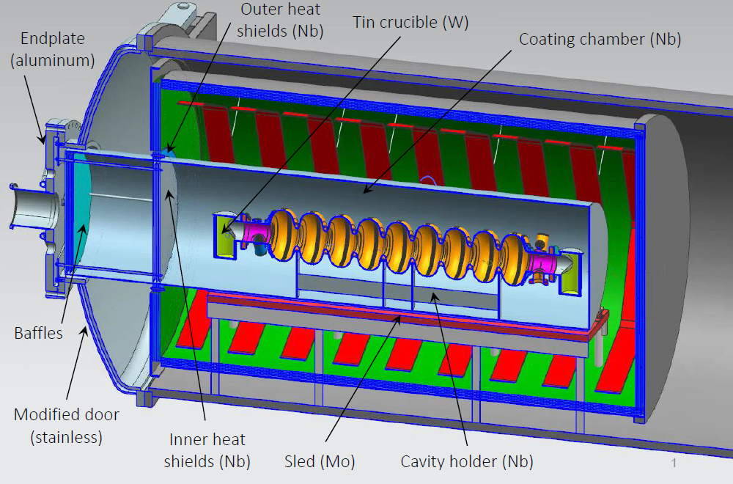
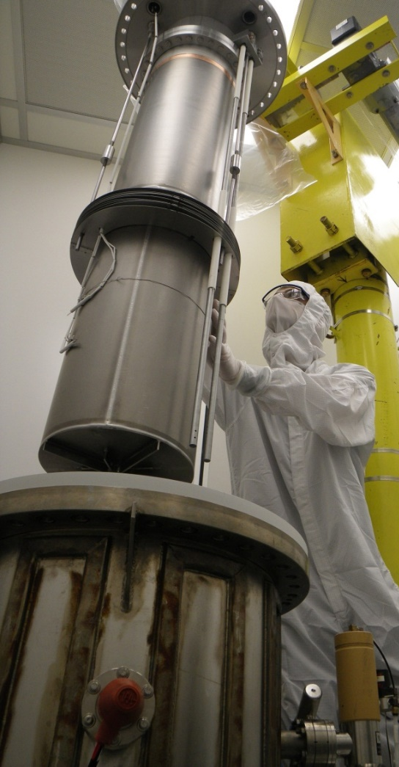
Active Nb₃Sn Vapor Diffusion Programs
Fermilab
Cornell
Jefferson Lab

Slide 10
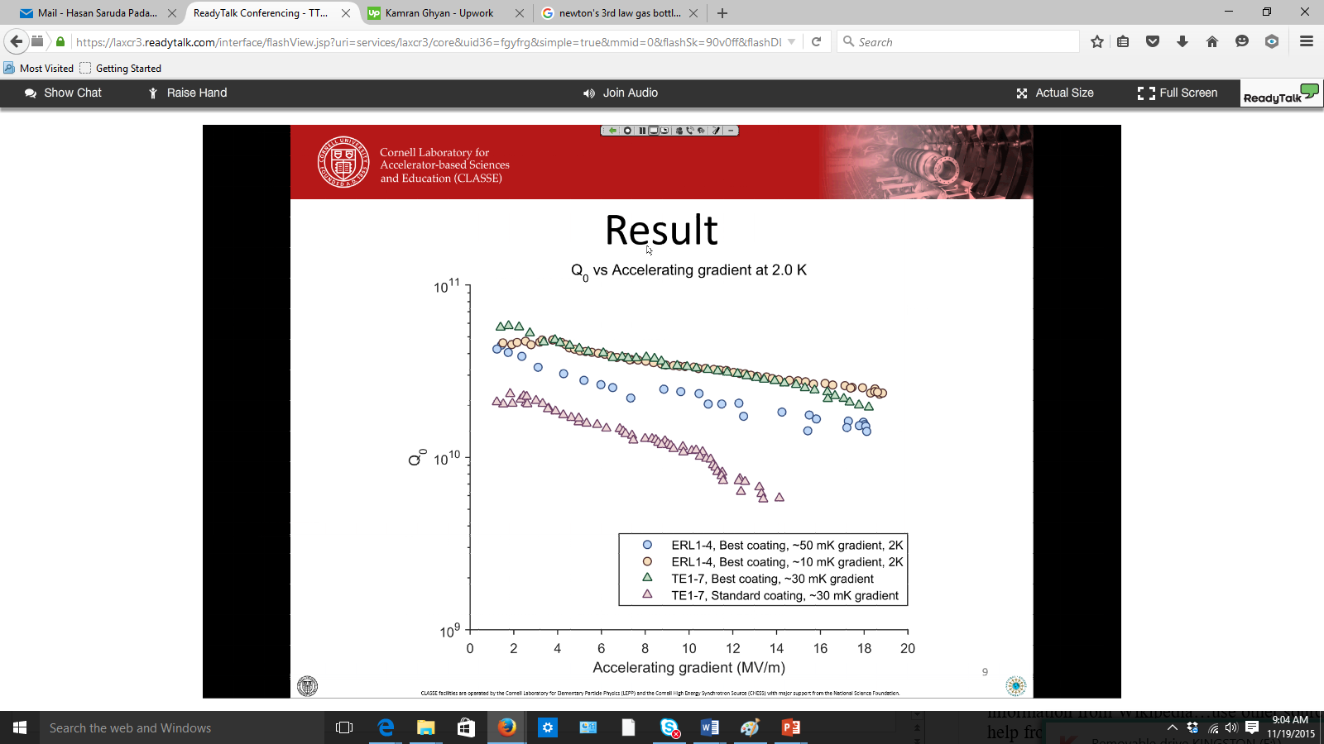
Nb₃Sn Recent Results: Cornell
Q > 2 x10¹⁰ at 2 K and 19 MV/m
Still work to be done for high field applications

Slide 11
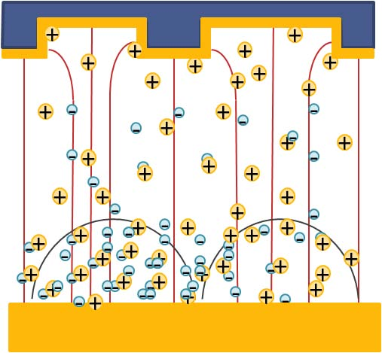
Hints for improvement in Nb/Cu
High Power Impulse Magnetron Sputtering (HiPIMS)
Target material is partly ionized
Nb ions reach substrate with a higher energy than magnetron sputtering
Produce high-quality homogeneous films.

Slide 12

Basic SRF R&D Advances: Funding Limited
Projects
Basic R&D

Slide 13
Goals for this TTC Workshop
Large number of new projects based on SRF
Exchange information on production of cavities, cryomodules, couplers and tuners to benefit new projects
  Esp LCLS-II, our hosts
Share knowledge and advance understanding of High Q frontier

Slide 14
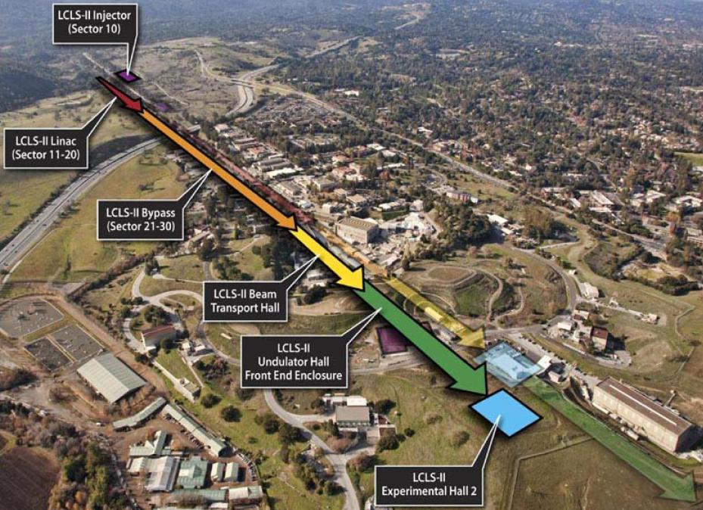
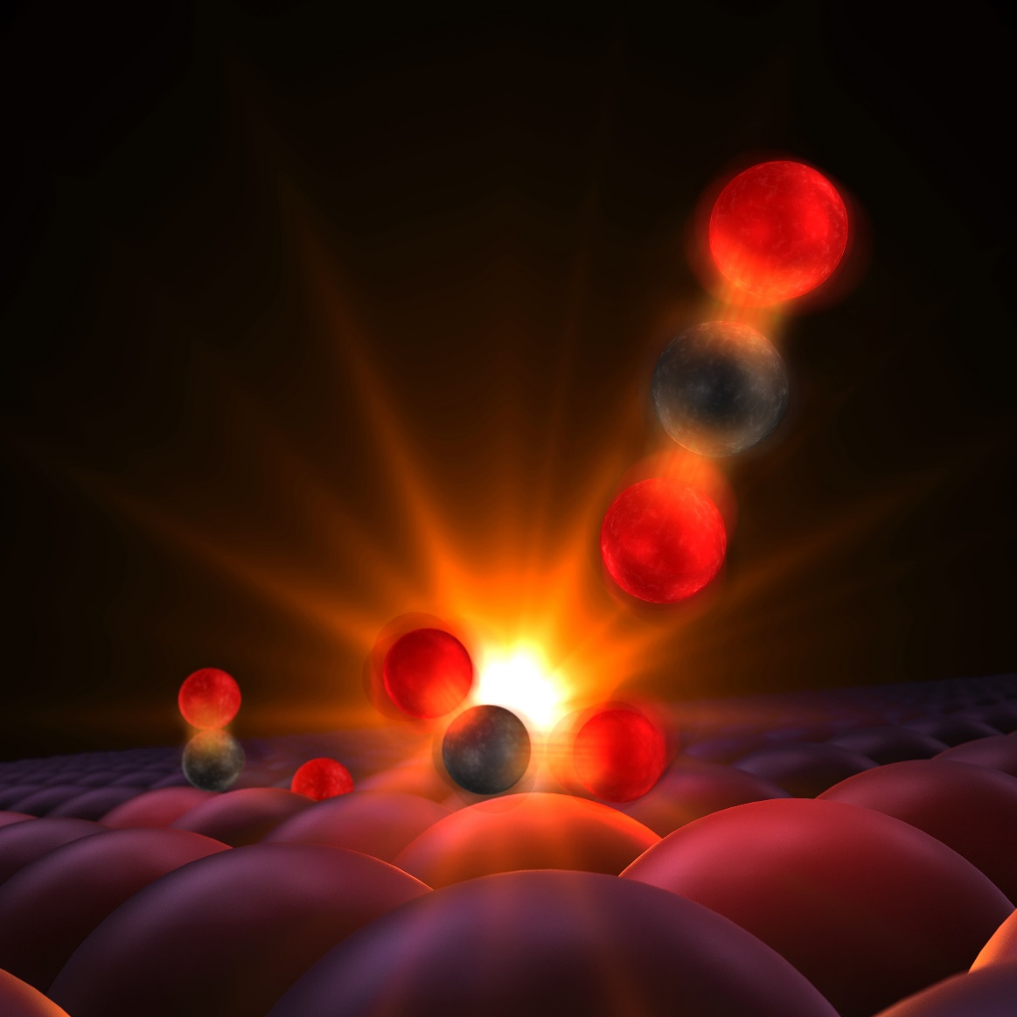
How we can help our hosts?
With LCLS-II at SLAC

Slide 15
LCLS-II Challenges
4 GeV, over 550 meters of SC Linac
35 Cryomodules at 1.3 GHz..like XFEL (ILC)
2 Cryomodules at 3.9 GHz
280 Cavities – 16 MV/m (max 18 MV/m)
CW Operation
Aiming for high Q at 2 K (> 2.7 x10¹⁰)
Q_{ext} is also high 4x10⁷
  need for good microphonics and resonance control
High Power CW coupler
  7 kW full reflection, CW

Slide 16
Overlapping Benefits to Other Accelerators
Unfortunately we are missing many interested colleagues from the other big US project
  MSU/FRIB low-beta community
  A review is going on at MSU
Other low-beta participants are here
  HI-ISOLDE, CADS, PIP-II…
  RISP project from Korea is another a big low-beta challenge
We hope that those present from low-beta community can fill the gap

Slide 17
Some Goals for 5 Working Groups
1. High Q
  Better Understanding of why N-doping gives increasing Q vs E
  Better Understanding of magnetic flux expulsion mechanism and optimization
2. Cavities
  Lessons learned from on-going/finished cavity production from XFEL and JLAB => for near-future projects like LCLS-II &…
3. Cryomodules
    Lessons learned from on-going/finished CM productions
4 &5. Input Coupler/Tuner

Slide 18
Presenters Tasks: Lessons Learned
What did we do well?
What could we improve?
Mistakes to avoid
Problems we could have avoided

Slide 19

Challenge for Co-Chairs
Work Around Human Limitations
Try to penetrate through the fog

Slide 20
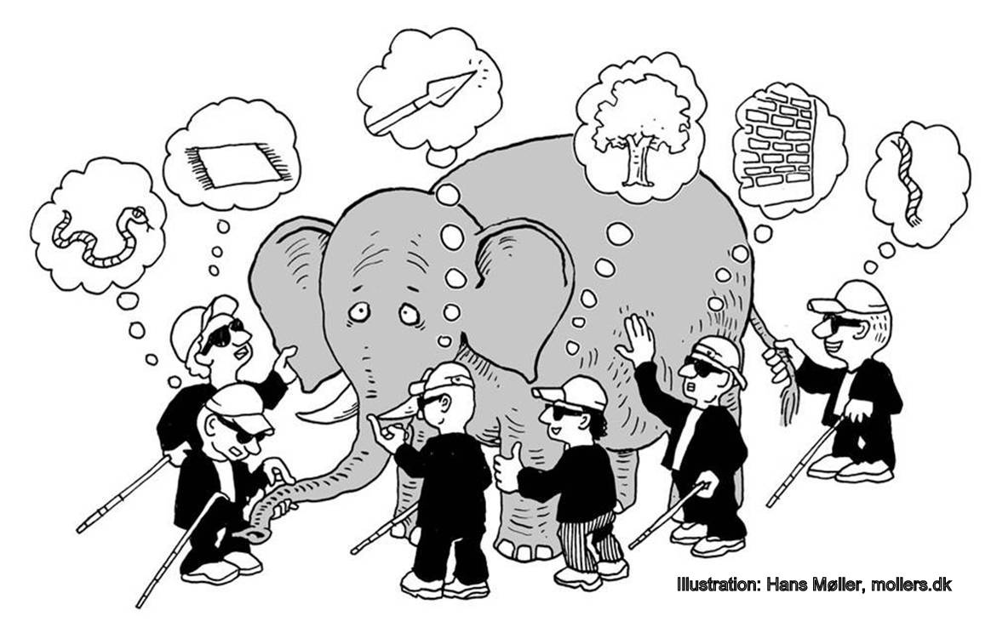
Each Presenter Tends to Give Limited Views of “Reality”
<= I see blanket
<= I see a snake
I see a rope =>

Slide 21
Co-Chairs Job!
Try to find the “true picture” through the fog

Slide 22
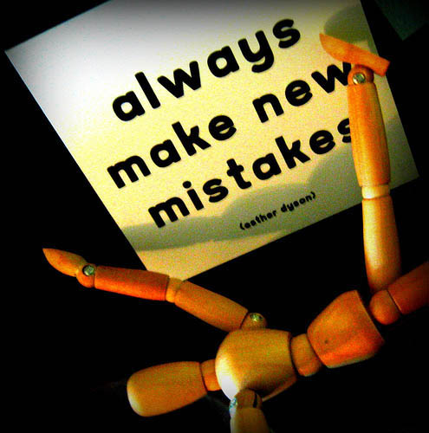
So Hopefully On-Going Projects Can
Minimize Natural Tendency to…

