Slide 1
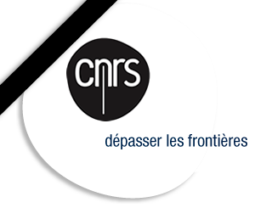


General Overview on Challenges in low-beta Cavities
Guillaume Olry
on behalf of the low-beta community
olry@ipno.in2p3.fr
1-4 December 2015, SLAC National Accelerator Laboratory, Menlo Park, California

Slide 2
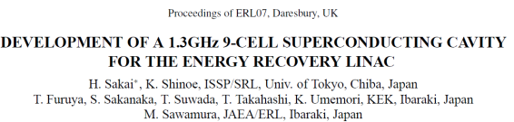
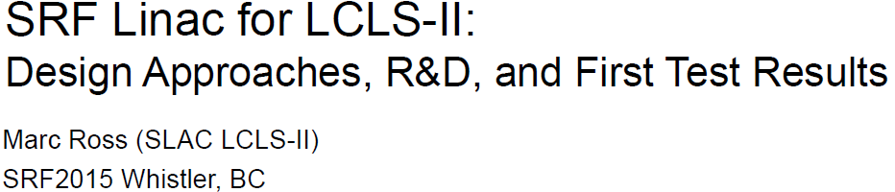
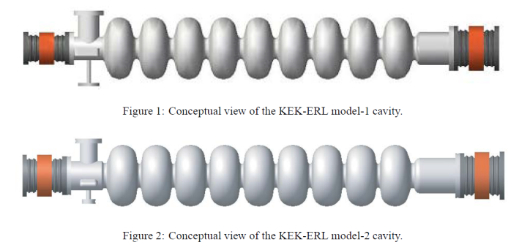
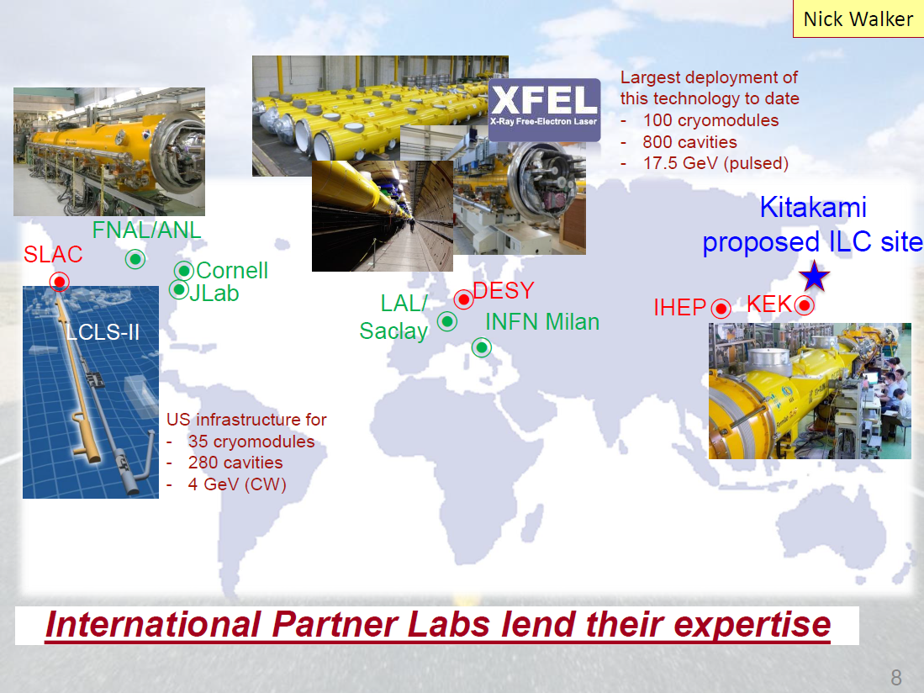
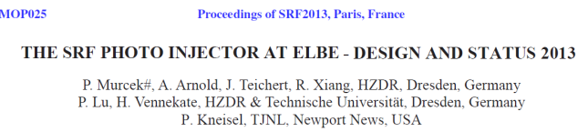
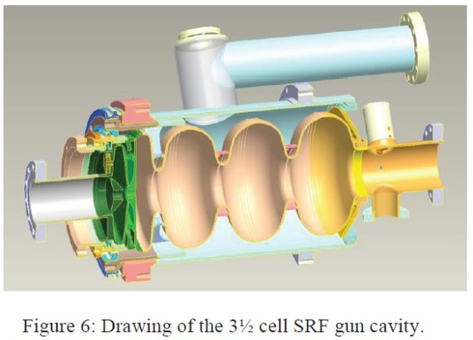
Introduction [1]
  High-beta and beta=1 elliptical cavities are well known over more than 25 years.
  In particular, the 1.3 GHz 9-cell Tesla cavity = “Universal” cavity. Baseline for XFEL, ILC, LCLS-II, ERL, photo-injectors, former Project-X, considered in C-ADS…

Slide 3
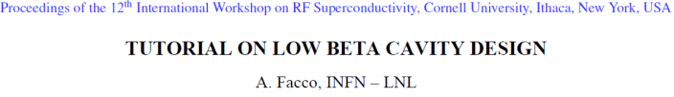
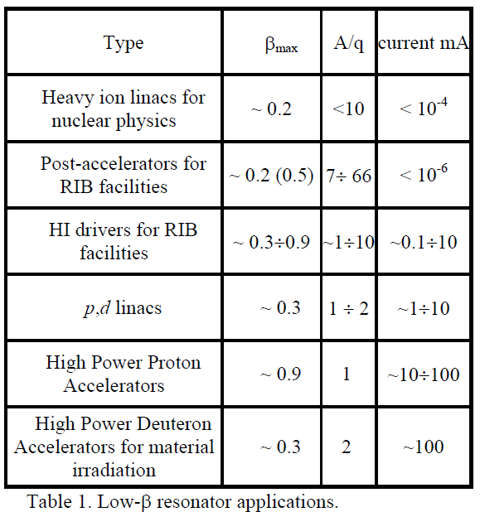
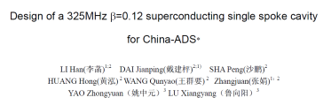
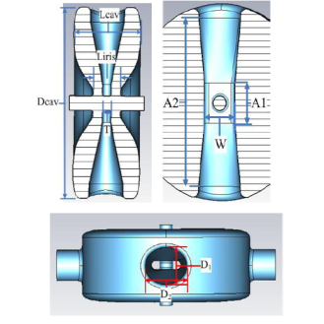

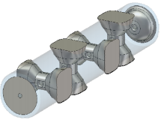
Introduction [2]
  In comparison, there is no such “Universal” cavity in the low-beta catalog. Because of the wide range of applications, there are a lot of possibilities:
    Cavity type: QWR, HWR, Spoke…
    Single & Multicells
    70MHz < Frequencies < 700MHz
    0,05 < beta < 1
    2 K < T < 4 K
  Example for Spoke cavities
    2, 3, 4, 5-gap
    219, 264, 325, 345, 350, 352, 500, 650, 700, 855 MHz
    All betas from 0.1 to 1
2-gap , 325 MHz, β₀=0.12
5-gap , 650 MHz, β₀=1

Slide 4
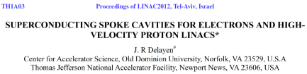
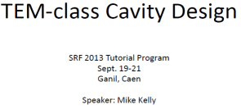
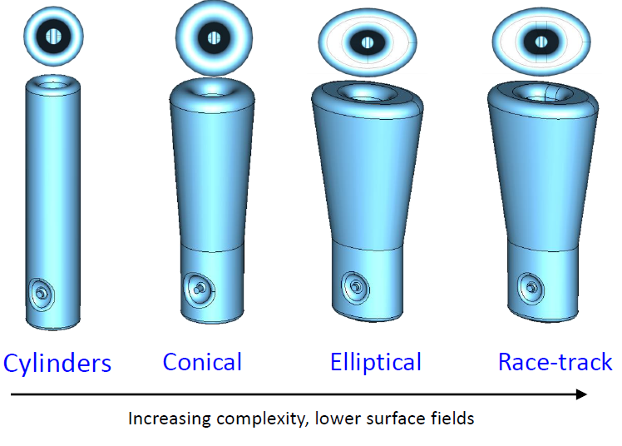
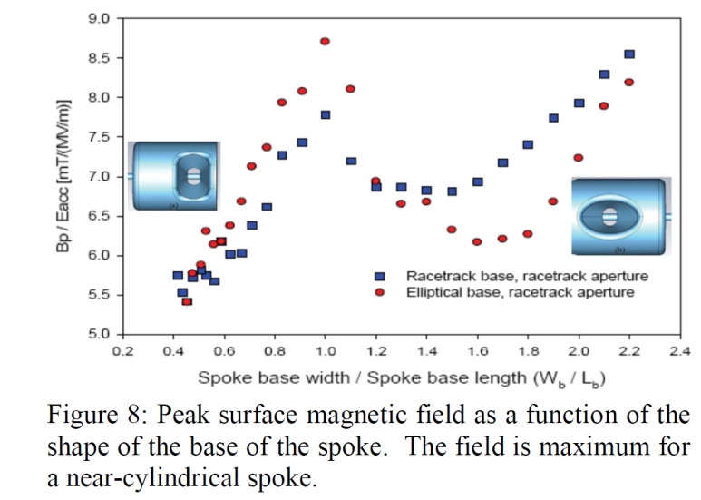

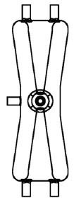
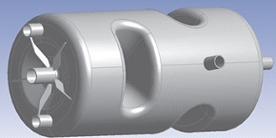
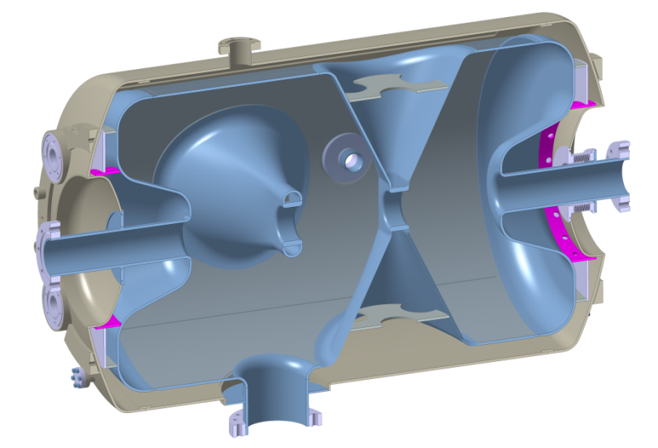
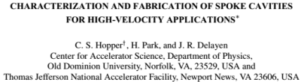
Introduction [3]
  There is not one way of optimizing a low-beta cavity…
  …but some good ideas remain and are adopted on most recent cavities:
    Conical shape for QWR & HWR stem
    Additional ports for cleaning:
      2 (top) + 2 (bottom) on QWR & HWR
      Laterally on Spoke
ANL
4 ports on cavity end-wall for HPR
ESS
ODU/JLAB

Slide 5
Introduction [4]
  Challenges, interesting studies or ideas, open questions… on a few topics:
  Cavity RF design
  Cavity Mechanical design
  Multipacting
  Fabrication
  Preparation
  Magnetic shield

Slide 6
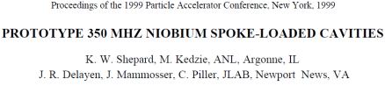
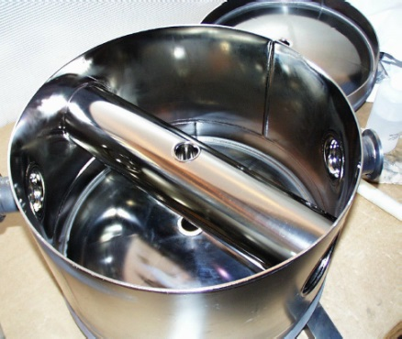
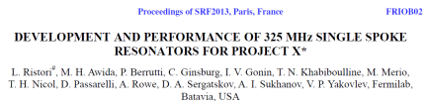
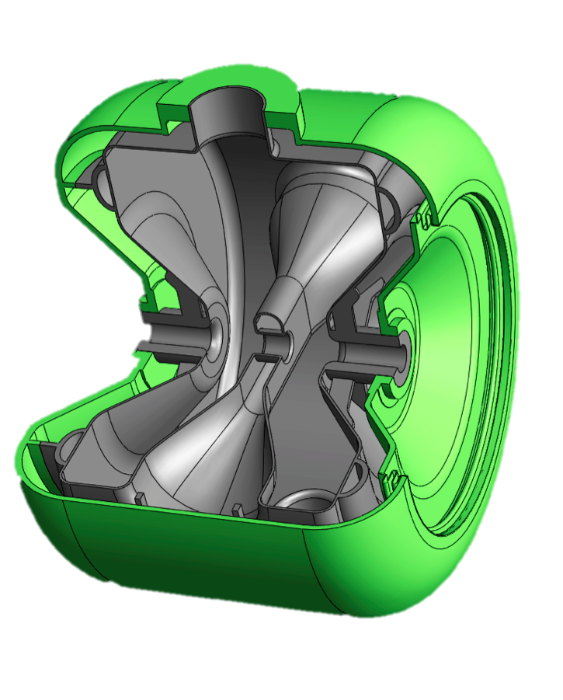
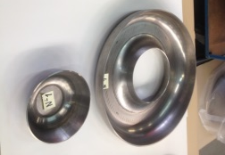
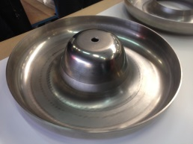
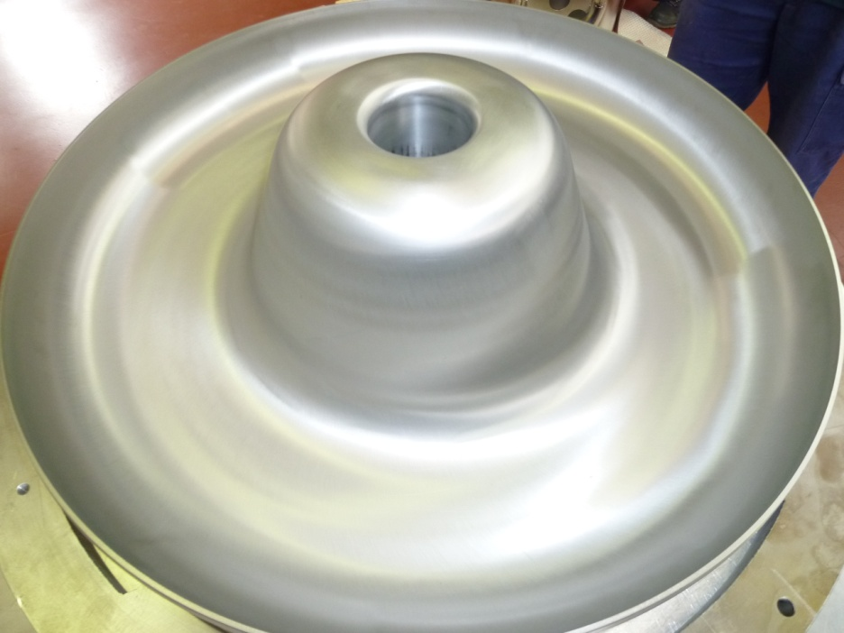
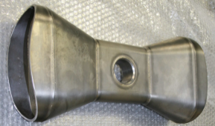
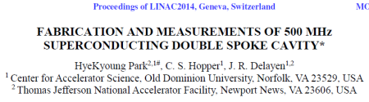
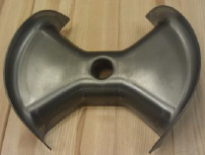
Cavity RF design [1]
Challenge: achieve the lowest Epk/Eacc & Bpk/Eacc ratios
Complex geometries
Impact on the: overall cost, feasibility, lead-time…
Labs: more engineering/design time.
Vendors: more tooling, more welding…
  Examples for Spoke
  reentrant end-cups
  racetrack or elliptical shapes of the spoke bases
1999
Epk/Ea = 5
Bpk/Ea = 13.3 mT/MV/m
ESS (IPNO)
Two parts (Deep-drawing & Spinning)
One part (Spinning)
2005
Epk/Ea = 3.8
Bpk/Ea = 5.8 mT/MV/m
EURISOL (IPNO)

Slide 7
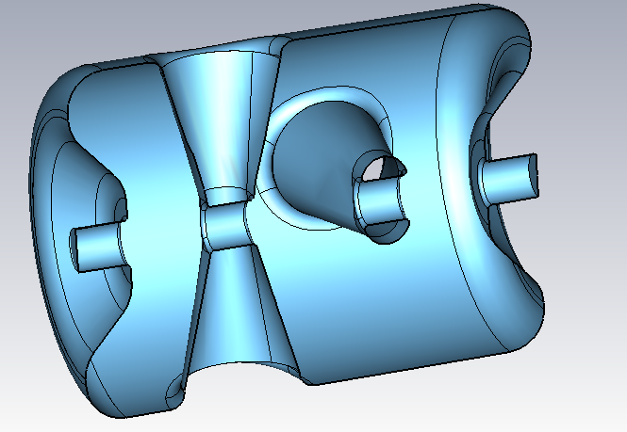
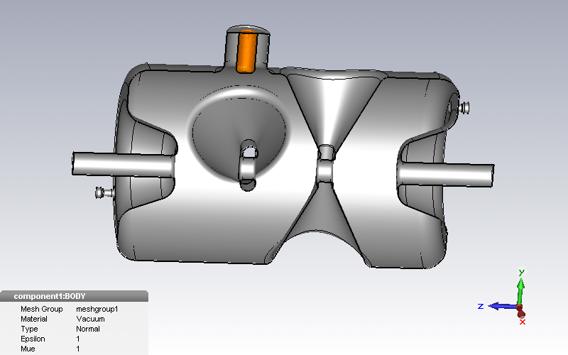
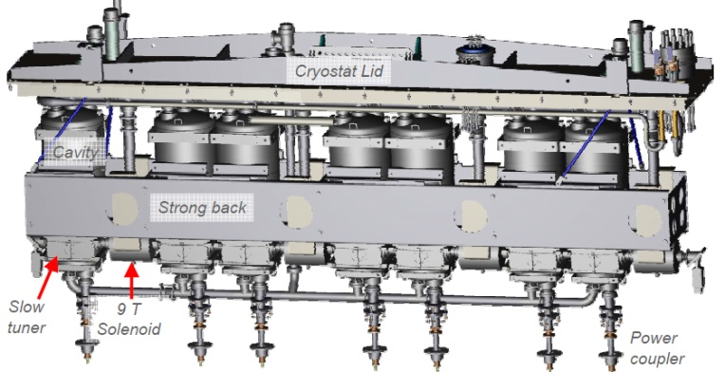
Cavity RF design [2]
  Main consequence of RF optimization → cavity size “inflation”
  Longitudinally: ex for ESS Double-Spoke with reentrant end-cup optimisation.
  → Impact on real-estate gradient
  → Impact on the cost: need of more Niobium
L=779mm
L=639mm
+140mm
 Bpk/Ea from 10.5 to 6.9 mT/MV/m
Model not optimized
Final model
  Radially : ex for QWR and HWR (ANL) with conical shape of the stem → impact on handling tools (for preparation), weight, integration of the cavities inside the cryomodule…

Slide 8
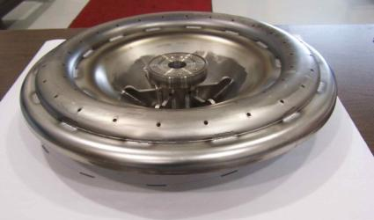
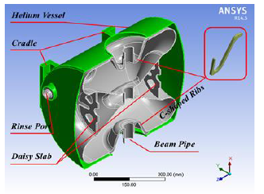
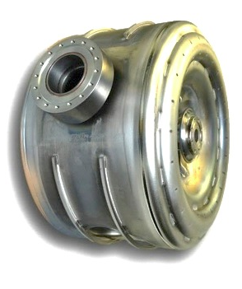
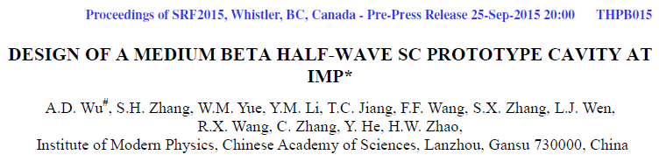
Cavity Mechanical design [1]
ESS (IPNO)
Challenge: vacuum load support
Yield strength <50 MPa @300K → Thickness: > 3 mm + stiffeners
  Complexity
  Impact on the cost
With bare cavity: limited displacements @ 300K (tenth of mm).
  Pay attention during leak thightness tests @ 300K
Stiffeners for vacuum load compensation
C-ADS (IMP)
PIP-II (FNAL)

Slide 9
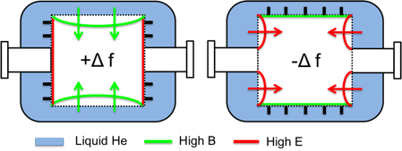
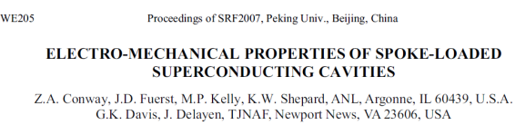
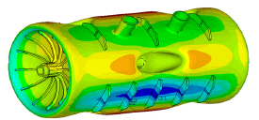
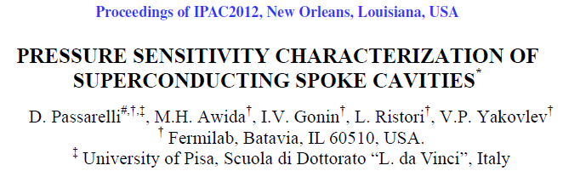
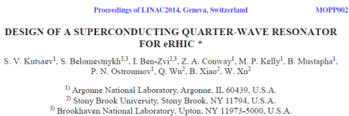
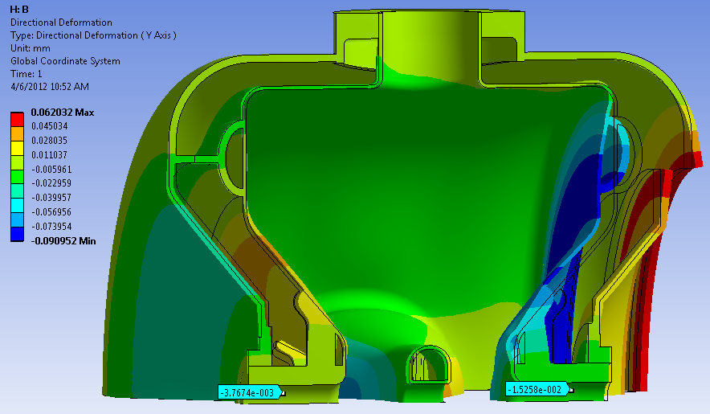
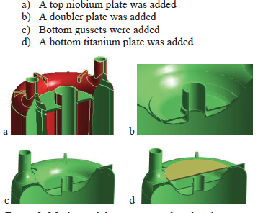
Cavity Mechanical design [2]
Challenge: df/dP compensation
Passive « Self-compensating » scheme for cancelling df/dP with additional stiffeners
AEBL (ANL)
10 years ago on TSR (ANL): cutting oversized ribs after measurements: -12.4 Hz/torr → 0.4 Hz/torr
Nowadays: calculated from the beginning
eRHIC
(ANL)
PIP-II (FNAL)
< 4 Hz/torr
→ More complexity → Impact on cost?
Meaningless for cavities operating @ 2K (dP~30mbar) and large BW

Slide 10
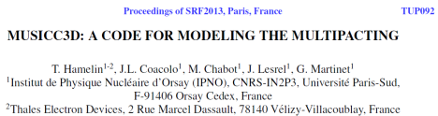
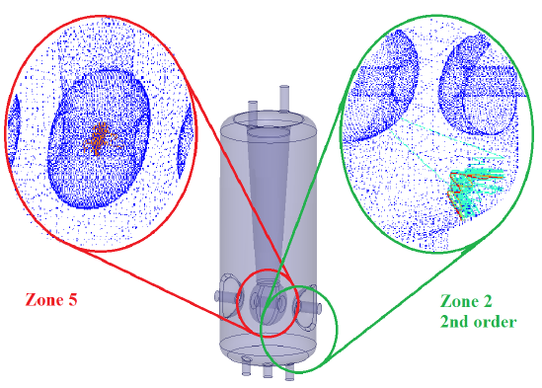
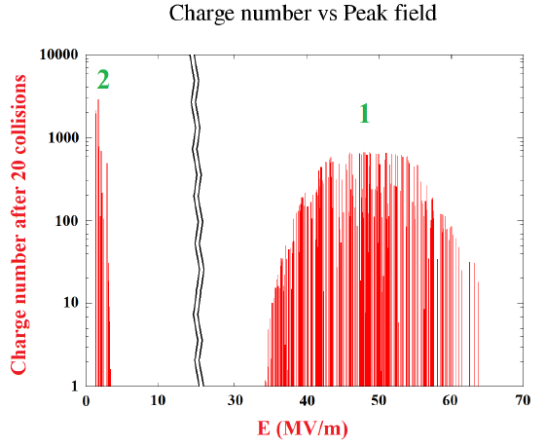
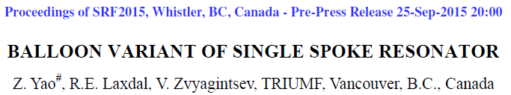
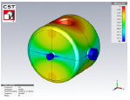
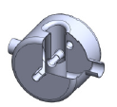



Multipacting
SPIRAL2 (IPNO)
Challenge: get a “MP free” cavity
3D codes needed, available quite recently.
TRACK3P (SLAC), MUSICC3D (IPNO)
Example @ FNAL: optimized SSR2 geometry based on measurements (compared with simulations) SSR1.
Interesting study @ TRIUMF: Spoke balloon cavity.
Examples:
QWR: very low MP barrier levels (10 kV/m to 100 kV/m) → hard to process
SPOKE: no low MP barrier levels (w.r.t QWR) but large ones over several MV/m (ex from Epk=35 to 55 MV/m for DSR ESS)
ESS (IPNO)
Epk (MV/m)

Slide 11




Fabrication [1]
Challenge: df=0 after Helium vessel integration
Numerous welding may induce non negligible df
and/or random values.
Example: ESS DSR prototypes
Vendor A, Cav #1: -531 kHz
Vendor Z, Cav #1: -39 kHz & Cav #2: -289 kHz
Tight tolerances on cavity frequency goal during the fabrication: +/- 50 kHz as a standard value?
→ Frequency cavity control during the fabrication
Interesting method
Adjustment with virtual
welds on HWR for FRIB
PIP-II (FNAL)

Slide 12








Fabrication [2]
eRHIC
(ANL)
Challenge: prevent Quench and MP with appropriate bending radius ports
Need to be carefuly studied in high magnetic field areas
Port-to-cavity wall junction more complex
Lesson learned with QWR (SPIRAL2) and HWR (IFMIF) fabrication
Bending radius smaller than expected
It is the origin of quenchs
Control each bending radius?
ESS
(IPNO)
IFMIF (CEA)
SPIRAL2 (IPNO)

Slide 13
Fabrication [3]
Compared to the Tesla 1.3 GHz 9-cell cavities
There is no “Universal” low-beta cavity: a lot of different cavity types, frequencies, betas... A low-beta cavity is always like a new “haute couture” dress → impact on the cost
Not so many low-beta cavities fabricated: some vendors did not produced any QWR, HWR and/or Spoke cavities but all of them already produced elliptical ones → impact on the cost
Niobium control by eddy-current scanning
Difficulties because of wide range of thicknesses (2 to 5 mm), types of material (sheets, rods, tubes, blocks…) and dimensions (from 100 x 100 mm to 800 x 800 mm for sheet)
Is it really worthwhile for small batch (<50 cavities)?

Slide 14





Preparation [1]
Challenges for chemical etching
BCP : reduce discrepancy (kHz/µm) between simulation and reality
Example : DSR for ESS
Simulation: + 1.3 kHz/µm
Meas. Horiz. position: -0.45 kHz/µm
Meas. Vert. position: +0.35 kHz/µm
Need of differential etch
Phase 1&2: Horizontal position
ESS
(IPNO)
Phase 3: Vertical position

Slide 15









Preparation [2]
Challenges for chemical etching
EP: increase achievable Ea max
- Fully integrated process at ANL on QWR & HWR
HWR
20 MV/m
100 mT
QWR
18 MV/m
128 mT
- For Spoke? Partial @ IUAC: EP before closure welding
→ No substantial gain / FNAL cavities etched by BCP

Slide 16







Preparation [3]
FRIB
(MSU)
Challenge for High Pressure Rinsing: no more FE!
All QWR (welded bottom) and HWR: ports on top and bottom (90°) for better cleaning
For Spoke (new thing): access to the reentrant end-cups with additional ports (ESS, ODU/JLAB).
→ design and fabrication more difficult.
→ take care of the bending radius
Interesting study on IFMIF HWR
Optimisation of the angles of the wand nozzle with a 3D ray tracing software
ODU/JLAB
Initial config.
New config.
1 jet
60°
2 jets
58° & 76°
IFMIF (CEA)

Slide 17


Magnetic shielding
Challenge: get the lowest residual magnetic field on cavity walls
Both warm and cold solutions exist but warm µ-metal solution is prefered → Costly effective?
More complex geometries with many ports on cavity body (as compared to elliptical) → many « holes » to be shielded
Effective efficiency of the shielding: no R&D on real 3D, scale 1:1, @300K, 80K, 4 and 2K. No validation tests with prototype before series production as compared to cavity prototyping… → Not worthwhile?
Several config. simulated
Objective: < 1µT on cavity walls
ESS (IPNO)

Slide 18


Ideas to conclude
Intrinsically : E and B fields are separated (especially with the QWR and HWR cavities). So, is it worthwhile to:
  Build a localized magnetic shield? Only on top for QWR, on top and bottom for HWR…and for Spoke? → substantial cost savings?
  Use high RRR (>250) Niobium only in the high/peak surface magnetic field areas? Stem for QWR, spoke base for Spoke → substantial cost savings?
QWR (ANL)
  Optimize the cooling scheme to expel magnetic field through E field areas (good example with QWR)
QWR (SPIRAL2)

Slide 19

Acknowledgments
L. Ristori (FNAL)
Z. Conway (ANL)
Y. He (IMP)
G. Devanz (CEA)
Thank you for your attention

