Slide 1

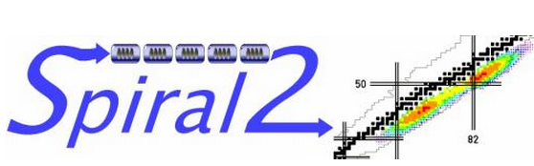
Tuner development at IPNO :
Spiral2 and ESS
N. Gandolfo
TTC Meeting at SLAC – 03 november 2015

Slide 2
Tuner development at IPNO : Spiral2 and ESS
Outline
Part 1 : Spiral 2 plunger tuner for b=0.12 QWR
  Tuner principle
  Successfully testing 7 cryomodules
  Technical issues
Part 2 : ESS piezo tuner for b=0.5 Spoke cavities
  Tuner principle
  2015, a year of testing
  Technical issues
Future plans

Slide 3
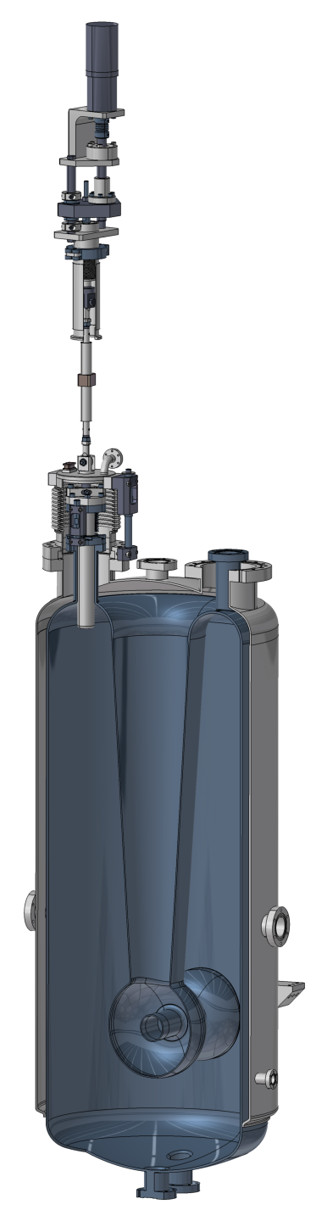
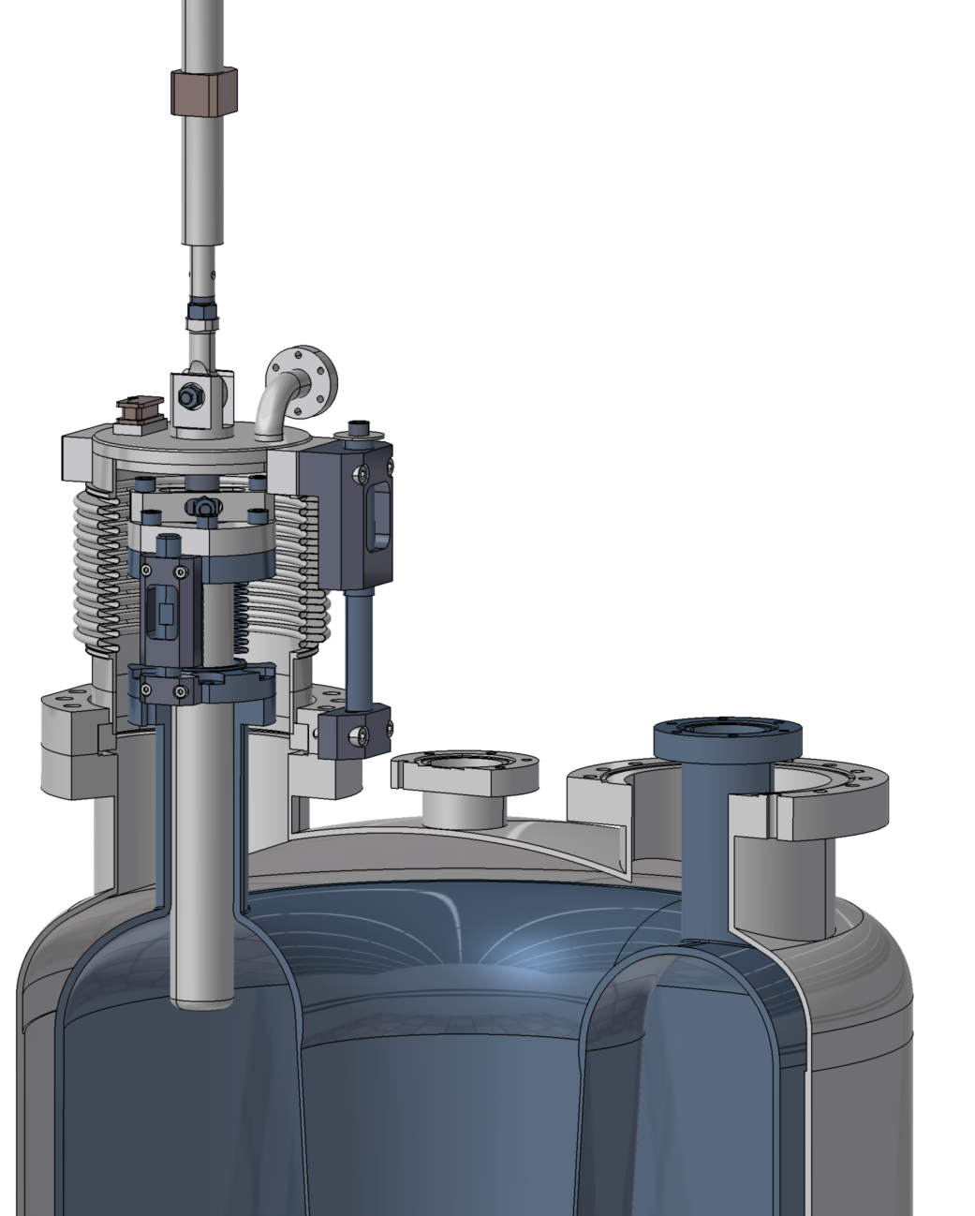
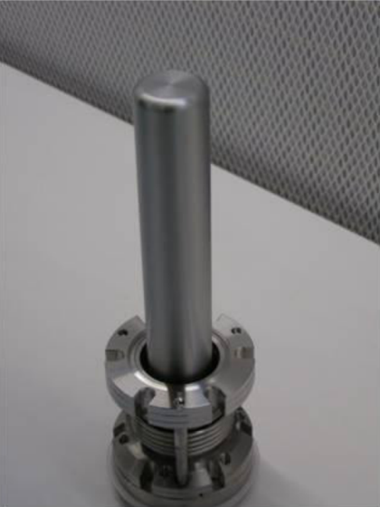
Spiral2 tuner : Working principle
Room temperature motorization
An external motorization provides motion to a Nb plunger that is moving up and down inside the cavity.
Tuning sensitivity : ~1 kHz/mm
Nominal stroke : 10 mm
Provided Motion
Ambient air
Thermal insulation vacuum
Sliding parts
LHe
Nb Plunger (actively cooled)
Nb Plunger
Ti LHe vessel
Nb Cavity
D. Longuevergne & al. "A Cold Tuner System With Mobile Plunger ". SRF’13.

Slide 4
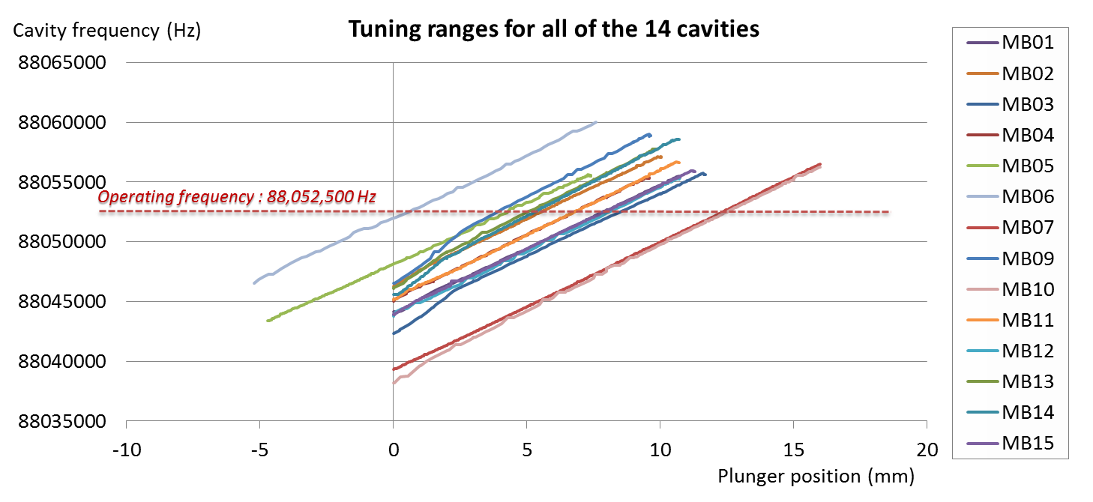
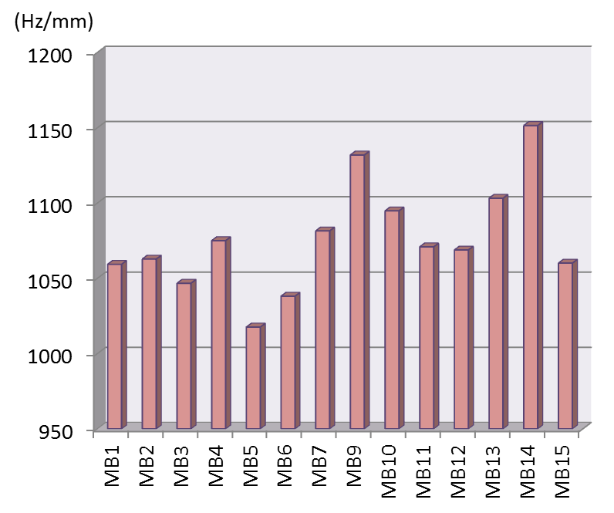
Spiral2 tuner : Scope on results
Status : 14 cavities + tuners inside 7 cryomodules successfully tested at IPNO prior transport in tunnel at GANIL (France) (last cryomodule tested last December)
Tuning sensitivity of 14 tuners
Note : MB05 and MB06 were equipped with prototype parts of the tuner, this explain why the range seems shifted compared to the others, and why it goes negative also.
On some tuners, the first 2 millimeters show a slope slightly different.

Slide 5
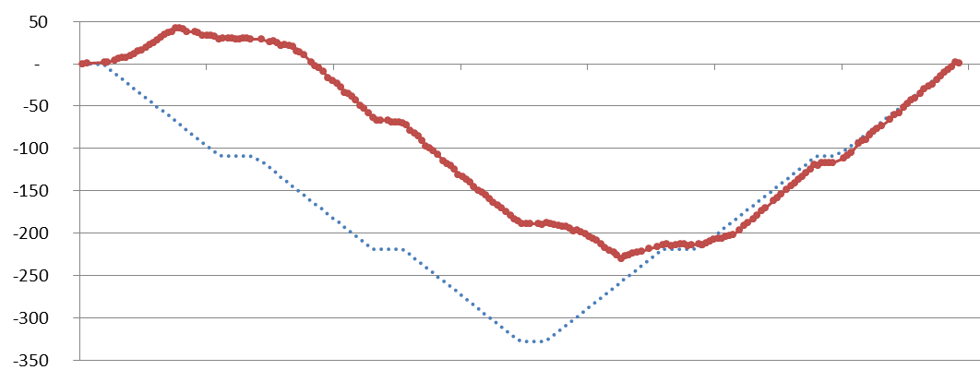
Spiral2 tuner : Back and forth tilting issue
During small displacement operation, for instances in a regulation mode while the tuner tracks the nominal frequency, a non-linearity (overshoot, hysteresis,… difficult to find an appropriate name) of the system occurs each time the direction of the motion is changed.
On Spiral2 b=0.12 cavities the bandwidth is around 88 Hz
Sometimes the measured overshoot exceeded 100 Hz !
1
2
1
2
3
4
df (Hz)
3
overshoot
4
Motor command (normalized in Hz)
Frequency shift (Hz)

Slide 6
Spiral2 tuner : Tilting issue whole story
[fall 2010] Problem detected, during DLLRF trials on the 1/7 series cryomodule qualification
Confirmed on 2nd cryomodules : 4/4 tuners failed
Trying to look the problem at room temperature by a lot of different ways :
  Frequency reading : not accurate enough due to large Q
  Position sensors : mechanical access difficult
Put both prototype and series tuners on a table, play at “find the differences” game
Trying improve mechanical assembly and parts : some improvement but not enough.
Take the problem in another way : If we don’t know why the series tuner fails, let’s understand why the prototype tuner worked ?
Re-test one of the first prototype tuner that "worked": problem appeared also
Prototype tuner was not qualified on small displacement, only large one (1k Hz steps) so maybe the problem was here and not seen …back again in the start position
Find a way to track the resonant frequency at room temperature with a precision around
1 Hz : Found it ! (using a lock in amplifier and a useful guy (thanks D. Longuevergne))
Suspecting a tilt of the plunger → Proven it with a laser pointer
Reduce the tilt : Not possible, due to residual play necessary inside the stainless steel guides.
Discover that the tilt direction have an incidence on the frequency hysteresis.
Modifying the position of the guides (related to the cavity support flange) : It works ! But not really at each assembly…
Applying systematic frequency measurement loop after cavity+coupler+tuner assembly, prior finishing to assemble cryomodule to verify the tuner is OK
And most important thing : practice extensive test of the tuners with large and low displacement and check hysteresis at different tuner positions
2 years

Slide 7
ESS tuner
Second part : ESS tuner

Slide 8
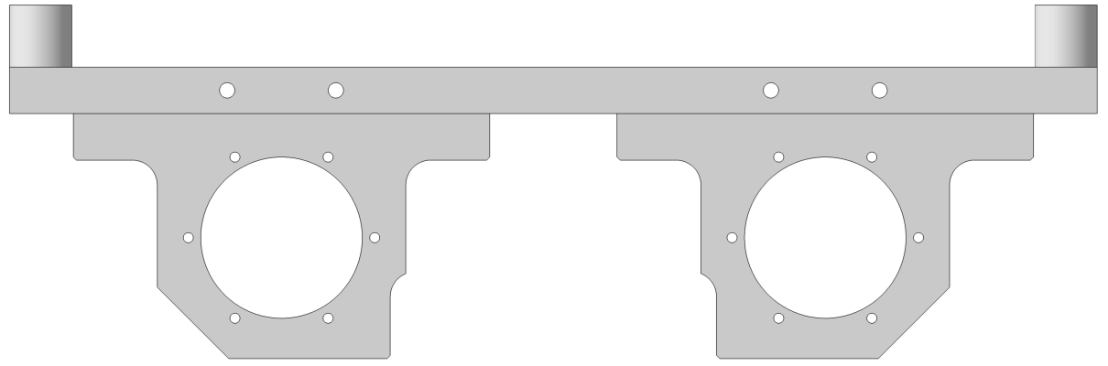
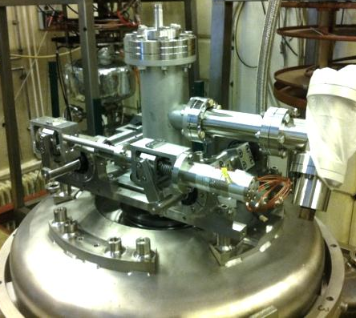
ESS tuner : Working principle
Slow tuner principle
A ball screw system driven by a stepper motor acts on a double lever arm mechanism to provide a significantly reduced displacement of the cavity flange along the beam axis.
Cavity body
Flange frame
Bellow
Cavity flange
LHe vessel
Vacuum
Insulation
vacuum
Cavity vacuum
LHe bath
Rods
d
Motor
D
Lever arm
(D/d = 10)
N. Gandolfo & al. "Deformation Tuner Design for a Double Spoke Cavity". SRF’13.
Ball screw (p = 2 mm)

Slide 9
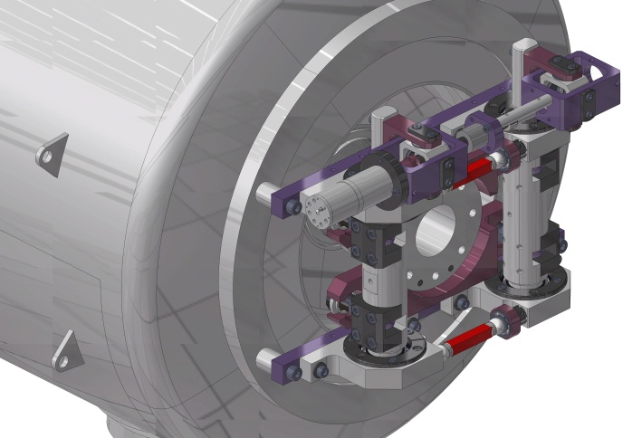
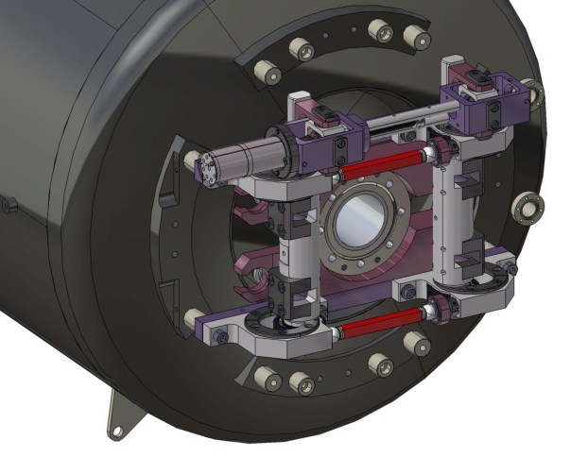
ESS tuner : 2015, a year of testing
First tuner version
Second tuner version
« only » modification : allow to put longer piezo 50 mm ➔ 90 mm

Slide 10
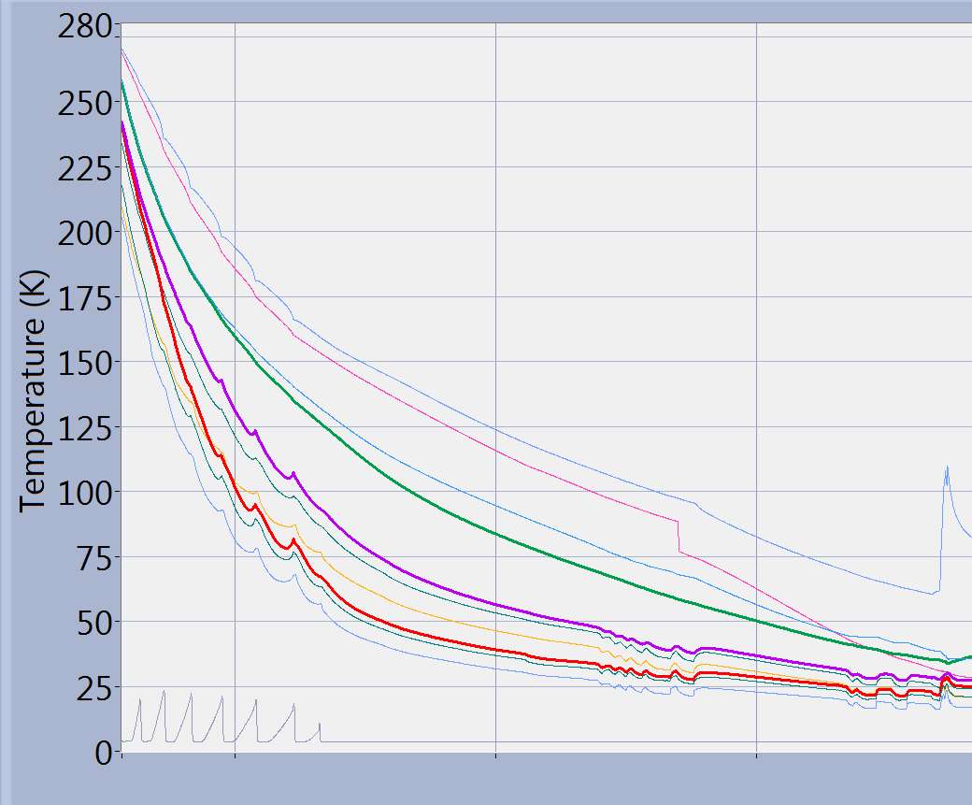
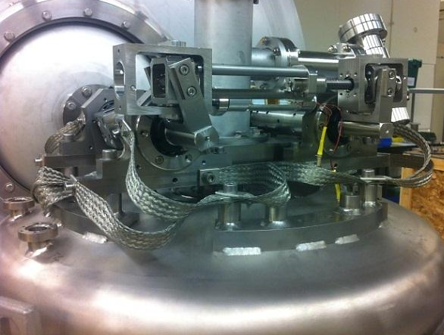
ESS tuner : Cooling down
Thermal improvement to accelerate cooling down
w/o thermal braids
After putting copper 16 copper braids, most of the tuner was under 30 K within a day (except motor and ballscrew which are the hottest spot) and stabilize between 10 and 20 K over few days
Nearly 3 days to reach T<50 K
09 feb.
10 feb.
11 feb.
12 feb.
T(K)
w/ thermal braids
Copper braids
Top of the cavity (vertical position) equipped with the tuner
Time (hours)

Slide 11
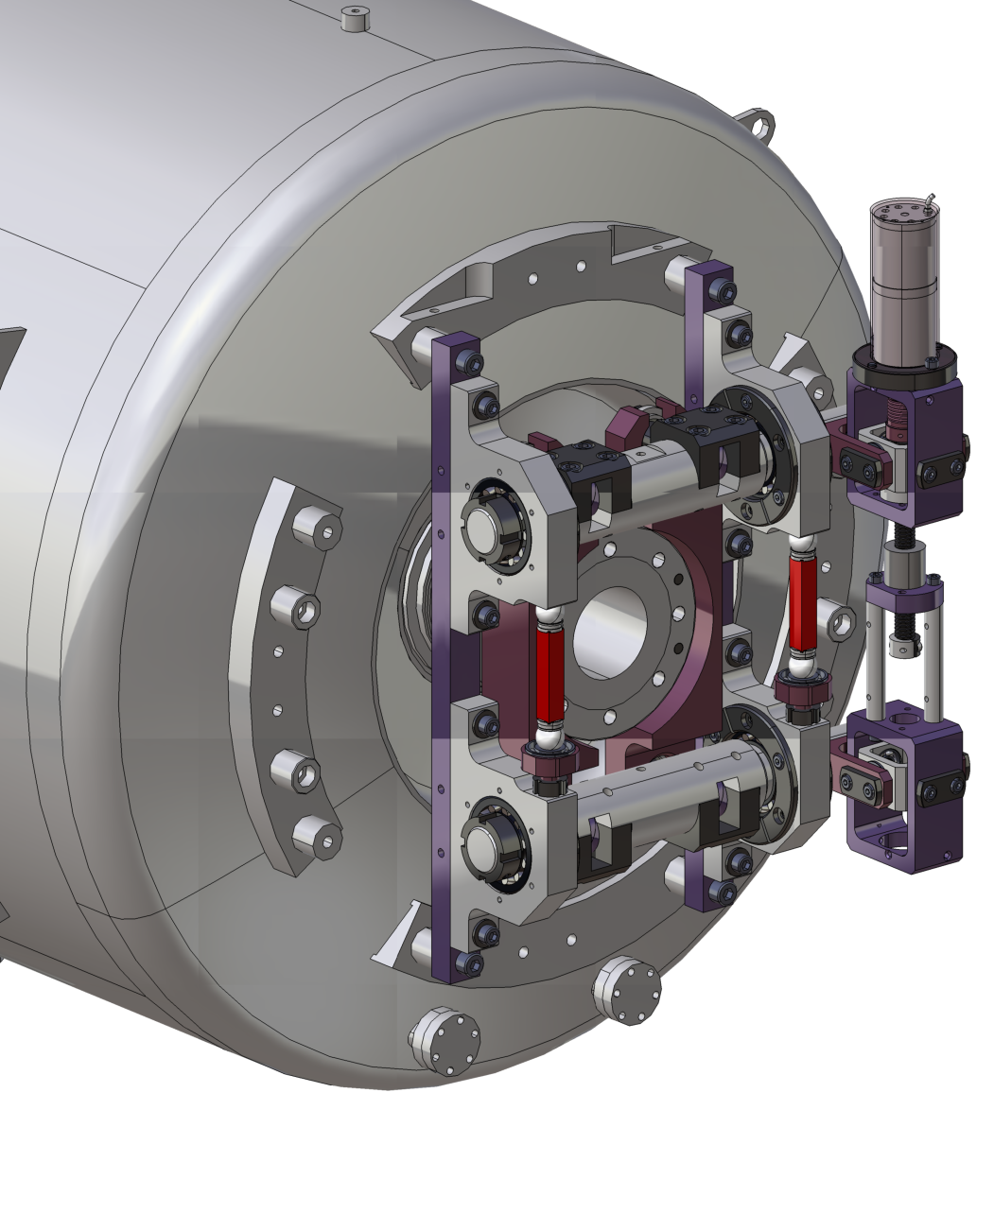
ESS tuner : Piezo detuning measurement @2K
Systematic difference depending on the piezo location on the tuner, due to asymmetric mechanical architecture has been observed on every tests
df (Hz)
Piezo voltage (V)

Slide 12
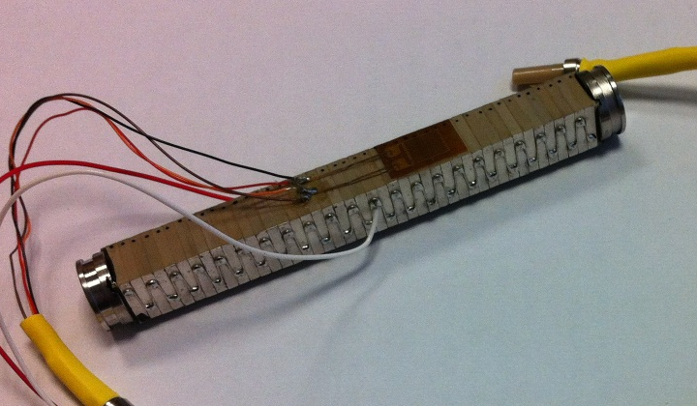
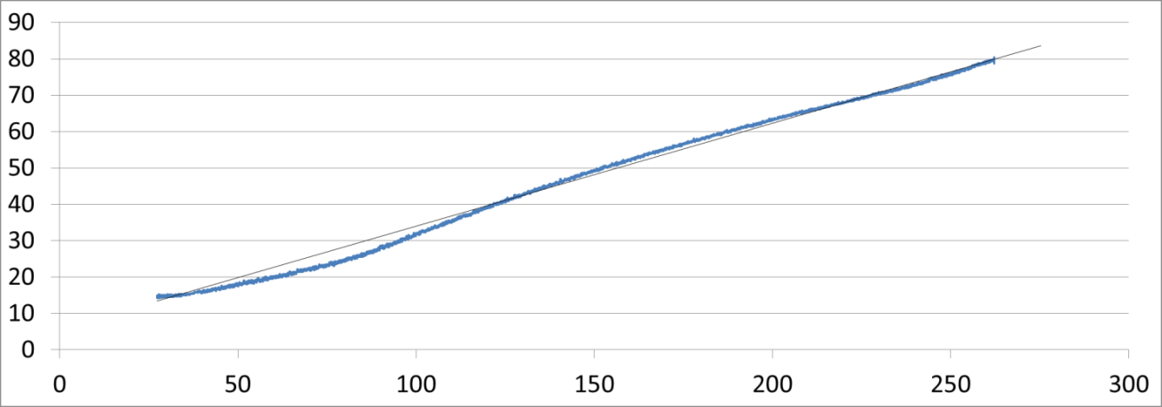
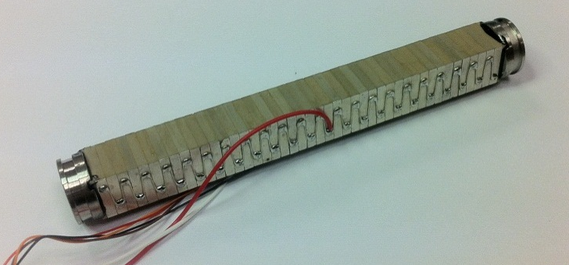
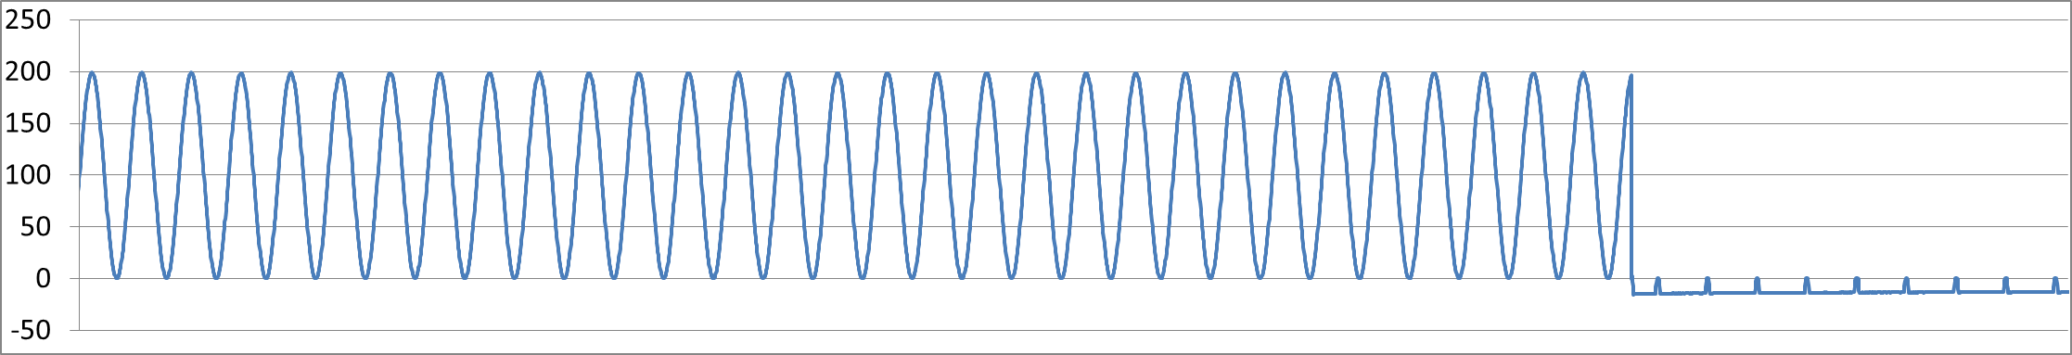
ESS tuner : Piezo strain measurement 30K → 300K
Piezo cycle measurement during warming up the cryostat for 3 days
Nominal no load stroke : 136.4 µm
Measured stroke @300K : 110 µm
Measured stroke @77K : 24 µm
Measured stroke @30K : 15 µm
Unipolar operation 0→200 V
90 mm Noliac piezo equipped with strain gage sensor
Breakdown during test (around 260K)
Piezo breakdown occurred accidentally probably due to vacuum → a.p. transition (while injecting nitrogen gas).
Piezo after breakdown, no visible damage, 3 ohm resistance, < 0.1 nF capacitance
Excitation voltage over time
Piezo breakdown
T = 100 s

Slide 13
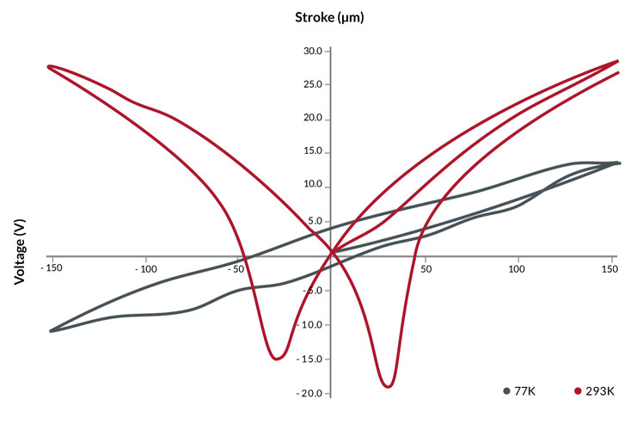
ESS tuner : Piezo self-heating measurement
At room temperature, piezo voltage for nominal operation must remain quasi-unipolar.
At low temperature (77K and below), it is possible to operate them at full bipolar voltages, in order to obtain higher strain.
Test with 14Hz sine drive show that self-heating warm the piezo above the 77K limit.
www.noliac.com
T(K)
0→200V 14 Hz sine drive : 85 K reached in 2 hours
dT= 50K
POWER ON
POWER OFF
Time (min)

Slide 14
ESS tuner : Slow tuner issue on second version
df (kHz)
Two problems occured on 3/3 low temperature tests :
Problem of large hysteresis (graph 1 and 2)
Problem of tuner getting stuck (graph 3)
Never observed on the first version (tuner #1 and #2)
Tuner #4 on cavity #1
STUCK !
Graph 3
df (kHz)
df (kHz)
Motor displacement (mm)
Tuner #3 on cavity #1
Tuner #3 on cavity #2
Graph 1
Graph 2
Motor displacement (mm)
Motor displacement (mm)

Slide 15
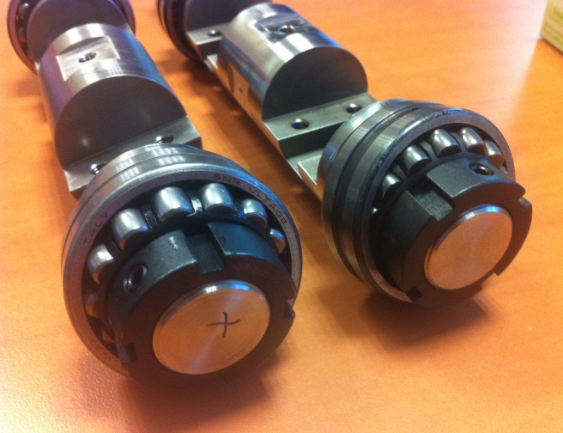
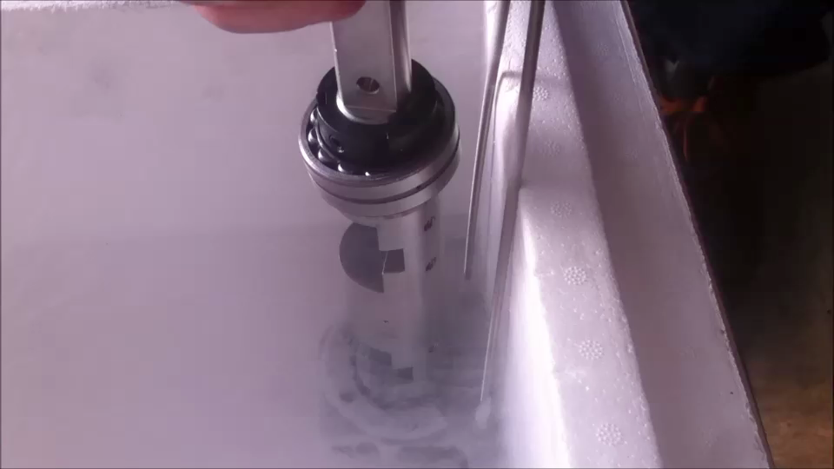
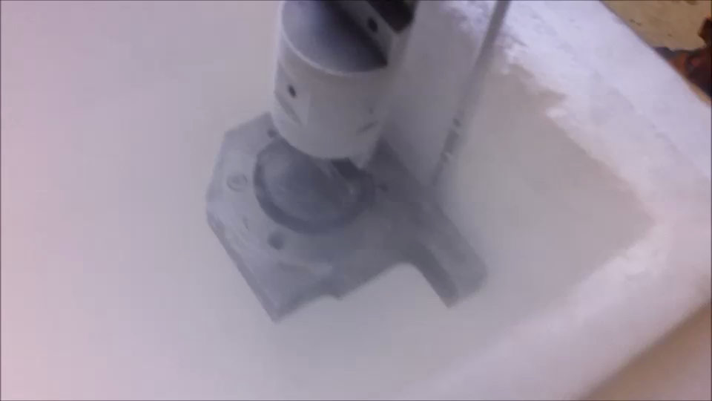
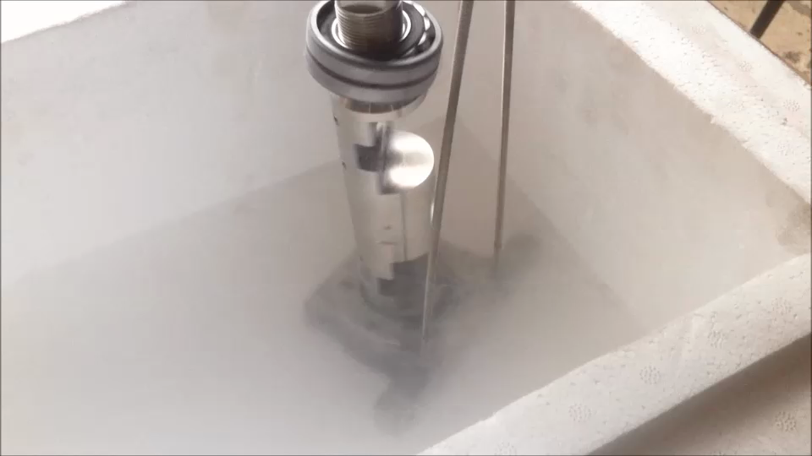
ESS tuner : Slow tuner issue on second version
Putting both version disassembled on a table for detailed check.
From few differences observed, one has been keeping our attention.
The largest bearing (spherical roller bearings) were not provided by the same
supplier for both version, and for the second version, significant amount of residual oil was seen on the rolling elements.
Liquid nitrogen test of both version revealed the following :
- On the first version, bearing were rolling but with significant friction torque. [A]
- On the second version, bearing were not rolling, they were completely stuck. [B]
Degreased them with ultrasonic cleaner and Tycopur for few minutes.
At room temperature : Bearings are ok even if they sounds no happy.
In nitrogen liquid : Bearing are rolling, even slightly better than the first version. [C]
Next steps :
1- Test second version tuner with cleaned bearing to verify the origin of the problem
2- Looking now for dry lubrication methods to apply on actual bearing… or replacement for already dry lubricated bearing. WS2 ? MoS2 ? Graphite ? PTFE ?
1st version
2nd version
A
B
C

Slide 16
Future plans
Spiral2 : Waiting for the first cooling down of the linac, scheduled for early 2016
ESS :
Investigate the inefficiency of the long piezo
Solve the problem of tuner getting stuck / hysteresis, improve bearing lubrication
Solve the piezo over-heating issue : Thermalizing piezo ? Using only unipolar operation ?
Prepare for mass production (2016..)
Also, developing a dedicated test bench (maybe low temperature capable) to qualify each tuner prior cryomodule assembly may be envisaged
R&D :
Extensive test of piezos on a dedicated compression test bench, low to room temperature characterization + lifetime test at LN2 temperature
Test a system of disengagement (recent development) to provide cavity safety against motor failure
Thank you

Slide 17
Back up slides

Slide 18
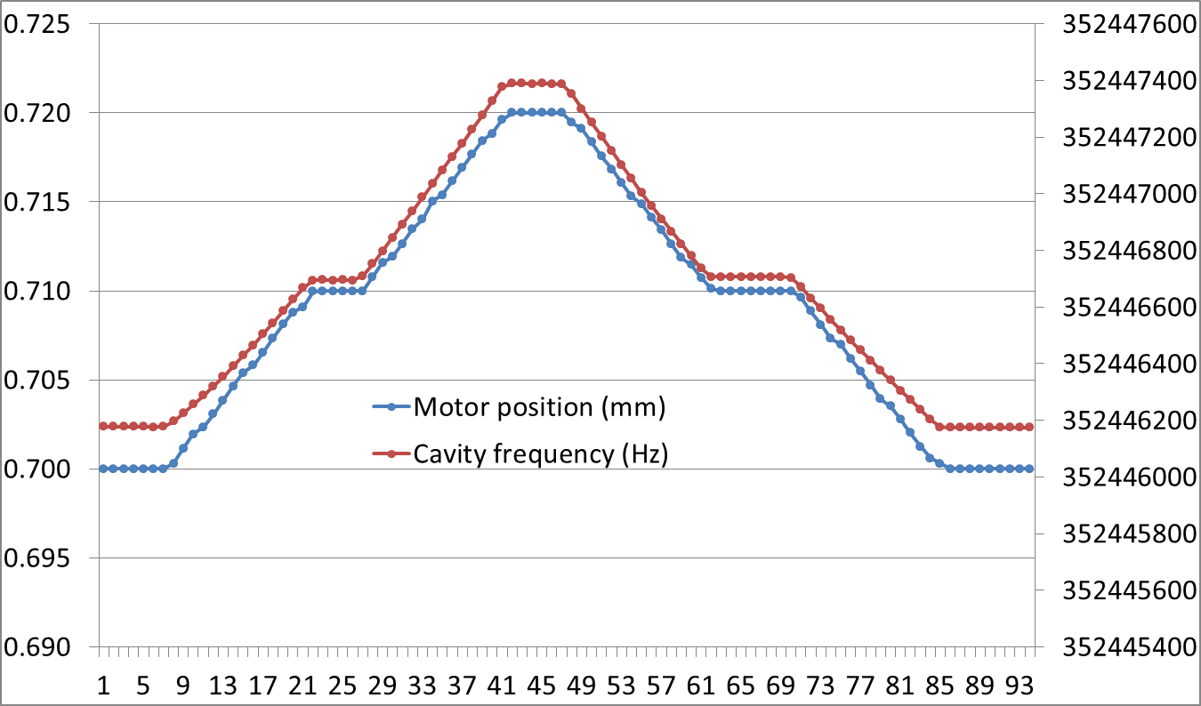
Low displacement measurement (first tuner version)
Sample of low motion back and forth to check hysteresis :
around 12 Hz for 0.01 mm motor position ( eq. ~ 694 Hz shift)
Time (s)

Slide 19
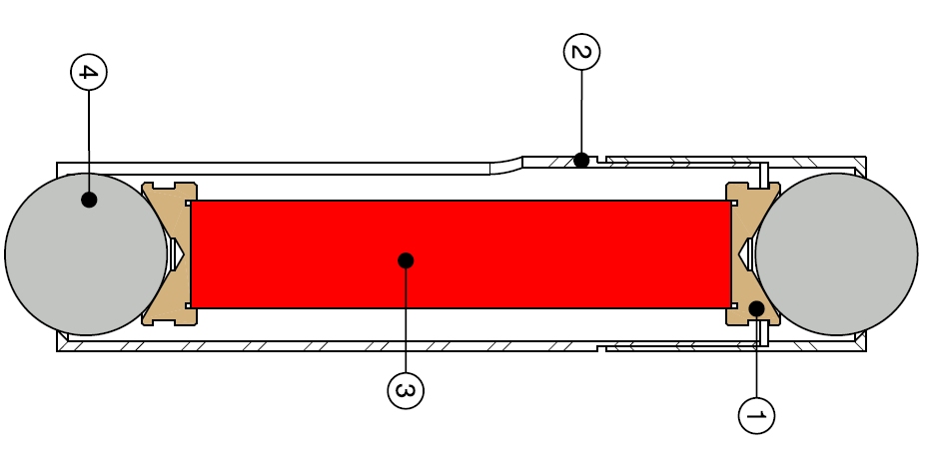
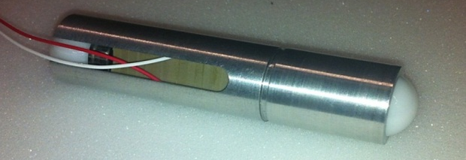
ESS Spoke tuner overview
Working principle :
A ball screw system driven by a stepper motor acts on a double lever arm mechanism to provide a significantly reduced displacement of the cavity flange along the beam axis.
Stepper motor
Piezo electric actuators (x2)
Stainless steel ball screw with MoS2 lubrication
Special encapsulation design to protect the piezo stacks and ease the assembly
Ceramic ball (ZrO2)
Protection tube (Aluminum)
Piezo
Top part (AISI 316L)
N. Gandolfo & al. "Deformation Tuner Design for a Double Spoke Cavity". SRF’13.

Slide 20
Tuning sensitivity of ESS first version tuners

Slide 21
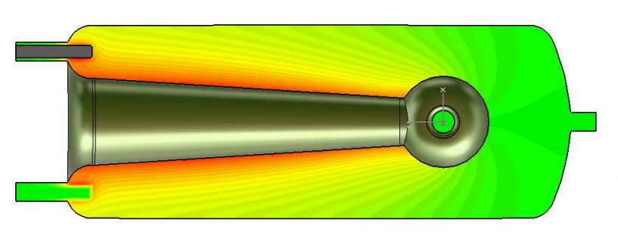
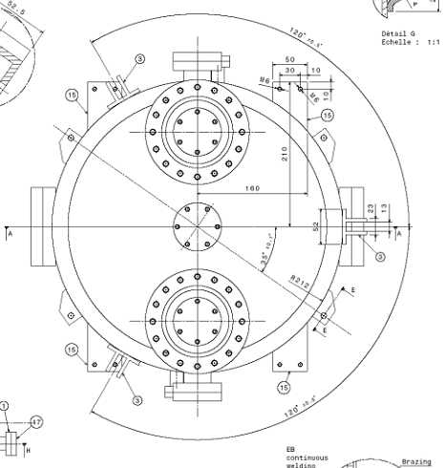
Magnetic field distribution on b=0.12 Spiral2 QRW

Slide 22
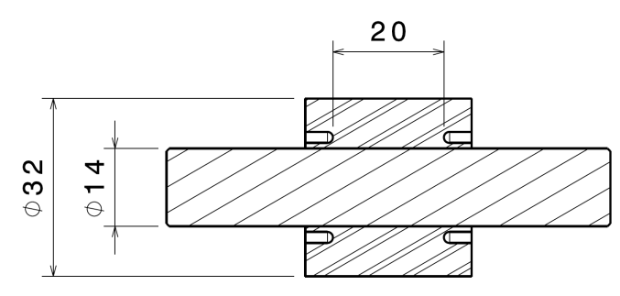
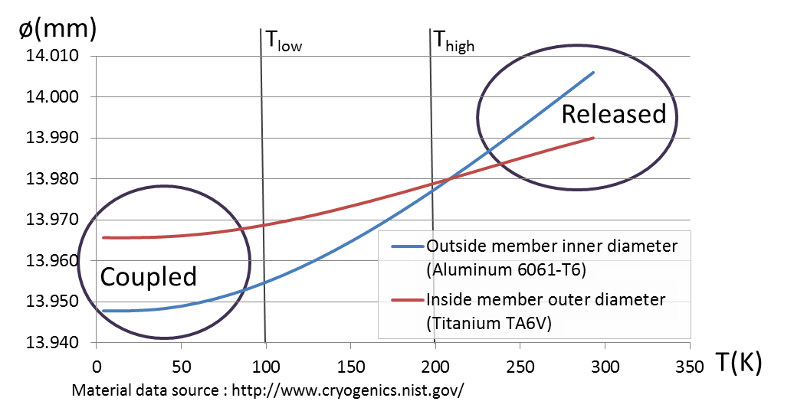
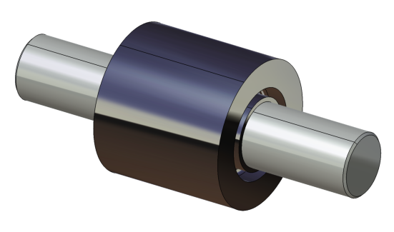
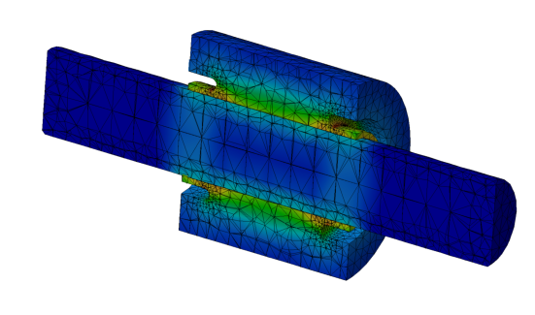
Thermal shrink fit coupling
Introduction : During operation, part of the cavity body is highly stressed (up to 311 MPa) by the tuner action, much far away from the ambient temperature elasticity limit (around 40 MPa). This can lead to cavity damage risk in a case where the tuner is stuck.
Goal : Get the possibility to release the cavity from the tuner prior any warming-up, even in case of failure of motor/gearbox/ballscrew.
Idea : Put inside the tuner a shrink fit coupler that rely on association of two different materials to :
Release the system at above a temperature (> T_{high})
Couple the system at low temperature (< T_{low})
A heater located on the outside member would provide heating to the whole assembly.

Slide 23
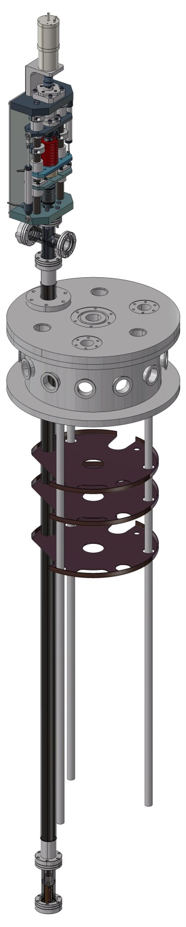
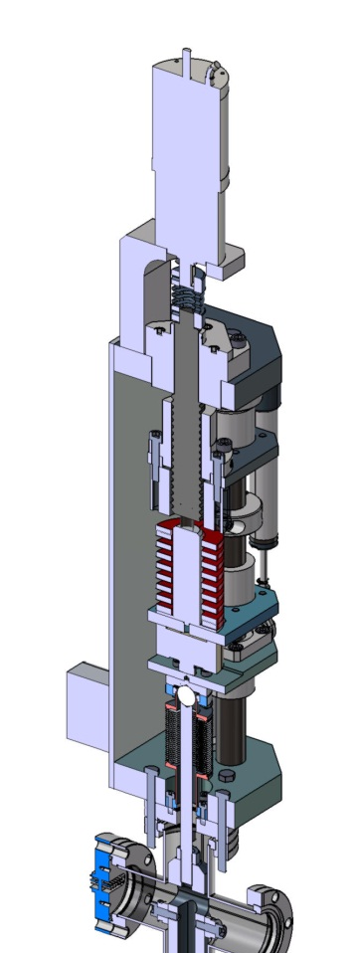

Compression test bench

