Slide 1

Beam vacuum leak repair without schedule impact: XM46
2015
WG cryomodule TTC 2015 @ SLAC / Stéphane BERRY– CEA Saclay

Slide 2
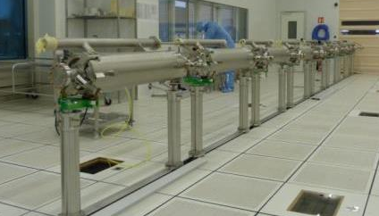
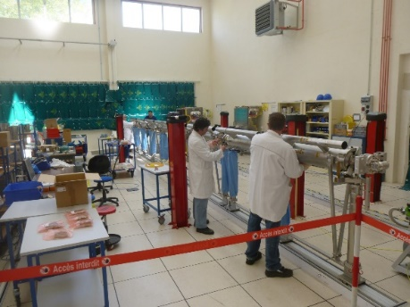
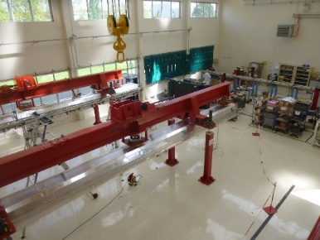
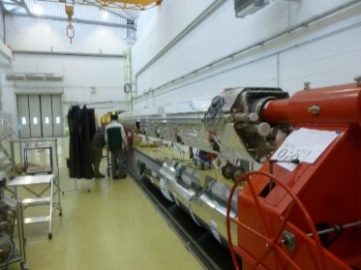
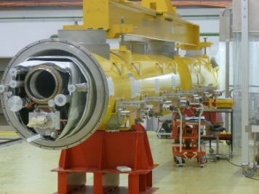
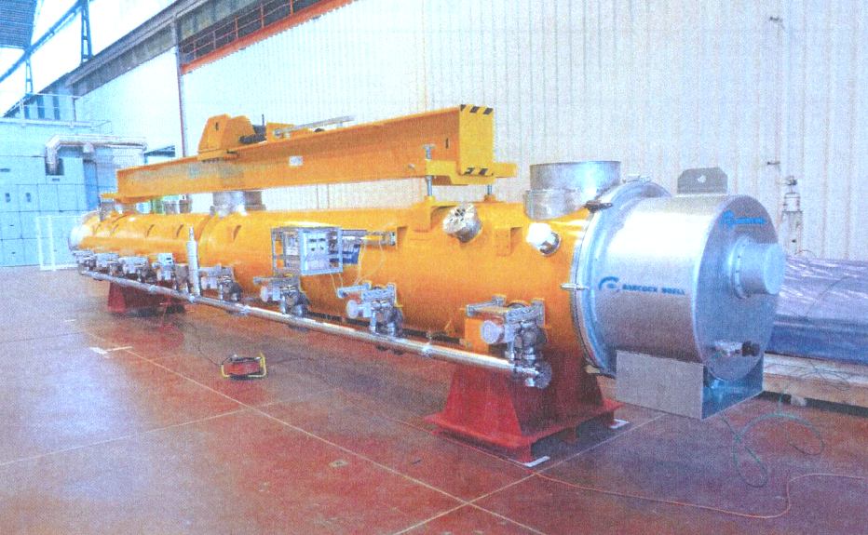
Cryomodule assembly principle
The cryomodule assembly process consist in a chain of 7 WS.
Each WS has a cryomodule at a different stage of the assembly.
The transfer from a WS to the following one is done every 4 days.

Slide 3
Flexible assembly line @CEA (2010)

Slide 4
Cryomodule perfromance: XM46 ☹ ☹
⟨E_{acc}⟩ = 19,7 MV/m
XM46 string was leaky in the clean room AND before shipment. Both leaks have been repaired at Saclay but they generated 2 extra connections of the beam vacuum to pumping groups, and 2 additional venting-pumping

Slide 5
Particules counting @ CEA
Show an Assembly report with part.counting number

Slide 6
problems @ CEA
· ON points out the XM46 string was already leaky in the clean room requiring already re-tightening in the clean room. Together with the repair of the beam line leak discovered after the full module assembly this generated three extra connections of the beam vacuum to the pumping units and two times additional venting and pumping. Furthermore, XM46 is the successor of XM45. XM45 suffered from a power break in the clean room and showed bad RFresults too.
· Case history: After the first complete assembly a 10-7 mbarL/s leak between beam-cavity and insulation vacuum appeared. Examinations revealed the leak between cavity #3 and cavity #4. The module has been dis-assembled the leak sealed by re-tightening the vacuum flange screws. Then the module has been re-assembled.
· Case history: (at the re-assembly of the module) the ceramic of two warm coupler parts (#4, #6) showed scratches and required some repair action.
TWO
1 10⁻⁸mbarL/s non contaminant leak threshold !?
Waiting for XM50 results (10-9mbarL/s)
What are real machine experience for this point ?

Slide 7
XM46 vacuum beam leak search in SA
Communication with Lutz: advice to perform the complete leak test again.
16h30 switch to LS mode to check the sensitivity of the mass; signal abnormally high (hypothesis: the helium introduced in the filter was maybe not detected rapidly and finally permeate slowly)
16h41 tightening of DN16CF -> no effect on Leak Signal
16h43 decision to remove of the filter
16h50 removal of the elbow and filter
16h52 introduction of helium against the valve DN16CF: no effect on the Leak Signal
The DN16CF valve is NOT leaky on line
Such high level of helium signal can be detected by helium spraying
16h55 decision to make leak detection by spraying helium over the full string (from QP to position 1+GV)
The leak might come from cold ceramic of the
17h start to open the cold ceramic one by one and inject helium from position 1 to position 8
17h13 close the angle valve of the string
17h15 the pressure (FRM) decrease because the volume pumped is smaller) and BUT the leak signal doesn’t change.
The leak is on the pumping line and NOT on the STRING
Communication with Lutz: advice to perform the complete leak test again.
16h30 switch to LS mode to check the sensitivity of the mass; signal abnormally high (hypothesis: the helium introduced in the filter was maybe not detected rapidly and finally permeate slowly)
16h41 tightening of DN16CF -> no effect on Leak Signal
16h43 decision to remove of the filter
16h50 removal of the elbow and filter
16h52 introduction of helium against the valve DN16CF: no effect on the Leak Signal
The DN16CF valve is NOT leaky on line
Such high level of helium signal can be detected by helium spraying
16h55 decision to make leak detection by spraying helium over the full string (from QP to position 1+GV)
The leak might come from cold ceramic of the
17h start to open the cold ceramic one by one and inject helium from position 1 to position 8
17h13 close the angle valve of the string
17h15 the pressure (FRM) decrease because the volume pumped is smaller) and BUT the leak signal doesn’t change.
The leak is on the pumping line and NOT on the STRING

Slide 8
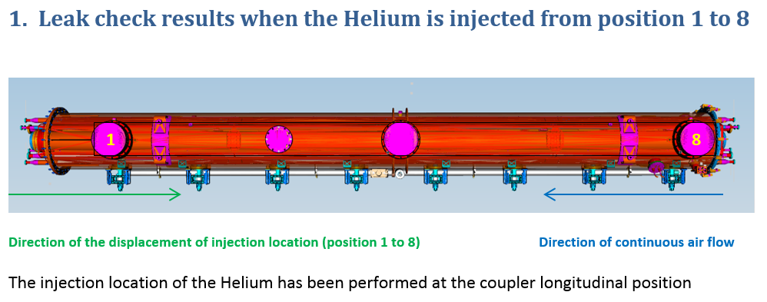
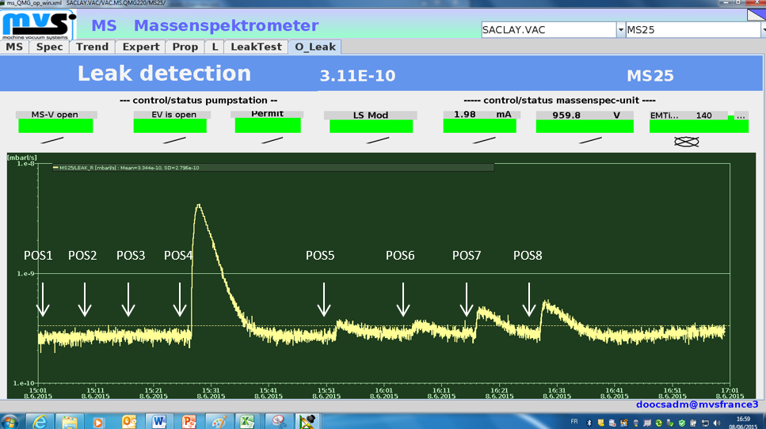
XM46 vacuum beam leak search report

Slide 9
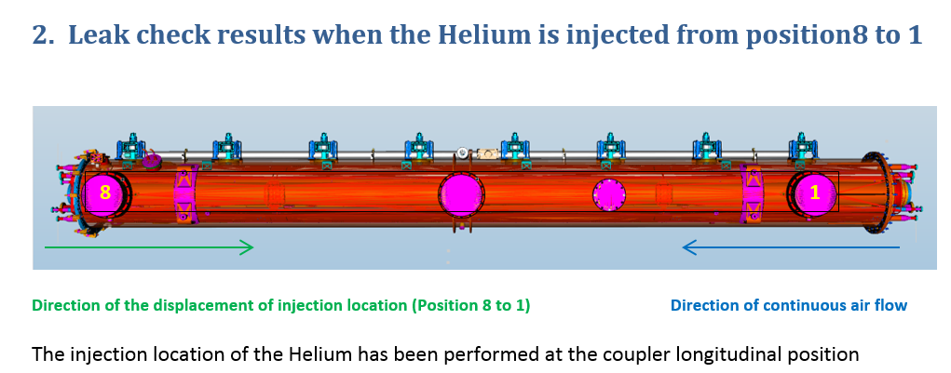
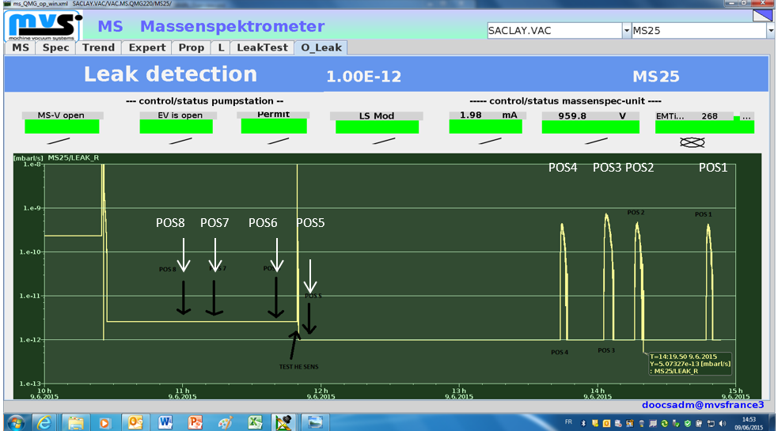
XM46 vacuum beam leak search report

Slide 10
problems @ DESY
XM46 (usable at 14 MV/m due to awful performance & huge dark current)
Status: (Module meeting 2015-11-04)
· test results:
 | · the performance of all cavities dropped significantly w.r.t. the vertical test result
 | · average gradient: 19,7 MV/m Not usable!
 | · dark current data has been taken: operating an average gradient of 19,7 MV/m the dark current is ten times higher than one would have accepted for modules operated in FLASH
 | · In succession to the normal test program, different lower gradients where operated while measuring dark current to figure out an operating gradient with acceptable dark current. 14 MV/m has been found as highest reasonable usable gradient.
 | · characteristic of one HOM filter is out of spec. but still ok
 | · heat load within cryogenic plant budget for "19,7 MV/m operation"
 | · the testing took 25 plus 6 days
· DK expresses the worry the module may spoil neighboring modules with its high dark current level. Eight in phase operating and radiating cavities may worsen the situation seriously.
· Case history: A leak at the 2 K circuit required warm up. To overcome the leak problem, the oval GRP flanges have been made more round and new GRP adapters installed.
· Case history: The coupler condition didn't show any progress applying the standard method; hence
 | · the interlock levels have slightly been increased
 | · A new vacuum pump station has been installed for additional investigations. No water was found in the mass spectrum of the coupler vacuum but according to LL some other contamination.
 | · The warm coupler conditioning proceeded and the first four couplers have finally been processed successfully.
 | · Full operation with the standard interlock levels is possible now.
 | · The procedure will now be repeated for the second four couplers.
 | · Until tomorrow lunchtime the module is expected being ready for cool down.
 | · In all, one week has been lost.
 | · WDM expresses the concern that the module may also need a long conditioning time in the XFEL tunnel.

Slide 11
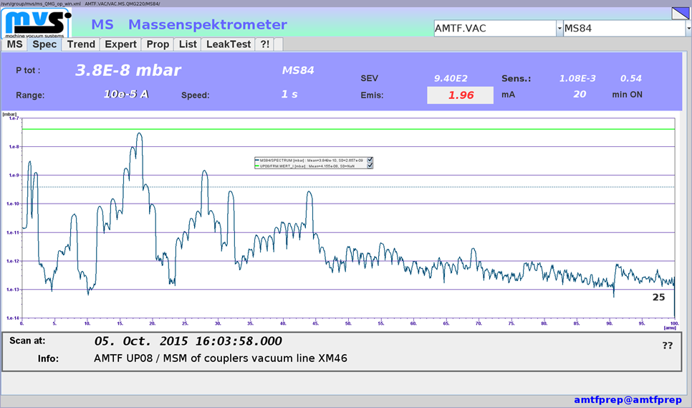
RGA on AMTF wo RF: conform

Slide 12
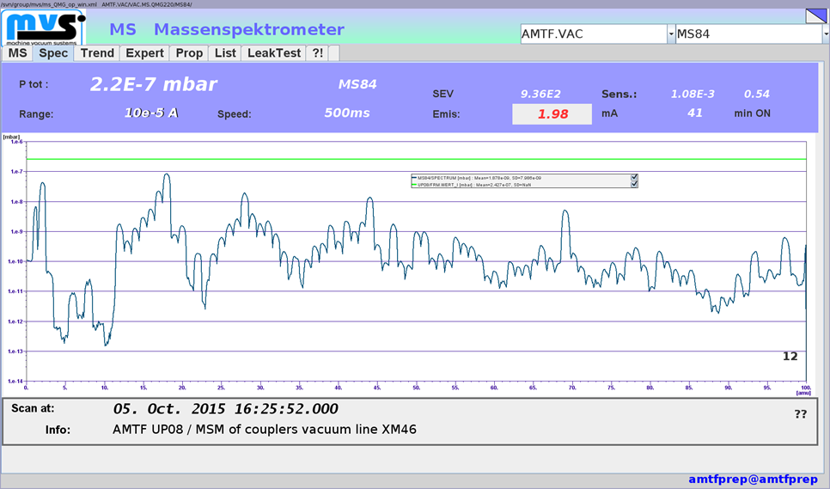
RGA on AMTF with RF: NON conform

Slide 13
DSM
Irfu
DIR
Commissariat à l’énergie atomique et aux énergies alternatives
Centre de Saclay | 91191 Gif-sur-Yvette Cedex
T. +33 (0)1 69 08 xx xx | F. +33 (0)1 69 08 99 89
  Etablissement public à caractère industriel et commercial | RCS Paris B 775 685 019

