Slide 1
Flux expulsion efficiency for different cavity materials and treatments
Sam Posen
TTC Meeting, SLAC
2 December 2015

Slide 2
Maintaining High Q₀ in Presence of External B Fields
High Q₀ can reduce cryogenic costs in high duty factor SRF linacs by tens of millions of dollars
High Q₀ in vertical test must be preserved to cryomodule
Significant source of Q₀ degradation: flux losses
B_{ext}
  Use of non-magnetic components
  Magnetic shielding/active compensation
B_{trap}
  Cool through transition with dT/dy (bulk Nb)
  Minimize pinning centers
R_{s}
  Optimize mean free path
Notes:
Even a few mG can have a dramatic effect

Slide 3
Maintaining High Q₀ in Presence of External B Fields
High Q₀ can reduce cryogenic costs in high duty factor SRF linacs by tens of millions of dollars
High Q₀ in vertical test must be preserved to cryomodule
Significant source of Q₀ degradation: flux losses
B_{ext}
  Use of non-magnetic components
  Magnetic shielding/active compensation
B_{trap}
  Cool through transition with dT/dy (bulk Nb)
  Minimize pinning centers
R_{s}
  Optimize mean free path

Slide 4
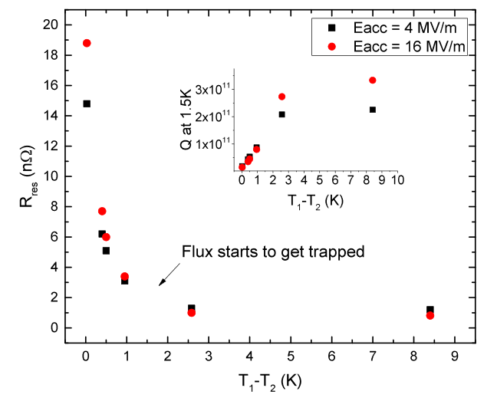
Minimize Trapping 1: Cool through T_{c} with dT/dy (bulk Nb)
A. Romanenko et al., Appl. Phys. Lett. 105, 234103 (2014).

Slide 5
Minimize Trapping 1: Cool through T_{c} with dT/dy (bulk Nb)
Clear trend – ΔT necessary for expulsion
A. Romanenko et al., Appl. Phys. Lett. 105, 234103 (2014).

Slide 6
Minimize Trapping 2: Minimize Pinning in SRF-Treated Nb
Surface features:
  Oxides
  Nitrides
  N- or O-rich niobium
  Mechanical damage
  Contamination
Bulk features:
  Grain boundaries
  Dislocations
  Impurities
How important are these to pinning?
Inner surface
Bulk
Outer surface
Notes:
Another important question is what qualities are important to pinning? For example, in N-doped niobium, we have surface features like nitrides and N-rich material—how does the pinning strength of these features compare to that of bgrain boundaries and dislocations?

Slide 7
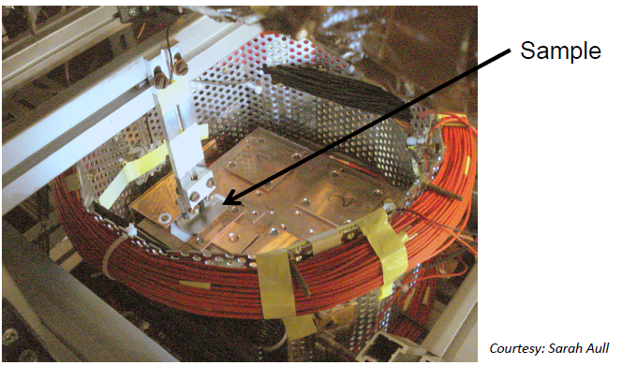
Previous Studies
Previous studies, e.g.
  Aull, Kugeler and Knobloch, PRSTAB 15, 062001 (2012)
  A. Dhavale et al, Supercond. Sci. Tech., 25, 065014 (2012)
  G. Ciovati, and A. Gurevich, Proc. SRF 2007, TUP13 (2007)
Qualitative trends, but no measurement as a function of thermal gradient, which is crucial
Notes:
Before N-doping, so limited understanding of dependence on state of surface
Before understanding that thermal gradient plays an important role in expulsion
Difficult to extract quantitative understanding

Slide 8
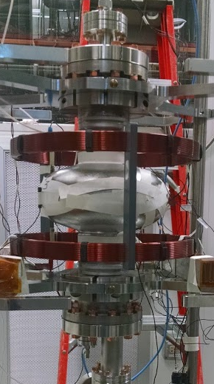
Experimental Considerations
Goal: measure flux trapping as a function of thermal gradient and material treatment
Connection to R_{res} – Performing study on cavities directly determines required conditions to avoid severely degraded RF performance
Notes:
In the last year or two we’ve recognized that cooling through transition with a spatial thermal gradient strongly affects the amount of flux that is trapped

Slide 9
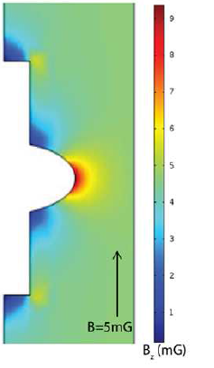
Measuring Flux Expulsion During Transition
An axial magnetic field on the order of 10 mG is applied during cooldown. Fluxgate magnetometers at the equator measured the magnetic field before B_{NC} and after B_{SC} superconducting transition.
Temperature sensors
External field coils
Fluxgate magnetometers
Complete trapping: B_{SC}/B_{NC} = 1
Complete expulsion: B_{SC}/B_{NC} ~ 1.8
Measurement technique from A. Romanenko et al., Appl. Phys. Lett. 105, 234103 (2014).

Slide 10
Measuring Flux Expulsion During Transition
Poor expulsion: B_{SC}/B_{NC} ~ 1.1
Good expulsion: B_{SC}/B_{NC} ~ 1.6

Slide 11
Example of Cavity that Expels Flux Well
Complete Expulsion
Complete Trapping

Slide 12
Example of Cavity that Expels Flux Poorly (Large Trapping)
Complete Expulsion
Complete Trapping

Slide 13
Large Survey
Measured many single cell 1.3 GHz cavities
Thermal cycles – start from 15-100 K, cool down to 7 K, warm up
Parasitic measurements on other experiments
22 datasets measured (i.e. treatment then into dewar)

Slide 14
Quickly Apparent Trend With Batches of AES Cavities
AES Single Cells Batch 1
AES Single Cells Batch 2
Notes:
7:30

Slide 15
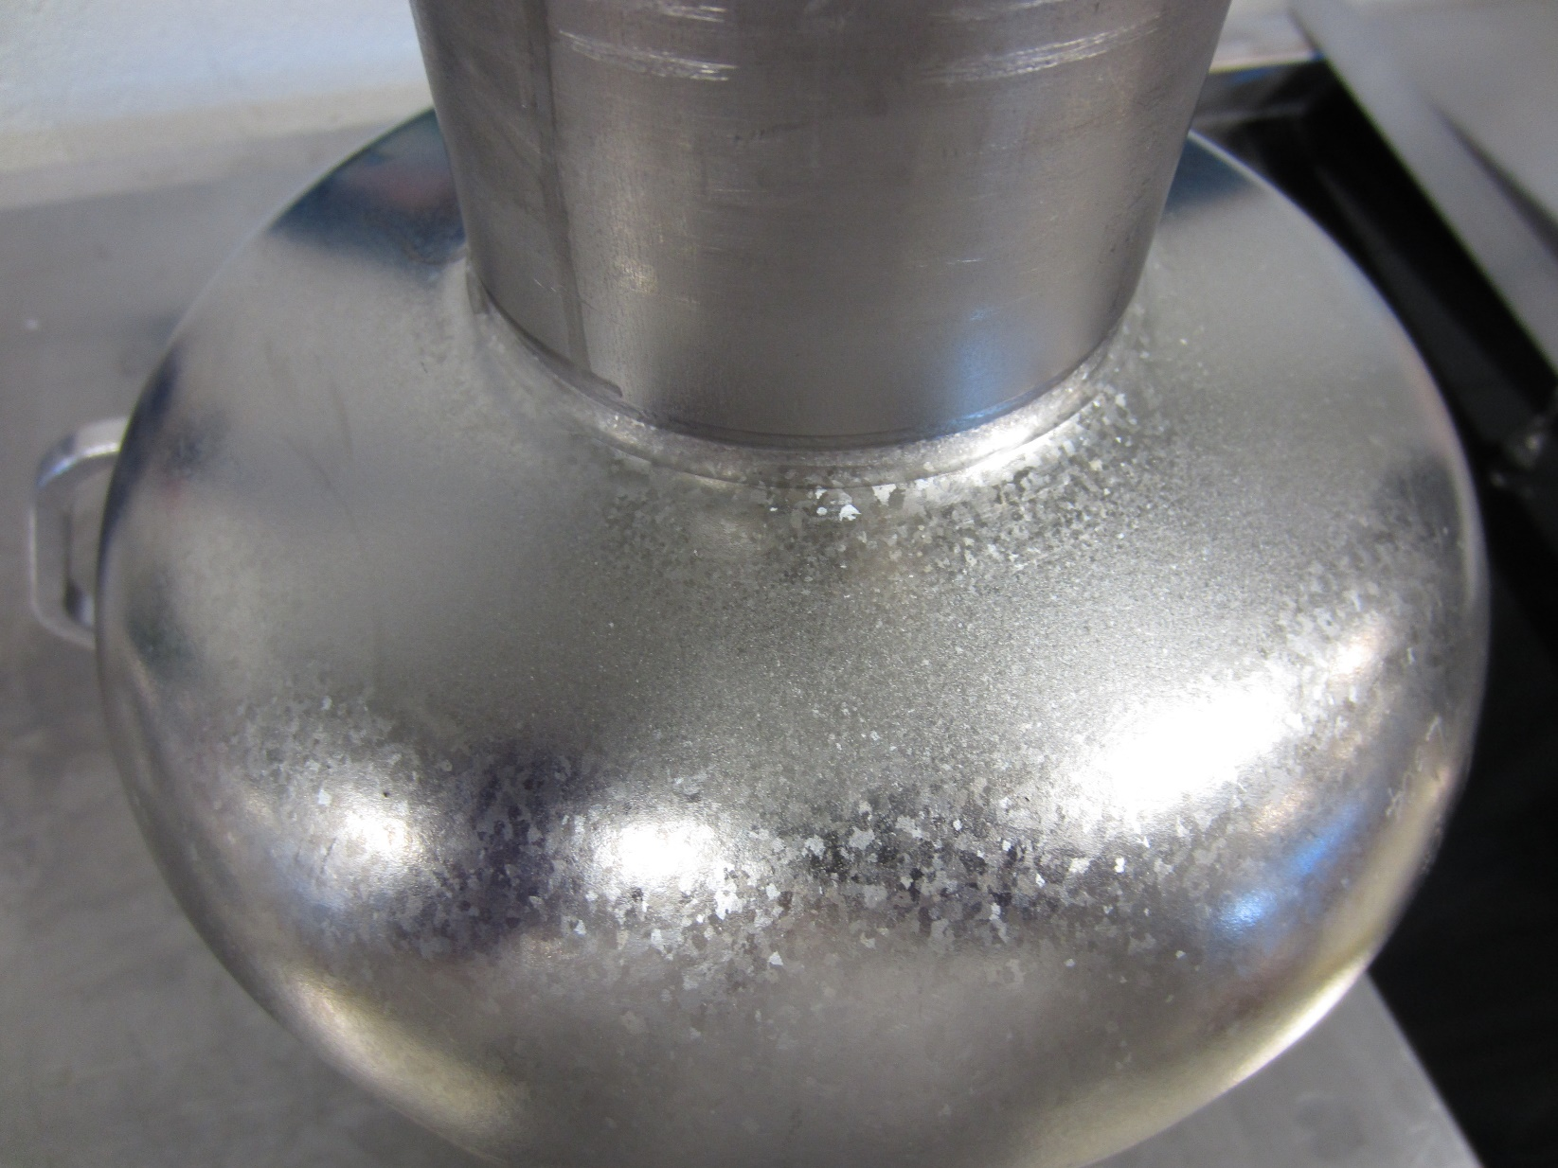
Quickly Apparent Trend With Batch of AES Cavities
AES Single Cells Batch 1
AES Single Cells Batch 2
Notes:
Another thing that quickly became apparent is that the first batch tends to grow very large grains after a few cycles of 800 C. Expulsion from large grain material would be similar to what was seen in the sample studies, but the trend with deltaT gives us a much clearer picture of the range of expulsion that is possible for a given cavity depending on cooldown.

Slide 16
Quickly Apparent Trend With Batch of AES Cavities
Large grains?
Dislocations?
AES Single Cells Batch 1
AES Single Cells Batch 2
Notes:
Another thing that quickly became apparent is that the first batch tends to grow very large grains after a few cycles of 800 C. Expulsion from large grain material would be similar to what was seen in the sample studies, but the trend with deltaT gives us a much clearer picture of the range of expulsion that is possible for a given cavity depending on cooldown.

Slide 17
Previous Studies
Previous sample studies, e.g.
  Aull, Kugeler and Knobloch, PRSTAB 15, 062001 (2012)
  A. Dhavale et al, Supercond. Sci. Tech., 25, 065014 (2012)
No measurement as a function of thermal gradient, but qualitative trend: larger grain material seems to expel better
Notes:
Before N-doping, so limited understanding of dependence on state of surface
Before understanding that thermal gradient plays an important role in expulsion
Difficult to extract quantitative understanding

Slide 18
Other Fine Grain Cavities – Poor Expulsion
Complete Expulsion
Poor expulsion observed for other fine grain cavities
Complete Trapping

Slide 19
Large Grain Cavity – Strong Expulsion
Complete Expulsion
Strong expulsion observed for LG cavity
Complete Trapping

Slide 20
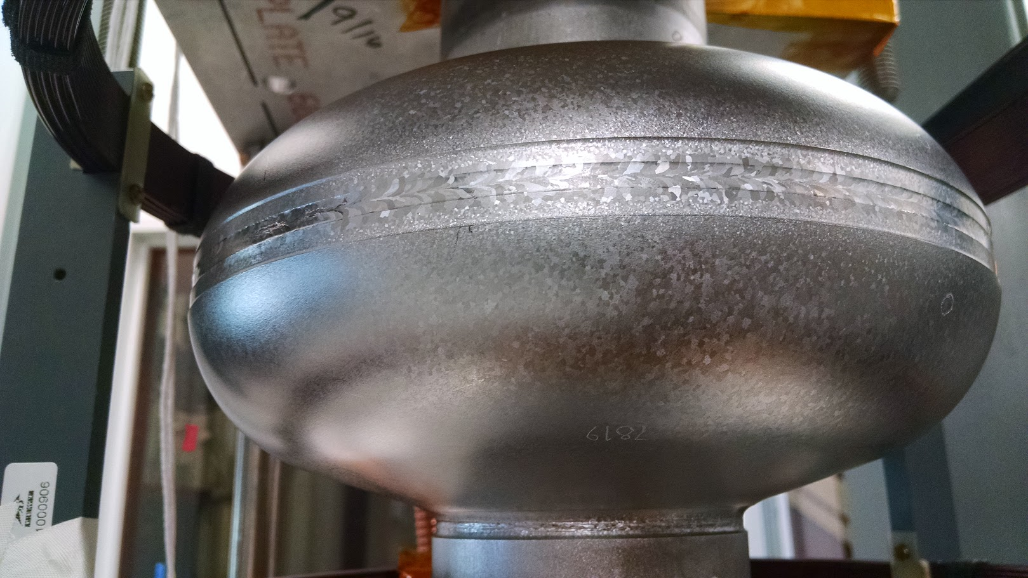
Conversion to From Poor to Strong Expulsion
Complete Expulsion
1000 C 4 h vastly improves expulsion
Complete Trapping

Slide 21
Long Treatment at 800 C
Complete Expulsion
After 5 days at 800 C, good expulsion observed in cavity from “Batch 2”
Complete Trapping

Slide 22
Long Treatment at 800 C
Complete Expulsion
Continued studies needed to optimize furnace treatment using standard 800 C
Complete Trapping

Slide 23
Surface Alteration With No Significant Effect on Expulsion
Outside BCP
N-dope 2/6
120 C bake
Different surface conditions in cavities with similar bulk history: similar expulsion
EP vs BCP
90 C bake
Add’l EP
Heavy doping

Slide 24
Effect on Q vs E
AES017 cooled in 10 mG
1000 C Bake
Poor expulsion: B_{SC}/B_{NC} ~ 1.1
Good expulsion: B_{SC}/B_{NC} ~ 1.6

Slide 25
Summary
Treating for strong expulsion can reduce requirements for:
  Shielding/active compensation of external fields – B_{ext}
  Sensitivity to trapped flux – R_{s}(B_{trap})
  Cryogenic plant size and power consumption
Experiment: Measure trapped flux as a function of treatment and spatial temperature gradient
  Thermal gradient at transition critical for all preparations
Modification of bulk structure through furnace treatment shows trend of improved flux expulsion
Modification of surface structure shows minimal influence on flux expulsion
Additional studies are required to determine reproducible conditions for strong expulsion of flux (try at 800 C)

Slide 26
Implications for Achieving High Q₀ in Cryomodules
If reduced grain boundary density improves expulsion, path to optimize preparation – furnace treatment, larger ASTM spec for half-cell sheets, ingot LG Nb for sheets
Consistent with high Q₀ in LG studies, e.g. W. Singer et al., Phys. Rev. ST-AB, 16, 012003 (2013)
N-doping discovery made on cavity with strong expulsion

Slide 27
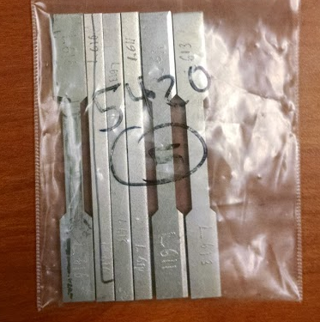
Outlook
Cavity studies – Progressive measurements with 6 hr 800 C furnace treatments
Sample studies – with progressive steps of 6 hr at 800 C, measure:
  Grain size and dislocation content (SEM-EBSD)
  Mechanical properties (tensile test)
  Flux expulsion (small dewar)

