Slide 1
N-doping trial at KEK ～not successful example～
2015/12/1
TTC meeting WG1
Kensei Umemori (KEK)

Slide 2
We tried three N-doping parameter
(1) 800deg, 3h + 3.3Pa N-dope, 2min + 800deg, 6min
(2) 800deg, 3h + 5.5Pa N-dope, 20min + 800deg, 30min
(3) 800deg, 3h + 2.7Pa N-dope, 20min + 800deg, 30min

Slide 3
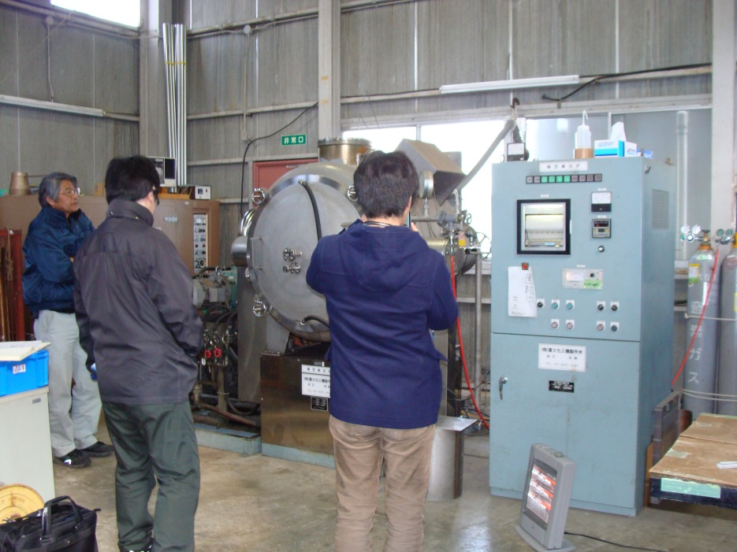
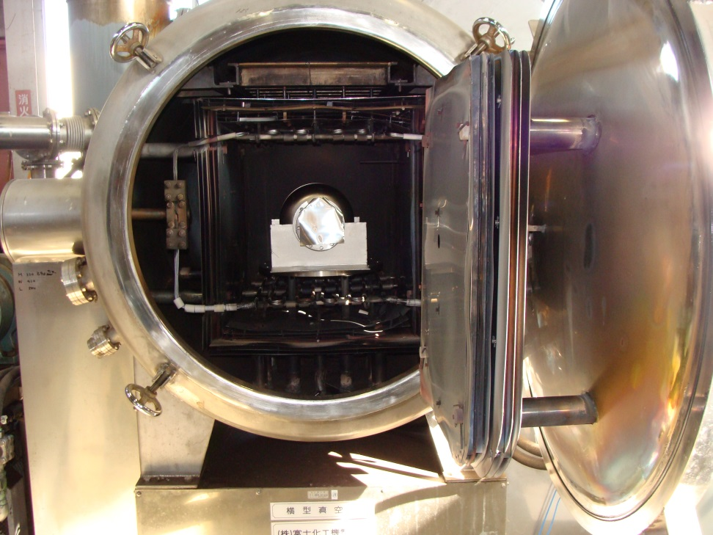
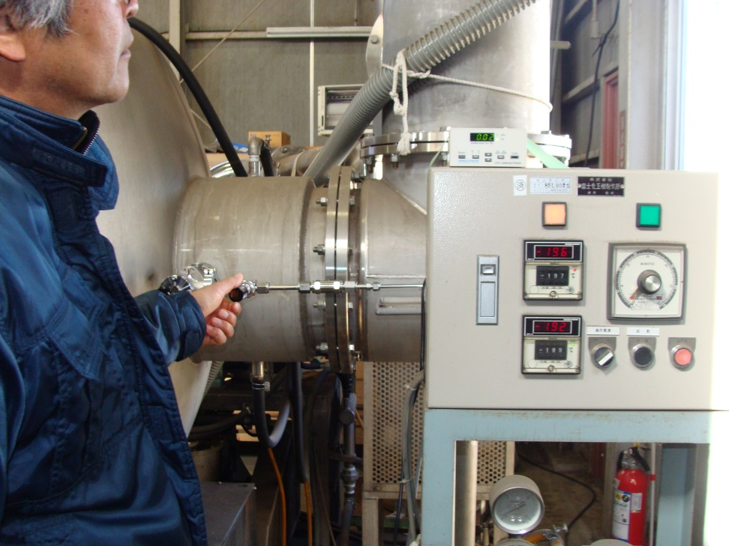
N-doping system(1) ~small furnace
・Simple N-doping system was constructed on small furnace which was for single-cell cavity annealing.
・Nitrogen pressure is controlled by manual valve.
・Nitrogen pressure is monitored by convection gauge.
・No cryopump. Diffusion pump works.

Slide 4
Typical N-doping by small furnace
Keep 3.3Pa 2min.
・Upto 800C with 3hours
・Keep 800C, 3hours
・N-doping
-- Stable state within 2min.
-- Keep 3.3Pa, 2min.
-- After valve close, vacuum recover quickly
・Keep 800C, 6min
・Heater OFF ⇒ cool down

Slide 5
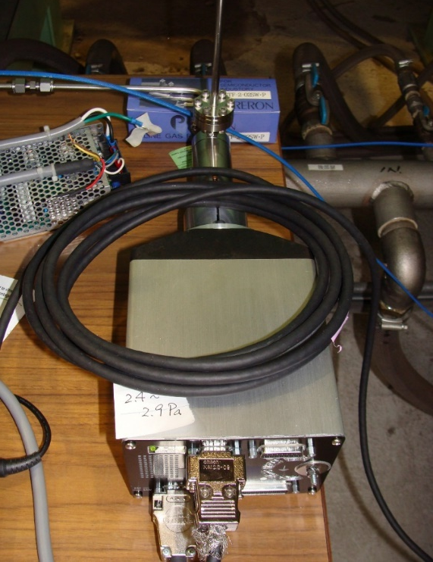
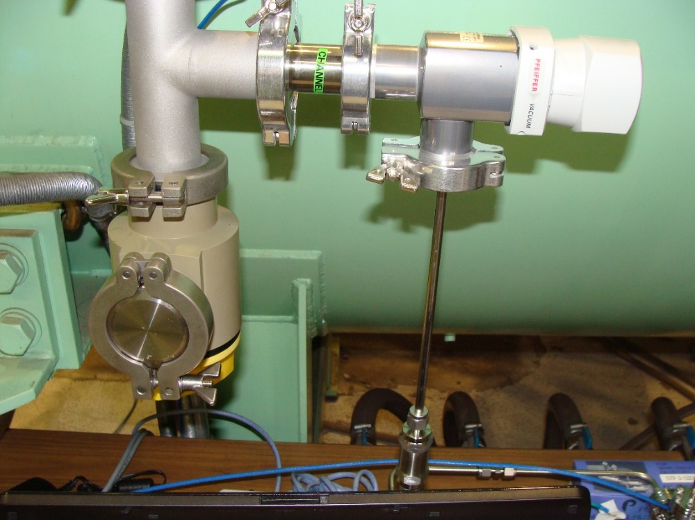
N-doping system(2) ~large furnace
・N-doping system was constructed on large furnace which was for 9-cell cavity annealing.
・Nitrogen pressure is controlled by variable leak valve.
・Nitrogen pressure is monitored by pirani gauge.
・No cryopump. Diffusion pump works.

Slide 6
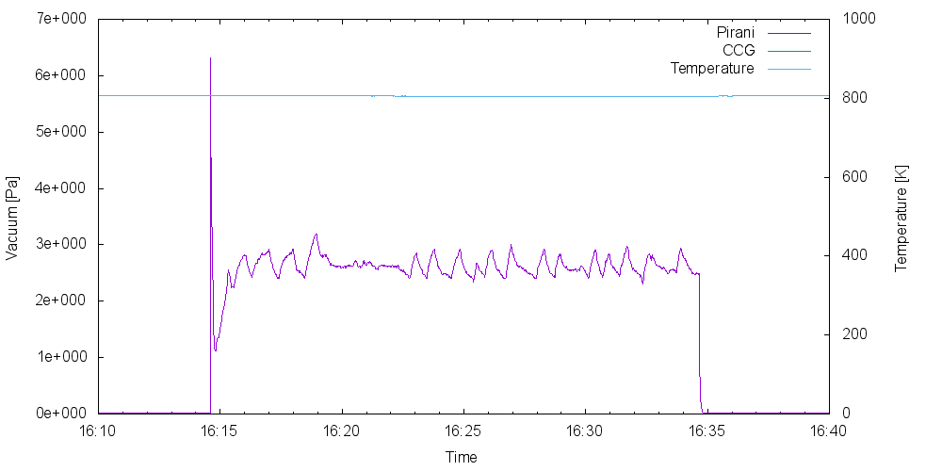
N-doping at large furnace
800C, 3hours
N-doping
・Upto 800C with 3hours
・Keep 800C, 3hours
・N-doping
-- Stable state within 1min.
-- Keep 2.7Pa, 20min.
-- After valve close, vacuum recover quickly
・Keep 800C, 30min
・Heater OFF ⇒ cool down
Cool down

Slide 7
History of Fine grain(Tokyo-denkai) single-cell cavity
Date | Process | Details
2014/7～ | EP-1(100um)⇒ anneal⇒ EP-2(20um)⇒ VT⇒EP-2(20um)
2015/1/22 | VT(2) | Confirm Eacc and Qo at bulk Nb condition
2015/2/9 | N-dope(1) | 800deg, 3h + 3.3Pa N-dope, 2min + 800deg, 6min
2015/2/17 | EP-2(3) | 5um EP-2, HPR, Assembly
2015/2/25 | VT(3)
2015/3/10 | EP-2(4) | 10um EP-2, PR, Assembly, Baking(140deg, 48hours)
2015/3/18 | VT(4)
2015/4/3 | N-dope(2) | 800deg, 3h + 5.5Pa N-dope, 20min + 800deg, 30min
2015/4/7 | EP-2(5) | 15um EP-2, PR, Assembly, Baking(140deg, 48hours)
2015/4/16 | VT(5)
2015/5/11 | EP-2(6) | 10um EP-2, PR, Assembly, Baking(140deg, 48hours)
2015/5/20 | VT(6)
2015/6/9 | EP-2(7) | 10um EP-2, PR, Assembly
2015/6/18 | VT(7)
2015/8/18 | EP-2(8) | 10um EP-2, PR, Assembly, Baking(140deg, 48hours)
2015/8/27 | VT(8)

Slide 8
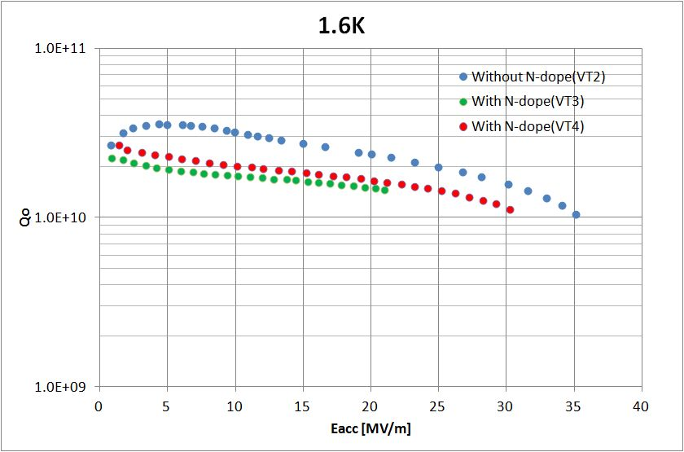
VT results (3.3Pa N-dope, 2min )
Without N-dope
↓
↑
Without N-dope
Without N-dope
↓
・Two times VT after N-dope, with 5um EP and additional 10umEP
・Q value degraded compared with No N-doping case.
・Quench field decreased to 22MV/m and 30 MV/m.

Slide 9
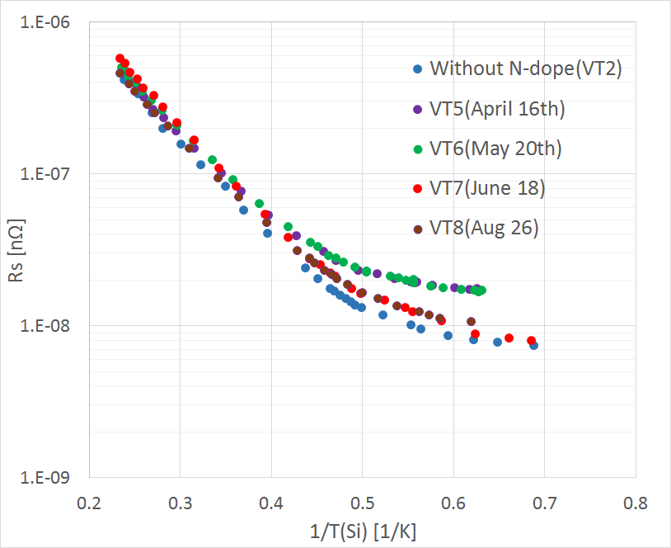
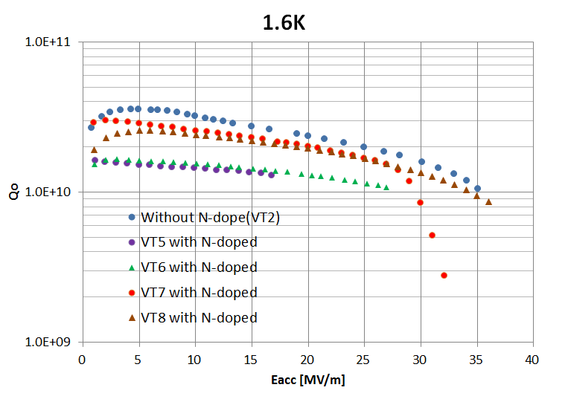
VT results (5.5Pa N-dope, 20min )
Without N-dope
↓
↑
Without N-dope
Without N-dope
↓
・Four times VT was carried out after N-doping, with 15um EP and additional 10um, 10um, 10um EP.
・Q values were always low.
・Quench field decreased to 17MV/m, and recovered with additional EP. Quench locations are different for every measurements.

Slide 10
History of Fine grain(ULVAC) single-cell cavity
Date | Process | Details
2015/2/12 | EP-1 | 100um
2015/2 | Anneal | 750deg, 3h
2015/3/3 | EP-2(1) | 20um EP-2, HPR, Assembly, Baking(140deg, 48hours)
2015/3/12 | VT(1) | Confirm Eacc and Qo
2015/5/19 | N-dope(3) | 800deg, 3h + 2.7Pa N-dope, 20min + 800deg, 6min
2015/6/2 | EP-2(2) | 15um EP-2, HPR, Assembly, Baking(140deg, 48hours)
2015/6/11 | VT(2)
2015/6/16 | EP-2(3) | 15um EP-2, HPR, Assembly, Baking(140deg, 48hours)
2015/6/25 | VT(3)

Slide 11
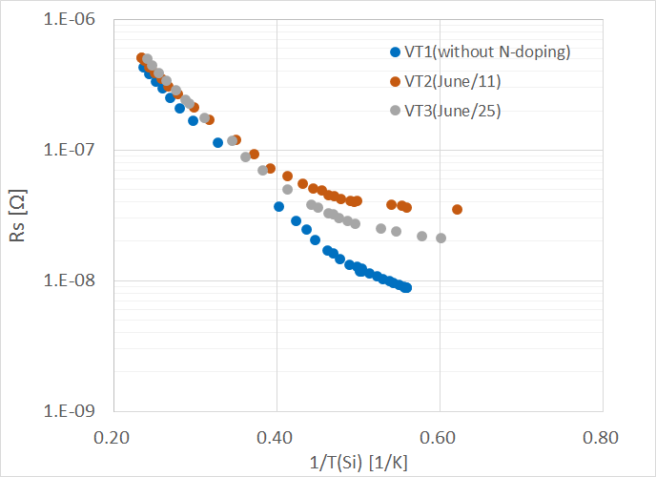
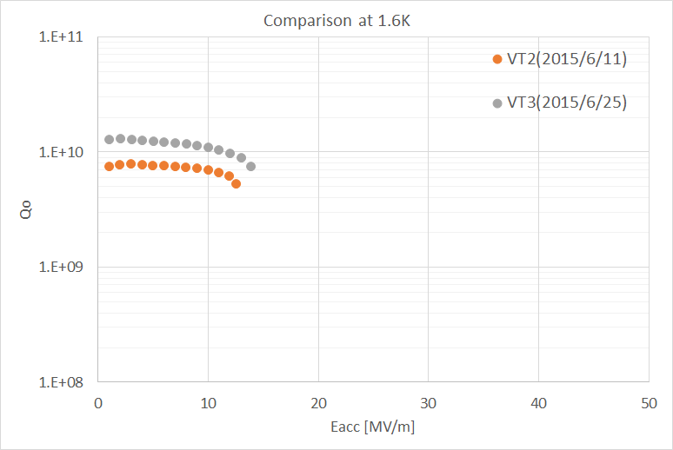
VT results (2.7Pa N-dope, 20min )
Without N-dope
↓
↑
Without N-dope
・Two times VT after N-doping, with 15um EP and additional 15um EP.
・Q values were drastically degraded.
・Quench field decreased to 13MV/m.
・Q values and quench field recovered little bit after additional EP.
・Quench location was same for both VTs.
(No N-dope data)

Slide 12
Discussion
Possible reason of bad results are followings.
Nb surface was not N-doped correctly.
Something wrong?
Difference of vacuum system? (Cryopump or diffusion pump)
Difference on N-doping system?
Effect doe to remnant field on vertical test cryostat.縦
Trapping of magnetic field on N-doped surface is more sensitive to remnant field on vertical test cryostat.(More than a few ～ several times sensitive?)
KEK’s VT cryostat has more than 10 mG.
Also depend on cooling procedure.

Slide 13
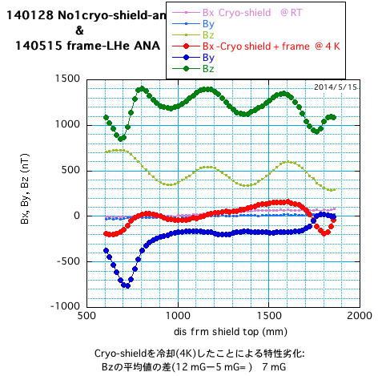
Remnant field inside STF VT cryostat(@4K)
Measurement was done with support tools for 9-cell measurement at 4K.
Remnant field was 12～13mG.
Part of contribution come from support tools ～5mG

Slide 14
Near future trial
Measure our N-doped cavity at FNAL
Perform vertical test at good magnetic condition
Compare with results at KEK
Improvement of KEK vertical test system
Improvement of monitors: flux gate sensor, temperature sensors, etc.
Improvement of magnetic field condition: Better magnetic shielding. Apply coils to control magnetic field.
R&D for cooling procedure.
Re-examination of support tools and so on.

Slide 15
Summary
N-doping systems were constructed on small and large furnace at KEK machining center and N-doping procedures were applied.
Three different N-doping conditions were applied, referred to FNAL, Cornell, J-lab parameters.
After applying EP-2, vertical tests were carried out.
Q-values decreased after N-doping.
Quench field also decreased and recovered with additional EP.
Quench locations are generally different for measurements.
We will continue studied to understand the reason of bad performances.
N-doping seems to be easy, looking at U.S. results.
But it may require actually sophisticated magnetic condition for vertical test and cryomodules.

