Slide 1
WG1 – High Q summary
Alexander Romanenko, Fumio Furuta, Kensei Umemori
TTC’2015
1-4 Dec 2015

Slide 2
High Q working group – focus this time
Two recent discoveries enabling high Q motivated a very active effort to reveal the science behind
  Nitrogen doping – DAY1 (Monday)
  Magnetic flux management – DAY 2 (Tuesday)
Focus on underlying science
Presentations fall into two categories:
  Experimental findings
  Theoretical models currently at the table to explain the experiments

Slide 3
WG1 – High Q – N doping - contributions
We know from the outset that R_{BCS} decreasing with rf field amplitude is underlying the drastic improvement in Q
  what is the physics behind?
Experimental clues: What can we learn from Rres/Rbcs decomposition and fitting? Can we isolate some superconducting parameters which drive the effect?
    A. Palczewski (Jlab)
    D. Gonnella (Cornell)
    M. Checchin (FNAL)
Theoretical models challenged with the particular charge of “what is different about N doping”?
    B. Xiao (BNL)
    A. Gurevich (ODU)
Example of unoptimal doping:
    K. Umemori (KEK)

Slide 4
N doping

Slide 5
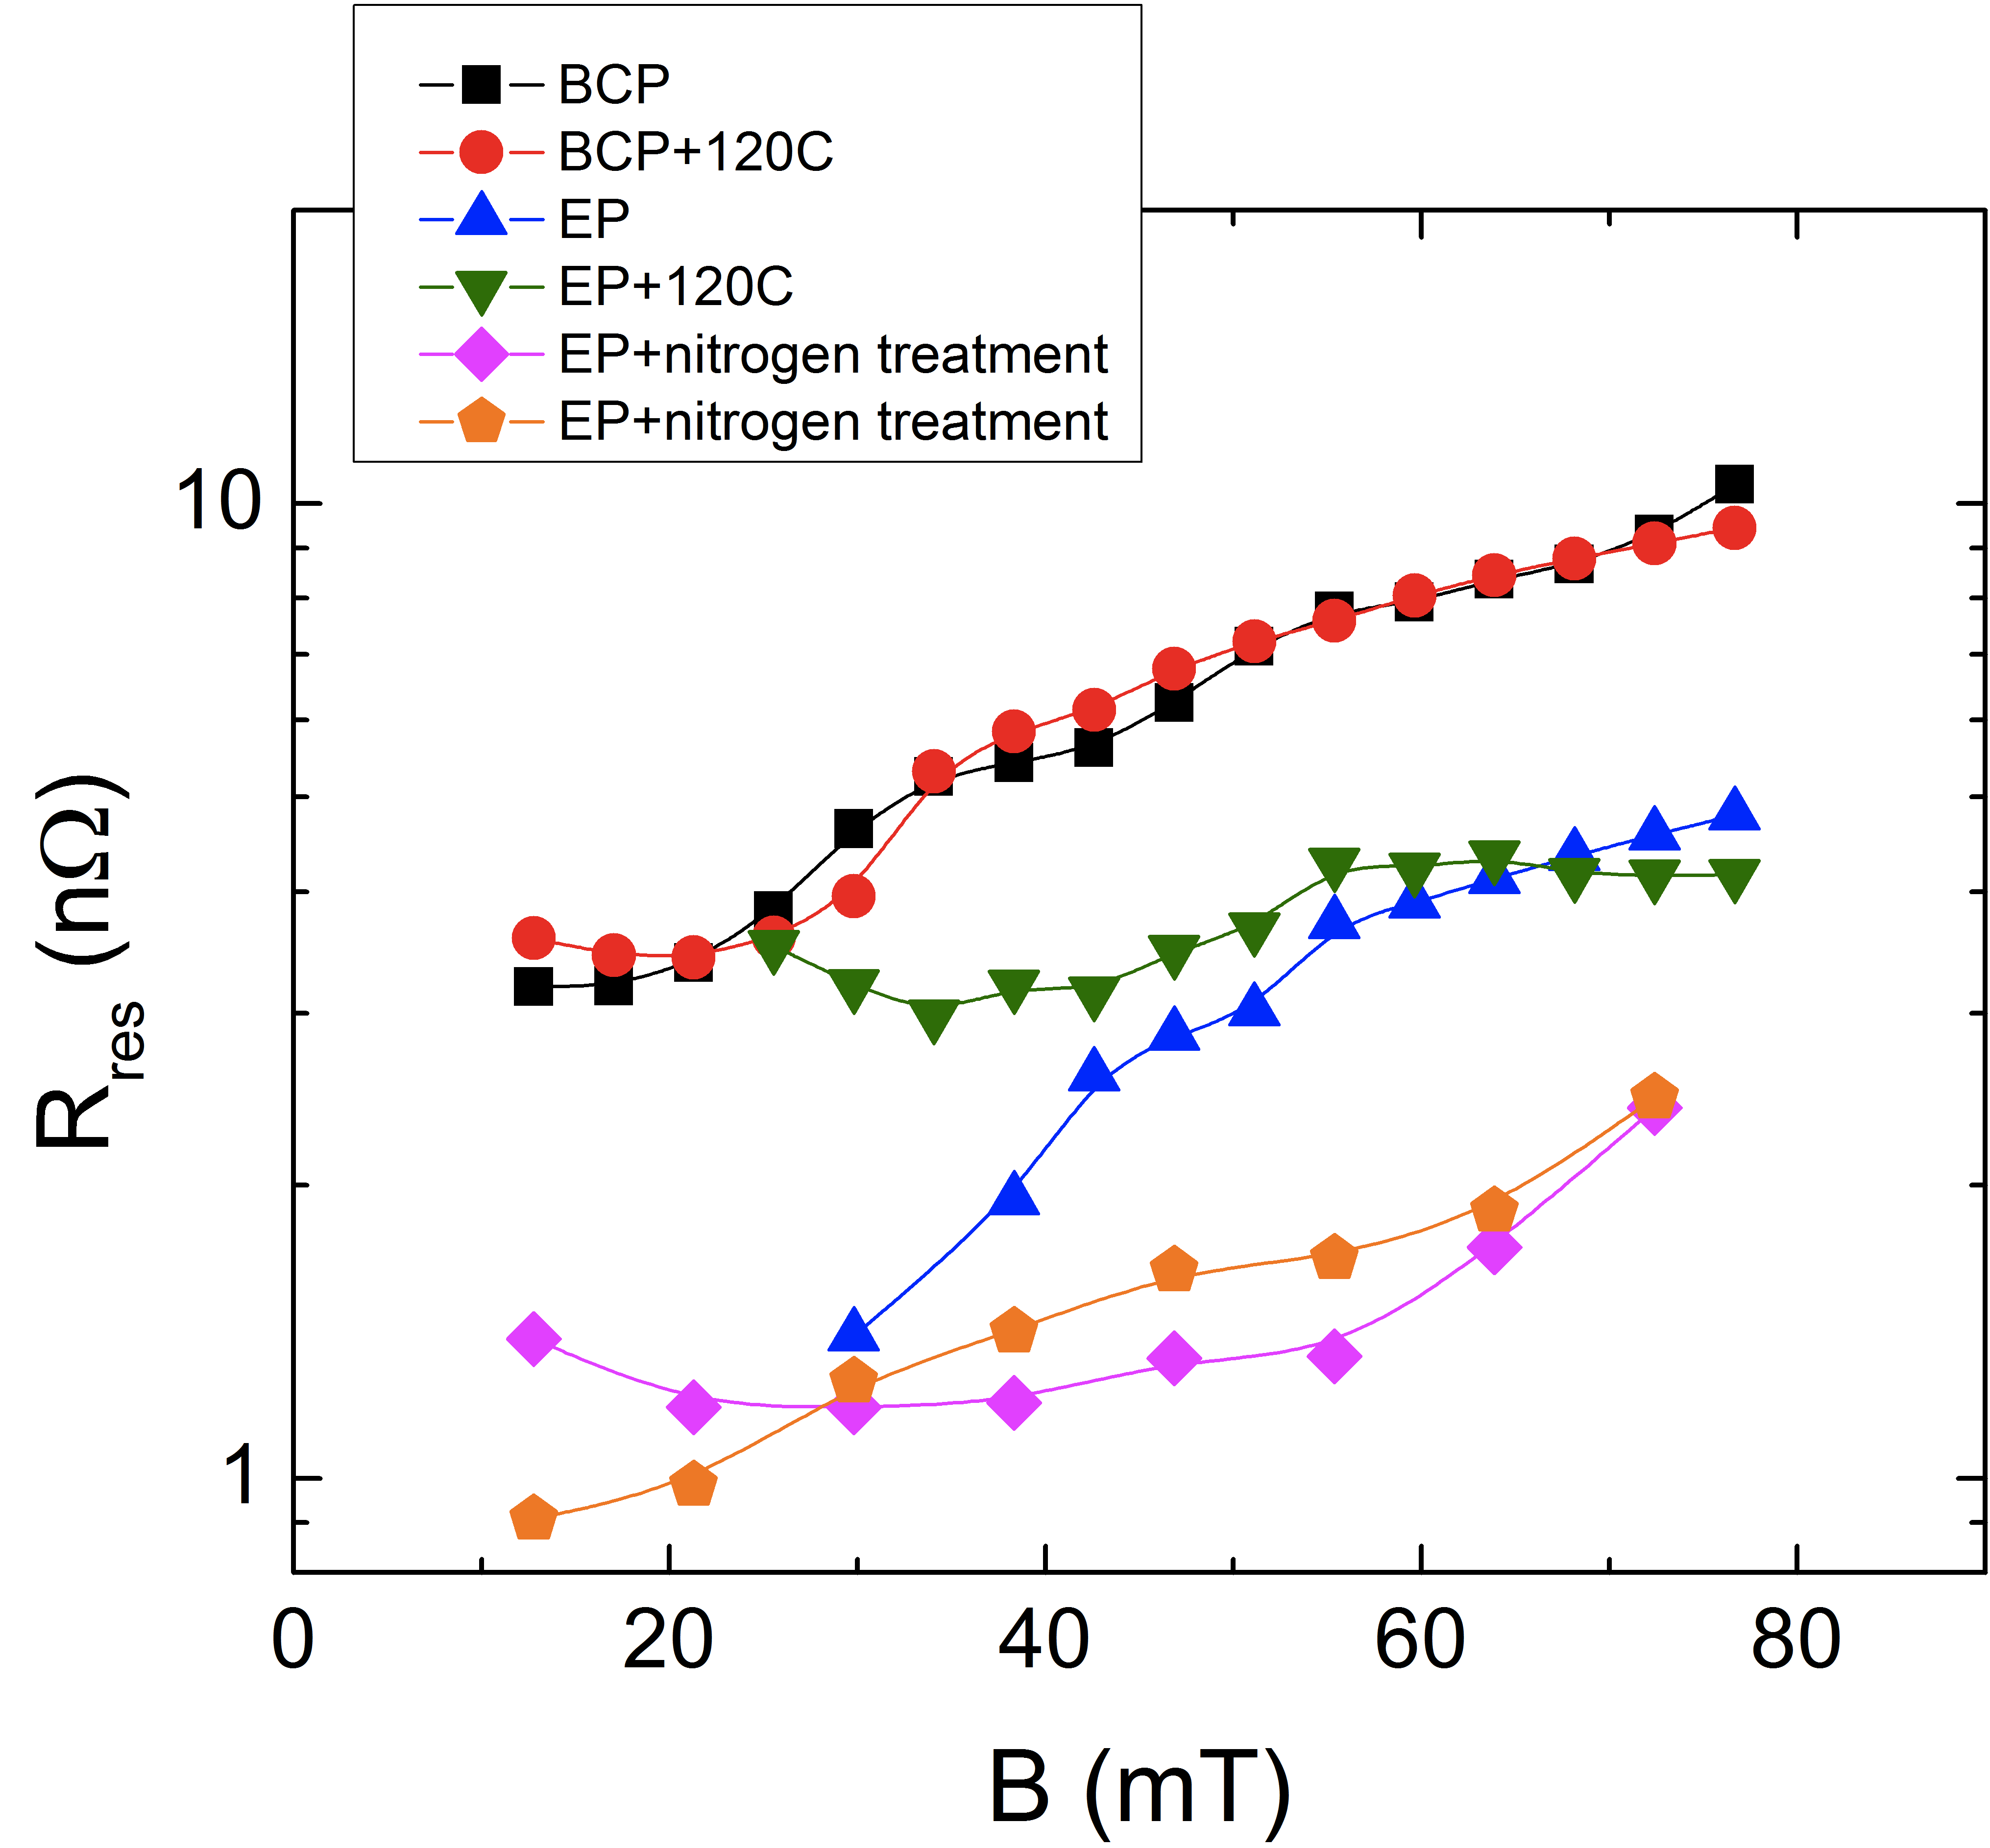
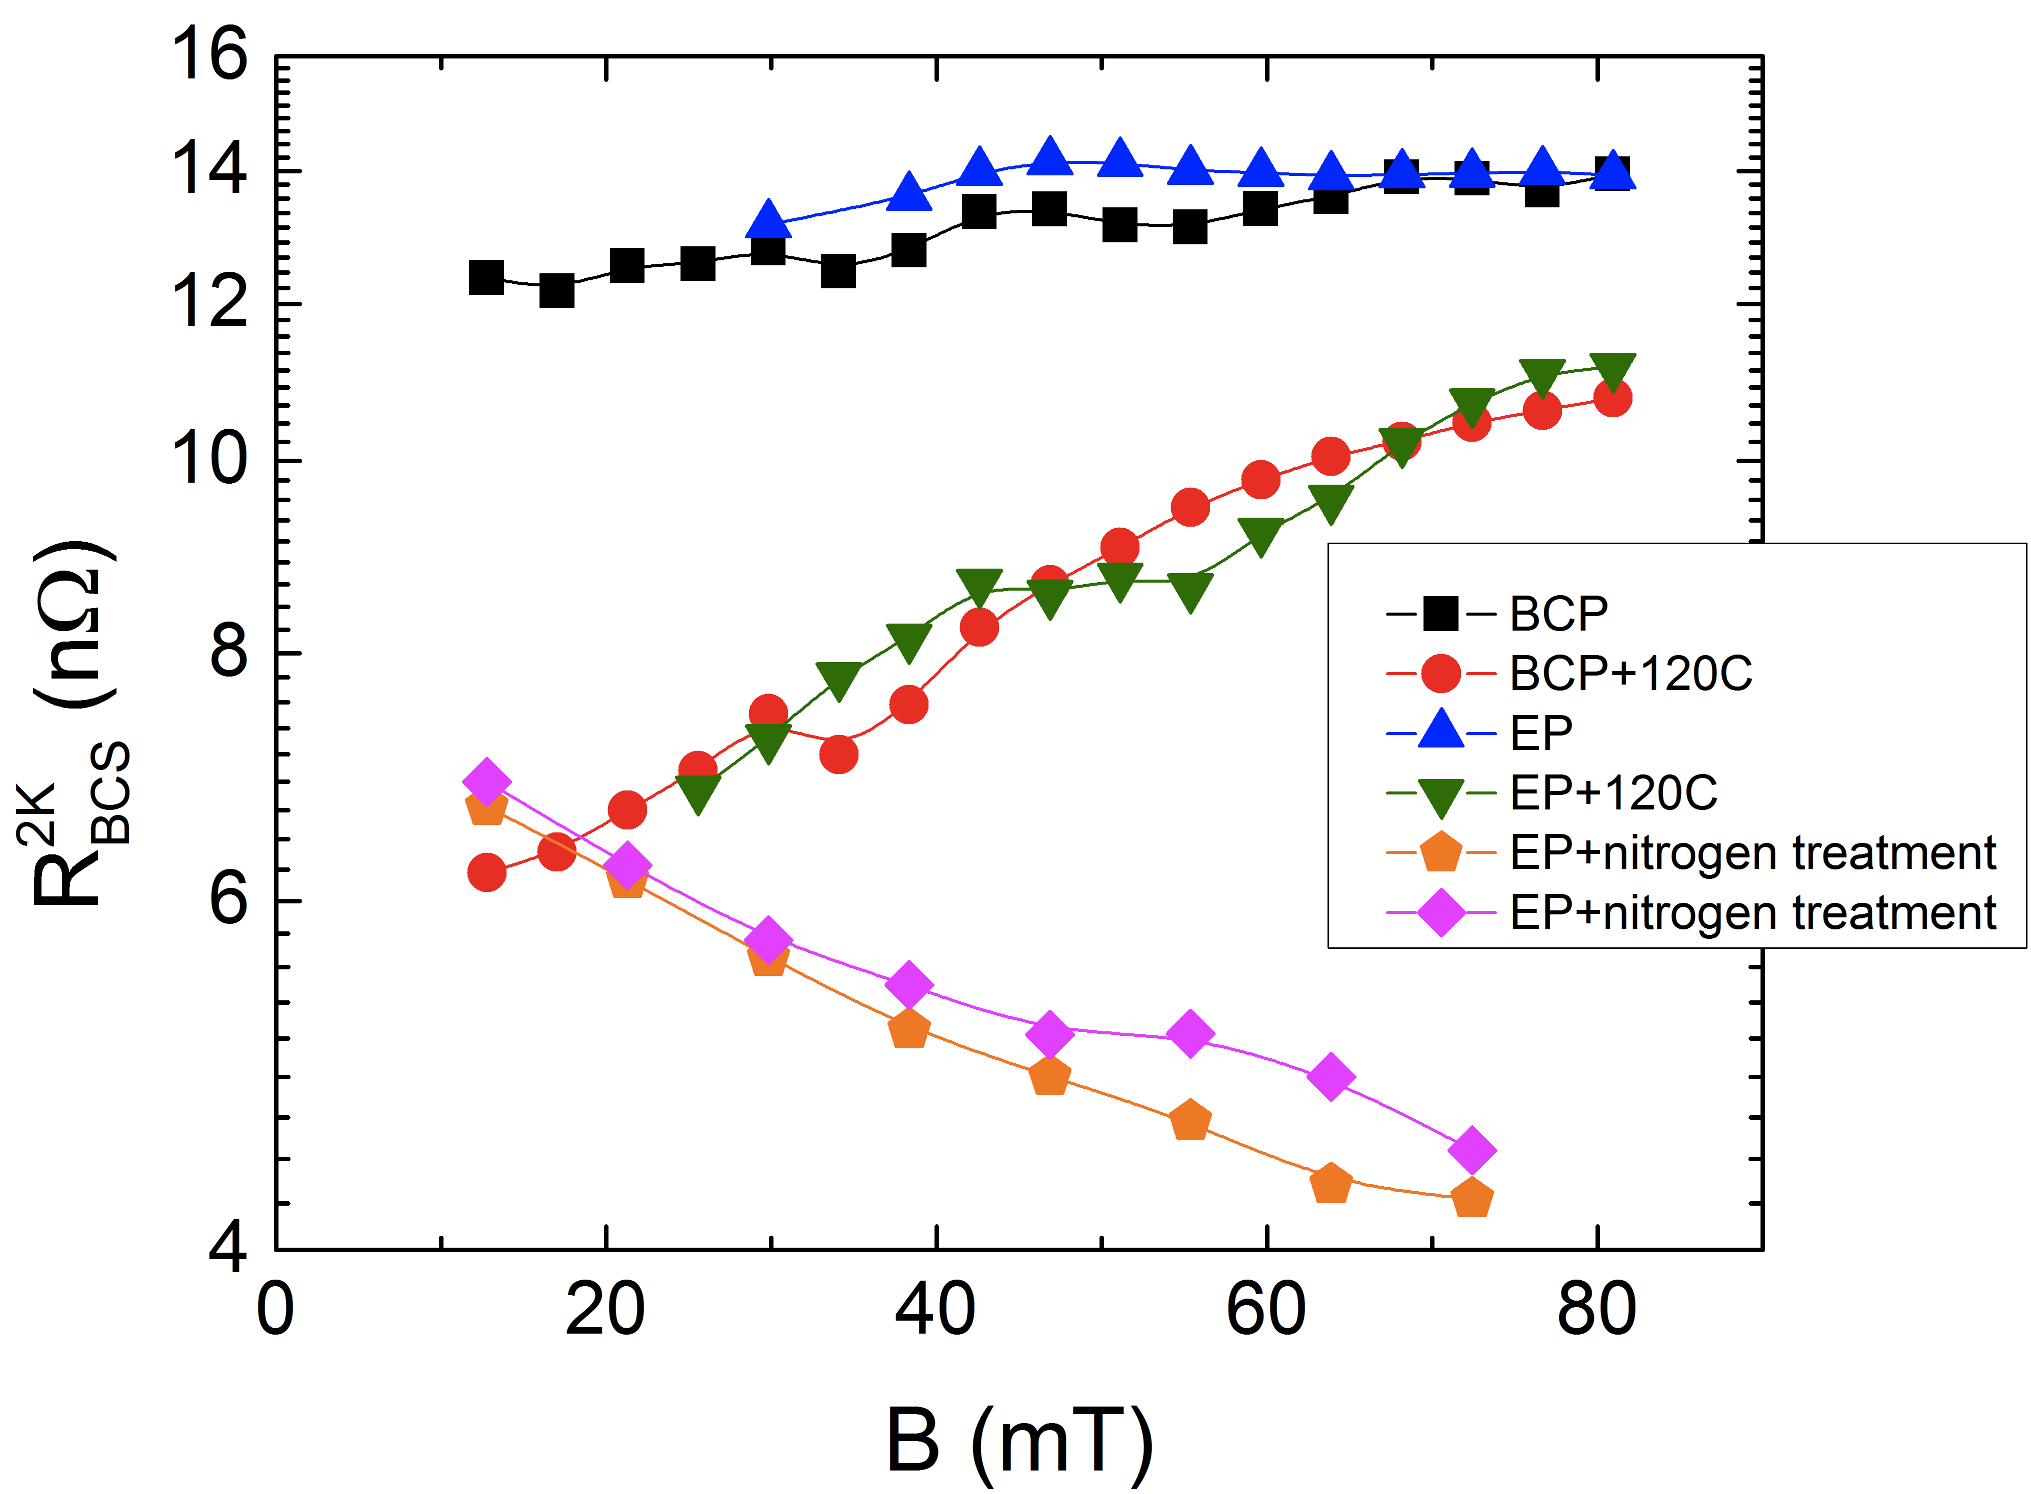
“Reversed” field dependence of R_{BCS}
R_{s}(T) = R_{BCS}(T)+R_{res}
Origin of the anti-Q-slope
A. Grassellino et al, 2013 Supercond. Sci. Technol. 26 102001 (Rapid Communication)
WG1 focused on this

Slide 6
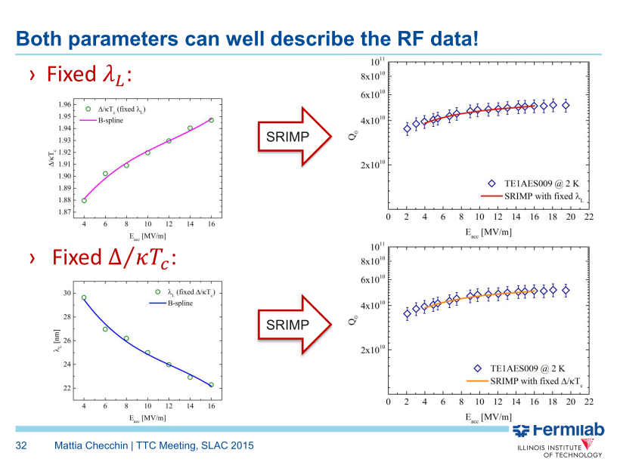
Fitting Rbcs by λ_{L} or Δ

Slide 7
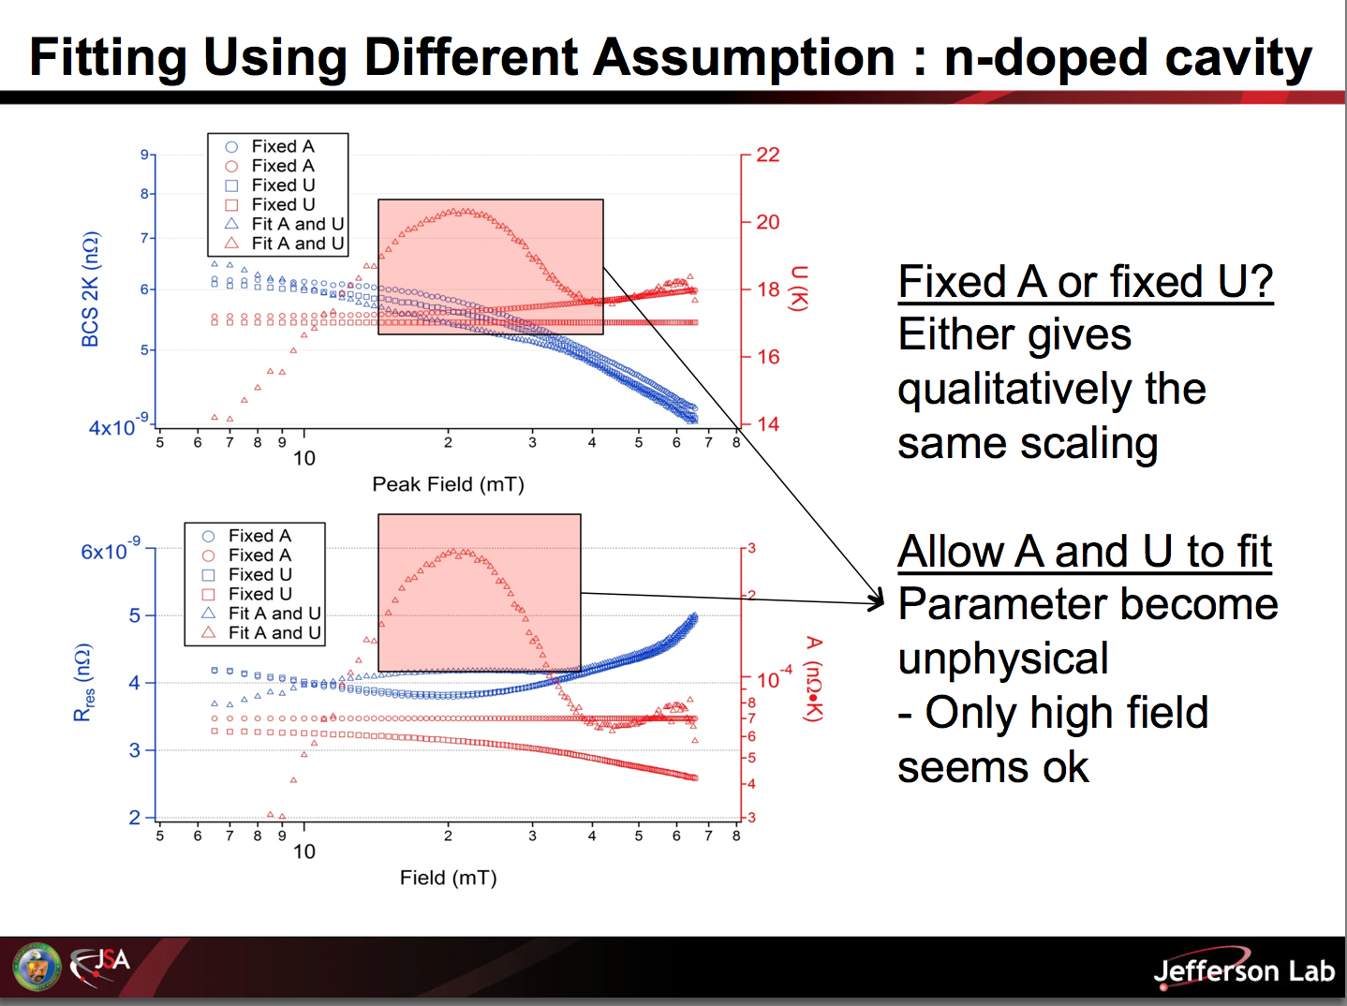
A. Palczewski (Jlab)
A. Palczewski

Slide 8
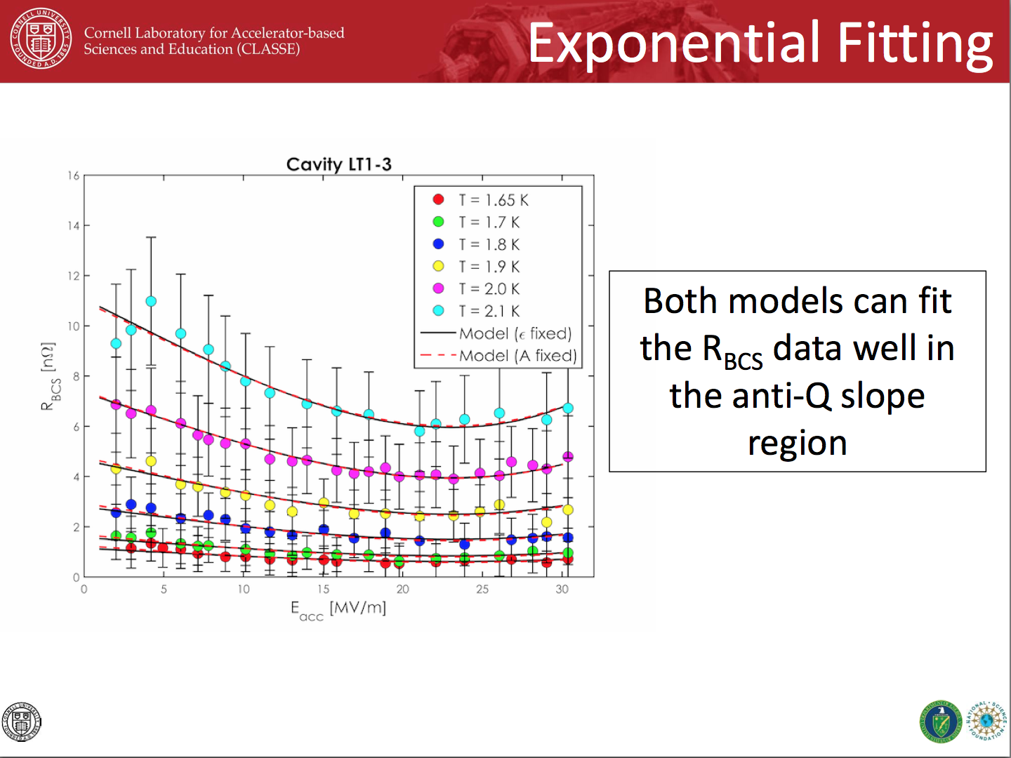
D. Gonnella

Slide 9
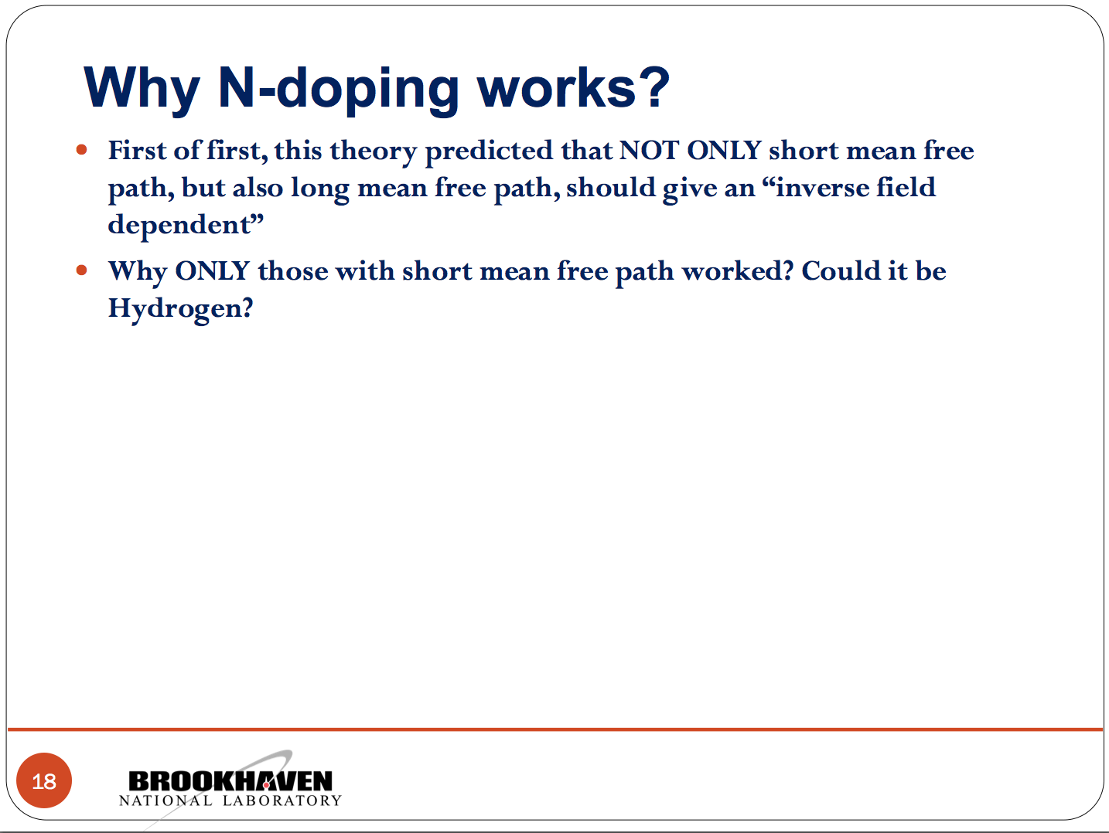
B. Xiao (BNL)

Slide 10
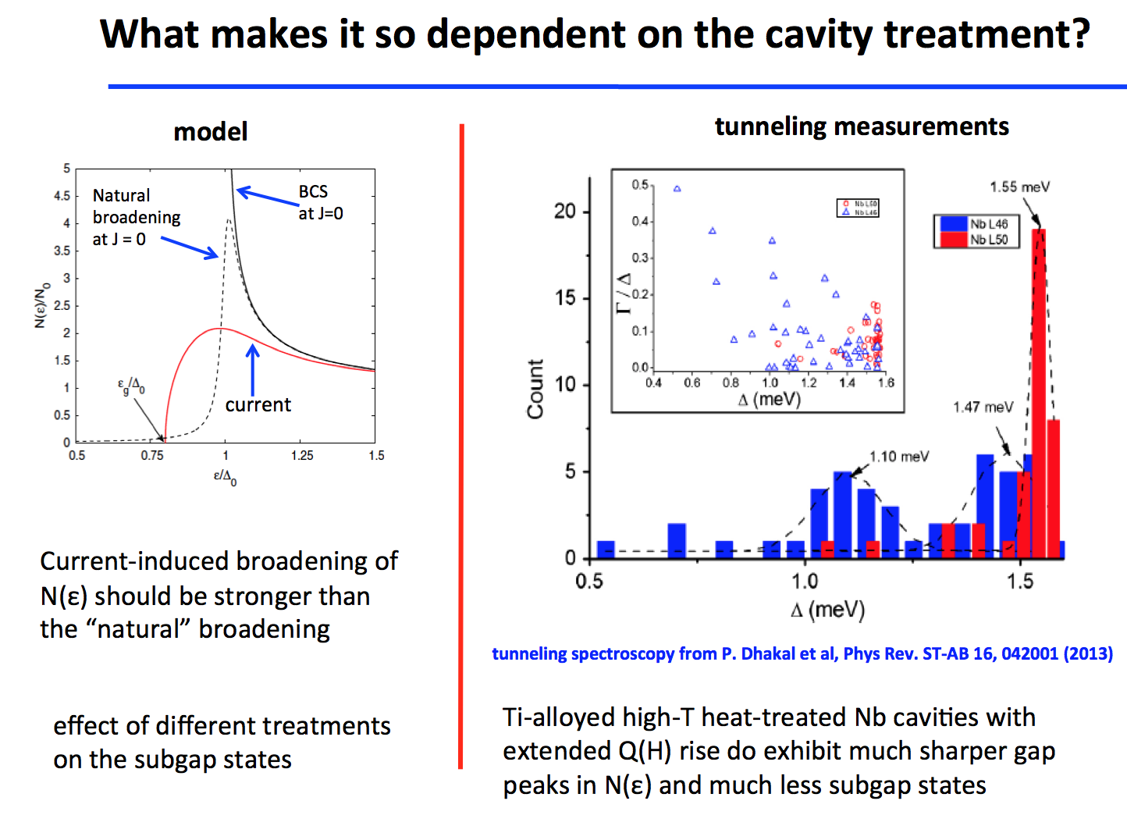
A. Gurevich (ODU)

Slide 11
N doping: conclusions
FNAL/Cornell/Jlab all in agreement that we can’t identify a single driving parameter (penetration depth, gap etc) behind Rbcs decrease with RF field based on the fitting of Rs(E, T) alone
Interesting models presented but cannot yet fully explain what distinguishes N doping
  From for example 120C baking which has even stronger mfp suppression
  Predicting anti-Q-slope as a general feature

Slide 12
WG1 – High Q – Magnetic flux management - contributions
What are the realistic magnetic environments we have to deal with?
  S. Chandrasekharan (FNAL)
We now understand that temperature gradient at the phase front is the main parameter for expulsion, why is it so?
  T. Kubo (KEK)
How does the material itself (bulk and surface) affect the flux expulsion?
  S. Posen (FNAL)
If the flux is trapped, how does its dissipation depend on the material properties (bulk and surface)?
  M. Martinello (FNAL)
What is the possible theoretical description of the observed trapped flux dissipation?
  A. Gurevich (ODU)
  M. Martinello/M. Checchin (FNAL)

Slide 13
Magnetic flux

Slide 14
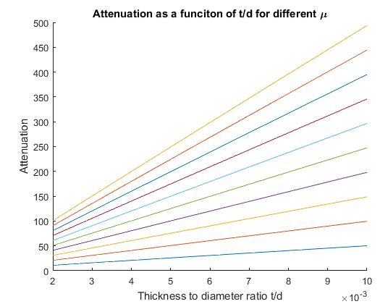
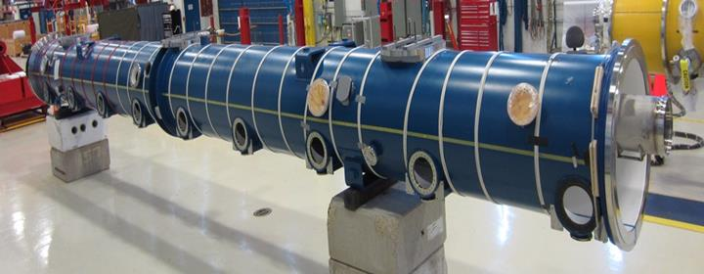
Chandrasekaran: Shielding ambient magnetic fields
Q₀ drives ambient magnetic field specifications
No available statistics on achieved magnetic shielding inside production CMs
Magnetic fields <10 mG not demonstrated in long cryomodules
  LCLS-II will be the first test bed for detailed studies
    Since we have eyes inside = fluxgates
Transverse field shielding relatively straight forward
Longitudinal field coupling of adjacent shields an issue
Active cancellation a proposed solution
Further shielding studies a must
Alternate magnetic field management currently required
Transverse shielding
Longitudinal coupling
End coils

Slide 15
Magnetic flux expulsion

Slide 16
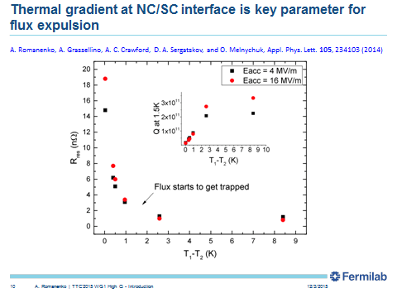

Slide 17
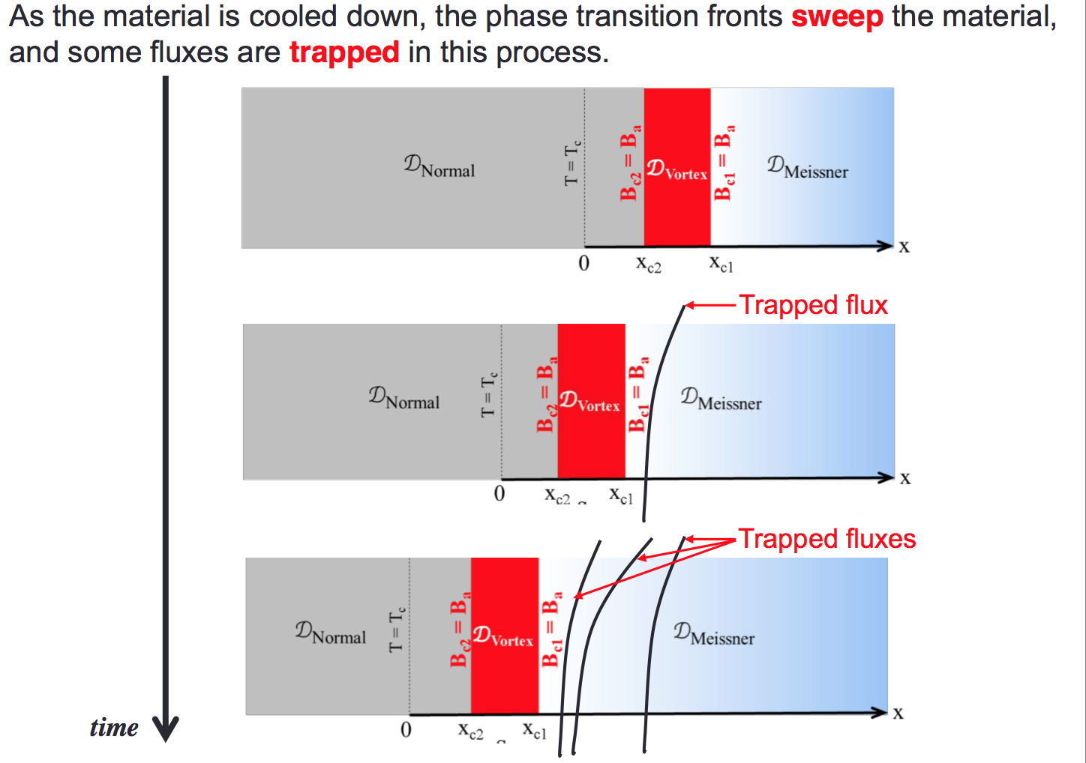
T. Kubo

Slide 18
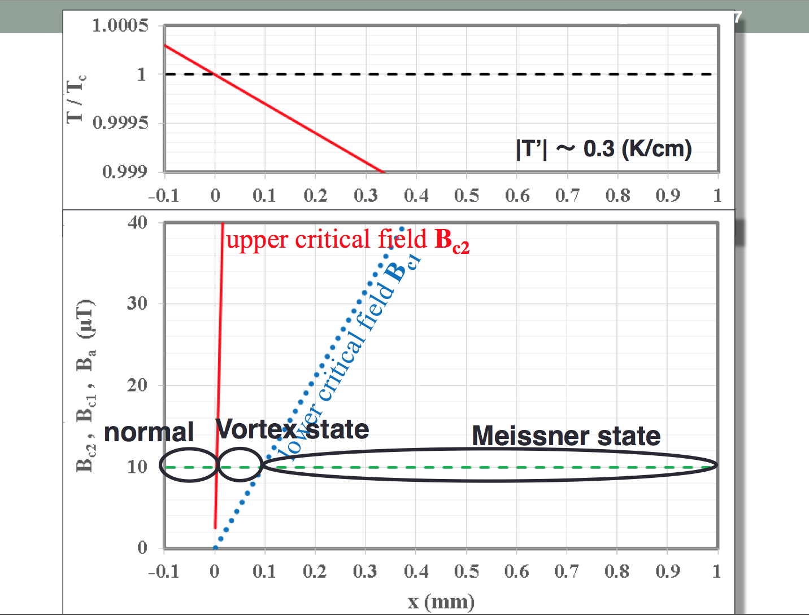

Slide 19
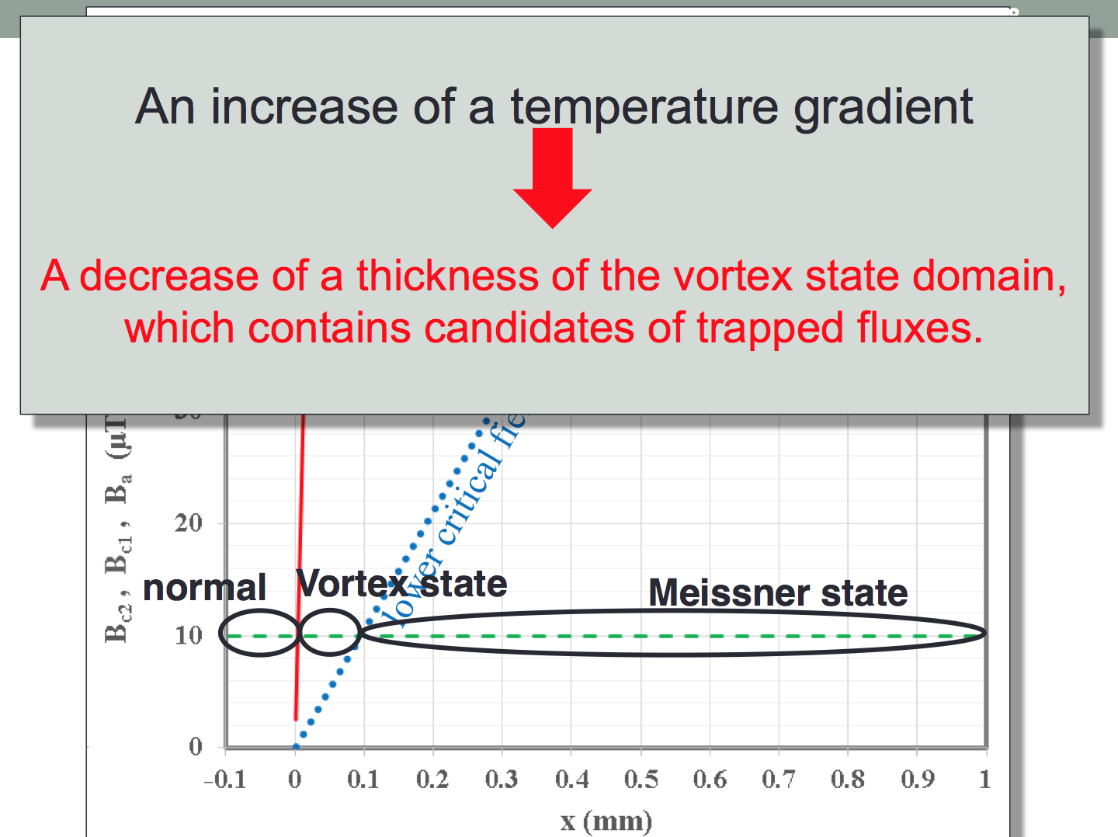

Slide 20
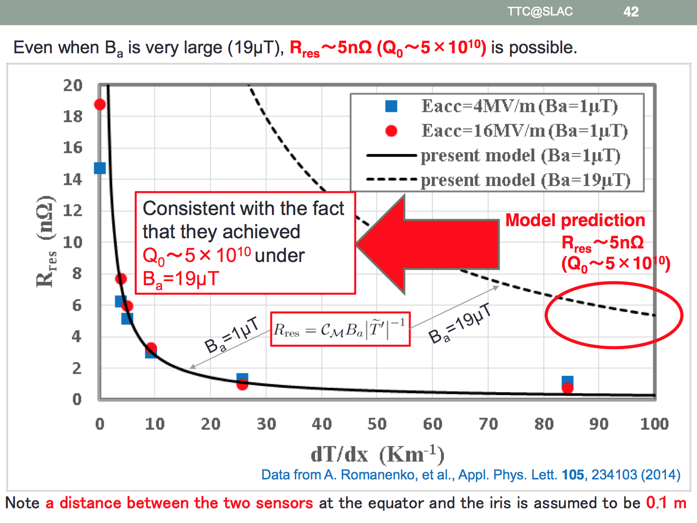
T. Kubo

Slide 21
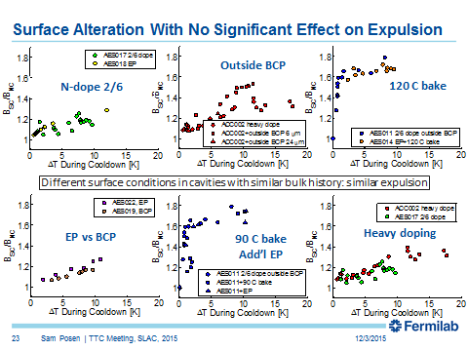
Flux management; expulsion of flux

Slide 22
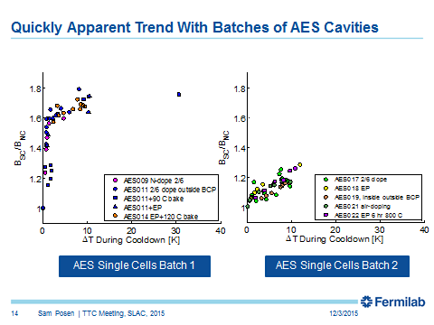
Flux management; expulsion of flux
Notes:
7:30

Slide 23
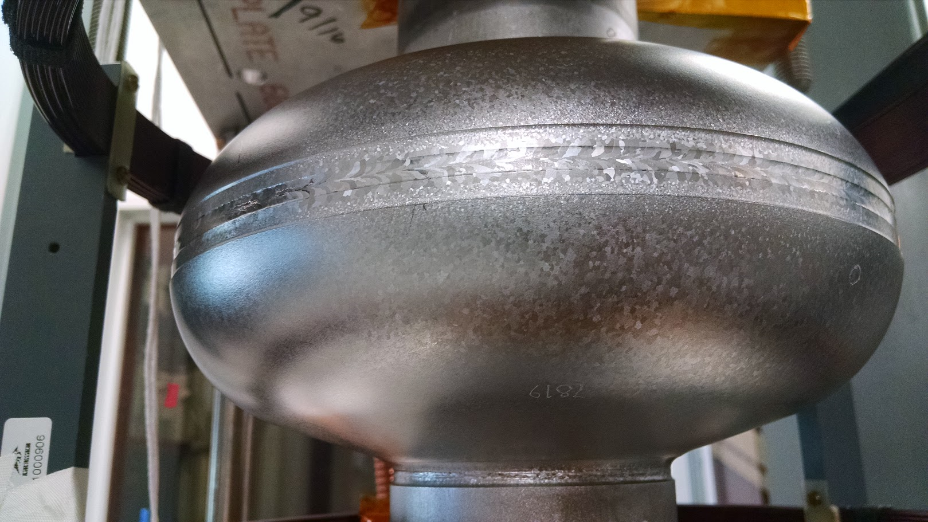
Conversion to From Poor to Strong Expulsion
Work is ongoing to optimize the “fix” and determine driving physics
Complete Expulsion
1000 C 4 h vastly improves expulsion
Complete Trapping

Slide 24
Sensitivity to trapped flux (how much is the dissipation per unit trapped)

Slide 25
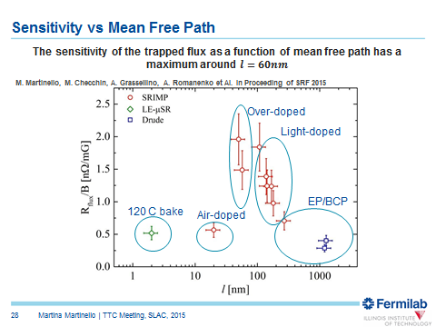
STRONG DEPENDENCE
Cavities with light N doped are not far from standard and optimization is not completed

Slide 26

Trapped Flux Sensitivity Field Dependence
M. Martinello, M. Checchin, A. Grassellino, A. Romanenko et Al. in Proceeding of SRF 2015
Sensitivity does have a field dependence
Lightly doped cavities have a smaller field dependence than EP
At high field the sensitivity of N doped might be comparable with EP

Slide 27
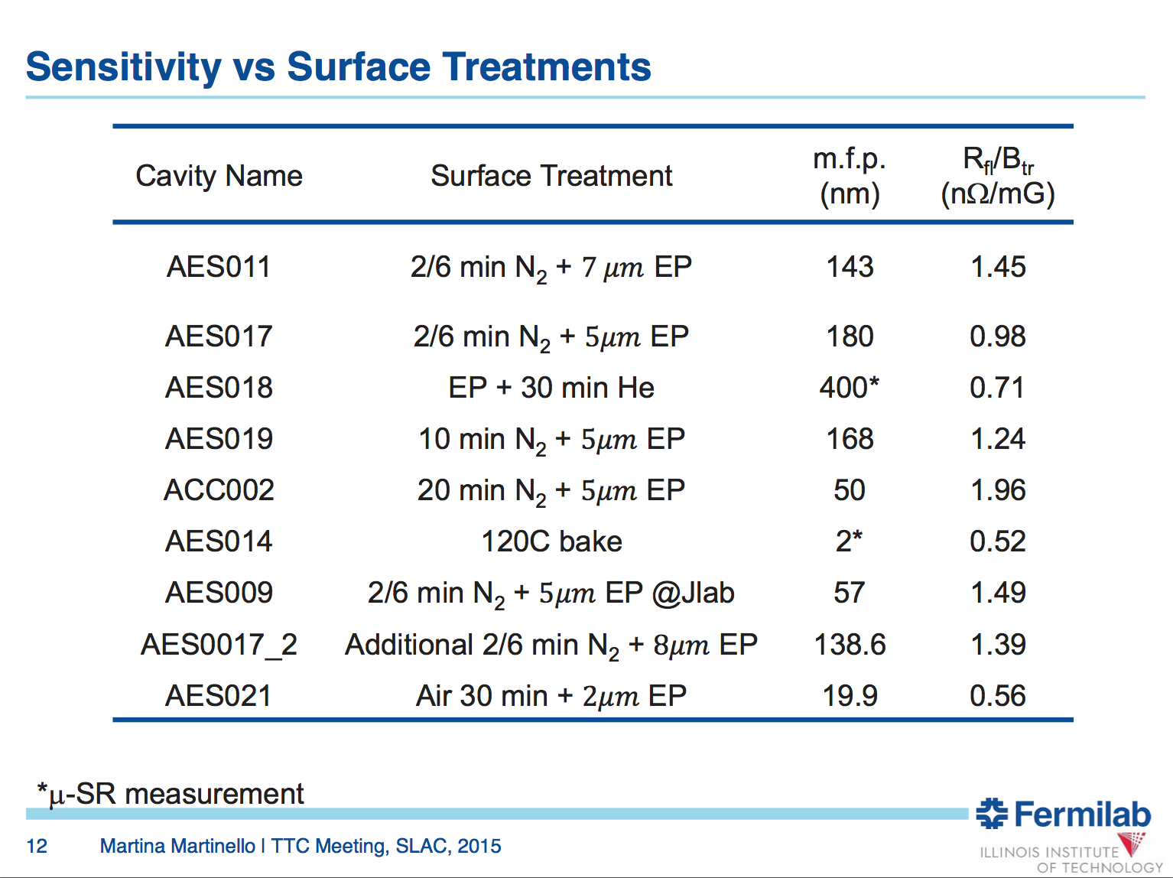

Slide 28
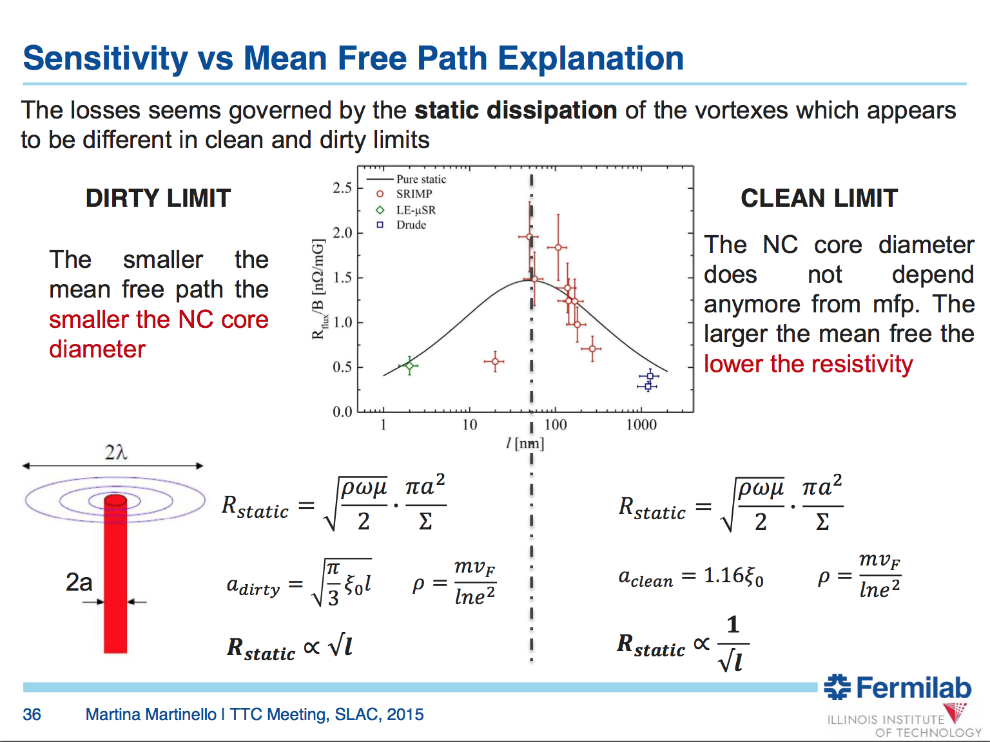

Slide 29
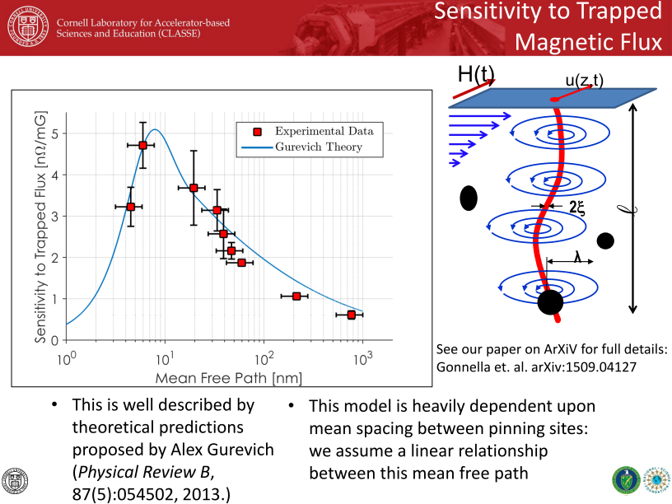
New data added since SRF => now in agreement with earlier FNAL findings

Slide 30
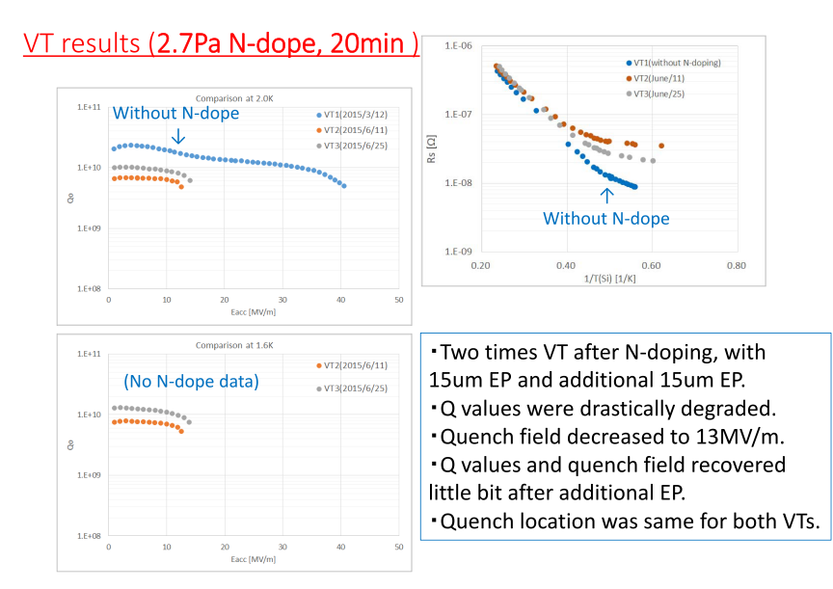
Flux management, lower Qo under larger ambient mag field

Slide 31
WG1 – High Q – summary
Conclusions on magnetic flux management
  Practical environments so far
    Not well known (no fluxgates inside)
    Have ~10 mG at best (from simulation)
    LCLS-II will be first test bed to lower magnetic fields in CM as much as possible
  How much is trapped (expulsion) does not depend on the surface treatment, determined by the bulk material state
    Larger thermal gradient always helping
    Some niobium “resists” expulsion more than the other
      Yet unclear if it is more dislocations, grain boundaries or maybe some bulk defect/impurity
    In those cases annealing at 800-1000C can improve the poor expulsion dramatically
      Need to establish the driving parameter
  Dissipation per unit of trapped flux is determined by the surface treatment
    Non-monotonous effect of mean free path is established and models successfully explaining it are on the table
    N doped cavities become less sensitive at higher fields as compared to standard treatments
      Sensitivity is also rf field-dependent

Slide 32
Conclusions
Significant and exciting progress on all aspects of high Q science
  Doping physics still unclear
    Agreement on impossibility tracing anti-Q-slope in Rbcs to one parameter (Palczewski, Gonnella, Checchin)
    Interesting models developed but still need further understanding (Xiao, Gurevich)
Magnetic flux management
    Simple and powerful theory of expulsion dependence on dT/dx is available (Kubo)
    Expulsion is driven by thermal gradients AND bulk properties (Posen)
    Dissipation per unit of trapped flux is driven by surface properties (Martinello, Checchin)
      Optimized N doping gives sensitivity close to standard at low fields
      Depends on the rf field, gets closer and may become better than standard upon increasing

