Slide 1
Working Group #4b SRF Cavity Tuners
Conveners Rocco Paparella, Yuriy Pischalnikov
TTC 2015, SLAC, December 3rd .

Slide 2
WG #4b Main focus on lessons learned
During process of the preparation for TTC workshop/requesting presentations conveners asked speakers to address instead of
Tuner description / design details / parameters / tests results
mainly following topics:
Tuner Reliability: problems, issues, strategies
from working machine → operational experience (SNS/CEBAF)
what components failed; how often; why?; how these failures can be avoid/what need to be change in design and/or in QC/QA
from machine under construction → reliability strategies
design decisions; selection of the components; ALT Accelerated Lifetime Test of components; assembly and testing of the tuners into CM.

Slide 3
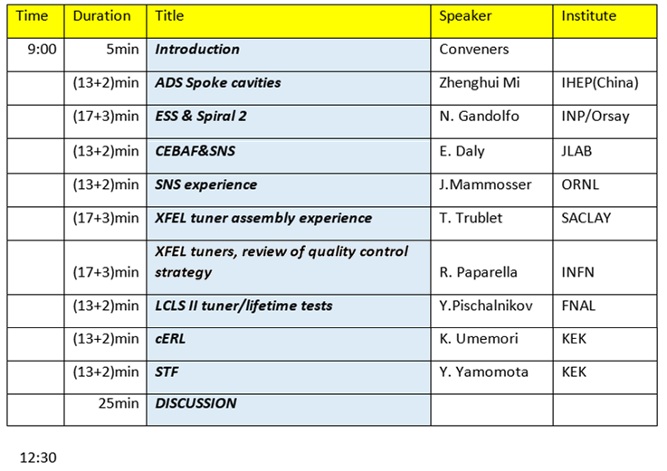
Final WG #4b Agenda

