Slide 1
LCLS II SRF cavity (1.3GHz) Tuner. Tuner Reliability R&D program at FNAL
Yuriy Pischalnikov
WG4, TTC2015, SLAC, December 3, 2015

Slide 2
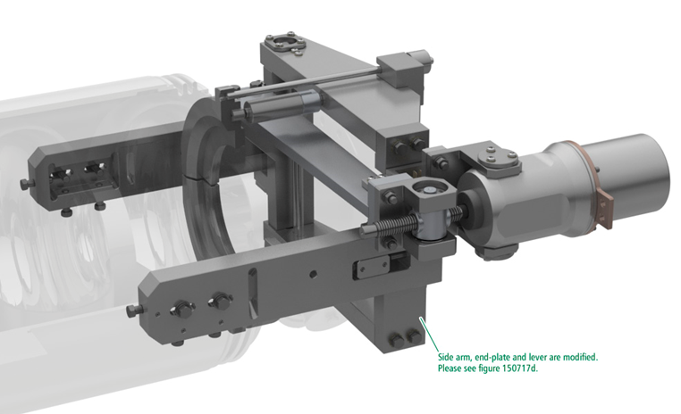
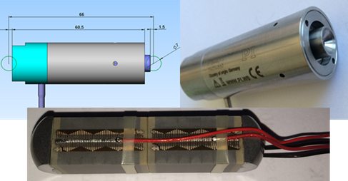
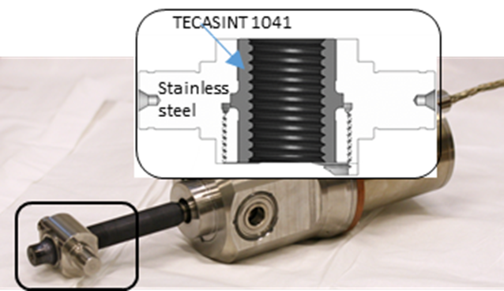
LCLS II SRF Cavity (1.3GHz) Tuner
3
Tuner designed in the way that active components can be replaced through special port
“DESIGN AND TEST Of compact tuner for narrow
bandwidth srf cavities “. IPAC2015
Coarse Tuner: double lever coarse (20:1 ration) similar to SACLAY-I tuner
Fine Tuner: two piezo-stacks installed close to cavity flange- direct translation of the stroke to the cavity
2
1
Designed by Phytron per FNAL specs
Encapsulated piezo P-844K075 made from two 10*10*18mm PICMA butted piezo-stacks.- built by Physik Instrumente (PI) per FNAL spec.
Electromechanical Actuator (LVA 52-LCLS II-UHVC-X1):
- Phytron stepper motor
- Planetary gear box (1:50)
- M12X1 spindle made form titanium
- Traveling nut made from SS with TECASINT-1041

Slide 3
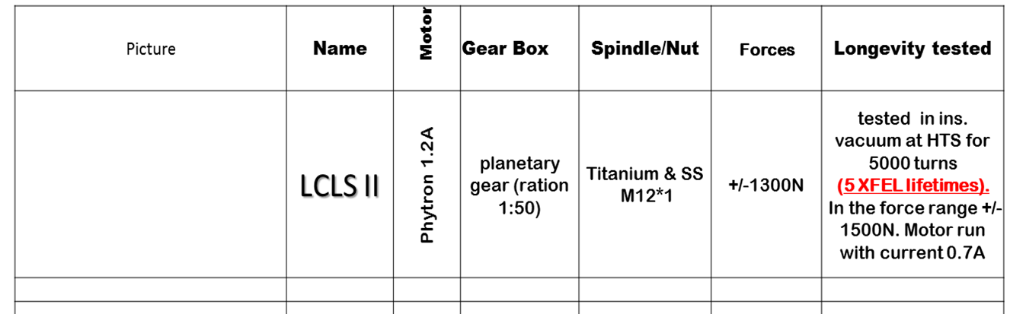
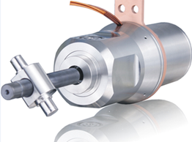
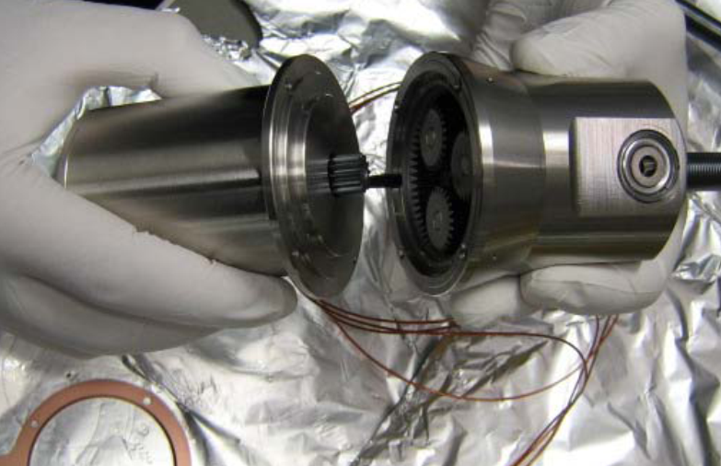
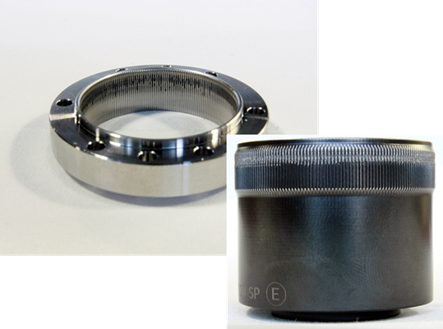
Electromechanical Actuator
Accelerated Lifetime Test
Estimations
~1,000 spindle rotation with piezo tuner
~20,000 spindle rotation without piezo tuner
3
1
2
Titanium spindle M12X1 with SS traveling nut with insert made from rad. hard material TECASINT 1041 (polyimide; fillers 30% Molybdenum disulfide (MoS2)
VS
CuBe spindle M12X1 with SS Nut
Planetary gear
vs
Harmonics drive

Slide 4
Piezo-tuner reliability/ lifetime R&D program (at FNAL as a part of LCLS II tuner design efforts)
Factors that can affect piezo-tuner lifetime :
Environment (warm .vs. cold)
- ( pros) - temperature, humidity, and voltage
- (cons) - transfer of the heat dissipated into piezo stack --- overheating piezo- ceramics at insulated vacuum environment
Shear forces on the piezo-ceramic stack (design of the fixture → “in-house design” vs “ industrial/experts design”);
Current Transients/ slew rate of the stimulus pulse (large acceleration applied to piezo-stack→ cracks→ HV breakdown)
design of the piezo-amplifiers with limited slew rate;
Radiation Damage.

Slide 5
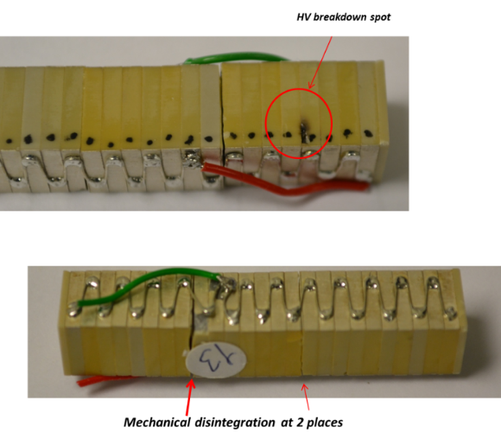
Shearing Forces on the piezo ----Piezo-stack capsulation Lessons Learned from CM2(FNAL); S1Global; SSR1(FNAL)
Piezo Ceramics stack is fragile system It can be damage very easily …
If design of the fast-tuner system done without taking into account “right” techniques.
Many “poor” fast/piezo tuner designs created “impression/opinions” that piezo tuner is not reliable system…

Slide 6
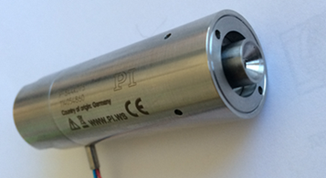
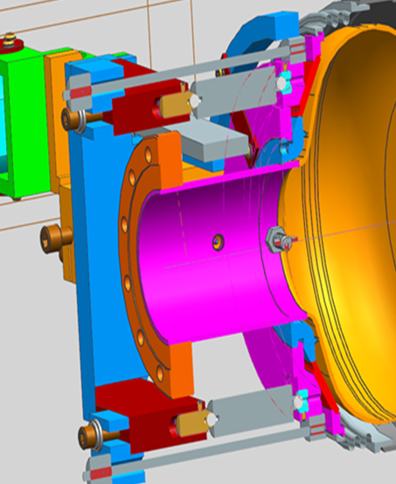
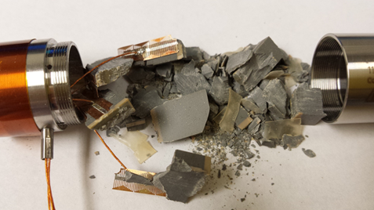
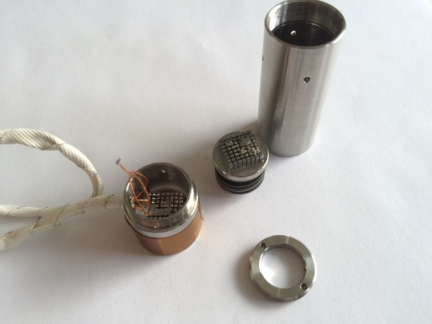
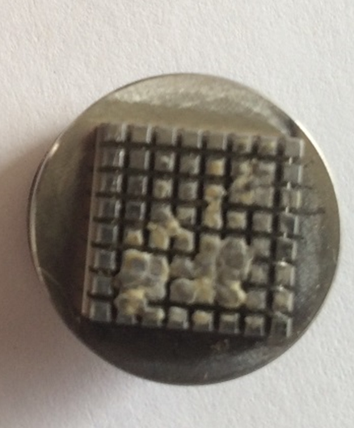
LCLS II piezo-stack ( designed and built in collaboration with PI )
Ceramics balls
Fixture with piezo-capsule was cool-down inside LN2, installed into INSTRON and measured S vs Forces
Piezo Survived 25kN test
2Piezo-stacks ==50kN (10kN requirements)
Crash
F> 2800kg
Internal preload (800N at 10-20K)
Minimization of the shearing forces
through balls connections
Piezo-ceramic stack glued to substrates (as recommended by all piezo companies)
PI using patented technology … taking into account different thermo-expansion coefficient for piezo-ceramics and stainless steel
316L stainless steel construction (High Q0 reqs)
Wiring with kapton insulation wires (rad.hard)
Piezo-ceramics
Stainless steel

Slide 7
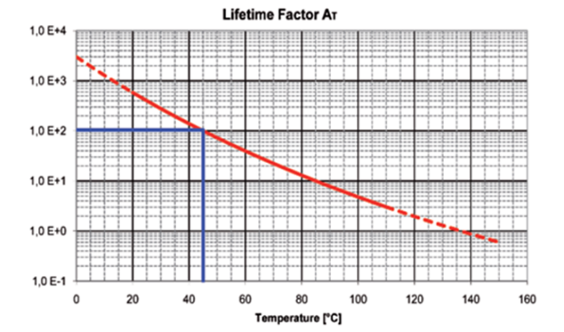
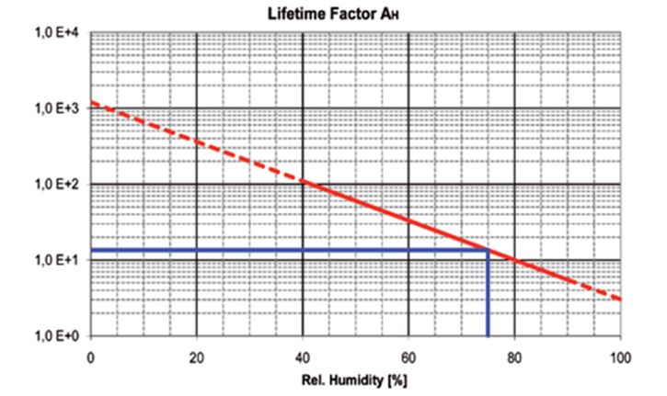
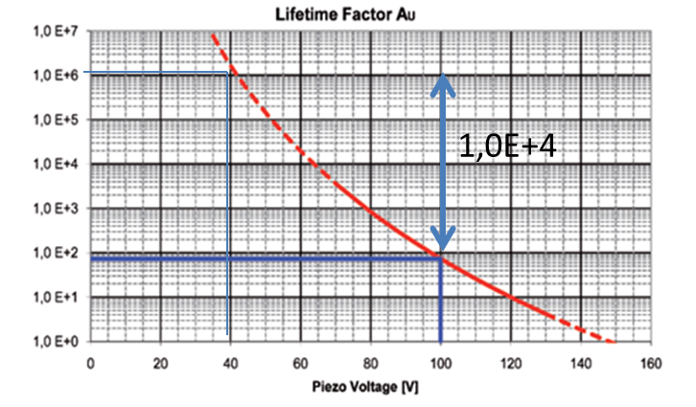
Piezo Tuner Lifetime (1)
In contrast with electromechanical devices , cold vacuum is an almost ideal environment for piezo actuators.
Voltage
Temperature
Humidity
With decrease voltage lifetime increase exponentially
Decreasing operational voltage from 100V to 40V will increase lifetime in 10,000 time.
Do not design piezo-tuner with assumption to run NEAR Vmax.
Selected longer piezo/ operate at lower possible V

Slide 8
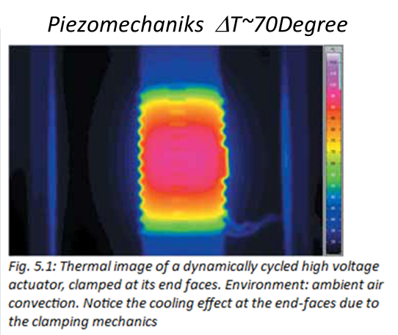
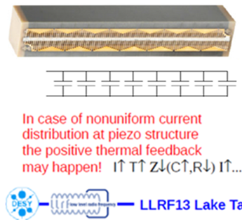
Piezo Tuner Lifetime (1)
In contrast with electromechanical devices , cold vacuum is an almost ideal environment for piezo actuators.
Voltage
Temperature
Humidity
…..cold vacuum is an almost ideal environment for piezo actuators… except the problems to heat transfer from piezo inside insulated vacuum…
With decrease voltage lifetime increase exponentially
Decreasing operational voltage from 100V to 40V will increase lifetime in 10,000 time.
Do not design piezo-tuner with assumption to run NEAR Vmax.
Selected longer piezo/ to operate at lower possible Voltage

Slide 9
Requirements to the piezo for operation in XFEL and LCLS II Impact on the longevity of the piezo
 |  | XFEL | LCLS II | FNAL-test-stand (2month)
 | Operation | 10 pulses/sec | CW | CW
 | stimulus pulse, Hz | 200 (2 sinewave per pulse) | 40 | 5000
 | Vpp, V | 120 | 2 | 2
 | piezo stroke,[um] | 5 | 0.2 | 0.2
 | number pulses for 20 years | 1E+10 | 2E+10 | 2E+10
 | total stroke of piezo for 20years, [km] | 60 | 5 | 5
 | Piezo-stack motion speed (rms) (mm/s) | 4.5 | 0.02 | 2.2
 | Piezo-stack motion acceleration (rms)(g) | 0.6 | 0.0004 | 7
 | Heat dissipation, [mW] | 90 | 0.05 | 6
 | Piezo ΔT raised | 20K | 0.1K | 2K
P_{av}=πCU²f *D, where D is dissipation Factor (~5-20%)
estimated
measured

Slide 10
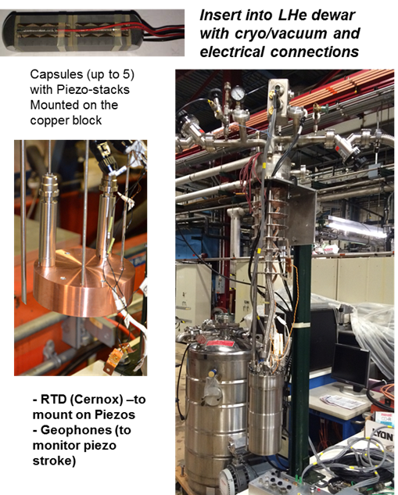
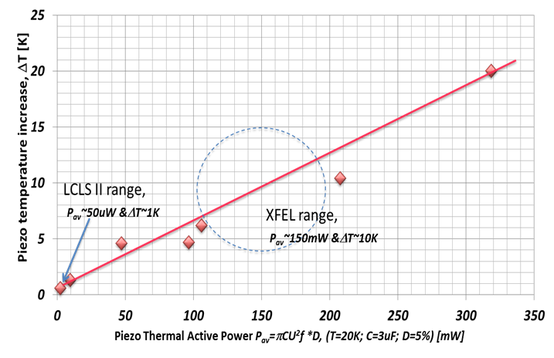
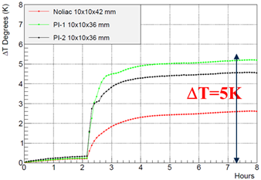
High reliability of tuner components (piezo-actuator) Accelerated Piezo Lifetime test at FNAL
Designated facility at FNAL to test piezo at the CM environment (insulated vacuum and LHe)
Accelerated piezo-stack lifetime test
2*10¹⁰ pulses (V_{pp} = 2V & F = 40Hz
20years → 2 month (40Hz→5kHz)
LCLS II --- P_{av}~ 50μW (40Hz, 2V) During ALT at 5kHz P_{av}~ 6mW (ΔT~2K)
Summary of the ALT “LCLS II Tuner piezo-stacks” test:
Temperature raised for just ΔT=2K even for ~100 times higher power dissipation than normal LCLS II operation
We run for 2.5*10¹⁰ pulses (or 125% of LCLS II expected lifetime) without any degradation or overheating

Slide 11
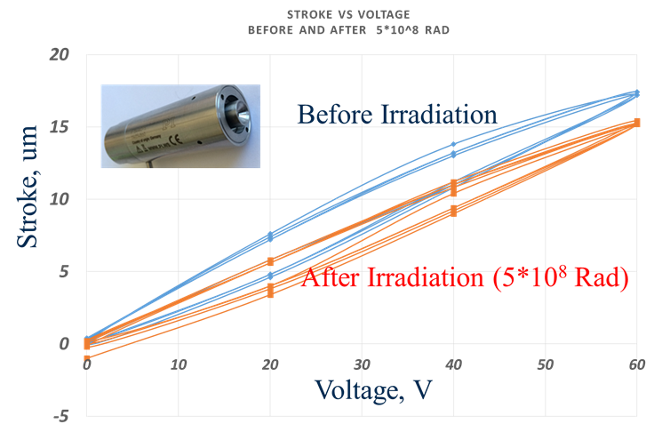
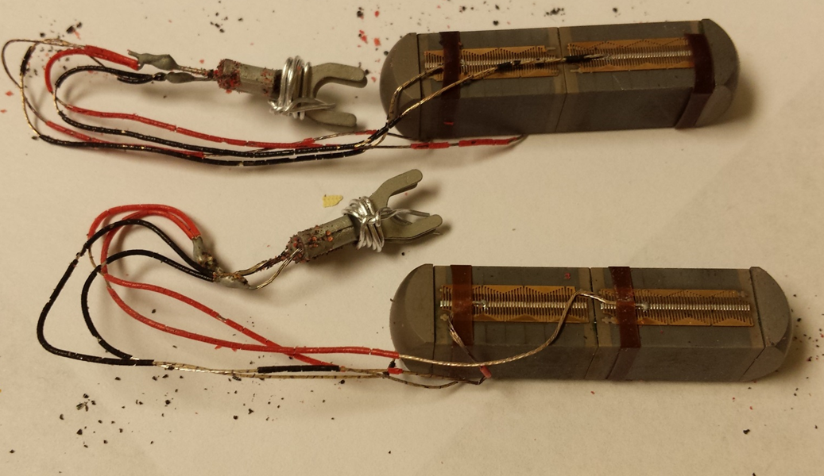
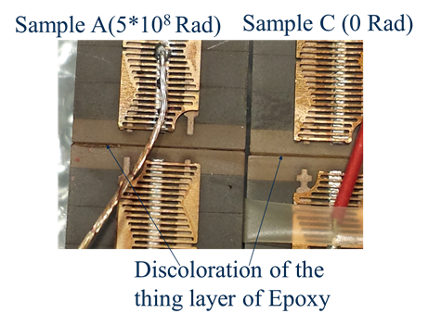
Irradiation of the Piezo-stacks up to 10⁹Rad (gamma)
Stroke of the piezo-stack decreased only on 10% after irradiation up to 10⁹ Rad

Slide 12
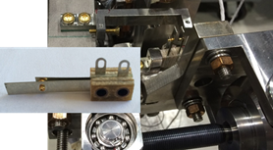
Radiation Hardness tests of the Electromechanical Actuator (up to 5*10⁸ Rad)
Phytron stepper motor internal windings after irradiation with dose 5*10⁸ Rad
Traveling nut on the Ti spindle. Schematic design of the nut made from the stainless steel with TECASIN-1041 insert. TECASINT 1041 is a high temperature polyimide with 30% MoS2. This material has excellent radiation resistance properties (1-10*10⁸ Rad ). ). Large radiation dose will cause material to “swell” [13]. This can lead to increased friction for Ti-spindle/traveling nut system. We conducted after-irradiation visual inspection and measurements of mechanical dimensions of the insert. No damages or size changes have been found.
There was no any degradation in the electromechanical actuator components:
Windings of the stepper motor
Limit switches
Traveling nut
Limit switches mounted on the tuner.

Slide 13
Summary
To insure reliability of the active components of the SRF cavity tuners:
(1) work with industry experts at the design stage
(2) order active components of the tuner at specialized company…
avoid as much as possible “in-house made” assembly of the electromechanical actuators and piezo-fixtures …
- lessons learned at FNAL (in course of CM2& S1G, etc.) –
how to build “non-reliable” tuner:
(1) buy separately stepper, harmonic drive in plastic bag, machine spindle and traveling nut, sent to specialized company for dry lubrication coating, assembly all components “in-house”
into “working (?)” actuator;
(2) buy piezo-ceramic stacks and installed (without internal preload & glue to substrates) into “in-house made” fixture

Slide 14
Summary of ALT and RadHard Tests during LCLS II tuner design/ design verification efforts
If it is possible design piezo-tuner to operate at voltage much less than Vmax. (decreasing voltage values are associated with exponential increases of lifetime)
Piezo overheating is not an issue (at least for LCLS II)
Electromechanical actuator has no any degradation of the performance after irradiation up to 10⁹Rad
PI piezo-stack (designed for LCLS II) lost ~10% of the stroke after irradiation up to 10⁹Rad

