Slide 1
LCLS-II Cryomodule Design
Technical Challenges
Joshua Kaluzny
December 1, 2015

Slide 2
Outline
Introduction
Large Dynamic Heatloads
Liquid Helium Management
Cooldown to Preserve High Qo
Thermal Cycle to Reset Qo of Cavities
Instrumentation
Summary

Slide 3
Introduction - Layout
Thirty-five 1.3 GHz 8-cavity cryomodules
Two 3.9 GHz 8-cavity cryomodules
Four cold segments (L0, L1, L2 and L3) which are separated by warm beamline sections.

Slide 4
Introduction - CAD model
From Yuriy Orlov

Slide 5
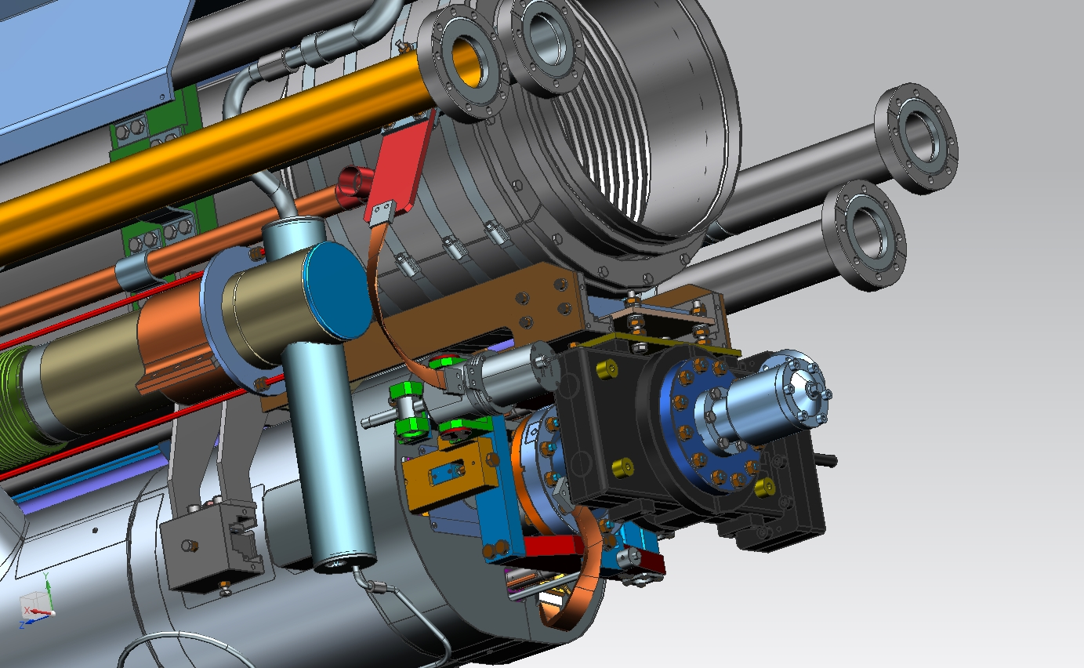
Introduction - CAD model

Slide 6
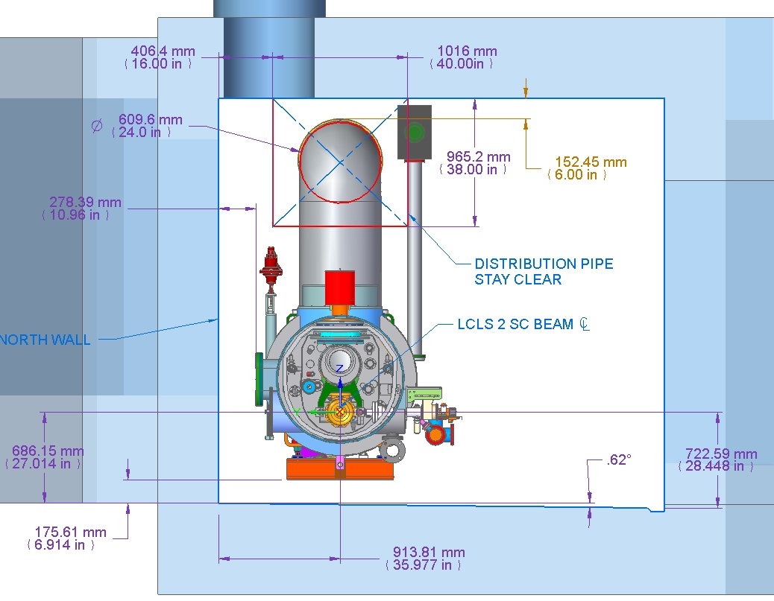
Introduction - SLAC Tunnel
Tunnel size: 10x11 Feet
Tunnel slope: 0.5%

Slide 7
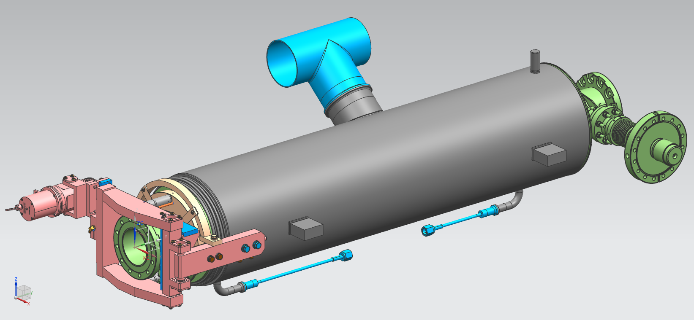
Large Dynamic Heatloads - CW operation
CW operation of cavities
80-150 watts per cryomodule
RF compensation heaters
25 watts per cavity
Eliminated 5K shield
Marginal value due to large heatloads
Increased chimney size to 4 inch tube (~100mm)

Slide 8
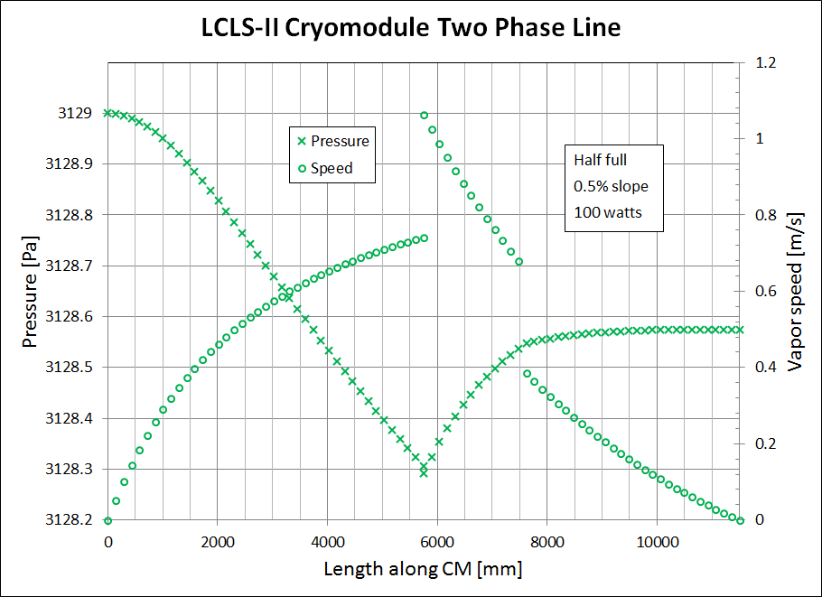
Large Dynamic Heatloads - Two-phase Pipe
Increased size of two-phase pipe to 4 inch tube (~100mm)
Reduces vapor velocity
Connection to GRP in center
Reduces vapor velocity

Slide 9
Liquid Helium Management
Manage liquid and vapor within and between cryomodules
0.5% slope
Magnet end lower and therefore a higher liquid level
Two-phase pipe closed at each end of the cryomodule
Allows for each cryomodule to have different liquid level
Two-phase vapor analysis
Slope and varying surface area accounted for
Cooldown line closed in cryomodule
Prevents liquid transfer from one cryomodule to another
Connection to GRP in center
A downhill connection would have made the connection too low

Slide 10
Liquid Helium Management

Slide 11
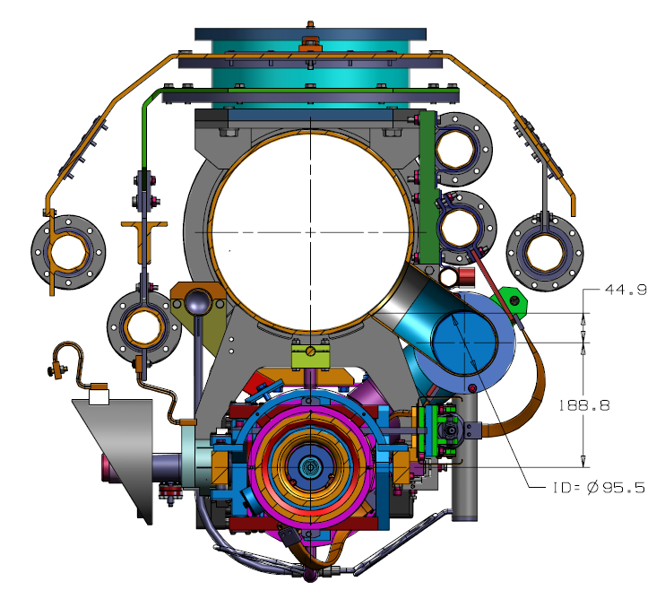
Liquid Helium Management
Increased two-phase pipe size
Cover cavities but not spill into HGRP
Full 2-phase pipe
just starts to spill into
the HGRP
Two-phase pipe is half full at connection to HGRP

Slide 12
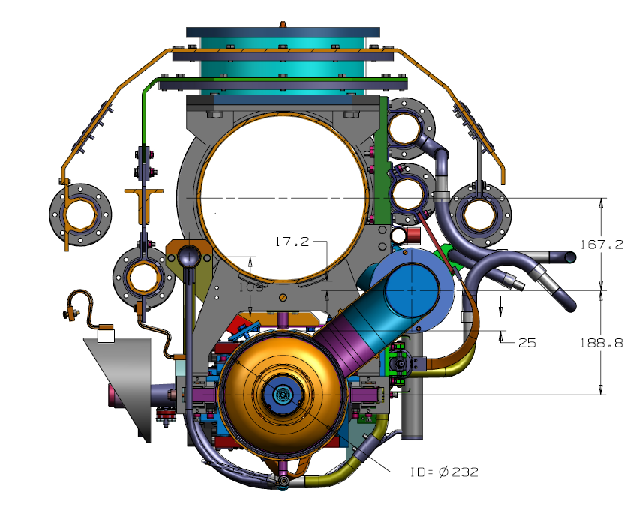
Liquid Helium Management
Bottom of two-phase pipe is above top of helium vessel
The cavity is covered when there is liquid in the two-phase pipe

Slide 13
Liquid Helium Management
Connection from two-phase pipe to HGRP
650 mm upstream of center

Slide 14
Cooldown to Preserve High Qo – Mass Flow Rate
Fast cool-down of a single cryomodule involves replacing ~200 liters of helium volume as quickly as possible.
A “fast” cooldown is 2-3 K/min
Start at 50 K and replace in 13 min
Flow into the cryomodule at 15 liters/min = 31 g/s liquid helium per cryomodule
~2 liters/min for each helium vessel
Cryoplant can produce ~130 g/s in liquefier mode
Can cool ~4 cryomodules at 31 g/s
May be able to use plant liquid storage to cool more than 4 cryomodules at once

Slide 15
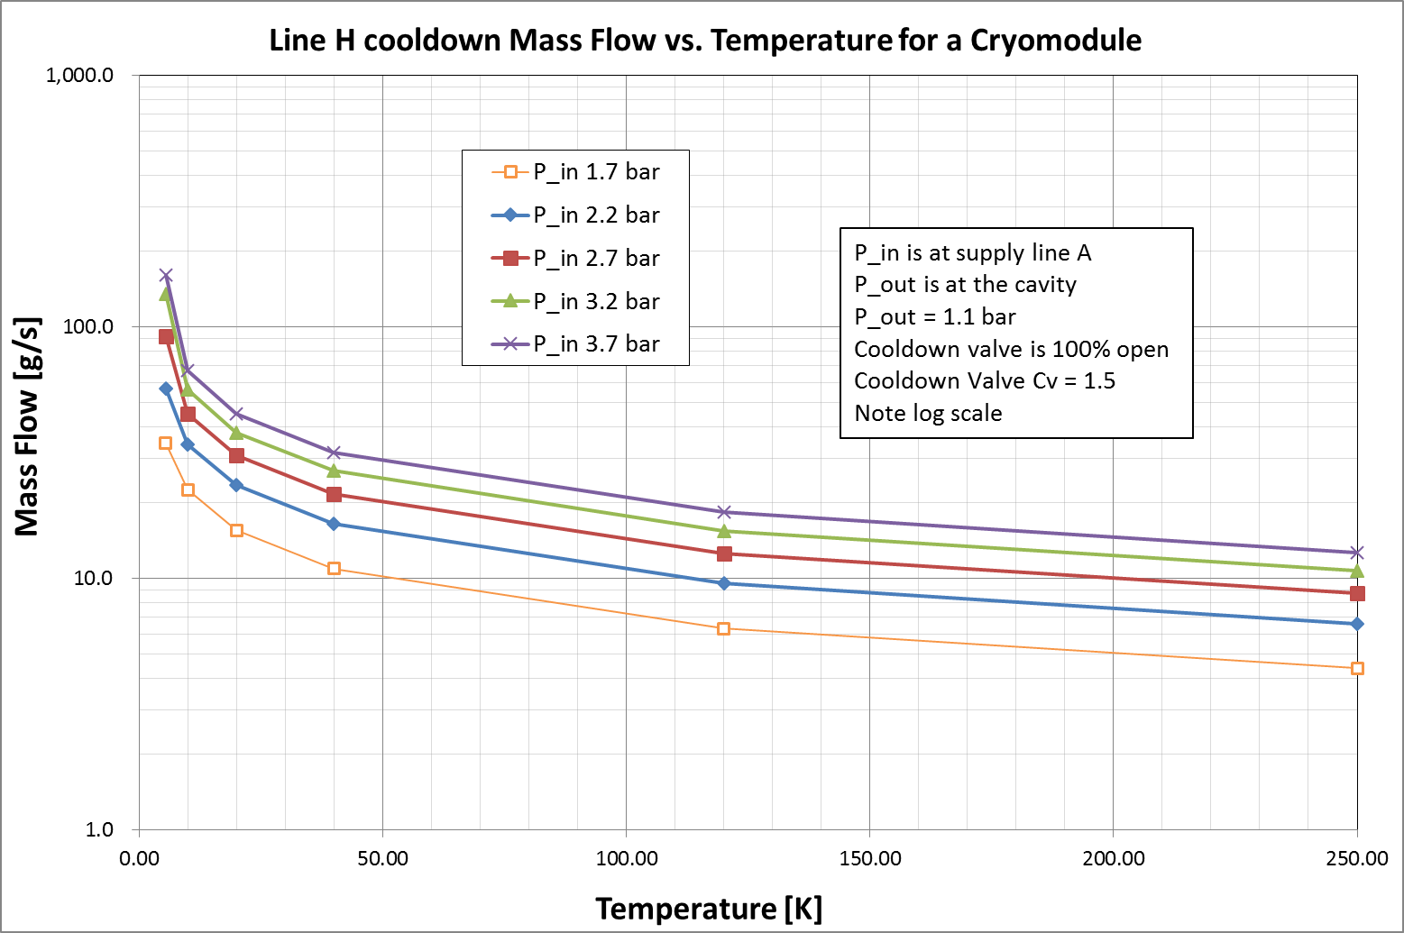
Cooldown to Preserve High Qo – Mass Flow Rate
Maximum mass flow rate in cooldown circuit (line H)

Slide 16
Thermal Cycle to Reset Qo of Cavities
Cavity can trap flux during quench
Thermal cycle above transition to reset Qo
RF compensation heaters on each helium vessel and/or liquid level can heaters could be used to burn off liquid

Slide 17
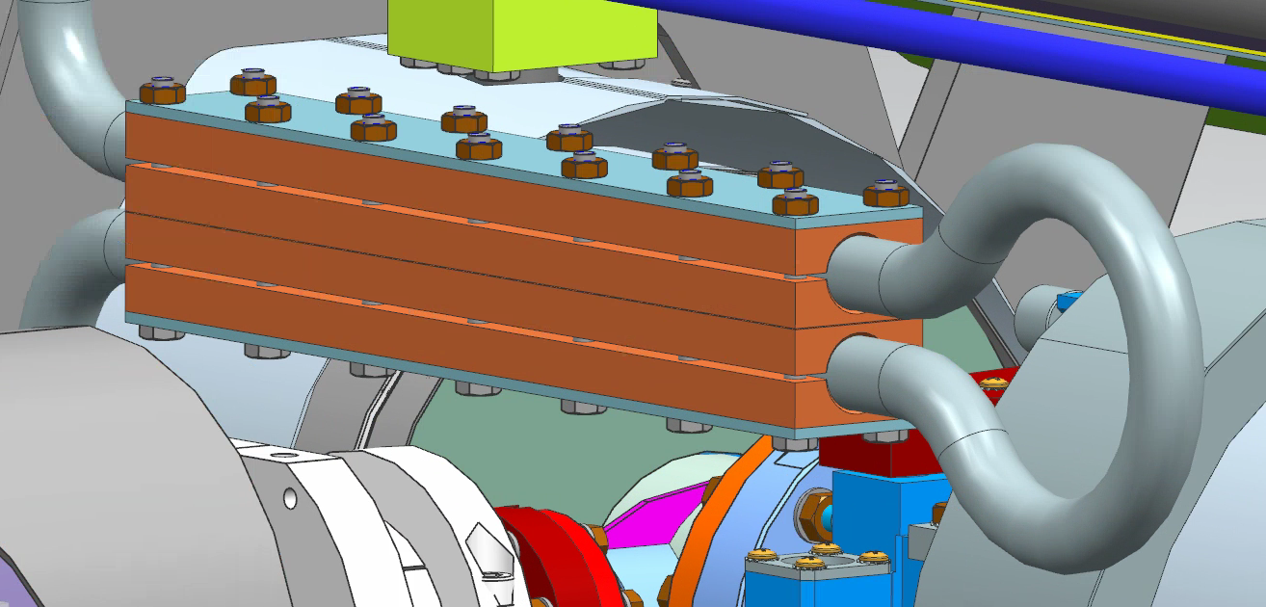
Thermal Cycle to Reset Qo of Cavities
Cooldown valve allows 0.5 g/s flow
15% valve position with 1:1000 eq% profile
150 W heater to raise temp of low flow gas to ~50K

Slide 18
Instrumentation
Prototype cryomodules well instrumented
Including sensors inside helium vessels
No cold flanges or feedthroughs
capillary tube to bring wires to warm feedthroughs
Sensors in helium vessels
4 cavities per prototype cryomodule instrumented
4 cernox sensors wired
2 fluxgate sensors

Slide 19
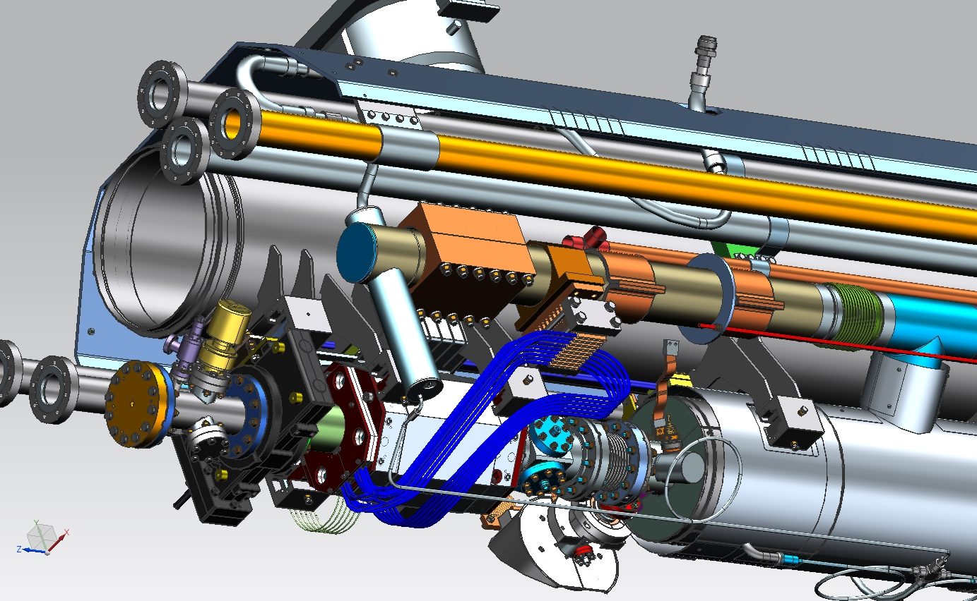
Instrumentation - Capillary Tube

Slide 20
Summary

Slide 21
Acknowledgments
This presentation includes information from many people at Fermilab, Jlab, and SLAC involved in cryomodule design, cryogenic distribution design, and overall cryogenic system design.
Special thanks to Tom Peterson, Camille Ginsburg, Chuck Grimm, Elvin Harms, Yun He, Arkadiy Klebaner, and Yuriy Orlov who provided information and slides for this presentation.

Slide 23
Backup slides - Additional information

Slide 24
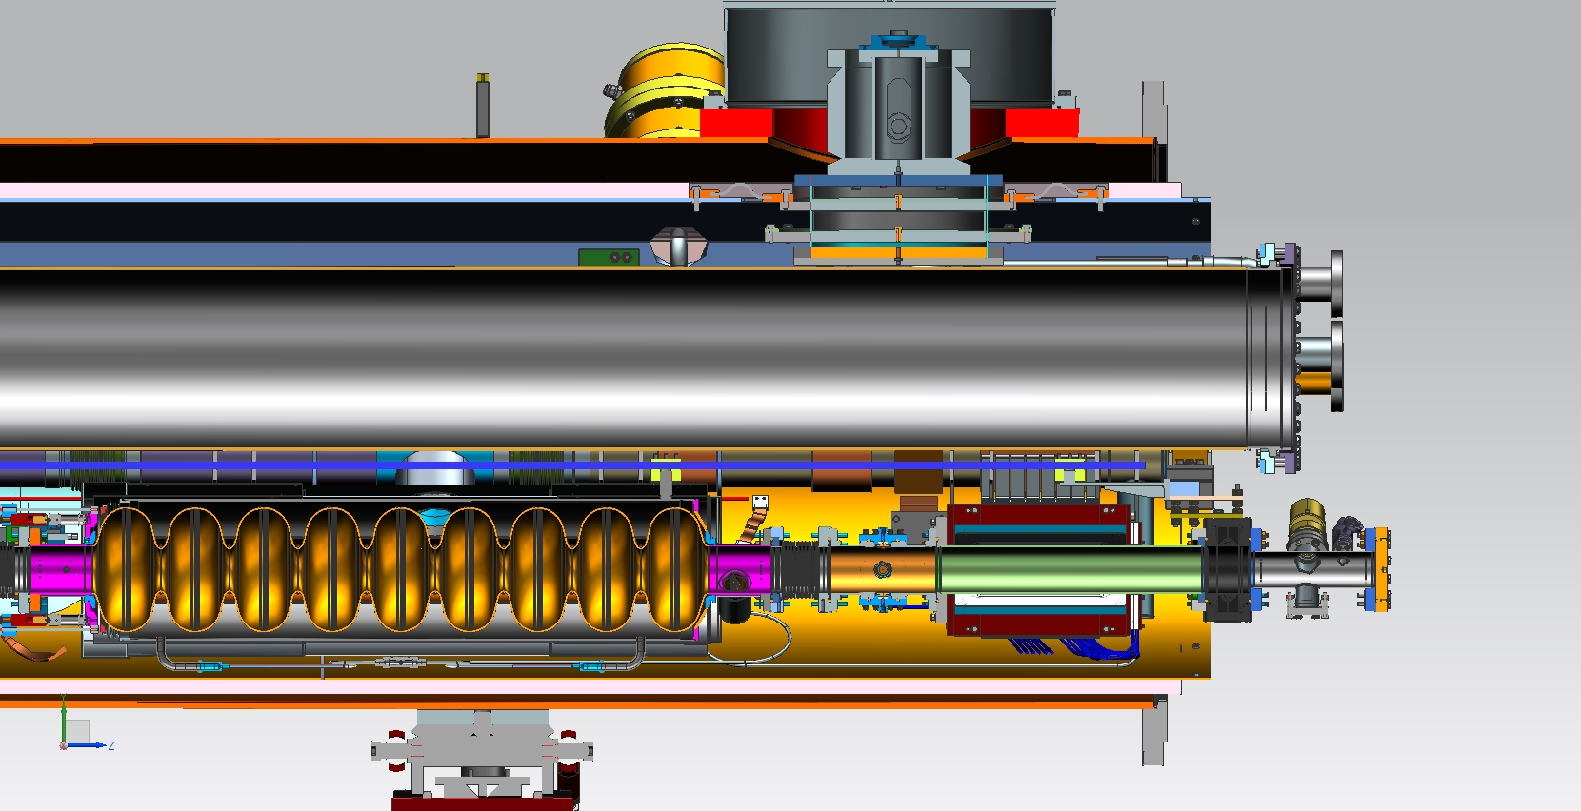
Downstream end with magnet and BPM

Slide 25
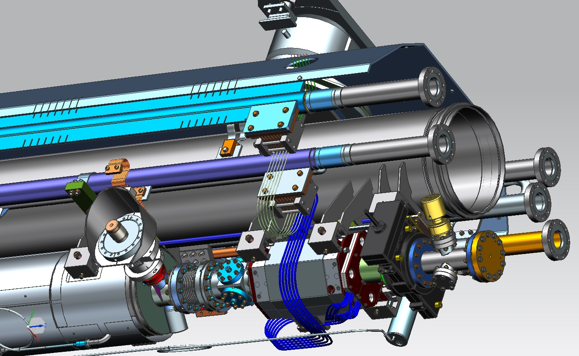
Another view, from the aisle side

Slide 26
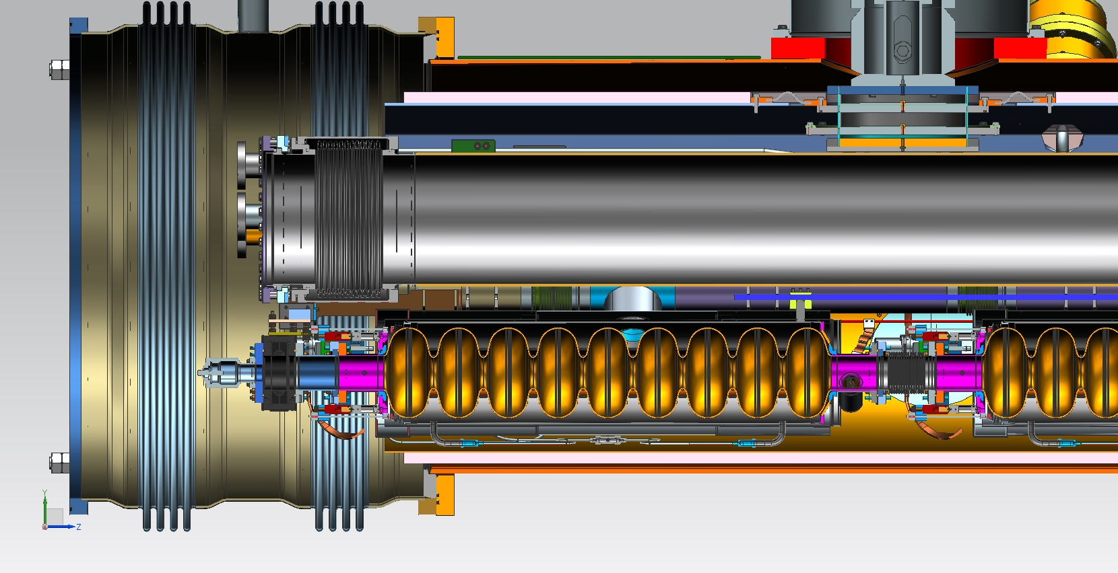
Upstream end, receives the sliding vacuum bellows

Slide 27
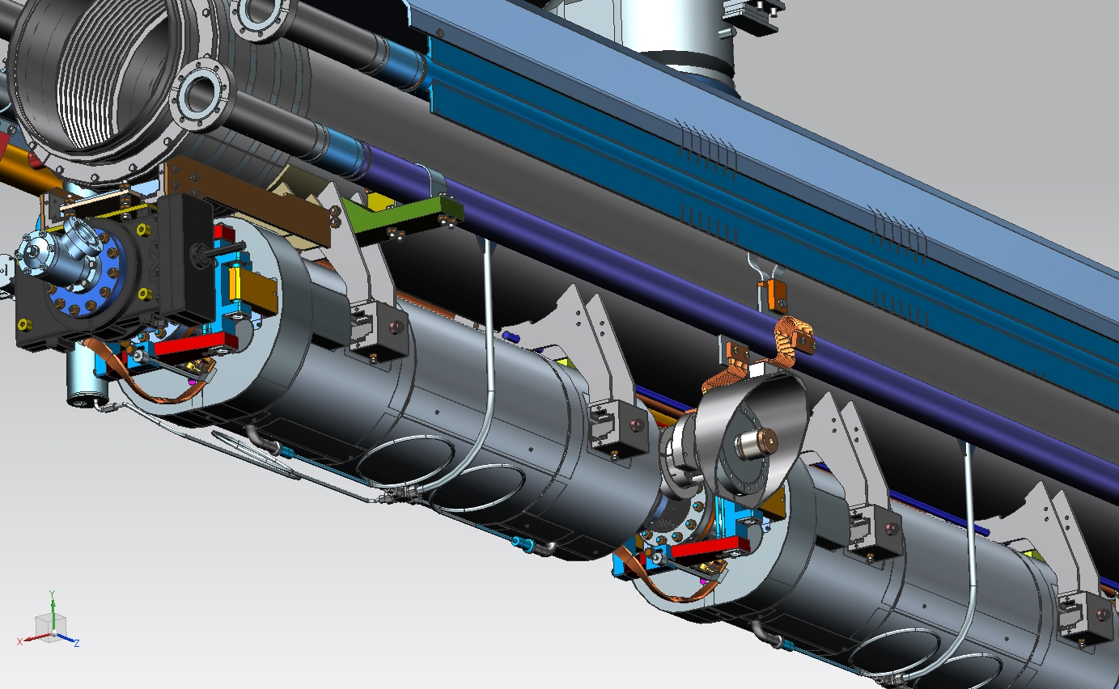
Upstream end

Slide 28
All the dimensions,
for reference

Slide 29
TESLA-style cryomodules compared

