Slide 1
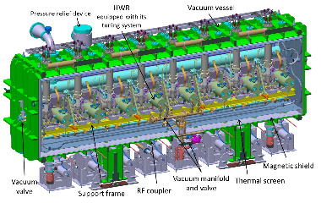
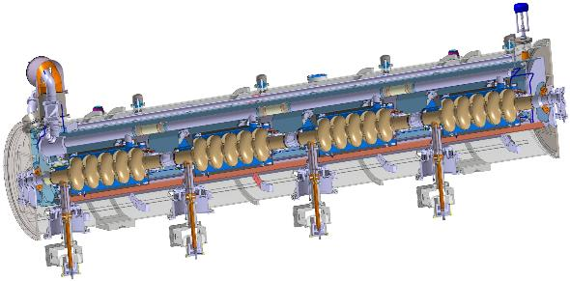
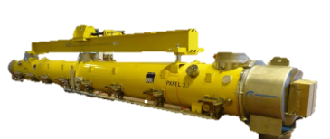
Lessons learned from cryomodule assembly toward future projects
other talks on WG3 By T. Trublet and S. Berry, WG4 by H. Jenhani
TTC 2015| Catherine MADEC

Slide 2

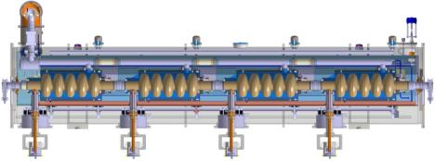


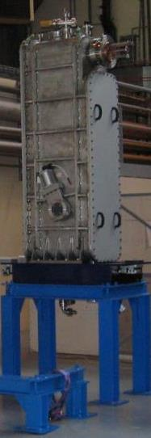
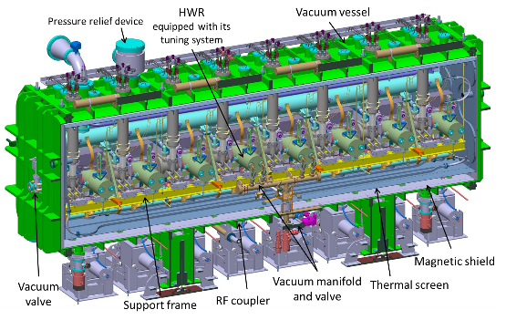



Cryomodules assembly at CEA
Booster
MACSE
SOLEIL
TTF
SPL
SPIRAL 2
ESS,
SARAF,
IFMIF
XFEL
100
30
3(+1)
12
E
B
λ/4
1

Slide 3
SRF dedicated INfrastructures
Clean rooms
CourtYard
Assembly halls
Labs
Warehouse
Chemistry
Cryo-RF area
©GoogleMap
Notes:
This is an sky view of the building dedicated to XFEL project in Saclay
The Xfel village is made of clean rooms, assembly halls, officces and warehouse

Slide 4
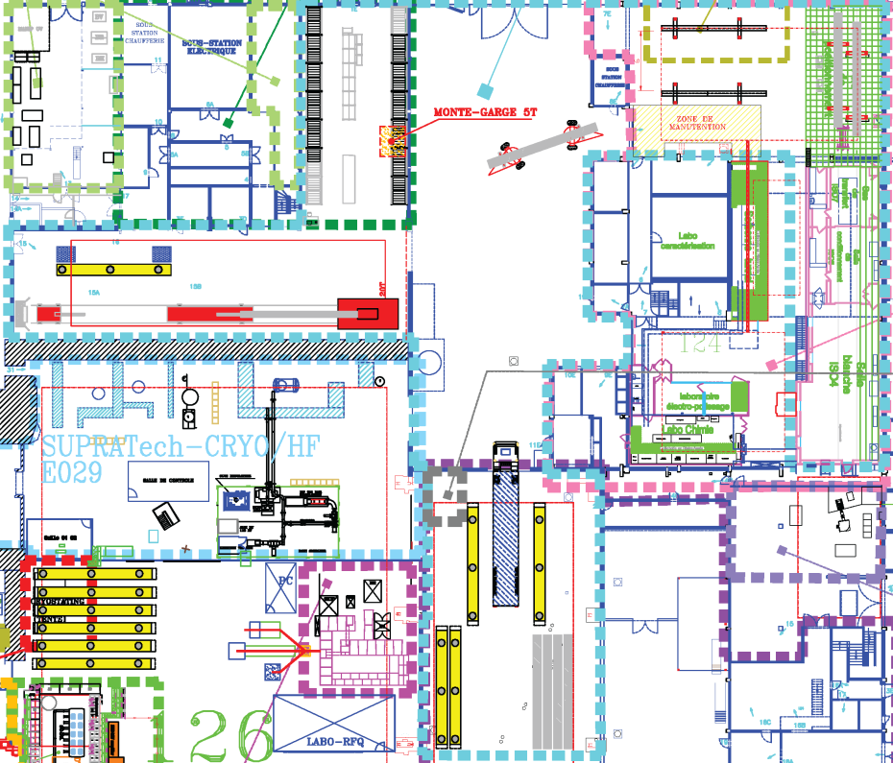
XFEL Workstations
Reception Area
REC-WS1a
Roll-out Area
RO-WS1 & 2
Alignment Area AL-WS1 & 2
Warehouse
Coupler Area CO-WS1 & 2
Reception Area
REC-WS1b
Clean room Area
CC-WS1
SA-WS1 & 2
Cantilever Area CA-WS1
Chemistry
SRF facilities
Shipment Area
SH-WS1 & 2
Assembly area
SRF facilities
Notes:
This is the top view scheme of the XFEL village.
One can see the different workstations in the assembly halls.
The workflow is the following
This is the warehouse ;
Parts have to pass through reception tests on this area.
The clean assembly of the most critical compounds occurs in a 100m2 ISO4 clean room.
Pursue assembly by rolling out the cavity string from the CR
The Alignment area is in the same hall
/cross the yard with special truck/
A big cantilever helps to hang the cold mass while sliding the vacuum vessel around it
This workstation is mostly dedicated to warm part of the coupler and its pumping line.
We have to move in another hall to check and prepare the module for shipment.
The RO area is the workstation where the cavity string is dressed with ancillaries
The

Slide 5
Project phases : ALL MODEL works even if not present at all the steps but
 | SPIRAL2 | XFEL | ESS | SARAF | IFMIF
Design | X |  | X | X | X
Preliminary study | X | X | X | X | X
Preparation of Infrastructure and tooling | X | X | X | X | x
Prototypes manufacturing | X |  | X | X | X
Mock-ups (training, tooling rework, assy procedure tests) | X | X | X | X | X
Prototyping | X | X | X | X | x
Parts manufacturing | X |  | X | X | X
Chemistry | X |  |  | X | X
Assembly | X | X | X | X | x
Test en bunker | X |  | X | X
Transport | X |  |  | X | x indiv
X : CEA has been involved
X : not present at this step
where not present
where not present
QC easier when at all steps including design
especially when one has to fix a problem
everything is in the details
If at design, the details are known, other problems will show up later but you’ll be able to handle
For ESS, CEA has to set up parts manufacturing follow up

Slide 6
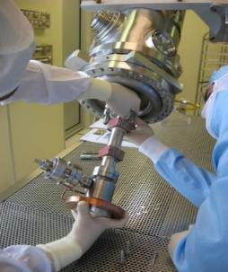
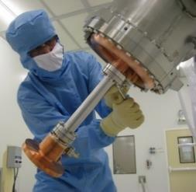
Assembly models at CEA
The assembly were performed :
CEA ressources for SPIRAL2
Subcontracted for XFEL
Main differences :
The thoughput was different (1CM/wk for XFEL),
The number of modules produced (100/12)
Lessons – learned :
Robust assembly procedures (which are not sensitive to the environment – SPIRAL 2 : 5 different assembly location 3CR @Saclay; IPNO, CERN )
Adapted to project
      - Analysis (drawback and advantages) of each scenario (industrial or CEA ressources) for each project
SP2 Coupler-cavity assembly in 2 different CR at CEA

Slide 7
Lessons learned on quality control
Pour insérer une image :
Menu « Insertion / Image »
ou
Cliquer sur l’icône de la zone image
 | SPIRAL2 | XFEL
Inspection of incoming parts | x | x
Controlling assembly | Auto | X
Documentation | X | X
Audits | x | x
X
X : random or rarely
X: on everything
Auto
X
x
    Random checks at manufacturer
    Inspection at CEA on critical components (cavities-valves-bellows = beam vacuum components) otherwise when ready to assemble
    Assembly late after SAT (site acceptance test – no warranty) rework by CEA
    Autocontrol by the technician themselves
    Improvment of the assembly procedure along the assembly
    Documentation : Record of all the steps, tests,
    Audit on coupler -> improvement

Slide 8
Lessons learned list on quality control
Pour insérer une image :
Menu « Insertion / Image »
ou
Cliquer sur l’icône de la zone image
 | SPIRAL2 | XFEL
Inspection of incoming parts | X | x
Controlling assembly | Auto | X
Documentation | X | X
Audits | x | x
x
X : random or rarely
X: on everything
    Manufacturer qualification by our lab partners
    -> parts come at CEA conformed
    Inspected at CEA :
    when possible at arrival
    not everything can be inspected
    so during assembly
    Stock so NCR parked (and repaired later) and
    replaced by next part
    NCR : parts reworked, sent back or trashed

Slide 9
Lessons learned list on quality control
 | SPIRAL2 | XFEL
Inspection of incoming parts | x | x
Controling assembly | Auto | X
Documentation | X | X
Audits | x | x
X : random or rarely
X: on everything
X
X
X
x
    Until end of 2014, the quality control group of Alsyom was too small (3 people) so they performed Incoming Inspection and Documenting in priority. CEA took over the Assembly Work Controling (‘Hold Points’). The ‘every day’ or ‘random’ controls were too few and this led to many mal-fabrication, most of them recorded at DESY before or during cryomodule cold test
    In November 2014, Increase of the quality control group of Alsyom to 5 people and a better organisation, cover the need of QC. In August 2015, increase of CEA quality control group.
    CEA also took over the NCR editing on EDMS and improvment proposal
    Audits (XM26 + local ones) are good – Feedback from the auditors (CEA experts) to the operators

Slide 10
Foreseen plan for quality control
Pour insérer une image :
Menu « Insertion / Image »
ou
Cliquer sur l’icône de la zone image
 | SPIRAL2 | XFEL | ESS | SARAF | IFMIF
Inspection of incoming parts | x | x | x | x | x
Controling assembly | Auto | X | X | Auto | x
Documentation | X | X | X | X | X
Audits | x | x | x | x | x
X : random or rarely X: on everything
    ESS : XFEL like with CEA efforts in order to check the components at manufacturer and at arrival (CEA ressources or subcontractor) and during the assembly
    SARAF : SPIRAL2 like
    IFMIF : new paradigm because components will be inspected and prepared at CEA control and shipped individually to Rokkasho for assembly

Slide 11


Lessons learned : industrial contract
      Contract signature when everything thought off – low engineering input
      No industrial was trained for cryomodule assembly
        CEA did the training of 8 first people and more 2/3 (good but CEA ressources - experts)
        The detailed industrial analysis lead to re-optimisation of the work flow in autumn 2014
      Infrastructure set up to the right level. We can accomodate the less than a wk throughput and rework on modules (XM46&XM50) ; Detailed by S. Berry and T. Trublet in WG3
5 day throughput was reached mid-October 2014 with XM15
Acceleration needed to close tunnel mid-2016
4-day throughput was reached in January 2015 with XM25
XM46
XM50
XM21
XM77 to be delivered at the end of December 2015
7wks
XM1 March 2014
6wks

Slide 12
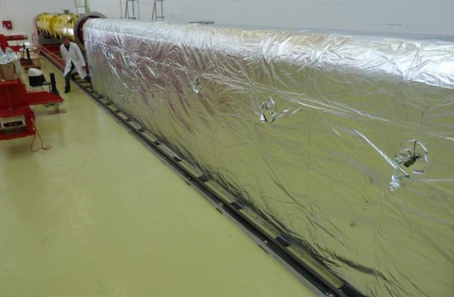
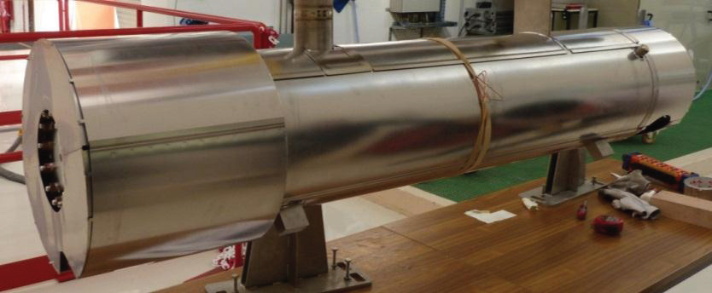
Lessons learnED : improvment
Pour insérer une image :
Menu « Insertion / Image »
ou
Cliquer sur l’icône de la zone image
  Output of the prototyping phase, the assy procedure written in english and appended to the call for tender. Alsyom translated in french and updated. This took much longer than expected Now on, in FRENCH then translated if needed/required
  Aging of tooling on XFEL (starting around 20th module) – clean room tooling spares
  Propose new solutions at prototype stage :
    MLI
    Magnetic shield
  Implement new tooling meanwhile producing
    Socks on cavity posts
    gate valve assembly in CC area
    leak detection
    Socks used to transfer cavity string from Clean Room to Rollout Area, reduce transfer time (no cleaning)
Realization of gate valve support for its assembly on Cold-Coupler workstation
Leak detection by accumulation

Slide 13
improvment on assembly which could IMpact performance
Pour insérer une image :
Menu « Insertion / Image »
ou
Cliquer sur l’icône de la zone image
New clean room assembly procedure: moving individual cavity venting after the leak check of the cold coupler assembly, rather than later before the string assembly. This eliminates one connection to pumping stations for cavity venting, and one valve closing-opening cycle. Cavity equipped with filters to be connected to N2.
Tested on XM27 and implemented from XM54
New clean room procedure

Slide 14
Impacted performances
XM26
XM45
XM46
-2.1MV/m
-0.9MV/m
0.4 MV/m
Clipping at 31 MV/m is done due to max. available RF power; limit given by waveguide distribution.
Eacc Spec = 23,6 MV/m Eacc Max = 31 MV/m
Average gradient is 16% above specs : ⟨Eacc⟩ = 27.5 MV/m.
XM6 to XM23, degradation while CEA and Alsyom put all their effort in achieving production goal of 1 CM/week
XM26 : audit
XM45: Electrical shutdown in clean room during assembly while the string of 3 cavities was under N2-flushing
XM46: Leak on the beam line in CR repaired, 2nd leak at the end of the assembly – Repaired at Saclay, 2 extra venting-pumping cycles

Slide 15
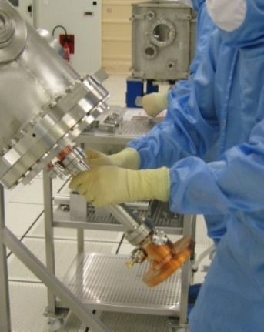
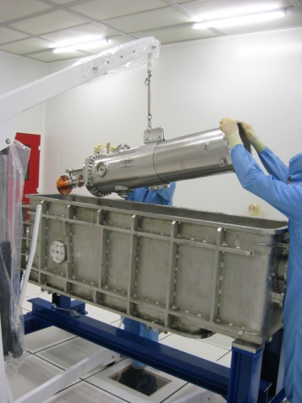
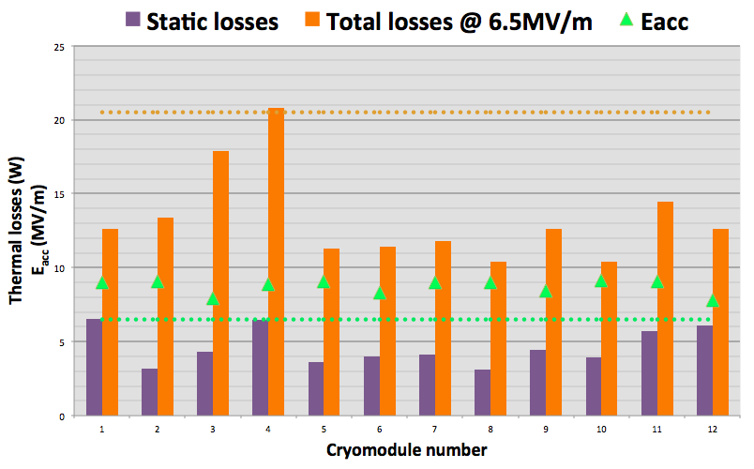
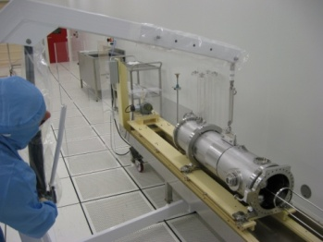
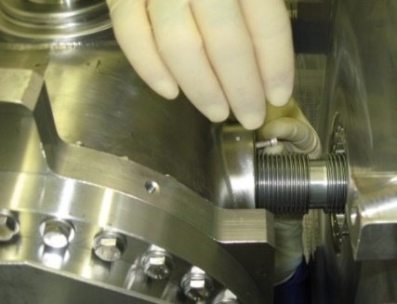
SPIRAL 2 Cryomodules performances
Q₀ |  | CMA | CMB
Specifications (10 W limit) |  | 4,0E+08 | 1,4E+09
Computed (simulation codes) |  | 7,6E+08 | 2,7E+09
Tests in VC @ 6.5 MV/m Deduced from RF losses | mean | 5,8E+08 | 3,7E+09
Tests in CM @ 6.5 MV/m Deduced from therm. losses | mean | 5,0E+08 | 3,0E+09
Vertical cryostat: P_{cav} = P_{RF}
Cryomodule: P_{cav} = P_{tot} – P_{stat}
measured via thermal losses @ 4K
(A: He level decrease; B: gas flow)
Courtesy of C. Marchand, SRF 2015, Whistler

Slide 16
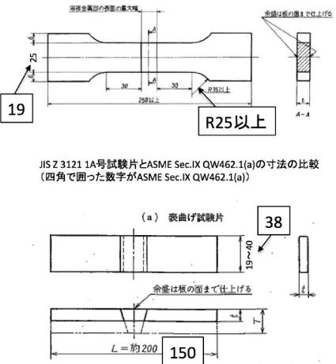
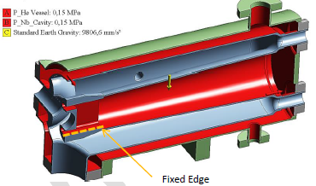
Licensing of niobium cavities
      Cryogenic fluid inside the IFMIF cryomodule ➔ Must comply with High Pressure Gas Safety Law
      Strategy negotiated with the Japanese authorities: design, fabrication and tests of all the cryomodule components according to ASME BPVC or B31.3
      HWR is the most complicated part to be licensed due to the use of non referenced materials (Nb, NbTi) and complicated geometry
The licensing procedure with the Japanese Authorities started with this component in Dec 2013.
7 meetings with KHK were necessary prior to the official submission in June 2015.
The licensing activity has been an unexpectedly time and resource consuming activity to perform the numerical simulations, deal with the many questions raised by KHK, prepare and test the samples (NbTi, Nb, NbTi-Ti, NbTi-Nb, Nb-Nb), and complete the application form.
For SARAF,
We agreed on
PED 3.3

Slide 17
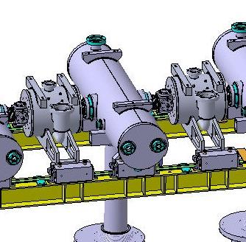
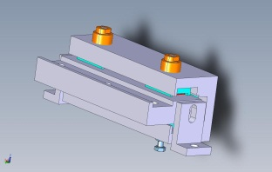
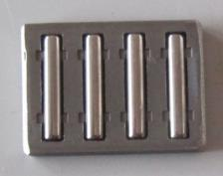
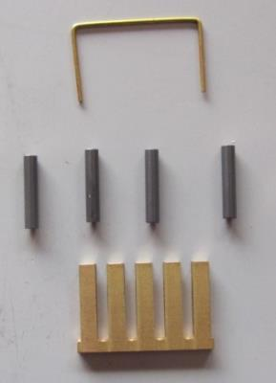
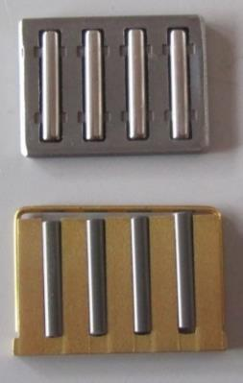
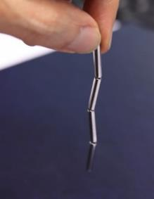
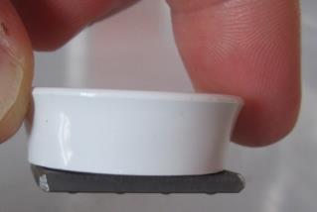
Lessons learned : Mitigation to minimize magnetization issues
  Magnetization hazard
        Solenoid packages and cryogenic stepper motors inside the magnetic shield
      ➔ Risk of magnetization of some components by the fringe field of the solenoids during operation of the cryomodule
      Ex: Off-the-shelf bearing originally intended to be used
Off-the-shelf rollers
Helps SARAF design
  Mitigation
      Use non ferromagnetic materials
  Mitigation
Ceramic needles
Brass
cage
Homemade rollers
Bearing cage
Homemade rollers
Needles magnetized

Slide 18
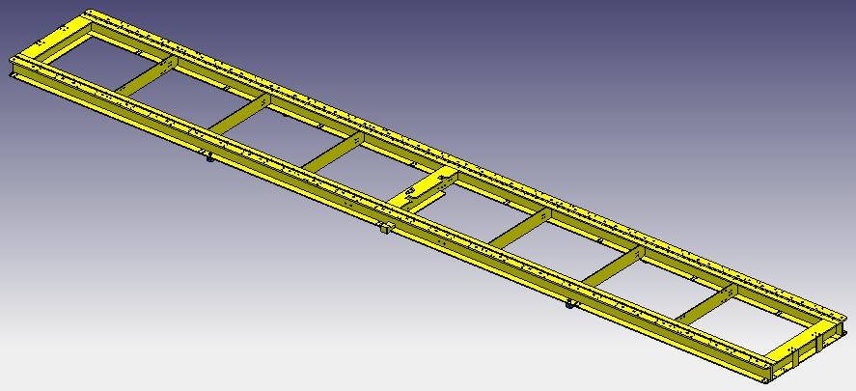
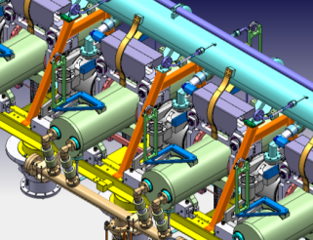
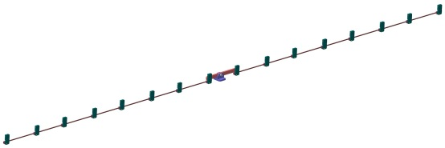
Mitigation to minimize magnetization issues
      New support frame in Ti40 instead of stainless steel 316L devised
      No more pb with the welds
      Additional benefits: shrinkage lowered, cooling time divided by 3
      Supporting elements of the phase separator in Ti40
  Studies and measurements of all parts inside the
  magnetic shield of the cryomodule liable to be magnetized or naturally magnetized
  Motors, rollers, circlips, Invar tie rod, rolling components and c-shape elements
  supporting the cavities, bearings of the tuning system, etc.
  Cf. PLOUIN et al, “CEA experience and effort to limit magnetic flux trapping in
  superconducting cavities”, SRF2015, TUPB100
  Procurement specifications and control procedures
  Systematic checking of the components liable to be magnetized before cryomodule assembly
  Additional studies to be performed
  Work out degaussing procedures to eliminate any magnetic pollution
  cf. R. LAXDAL, Review of the Magnetic Shielding Design of Low-Beta Cryomodules, SRF2013, WEIOD01

Slide 19
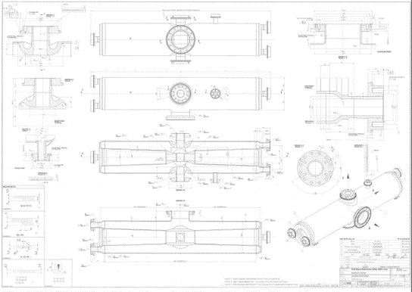
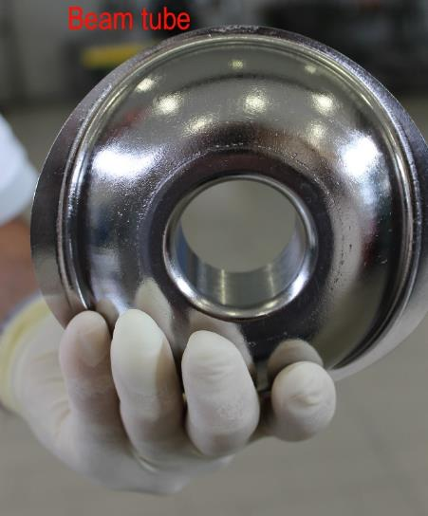
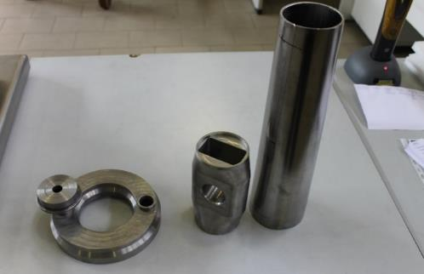
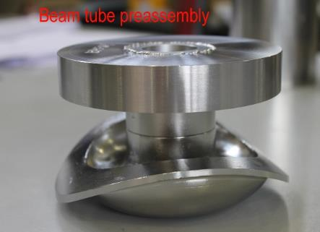
Manufacturing status
  Manufacturing phase ongoing
      Contract launched in Dec. 2014
      Qualification of the welds according to ASME BPVC ongoing (with a Lloyd’s register third part inspector)
      Pre-serieries cavity to be delivered at Saclay in Dec. 2015 for chemical etching
      cf. G. Devanz et al, Progress in IFMIF half wave resonators manufacturing and test preparation, THPB045
      First test in SaTHoRI test bench by early 2016
Feedback to SARAF CEA team
cavity torus, central drift tube, conical stem

Slide 20
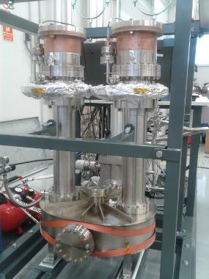
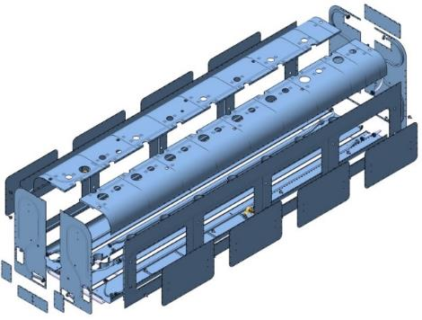
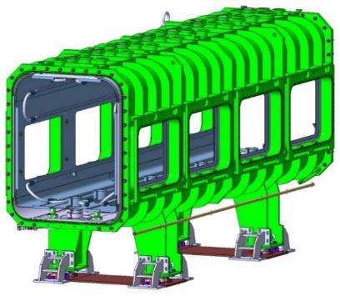
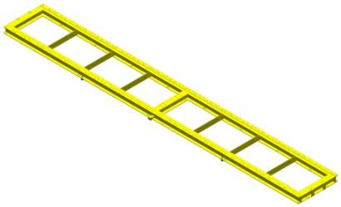
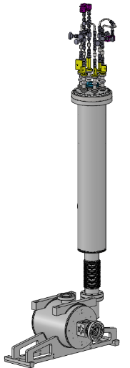
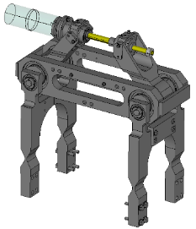
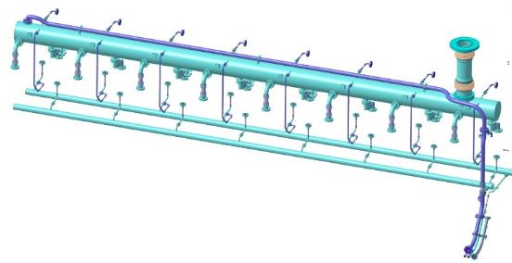
Manufacturing status of the other main Cryomodule components
  Ongoing fabrication of key cryomodule components
                Power couplers
                Vacuum tank, thermal shield
                tuning systems
Talk by H. Jenhani talk on WG4a
  Manufacturers selected or calls for tender on going
        Phase separator, Support frame, magnetic shield
  Technical specifications being prepared
        Current leads and solenoid packages (CIEMAT),
        MLI, cryo and vacuum piping (CEA)

Slide 21


ESS Cryomodule design
Similar to CEBAF/SNS cryomodule concept with 4 cavities per cryomodule
Common design for medium (6 cells) and high beta (5 cells) cavities
Regulation He valve
Thermal shielding
Alignement fiducial
Vacuum valve
Jumper connection
Magnetic shielding
Spaceframe support
Heat exchanger
Diphasic He pipe
Proton Beam
Cavity with Helium tank
Intercavities belows
Power coupler
Cold to warm transition

Slide 22
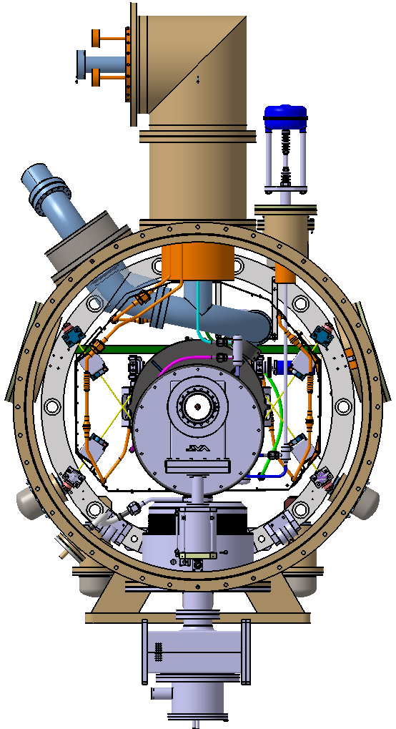
Bursting disk
Spaceframe
Cold tuning system
Access trap
Cavity supporting rods
Three supports at 120°C for the spaceframe
Vacuum vessel
Cryomodule support (no ground support design yet)

Slide 23
ESS : Looking at the contrat model
  Time to reach nominal throughput longer than excepted (ESS – XFEL)
ESS number of modules
ESS : evaluating the best model
for the production – throughput 1 cryomodule /
3 wk

Slide 24
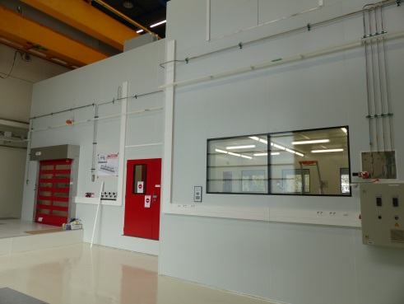
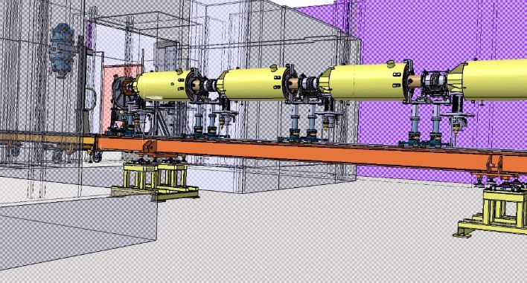
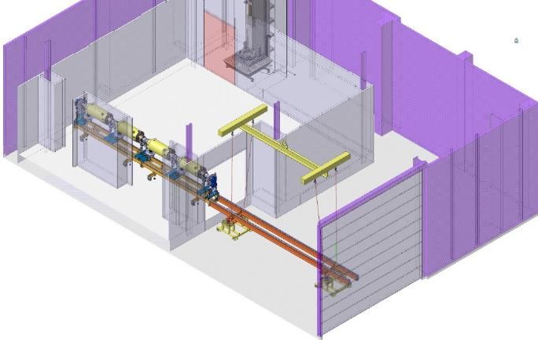
ESS prototyping phase : transfert
124E
H
126

Slide 25
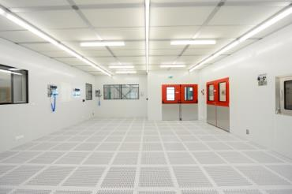
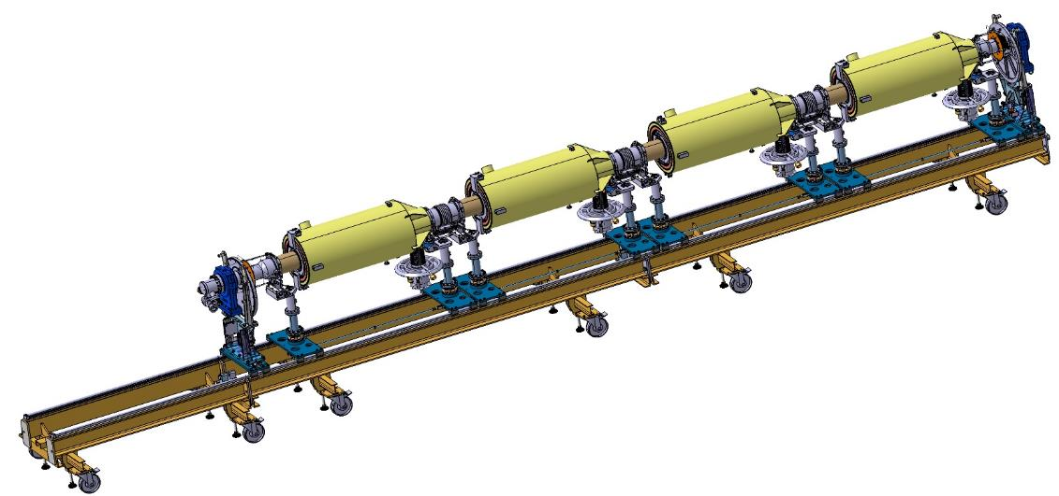
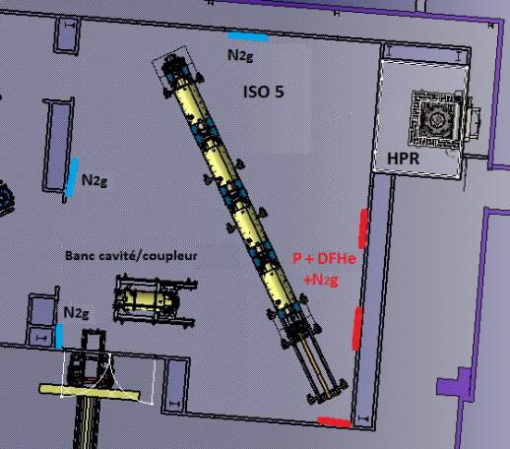
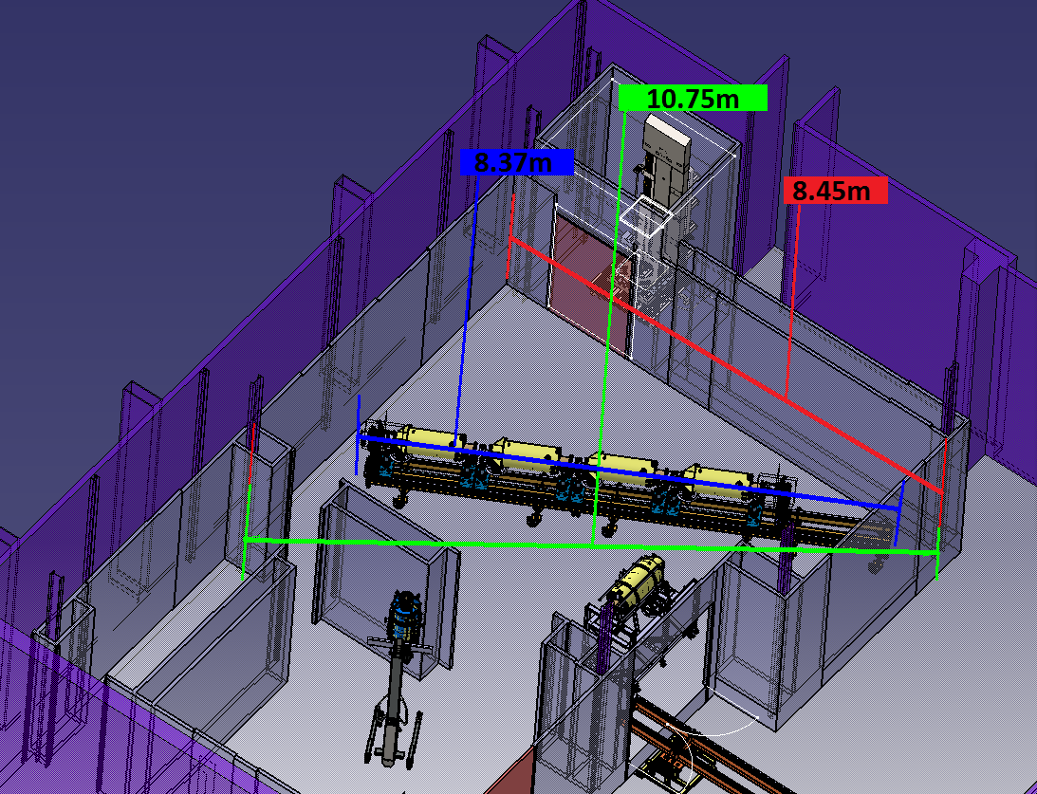
ESS prototyping phase : clean room assy
ESS cavity string in CR
on carriage
124E clean room (CR)
Views of ESS cavity string in CR
on carriage

Slide 26
ESS prototyping phase : transfert
124E
H
126

Slide 27
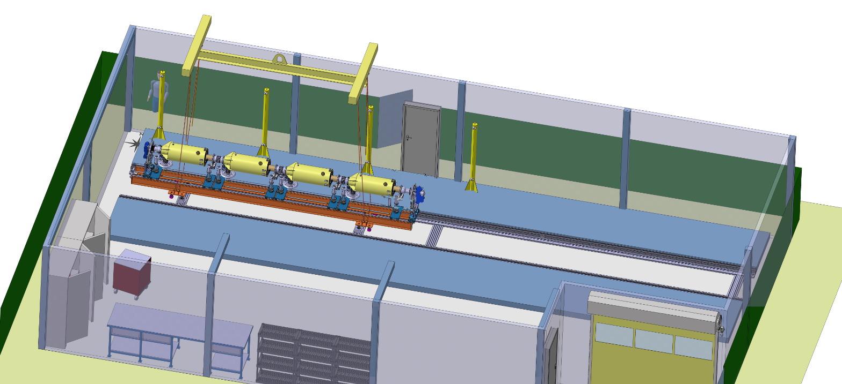
Both for ESS CRYOmodule assembly

Slide 28
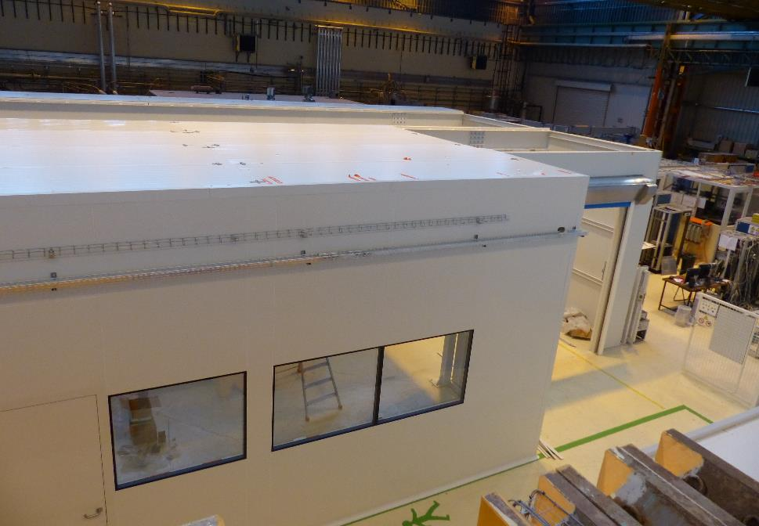
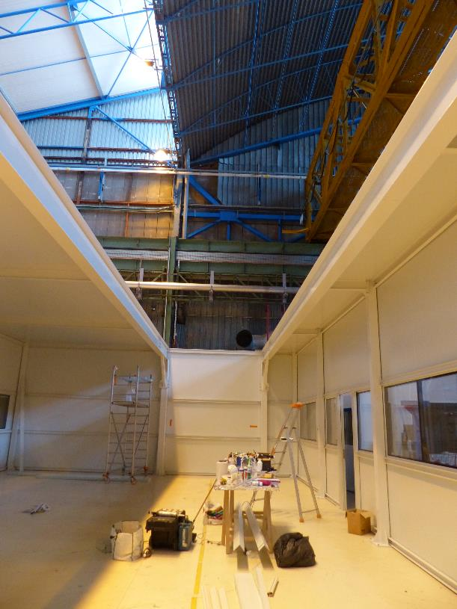
Both for ESS CRYOmodule assembly

Slide 29





ESS prototype Cryomodule assembly

Slide 30



ESS prototype Cryomodule assembly

Slide 31
ESS prototype Cryomodule assembly

Slide 32







SARAF cryomodule TRANSPORT
Transportation
      Transportation by sea = Cheapest solution but:
      Several loadings/unloadings ➔ heavy shocks possible during transshipment
      Coupler window failure or weakening due to fatigue (resulting from ocean swell)
      Risk of contamination of the beam vacuum during shipment (long journey)
Mitigation action:
Transportation by plane
Design complementary constraints: dimensions of the doors of the widespread 747-8F cargo plane: the nose door is 94 in. (239 cm) wide and 96 in. (244 cm) high, while the large side cargo door allows to charge 238.5 in. (606 cm) long and 96 in. (244 cm) wide loads
| PAGE 32

Slide 33
Conclusions (1)
 | Lessons learned
Design
Preliminary study
Preparation of Infrastructure and tooling
Prototypes manufacturing
Mock-ups (training, tooling rework, assy procedure tests)
Prototyping
Parts manufacturing
Chemistry
Assembly
Test en bunker
Transport

Slide 34
Conclusions (2)
With the various number of modules, we adapt to new situation
Manpower estimation especially in QA/QC should never be minimised
Infrastructure eases assembly and prototyping
Scrutinize project for other projects

Slide 35
DSM
Irfu
SACM
THANK you for your attention
Commissariat à l’énergie atomique et aux énergies alternatives
Centre de Saclay | 91191 Gif-sur-Yvette Cedex
T. +33 (0)1 69 08 69 39 | F. +33 (0)1 69 08 99 89
  Etablissement public à caractère industriel et commercial | RCS Paris B 775 685 019

