Slide 1
WG1: High Q - Introduction
Alexander Romanenko
TTC Meeting, SLAC
1 Dec 2015

Slide 2
High Q working group – focus this time
Two recent discoveries enabling high Q motivated a very active effort to reveal the science behind
  Nitrogen doping – DAY1 (Monday)
  Magnetic flux management – DAY 2 (Tuesday)
Focus on underlying science
Presentations fall into two categories:
  Experimental findings
  Theoretical models currently at the table to explain the experiments

Slide 3
Nitrogen doping: a breakthrough in Q
Record after nitrogen doping – up to 4 times higher Q!
This was the highest Q possible up to 2012
Since the discovery -> developed to production-ready for LCLS-II within the context of high Q collaboration (FNAL/Cornell/Jlab)
Standard state-of-the art preparation
1.3 GHz
A. Grassellino et al, 2013 Supercond. Sci. Technol. 26 102001 (Rapid Communication) – highlights of 2013

Slide 4
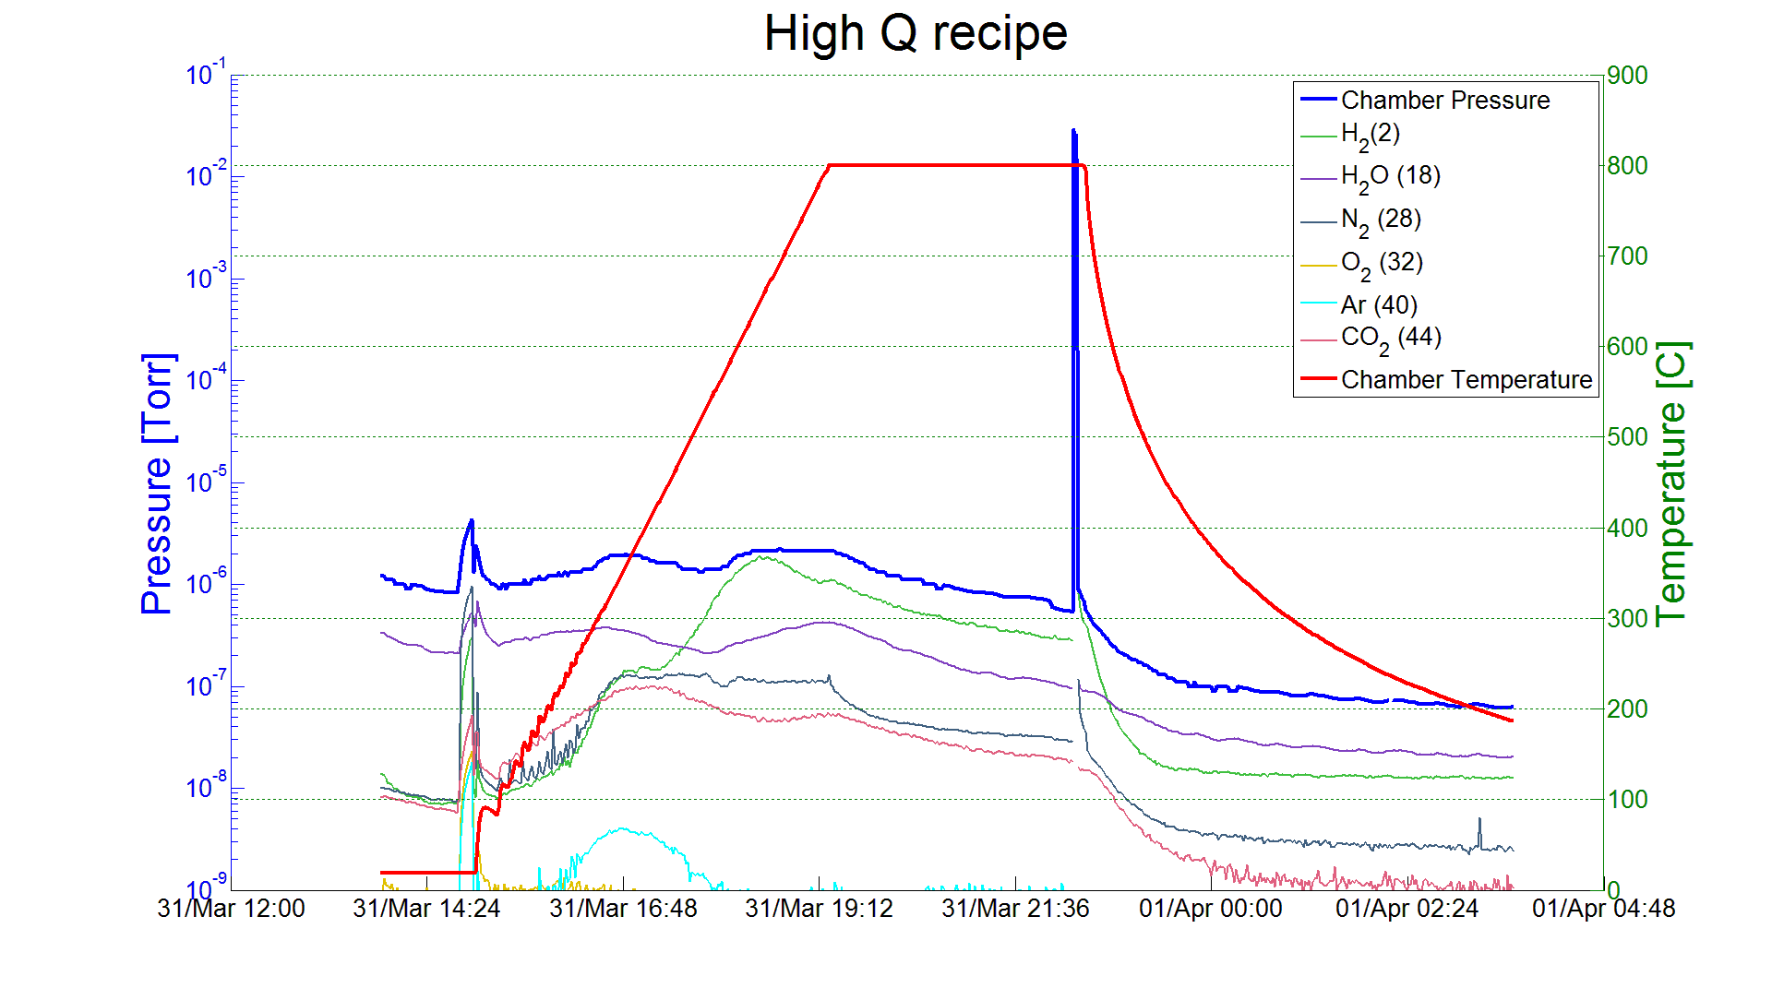
N Doping – small deviation from standard ILC treatment
Example from FNAL 2/6 doping process:
Bulk EP
800 C anneal for 2 hours in vacuum
2 minutes @ 800C nitrogen diffusion
800 C for 6 minutes in vacuum
Vacuum cooling
5 microns EP
A. Grassellino et al, 2013 Supercond. Sci. Technol. 26 102001 (Rapid Communication)
Ship to DESY
Cavity after Equator Welding
HOM Tuning
X
EP 140 um
120C bake
Short HPR
Leak Check
External 20 um BCP
Final Assembly
XFEL
Long HPR
Ethanol Rinse
VT Assembly
800C HT Bake
Helium Tank Welding Procedure
RF Tuning
Long HPR
EP 40 um
Ethanol Rinse
HPR

Slide 5
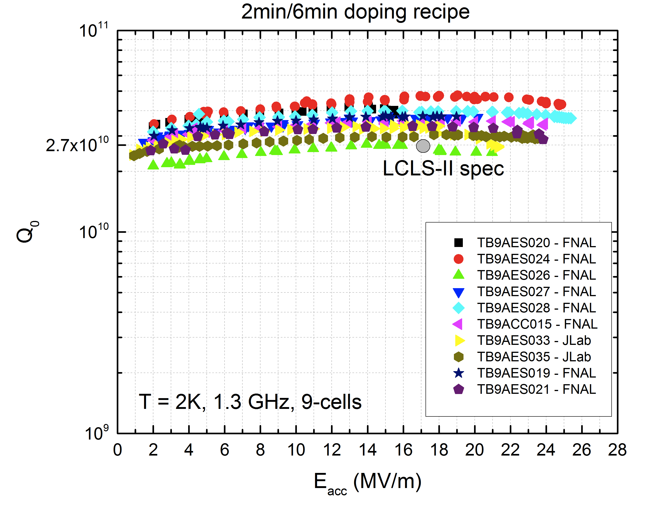
“Production” recipe for LCLS-II – 9-cells for prototype cryomodule(s)
Work in collaboration with Jlab and Cornell to demonstrate transfer and validation of best recipe

Slide 6
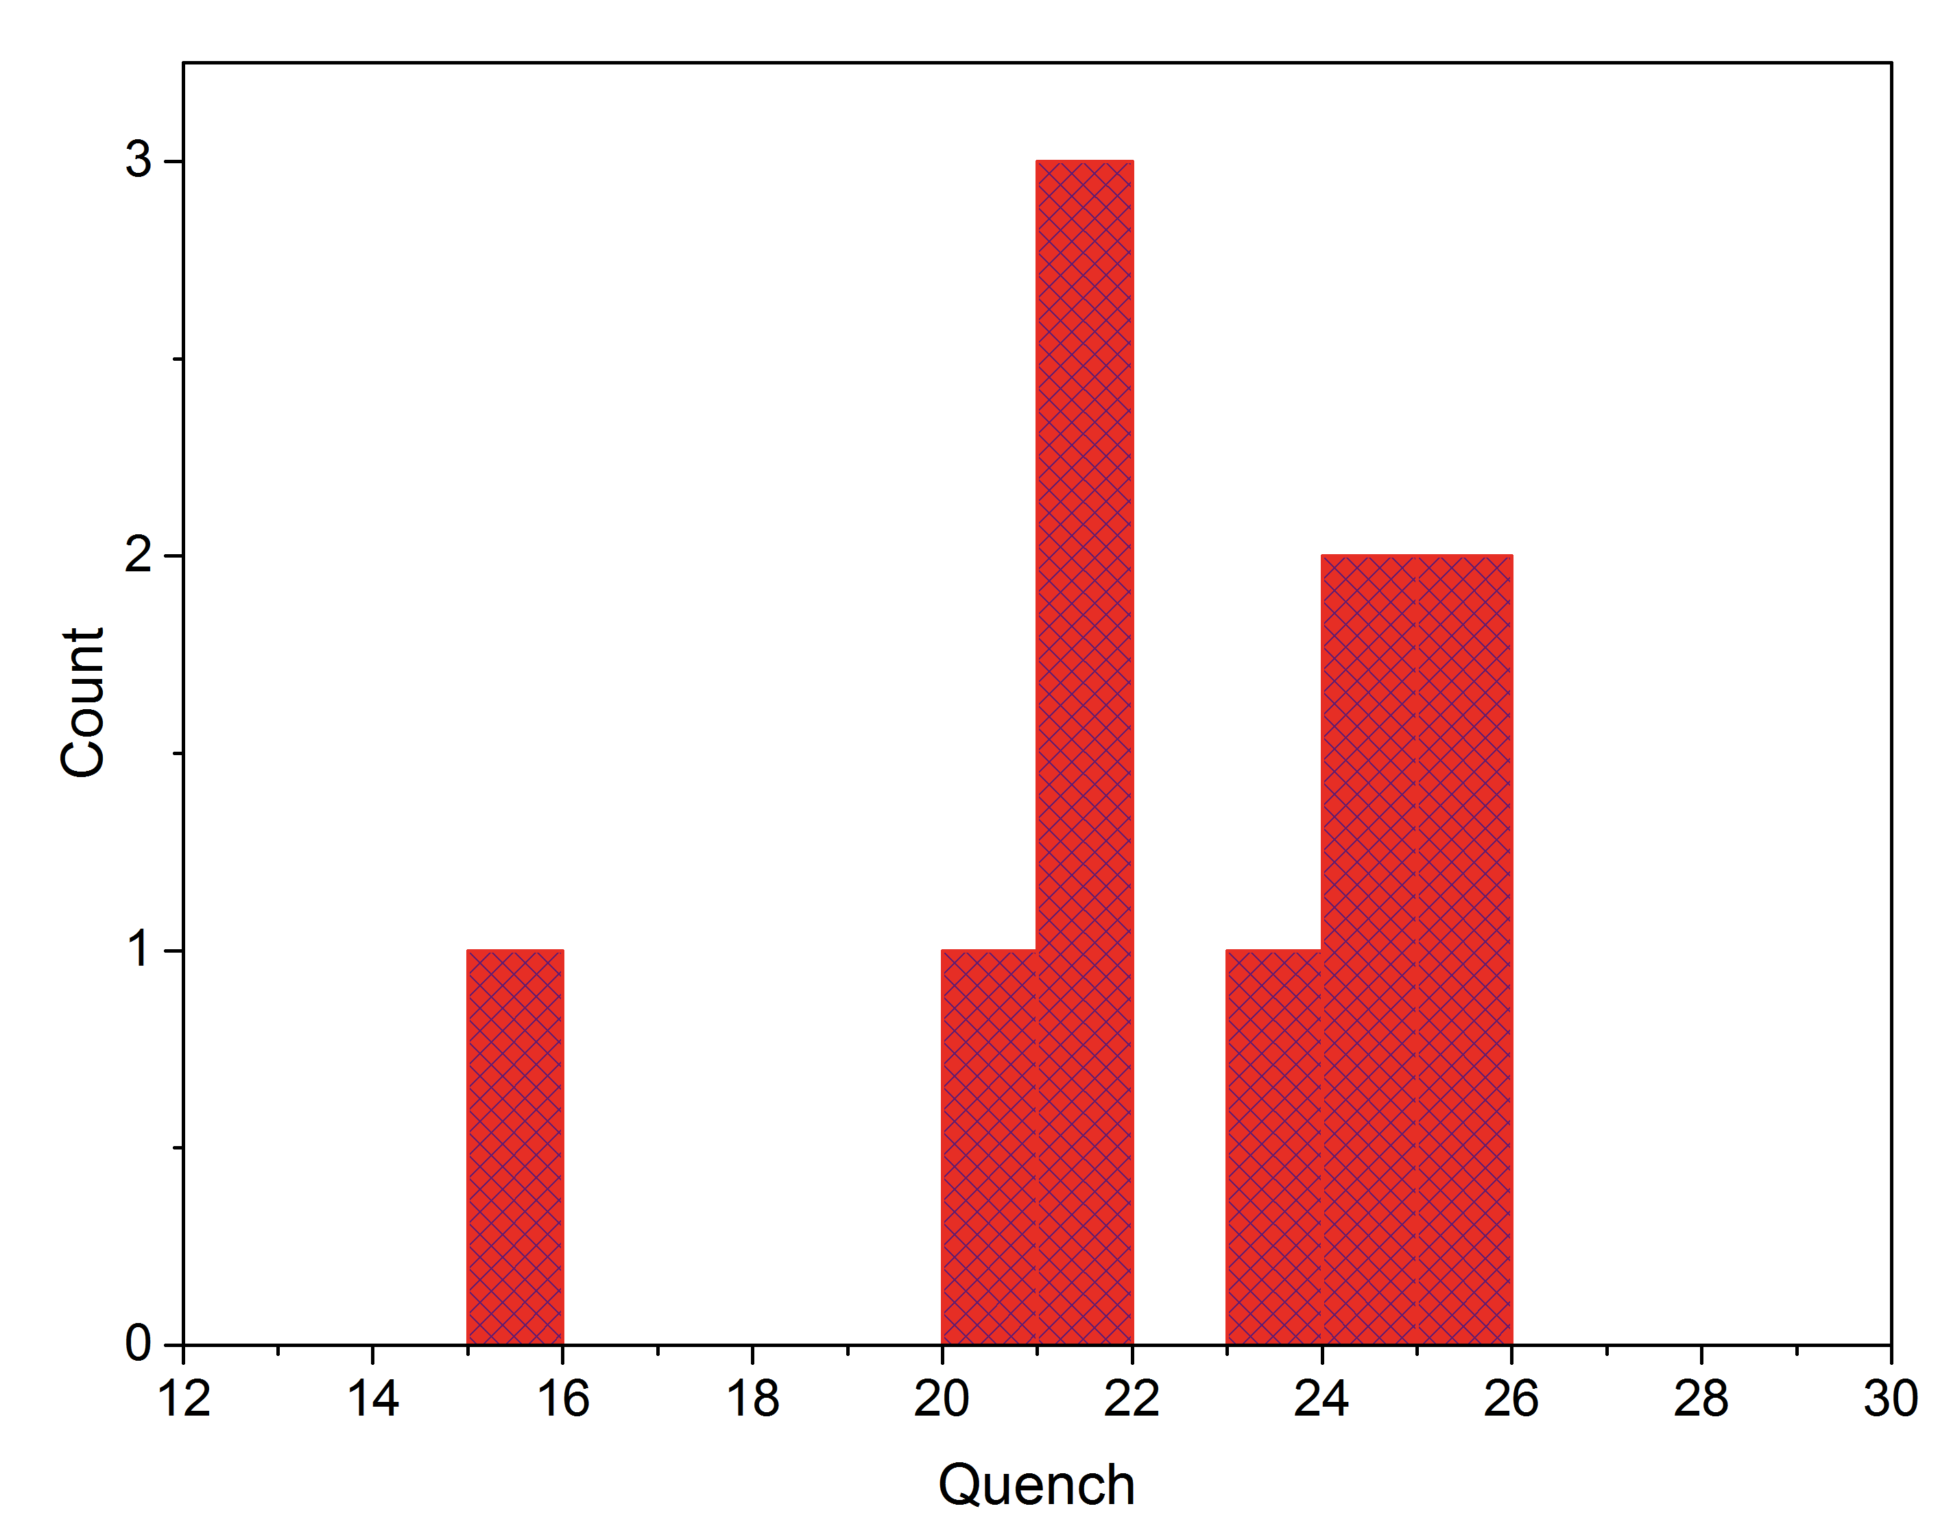
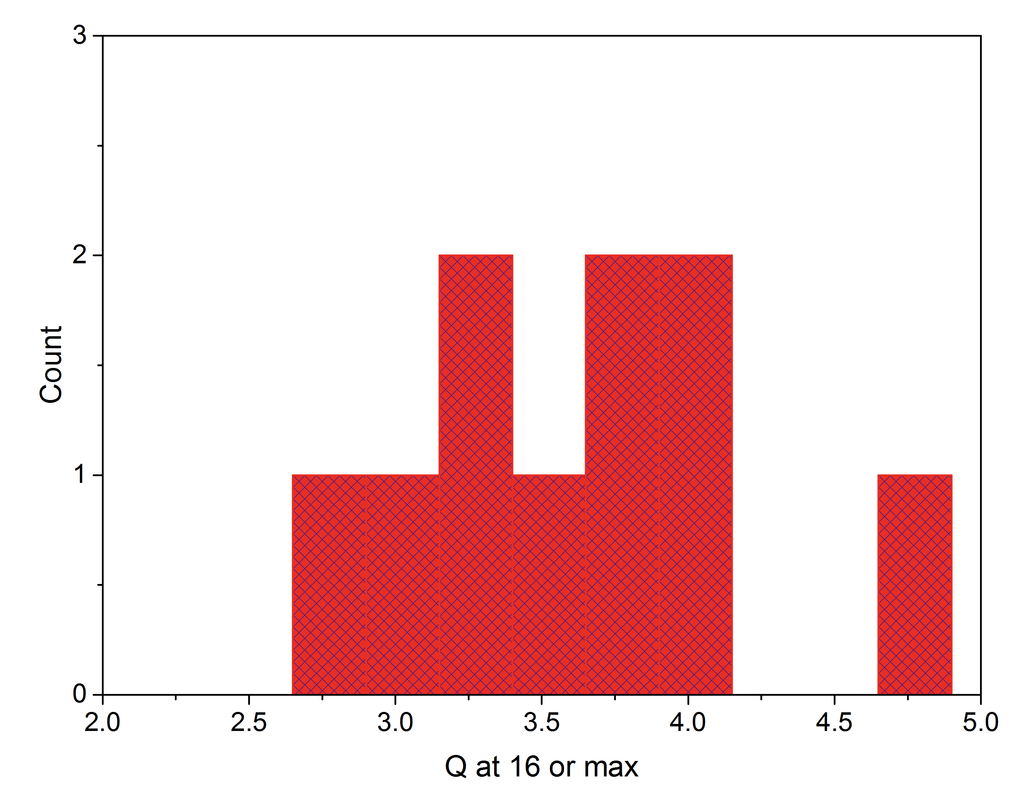
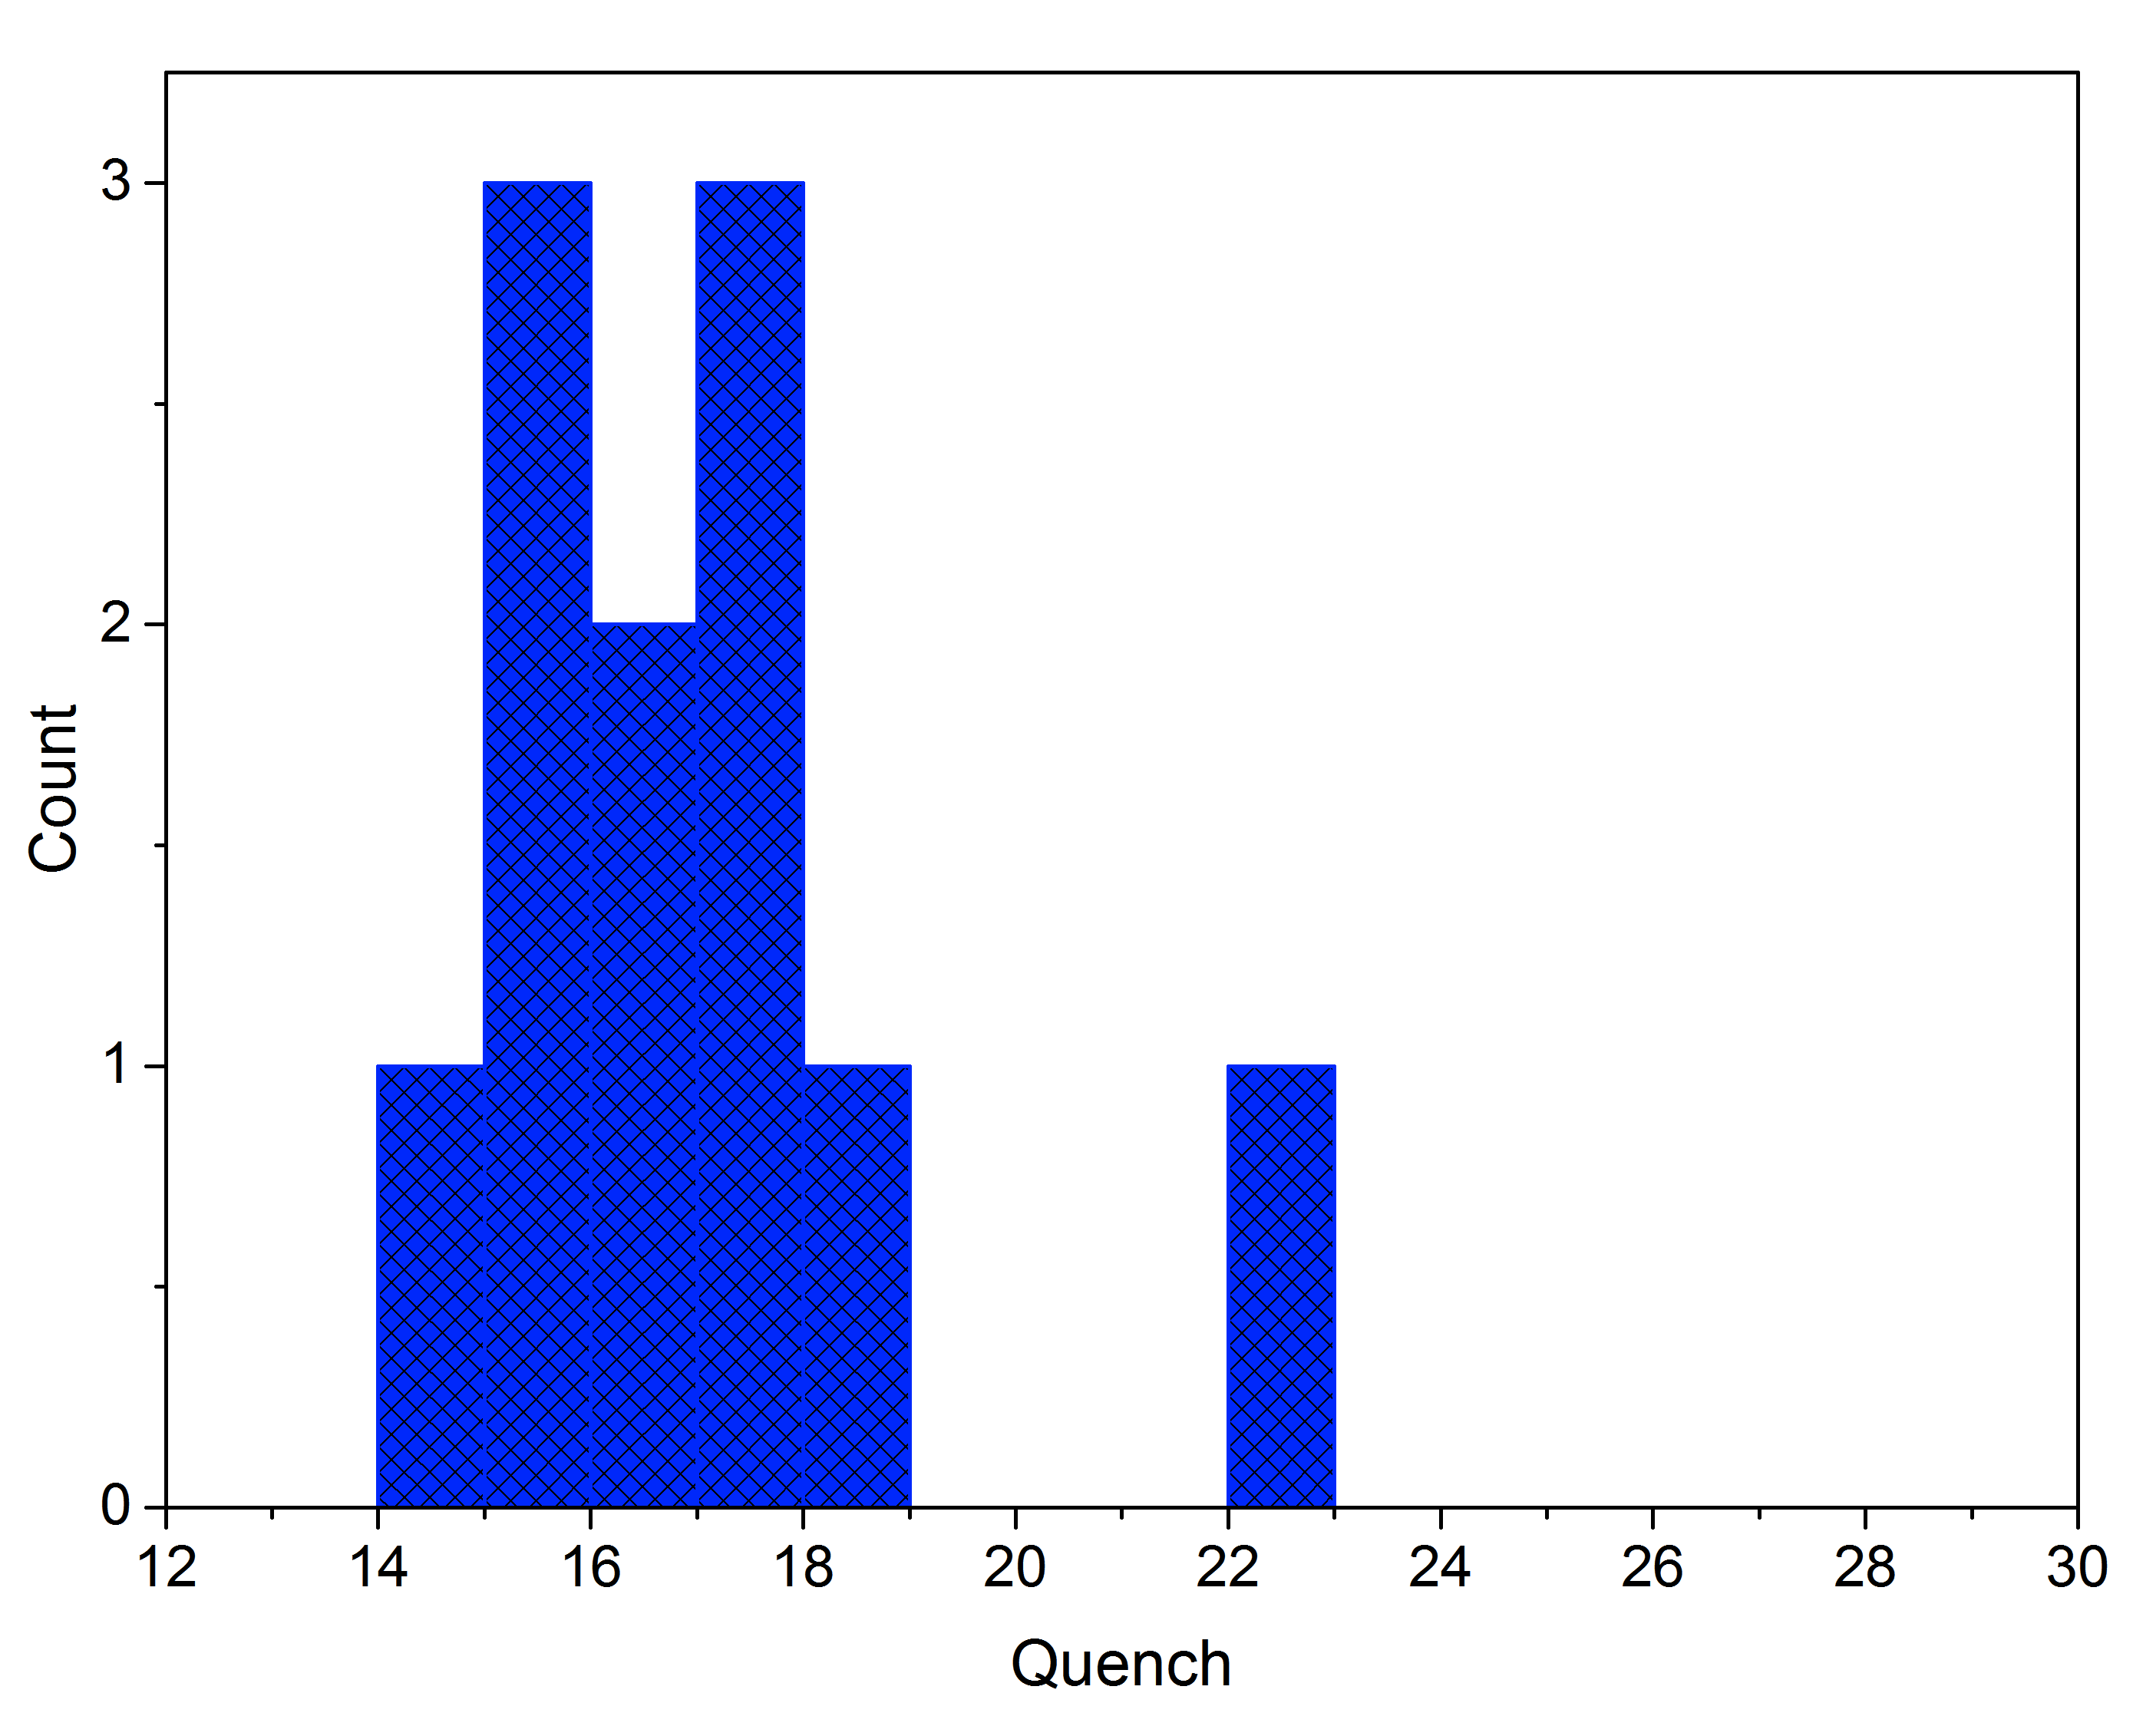
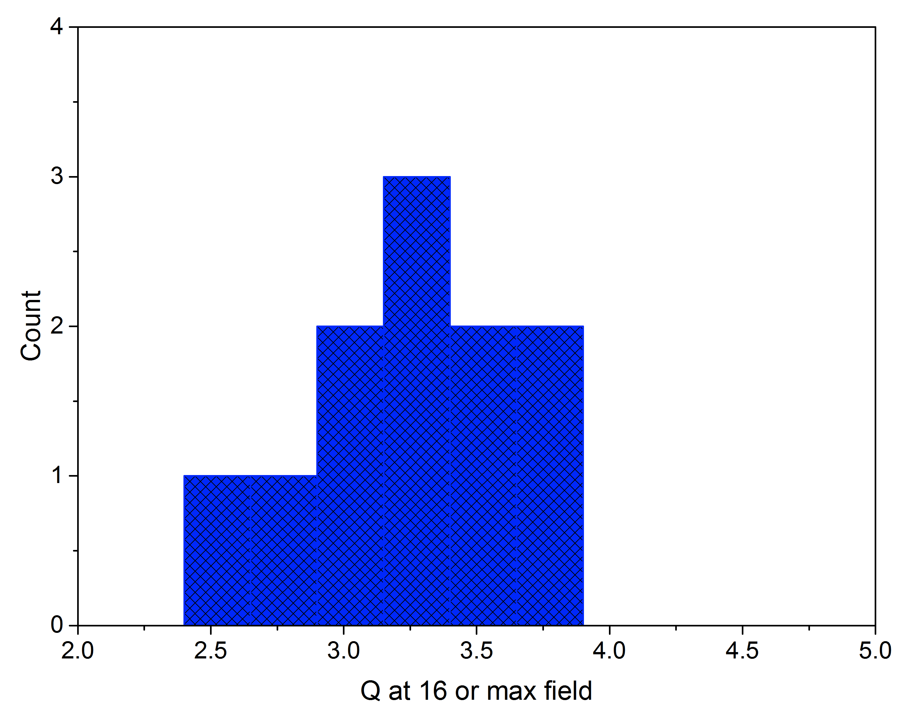
Statistics for two doping recipes on 1.3 GHz 9-cells
Recipe 2/6
16 MV/m
2.7e10
Data from FNAL/JLab
<Q>=3.6e10
<E_{max}>=22.2 MV/m
E_{max}median=22.8MV/m
Recipe 20/30
Data from Cornell/Jlab/FNAL
<Q>=3.24e10
<E_{max}>=16.3 MV/m
E_{max}median=16.5MV/m

Slide 7
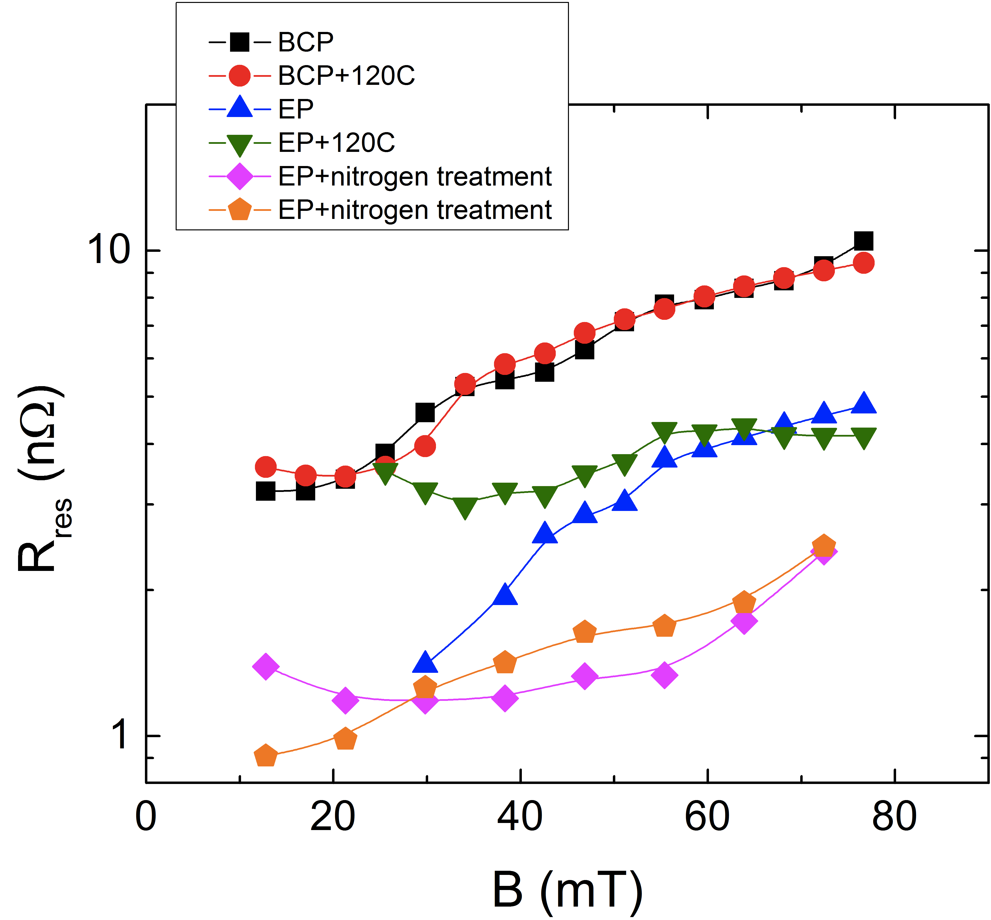
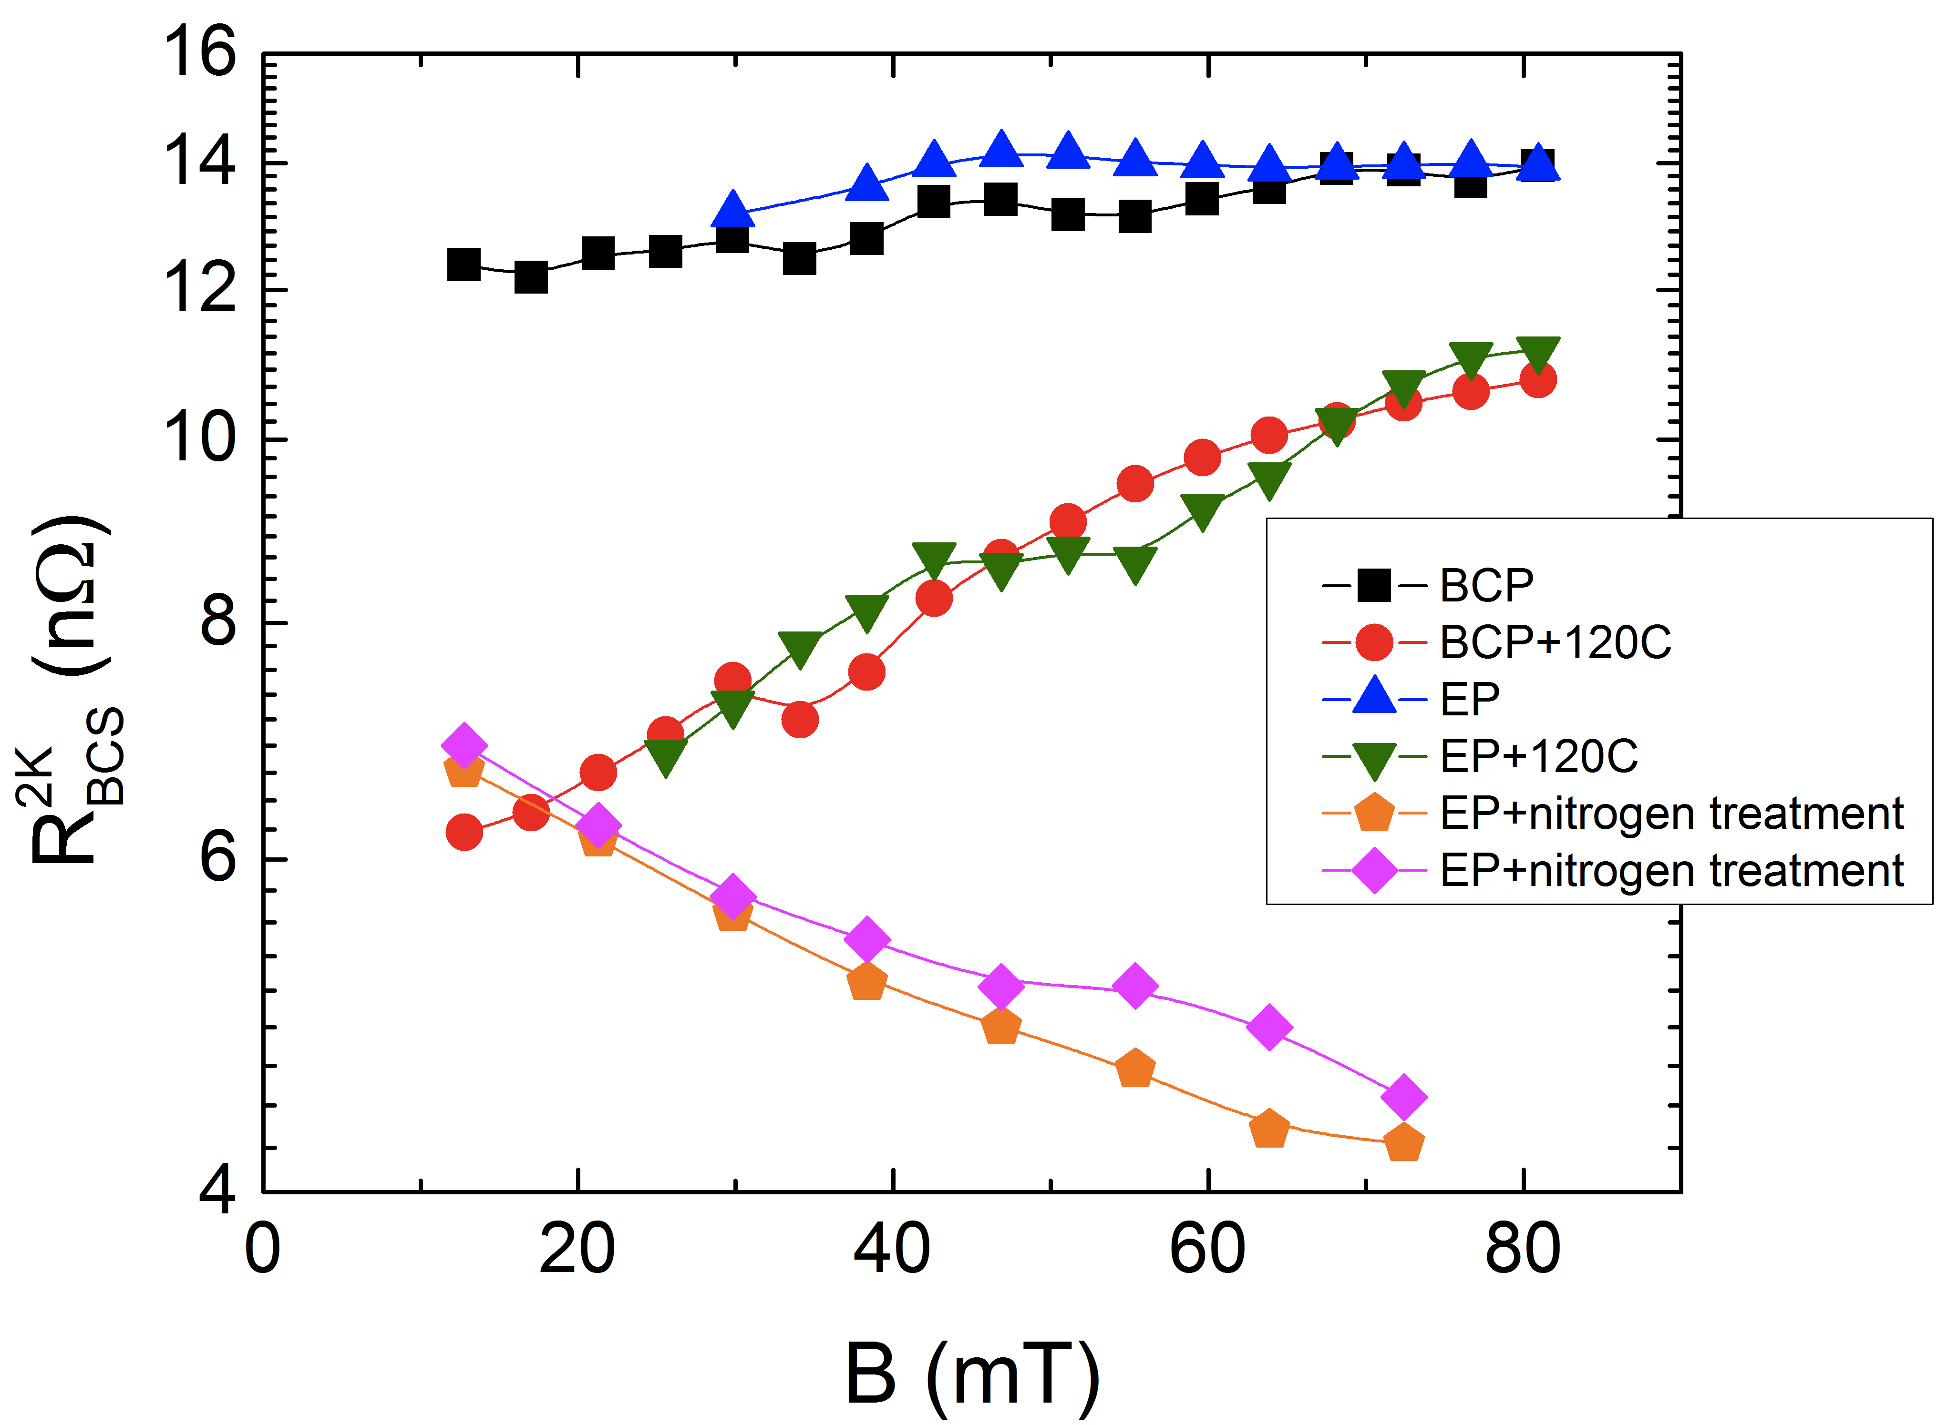
“Reversed” field dependence of R_{BCS}
R_{s}(T) = R_{BCS}(T)+R_{res}
Origin of the anti-Q-slope
A. Grassellino et al, 2013 Supercond. Sci. Technol. 26 102001 (Rapid Communication)

Slide 8
WG1 – High Q – N doping - contributions
We know from the outset that R_{BCS} decreasing with rf field amplitude is underlying the drastic improvement in Q
  what is the physics behind?
Experimental clues: What can we learn from Rres/Rbcs decomposition and fitting? Can we isolate some superconducting parameters which drive the effect?
    A. Palczewski (Jlab)
    D. Gonnella (Cornell)
    M. Checchin (FNAL)
Theoretical models challenged with the particular charge of “what is different about N doping”?
    B. Xiao (BNL)
    A. Gurevich (ODU)
Example of unoptimal doping:
    K. Umemori (KEK)

Slide 9
Day 2: Magnetic flux management
Same cavity, just cooled differently through 9.2K
Flux expelled efficiently
Flux mostly trapped
2K, 1.3 GHz
A. Romanenko, A. Grassellino, O. Melnychuk, D. A. Sergatskov, J. Appl. Phys. 115, 184903 (2014)

Slide 10
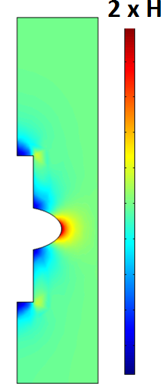
Magnetic probes reveal the new physics
Full expulsion of the magnetic field should give ~2x higher field at the equator in superconducting state
It turns out the expulsion efficiency can be controlled by the cooldown procedure (fast/slow, uniform or not)
Efficient flux expulsion
H
Poor flux expulsion
Fluxgate
magnetometers
A. Romanenko, A. Grassellino, O. Melnychuk, D. A. Sergatskov, J. Appl. Phys. 115, 184903 (2014)

Slide 11
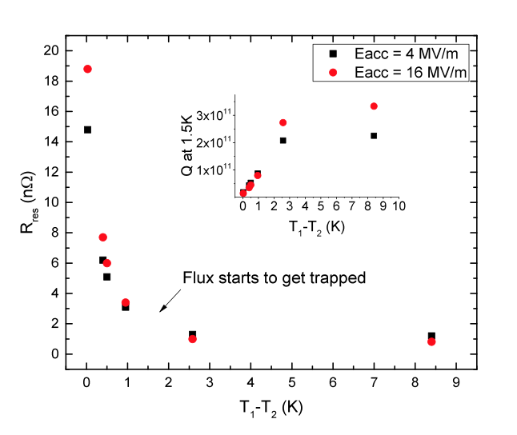
Thermal gradient at NC/SC interface is key parameter for flux expulsion
A. Romanenko, A. Grassellino, A. C. Crawford, D. A. Sergatskov, and O. Melnychuk, Appl. Phys. Lett. 105, 234103 (2014)

Slide 12
WG1 – High Q – Magnetic flux management - contributions
What are the realistic magnetic environments we have to deal with?
  S. Chandrasekharan (FNAL)
We now understand that temperature gradient at the phase front is the main parameter for expulsion, why is it so?
  T. Kubo (KEK)
How does the material itself (bulk and surface) affect the flux expulsion?
  S. Posen (FNAL)
If the flux is trapped, how does its dissipation depend on the material properties (bulk and surface)?
  M. Martinello (FNAL)
What is the possible theoretical description of the observed trapped flux dissipation?
  A. Gurevich (ODU)
  M. Martinello/M. Checchin (FNAL)

