Slide 1
Microwave suppression of nonlinear surface resistance and extended Q(H) rise in alloyed Nb cavities
Alex Gurevich
Old Dominion University,
Department of Physics and Center for Accelerator Science,
Norfolk, VA 23529, USA
Supported by DOE under grant No. DE-SC0010081
TESLA Meeting, SLAC, Dec. 1, 2015

Slide 2
Outline
What is behind the extended Q(H) rise in Ti or N -doped Nb cavities and what makes
them special: exotic defects, special processing, new SRF physics or else?
Counterintuitive suppression of surface resistance by the rf field extending to
100-120 mT – half of the superheating field of Nb!
Effect comes from the tell-known broadening of gap peaks in the density of states by
strong dc or rf currents in the BCS theory.
Quick fixes of the low-field Mattis-Bardeen theory are inadequate. Recently R_{s}(H)
has been derived from the dynamic nonequilibrium BCS theory which describes
well the experimental data on Ti and N-doped cavities. A.Gurevich, PRL 113, 087001 (2014).
Materials conditions: sharp peaks in the density of states and fewer subgap states:
apparently N or Ti-allowing does the job.
How far can it be extended and can negative Q-slopes be fully reversed without reducing
the breakdown field? If so can it be extended beyond the superheating field of Nb?
S-I optimal Nb dirty layer may extend the Q-rise above the superheating field of Nb
A.Gurevich, AIP Advances, 5, 087001 (2015).

Slide 3
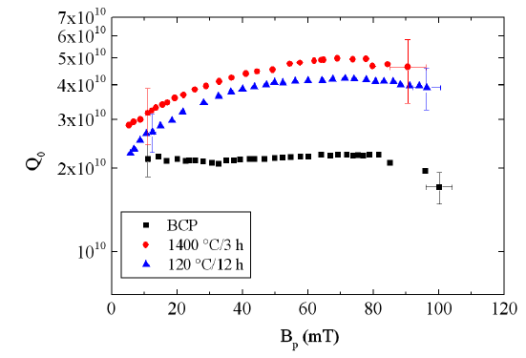
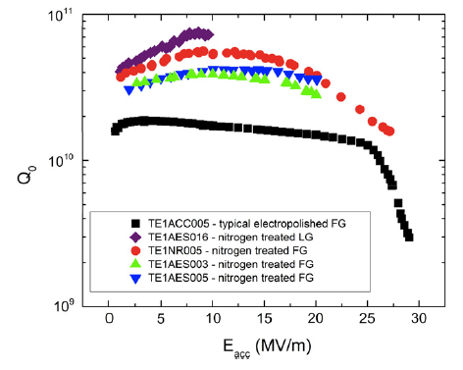
Extended microwave enhancement of Q(H)
P. Dhakal et al, Phys Rev. ST-AB 16, 042001 (2013)
A. Grasselino et al, SUST 26, 102001 (2013)
Ti-alloying, JLab
N and Ar alloying, FNAL
Dirty layer due to diffusion of N or Ti into a few μm thick layer ( >> λ = 40 nm)
at the surface
Decrease of R_{s}(B) up to B ≈ 0.5B_{c}: microwave suppression of surface resistance

Slide 4
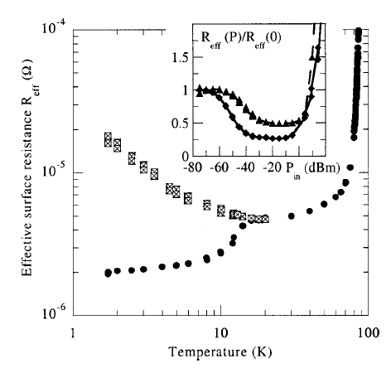
Microwave suppression of R_{s} is not unique to Nb cavities
350 nm thick YBa₂Cu₃O₇ or Nb
striplines on MgO substrates:
minimum in R_{s} at 10 kV/m
but no minimum on sapphire
or LaAlO₃ …? Surface states or
nonlinear dielectric losses in MgO?
Recent observations on 60 nm
Al striplines @ 5.5 GHz and 0.2 K
P.J. deVisser et al, PRL 112, 047004 (2014)
M. Hein et al, APL 80, 107 (2002)
Earlier observations on Pb and other LTS
A.B. Pippard, Proc. Roy. Soc. 203, 210 (1950)
M. Spiewak, Phys. Rev. 113, 1479 (1959)
Yu.V. Sharvin and V.F. Gantmakher, JETP 12, 866 (1961)
R.L. Richards, Phys. Rev. 126, 912 (1962)
R.T. Lewis, Phys. Rev. 134, A1 (1964)
J.F. Koch and C.C. Kuo, Phys. Rev. 164, 618 (1967)
S. Sridhar and J.E. Mercerau, PRB 43, 203 (1996)
Suppression of R_{s}(H) by dc or rf field can be:
1. significant but also very sample dependent
2. masked by high radiation and vortex losses
3. Affected by substrates

Slide 5
What could make R_{s}(H) to decrease with field?
Mattis-Bardeen formula for the surface resistance in the dirty limit:
In BCS the product λ³Δ is inversely proportional to the superfluid density , Δ² so:
Here Δ decreases with H because currents break Cooper pairs. Thus, according
to the conventional wisdom, R_{s}(H) should increases with H proportionally to the
density of thermally-dissociated electrons
Can the microwave suppression of R_{s}(H) come from the log. (often hidden in the A factor)
in R_{s} = (Aω²/T)exp(-Δ/kT) ?

Slide 6
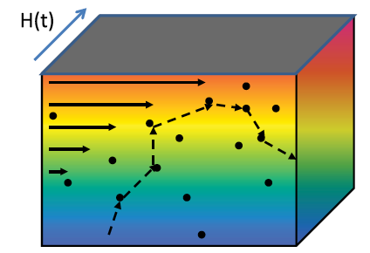
Mattis-Bardeen theory in the dirty limit
In the dirty limit of l < ξ, the relation between the current density J(r) and the electric
field E(r) becomes local:
The reactive conductivity σ₂ = 1/ωμ₀λ² accounts for the Meissner effect, and the small
dissipative conductivity σ₁ results from thermally-dissociated quasiparticles at hω << kT
At hω ➔ 0, the integral diverges. At finite hω, the
divergence is cut off giving the logarithmic factor

Slide 7
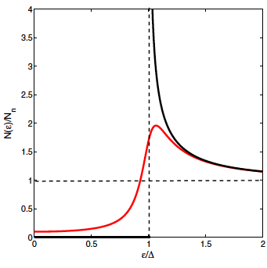
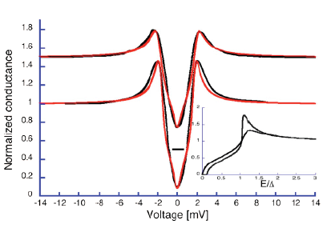
Broadening of gap peaks in N(ε) reduces R_{s}
At 1-2 GHz and 2K, we have hf/kT ≈ 10⁻², so R_{s} simplifies to:
Broadened gap
peak and subgap
states in the
Dynes model
Idealized
BCS model
Density of states with broadened peaks:
The log. term in R_{s} results from the singularity
in the BCS density of states (γ = 0) at ε = Δ
No singularity in N(ε) extracted from tunneling exps.
which reveal finite N(ε) at ε < Δ (subgap states)
Small broadening of gap peaks
in N(ε) can reduce R_{s} by 4-5 times
T. Proslier et al, APL 92, 212505 (2008)

Slide 8
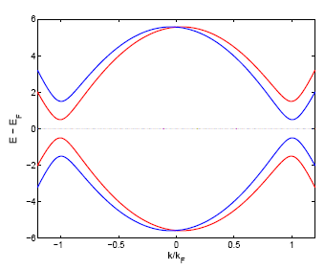
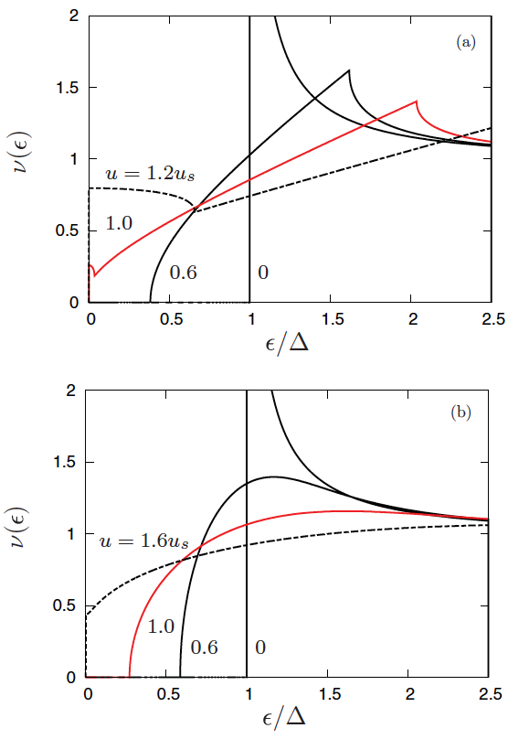
Current-induced broadening of N(ε) in clean limit
J. Bardeen, Rev. Mod. Phys. 34, 667 (1962)
Rocking “tilted” electron spectrum in the
current-carrying rf state, J(t) = J₀cosωt
2Δ - 2vp_{F}
2Δ + 2vp_{F}
Superfluid velocity v_{s}(t) = J/n_{s}e
At J > 0, the energy gap ε_{g} is no longer equal to Δ
Reduction of the energy gap ε_{g} = Δ - p_{F}|v_{s}|
increases the density of thermally-dissociated
normal electrons, which supposedly increases
??
Critical pairbreaking velocity v_{c} = Δ/p_{F}
Current-induced broadening of N(ε)

Slide 9
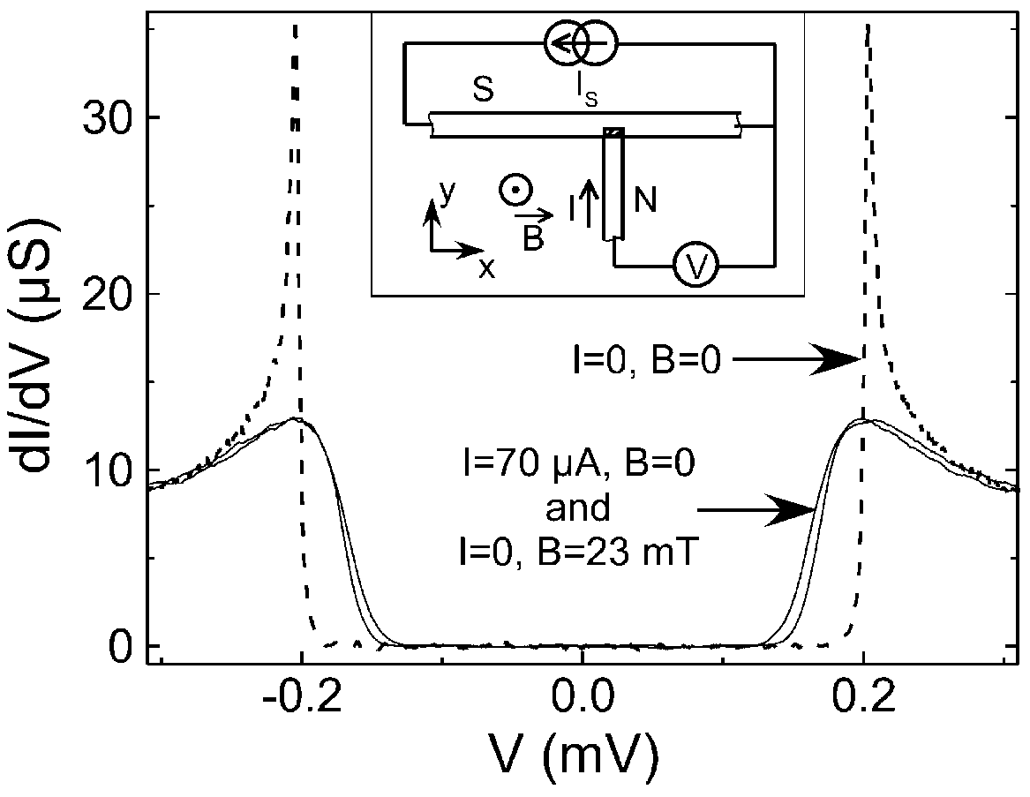
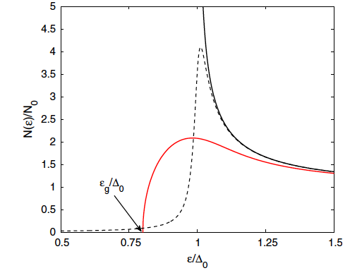
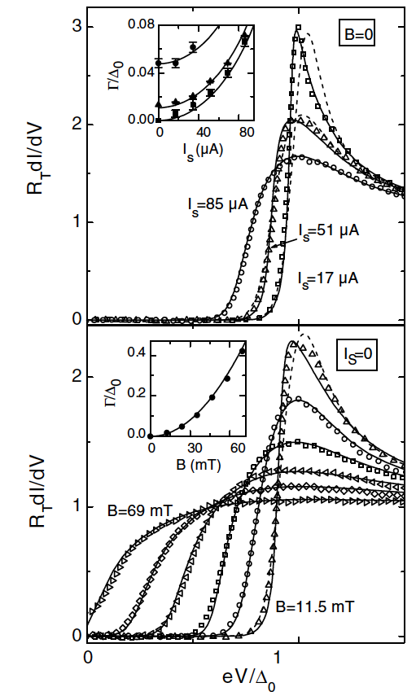
Current-induced broadening in dirty limit
Dynes natural
broadening
at J = 0
BCS
at J=0
Broadening of the gap peaks in N(ε) by current was calculated some 50 years ago:
K. Maki, Prog. Theor. Phys. 29, 10; 333 (1963);
in Superconductivity, part 2, ed. R.D. Parks, 1967;
P. Fulde, Phys Rev. 137, A783 (1965)
current
N(ε) oscillates between black (H=0) and red (H=H_{a}) curves
If H > H_{c}(γ/Δ)^{3/4} the current-induced broadening takes over:
Tunnelinng measurements by Anthore,
Pothier, and Esteve, on a 40 nm Al wire, PRL 90, 127001 (2003)
A poor man prediction of logarithmic decrease of R_{s}(H)

Slide 10
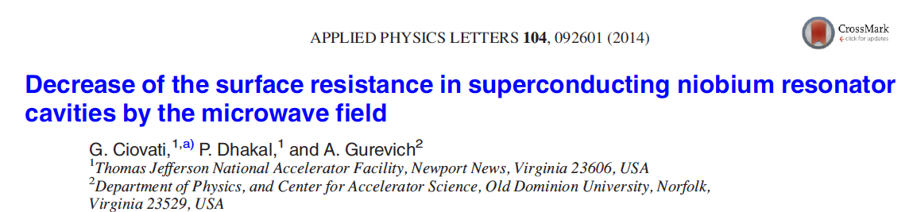
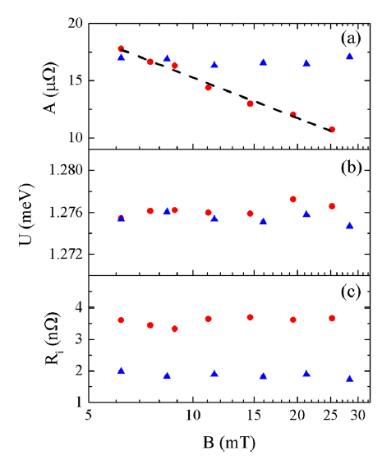
Sanity check from experiment
Arrhenius fit of the Ti-doped Jlab data using
the generic formula:
where A(H), U(H) and R_{i}(H) were measured at
different fields
Take into account rf heating to provide
stable fit in a wide temperature range
Both U and R_{i} depend weakly on H, but A exhibits a logarithmic decrease, consistent
with the above qualitative consideration

Slide 11
Can Mattis-Bardeen help us obtain R_{s}(H) at high fields?
Linear response nonlocal relation for the current density J induced by a weak
magnetic vector potential A
R_{s} is defined by the exponentially small, out-of-phase dissipative component of J which
must be calculated with big care.
I(ω,R,T) is given by a complicated MB integral which is entirely determined by the
density of states and coherence factors of a clean superconductor.
The effect of impurities is accounted by the factor exp(-R/l)
What if we substitute current-broadened N(ε,J) and the coherence factors into the M-B
I(ω,R,T) to calculate R_{s}(H) at high fields? B.P. Xiao, C.E. Reece, M.J. Kelly, Physica C490, 26 (2013)
M-B theory cannot be used to calculate the nonlinear response by
inserting field-dependent parameters in the linear conductivity σ₁

Slide 12
Why a quick fix of M-B does not work?
The M-B factorization I(ω,R,T)×exp(-R/l)
only works at very weak fields below few mT:
At high fields current pairbreaking becomes
intertwined with impurity scattering which
affect both N(ε) and the coherent factors
clean
Problems of calculation of R_{s}(H)
Go back to BCS and rederive R_{s}(H) at high fields
Solve nonlinear dynamic BCS equations with
strongly oscillating N(ε) and other parameters
To account nonlinear current pairbreaking and kinetics
of nonequilibrium quasiparticles at strong rf fields
Much more complicated problem than the
low-field M-B linear response
dirty
N(ε) in the clean limit is
very different from N(ε) in
the dirty limit

Slide 13
Nonequilibrium theory in the dirty limit
A.I. Larkin and Yu.N. Ovchinnikov, In Nonequilibrium
Superconductivity, (North Holland, 1986),
W. Belzig, et al Superlatt. & Microstruct. 25, 1251 (1999).
N.B. Kopnin, Theory of Nonequilibrium Superconductivity (2001).
time-dependent Usadel equation for 4x4 matrix Green’s functions
A(r,t) is the magnetic vector potential,
nonlinear electromagnetic response for slow variations of A(r,t) at low frequencies hν << kT
D(t,t’) explicitly depends on both A(r,t) and the impurity mean free path

Slide 14
Results
A.Gurevich, Phys. Rev. Lett 113, 087001 (2014).
Slow temporal and spatial variations of J(x,t):
λ >> ξ and hω << kT.
rf driving parameter:
Nonlinear conductivity as a function of rf amplitude:
Quasiparticle gap
reduced by current
Temporal oscillations of spectral function M(t):
Δ₀ is the SC gap at H =0

Slide 15
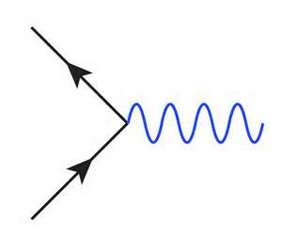
Nonequilibrium superconductivity
Oscillating rf field causes strongly oscillating density of states N(ε,t) which drives quasi-particles out of equilibrium
BCS
at J=0
Dynes natural
broadening
at J = 0
Non Fermi-Dirac
distribution function
current
Temporal oscillations of the quasiparticle
density under strong rf fields
dissociated
quasiparticles
Do quasiparticles have enough time during
the rf period (1 ns) to absorb a phonon
and recombine at low T?
phonon
Cooper pair
at hν << Δ the number of quasiparticles
can only change due to dissociation
and recombination of Cooper pairs
caused by electron-phonon collisions
Oscillating or frozen density of quasiparticles?

Slide 16
RF power transfer mechanisms
phonon-assisted dissociation
and recombination of Cooper pairs
inelastic scattering of quasiparticles
on thermal phonons
e
phonon
dissociated
quasiparticles
phonon
e
Cooper pair
does not change the number
of quasiparticles
changes the number of quasiparticles
For Nb @ 2K, τ_{r} ≅ 400 ns
For Nb @ 2K, τ_{s} ≅ 17 ns
Kaplan, Chi, Langenberg, Chang, Jafarey, Scalapino PRB 14, 4854 (1976)
Both processes transfer the absorbed rf power from quasiparticles to the lattice, but
because (τ_{r}, τ_{s}) >> ν⁻¹ = 0.5 ns (2GHz), electrons cannot effectively transfer power
during the rf period: quasiparticles are overheated with respect to the lattice:
Temperature of electrons T(H) is higher than temperature of the lattice
frozen density of quasiparticles does not change during the rf period

Slide 17
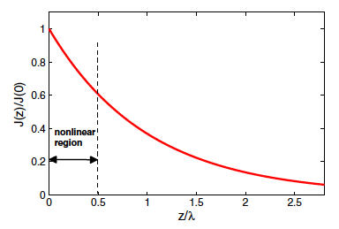
Field-dependent surface resistance
Integration of the total rf power over the region of the rf
field penetration yields the surface resistance:
R_{s} depends on the electron temperature T(H) which is determined self-consistently
by the global power balance:
α is determined by multiple mechanisms of the rf power transfer
which of the three is a
bottleneck?
electron
overheating
diffusion
of heat
Kapitza

Slide 18
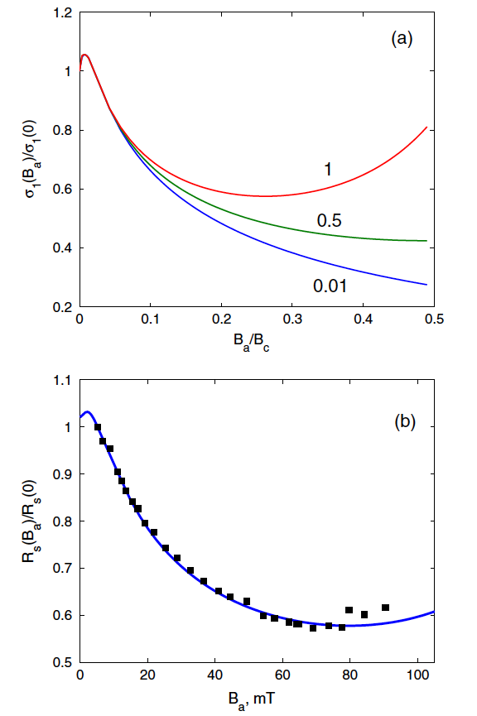
Good agreement with experiment
different values of α
Fast Matlab code to calculate R_{s}(H)
3-4 fold microwave reduction of σ₁(H)
for weak overheating, α < 0.1
Of α = 0.91 used to fit the data indicates
significant electron overheating as only 9%
comes from the phonon heat transfer.
For α = 0.91, the maximum overheating
remains weak even at the breakdown field
where ΔT ≈ 0.17 K
Microwave suppression of R_{s} (H) is not a
“new BCS”: it can be derived from the
dynamic BCS at low temperatures and
frequencies hf << kT in the dirty limit
α = 0.91
1400 C data from P. Dhakal et al,
Phys Rev. ST-AB 16, 042001 (2013)

Slide 19
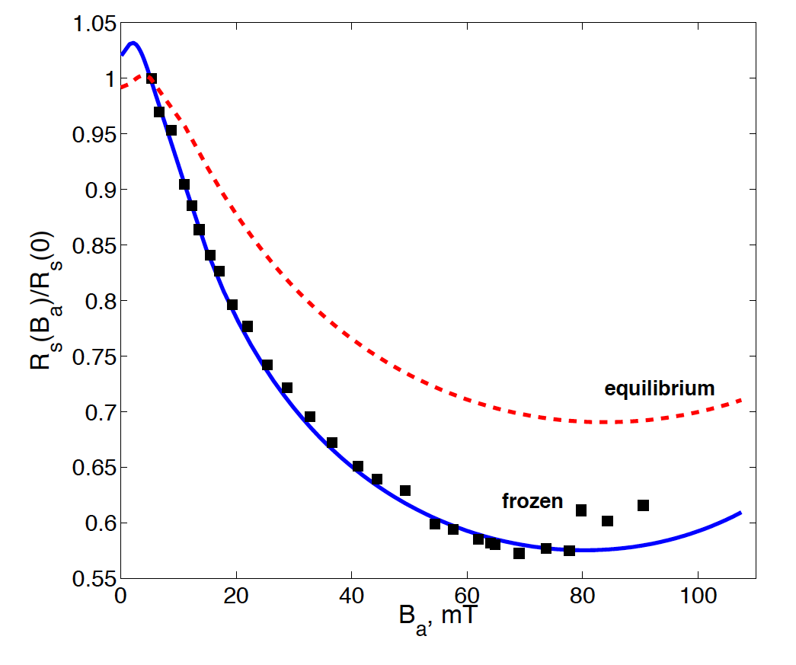
Are nonequilibrium effects important in Nb cavities?
Theory with equilibrium
distribution function and
no electron overheating is
not sufficient to explain the
observed microwave
suppression of R_{s}(H) on
1400 C Ti-alloyed cavities
A lot of poorly understood
physics of nonequilibrium
energy relaxation is hidden
in the parameter α
most likely reduced H_{c1} in the dirty limit

Slide 20
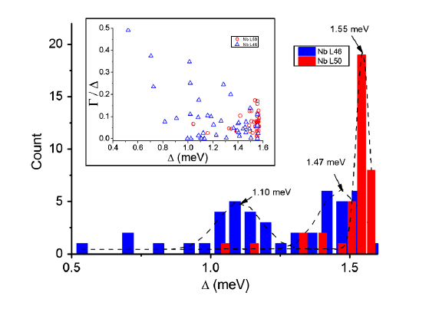
What makes it so dependent on the cavity treatment?
model
tunneling measurements
Natural
broadening
at J = 0
BCS
at J=0
current
Current-induced broadening of
N(ε) should be stronger than
the “natural” broadening
tunneling spectroscopy from P. Dhakal et al, Phys Rev. ST-AB 16, 042001 (2013)
effect of different treatments
on the subgap states
Ti-alloyed high-T heat-treated Nb cavities with
extended Q(H) rise do exhibit much sharper gap
peaks in N(ε) and much less subgap states

Slide 21
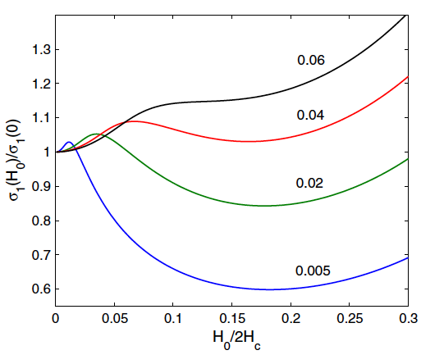
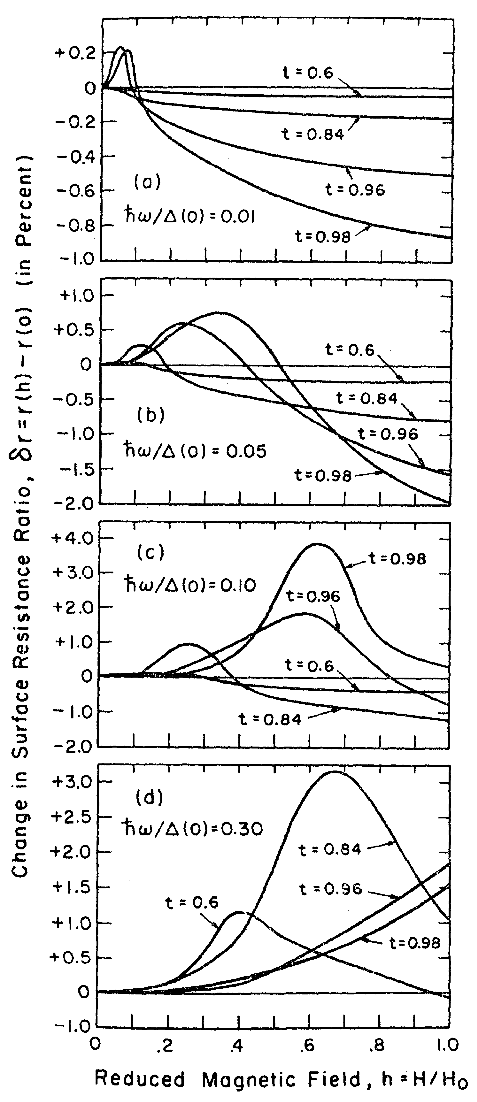
Tuning R_{s} for weak rf field with parallel dc field
Superimposed parallel strong dc and weak rf fields probe the rf suppression of R_{s}(H) under equilibrium conditions
H_{a}
H₀
R_{s}(f,H₀) tuned
by dc field
Similar to old
calculations of
R_{s}(H) for the
clean limit
Calculated for different ratios of hν/Δ
AG, PRL 113, 087001 (2014).
M.P. Garfunkel, Phys. Rev.
173, 516 (1968)

Slide 22
Can the extended Q(H) rise in N-doped Nb cavities be extended above the superheating field of Nb?
Possible cure by optimized dirty layer?
Alloyed Nb
film of optimum
thickness
H_{s}, H_{c1}?
Cavity grade
bulk Nb
A few nm thick
Al₂O₃ spacer
A. Grasselino et al, SUST 26, 102001 (2013)
A few μm thick dirty layer at the surface
Increases the GL parameter κ = λ/ξ, and
decreases both H_{s} and H_{c1}:
To combine the extended Q(B) rise and
to reverse the reduction of H_{c1} and H_{s}
Use an optimized Nb bilayer to push
the breakdown field above both
superheating fields up to 250-300 mT
before
after
A. Gurevich, AIP Advances, 5, 017112 (2015)

Slide 23
Conclusions
Extended Q(H) rise occurs as N or Ti doping results in a dirty layer with non-suppressed
T_{c} and Δ at the cavity surface. Penalty of reduced H_{c1} and H_{s}
The microwave suppression of R_{s}(H) is not unique to Nb cavities: it has been observed
on many other materials.
The effect results from the well-know current-induced broadening of the gap peaks
in the density of states in the BCS theory at hν << kT.
A theory of R_{s}(H) was proposed based on the solution of time-dependent Usadel
equations of nonequilibrium BCS superconductivity in the dirty limit. Dependence of
R_{s}(H) on the mean free path at high fields can be different from R_{s} at low fields
Good agreement with experiments on Ti and N-alloyed Nb cavities
Extended Q(H) rise is facilitated by sharper peaks in the density of states N(ε)
and fewer subgap states. Apparently it is what Ti or N-doping does.
Possibility to extend the extended Q(H) rise beyond the superheating field of Nb
by depositing optimized N-doped Nb multilayers

