Slide 1
SNS Operational History
J. Mammosser
(material from S-H Kim)

Slide 2
SNS Linac Operational Strategy
During the startup period when beam power was ramped up the SCL linac operational knowledge was developed
  Many of the operational limitations were identified, issues were identified and some problems were resolved
  Cavity to cavity interactions were identified
  Careful startup was identified as necessary to reduce risks of degradation in performance
  Vacuum trips were a consistent limitation to easy startup
This understanding developed the strategy

Slide 3
To have high availability while keeping high power beam operation requires:
Understanding of the machine & reliable machine setup as a whole
Systems should be as simple as possible
Adequate diagnostics/protection needed to be developed
Have energy margin is needed to take advantage of operational flexibility
      to circumvent problems that can’t be addressed during operation and to minimize a down time
Proactive/preventative maintenance was needed
Good communication between machine experts and machine operators was necessary

Slide 4
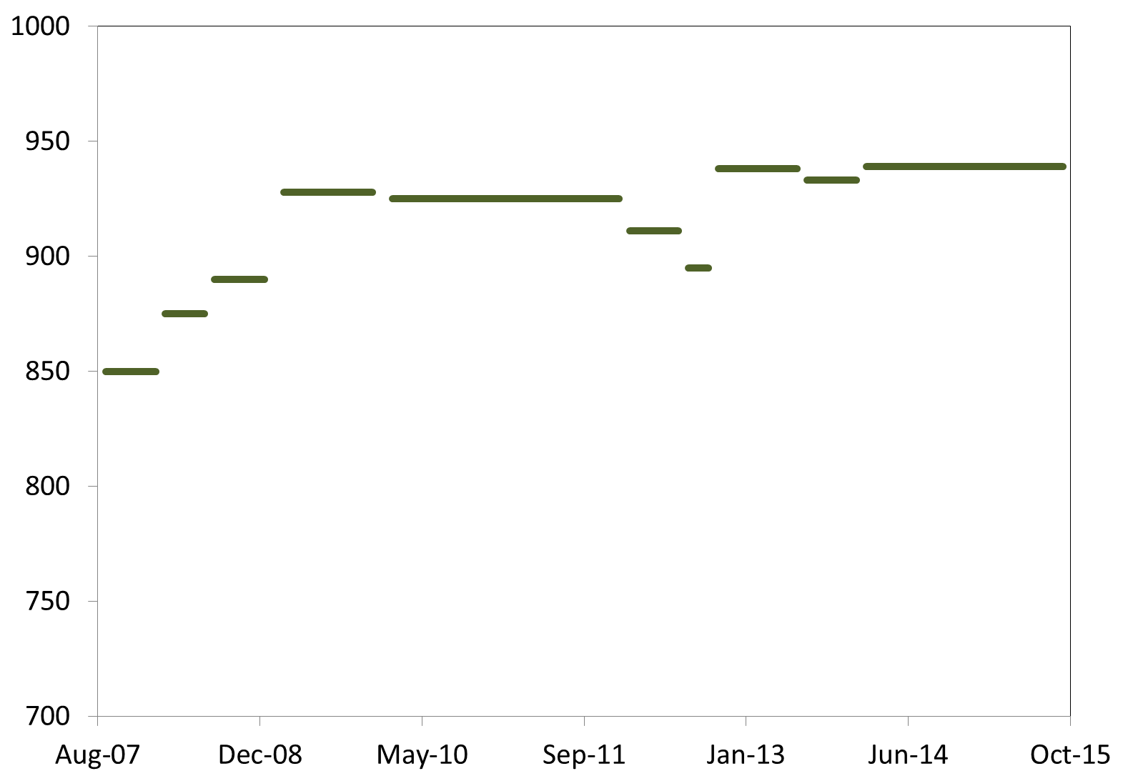
Linac Output Energy History at 60Hz
Changes of output energies are the result from specific activities and events
CM6, CM20 out
for repair
Recognized
Errant
Beam
Full pulse length
for 1.4 MW
3 cavities
Turned off
(errant beam)
Additional
HVCM
High beta spare CM in for slot 20
Linac Output Energy (MeV)
RF/Control improvement
Two CM Repairs
Other misc.
CM6 in
Worst performing CM (CM19) out,
CM 20 in for slot 19

Slide 5
Performance degradation during operation
Degradation related to vacuum activity
  Observed performance degradations from ten cavities
  Beam halo, errant beam, e- activity and ion pump pressure spike
    Desorption and redistribution of gas → could create conditions for vacuum breakdown or hot spots
    Main event: Interaction with RF (one of the worst case is surface damage and particulate contamination)
    Not every event makes a cavity trip. But the probability for degradation increases with frequency and intensity of events
Other potential degradation related to particulate contamination
  Gate valve operation
When a cavity shows a symptom of performance degradation, the gradient is lowered slightly (typically lowered by 1 MV/m or less) to avoid further degradation and to minimize downtime
  Early diagnostics and prompt involvement from system experts are the key to minimize additional degradation

Slide 6
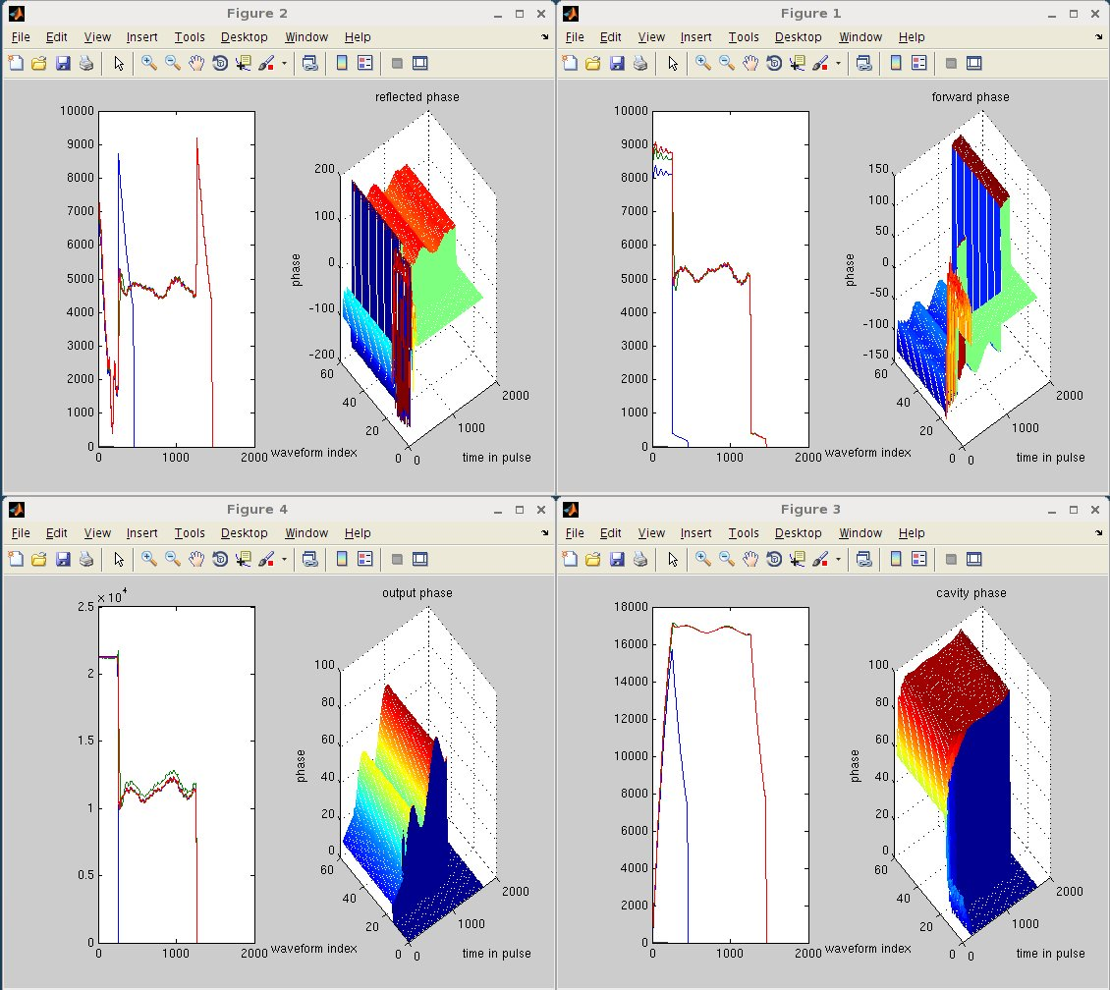
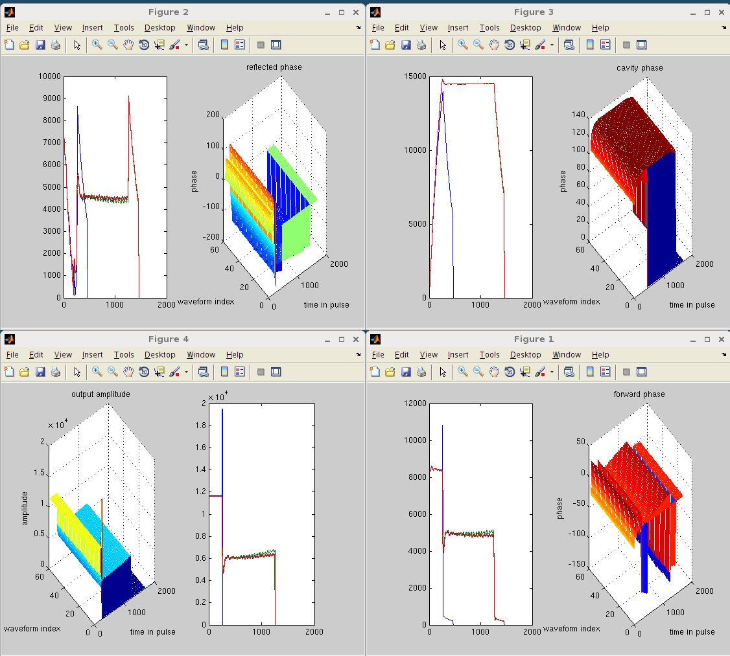
RF waveforms at cavity trip
Very useful to understand the trip event
LLRF
Drive
HPRF
Forward
Eacc
HVCM
Voltage
Fluctuation
or
Instability of HPRF
Trip case 1
In both cases, cavities tripped because cavity field did not reach set-point during filling time
Eacc
LLRF
Drive
HPRF
Forward
Cavity
partial
quench
Trip case 2

Slide 7
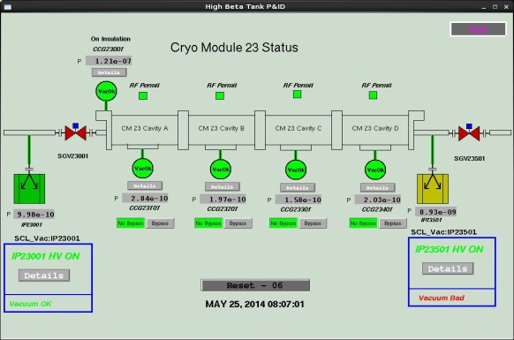
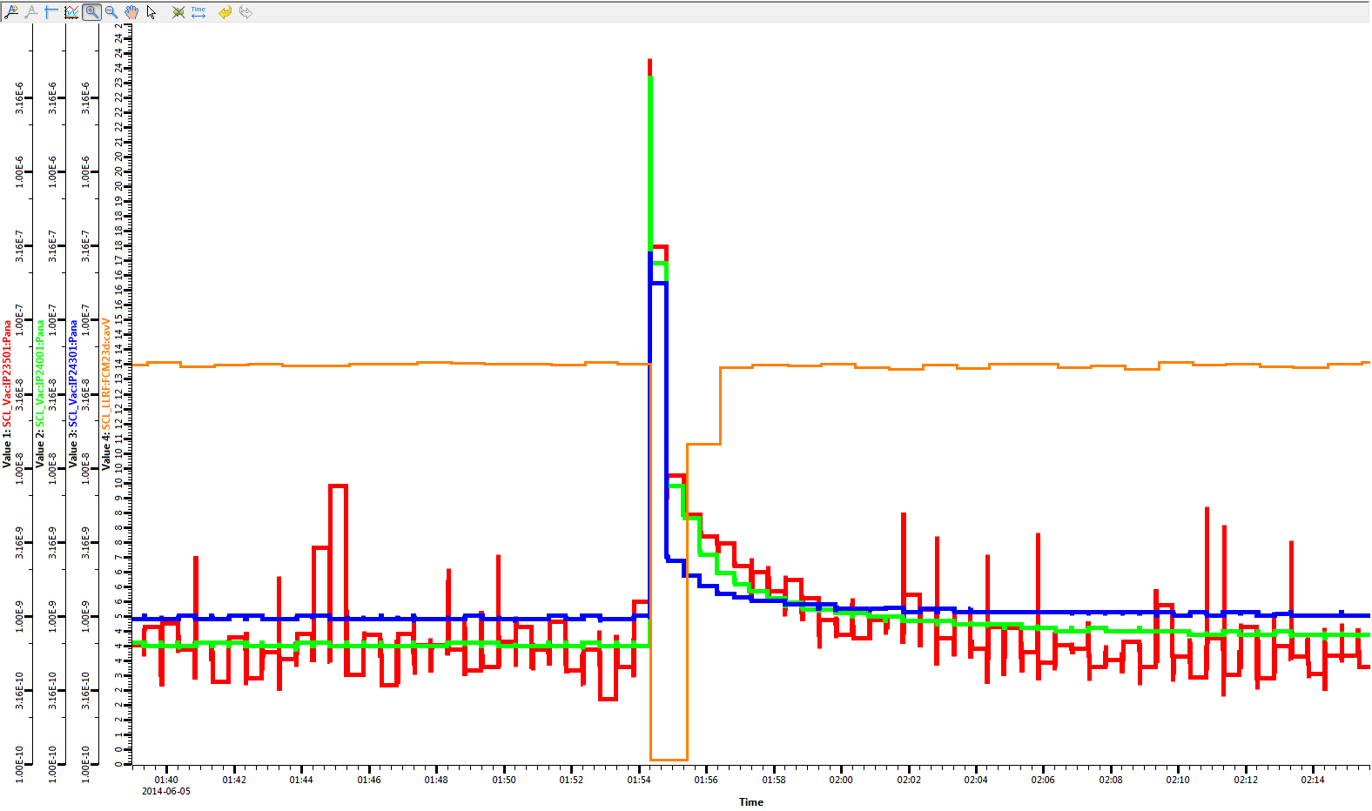
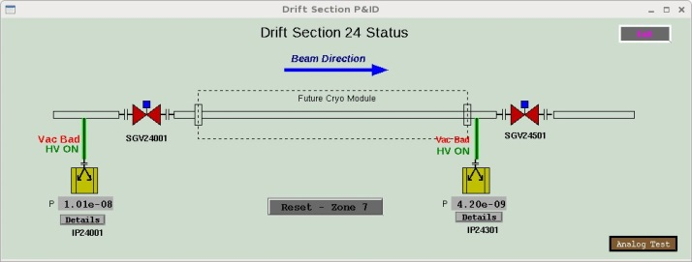
Ion pump pressure spike example
A cavity was tripping with ion pump pressure spikes. Slight performance degradation (~1 MV/m) was observed.
The cavity trips and pressure spikes became more frequent
  What is the root cause?
To verify the cause we turned off one ion pump after interlock logic changes
  No trip since summer 2014
Vacuum reading
from ion pumps
Cavity field

Slide 8
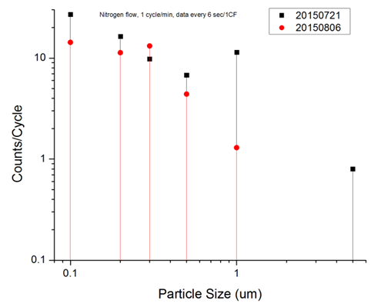
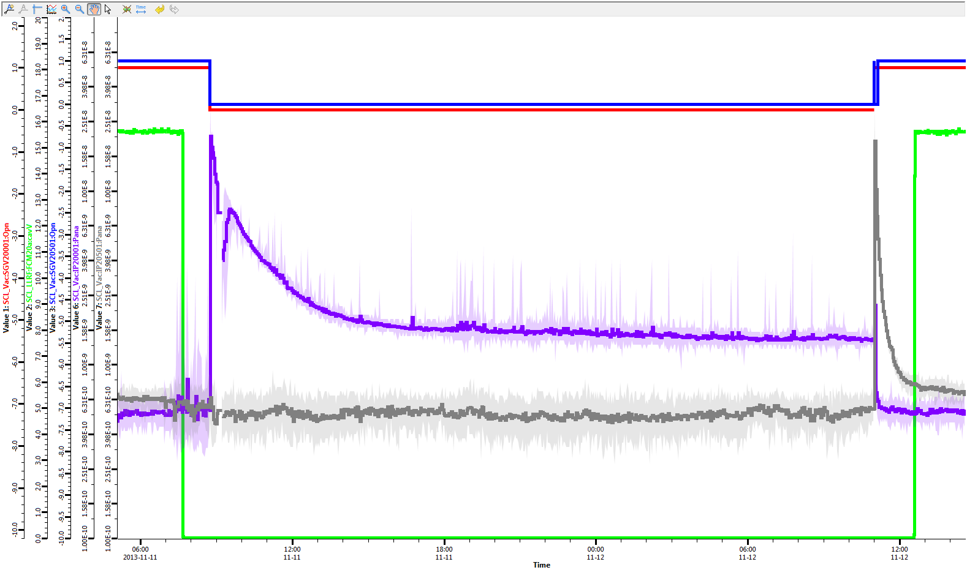
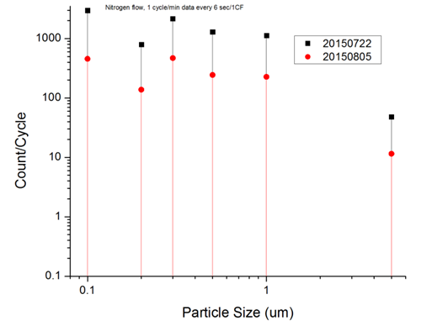
Gate valve
Valve actuations causing pressure spikes: observed from a few valves in the tunnel
Particulate generation are measured on the test bench
  Tested gate valves from three vendors
Valve verification before installation
During operation: Minimize valve actuation
Vendor 1
open
open
Valve closed
Warm section IP
CM IP
Vendor 3

Slide 9
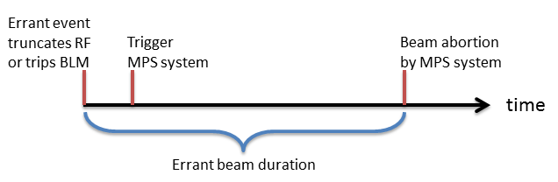
Errant beam (I)
Our definition:
  Off-energy beam generated from a fault condition
  Beam transported downstream and lost until beam abortion by MPS system
Main sources of errant beam
  Warm linac RF truncation: arc, pressure burst, etc.
  Ion source/LEBT: arc, unstable plasma, etc.
SCL beam loss monitors (BLM) are the primary indication of errant beam event
MPS delay: time between RF truncation/BLM trips and beam abortion
  It was recognized that MPS delay was too long in 2009 :~300 us
  MPS circuit was fixed in 2010 → MPS delay: 25 us→ with dedicated MPS for errant beam: 17 us

Slide 10
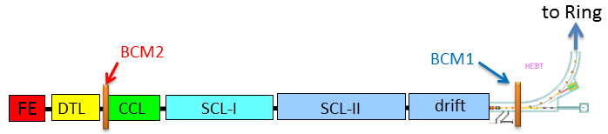
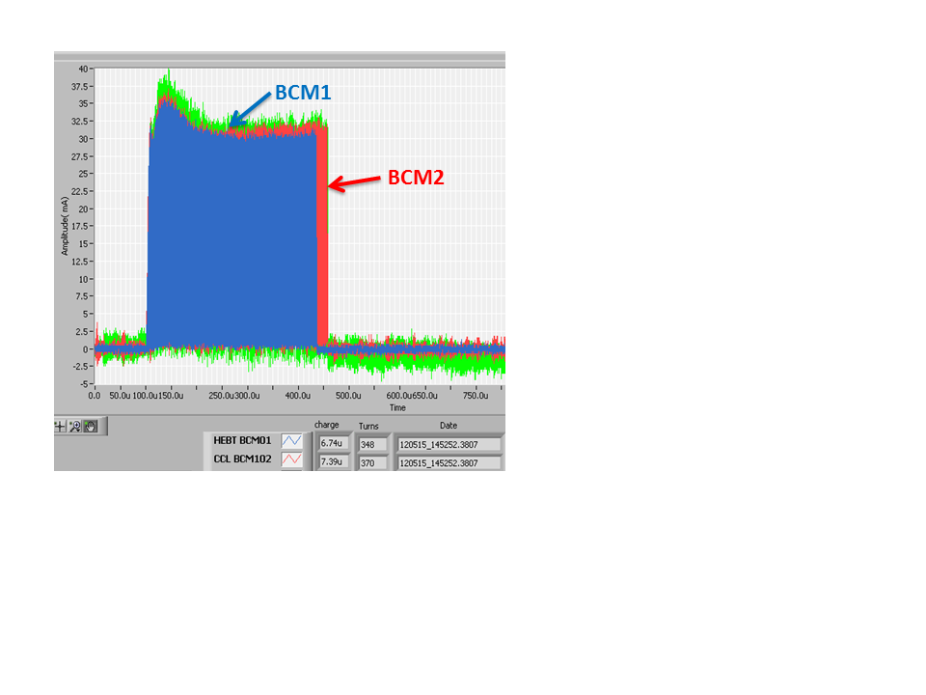
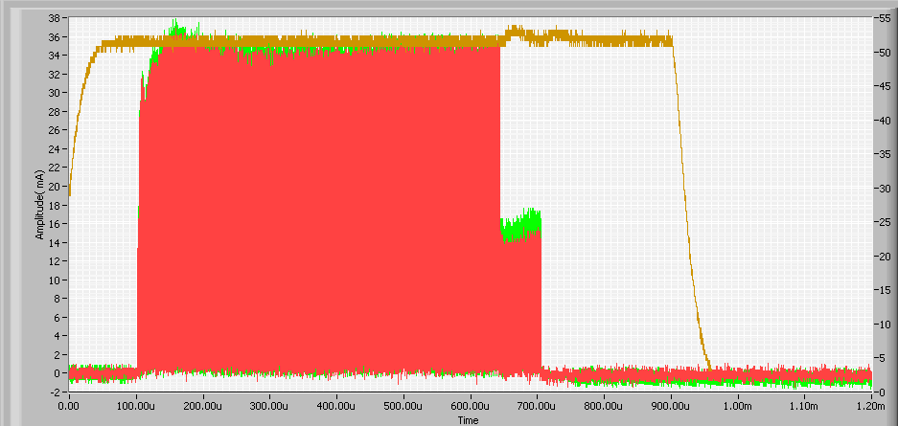
Errant beam (II)
Errant beam hitting a cavity surface desorbs gas and could create vacuum breakdown environment
Errant beam events before 2012: 35 per day
    Performance degradations by errant beam were observed
Warm linac RF truncation
In this example,
20-25 us beam
lost in SCL
  More diagnostics were added to detect errant beam event
  Due to this, more careful operation/conditioning of all warm linac structures and front end
Errant beam events after 2012: 15 per day
    Dedicated MPS circuit for errant beam event is recently installed: MPS delay <17 us
Errant beam events since 08/2015: 5 per day
  Warm linac vacuum system was improved last summer
Example of
abnormal beam from ion source

Slide 11
Beam halo
Performance degradation from beam halo is observed in the first few cryomodules of the SC linac
It is difficult to diagnose since the process is very slow
  BLM is less sensitive at low energy region
  Temperature diodes sometimes indicate slight temperature increment before quench
  Degradation seems to develop over a long time
  Cavity becomes very sensitive to small changes of operating conditions
Beam scraping in the front-end helps
More sensitive BLMs for low energy region are being prepared

Slide 12
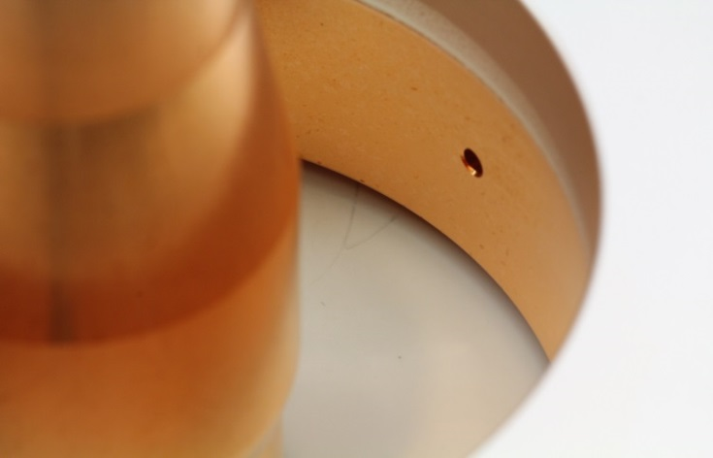
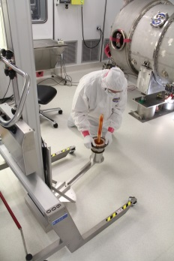
Performance degradation, component damages and recovery
Most frequent symptom is hot spot creation in the end group
  Dynamic load changes 10 times higher
    Some cavities run in this condition
    Some others need lower Eacc by <1MV/m
  No changes of x-rays
  Once hot spot is developed, no correlation with beam
  Recovery
    RF conditioning starting from low repetition rate
    Thermal cycling
Other degradation/component damage
  Two FPC windows showed leak after errant beam events in 2009
    ~10⁻⁶ torr l/s leaks, both were replaced with new FPCs at the SNS test facility and reinstalled in the tunnel
  Another cavity is arcing around FPC/end group: turned off for now.

Slide 13
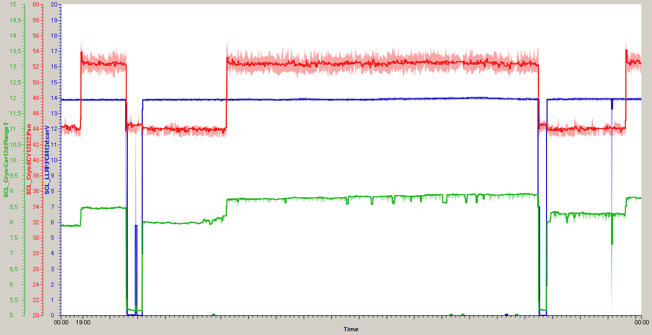
Hot spot example 1: meta-stable condition at the same gradient
JT valve position (10% more: 50-60 W)
Cavity gradient
Coupler flange temperature
(not hottest spot)
Some part in the end group (must be very low field region) must be normal conducting but still operable
Additional cryogenic load at 2K is about 50W more from one cavity (would be 800W in CW)

Slide 14
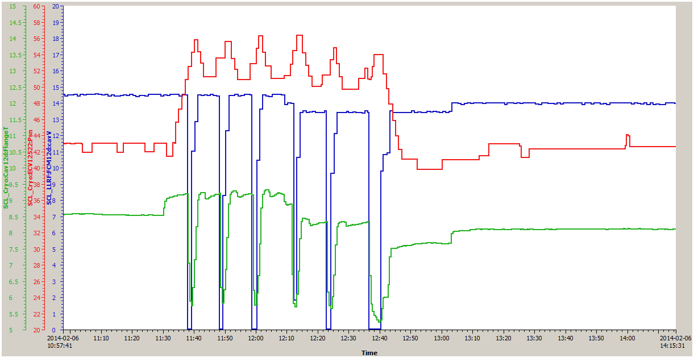
Hot spot example 2: unstable condition
JT valve position (10% more 50-60 W)
Cavity gradient
Coupler flange temperature
(not hottest spot)
Reduce gradient during operation by 0.5-1MV/m due to end group quench
Cavity still unstable → have to wait 10-15 min. for cool-down
Performance recovered by thermal cycle during long-maintenance period

Slide 15
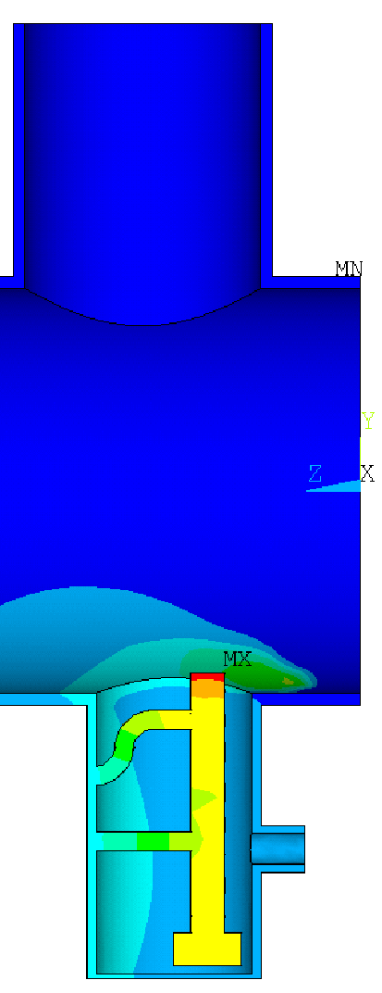
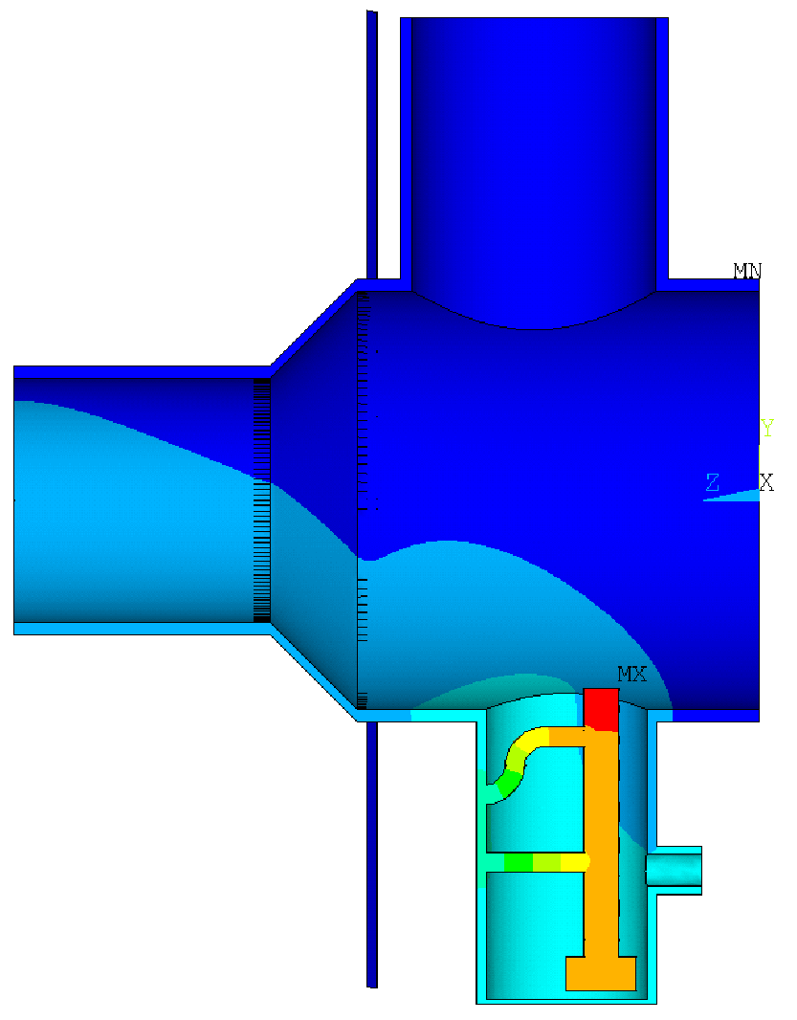
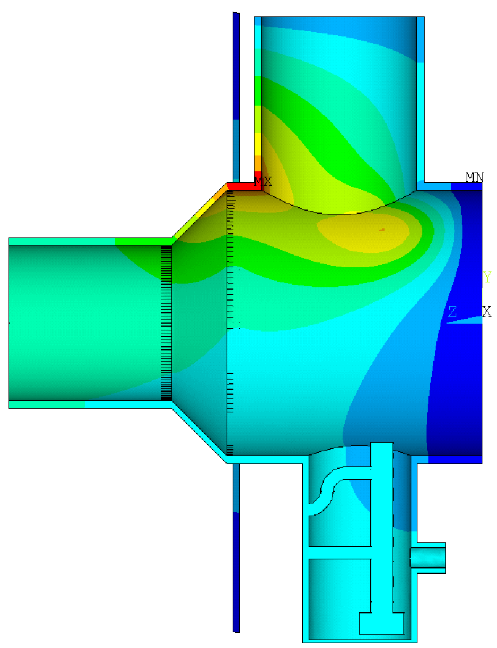

Slide 16
Summary
The SNS SCL is providing stable operation for the neutron production up to 1.4 MW beam power on target
  Understanding of system as a whole leads to the most efficient and reliable operation
Causes for performance degradation during operation at SNS are identified
  Continuous development of dedicated diagnostics and protection systems
  Recovery actions including thermal cycling and offline repair are ongoing

