Slide 1

Trapped flux dissipation in SRF cavities: experimental results and model
Martina Martinello
TTC Meeting, SLAC
2 December 2015

Slide 2

Outline
Introduction
Experimental procedure
Trapped flux sensitivity
Consistency of the calculation
Mean free path calculation
Sensitivity vs Mean free path
Trapped flux theoretical model
Conclusions

Slide 3
Introduction on Sensitivity
Accelerators in CW need very low surface resistance to decrease cryogenic costs
To maintain the ultra-high Q-factors of N-doped cavities it is necessary to reduce the trapped field losses
This losses can be reduced by:
  Minimizing environmental field B_{ext}
  Minimizing trapped field with fast cooldown and bulk material optimization
  Minimizing trapped flux sensitivity

Slide 4
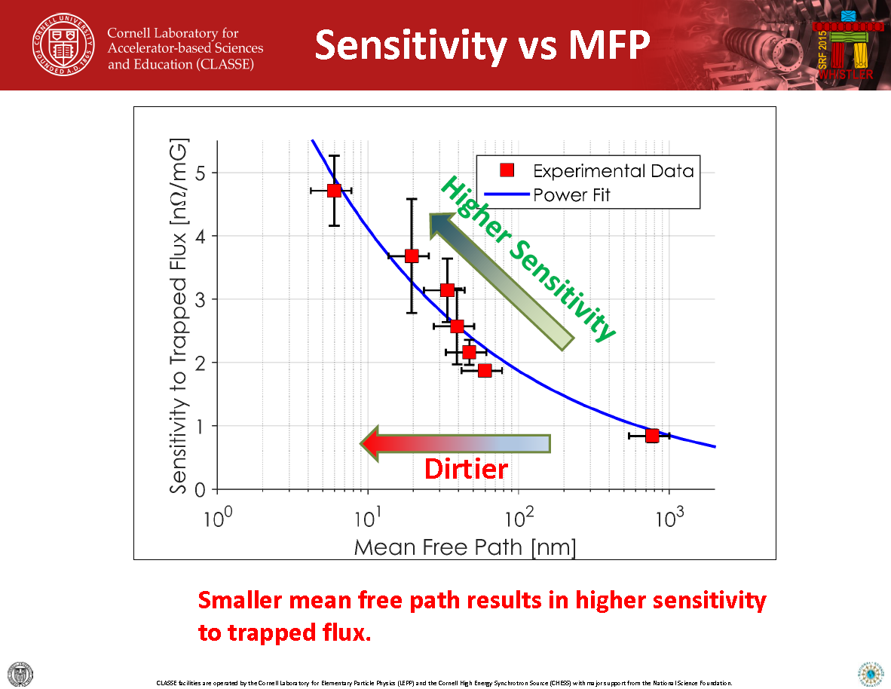
Previous Results
Slide from D. Gonnella SRF 2015

Slide 5
Outline
Introduction
Experimental procedure
Trapped flux sensitivity
Consistency of the calculation
Mean free path calculation
Sensitivity vs Mean free path
Trapped flux theoretical model
Conclusions

Slide 6
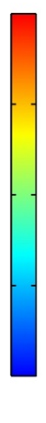

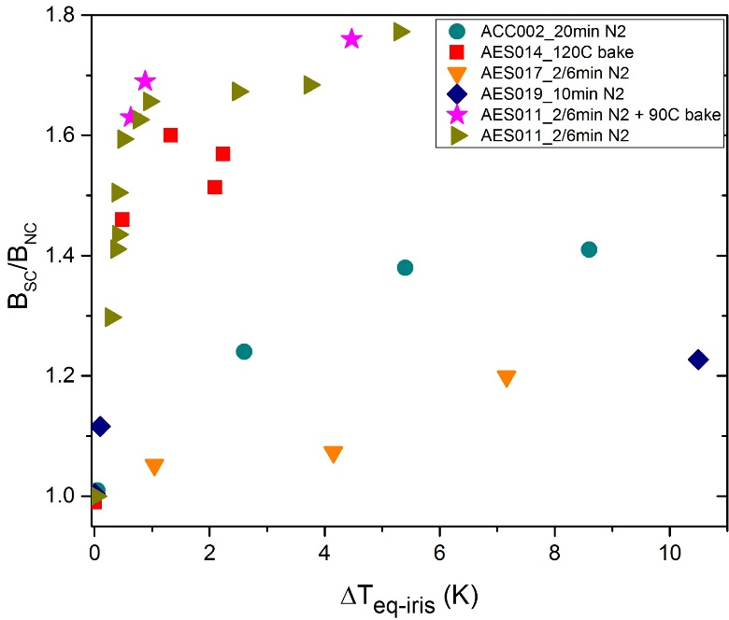
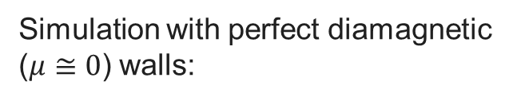
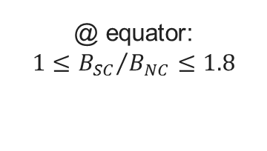
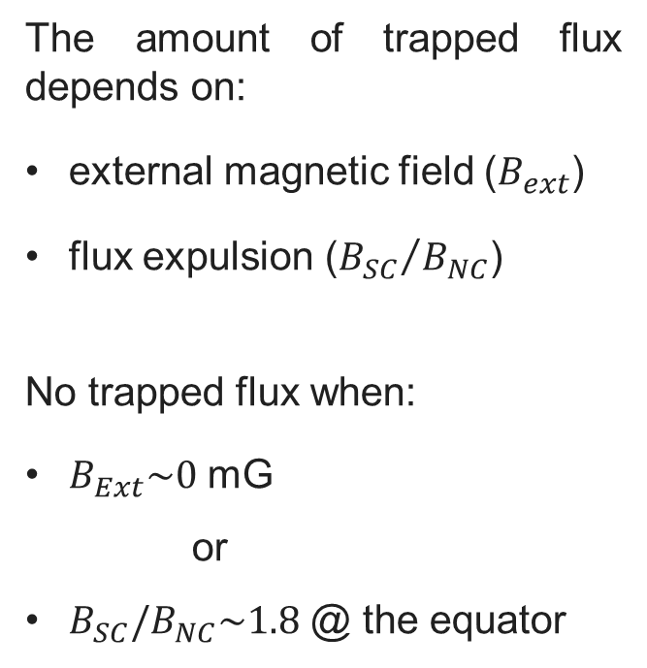
Flux Trapping during Cooldown
Simulation with perfect diamagnetic ($μ≅0$) walls:
2
The amount of trapped flux depends on:
external magnetic field ($B_{ext}$)
flux expulsion (${B_{SC}}/{B_{NC}}$)
No trapped flux when:
      $B_{Ext}\sim 0$ mG
      or
      $B_{SC}/B_{NC}\sim 1.8$ @ the equator
1.5
@ equator:
$$1≤{B_{SC}}/{B_{NC}≤1.8}$$
1
0.5
0
Magnetic flux fully expelled
Magnetic flux fully trapped

Slide 7



Trapped Flux Surface Resistance
The surface resistance is defined as:
$$R_{0}+R_{Fl}(B_{Trap})$$
$$R_{S}(T,B_{Trap})=R_{BCS}(T)+R_{res}$$
“Intrinsic” residual resistance
Trapped flux surface resistance
At low T (1.5K):
$$R_{S}(1.5 K,B_{Trap})≅R_{o}+R_{FL}(B_{Trap})$$
The trapped flux surface resistance can be defined as:
$$R_{FL}\left(B_{Trap}\right)=R_{S}\left(1.5 K,B_{Trap}\right)−R_{0}$$

Slide 8



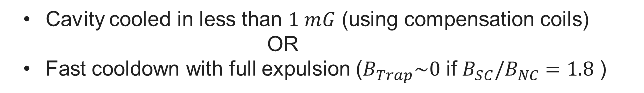

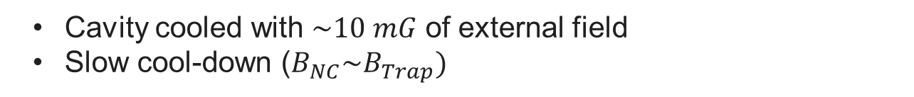
Experimental procedure
$$R_{Fl}\left(B_{Trap}\right)=R_{S}\left(1.5 K,B_{Trap}\right)−R_{0}$$
In order to estimate $R_{S}\left({1.5 K,B}_{Trap}\right):$
Cavity cooled with $\sim 10 mG$ of external field
Slow cool-down ($B_{NC}\sim B_{Trap})$
In order to estimate $R_{0}:$
Cavity cooled in less than $1 mG$ (using compensation coils)
OR
Fast cooldown with full expulsion ($B_{Trap}\sim 0$ if $B_{SC}/B_{NC}=1.8$ )
$$R_{S}(1.5K,B_{Trap}=0)≅R_{o}$$

Slide 9
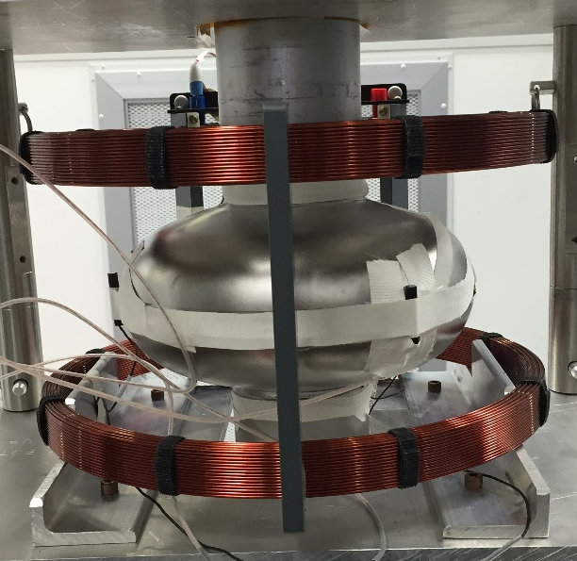
Cavity instrumentation
Helmholtz Coil
3 fluxgates at the equator
3 thermometers:
  Bottom iris
  Equator
  Upper iris

Slide 10
Outline
Introduction
Experimental procedure
Trapped flux sensitivity
Consistency of the calculation
Mean free path calculation
Sensitivity vs Mean free path
Trapped flux theoretical model
Conclusions

Slide 11
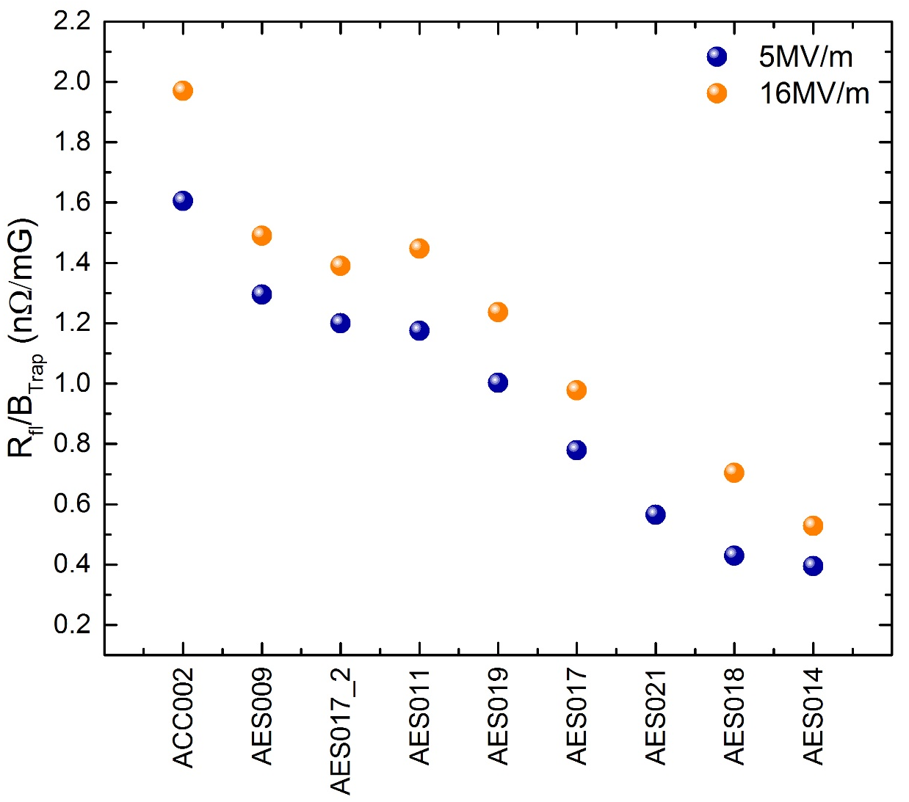
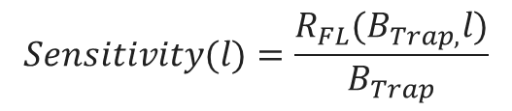
Trapped Flux Sensitivity
  Trapped flux sensitivity defined how much the cavity dissipate per unit of trapped magnetic field :
$$Sensitivity(l)=\frac{R_{FL}(B_{Trap,}l)}{B_{Trap}}$$
120C baked
  Cavities subject to different surface treatment show different trapped flux sensitivity
EP
N doped
“Air doped”

Slide 12
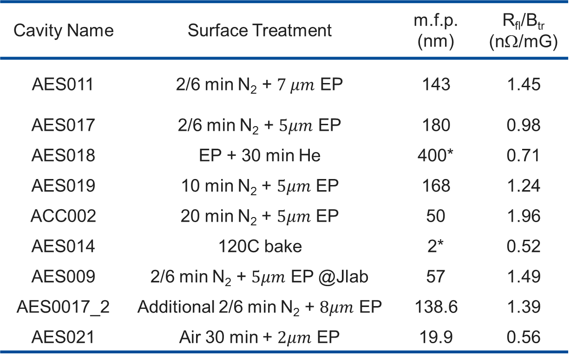
Sensitivity vs Surface Treatments
Cavity Name | Surface Treatment | m.f.p. (nm) | R_{fl}/B_{tr} (nΩ/mG)
AES011 | 2/6 min N₂ + $7 μm$ EP | 143 | 1.45
AES017 | 2/6 min N₂ + $5μm$ EP | 180 | 0.98
AES018 | EP + 30 min He | 400* | 0.71
AES019 | 10 min N₂ + $5μm$ EP | 168 | 1.24
ACC002 | 20 min N₂ + $5μm$ EP | 50 | 1.96
AES014 | 120C bake | 2* | 0.52
AES009 | 2/6 min N₂ + $5μm$ EP @Jlab | 57 | 1.49
AES0017_2 | Additional 2/6 min N₂ + $8μm$ EP | 138.6 | 1.39
AES021 | Air 30 min + $2μm$ EP | 19.9 | 0.56
*μ-SR measurement

Slide 13
Trapped Flux Sensitivity Field Dependence
M. Martinello, M. Checchin, A. Grassellino, A. Romanenko et Al. in Proceeding of SRF 2015
Sensitivity does have a field dependence
Lightly doped cavities have a smaller field dependence than EP
At high field the sensitivity of N doped might be comparable with EP

Slide 14


Impact of different sensitivity
N-doped
120C baked
$$B_{trap }≈0 mG$$
$$B_{trap }≈0 mG$$
1.5K

Slide 15
Impact of different sensitivity
N-doped
120C baked
120C baked Btrap=10.7mG
$$B_{trap }≈0 mG$$
$$B_{trap }≈0 mG$$
B_{trap}=10.8 mG
Sensitivity=0.5 nΩ/mG
1.5K

Slide 16
Impact of different sensitivity
N-doped
N-doped Btrap=10.8 mG
120C baked
120C baked Btrap=10.7 mG
$$B_{trap }≈0 mG$$
$$B_{trap }≈0 mG$$
B_{trap}=10.8 mG
Sensitivity=0.5 nΩ/mG
B_{trap}=10.7 mG
1.5K
Sensitivity=1.5 nΩ/mG

Slide 17
Outline
Introduction
Experimental procedure
Trapped flux sensitivity
Consistency of the calculation
Mean free path calculation
Sensitivity vs Mean free path
Trapped flux theoretical model
Conclusions

Slide 18

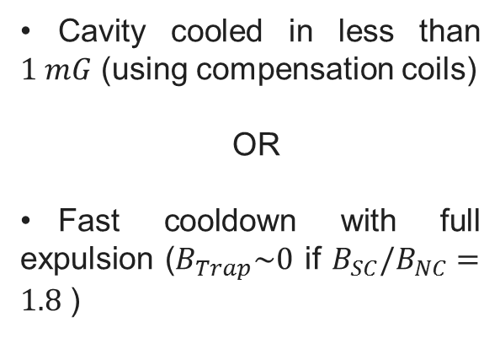
Consistency of Ro calculation
In order to estimate $R_{0}:$
Cavity cooled in less than $1 mG$ (using compensation coils)
OR
Fast cooldown with full expulsion ($B_{Trap}\sim 0$ if $B_{SC}/B_{NC}=1.8$ )
1.5 K
Same results within the measurement uncertainty

Slide 19
Consistency of the sensitivity calculation
AES009 10mG

Slide 20
Consistency of the sensitivity calculation
AES009 10mG
AES009 23mG

Slide 21
Consistency of the sensitivity calculation
AES009 10mG
AES009 23mG
AES017 10mG

Slide 22
Consistency of the sensitivity calculation
AES009 10mG
AES009 23mG
AES017 10mG
AES017 20mG

Slide 23
Consistency of the sensitivity calculation
AES009 10mG
AES009 23mG
AES017 10mG
AES017 20mG
AES019 10mG
AES009 10mG
AES009 23mG
AES017 10mG
AES017 20mG
AES019 10mG

Slide 24
Consistency of the sensitivity calculation
AES009 10mG
AES009 23mG
AES017 10mG
AES017 20mG
AES019 10mG
AES019 20mG

Slide 25
Outline
Introduction
Experimental procedure
Trapped flux sensitivity
Consistency of the calculation
Mean free path calculation
Sensitivity vs Mean free path
Trapped flux theoretical model
Conclusions

Slide 26
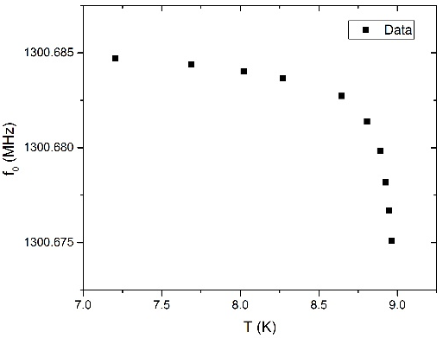
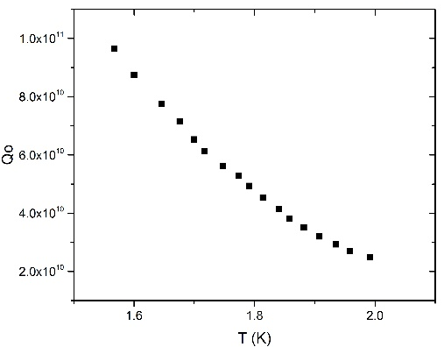
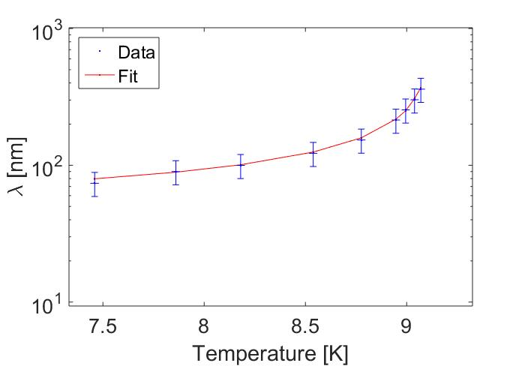
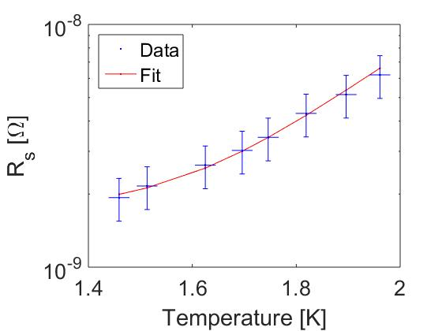
Mean Free Path Calculation using SRIMP
From frequency vs T (close to Tc) data:
From Q vs T (at low T) data:
The code used for these interpolation find the values of mean free path and energy gap which minimize the errors in both these interpolation.
Matlab SRIMP program used to calculate mean free path:
J. Halbritter, KFK-Extern, 3/70-6 (1970)
N. Valles. Ph. D. Cornell University (2013)
S. Meyers, Proceeding of LINAC 14 (2014) TUPP018

Slide 27
Outline
Introduction
Experimental procedure
Trapped flux sensitivity
Consistency of the calculation
Mean free path calculation
Sensitivity vs Mean free path
Trapped flux theoretical model
Conclusions

Slide 28
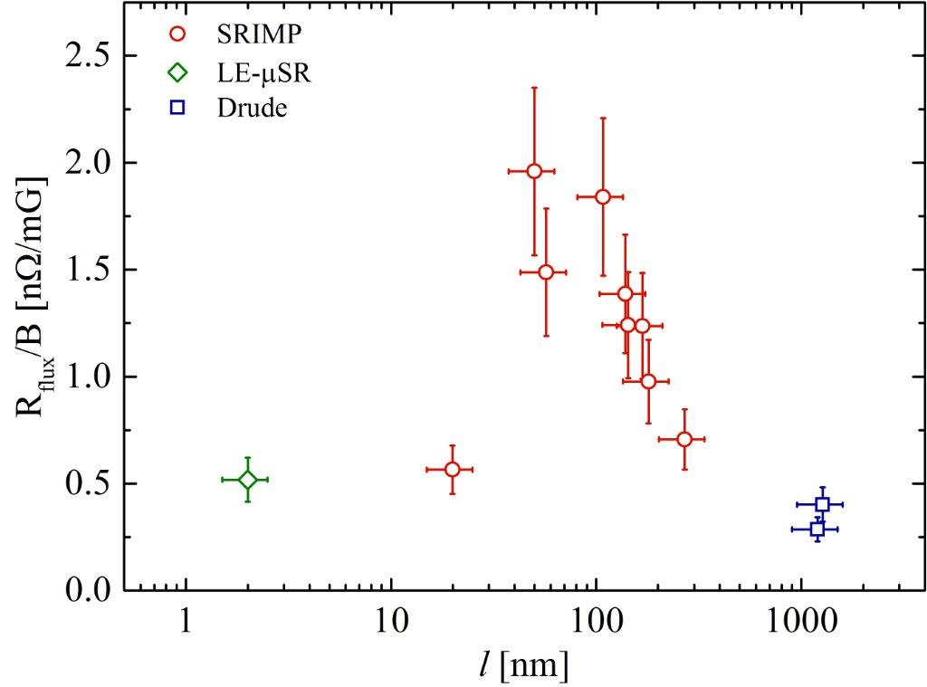
Sensitivity vs Mean Free Path
The sensitivity of the trapped flux as a function of mean free path has a maximum around $l=60nm$
M. Martinello, M. Checchin, A. Grassellino, A. Romanenko et Al. in Proceeding of SRF 2015
Over-doped
Light-doped
EP/BCP
120 C bake
Air-doped

Slide 29
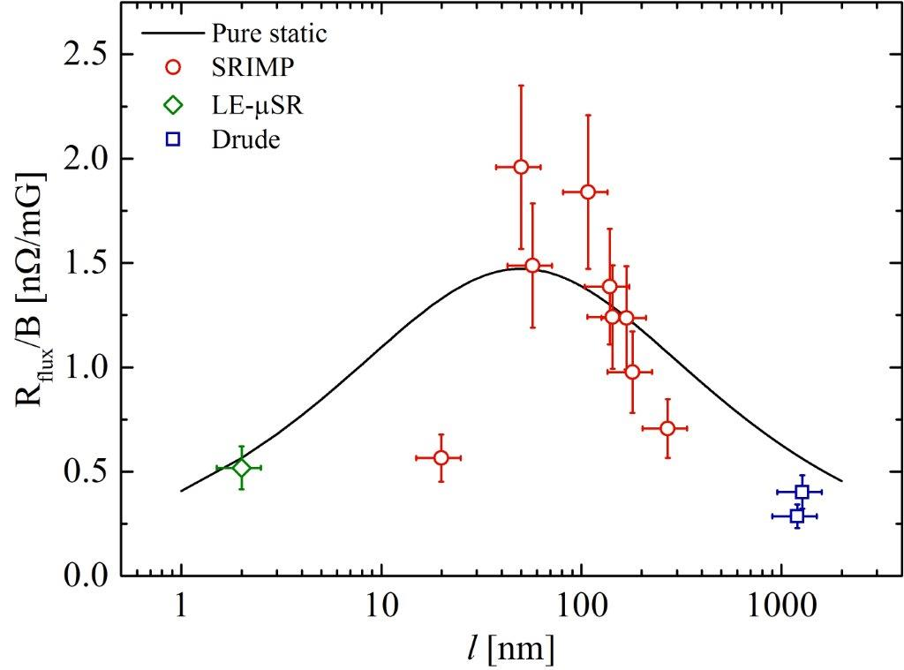
Sensitivity vs Mean Free Path
The sensitivity of the trapped flux as a function of mean free path has a maximum around $l=60nm$
M. Martinello, M. Checchin, A. Grassellino, A. Romanenko et Al. in Proceeding of SRF 2015

Slide 30
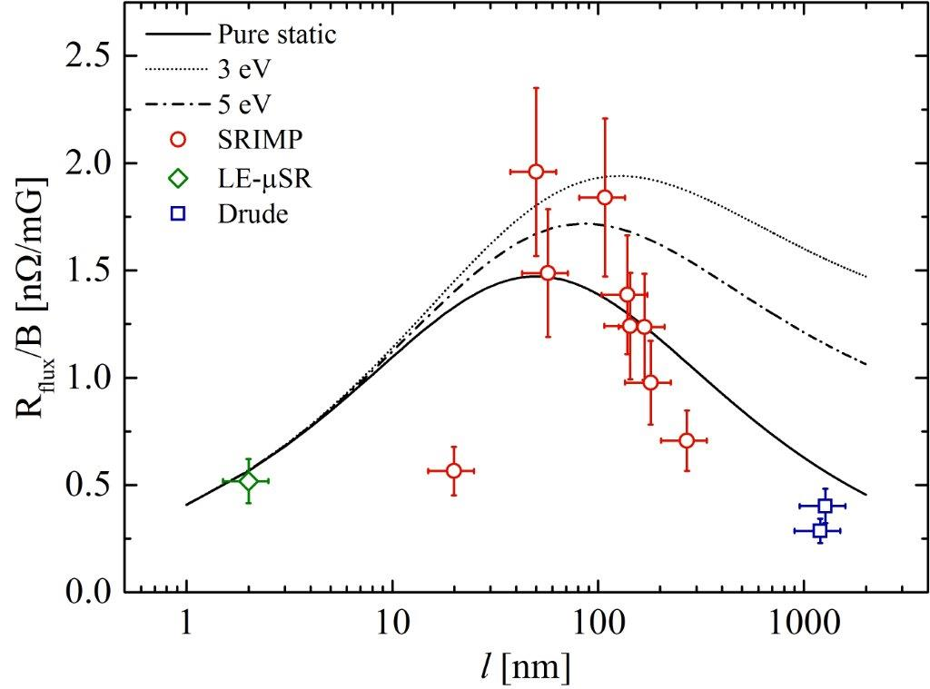
Sensitivity vs Mean Free Path
The sensitivity of the trapped flux as a function of mean free path has a maximum around $l=60nm$
M. Martinello, M. Checchin, A. Grassellino, A. Romanenko et Al. in Proceeding of SRF 2015

Slide 31
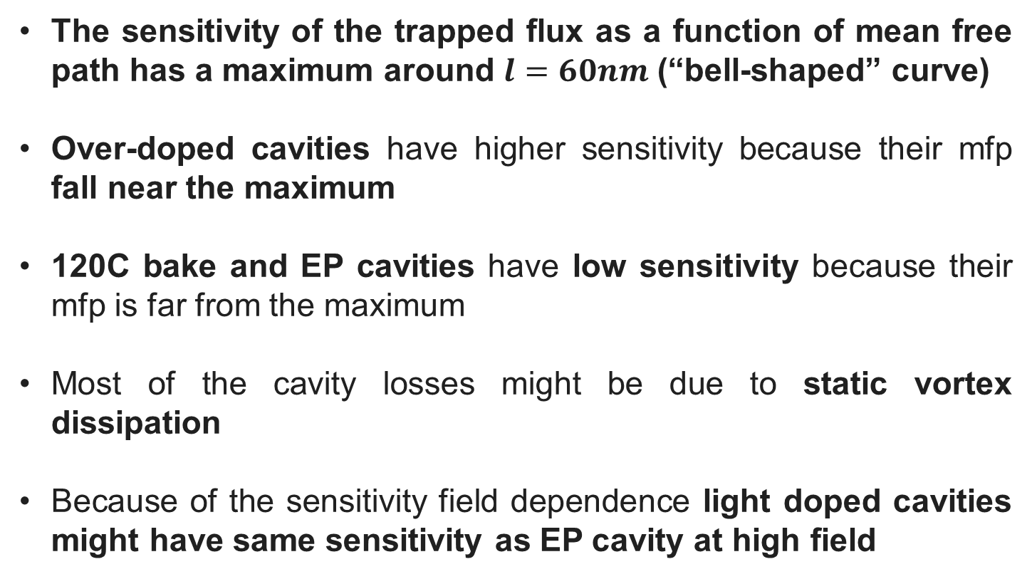
Experimental results summary
The sensitivity of the trapped flux as a function of mean free path has a maximum around $l=60nm$ (“bell-shaped” curve)
Over-doped cavities have higher sensitivity because their mfp fall near the maximum
120C bake and EP cavities have low sensitivity because their mfp is far from the maximum
Most of the cavity losses might be due to static vortex dissipation
Because of the sensitivity field dependence light doped cavities might have same sensitivity as EP cavity at high field

Slide 32
Outline
Introduction
Experimental procedure
Trapped flux sensitivity
Consistency of the calculation
Mean free path calculation
Sensitivity vs Mean free path
Trapped flux theoretical model
Conclusions

Slide 33

Model Assumptions
Local vortex description
Non-interacting vortexes
Single flux quantum per vortex
T<<T_{c} (no T dependent)
Two contributions:
  Static (NC Core)
  Dynamic (Lorentz force)
    Parabolic pinning potential
    Single pinning point per vortex
Magnetic field 100% trapped
M. Checchin, M. Martinello, A. Grassellino, A. Romanenko in Proceeding of SRF 2015

Slide 34
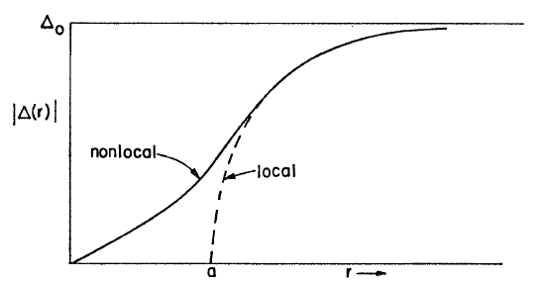

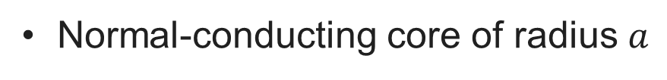
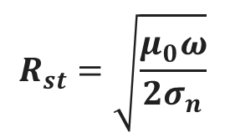
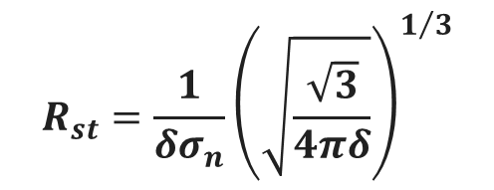
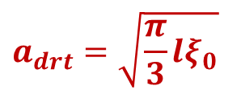

Local vortex description
J. Bardeen, M.J. Stephen, Phys. Rev. 140, A1197 (1965)
Normal-conducting core of radius $a$
Clean limit:
Dirty limit:
$$a_{drt}=\sqrt{\frac{π}{3}lξ_{0}}$$
$$a_{cln}=1.16ξ_{0}$$
Static dissipation (NC core)
RF
Normal skin effect:
Anomalous skin effect:
B_{RF}
$$R_{st}=\frac{1}{δσ_{n}}{\left(\sqrt{\frac{\sqrt{3}}{4πδ}}\right)}^{1/3}$$
$$R_{st}=\sqrt{\frac{μ_{0}ω}{2σ_{n}}}$$
λ
Dynamic dissipation (flux oscillation)
$$M\ddot{x}=F_{v}+F_{p}+F_{L}$$
2a
z

Slide 35
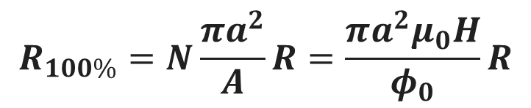
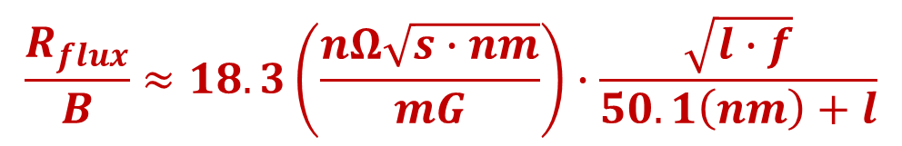

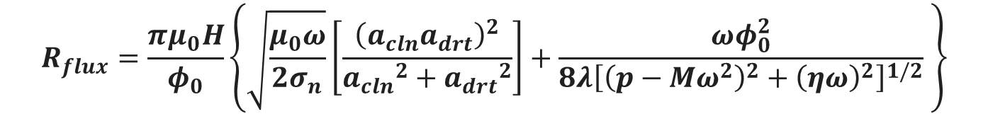
Dynamic Resistance: Vortex Dissipation
During the SC transition the field H is applied to the superconductor of area A. The magnetic field will be 100% trapped creating N vortexes with a single flux quantum φ₀ each, and area πa²:
$$R_{100\%}=N\frac{πa^{2}}{A}R=\frac{πa^{2}μ_{0}H}{φ_{0}}R$$
$$Aμ_{0}H=Nφ_{0}$$
Final formula with static and dynamic contributions:
$$R_{flux}=\frac{πμ_{0}H}{φ_{0}}\left\{\sqrt{\frac{μ_{0}ω}{2σ_{n}}}\left[\frac{{\left(a_{cln}a_{drt}\right)}^{2}}{{a_{cln}}^{2}+{a_{drt}}^{2}}\right]+\frac{ωφ_{0}^{2}}{8λ{\left[{\left(p−Mω^{2}\right)}^{2}+{\left(ηω\right)}^{2}\right]}^{1/2}} \right\}$$
May be approximated as (pure static contribution):
$$\frac{R_{flux}}{B}≈18.3\left(\frac{nΩ\sqrt{s∙nm}}{mG}\right)∙\frac{\sqrt{l∙f}}{50.1\left(nm\right)+l}$$

Slide 36
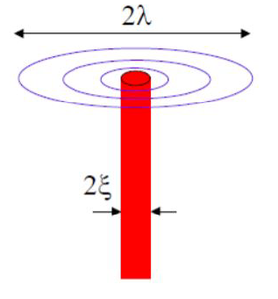
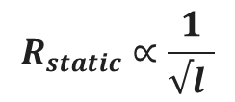



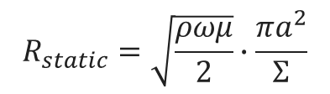
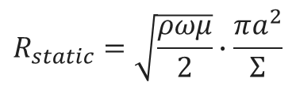


Sensitivity vs Mean Free Path Explanation
The losses seems governed by the static dissipation of the vortexes which appears to be different in clean and dirty limits
DIRTY LIMIT
CLEAN LIMIT
The NC core diameter does not depend anymore from mfp. The larger the mean free the lower the resistivity
The smaller the mean free path the smaller the NC core diameter
$$R_{static}=\sqrt{\frac{ρωμ}{2}}∙\frac{πa^{2}}{Σ}$$
$$R_{static}=\sqrt{\frac{ρωμ}{2}}∙\frac{πa^{2}}{Σ}$$
2a
$$a_{dirty}=\sqrt{\frac{π}{3}ξ_{0}l}$$
$$ρ=\frac{mv_{F}}{lne^{2}}$$
$$a_{clean}=1.16ξ_{0}$$
$$ρ=\frac{mv_{F}}{lne^{2}}$$
$$R_{static}∝\frac{1}{√l }$$
$$R_{static}∝√l$$

Slide 37
Outline
Introduction
Experimental procedure
Trapped flux sensitivity
Consistency of the calculation
Mean free path calculation
Sensitivity vs Mean free path
Trapped flux theoretical model
Conclusions

Slide 38
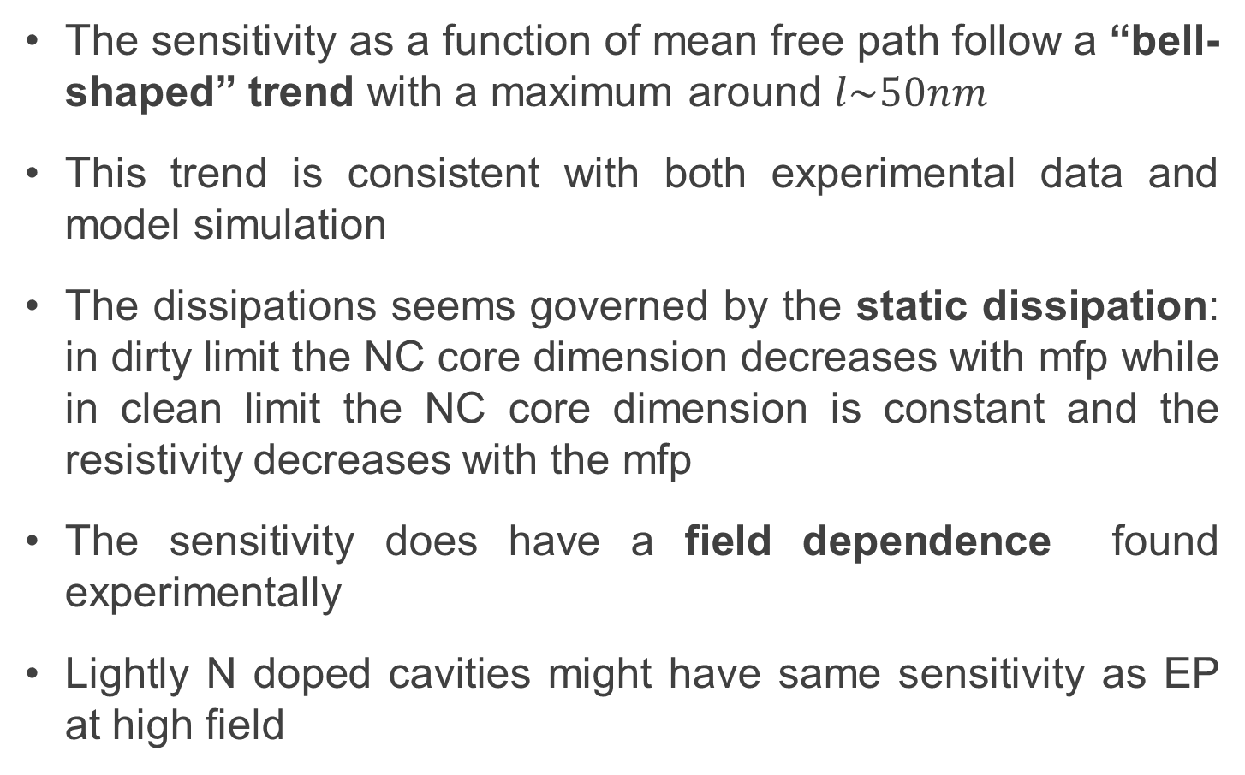
Conclusions
The sensitivity as a function of mean free path follow a “bell-shaped” trend with a maximum around $l\sim 50nm$
This trend is consistent with both experimental data and model simulation
The dissipations seems governed by the static dissipation: in dirty limit the NC core dimension decreases with mfp while in clean limit the NC core dimension is constant and the resistivity decreases with the mfp
The sensitivity does have a field dependence found experimentally
Lightly N doped cavities might have same sensitivity as EP at high field

Slide 39
Thank you for your attention

Slide 40
Back up Slides

Slide 41
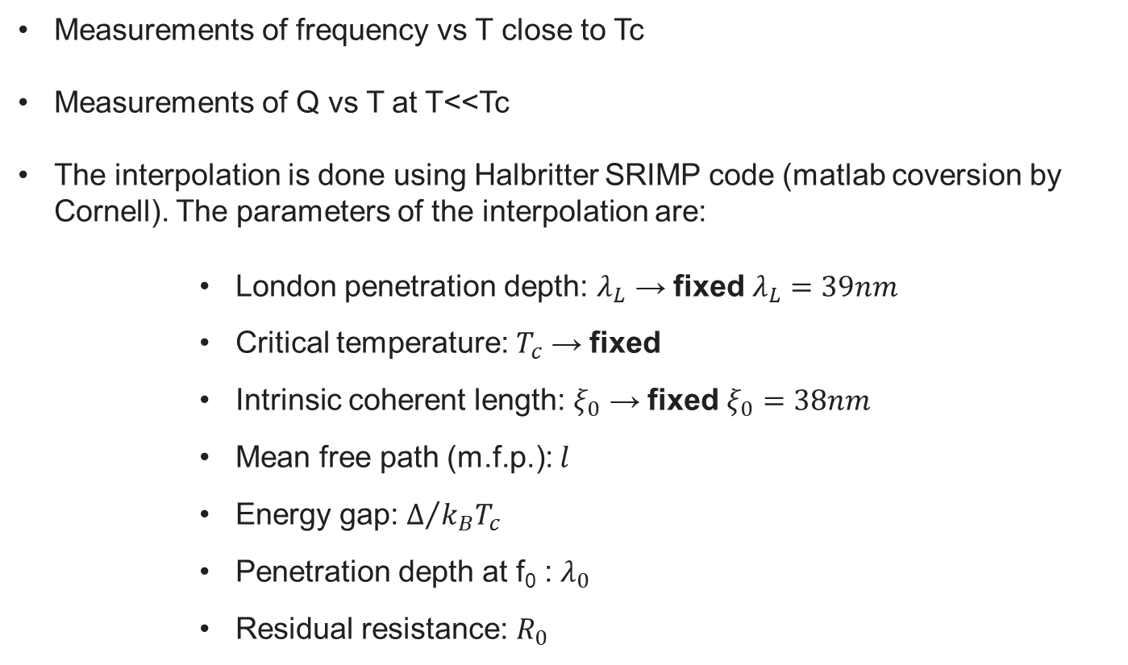
Mean Free Path Calculation
Measurements of frequency vs T close to Tc
Measurements of Q vs T at T<<Tc
The interpolation is done using Halbritter SRIMP code (matlab coversion by Cornell). The parameters of the interpolation are:
                London penetration depth: $λ_{L}$ → fixed $λ_{L}=39nm$
                Critical temperature: $T_{c}$ → fixed
                Intrinsic coherent length: $ξ_{0}$ → fixed $ξ_{0}=38nm$
                Mean free path (m.f.p.): $l$
                Energy gap: $Δ/{k_{B}T_{c}}$
                Penetration depth at f₀ : $λ_{0}$
                Residual resistance: $R_{0}$
Matlab SRIMP program used to calculate mean free path:
J. Halbritter, KFK-Extern, 3/70-6 (1970)
N. Valles. Ph. D. Cornell University (2013)
S. Meyers, Proceeding of LINAC 14 (2014)

