Slide 1
RF dissipation due to trapped vortices
Alex Gurevich
Dept. Physics and Center for Accelerator Science,
Old Dominion University, Norfolk, VA
2015 TESLA Meeting, SLAC, Dec. 2, 2015.

Slide 2
Motivation
Trapped vortices can produce significant RF power in hotspots, contributing to the residual surface resistance.
The problem of getting rid of trapped vortices. Screening the Earth magnetic field and reducing thermoelectric currents. Moving and breaking vortex hotspots into pieces by scanning laser beams and external heaters (Ciovati and Gurevich, Phys. Rev. ST-AB 11, 122001 (2008); Gurevich and Ciovati, Phys Rev. B 87, 054502 (2013).
Increasing Q by flushing some of trapped vortices out by strong temperature gradients during the cavity cooldown through T_{c} Romanenko et al, APL 105, 234103 (2014), J. Appl. Phys. 115, 184903 (2014); Vogt, Kugeler and Knobloch, Phys. Rev. ST-AB 16, 102002 (2013); 18, 042001 (2015).
How much vortex dissipation can be tolerated? Theory of rf dissipation and residual surface resistance produced by oscillating flexible vortex lines. Gurevich and Ciovati, Phys Rev. B 77, 104501 (2008); 87, 054502 (2013)
Intricate dependencies of the vortex residual resistance on frequency, pin spacing and the mean free path. Optimization of R_{i}
RF nonlinearities and thermal instabilities ignited by vortex bundles

Slide 3
Why are vortices so deadly for SRF?
B(x)
Suppose that H_{c1} = 0, then we have the Bean critical state
of pinned vortices parallel to the surface with the flux gradient
equal to the critical current density J_{c}:
x
B_{a}(t)
Bean flux penetration depth L = B_{a}(t)/μ₀J_{c} is orders
of magnitude greater than the London λ = 30-40 nm
L
Remagnetization hysteretic losses can be orders of
magnitude higher than Ohmic losses in Cu:
Flux surface resistance is linear in B_{a},
independent of resistivity and can be
decreased by stronger pinning, BUT:
For Nb at f = 2GHz, and J_{c} = 10⁸ A/m²,
we get R_{i} = 0.27 Ohm at B_{a} = 20 mT !
Surface fraction of vortices α < 10⁻⁷

Slide 4
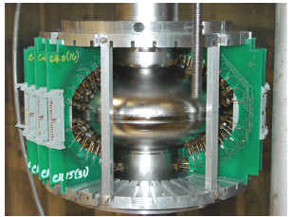
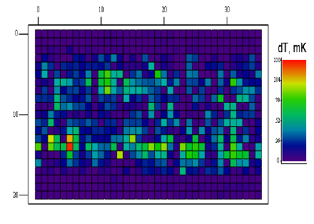
Detection of trapped vortices?
In films vortices are observed using scanning SQUID (J. Kirtley, Rep. Prog. Phys. 73, 126501 (2010)), MO imaging, Hall probe, STM, MF or Lorentz microscopy, …
hotspots
Hotspots in Nb cavities revealed by temperature
maps with the sensitivity of a few mK and spatial
resolution of a few mm (Knobloch, Padamsee, Giovati et al)
But how do we know that hotspots are caused by
trapped vortices but not surface materials defects
(metallic suboxide islands, arrays of hydeides, etc)

Slide 5
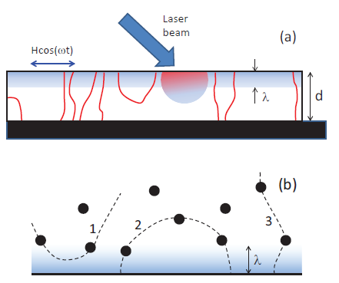

Pushing vortices by thermal gradients
Thermal force acting on the vortex:
Critical gradient to unpin vortices:
For Nb with B_{c1} = 0.17 T, J_{c} = 1kA/cm²
and T = 2K: |dT/dx| = 1.6 K/mm
A. Gurevich, 13-th SRF Conference,
Beijing, 2007
Topological problem
Except for closed semi-loops at the surface,
line vortices disappear only if they are pushed
all the way to the orifice
Laser beam mostly redistributes vortices
over the surface
Ciovati and Gurevich,
Phys. Rev. ST-AB 11, 122001 (2008)

Slide 6
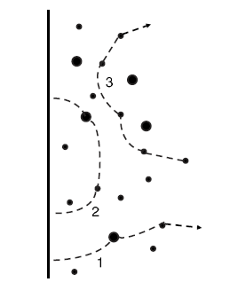
How do trapped vortices appear?
Nb
Cooldown
in field from
T > T_{c} to 2K
H(t)
RF field
Trapped appear during cooling through T_{c}
due to any stray magnetic fields
λ
Trapped vortices spaced by a = (φ₀/H_{E})^{1/2} = 6-7 μm due to
the Earth magnetic field produce the RF dissipation 2-3
orders of magnitude higher than the exponentially small
BCS contribution in Nb at 2K.
London penetration depth of
superconducting rf currents
≈ 40 nm << d = 3mm
Even good screening (only 1% of H_{E} is allowed in accelerating cavities) cannot eliminate
trapped vortices because of the large demag factor of cavities.

Slide 7
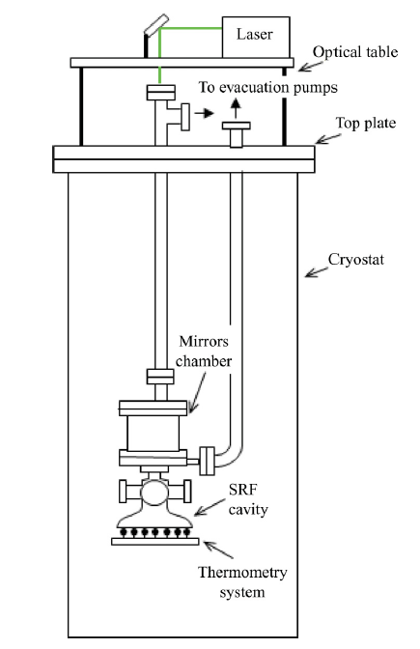
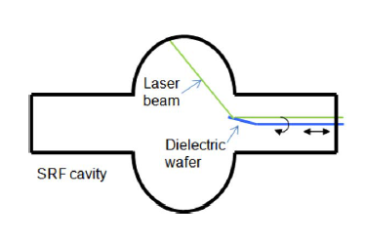
Laser scanning the inner cavity surface
G. Ciovati et al. Rev. Sci Instr. 83, 034704 (2012)
Push trapped vortices with the laser beam
(high-power LTLSM mode, Λ = 532 nm)
Beam power can be varied from 3mW to 10 W,
and the beam diameter from 0.9 to 3mm
Measurements of thermal maps with the rf power
and the scanning beam on
If laser scanning changes thermal maps, the
hotspots can only be due to vortices but not fixed
materials defects
superfluid He, @ 2K

Slide 8
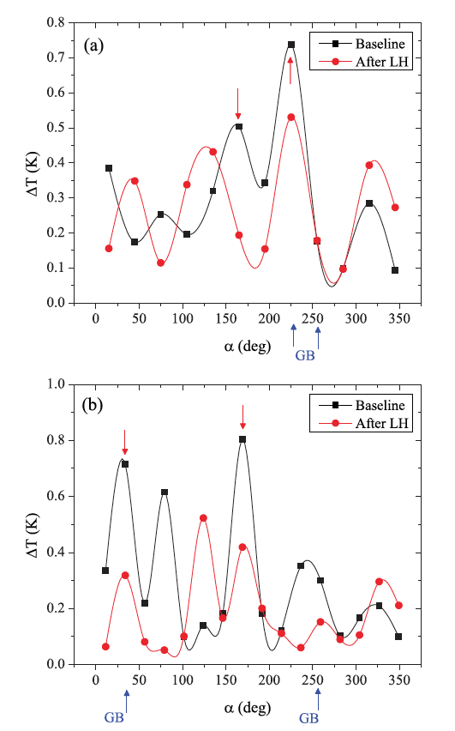
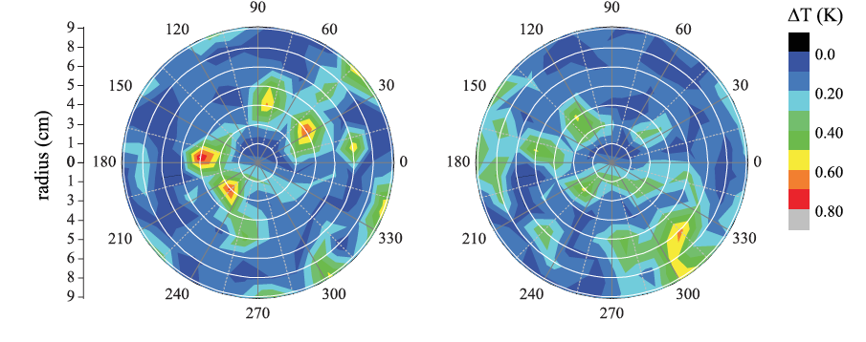
Experiment
before LH
after LH
Laser scanning does change temperature maps
Laser scanning does not eliminate hotspots
but rather move them around and break in
smaller pieces

Slide 9
Pinning of vortices in Nb
Typical J_{c} = 1-10 kA/cm² in clean Nb are some 4-6 orders of magnitude lower than the
depairing current density J_{c} = H_{c}/λ, = 600 MA/cm^{2,} indicating weak pinning:
H(t)
Randomly distributed pinning
nanoprecipitates spaced by
L >> the vorttex core diameter
2ξ = 30-80 nm
Randomly distributed Impurities with
the m.f.p. which can be either smaller
of greater than 2ξ.
Generally, there is no direct
correlation between the m.f.p.
and the pin spacing
Coalescence or appearance of pins
during heat treatment changes both
the pin spacing and the impurity
concentration
•
•
•
λ
•
•
•
•
•
•
•
•
•
•
•
•
2ξ
•
•
•
l
•
•
•
•
•
•
•
λ
•
•
•
•

Slide 10
Parallel vortices near the oscillating surface barrier
Gurevich and Ciovati,
Phys. Rev. B 77, 104501 (2008)
d
H₀
u(t)
Vortex viscous drag: η = φ₀B_{c2} /ρ_{n}
Onset of vortex penetration B_{v} = ϕ₀/4πλξ = 0.71B_{c}
Vortex time constant: τ = μ₀λ²B_{c2}/B_{v}ρ_{n} ≅ 1.6×10⁻¹² s
for Nb₃Sn, ρ_{n} = 0.2 μΩm, B_{c2} = 23T, B_{c} = 0.54T, λ = 65 nm
Supersonic penetration velocity v = λ/τ ≅ 400 km/s
Penetration times much shorter than the rf period (instant for the SRF cavities)
Bardeen-Stephen viscous vortex drag is inadequate for high velocities;
jump-wise instabilities (Larkin-Ovchinnikov and overheating) of vortex oscillations
x
ℓ
d_{m}
λ

Slide 11
Wagging vortex tail
H(t)
u(z,t)
Nonlocal vortex line tension
2ξ
l
λ
All vortex bending modes:
A. Gurevich and G. Ciovati, Phys. Rev. B 87, 054502 (2013)

Slide 12
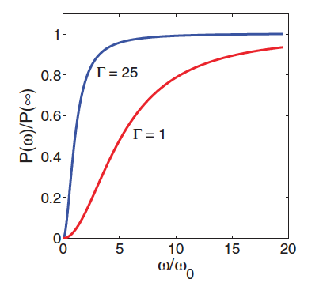
General expression for low-field RF power
Anisotropy increases P at low and
intermediate ω but does not affect P(∞)
For a long vortex segment l > λ, P(ω) becomes:

Slide 13
Characteristic frequency ranges
Low frequencies
ω << ω_{l}
Entire vortex segment swings
Intermediate frequencies
ω_{λ} << ω << ω_{l}
Only the vortex tail of
length L(f) >> λ swings
High frequencies
ω >> ω_{λ}
Only the vortex tip
of length λ swings
RF power is
independent of
the pin spacing
For clean Nb, f_{l} becomes
smaller than 2 GHz for the
pin spacing > 150-200 nm
For clean Nb, f_{λ} ≈ 40 GHz,
but it decreases rapidly
with the m.f.p. in the dirty limit:
RF power depends on the
pinned segment length

Slide 14
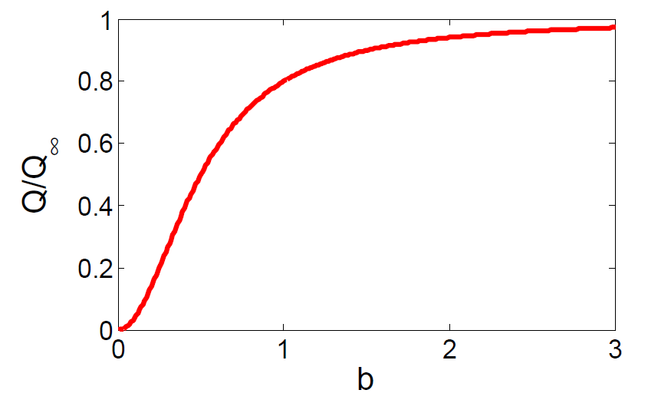
RF power
Low frequencies. Entire
vortex segment swings
ω > ω_{λ}
ω^{1/2}
P decreases strongly as the
pin spacing l decreases
P/P∞
ω²
Intermediate ω.
ω << ω_{l}
No dependence on the pin spacing
ω/ω_{λ}
High ω.
P ∼ 0.13 μW at B = 100 mT and 2 GHz.
No dependence on the pin spacing
Hotspots revealed by thermal maps require
regions ∼ few mm with ∼ 10⁶ vortices

Slide 15
More frequency dependencies

Slide 16
Dependencies of P on the pinned length
For random distribution
of pins, P should be
averaged over pin spacings
Here F(l) is the distribution
function of pin spacings:

Slide 17
Dependencies of P on the mean free path
Assume that heat
treatments only affect the
m.f.p. but not the spacing
between pinning
nanoprecipitates
Dependence of P on
pin spacing intertwined
with the m.f.p. does not
allow to describe the
behavoior of R_{i} in terms
of m.f.p. only
Distribution of pin
spacings also plays
a role

Slide 18
Residual resistance due to trapped vortices
For Nb with ρ_{n} = 10⁻⁹ Ωm, B_{c} = 200 mT, the observed R_{i} = 5 nΩ at 2GHz can be produced
by the residual field B₀ ∼ 0.3 μT much smaller than the Earth field B_{E} = 20-60 μT.
Vortex hotspots contribute to the field dependence of Q(H)
Vortex hotspots can ignite thermal instability and lateral quench propagation
Field dependent R_{i} due to thermal feedback controlled by thermal conductivity κ and the
Kapitza thermal conductance α_{K} between the film and the substrate/coolant
Thermal feedback makes R_{i}(H) interconnected with R_{BCS} and causes thermal instability at the rf field at which the denominator goes to zero

Slide 19
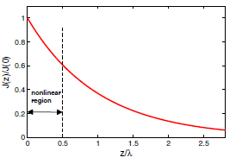
Vortex RF nonlinearities
At H = H_{c}, the velocity of Cooper pairs reaches the critical
pairbreaking value v_{c} = Δ/p_{F} .
Meissner current density J_{d} ≈ H_{c}/λ is 10⁴ times higher than the pinning J_{c} ∼ 0.1 MA/cm² in Nb
How fast could the vortex tip move?
This yields v = 10 km/s, which exceeds both
the speed of sound and v_{c} = Δ/p_{F} = 1 km/s
Linear Bardeen-Stephen vortex dynamics fails.
Larkin-Ovchinnikov and/or thermal instabilities
Vortex jumps at
v > v₀ ∼ 0.1 km/s
as was measured on Nb films

Slide 20
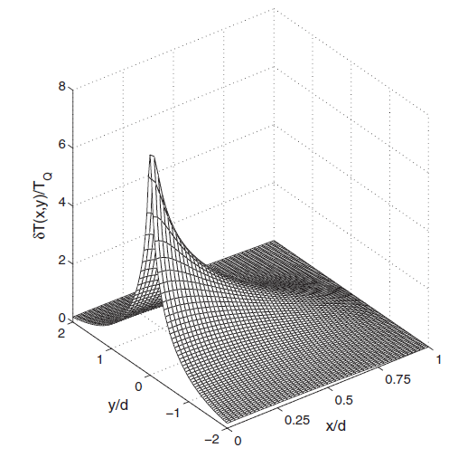
Vortex lighter
Meissner state at strong rf fields is thermally
metastable as the rf power P(T) increases with
T much faster than the Kapitza heat transfer W(T):
Uniform heat balance P(T) = W(T) becomes
impossible above the thermal breakdown field:
for R_{i} < R₀ = R_{BCS}(T₀).
Weak vortex hotspots at low fields can ignite
local thermal instability and lateral propagation
of hot normal phase at high fields H < H_{b}

Slide 21
Conclusions
Trapped mesoscopic vortex bundles can produce the main contribution to the
residual surface resistance at low temperatures
Temperature mapping combined with the laser scanning technique allows us to
identify vortex hotspots in superconducting cavities, move vortex bundles around
and break them into smaller pieces.
Typical vortex bundles revealed by reconstruction of hotspots from temperature
maps have 10⁶ vortices spread over regions from few mm to few cm.
Theory of dissipation of oscillating flexible vortex lines driven by the rf Meissner
currents gives a complicated dependence of P on ω, pin spacing and m.f.p.
The observed residual resistance R_{i} = 2-5 nOhm can be produced by low vortex
density corresponding to B₀ ∼ 0.1-0.3 μT much smaller than the Earth field
B_{E} = 20-60 μT.
Trapped vortices can cause microwave nonlinearities and ignite thermal instabilities

