Slide 1
TTF-III like Coupler R&D at IMP
Yongming Li
Institute of modern physics
12/03/2015

Slide 2
Outline
Motivation
New Coupler design
Future Plan

Slide 3
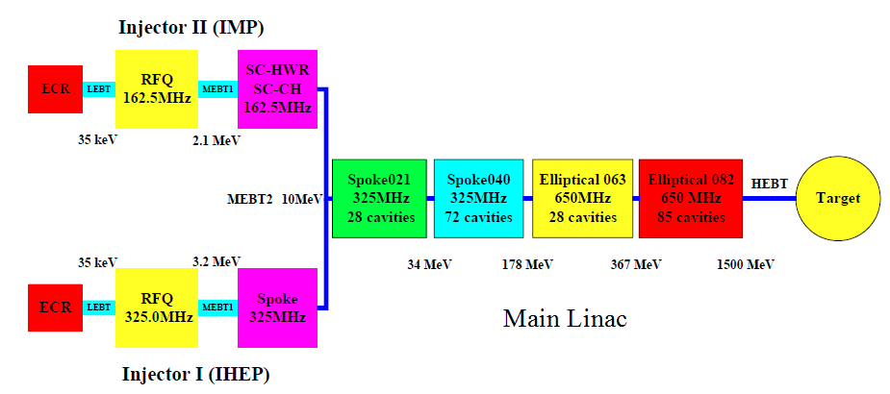
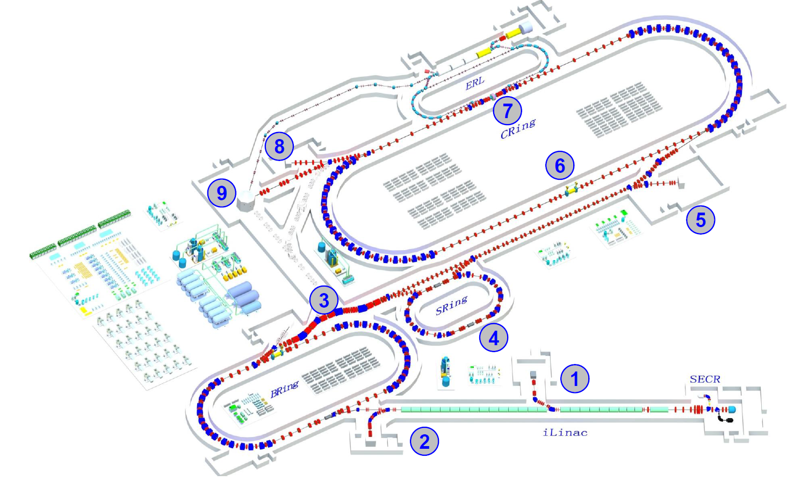
Motivation
10 mA H⁺
Cooperated with IHEP
ADS
HIAF
~3 mA ion
Neutron Source ~10mA D⁺

Slide 4
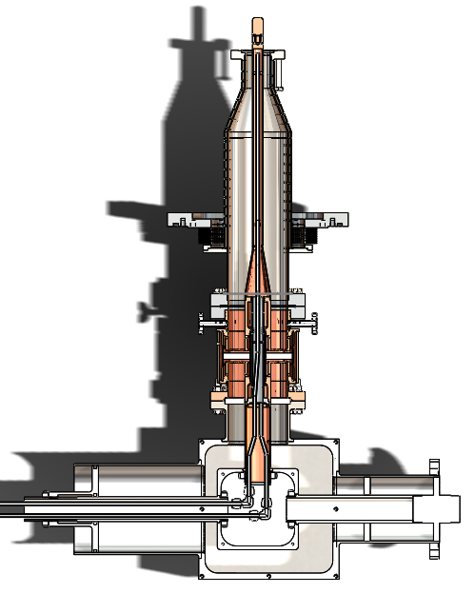
Coupler of SC cavities used in IMP
IHEP provide the couplers for HWR cavities
Single ceramic window
Not easy for cavity assembling
Qe fixed (not good for plasma cleaning)
No bias
7 couplers are used, proved to be reliable, and six couplers are assembling to SC cavities, 6 will condition next week.

Slide 5
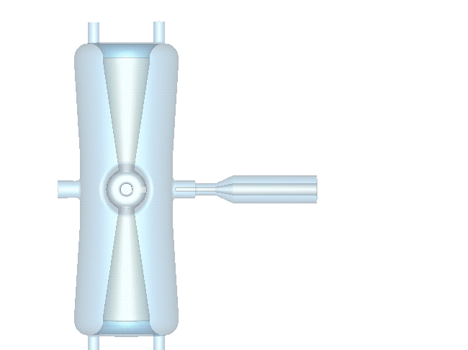
Field emission in Low beta cavities

Slide 6
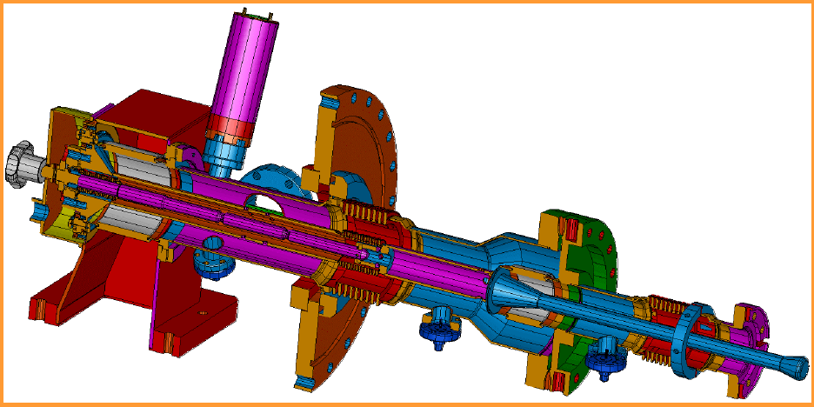
New coupler design
TTFIII
1.3GHz
Prototype I
162.5 MHz

Slide 7
New coupler RF design
output
input

Slide 8
Window selection
Material | Loss Tangent | Thermal Conductivity W/m/K
AL2O3 | 0.00018 | 31.5
BeO | 0.0011 | 251.5
BN | 0.00025 | 61
SiC | 0.0036 | 129.8
SiN | 0.0036 | 26.3
AlN | 0.00195 | 154
Sapphire | 0.00001 | 38
Transtar | 0.0001 | 35
Shapal-M | 0.007 | 90
ALON | 0.00031 | 9.5

Slide 9
Alumina Ceramic
Morgan Deranox 975:
Compressive strength: 2500 MPa, Flexural strength: 350 MPa

Slide 10
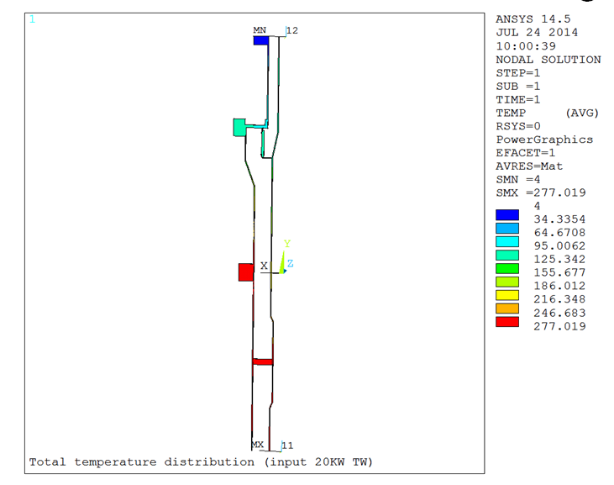
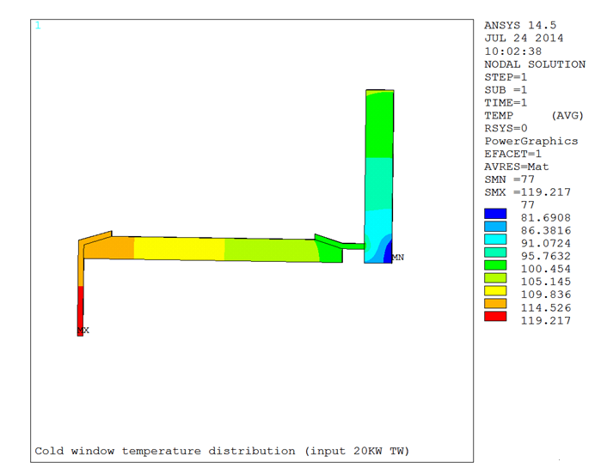
Thermal &MP simulation
Thermal simulation
 | 4K (W) | 80K (W)
static | 0.1 | 10
20 KW (travelling) | 0.8 | 35
Coupler thermal analysis , Wang Ruoxu , 7, 22, 2014

Slide 11
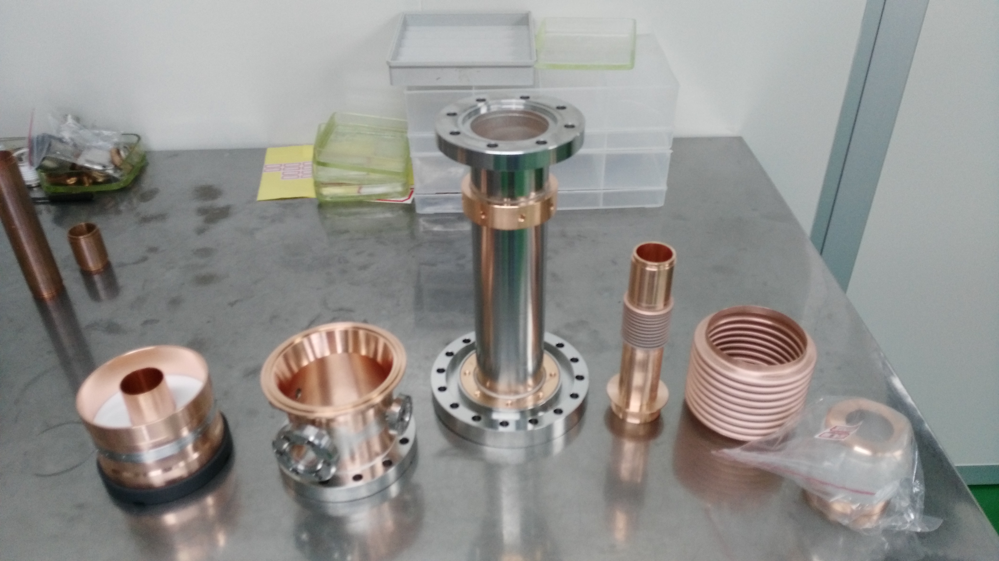
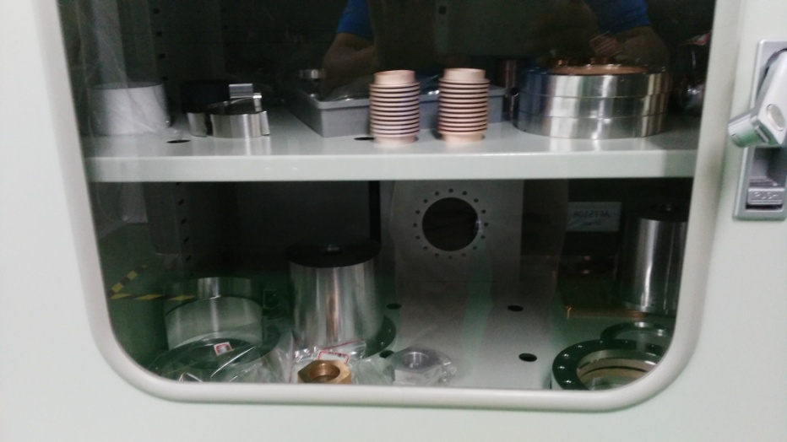
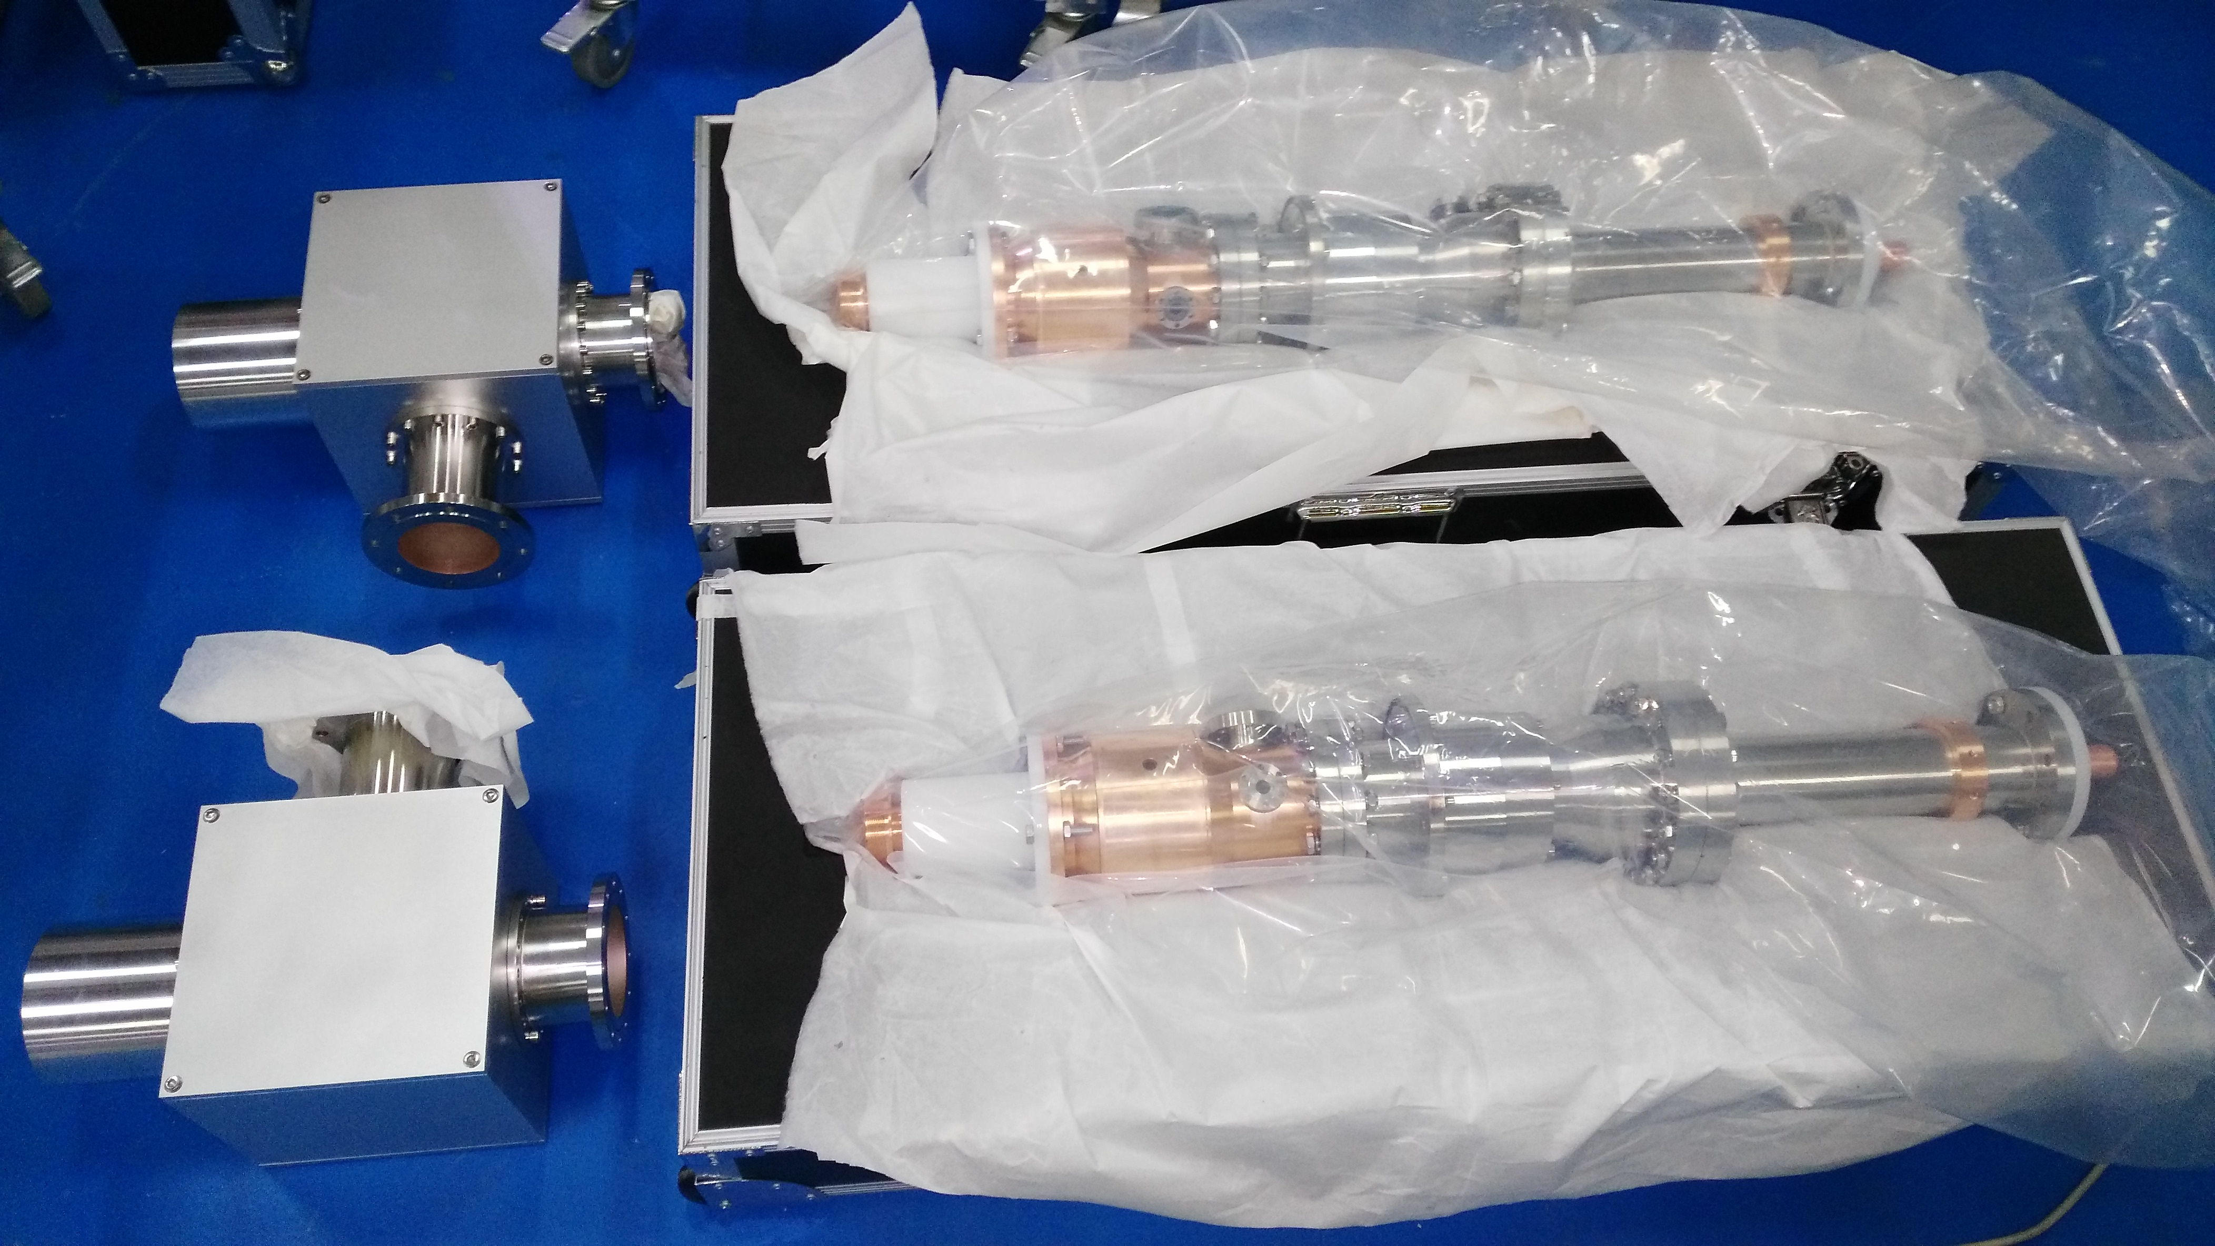
Coupler machining

Slide 12
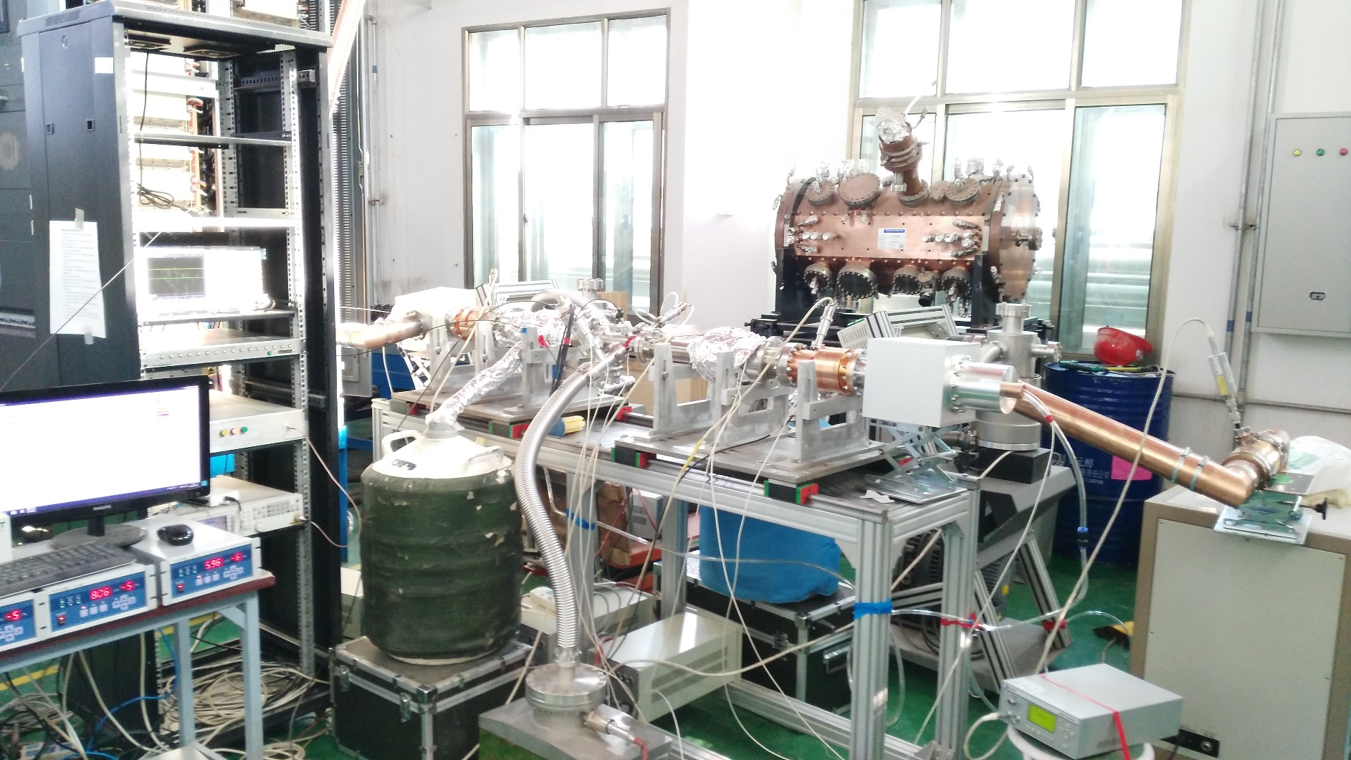
Coupler test is going on
20 KW
RF source
Coupler 1
Coupler 2
Machine protection
Load
6KW, 1%, 33Hz has achieved, 250W-6KW, MP barrier, (3 days)

Slide 13
Horizontal Test

Slide 14
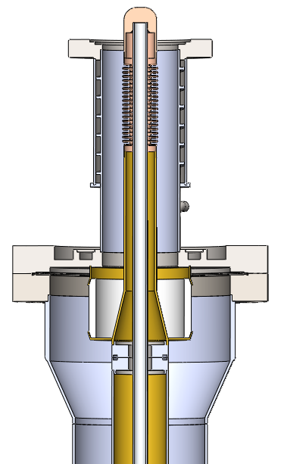
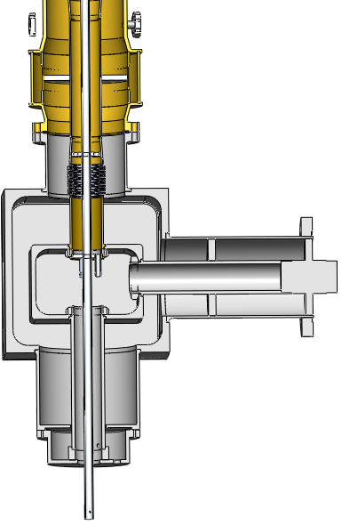
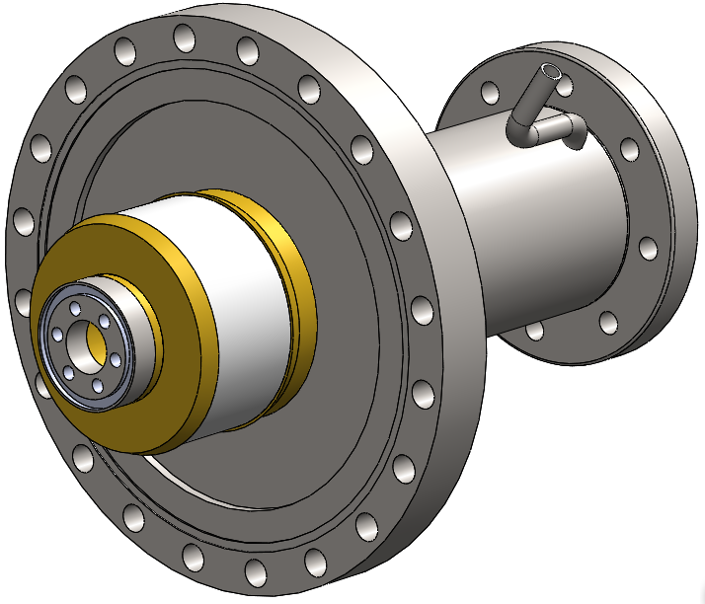
Future Plan-- Variable design

Slide 15
Thank you！

