Slide 1
LCLS-II Coupler Challenges
Chris Adolphsen and Nikolay Solyak for the LCLS-II Coupler Team
TTC Meeting
Dec 2, 2015

Slide 2
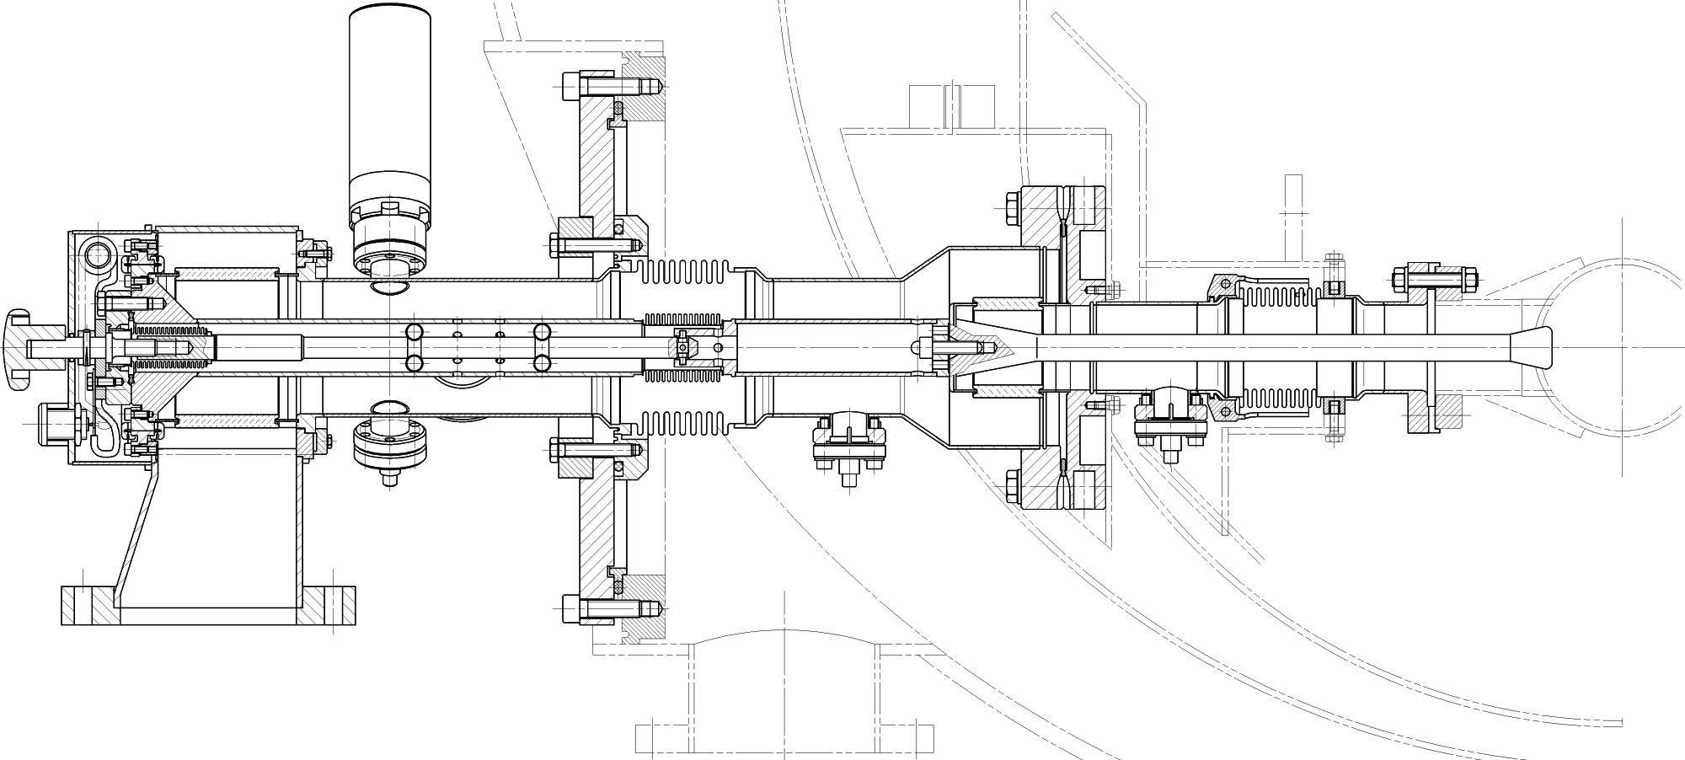
Cavity Power Coupler
Use basic DESY/XFEL TTF3 design, but
Shift Qext range higher by shortening antenna 8.5 mm
Improve cooling of warm section so can run up to 7 kW CW with full reflection
Modify waveguide assembly (use flex ring and aluminum WG box) but retain original manual knob antenna positioner
Two vendors (CPI and RI/Thales) will build full 280 coupler order, will receive 16 soon

Slide 3
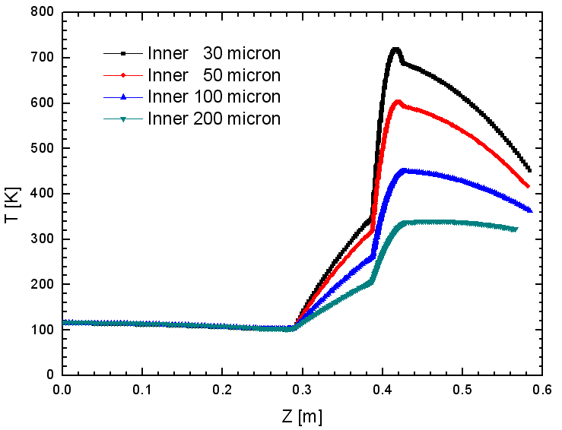

Coupler Heating
Inner conductor temperature for 15 kW TW operation for various thicknesses of the warm section inner conductor copper plating
Plating Thickness
Limit to 450 K (bake temp)

Slide 4
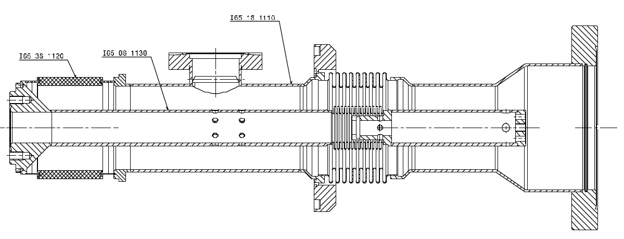
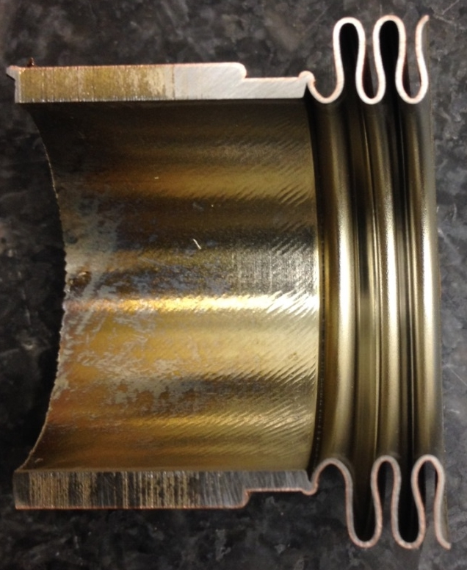
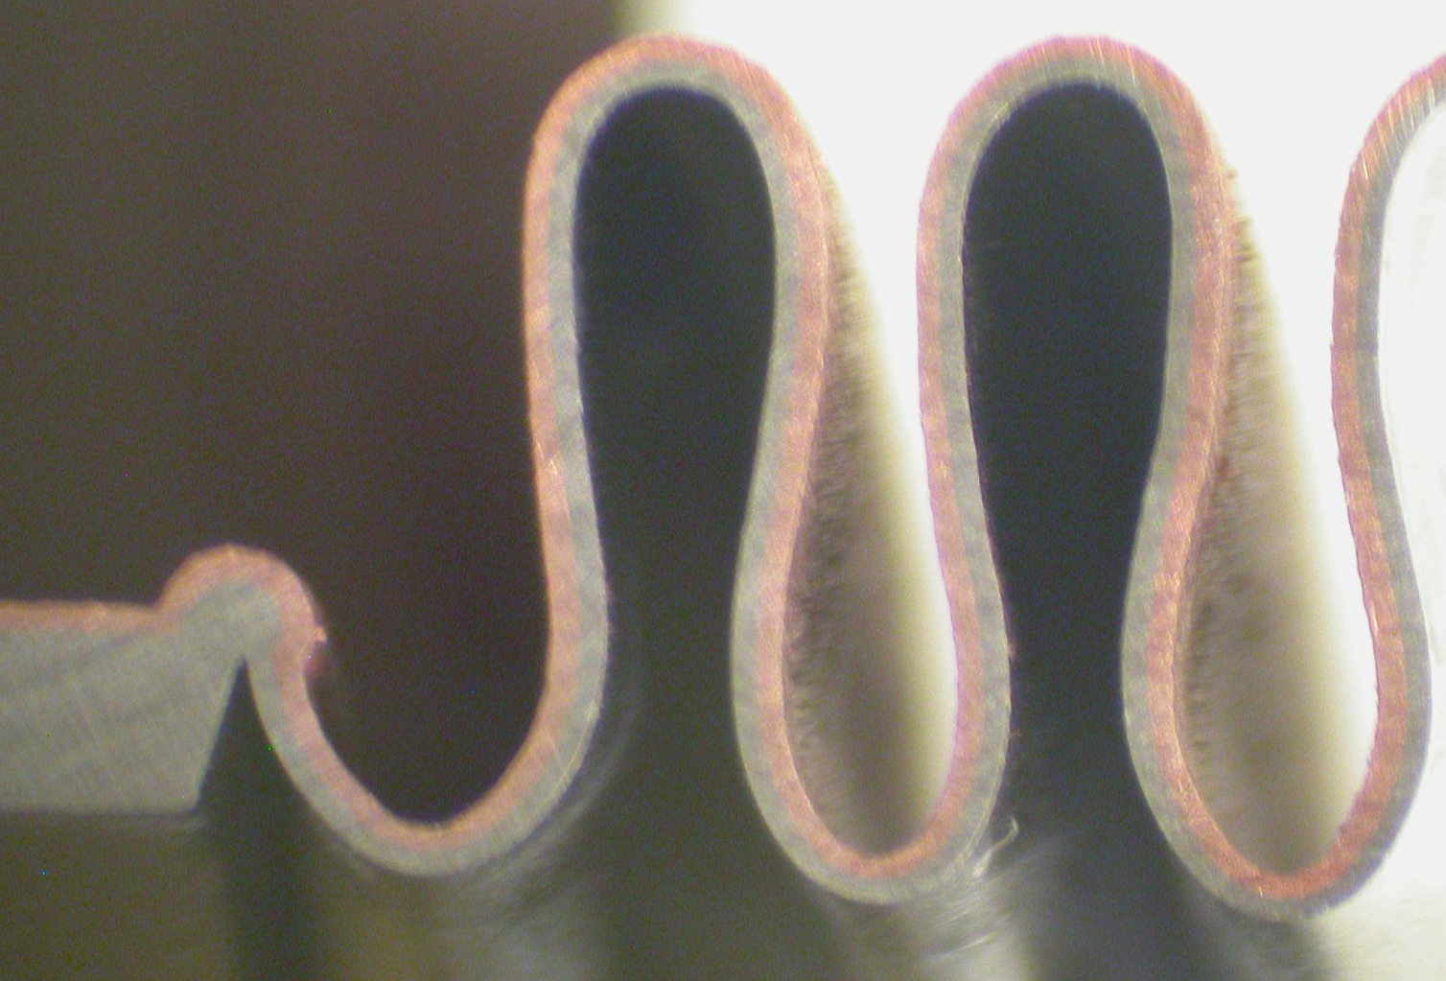
Thicker Copper Plating Qualification
Increase copper plating thickness on warm section inner conductor from 30 um to 150 um
Had 5 ILC sections modified in this way – use for metrology and HTS tests
Cross section of inner conductor bellow in a test section: measure 120-180 um copper thickness variation

Slide 5
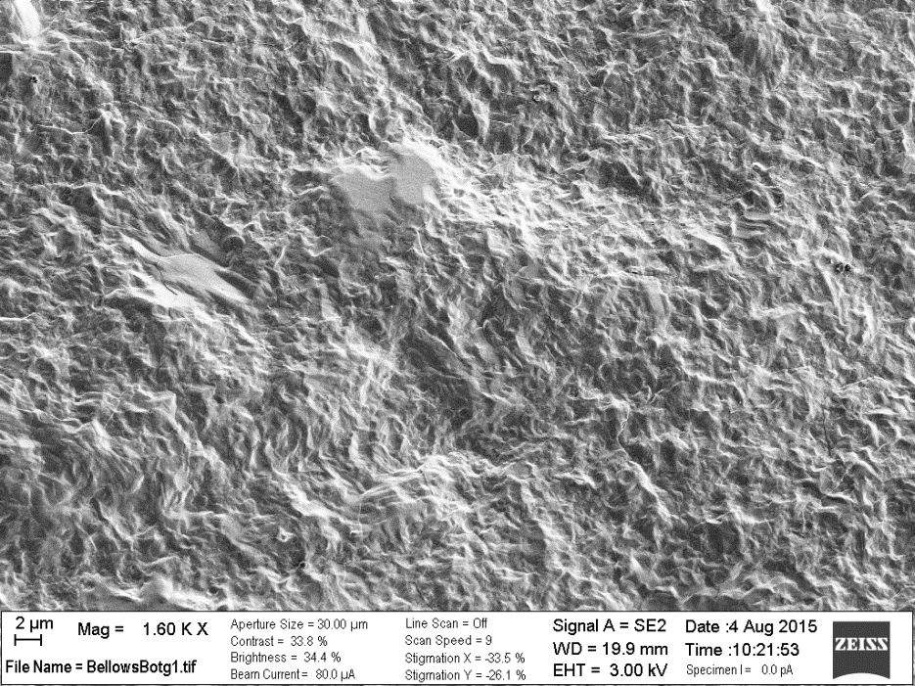
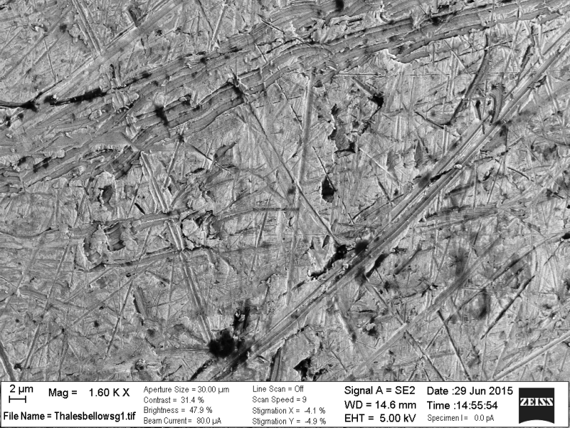
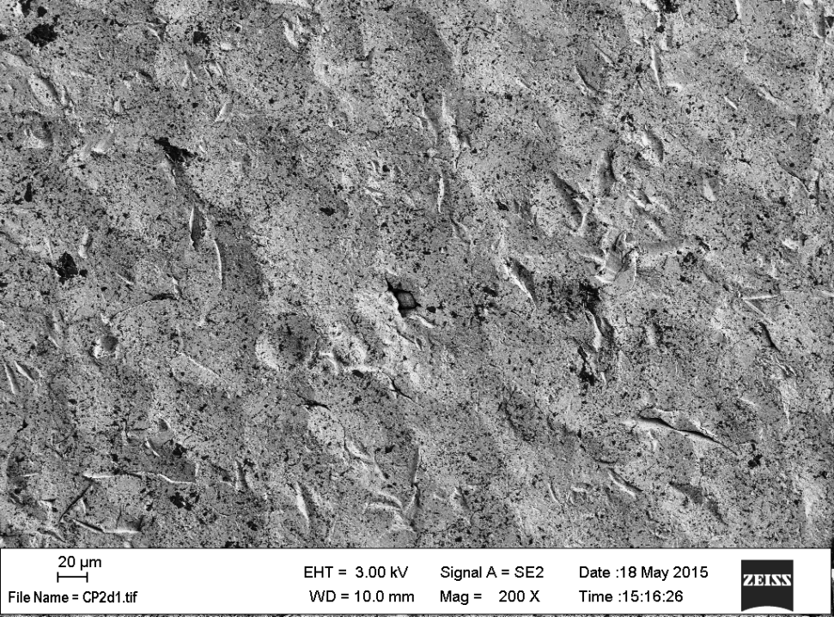
Copper Plating Issues
After plating, the surfaces do not always look pristine as there can be loosely attached particles, blemishes and oxidation. Various methods are used to improve the surface appearance including brushing, Mo wool polishing and glass bead blasting.
The concern is that this can imbed particles in the surface that may come loose later, and that it produces trapped volumes when protrusions are folded over.
Below are SEM photos of various 150 um thick copper plated samples – our preference is not to do post processing
Bellows - No post processing
Bellows - Mo wool polished
Coupon - Bead blasted

Slide 6
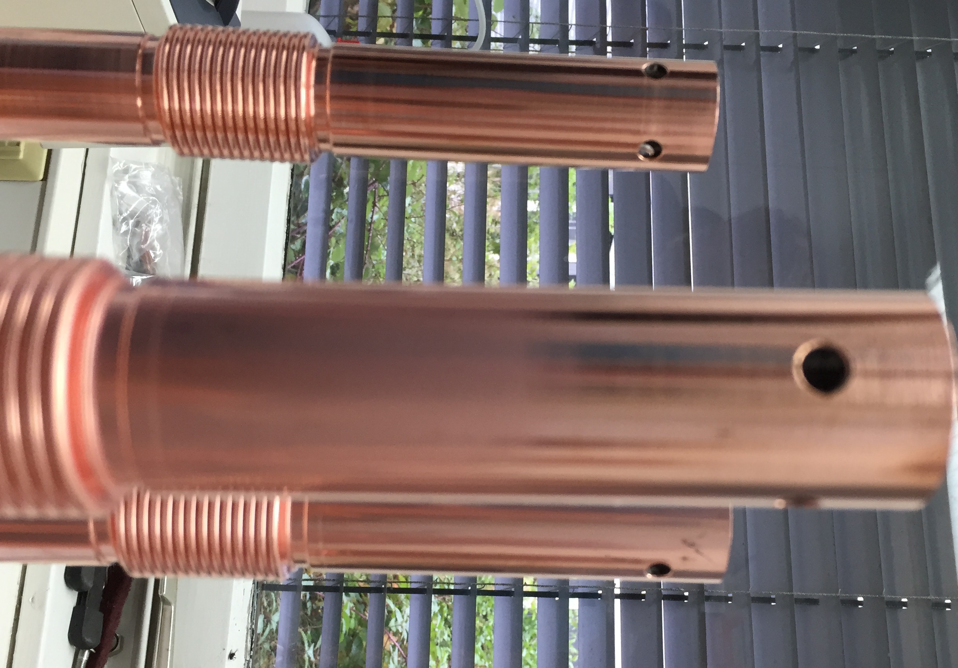
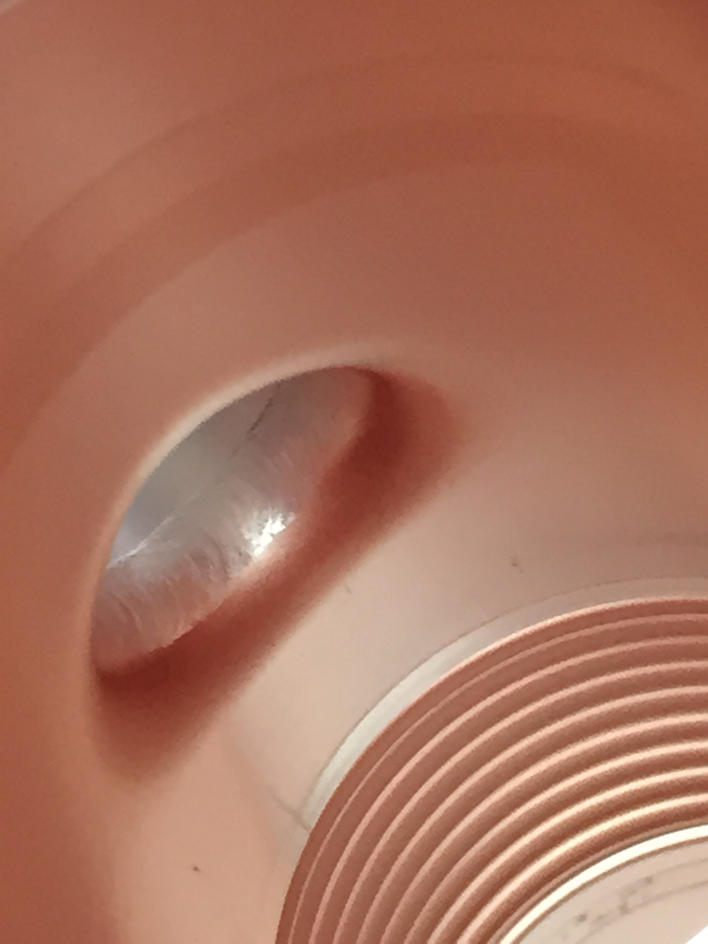
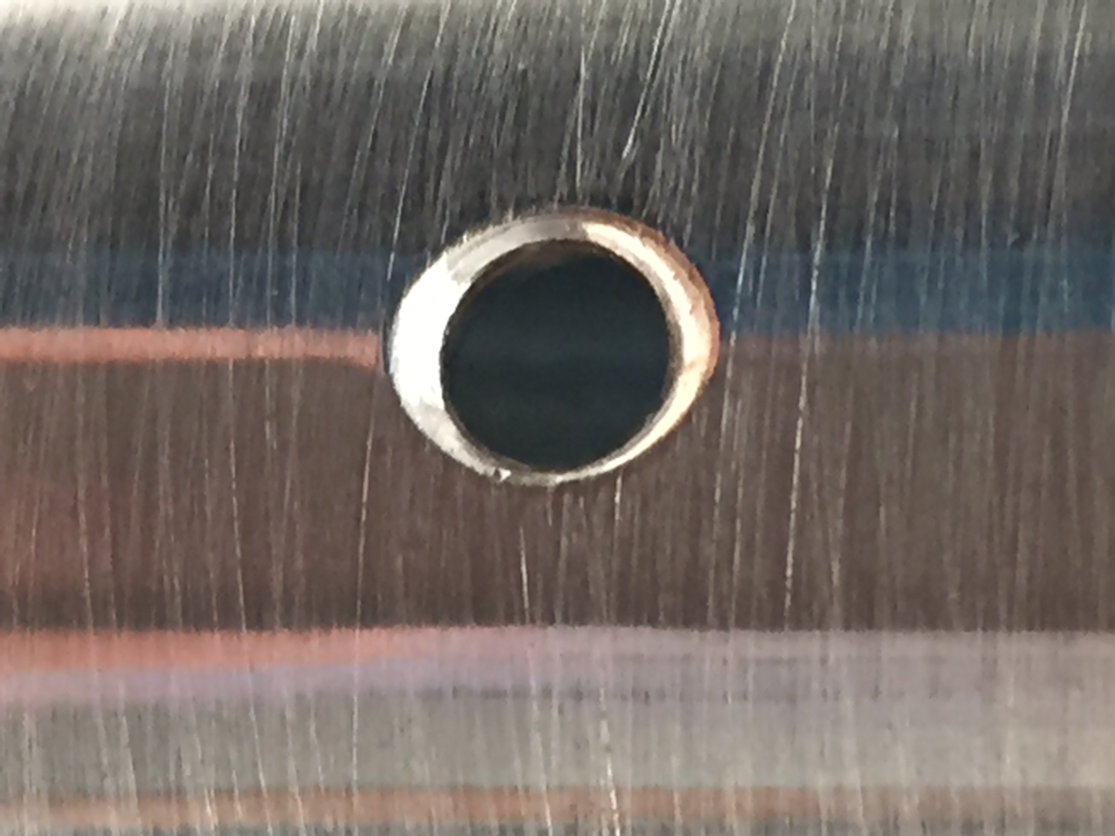
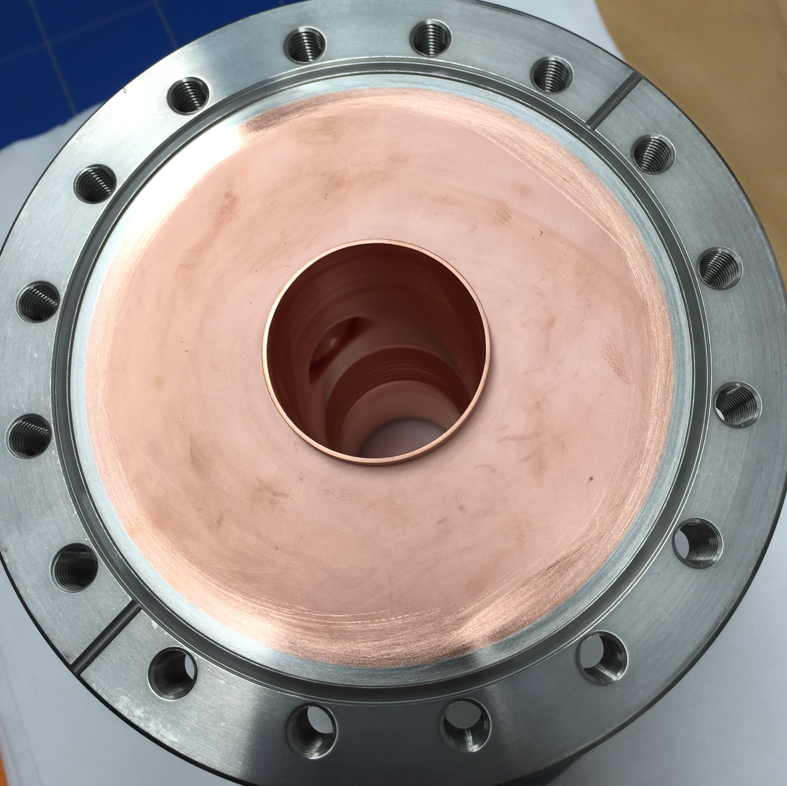
Example Plated Parts

Slide 7
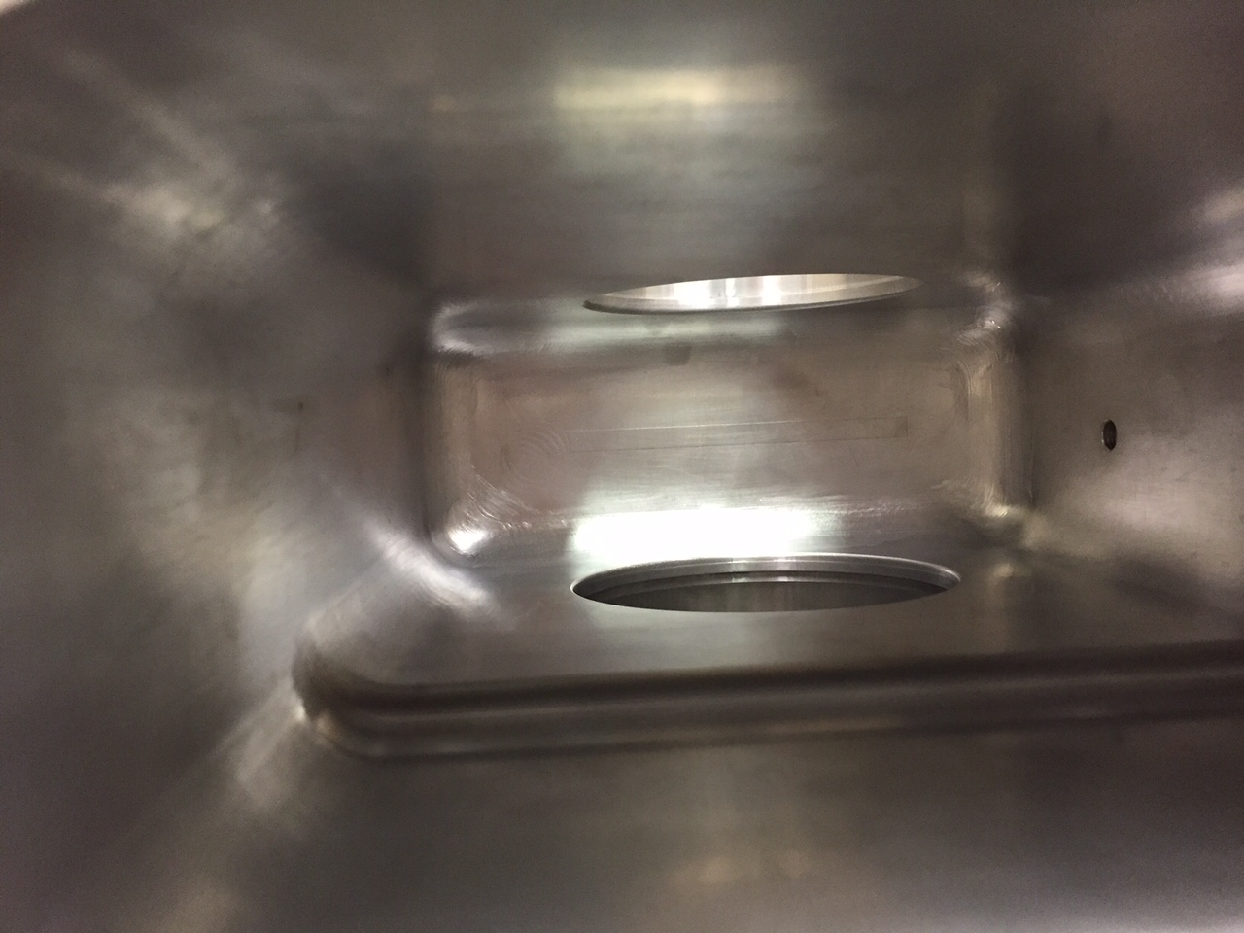
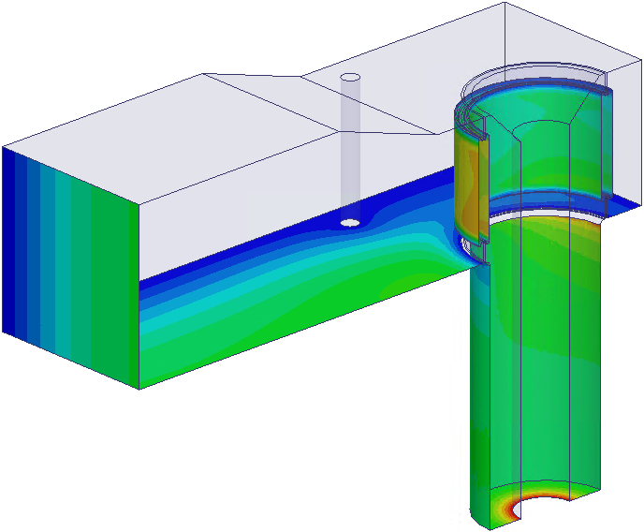
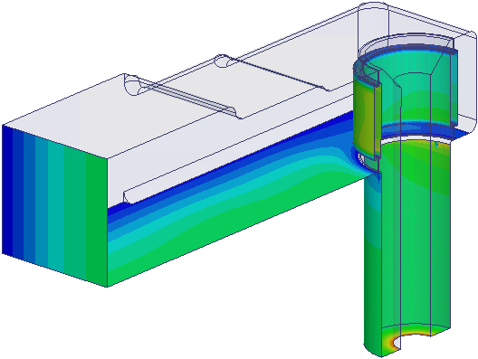
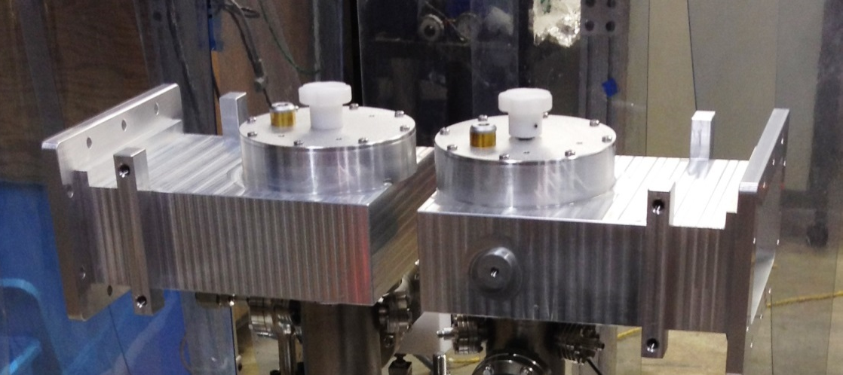
Value Engineered WG box
Original TTF3 box
designed for sheet-copper soldering
New post-less, radius’d box
designed for aluminum block machining
View into Box
Pair of New Boxes being used for Coupler Tests

Slide 8
Coupler RF Processing
The coupler fields are generally below its multipacting threshold so it is not clear that RF processing does much other than to bake the coupler in-situ due to the RF heating.
For example, the plot below shows that the vacuum levels are unaffected by large variations in the 30 kW input power at low duty (~ 0.5%) during TW operation of a pair of couplers.
However, will have a least one coupler pair cold tested and rf processed at CW (working with labs to arrange this) before being installed in the cryomodules.

Slide 9
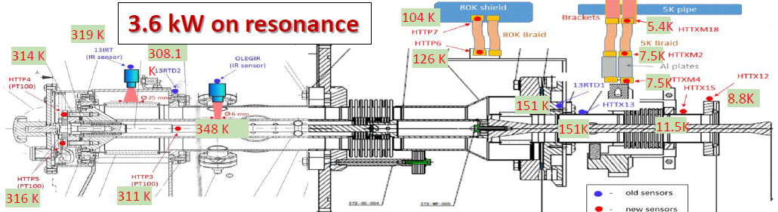
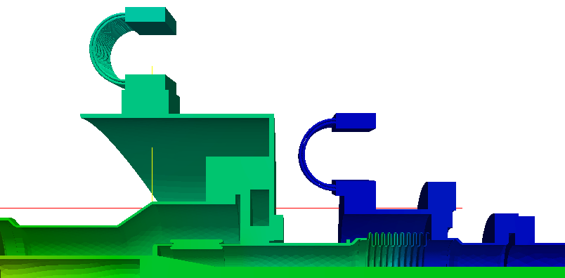
Temperature Measurements and Simulations
104 K
At FNAL HTS, measure various temperatures to infer 5 and 80 K heat loads (from ΔT across cooling braids) versus rf input power.
Also simulate the coupler operation using the measured thermal intercept temperatures.
119 K
5.4 K
126 K
6.4 K
9 K
131 K
11 K

Slide 10
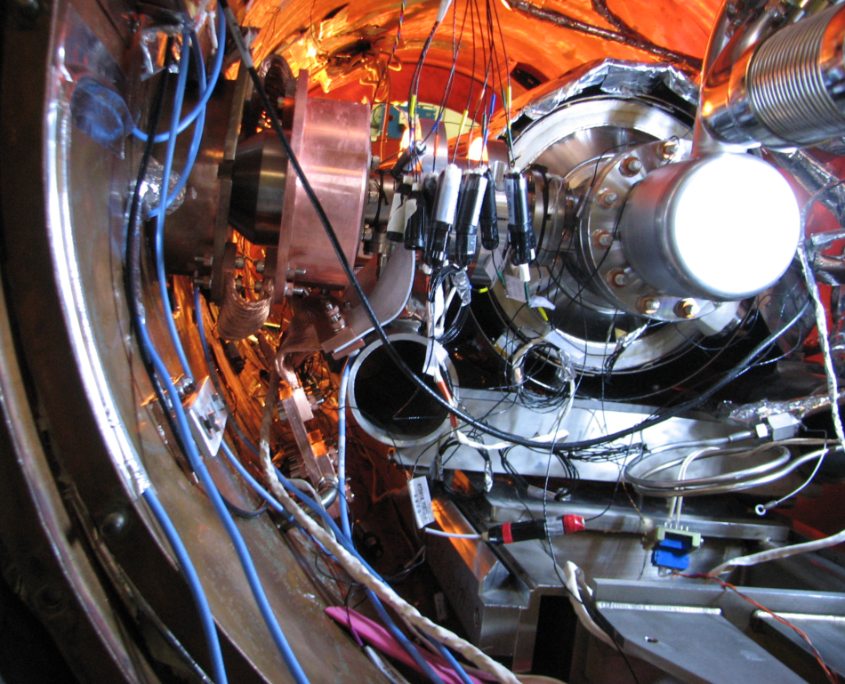
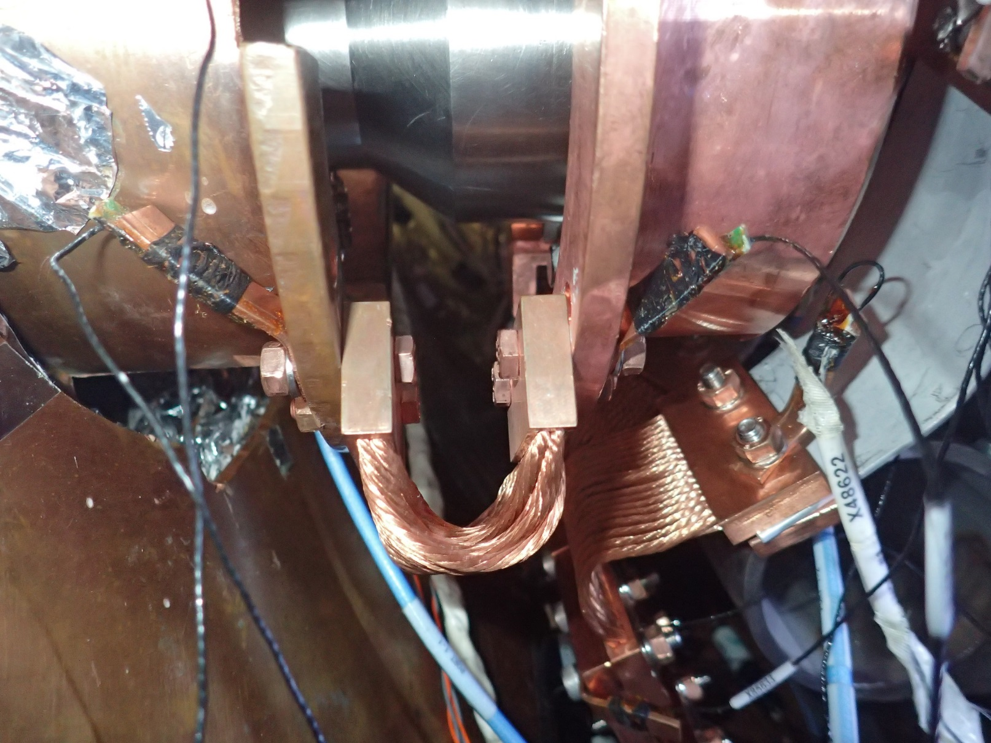
80 K Thermal Connection
HTTP6
XM2
HTTP7
Note: In HTS CF100 flange connected to Copper can

Slide 11
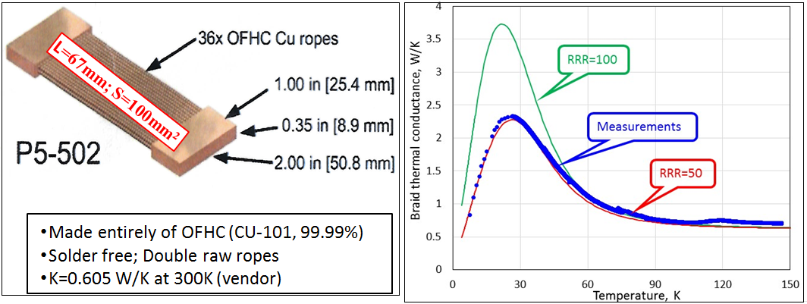
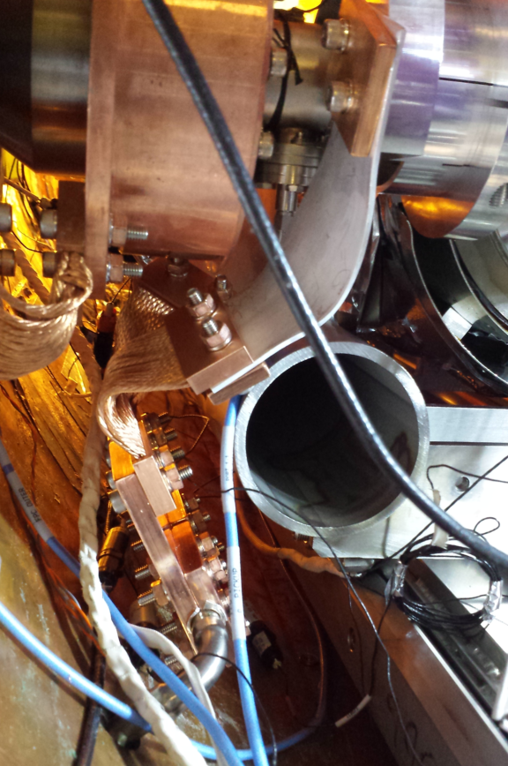
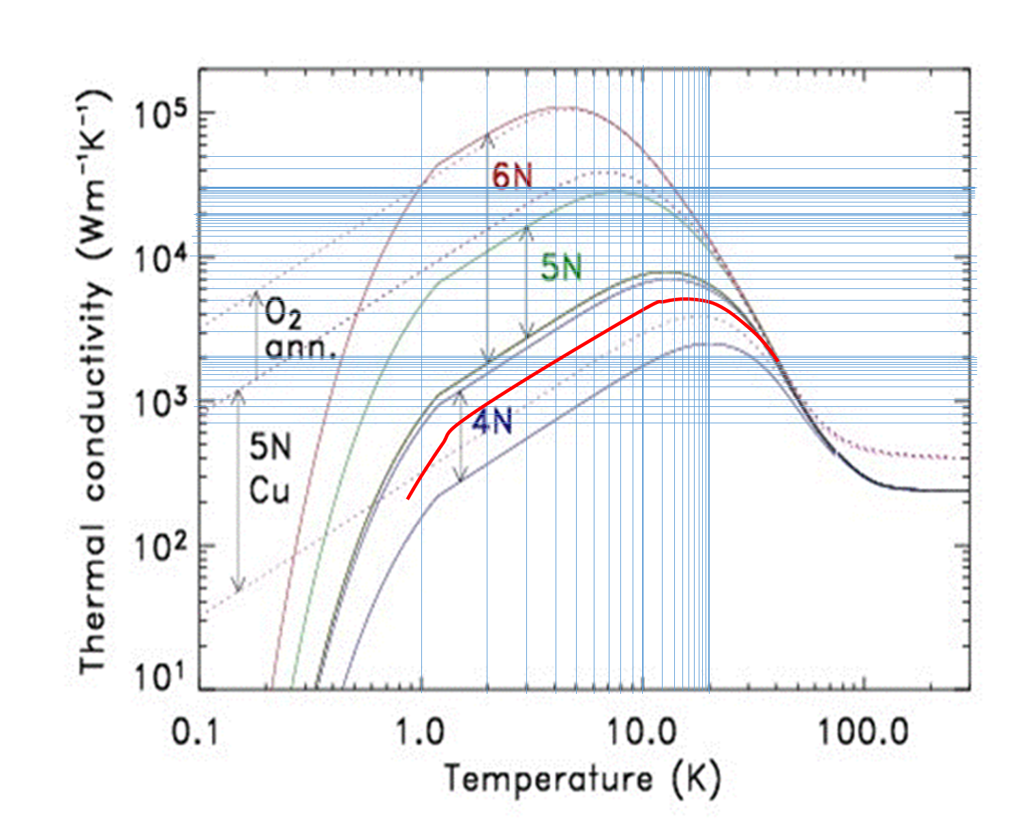
P5 – 502 Copper Thermal Straps (TAI Inc.)
Calibration at 4-150K
AL5N extension: Calibration at 5-10K (in cryostat)
 | Measurements
P, W | ΔT, K | <T> | K [W/m-K]
2.44 | 9.3 | 11.9 | 4208
4.34 | 14.3 | 15.3 | 4853

Slide 12
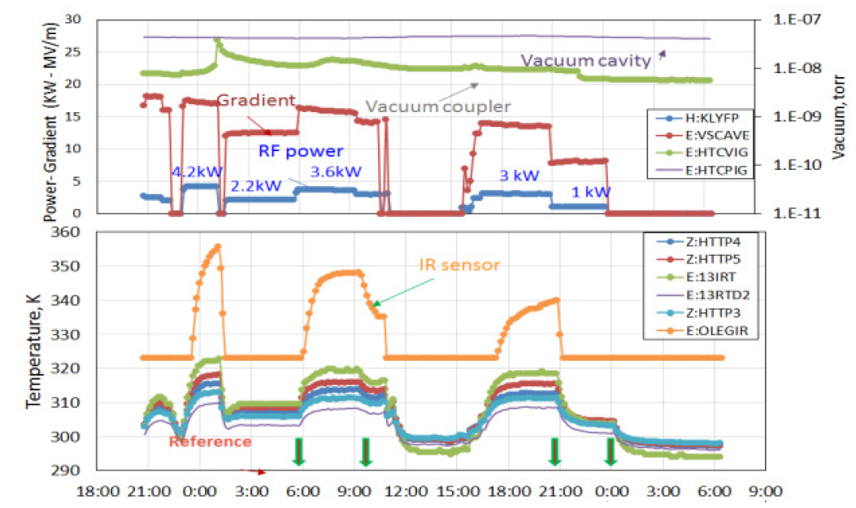
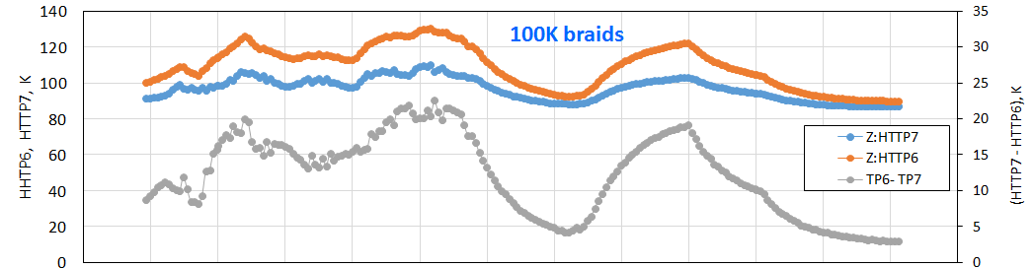
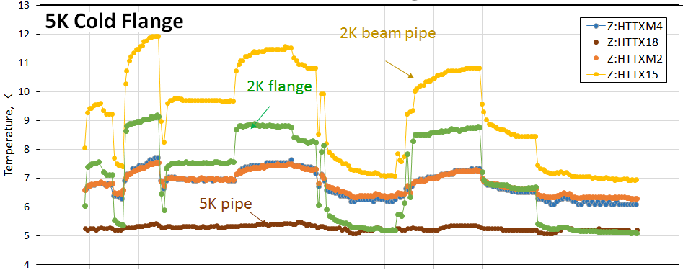
300K zone
History of coupler test with cavity “ON” resonance regime in AES021 integrated study.
Top plot shows RF power, accelerating gradient and vacuum in warm section of FPC.
Bottom plots show temperature of sensors at 300K, 80K and 5K zones of the coupler.
Longest time constant for 80K zone
80K zone

Slide 13
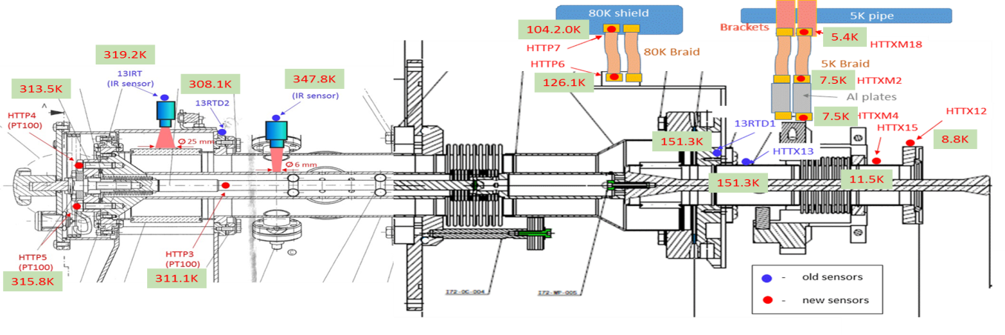
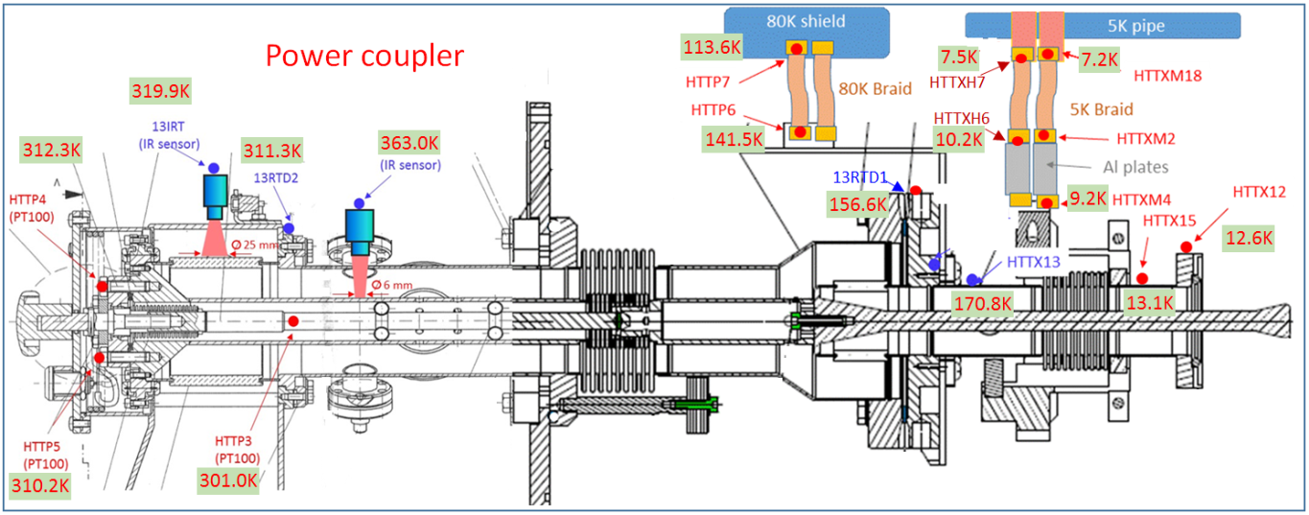
Temperature Maps: Cavity ON-Resonance
AES021: 3.6kW; “ON-resonance”
AES027: 4kW; “ON-resonance”

Slide 14
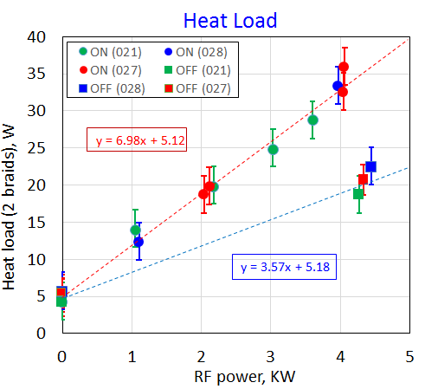
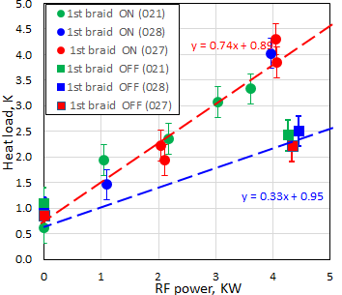
FNAL HTS Coupler Heat Load Results for 3 Cavities
On and Off Resonance
5 K Intercept Heat Load
80 K Intercept Heat Load
W
On Resonance 3D Simulations: tan(delta) = 3e-4, plating RRR = 50, 5.4 K, 104 K and 320 K intercepts at 3.6 kW

Slide 15
Comparison to XFEL CM Dynamic Heat Loads
The plots below show XFEL measured 4 and 40 K CM heat loads normalized to our coupler simulation results for their couplers (5, 50 and 310 K intercepts) at their average rf power (forward + reflected), in particular, 2.6 kW at 23.6 MV/m
4 K Normalized Load
40 K Normalized Load
CM Number
CM Number

Slide 16
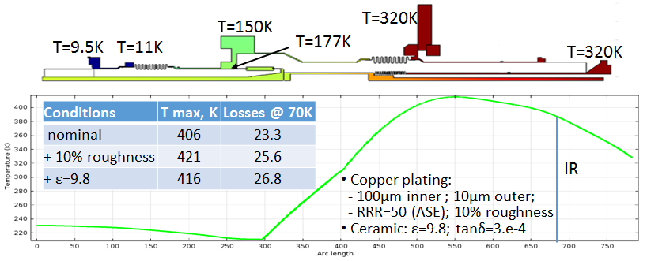
  Simulated Inner Conductor Temperature
  4 kW, ON-resonance (COMSOL)
Measurement
Increase Cu plating (inner conductor) 100→150um: T_{max}=400K; Heat flux to 80K = 28W (worst case with 10% of surface roughness).

Slide 17
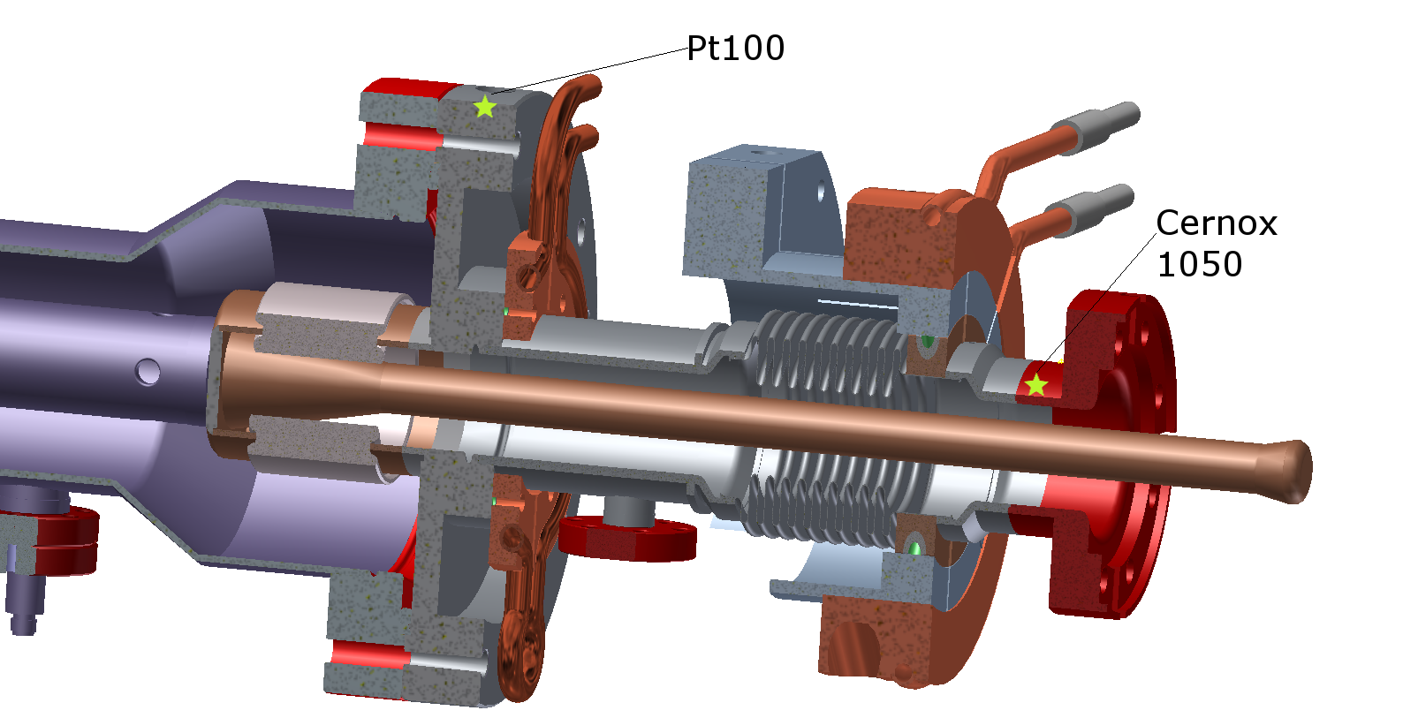
Cornell Coupler Test
Cornell HTC tests with modified couplers showed no decrease in Qo when varying the on-resonance input power up to a level comparable to that at LCLS-II for a fixed gradient of 15 MV/m
Cooled flanges with He gas lines
P_{f} = 2kW
P_{f} = 200W

Slide 18
Summary
Have successfully reduced the warm section inner conductor temperature using thicker copper plating.
Reexamined issues of plating surface finish, surface roughness, oxidation and rf processing. Also improved WG box design.
Measurement of the coupler heat loads in HTS is difficult as it requires detailed knowledge of the material thermal properties.
Measured loads are about twice that predicted, XFEL data in better agreement but have large errors.
The coupler dynamic loads are only ~ 20% of total loads at 4 K and 40 K, and have ~ 100% overhead with two cryoplants, so can accommodate larger loads.

