Slide 1
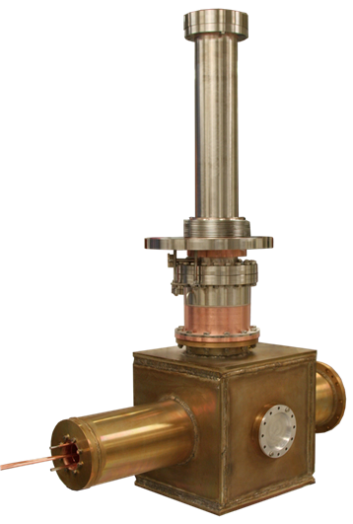

Manufacturing of the IFMIF series power couplers
Presented by : Hassen JENHANI
IRFU/CEA
TTC MEETING AT SLAC, DECEMBER 1-4, 2015

Slide 2
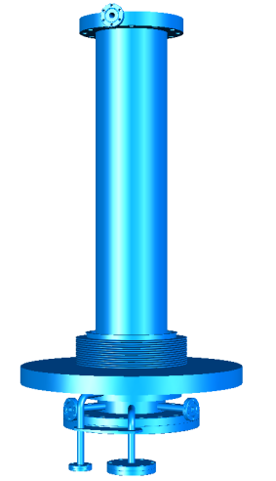
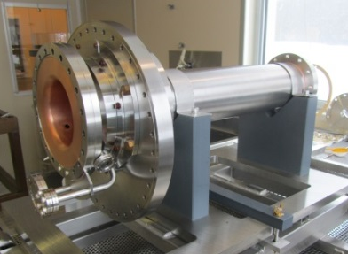
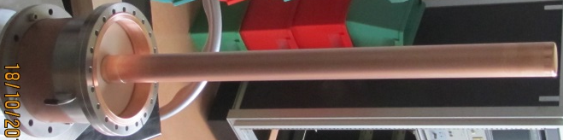
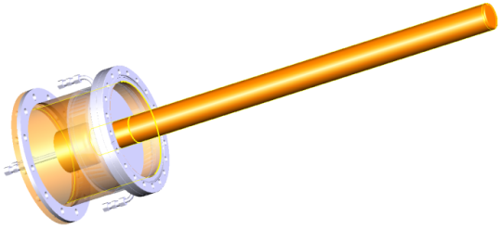
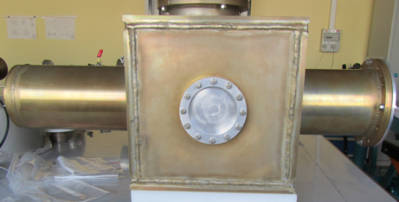
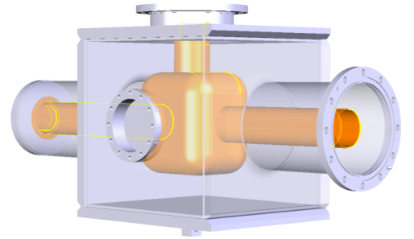

IFMIF Power Coupler Layout
Cooled outer conductor:
Stainless steel + OFHC Copper
High purity copper plating of all the RF surfaces
Window :
Ceramic: AL995
External conductor & inner conductor: OFHC Copper +SS
Antenna: Stainless steel with high purity copper plating
All brazed*
“T” Transition:
Internal conductor: OFHC Copper (all brazed)
External conductor: Aluminum (TIG welded)
*Ghe cicuit connectors are TIG welded
RF specifications for the couplers dedicated to the first cryomodule of IFMIF :
Frequency: 175MHz
Qext: 6.5x10⁴
Maximum nominal operating RF power: 70 kW CW
RF power validation needs : 100 kW CW in TW and SW
1092 mm

Slide 3
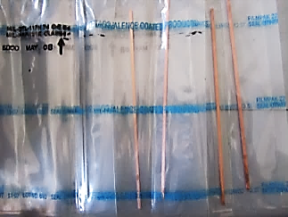
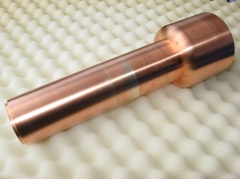
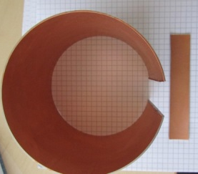
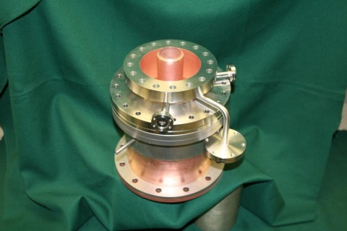
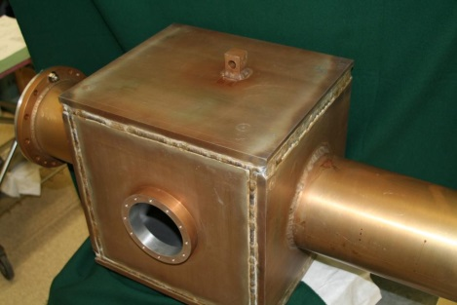
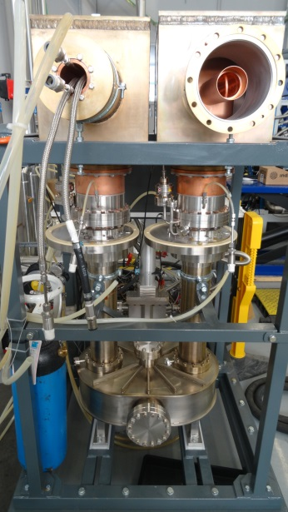
Main validation Stages
Validation of processes based on samples:
  Copper plating validation: RRR, thickness, adhesion
  TiN validation: Thickness measurements
Samples for RRR measurements
Samples for antenna plating validation
Samples for outer conductor plating validation
Validation based on muck-up:
  Assembling processes validation
  RF measurements
  Easy cleanability of vacuum parts
Validation based on prototype coupler pair:
  Desorption rate measured on the final vacuum parts <<5 x 10-9 Pa.m/sec
  Detailed visual inspections
  RF conditioning up to 100 kW CW TW/SW (results were presented in TTC 2014)

Slide 4
SERIES couplers manufacturing
Validation of two PC prototypes ➔ Manufacturing of eight PCs has been lunched.
The design of the coupler was validated, however new considerations related to the cryogenic system for the cryomodule suggested slight modifications
The most significant change due to these new considerations impacted the copper plating acceptance criteria
 |  | Prototype Couplers | Series Couplers | Impact on the manufacturing
Copper plating | Thickness | ~ 40 µm | From 20μm to 30µm | Modification of the plating process parameters ➔ New validation tests
 | RRR | 30 ≤ RRRCu ≤ 80 | 20 ≤ RRRCu ≤ 80
  ➔ New samples are needed for copper plating validation
  Copper plating process is still the same:
    1µm Nickel layer
    Bead blasting after copper plating
    400 °C heat treatment during 2h
  ➔ No additional desorption test measurements are requested as the same copper plating processes is maintained.
  Concerning the inspection acceptance criteria, the visual inspection report established for the prototypes is used as a baseline document for the series PCs.

Slide 5
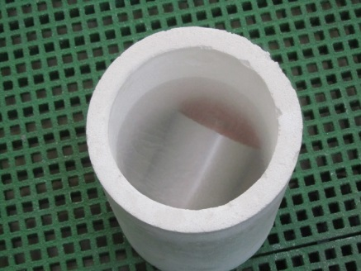
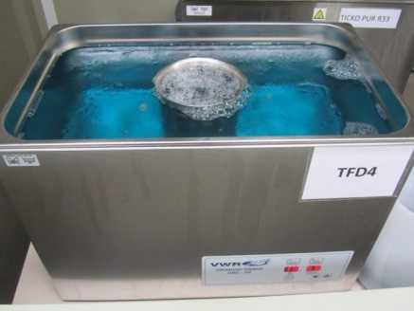
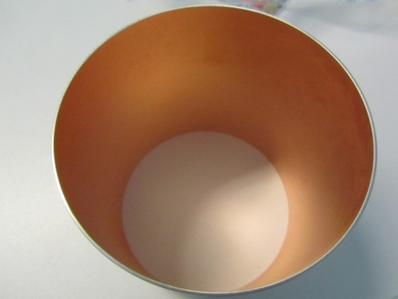
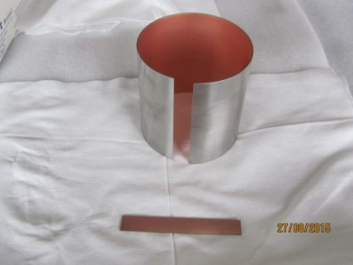
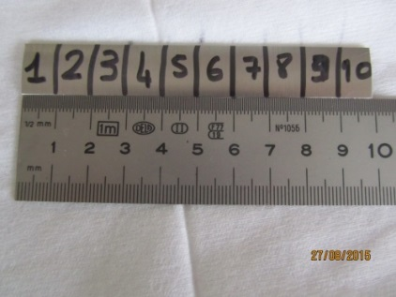
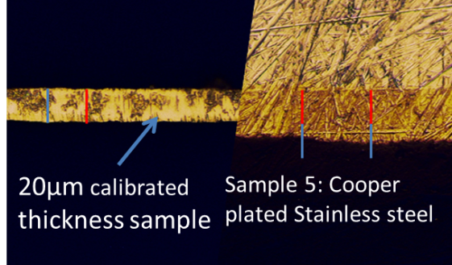
New validation tests for the copper plating
Adhesion test:
Copper after the tests
U.S Bath cleaning at 60°C (UP water +detergent)
Liquid Nitrogen cooling
➔ No surface degradation was observed
Thickness measurements on representative sample:
SS
Cu
➔ Thickness corresponds to the specification: From 20μm to 30µm
RRR measurements results:
  RRR SS = 1.5
  RRR SS-Cu not heat treated = 15
  RRR SS-Cu heat treated = 32 => corresponds to the specification: 20 ≤ RRRCu ≤ 80

Slide 6
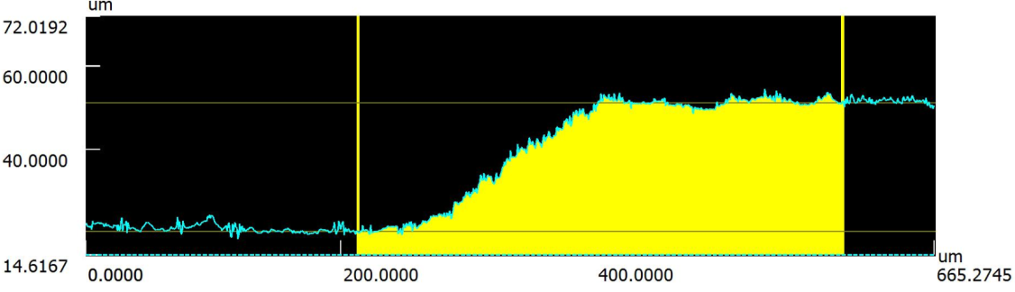
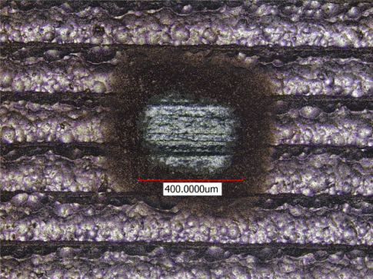
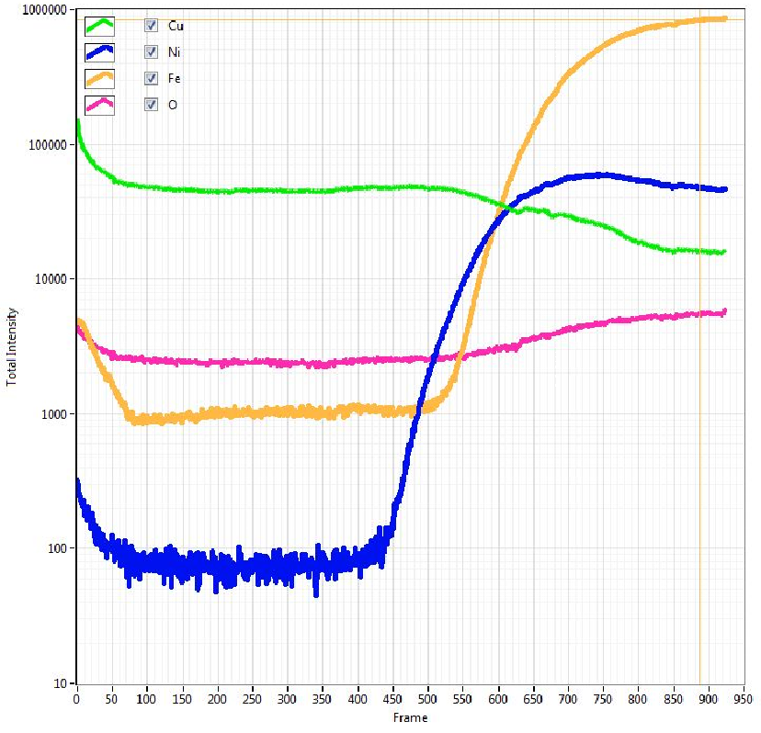
Additional investigations: SIMS Analysis of a copper plated sample
Analysis performed in the MAterial ANAlysis Platform (PANAMA) / Thanks to David LONGUEVERGNE
Confocal Microscopy (KEYENCE VK-X200)
Depth measurements of the crater
30µm
SIMS Analysis (HIDEN ANALYTICAL)
Crater created by SIMS Analyses
Inputs:
Measured depth of the crater generated by the SIMS analysis: ~30µm
Cu
O
Expected Cu thickness: 21µm..25µm
Fe
Initial Ni layer thickness: 1µm
Ni
Heat treatment: 400°C (2h)
~15µm
~30µm
Ni concentration is the same from the copper surface to 15µm depth. Concentration increases from that depth to the SS interface
Expected location for the SS substrate boundary

Slide 7
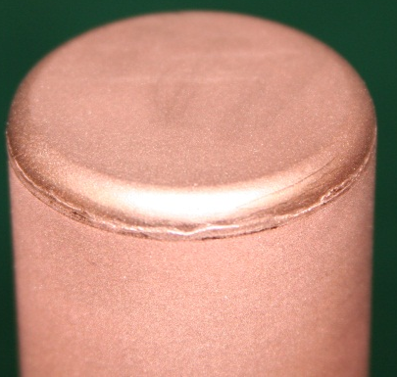
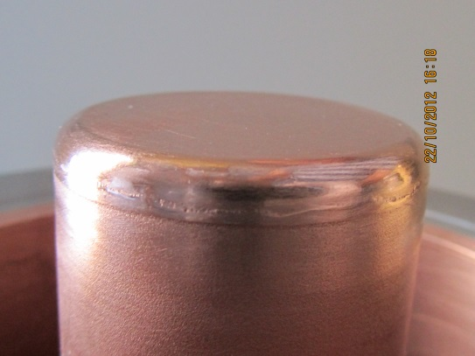
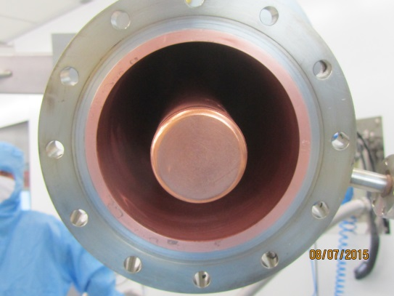
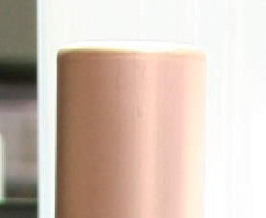
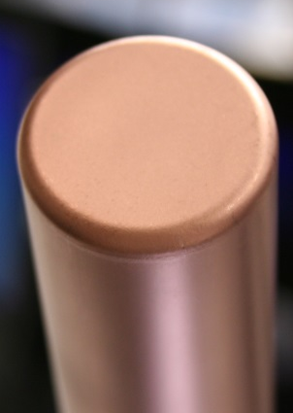

Visual inspections on the first series PC (1)
Prototype Coupler
After Copper Wool burnishing
After RF Conditioning
Brazing roll
Series Coupler
No brazing roll for the first coupler inspection

Slide 8
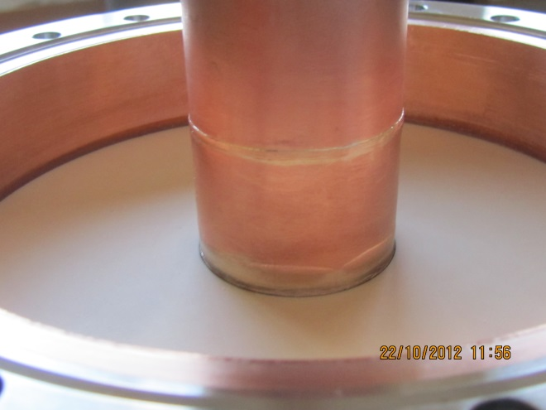
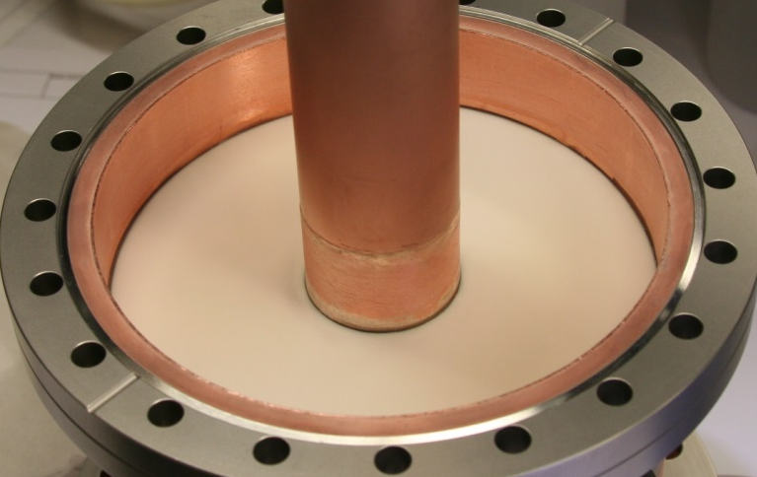
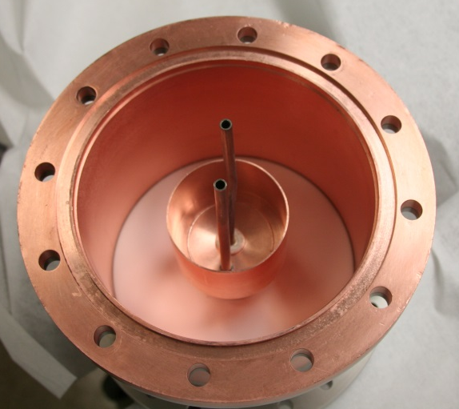

Visual inspections on the first series PC (2)
Prototype
Series
Dark color due to the brazing material oxidation
Brazing material traces but surface was smoothed before the TiN deposition
Ceramic window (Vacuum side) is clean and has the same coloration in the two case
Dark color on the air side of the ceramic
No problem encountered during RF power tests of the 2 coupler prototypes
Can be removed by sandblasting

Slide 9
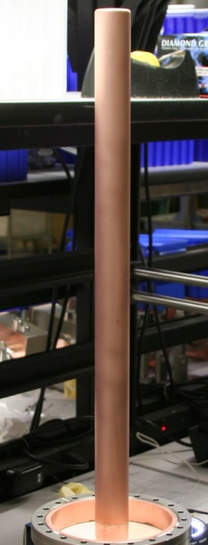
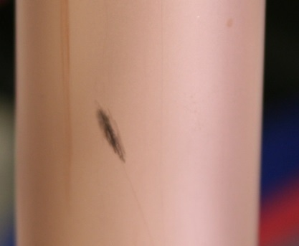
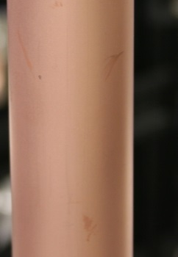
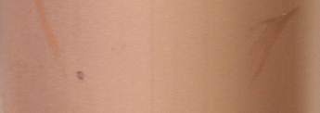
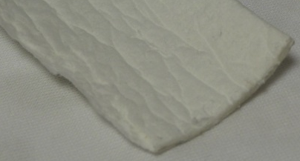
Visual inspections on the first series PC (3)
Inspection of the plated antenna of the first series PC
Dark color on the entire antenna seems to be due to oxidation:
  Chemical solution? Sulfamic acid or citric acid…
  Or mechanical solution? Burnishing or bead blasting.
For the next couplers, we asked for photos of the antenna before and after brazing operation to check if antenna copper plating is initially ok.
Traces on the antenna copper plating
Antenna after the final brazing operations
Surface finishing proposal: Ceramic wool wiping
Ceramic wool

Slide 10
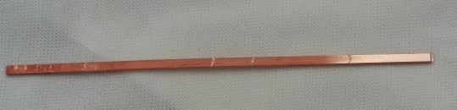
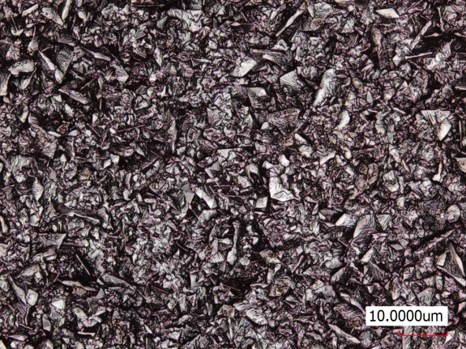
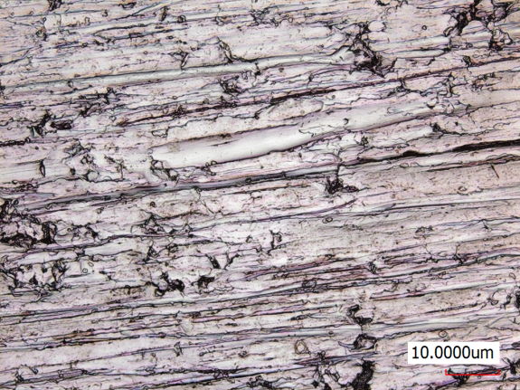
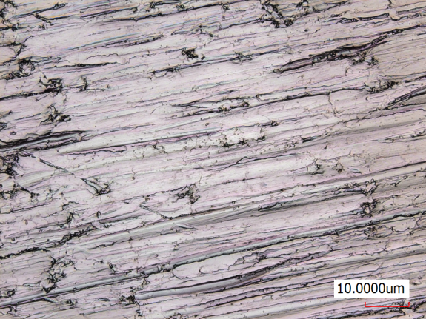
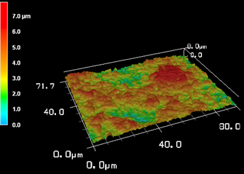
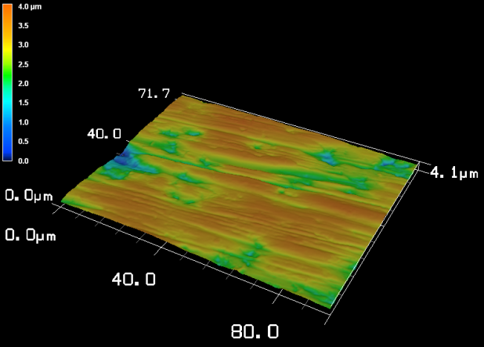
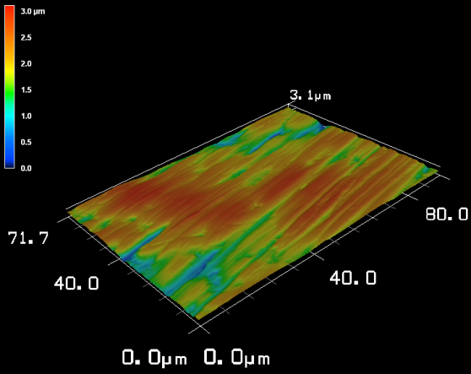
Investigation on the ceramic wool wiping impact on the copper surface
Ceramic wiping applied on copper plated sample
Ceramic wool wiped region
SS copper plated sample
Surface investigation using Confocal Microscopy (KEYENCE VK-X200)
NO Ceramic
Wiping
Light Ceramic Wiping
More Ceramic
Wiping
Ra=1.04
Ra=0.42
Ra=0.39
Particle counting in ISO5 clean room:
Cleaning with UP water/US bath/detergent, then particle counting ➔ The counted particles number decrease down to zero ➔ No cleaning issues due to the ceramic wool wiping

Slide 11
We would appreciate having your experience feedback and comments.
Thank you for your attention!

Slide 12
Thanks to P. Hardy, V. Hennion, N. Berton, H. Dzitko, G. Devanz, Y. Gasser, Y. Boudigou, C. Antoine and N. Bazin from IRFU (CEA)
A special thank to David Longuevergne from IPNO (IN2P3/CNRS)

