Slide 1

Development of a quarter-wave coaxial coupler unit for 1.3 GHz TESLA-type SRF cavities
Yi Xie
Fermilab
TESLA Technology Collaboration Meeting 2015
Dec. 2nd 2015

Slide 2
Outline
Motivation;
  What and why coaxial coupling;
  Previous work;
Our work on coaxial coupling scheme;
  Design and fabrication;
  Superconducting joints;
  Cavity processing and testing results;
Discussions and future work.

Slide 3
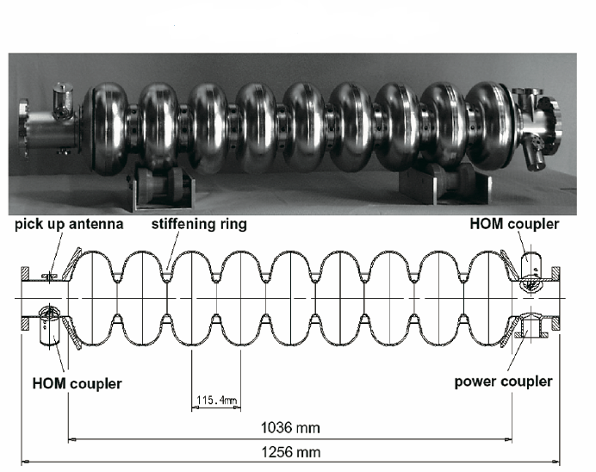
Coaxial coupling scheme
Fields asymmetries and kicks from all couplers

Slide 4
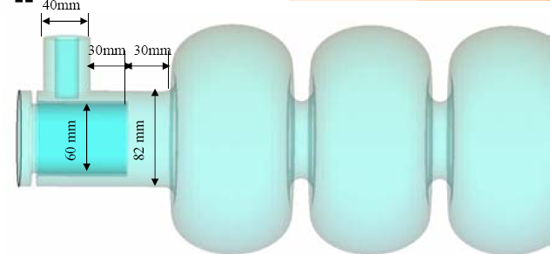
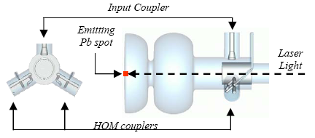
Different coaxial coupling scheme
Waveguide-coaxial (Cornell)
Coaxial coupler (FNAL)
Nb-Pb SRF gun (DESY/Jlab)
To preserve axial symmetry of RF structure in the acceleration channel.

Slide 5
Advantages of coaxial coupling
  Preserve field symmetries, no coupler kicks;
  Distance between can be shorter, for ILC cavity, difference is 9 cm, higher real estate gradient;
  Cavity body stay cylindrically symmetric, easy fabrication;
  Better cleaned separately if using flange connections (superconducting joints);

Slide 6
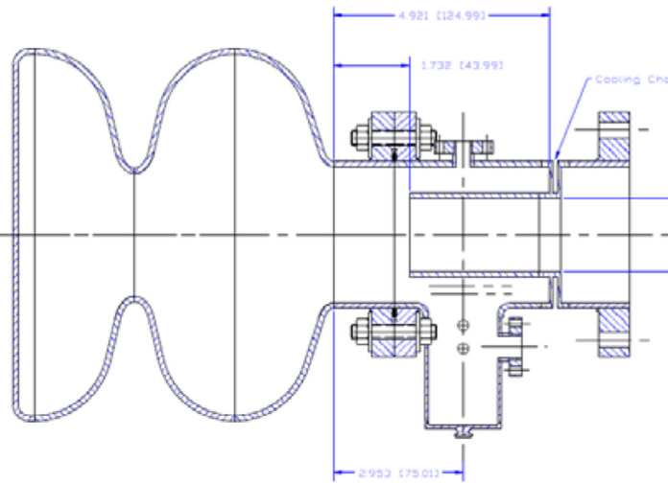
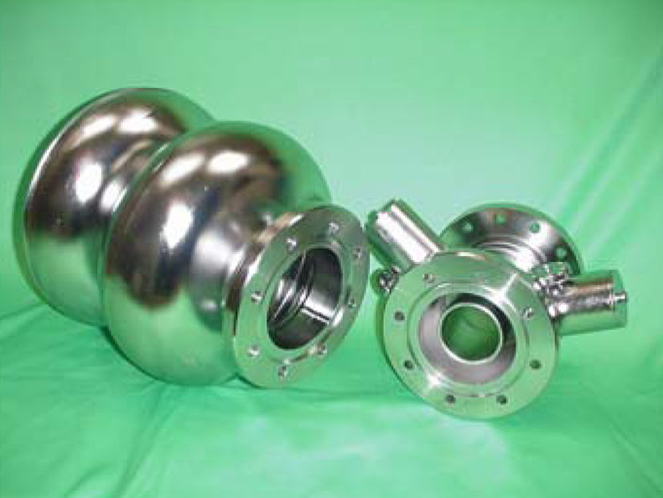
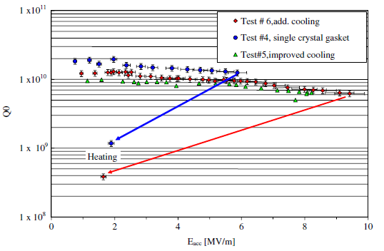
Jlab-DESY effeorts
Assembly drawing
Parts before assembly
Test results
See P. Kneisel & J. Sekutowicz
PRST-AB 13, 022001 (2010)

Slide 7
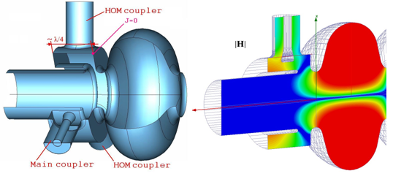
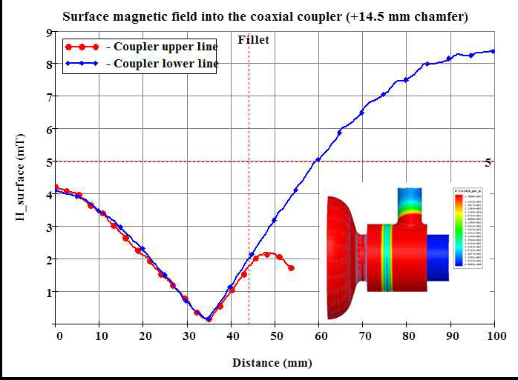
Euclid-Fermilab methods
Quarter-wave
For Eacc ~ 35 MV/m,
the Hsurf is < 0.15 mT,
Lower enough permitting
Superconducting joints

Slide 8
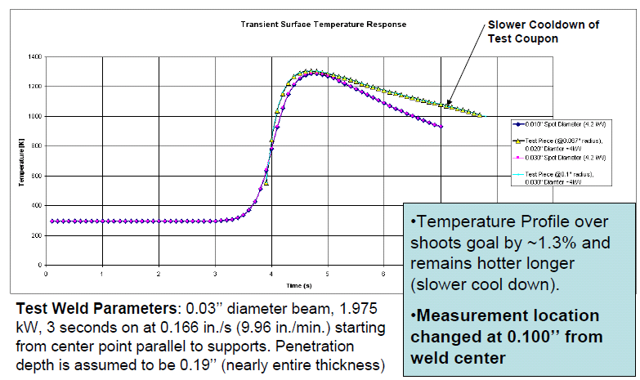
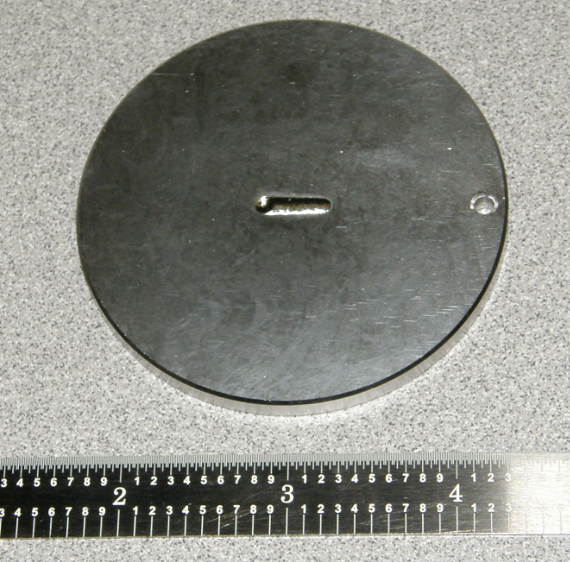
Flange choice
  There are two ways to attach coaxial coupler: welded on or detachable using SC joints.
  We choose detachable CF flanges with Nb1Zr material, and RRR300 Nb gaskets.
Test welding with Nb1Zr
Temperature rise at the knife edge of Nb1Zr CF

Slide 9
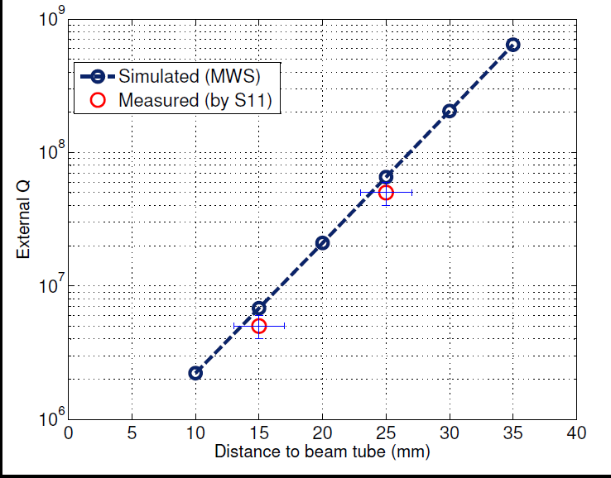
Qext measurments
  Simulations and room temperature RF measurements
  make sure the coupler provides enough coupling.
Measured and simulated Qext of the quarter-wave coaxial coupler

Slide 10
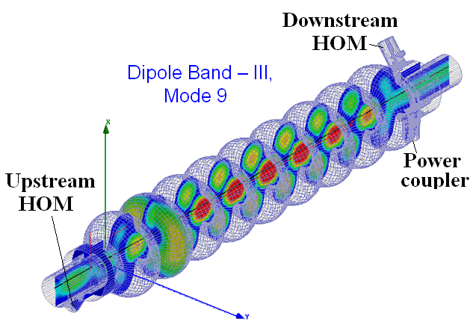
HOM damping
  Simulations (HFSS) show coaxial coupler provides required Qext for HOMs .
A very detailed band calculations (Qext, R/Q) shows that the proposed quarter-wave coupler unit supplied with standard HOM dampers meets the ILC requirements for HOM damping.
S21 from FPC to HOM coaxial couplers

Slide 11
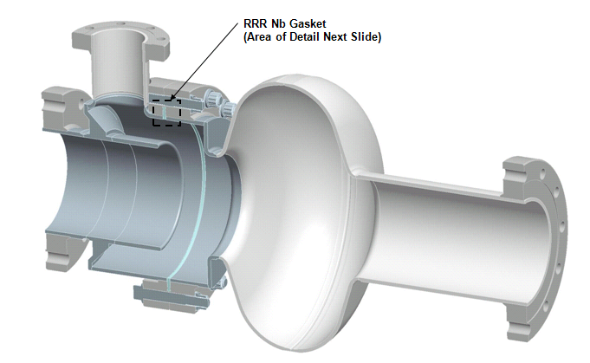
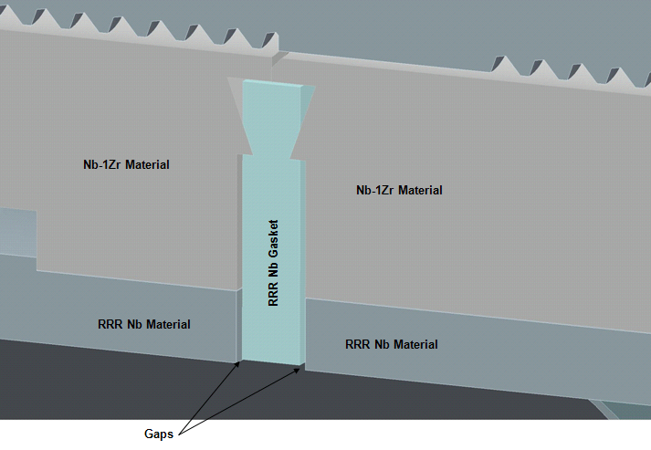
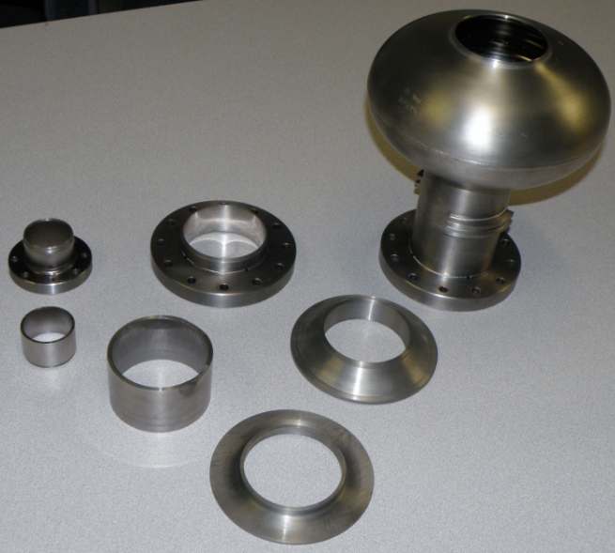
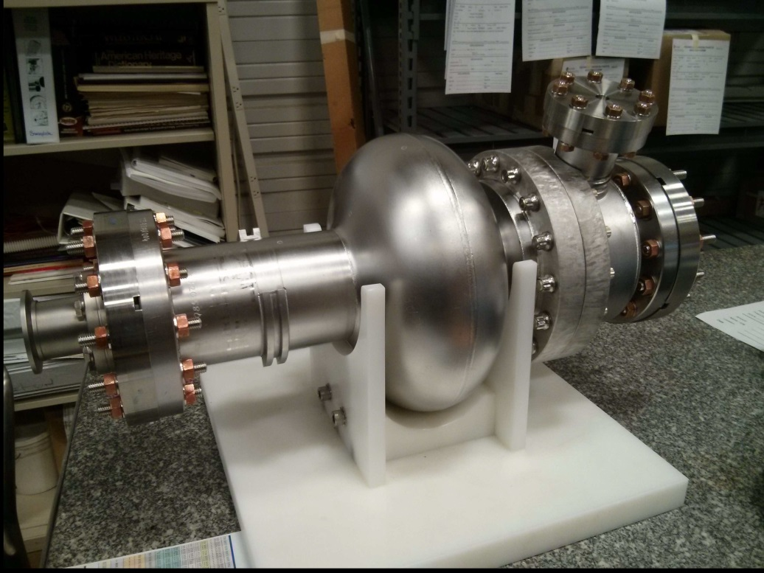
Coupler fabrication
  AES fabricated the coupler unit along with a single-cell PAVAC cavity provided by Fermilab.

Slide 12
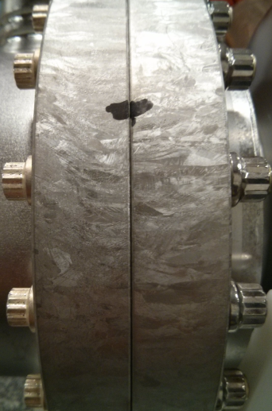
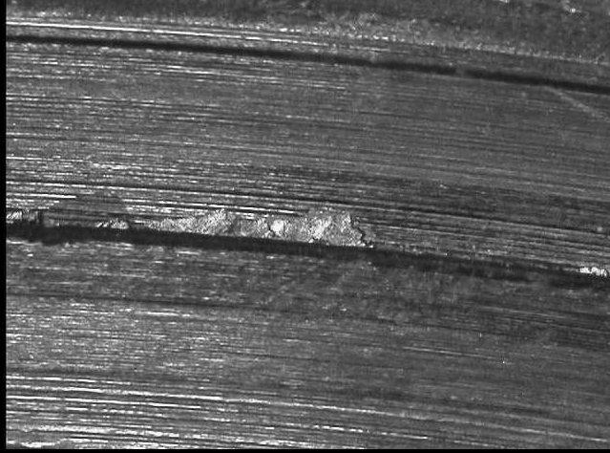
Superconducting joints
When we tighten the bolts,
this gap get down to very thin-one A4 paper thickness probably,
We could face off NbZr Flanges a little bit so we can tighten the bolts more.
First try with Copper seal, then Nb seal.
Not great Nb1Zr knife edge.

Slide 13
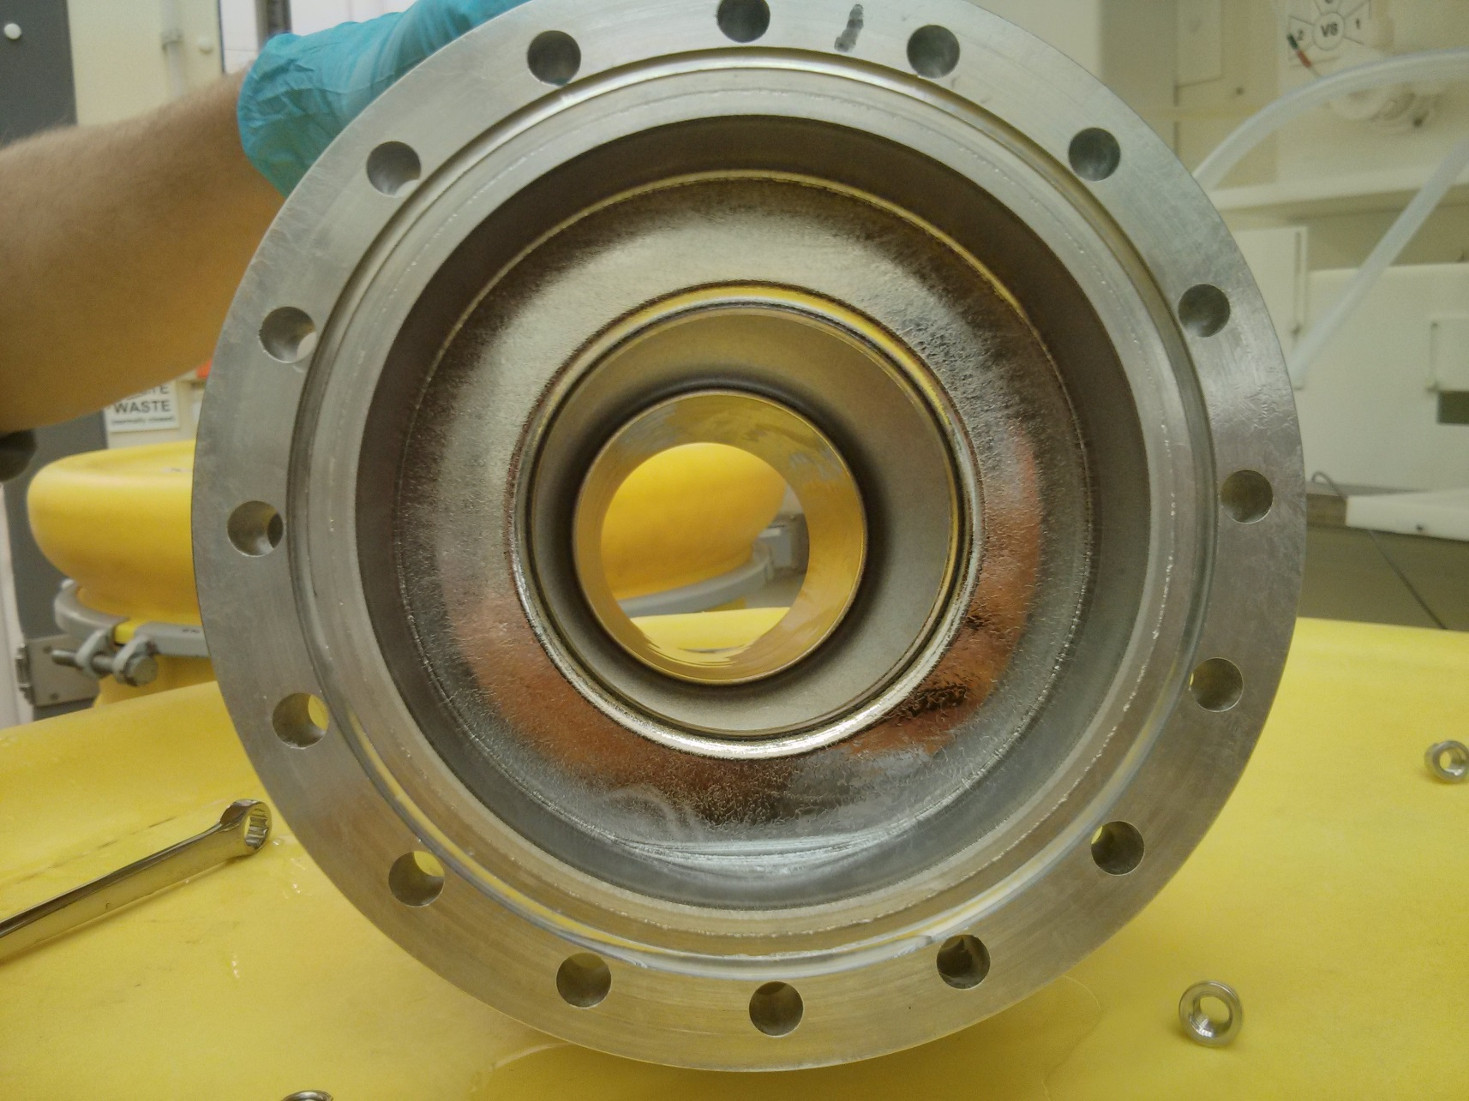
Cavity-coupler unit processing
1. Vacuum Leak Check (with copper);
2. Optical inspection of the cavity and the coupler unit;
3. Thickness measurements;
4. BCP/HPR validation (due to exotic geometry);
5. 120 um BCP ;
6. Pre-bake cleaning/HPR;
7. 600C bake 3 hour;
8. Light BCP (20 um);
9. Installation with niobium seal (SC joint);

Slide 14
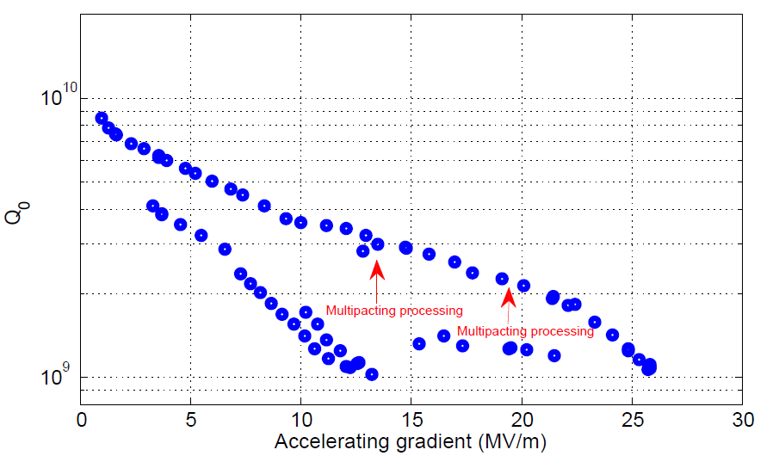
First vertical rf test results
1.7K
Strong X-ray
No quench
Power limit

Slide 15
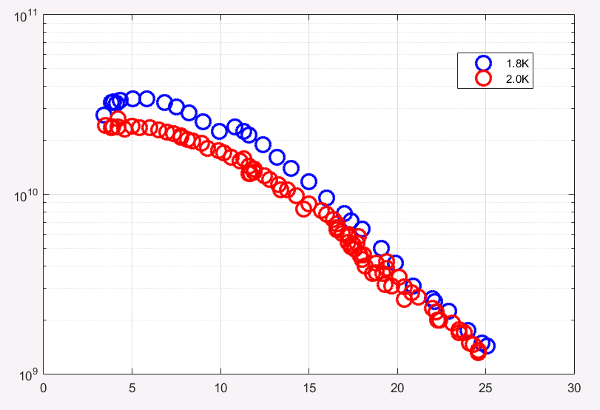
Previous baseline Parvac cavity results
2K
Q0
Eacc(MV/m)

Slide 16
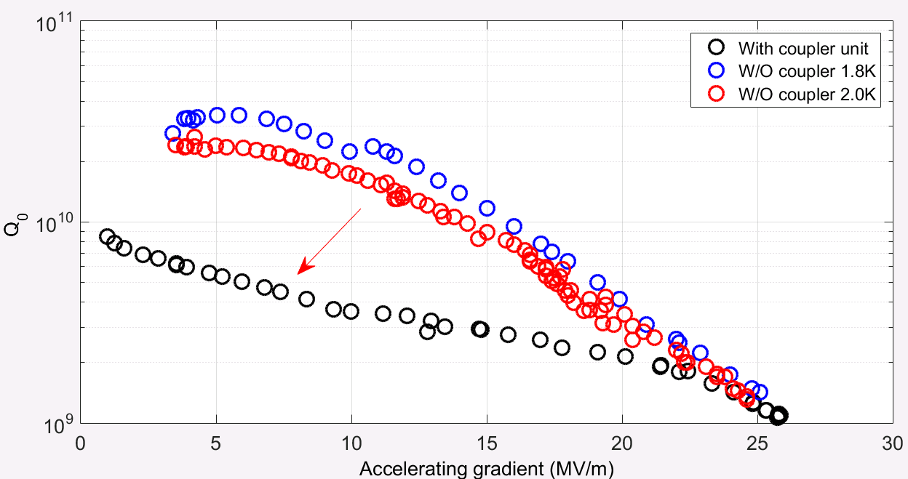
Before and after adding coupler unit

Slide 17
Conclusions
Achievements;
  Working coaxial coupling unit until 26 MV/m;
  First working SC joints inside a 26 MV/m cavity;
Discussions;
  120 C bake to eliminate multipacting (no working);
  More tests to identify Q loss:multipacting or joint loss;
  Add coupler unit to a 9cell;
Suggestions?

Slide 18
Acknowledgement
As a SBIR project, we thank the entire Fermilab SRFD department for collaborations.

Slide 19
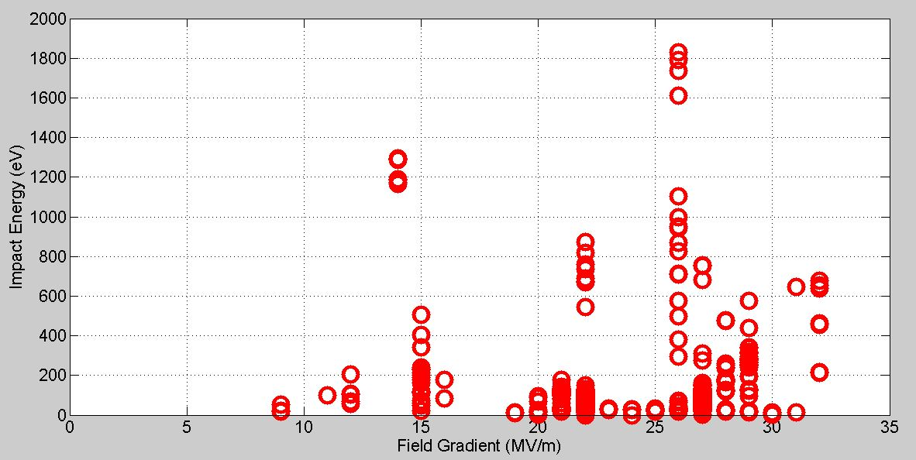
Multipacting events

