Slide 1
PAVAC INDUSTRIES INC.
PAVAC'S VIEW ON CAVITY PRODUCTION FOR FRIB, FERMILAB, IHEP, TRIUMF OR “HOW TO MEET THE BUDGED AND SCHEDULE”
TTC Meeting
SLAC National Accelerator Laboratory
December 1-4, 2015
Ralf Edinger

Slide 2
Introduction
Cavity examples
Transition from prototyping to production
Tools
QC
Summary
Hello, my name is PAVI the super electron. I will guide you through this presentation.
Ready? Set, GO!

Slide 3
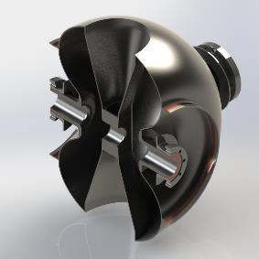
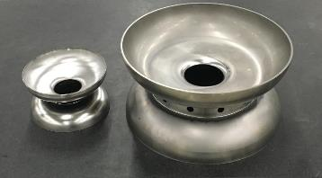
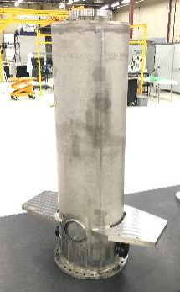
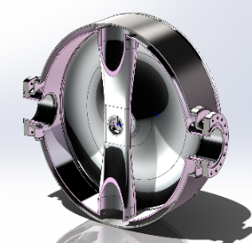
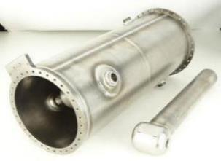
Cavity Examples
Elliptical
650 MHz to 1.3 GHz
Quarter Wave
80 to 160 MHz
Spoke – “Balloon Spoke” 325 MHz
Lets Look At Making 115 Quarter Wave Cavities For FRIB!!!

Slide 4
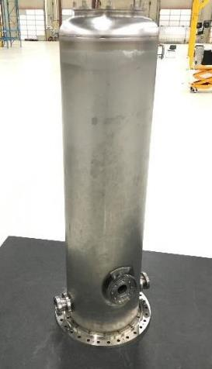
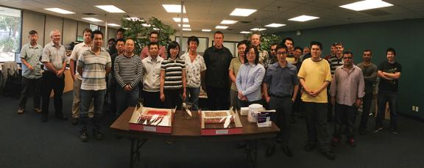
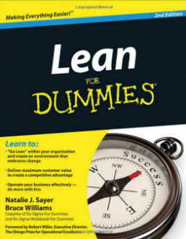
SRF & Lean Manufacturing
PAVAC’s way to success is cultural change to individual responsibility and lean processes!
Production of 115 FRIB cavities require change in production philosophy in order to meet budged and schedule
=> PAVAC selected Lean Manufacturing (Lean Organization) as strategy in 2014
PAVAC Team During Lean Activity – Ice Cream Cake

Slide 5
Lean Tools applied currently @ PAVAC
NOTE !!! MSU was looking for a partner in the FRIB project, not necessary a “vendor”!
Lean Tool | Description
Gemba | Go to the problem or where the value is created
Kaizen | Continues improvement
Kanban | PULL production flow
Bottleneck Analysis | Identify what limits the overall throughput
KPI | Key performance indicators
Takt time | Cycle time reductions
> Value Stream Map (VSM) | Mapp of the production flow = creating value
5s | Sort, Set in order, Shine, Standardize, Sustain
> Visual Factory | Display production and allow pull production
> Huddle meeting | meet regular to reduce pressure
Rootcause analyses | Find the underlying cause for a problem

Slide 6
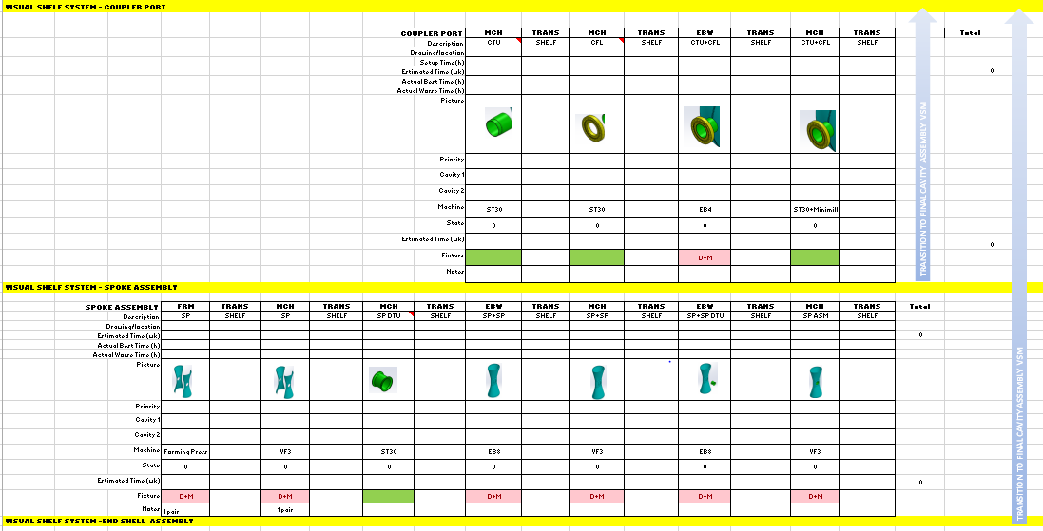
VSM – Optimal Process Flow
Value Stream Mapping allows to optimize to production flow and to discover “BOTTLENECKS”

Slide 7
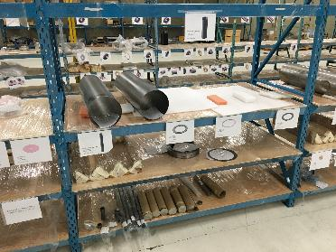
Visual Factory – Visual Shelf
Final
Start
Huddle
Visual Factory – Visual Shelf is based on VSM and a Kanban or Pull configuration. Raw material enters the left and completed cavities are stored at the right.
“A Picture Is Worth A Thousand Words”
Overcoming Language Barriers

Slide 8
Daily Huddle Meetings
Huddle Meetings must be held regular at short, 5 to 10 min, intervals – Cavity Huddle @ PAVAC are dally to reduce diverging from goals by adjusting the production flow.
Huddle’s requires “Gemba” => meet where the issue arises.
Customer Huddle - Weekly Project Meeting – Call-in With FRIP

Slide 9
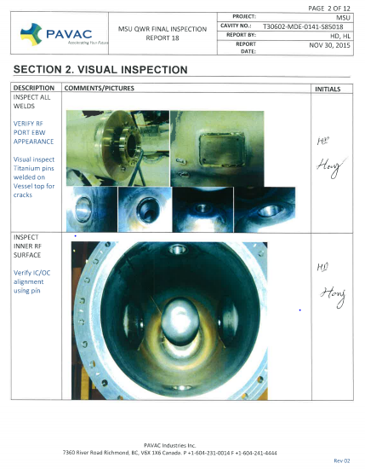
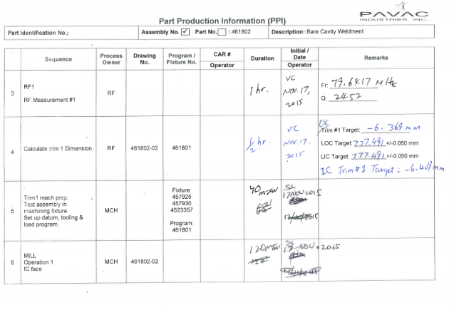
QC – Documented at the Source
QC or Quality Control – Data are where the parts are at the Visual Shelf and will be archived with cavity shipment including cavity test report.

Slide 10
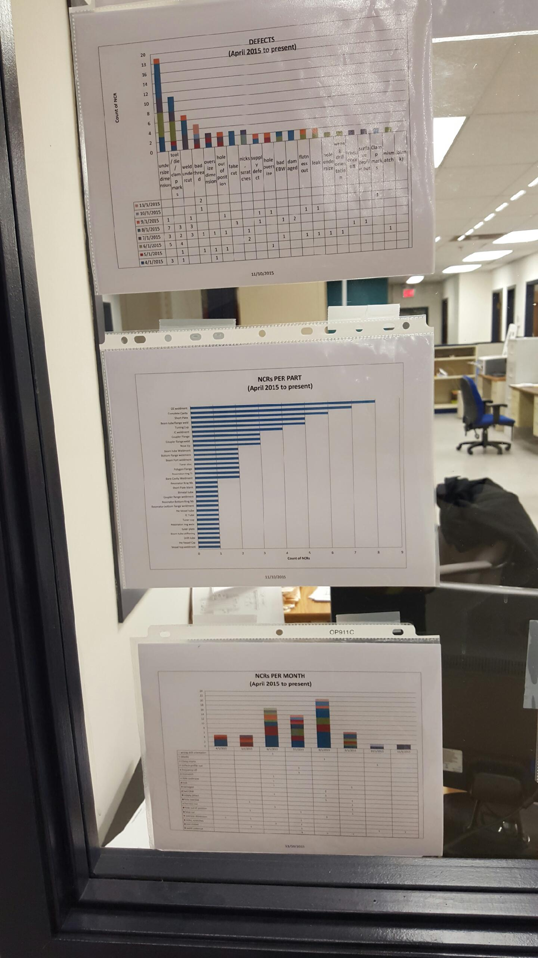
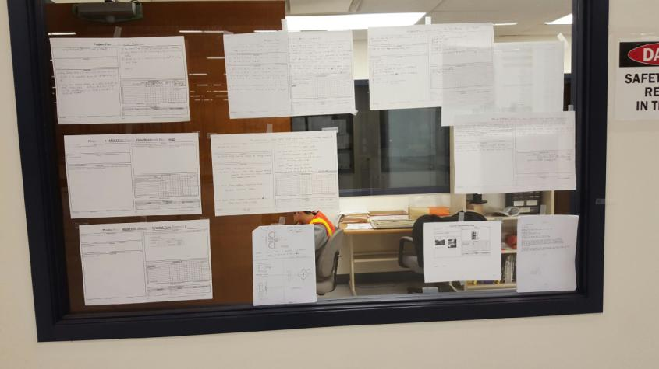
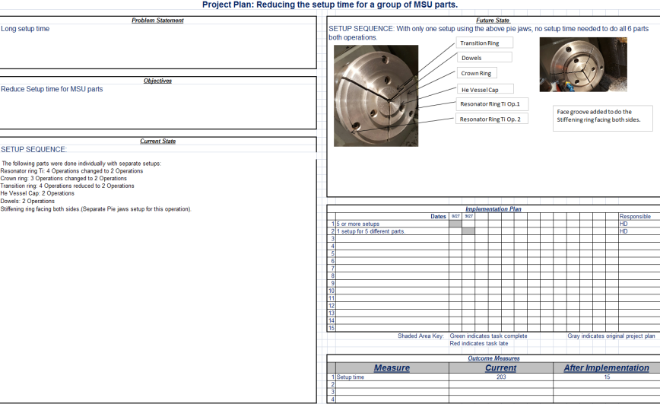
How to Maintain Quality and Awareness – Quality Management
Quality and Efficiency Display at Shop Entrance
NCR Tracking
Proposals for Cycle Time Reduction
Buy-In from Everyone is a MUST!
Proposals for cycle-time-reduction posted and reviewed!
Simple is better! Many small steps are better than one big jump!

Slide 11
Summary what we learned new …… so far…..
Organization
Lean Manufacturing’s (Lean Organization) fundamental goal is CUSTOMER FOCUS
Lean Manufacturing provide us a strategy to increase productivity by improving quality
Lean Tools must be applied and become part of the day to day operation NOT RANDOM EVENTS
Technical
Sometimes feedback comes delayed (e.g. Vertical Testing) and feedback cannot be implemented timely in ongoing production
Large cavities makes it more difficult to maintain perfect surface condition during fabrication like forming or machining
Little things may be big issues during production; things like threads, seals (knife edges) etc.

Slide 12
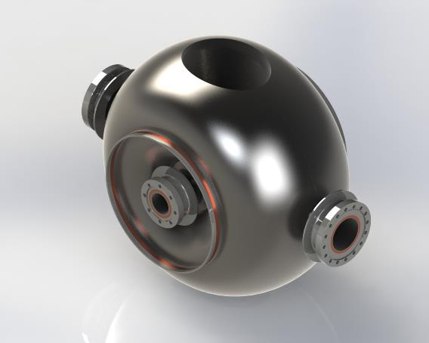
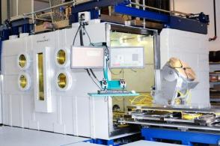
“Balloon Spoke” a new
TRIUMF/PAVAC SRF
Cavity with RISP support
All PAVAC SRF cavities are made on PAVAC’s “LASTRON” EB Welders!
THANK YOU!
 | 7360 River Rd, Richmond BC V6X 1X6 CANADA Telephone: (604) 231-0014 Email: info@pavac.com URL: www.pavac.com

