Slide 1
HWR Cavities for China ADS
TTC, 2th December, 2015 SLAC
Weiming Yue, Yongming Li
On behalf of Linac Center
Institute of Modern Physics
Chinese Academy of Sciences

Slide 2
Contents
Introduction of background
RF design
Mechanical Study Results
Fabrication
Vertical test result

Slide 3
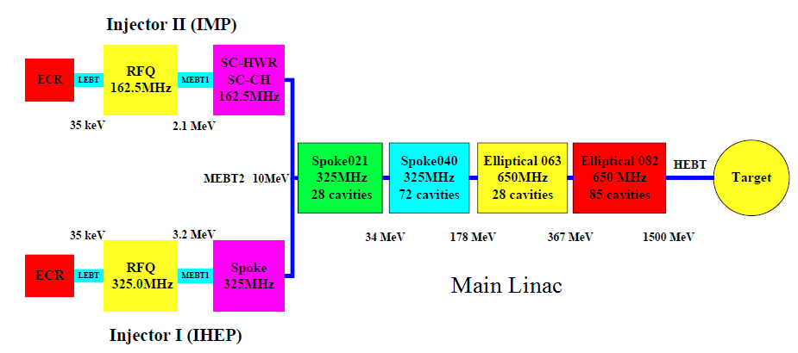
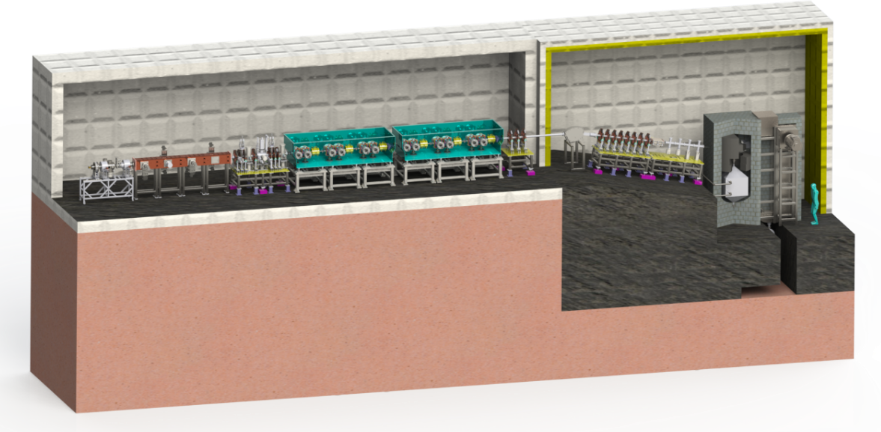
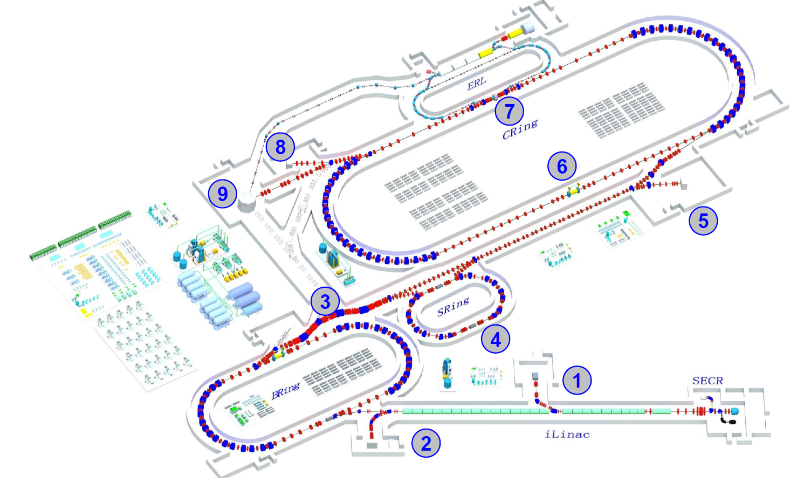
Motivation
10 mA H⁺
Cooperated with IHEP
ADS
HIAF
~3 mA ion
Neutron Source ~10mA D⁺

Slide 4
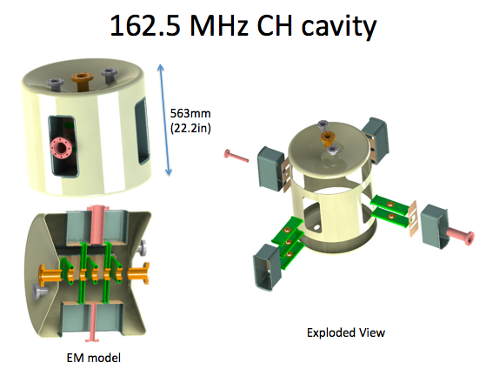
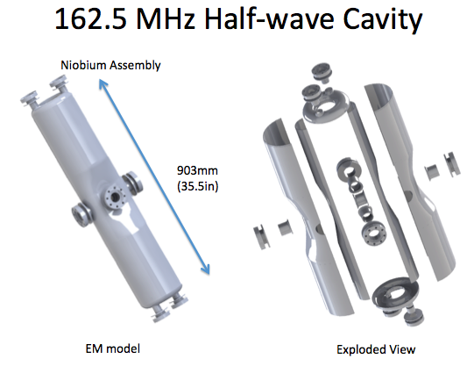
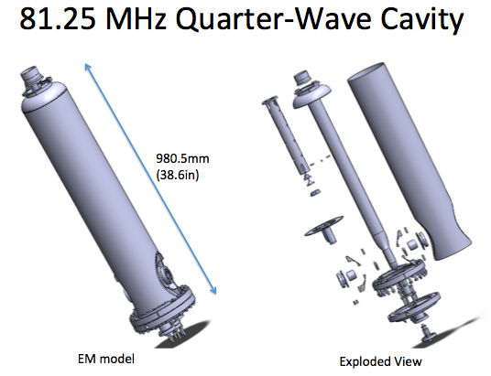
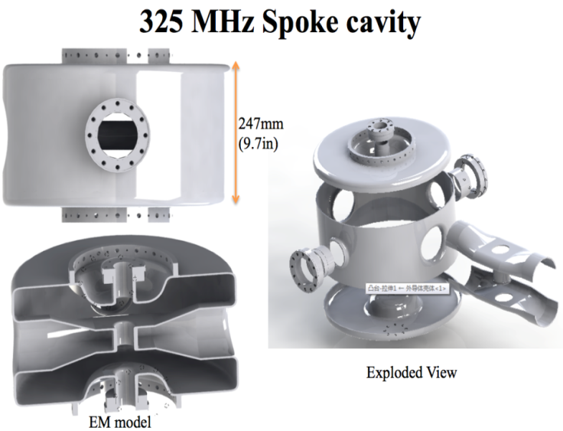
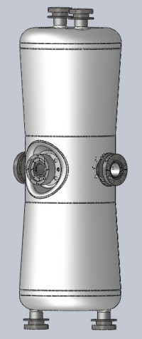
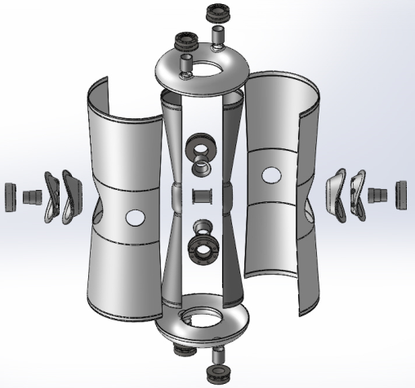
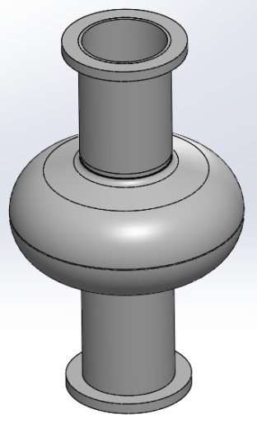
SC Cavity developed at IMP
162.5 MHz HWR015
1.3 GHz Single-cell

Slide 5
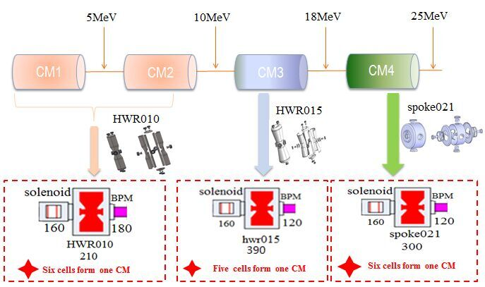
Physics design of ADS injector II

Slide 6
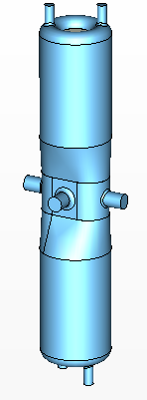
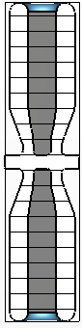
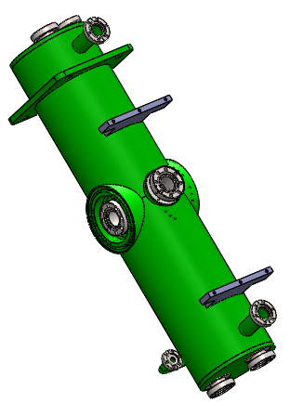
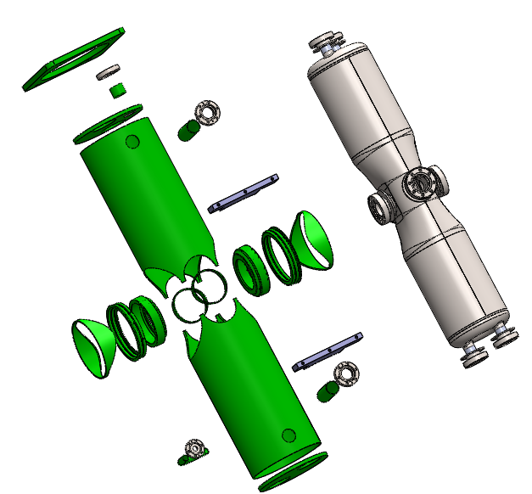
HWR 010
RF Parameters
models
f (MHz) | 162.5
β_{opt} | 0.101
Epeak / Eacc | 5.9
Bpeak / Eacc | 12.1
G = Rs×Q0 (Ω) | 28.4
R / Q0 | 153
Q0 (4.4K, Rs=71.4 nΩ) | 4E8
Vacc (MV) | 0.78
Epeak (MV/m) | 25
Bpeak (mT) | 50
Pdiss(W) (4.4K, Rs=71.4nΩ) | 10

Slide 7
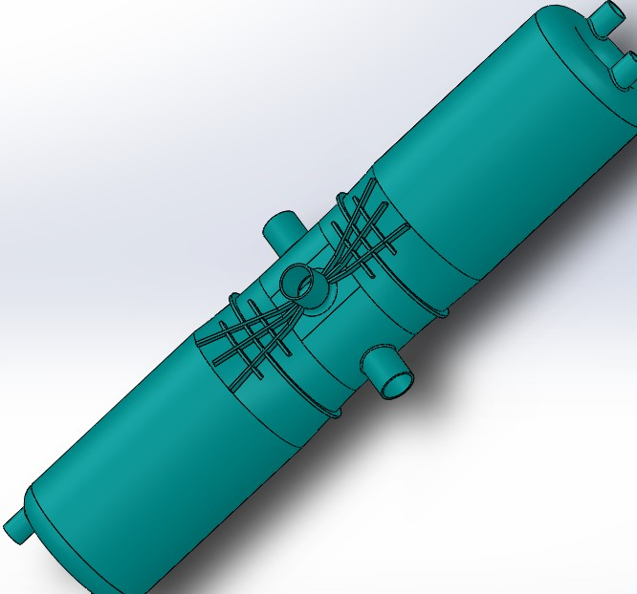
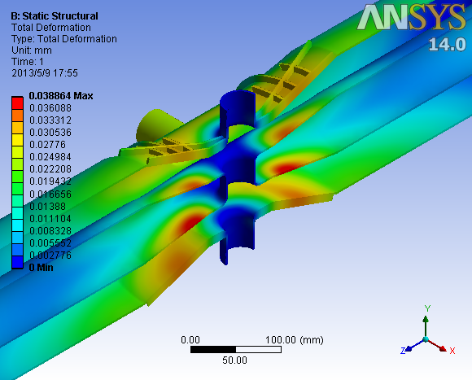
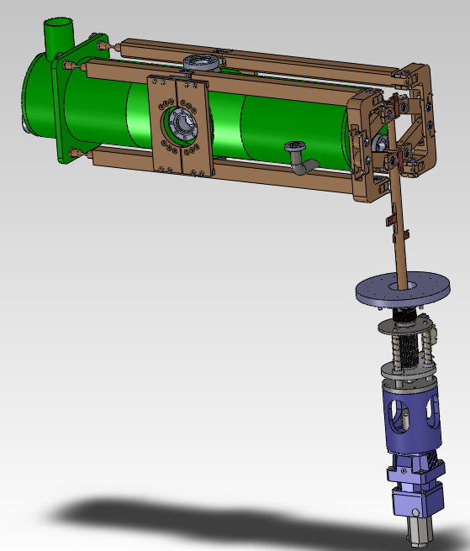
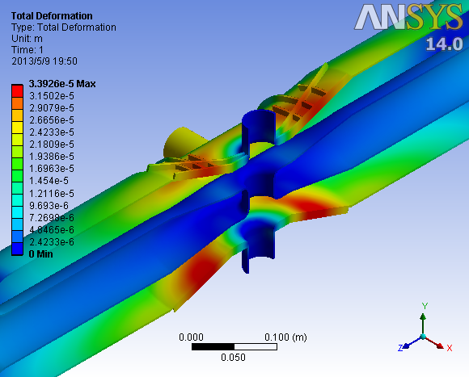
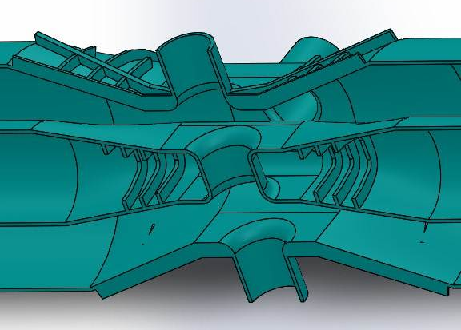
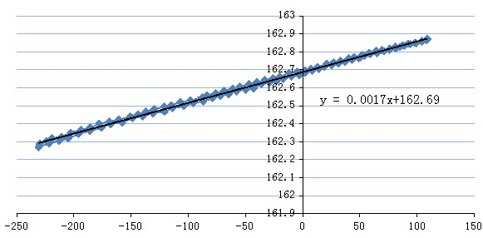
HWR010 Mechanical Analysis
Pressure Sensitivity
Tuner R&D
Pressure Sensitivity：— 5.657Hz/mbar
Pressure Sensitivity ：— 1 Hz/mbar
Test result: Pressure sensitivity 20 Hz/mbar
Tuning range >200Hz @4.2K

Slide 8
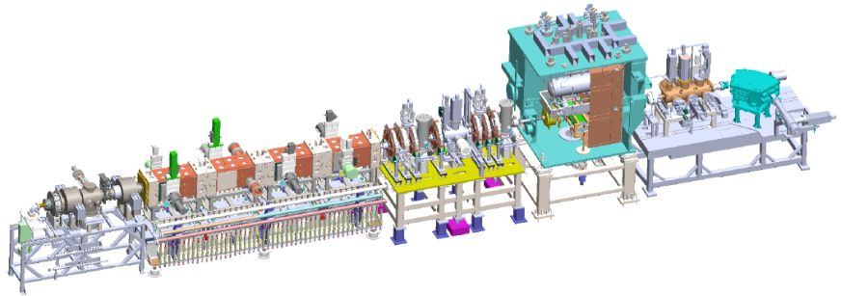
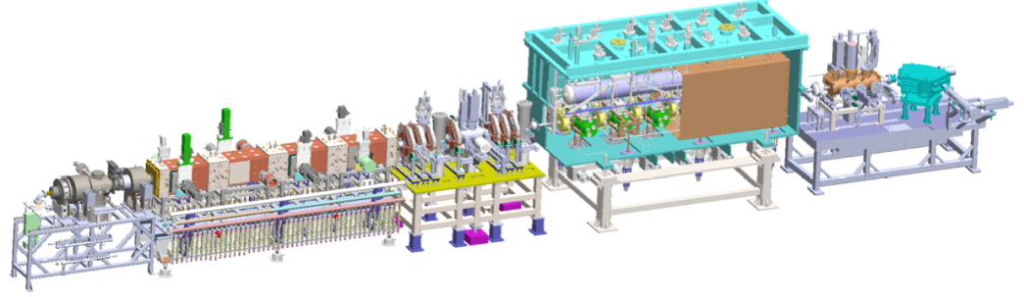
Beam Condition
ECRIS + LEBT + RFQ + MEBT + TCM1, 2.5 MeV
RFQ commissioning, validate CM design.
Feb. 13th, 2015, 2.55 MeV/11 mA/CW
162.5 MHz HWR010
ECRIS+LEBT+RFQ+MEBT+CM6, 5 MeV
Dec 28th, 2015, 4.6 MeV/4 mA/CW
limitation is the RFQ Power source
162.5 MHz HWR010

Slide 9
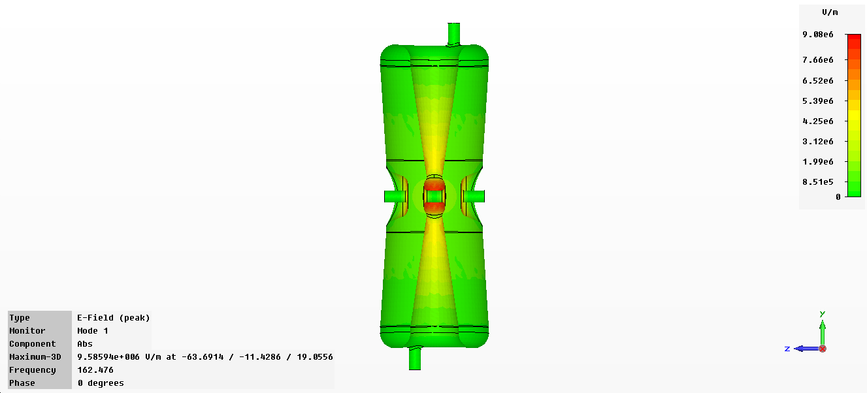
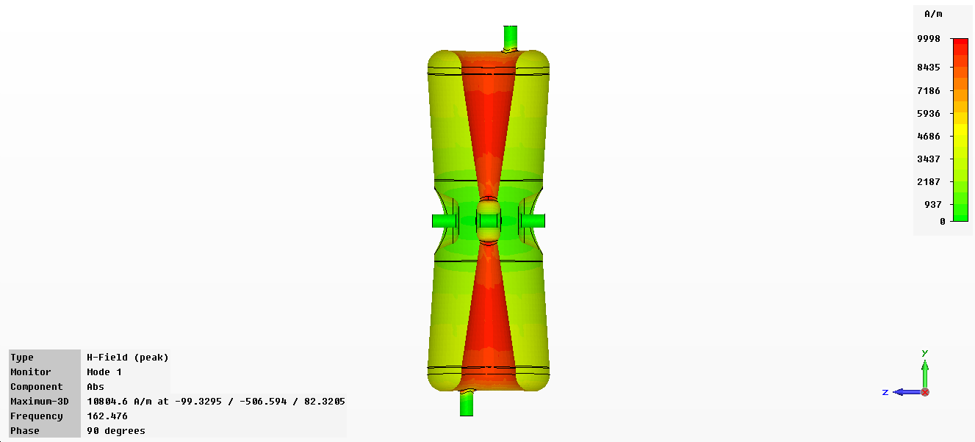
HWR015 EM Design
Design Goal
EM Results
f(MHz) | 162.5
Vacc(MV) | 1.8
Bpeak(mT) | 40
Epeak(MV/m) | 32
R/Q(Ω) | 292
G（Ω） | 51
Eacc(MV/m) | 6.6
P(W)(Rs=70nΩ) | 16
βopt | 0.15
Q0 | 7.2E+08
f(MHz) | βopt | Emax/Eacc | Bmax/Eacc (mT/(MV/m)) | R/Q0 (Ω) | G(Ω)
162.41 | 0.15 | 4.8 | 6.1 | 292 | 51
Notes:
9

Slide 10
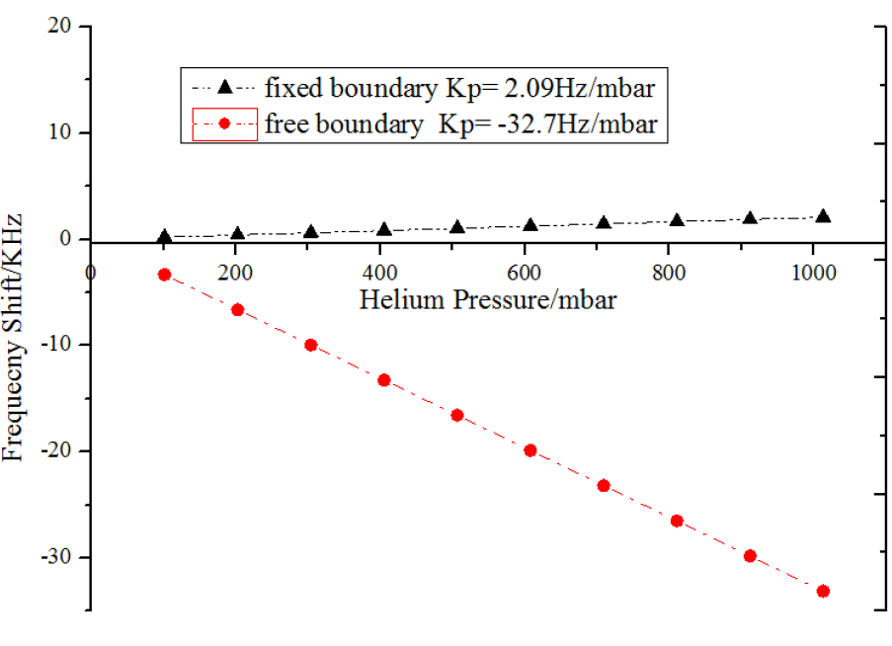
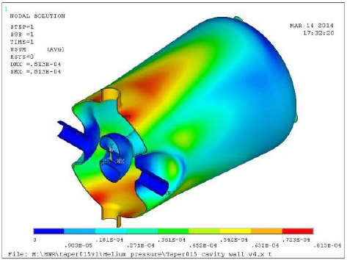
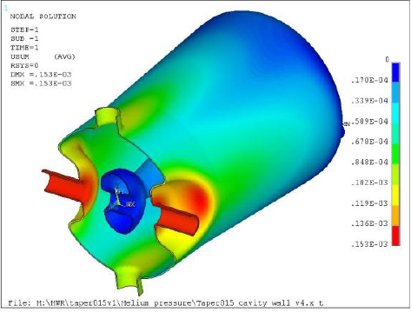
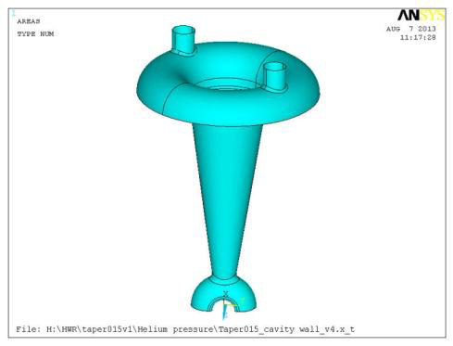
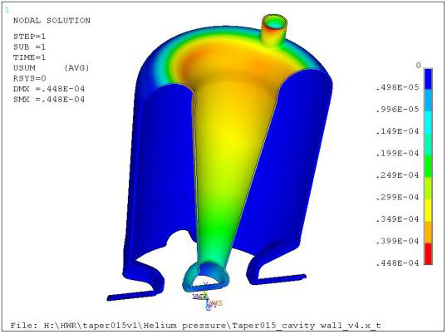
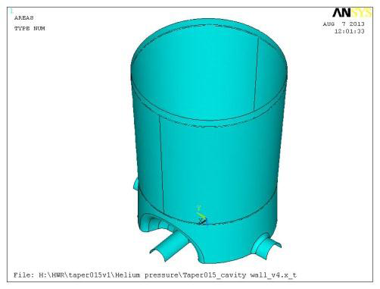
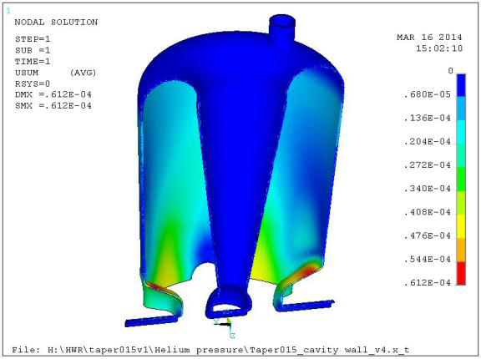
Mechanical analysis
Fixed the beam port
Free the beam port
Fixed the outer
conductor
E-field: -4.02Hz/mbar
Fixed the inner
conductor
B-field: 6.07Hz/mbar

Slide 11
Preparation and test of #02 HWR
Cavity parameter | Without ribs | With ribs | Test with ribs
Frequency (MHz) | 162.5
Bandwith (Hz) | 243
Pressure Sens. (Hz/mbar) Free the beam port | -32.7 | -26 | -21
Pressure Sens. (Hz/mbar) Fixed the beam port | 2.09 | 0.82
The final results with Helium Vessel will be given after further optimization.

Slide 12
Fabrication
Four HWR015s Fabricated in two companies
  #01, #02 in Ningxia
  #03, #04 in Haerbin
Material
  OTIC，RRR>300，partly RRR>380
Drawing, machining and BCP
  Punching die，Al 7075
  Surface survey before every step of fabrication
  BCP (65%HNO₃:40%HF:85%H₃PO₄=1:1:2) 10um, resin by UPW, drying in cleanroom of class 100，before EBW
  Polishing every weld seam after EBW

Slide 13
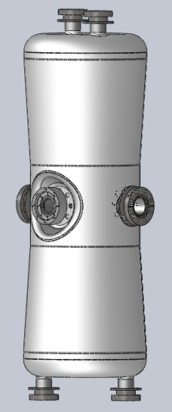

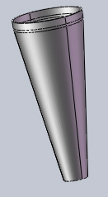
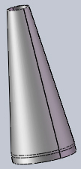
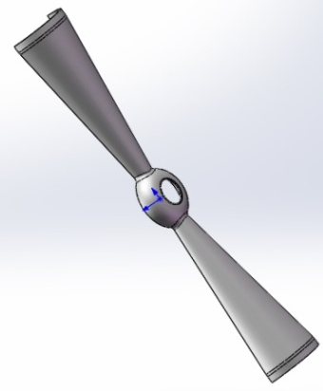
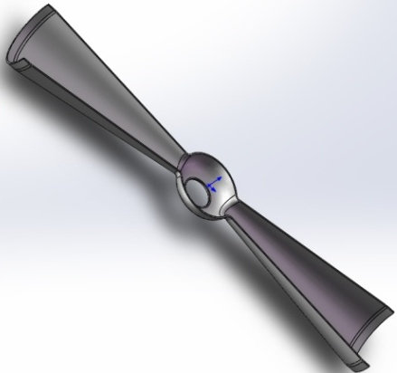
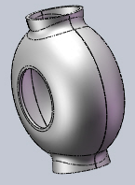
Fabrication
Haerbin
Ningxia

Slide 14
Processing
Ultrasonic
rinsing
BCP
6h
130um
Annealing 850℃, 3h
BCP
50min
12um
Ultrasonic
rinsing
baking120℃，50h
Pumping and leak checking
Clean room class100 assembly
Clean room class100
Drying 24h
HPR
84bar
7h

Slide 15
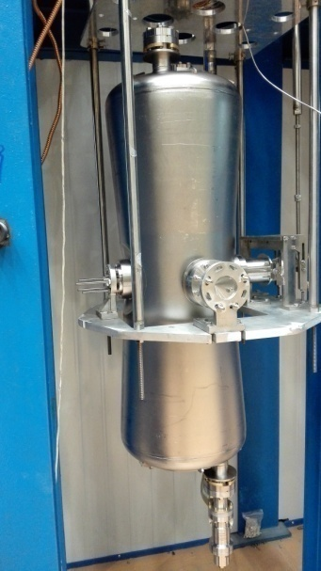
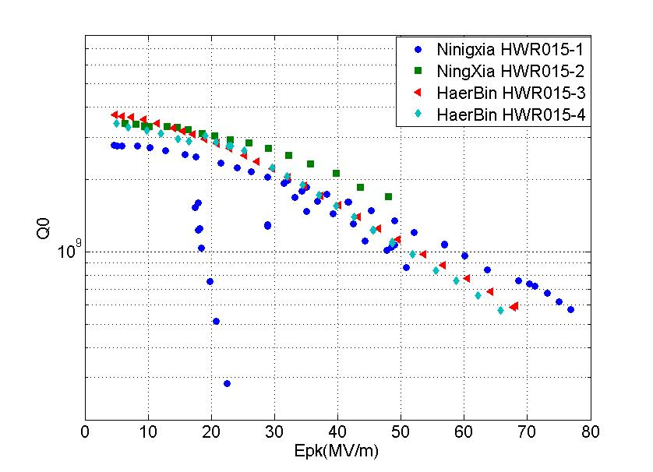
Vertical test

Slide 16
Summary
The fabrication and treatment of HWRs have been qualified by Vertical testing.
The df/dp test result is larger than the simulation result, The final results with Helium Vessel will be given after further optimization.
The helium Vessel and Tuner are being constructed now.
HWR010 Cavities has passed the 10mA beams

Slide 17
Thanks for your attention!

