Slide 1
Performance of LG and FG dressed cavities in XFEL cryomodules
J. Sekutowicz
TTC15 Meeting/SLAC
December 2nd, 2015

Slide 2
Outline
Introduction
  European XFEL and FLASH
  Cooling procedures
LG prototype cryomodule (XM-3)
    Vertical test at 2K and 1.8K and sp test
    Qo at 2K and 1.8K after the FCD and SCD
FG production cryomodule (XM4)
    Vertical test at 2K and sp test
    Qo at 2K, 1.8K and 1.56K after the FCD and SCD
    Mechanical vibrations and VS stability
Upgrade scenario
    FLASH
Final Remarks

Slide 3



  Introduction a. European XFEL and FLASH
Layout of the XFEL sc linac
Injector linac 4 cryomodules
BC1
Booster Linac 12 cryomodules
BC2
3rd harmonic RF section
Undulators
e- gun
E=5MeV
E=2 GeV
101 cryomodules in total: 17 in the injector section and 84 in the main linac
Each cryomodule houses eight 1.3 GHz 9-cell sc TESLA cavities.

Slide 4
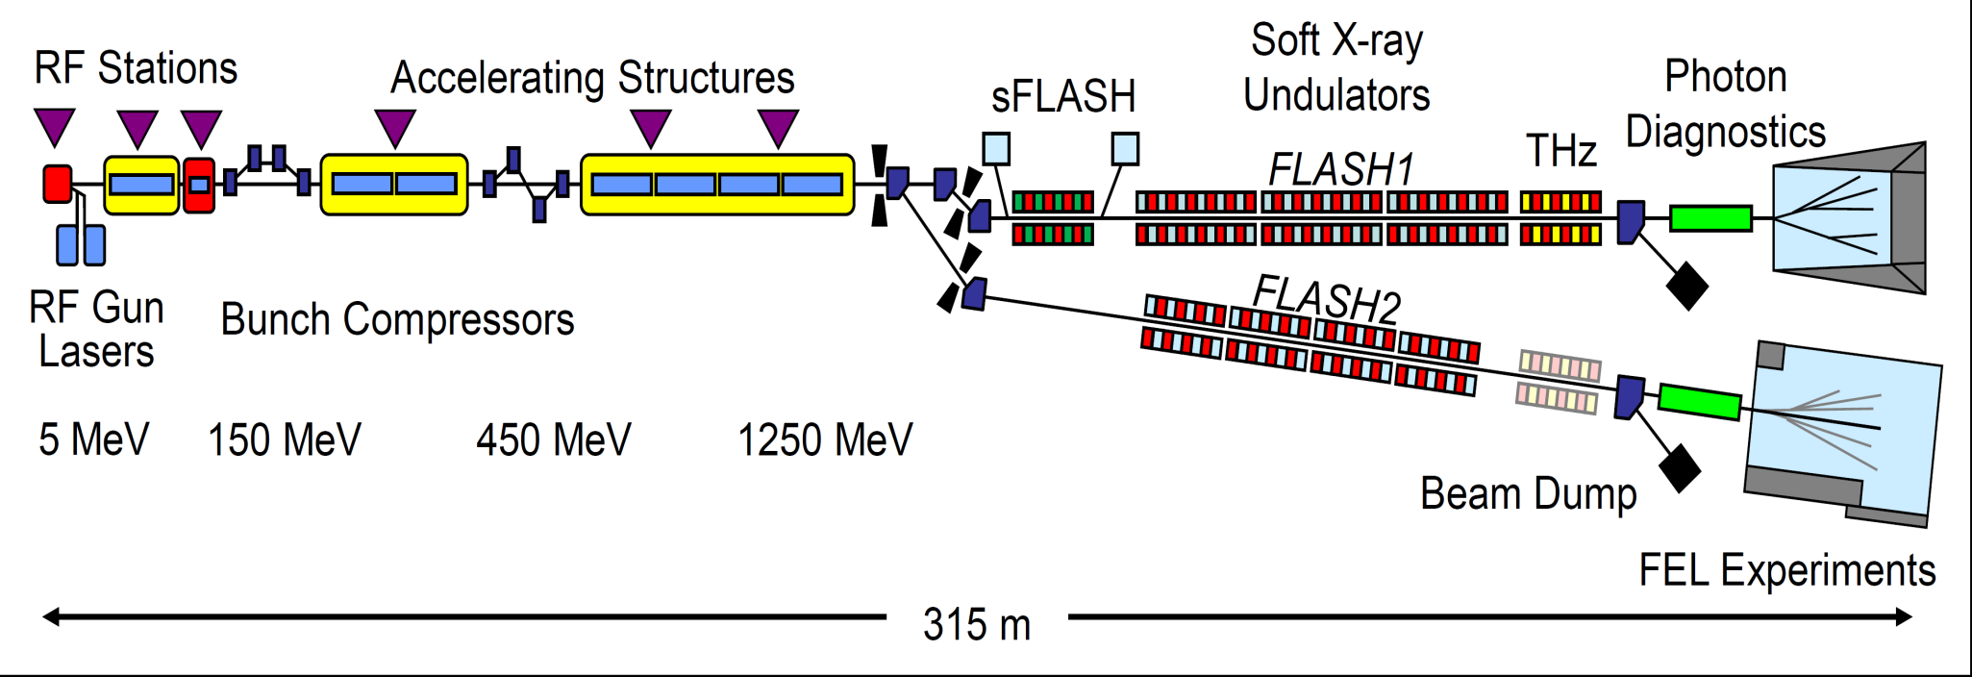
  Introduction a. European XFEL and FLASH
Layout of the FLASH facility
7 “old fashion” TESLA-type cryomodules, 56 cavities with old end-groups.
There is space for 8 CMs or even more if we make tunnel longer and re-locate the injector (funding is not clear for this option).

Slide 5
  Introduction a. European XFEL and FLASH
E-XFEL and FLASH originate from the TESLA collider and therefore they nominally operate (FLASH) and will operate (E-XFEL) in so called short pulse (sp) mode
RF-pulses |  | Max RF DF [%]
Max RF pulse length incl. rise time [µs] | Rep. Rate [Hz]
1400 | 10 | 1.40
Both accelerators are based on the SRF technology and thus have potential for much larger DF, up to 100% (cw).
Having additional cw and long pulse modes will allow for more flexibility in the time structure of the photon beams and will make both facilities even more attractive to the users.

Slide 6
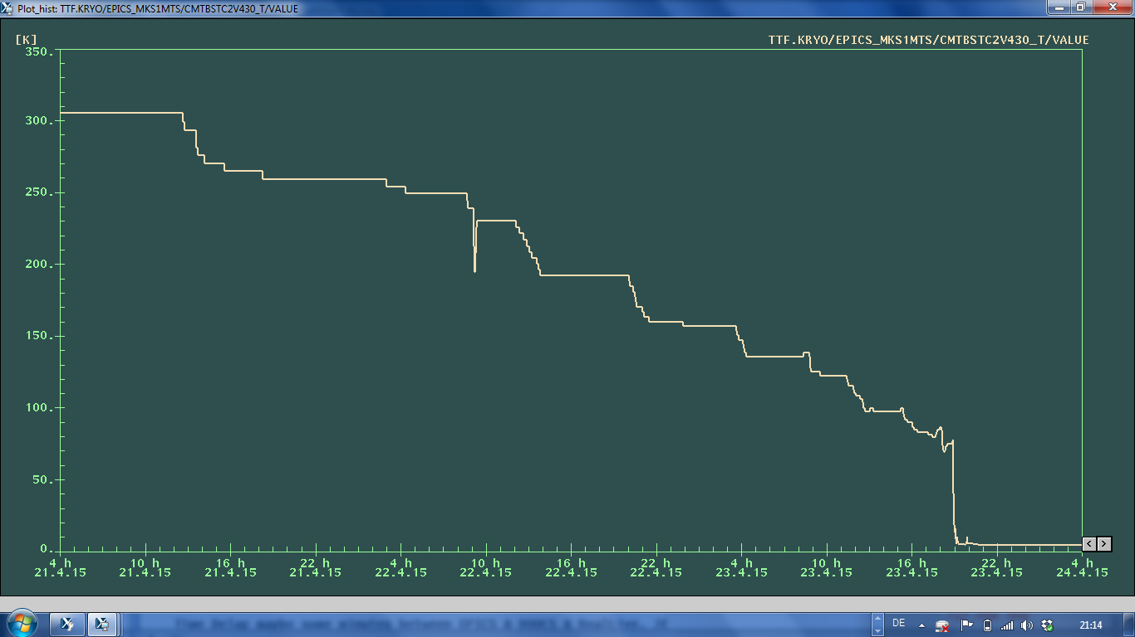
  Introduction b. Cooling procedures
Fast cool-down (FCD), which is applied always at CMTB as the first cool-down procedure.
300
-0.07 K/min
T
[K]
-3 K/min
0

Slide 7
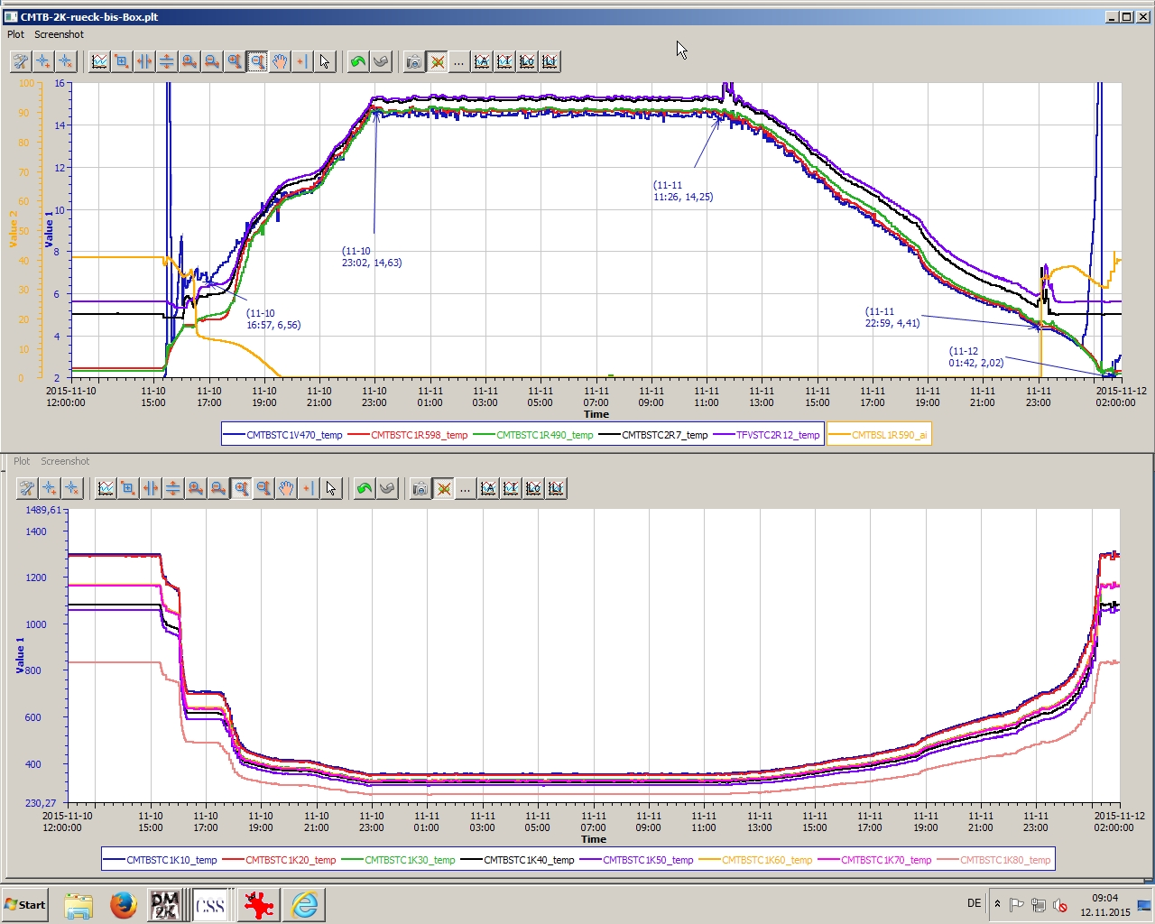
  Introduction b. Cooling procedures
Slow cool-down (SCD), which up to now was applied at CMTB twice (XM-3 and XM4) to study its impact on Qo.
16
13 h at ca. 14K
-0.016 (-0.03) K/min
T
[K]
2
Diagram shows T measured on LHe vessels vs. time

Slide 8
  2. LG prototype cryomodule (XM-3) a. Vertical test at 2K and 1.8K and sp test
XM-3 cavities:
7 cavities have cells (not end-groups) made of LG Nb, 1 of FG Nb
All cavities had new HOM feedthroughs.

Slide 9
  2. LG prototype cryomodule (XM-3) a. Vertical test at 2K and 1.8K and sp test

Slide 10
  2. LG prototype cryomodule (XM-3) a. Vertical test at 2K and 1.8K and sp test
XM-3 cavities, sp-test (FCD):
Cavity | Max Eacc [MV/m] | Max oper. Eacc [MV/m] | Operation Limit
C1_114 | 26.1 | 23.2 | X-ray > 10⁻² mGy/min
C2_156 | 31.6 | 31.1 | Quench
C3_146 | 40.8 | 40.3 | Quench
C4_154 | 38.5 | 38.0 | Quench
C5_157 | 31.5 | 31.0 | Quench
C6_158 | 38.1 | 37.6 | Quench
C7_151 | 28.1 | 22.7 | X-ray > 10⁻² mGy/min
C8_152 | 33.0 | 32.5 | PWR
Gradients
Eacc [MV/m] | 14.1 | 20.0 | 23.5
P_{diss} [W] | 0.62(?) | 1.63(?) | 2.77
<Qo> [10¹⁰] | 3.45 (?) | 2.7(?) | 2.04
Qo (2K)

Slide 11
  2. LG prototype cryomodule (XM-3) b. Qo at 2K and 1.8K after FCD and SCD
<Qo> summary for XM-3:
Eacc | Mode | <Qo> at 2K FCD | <Qo> at 2K SCD | <Qo> at 1.8K FCD | <Qo> at 1.8K SCD
[MV/m] | - | [10¹⁰] | [10¹⁰] | [10¹⁰] | [10¹⁰]
~7.0 | cw | 3.1 | 2.5 (-25%) | 4.7 | 3.3 (-42%)
9.5 | cw | - | - | 4.7 | -
10.1 | lp | 2.6 | - | 4.7 | -
12.0 | lp | 2.4 | - | - | -
13.6 | lp | - | - | 4.4 | -
14.7 | lp | - | - | 4.1 | -
<Eacc> summary for XM-3
Mode | sp | lp | cw
Max <Eacc> [MV/m] | 33.5 | 14.7 | 9.5

Slide 12
  3. FG production cryomodule (XM4)
XM4- technical remarks
XM4 houses 8 TESLA/XFEL cavities made of polycrystalline Nb.
All HOM couplers are equipped with high conduction feedthroughs.
During tests at AMTF in 2014, four FPCs (Cav# 1, 2, 3, 4) were heavily overheated and burned. This happened due to improper assembly of inner conductors of warm parts . All 4 warm parts have been exchanged.
Two HOM couplers have detuned filters:
Cav#1 HOM2 Qext = 6.9E10
Cav#2 HOM1 Qext = 1.4E10 !!

Slide 13
  3. XM4 a. Vertical test at 2K and sp test
XM4 cavities:

Slide 14
  3. XM4 a. Vertical test at 2K and sp test
XM4 cavities: sp test at CMTB (Denis Kostin)
Cavity | Max Eacc [MV/m] | Max oper. Eacc [MV/m] | Operation Limit
C1_0626 | 33.5 | 31.0 | PWR
C2_0607 | 34.8 | 31.0 | PWR
C3_0556 | 31.1 | 30.6 | Quench
C4_0597 | 34.5 | 29.9 | X-ray > 10⁻² mGy/min
C5_0606 | 39.0 | 31.0 | PWR
C6_0621 | 24.4 | 23.9 | Quench
C7_0592 | 22.0 | 21.5 | Quench
C8_0594 | 35.1 | 31.0 | PWR
Gradients
Qo(2K)
Eacc [MV/m] | 15 | 20.5
<Qo> [10¹⁰] | 2.4 | 2.3 (?)

Slide 15
  3. XM4 b. Qo at 2K, 1.8K and 1.56K after FCD and SCD
cw tests at 2K, FCD & SCD
cw and sp Qo values agree
No Qo difference for FCD and SCD
sp Qo value is too high
21% difference in Qo for FCD and SCD
In most of runs 3 methods (3M) were used to determine E_{acc} (to minimize an error): Read out of pickups (calibrated the sp mode), {P_{in} , Q_{load} } for each cavity, and IOT (P_{IOT}*0.95/8).

Slide 16
  3. XM4 b. Qo at 2K, 1.8K and 1.56K after FCD and SCD
cw tests at 1.8K (FCD & SCD) and 1.56K (SCD). 2K (SCD) for comparison
There is no difference between in Qo for the FCD and SCD at 1.8K.

Slide 17
  3. XM4 b. Qo at 2K, 1.8K and 1.56K after FCD and SCD
Surface resistance vs. T for SCD

Slide 18
  3. XM4 b. Qo at 2K, 1.8K and 1.56K after FCD and SCD
<Qo> summary for XM4
Eacc | Mode | 2K FCD | 2K SCD | 1.8K FCD | 1.8K SCD | 1.56K SCD
[MV/m] | - | [10¹⁰] | [10¹⁰] | [10¹⁰] | [10¹⁰] | [10¹⁰]
7-8 | cw | 3 | 2.9 | 4.0 | 4.3 | 6.9
~10 | cw | 2.8 | 2.2 (-21%) | - | 4.1 | 5.9
11-12 | cw | 2.5 | - | - | -
13.5 | cw | 2.3 | - | 3.76 | -
15 | cw | 2.3 | - | 3.5 | -
19 | lp(DF=0.18) | 2.0 | - | - | -
?
<Eacc> summary for XM4
Mode | sp | lp | cw
Max <Eacc> [MV/m] | 31.8 | 19 | 15

Slide 19
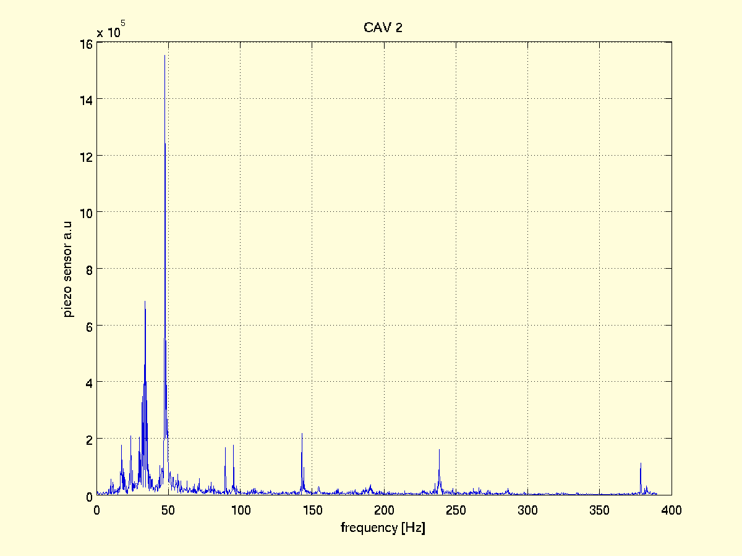
  3. XM4 c. Mechanical vibrations and VS stability
Typical microphonics spectrum observed at CMTB for TESLA/XFEL structures assembled in a XFEL cryomodule.
2 dominating mechanical vibrations
30Hz and 49Hz

Slide 20
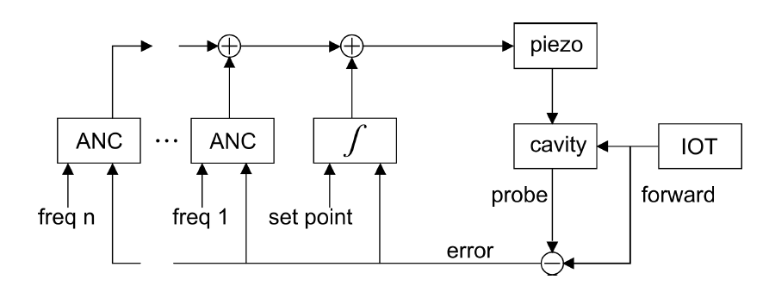
  3. XM4 c. Mechanical vibrations and VS stability
Piezo tuner: An Active Noise Cancellation (ANC) with Integral Feedback Controller for slow drifts and RF-feedback were applied for the vector sum stabilization :
Piezo fast tuner with ANC and integral feedback controller
Courtesy R. Rybaniec

Slide 21
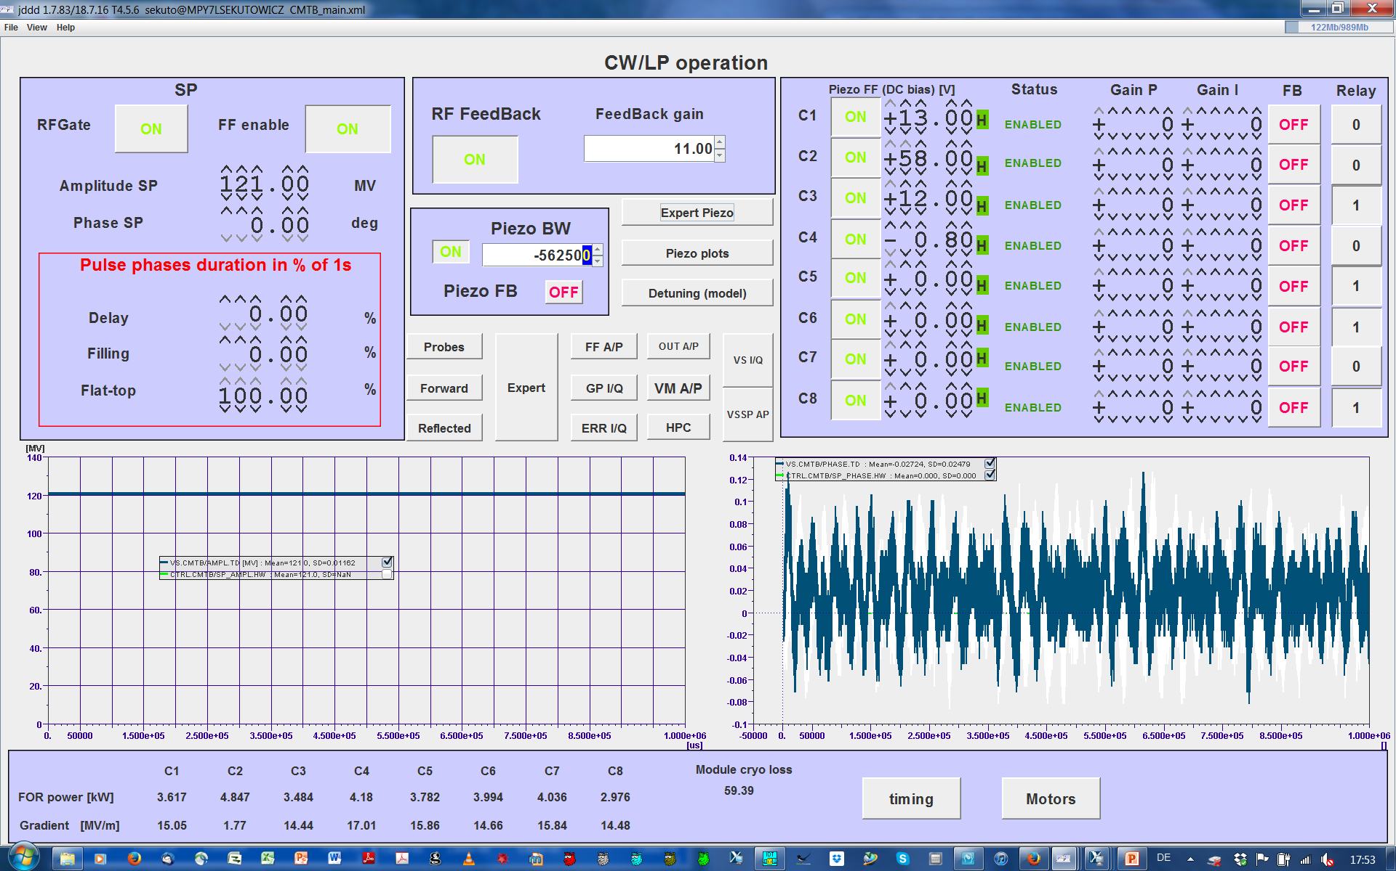
  3. XM4 c. Mechanical vibrations and VS stability
Example: cw mode, operation at 15MV/m, Q_{load} =1.5E7 for all FPCs, C#2 detuned.
VS amplitude SD= 1E-4
XFEL spec
Phase SD= 0.02°
spec missed by factor of 2
sp E-XFEL spec

Slide 22
  4. Upgrade scenario
Summary of LG and FG cavities tests in all 3 operation modes
Demonstrated Gradients
 | Mode | sp | lp | cw
XM-3 / LG | Max <Eacc> [MV/m] | 33.5 | 14.7* | 9.5*
XM4 / FG | Max <Eacc> [MV/m] | 31.8 | 19 | 15
*limit was set at that time for DHL to 16W.
Demonstrated Qo in lp/cw operation at 2K and 1.8K
Mode | lp | cw
XM-3 / LG | 4.1E10 @14.7MV/m | 4.7E10 @9.5MV/m
XM4 / FG | 2.0E10 @19MV/m | 2.3E10 / 3.5E10 @15MV/m

Slide 23
  4. Upgrade scenario
Summary, cont.:
No quench was observed for cw/lp modes in all conducted tests.
Only one of 32 HOM couplers, which had detuned filter (HOM1, C#2), was causing heating of its end group in cw mode when out-coupled power was >8W. All other 31 operated very stable.
Maximum demonstrated DHL was 71 W in cw mode at ~15 MV/m. Operation was very stable. This proves that the E-XFEL cryomodule helium supply and return system can handle at least 77W dissipation.

Slide 24
  4. Upgrade scenario a. FLASH
  Three remarks
  We are at the very beginning of the discussion to determine the best upgrade of the FLASH accelerator. Nothing has been decided yet! Funding is unclear.
  It seems, that FLASH can be upgraded both to the higher beam energy and higher duty factors.
  The FLASH upgrade could be seen as a pilot project for the duty factor upgrade of E-XFEL, but it does not mean that the whole concept will be the same for both. The main difference results from the cry-losses budget /CM.

Slide 25
  4. Upgrade scenario a. FLASH
  One of the possible options:
  All cavities of 7 present CMs will be replaced with new XFEL FG or LG cavities
  One XFEL-like CM will be added
  Present FPCs will be replaced with new XFEL-like FPCs which warm parts will have thicker Cu-coating (LCLS II like) and which Qext will be adjustable in the range from 3E6-3E7.
  New cw-operating RF-sources will be added to the klystrons and new cw-operating electron injector will be implemented.

Slide 26
  4. Upgrade scenario a. FLASH
Proposed key parameters, based on demonstrated gradients.
Mode Parameter | sp | lp | cw
Max Eacc [MV/m] | 30 | ← | 15
DF [%] | 1.4 | → | 100
Beam Energy [GeV] | 1.9 | ← | 1
FG: 2K Cryo-losses/CM [W] | 15 (Qo=1E10) | ← | 90 (Qo=2.3E10)
LG: 1.8K Cryo-losses/CM [W] | 9.5 (Qo=2E10) | ← | 52 (Qo=4.1E10)

Slide 27
  5. Final remarks
cw and lp tests of the E-XFEL production cryomodule (XM4) prove feasibility of the FLASH upgrade both to higher energy and higher DF.
Demonstrated XM4 gradients, up to 15MV/m in cw mode, make feasible an inexpensive (not necessary an optimal) option of the E-XFEL cw upgrade.
Both LG and FG XFEL cavities demonstrate very high gradients, not only in VTs but also in cryomodules, up to 40MV/m, which are crucial for high beam energies in the nominal sp mode.
Very high Qo, up to 4.7E10@15MV/m@1.8K of the LG cavities demonstrated both in VTs and in cryomodule and their very high maximum gradients, make them very attractive for the FLASH and XFEL upgrades.

Slide 28
Acknowledgements
I want to express my gratitude to all Colleagues contributing to and supporting the experiments and R&D programs towards cw/lp operation modes:
DESY: V. Ayvazyan, J. Branlard, M. Ebert, J. Eschke, T. Feldmann, A. Gössel, D. Kostin, F. Mittag, W. Merz, W.-D. Möller, C. Müller, R. Onken, D. Reschke, , R. Rybaniec, I. Sandvoss, H. Schlarb, A. Sulimov……
and R. Brinkmann and H. Weise
TUL: W. Cichalewski, A. Piotrowski, K. Przygoda
Thank you for your attention

Slide 29
Backup

Slide 30
  Backup sp mode
Time structure of the XFEL nominal electron beam (sp, short pulse operation)
Beam pulse length | ms | 0.65
Repetition rate | Hz | 10
Max. # of bunches per pulse |  | 2700
Min. bunch spacing | ns | 240
Bunch charge | nC | ≤ 1
Beam current | mA | 4.2
Nominal beam DF | % | 0.65
650 µs
~100 fs
100 ms
240 ns

Slide 31
Backup sp mode
Additional operation modes;
Continuous wave (cw) operation for E_{acc} ≤ 7 MV/m
Long pulse (lp) operation at E_{acc} > 7 MV/m with DF ≤ (7/E_{acc})² to keep HL constant
Example of lp operation at E_{acc} = 14 MV/m with DF up to 25%
≤ 250 ms
≥ 750 ms
f_{rep} = 1Hz
1s
10 µs, up to 0.1nc
~100 fs

