Slide 1
Fabrication and evaluation of low RRR large grain single cell cavity
2015.12.2 TTC Meeting @SLAC
Mechanical Engineering Center, KEK
Masashi YAMANAKA

Slide 2
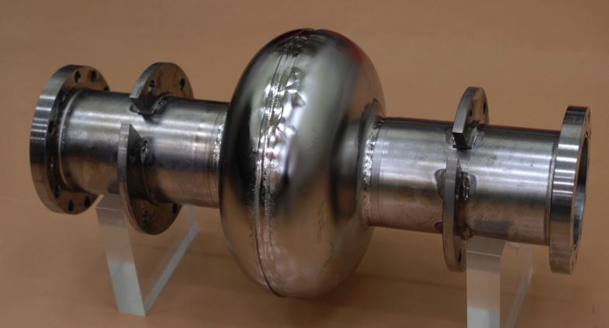
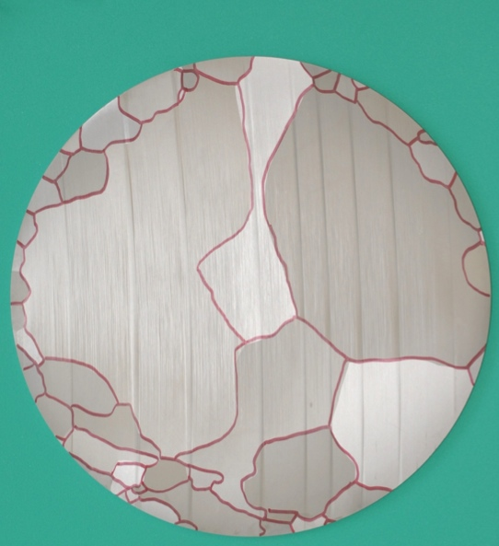
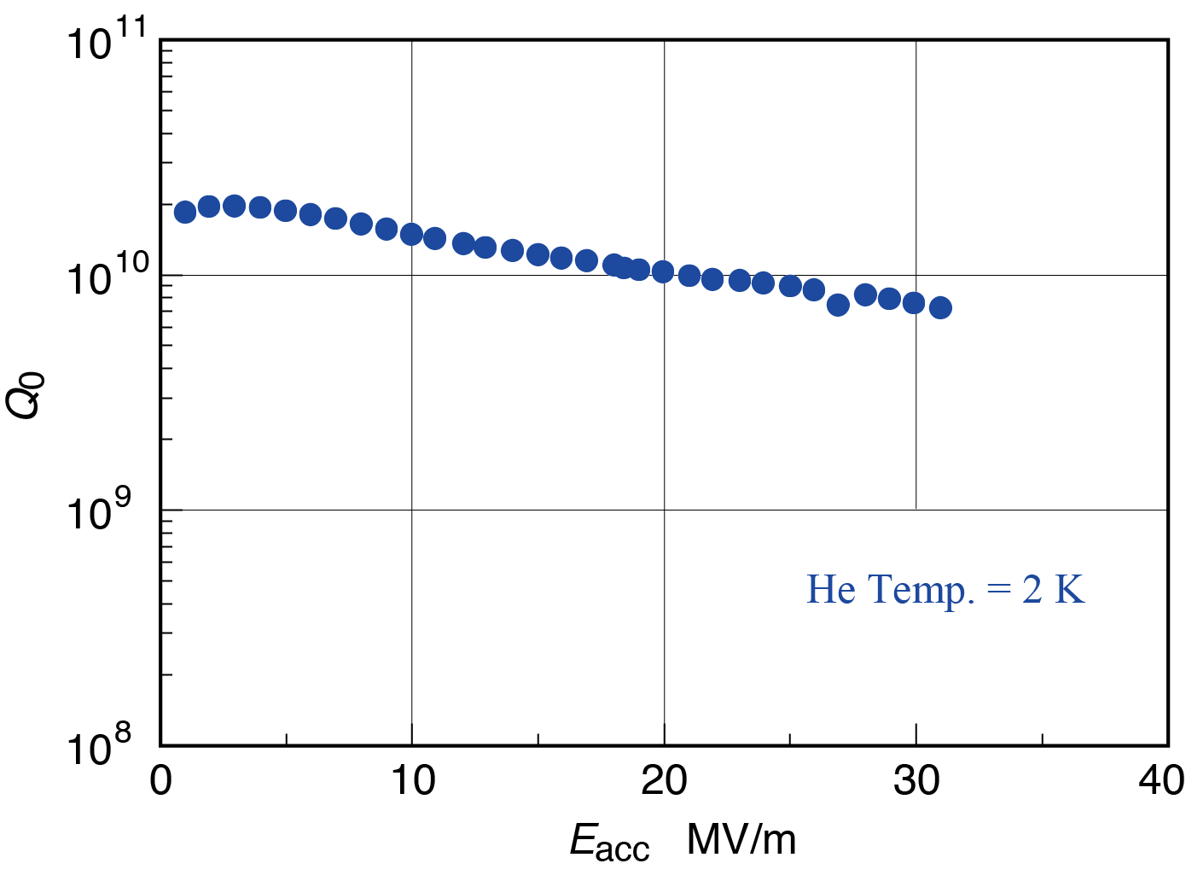
Objectives and result
Chemical compositions (unit: ppm) and RRR
Motivation
Reduce the niobium material cost
Approach
Use low RRR cheap niobium
Use sliced ingot sheet
Objectives
Manufacture a single cell cavity
Evaluate the performance
H | C | O | N | Fe | Si | Ta | RRR
< 10 | < 30 | < 30 | 10 | 3 | 20 | 1034 | 100
1.3 GHz single cell cavity manufacture by CFF at KEK
Cell shape: TESLA-like (end cell)
31
50 mm
Sliced ingot niobium（φ260）
Boundary was traced by felt pen
Material was manufactured by CBMM
Result of vertical test

Slide 3
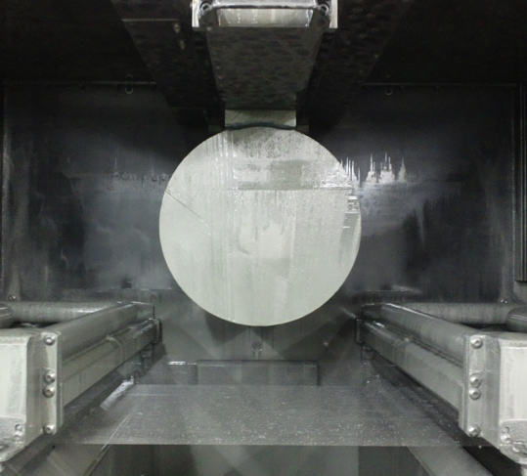
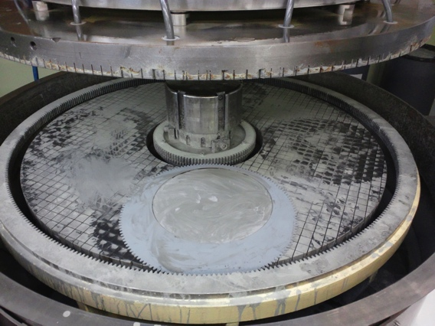
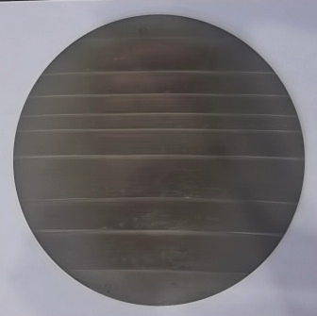
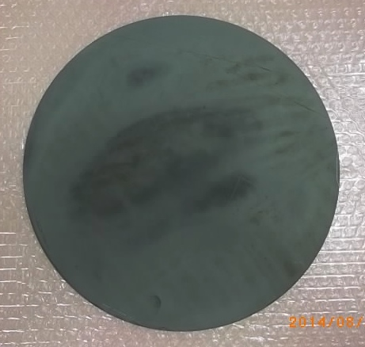
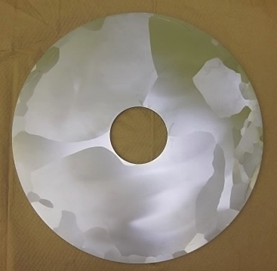
Slicing of niobium ingot
I want to omit this process
HF
HNO₃
H₃PO₄
（1：1：2）
Multi-wire saw*
(Max. 450 mm available)
Mechanical polish*
After sawing
After mechanical polishing
After chemical polishing
Saw marks are observed
* These processes were held at Japanese company outside KEK

Slide 4
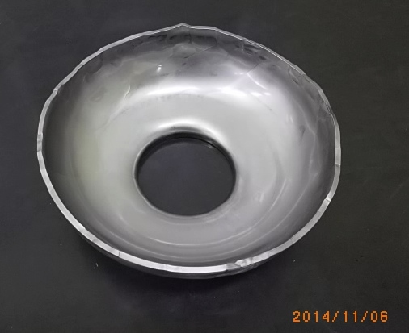
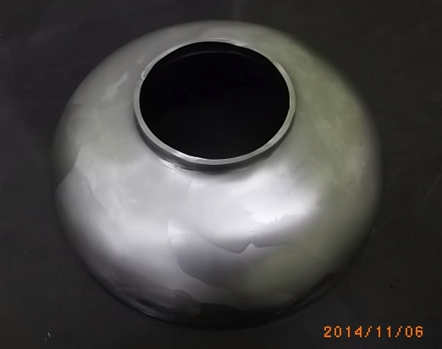
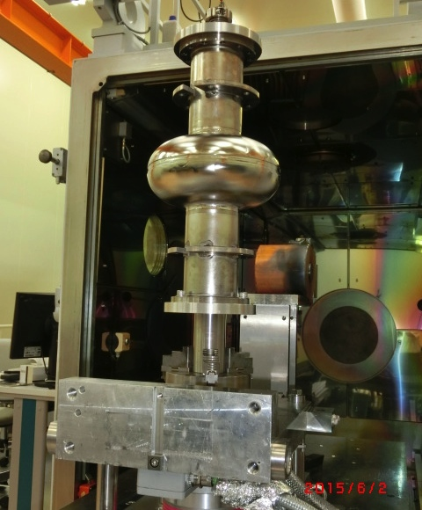
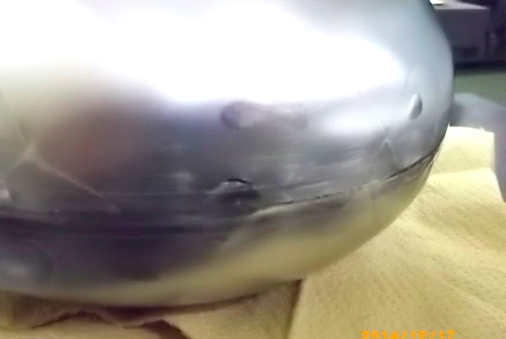
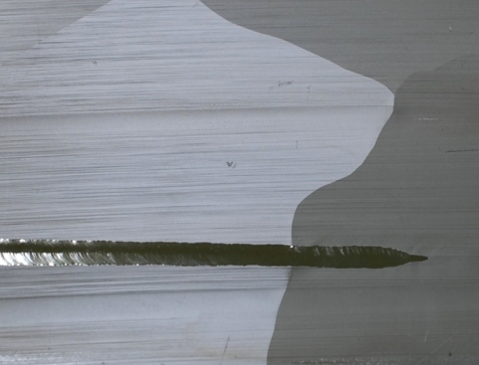
Fabrication
Deformation is not uniform due to anisotropy
It is difficult to keep circularity at edge (equator)
Press forming for cells（Same way to ordinary process）
Crack occurred
Just at surface, no leak
Welding bead across the boundary is smooth (not affected)
Leak check was achieved before trimming edge
EBW test (plate)
EB welding for equator part

Slide 5
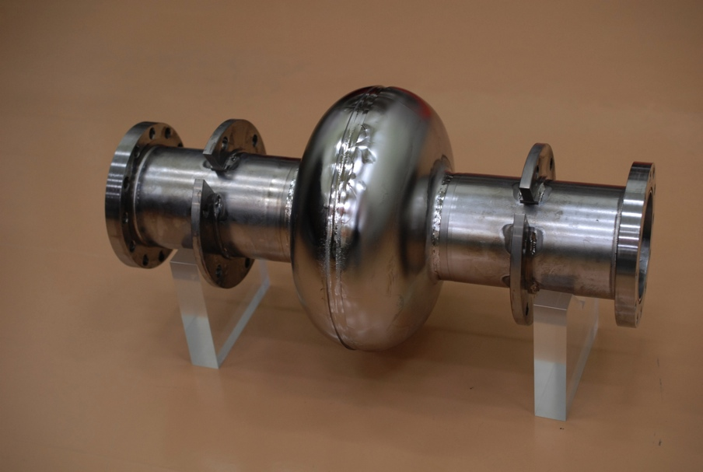
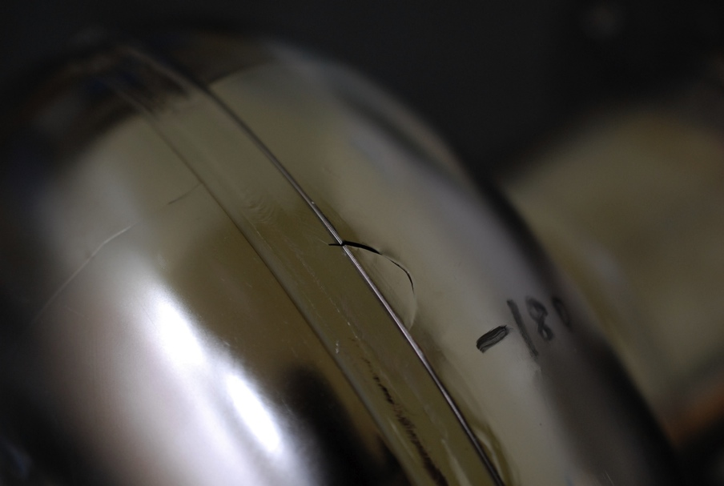
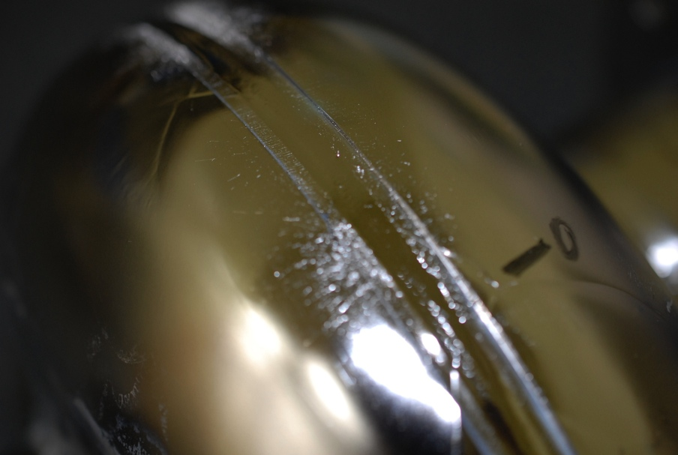
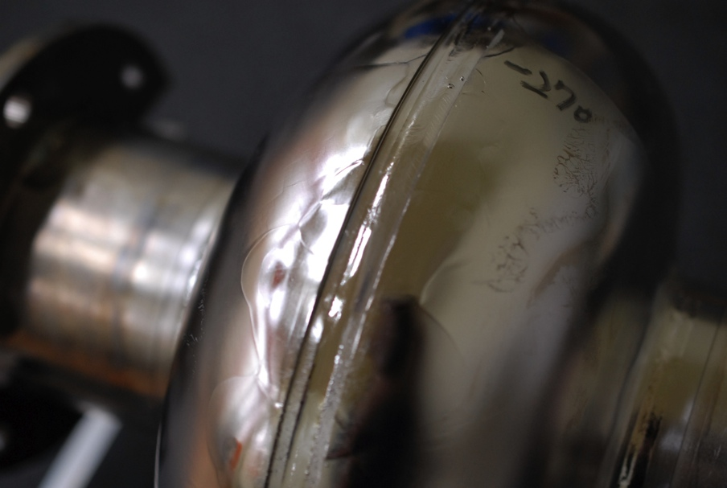
1-cell cavity made by CBMM niobium
Crack
Sputter
Bead is not uniform
LG takes time to fabricate a cavity comparing with FG

Slide 6
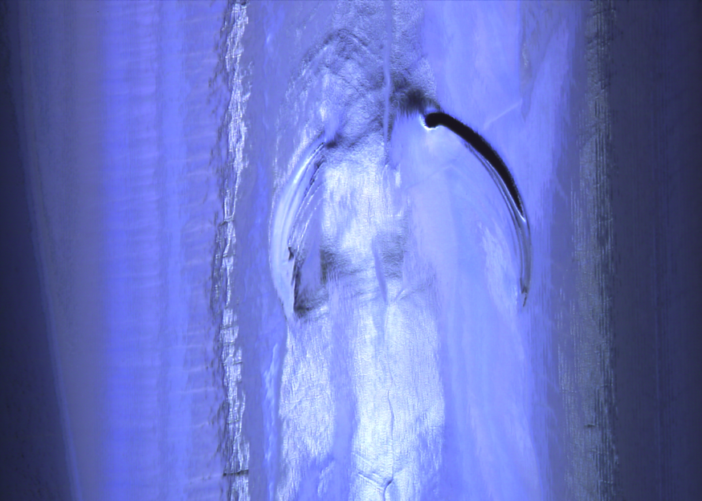
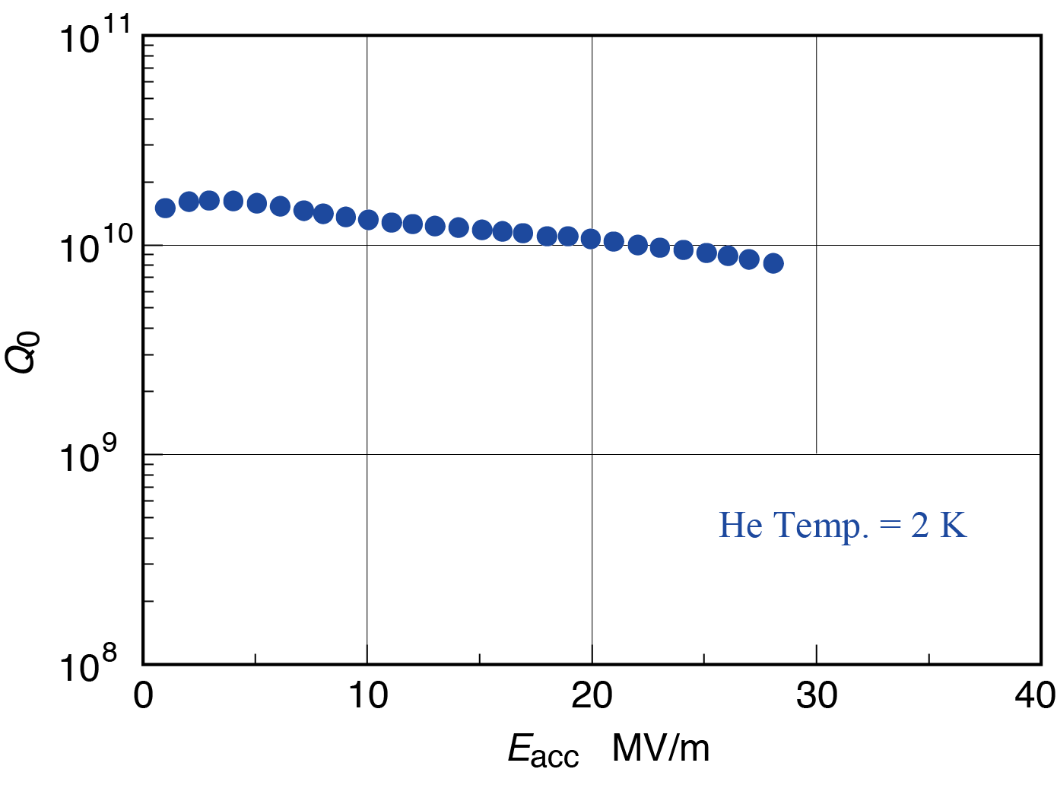
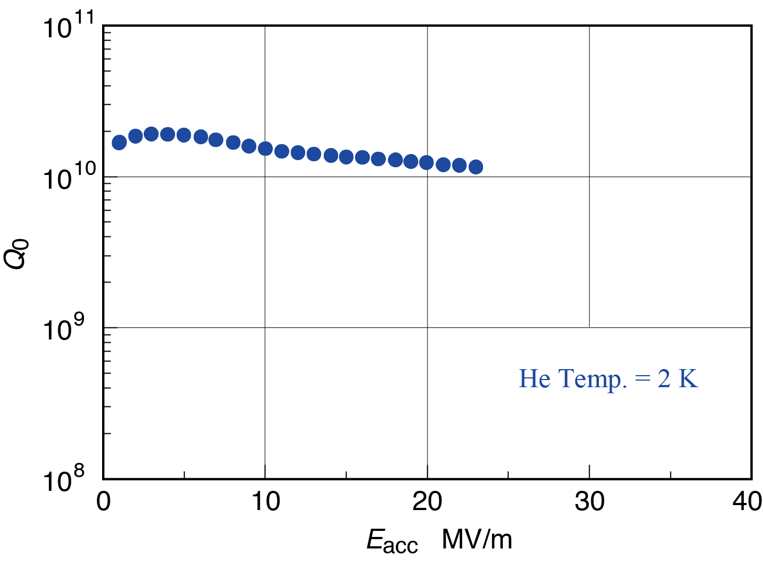
Vertical test
Welding
bead
Polishing
inside
5 mm
5 mm
Inner view at the equator after 1st VT
There are ripple and crater cause quench
Inner view (same position to left) after polishing. Well removed.
The max. gradient was not improved.
Does the quench occur at another point?
We decided to try one more time.
1st VT：28 MV/m
2nd VT：23 MV/m

Slide 7
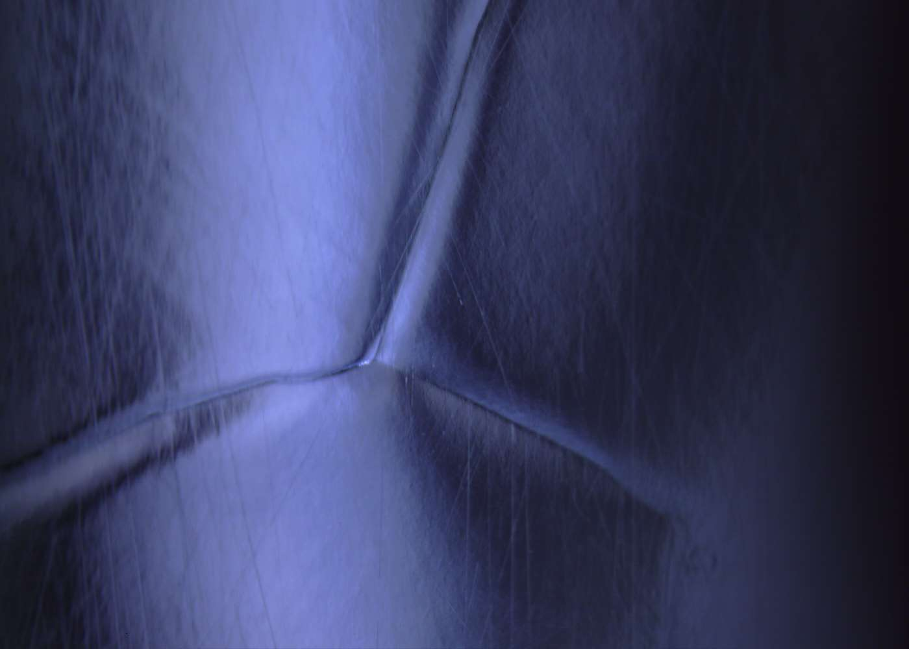
Vertical test2
We could not detect the quench or heat sources by inspection
To polish widely around heated point
Finish by hand polishing
5 mm
5 mm
Example of polishing (before)
(position: between iris and equator)
Boundary is observed (it is not a defect)
After polishing (same position to left)
It became smooth as we cannot observe
the boundary clearly
The max. gradient was improved.
We needed 3 times VT
including EP, inspection, repairing ….
It means high cost
2nd VT：23 MV/m
3rd VT：31 MV/m

Slide 8
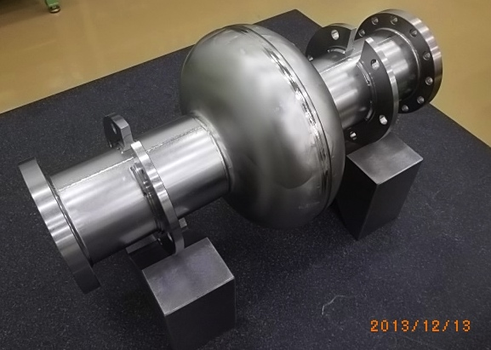
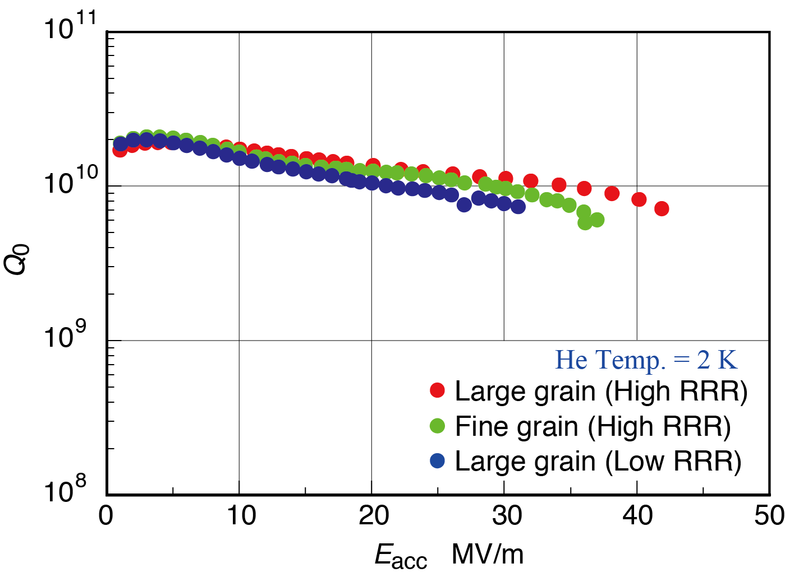
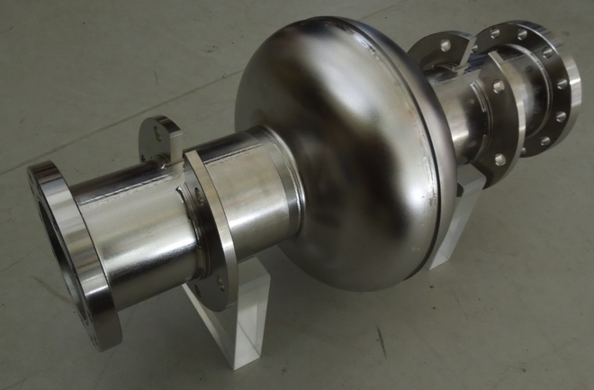
Comparison with high RRR niobium
 | H | C | O | N | Fe | Si | Ta | RRR
LG (TD) | < 5 | < 10 | < 10 | < 10 | < 10 | < 10 | 80 | 390*
FG (TD) | < 10 | 40 | 100 | 40 | 20 | 20 | 700 | 258**
LG (CBMM) | < 10 | < 30 | < 30 | 10 | 3 | 20 | 1034 | 100*
Measurement RRR: * by KEK, ** by TD
Large grain (TD)
31
42
36
Fine grain (TD)
The effect of low RRR and high Ta is not separated here.

Slide 9
Summary and acknowledgement
A single cell cavity using low RRR large grain niobium was fabricated and evaluated. The gradient attained to 31 MV/m.
3 times VT and repairing inside with inspection were required to get high gradient. It becomes the reason of high cost.
LG takes time to fabricate a cavity comparing with FG.
The effect of Low RRR and high Ta is not separated here.
φ260×500 niobium ingot was provided by CBMM
RRR
Ta

