Slide 1
Production of High Purity
Niobium for SRF Accelerators
ULVAC Inc.
Tomohiro Nagata, Hiroaki Masui, Noriyuki Abe,
Seiichi Shinozawa, Hirohiko Murakami
KEK
Masashi Yamanaka, Hitoshi Inoue, Eiji Kako

Slide 2
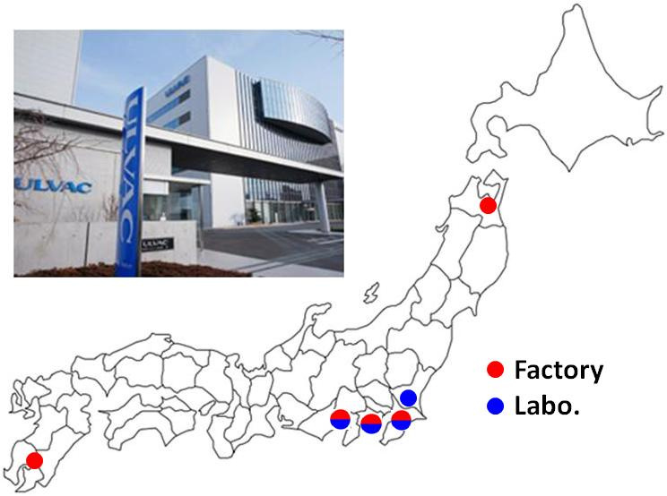
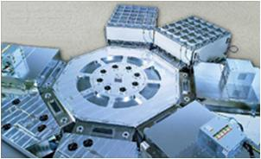
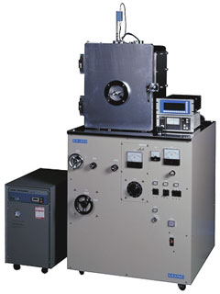
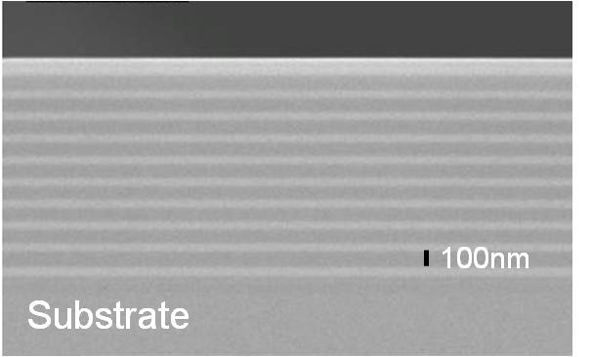
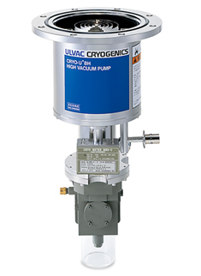
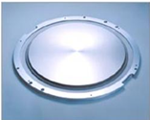
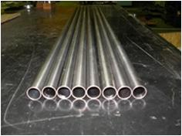
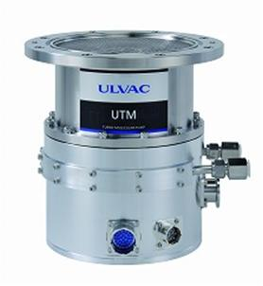
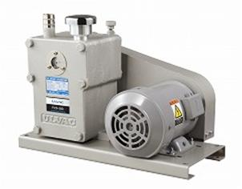
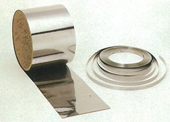
About ULVAC
Vacuum Equipments
Vacuum Technology
Vacuum Pump
Materials

Slide 3
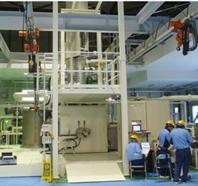
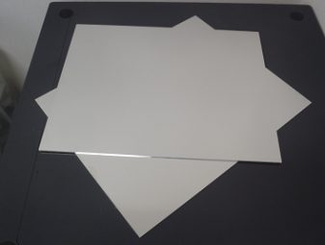
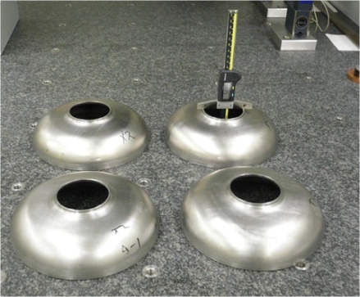
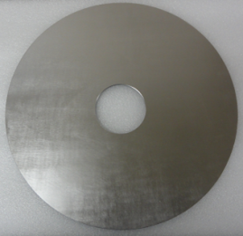
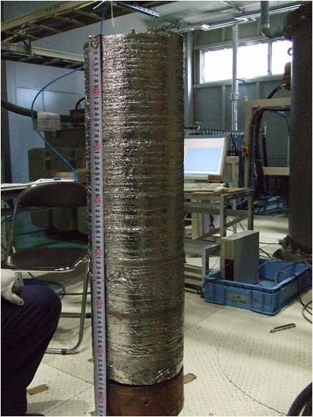
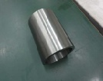
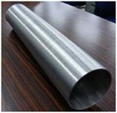
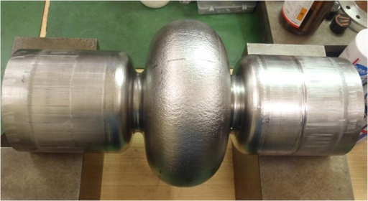
Products for SRF accelerators
Nb sheets:
600kW EB melting furnace
For welding-type cavities
Nb tubes:
For beam tubes
ULVAC can produce
high-purity Nb ingots
Nb ingot
RRR > 300
For seamless cavites

Slide 4
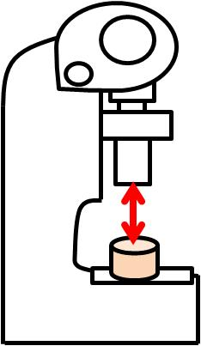
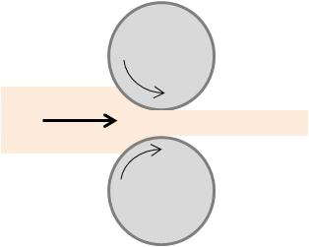
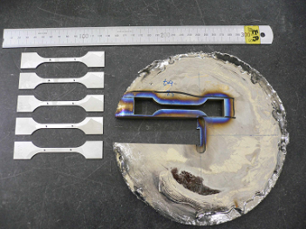
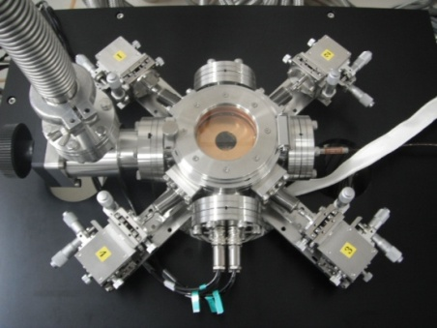
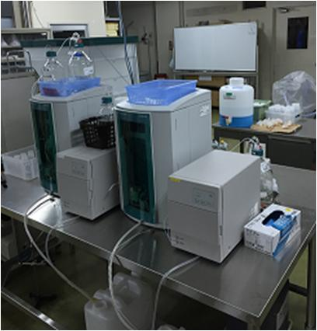
Manufacturing scheme
Refining
Forging
Deforming
Mechanical
Machining
Evaluation
RRR
Recycle
Annealing
Chemical
Consistently integrated production
We can supply various shape and size
as you like.
Comparable with
KEK measurements

Slide 5
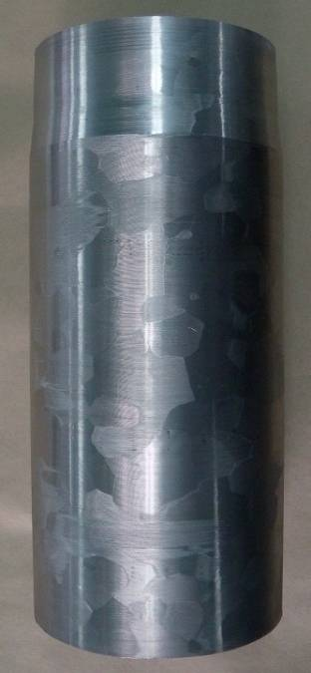
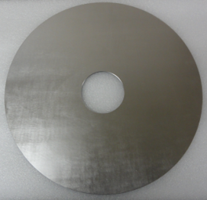
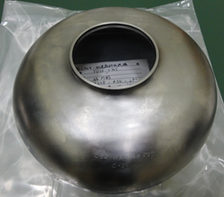
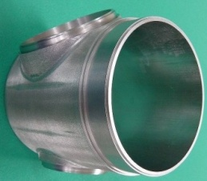
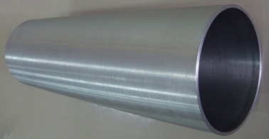
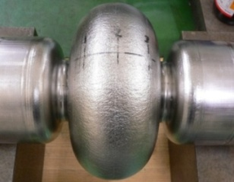
Collaborative cavity development
Parts supply
Forming
Disk
Half cell
Welding
Polish
Small tube
Beam tube
Rinse
Large tube
Seamless cavity
Assembly
Nb Ingot
RRR>300
Vertical Test

Slide 6
Welding type 1-cell cavity
Parts supply
Forming
Disk
Half cell
Welding
Polish
Small tube
Beam tube
Rinse
Large tube
Seamless cavity
Assembly
Nb Ingot
RRR>300
Vertical Test
Can be used our Nb materials for SRF accelerators?

Slide 7
Welding type 1-cell cavity
Property confirmation
Chemical components (for Ingot)
(ppm)
 | H | O | N | C | Zr | Fe
ASTM Type5 | 5 | 40 | 30 | 30 | 100 | 50
ULVAC | 1 | <10 | <10 | 10 | <10 | <10
 | Si | W | Ni | Ti | Al | Ta
ASTM Type5 | 50 | 70 | 30 | 50 | 50 | 1000
ULVAC | <10 | 10 | <10 | <5 | <10 | 140
Mechanical properties (for Disk)
RRR (for Ingot and Disk)
 | Ultimate Tensile Strength (MPa) | Yield Strength (MPa) | Elongation (%)
ASTM Type5 | >95 | >50 | >30
ULVAC | 149 | 61 | 38
 | Top | Bottom
Ingot | 324 | 338
Disk | 325
Nb disk satisfies the ASTM Type 5 (RRR Grade) specification
No degradation in process to disk

Slide 8
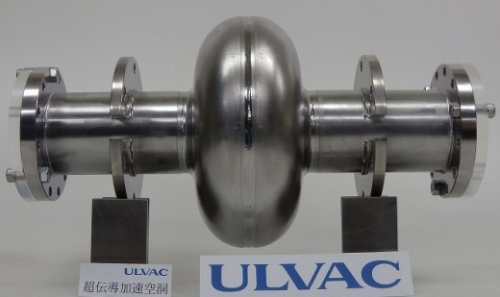
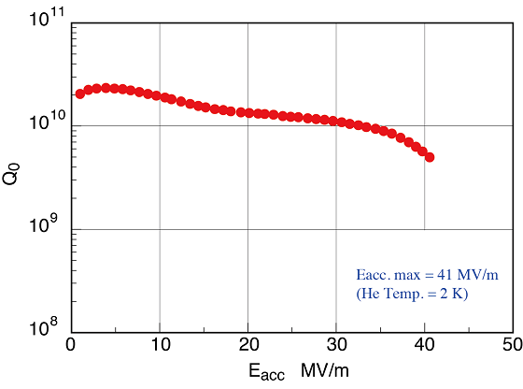
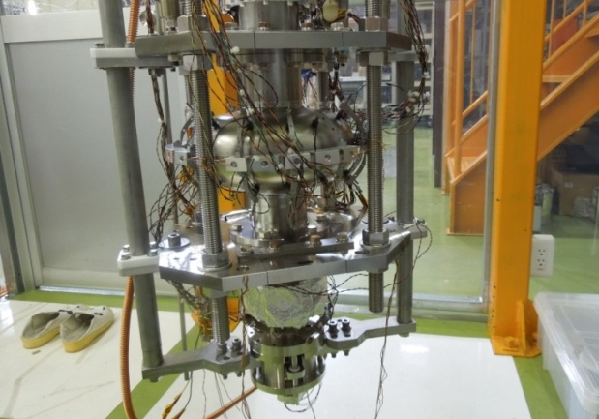
Welding type 1-cell cavity
Vertical test @ KEK
E_{acc} max. = 41 MV/m @2K
Can be used our Nb materials for SRF accelerators?
Yes !

Slide 9
Seamless type 1-cell cavity
Parts supply
Forming
Disk
Half cell
Welding
Polish
Small tube
Beam tube
Rinse
Large tube
Seamless cavity
Assembly
Nb Ingot
RRR>300
Vertical Test
Investigation for low-cost manufacturing

Slide 10
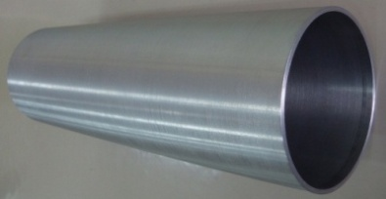
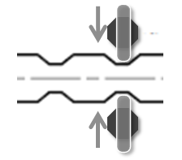
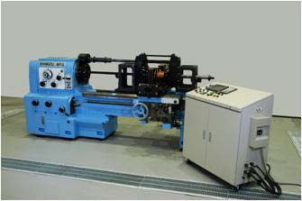
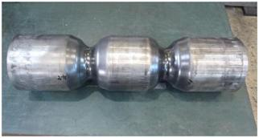
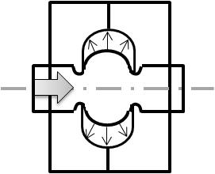
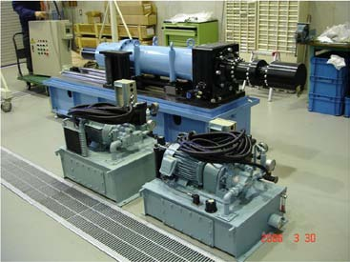
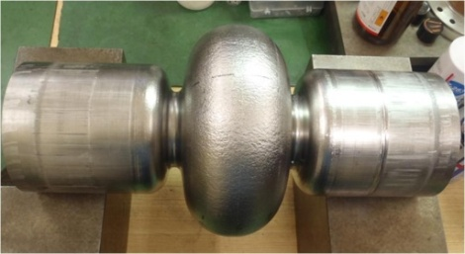
Seamless type 1-cell cavity
OD 130mm x ID 123mm (t = 3.5mm)
Length : 400mm
After process is performed at KEK
< Necking >
Roller
< Hydroforming >
Mold
Oil injection
Succeed in forming

Slide 11
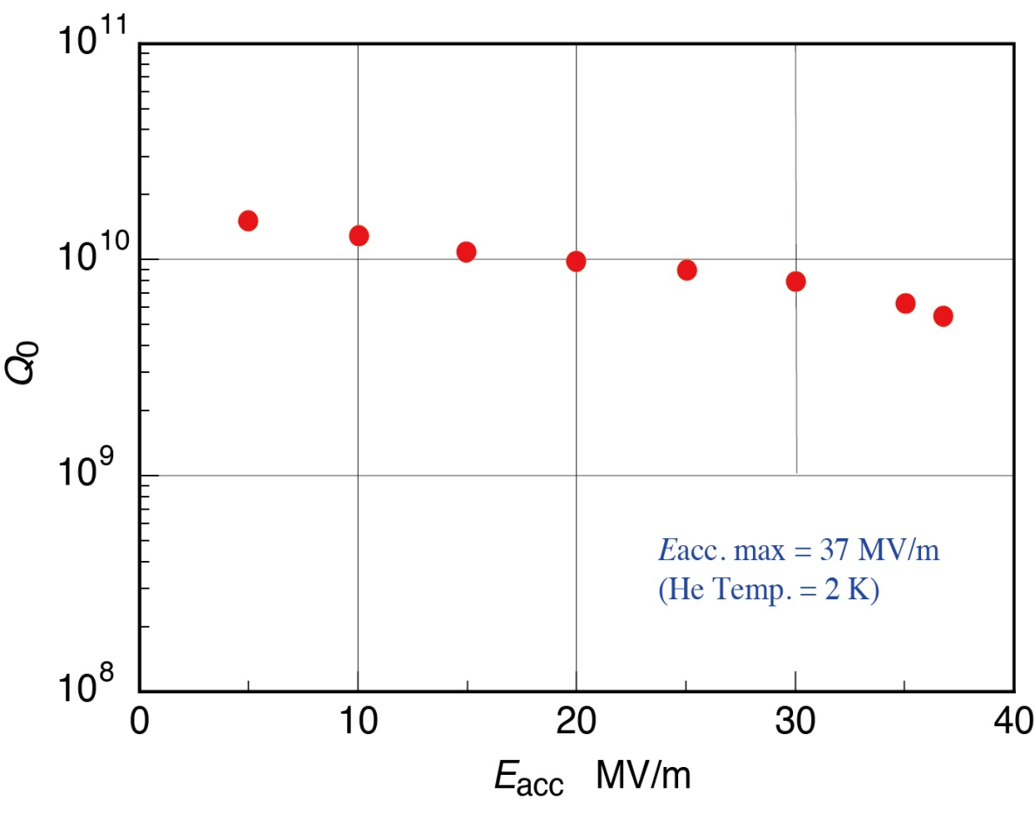
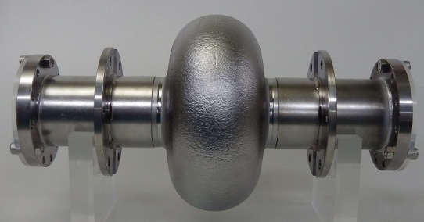
Seamless type 1-cell cavity
Vertical test @ KEK
< Welding beam tube >
< Polish >
< Rinse>
E_{acc} max. = 37 MV/m @2K
E_{acc} max exceeds ILC specification (> 35 MV/m)
E_{acc} max and Q₀ value are slightly lower than welding-type cavity

Slide 12
Seamless type 1-cell cavity
Why accelerating performance is lower than that of welding type cavity?
Outside view
Inside view
Micro size dent inside cavity
Origin of performance degradation?
Non-uniform crystalline grain size
We could not remove deep rough point
Or, material starts to thinner locally
Dent
After polish

Slide 13
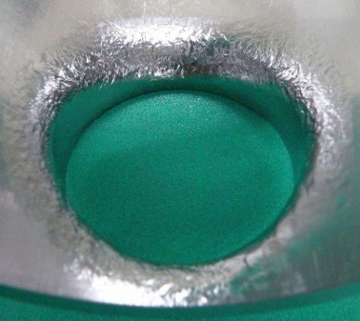
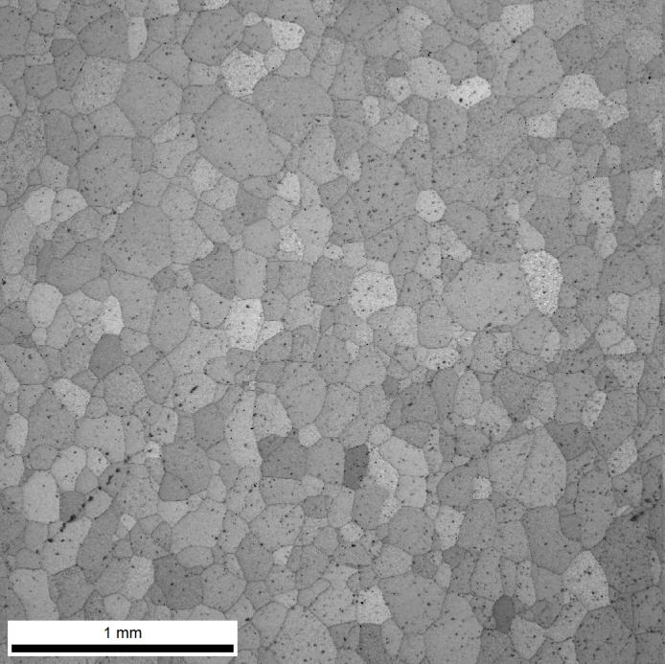
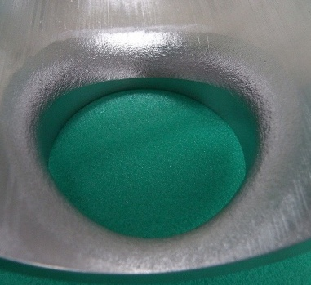
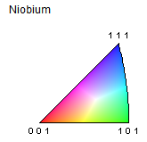
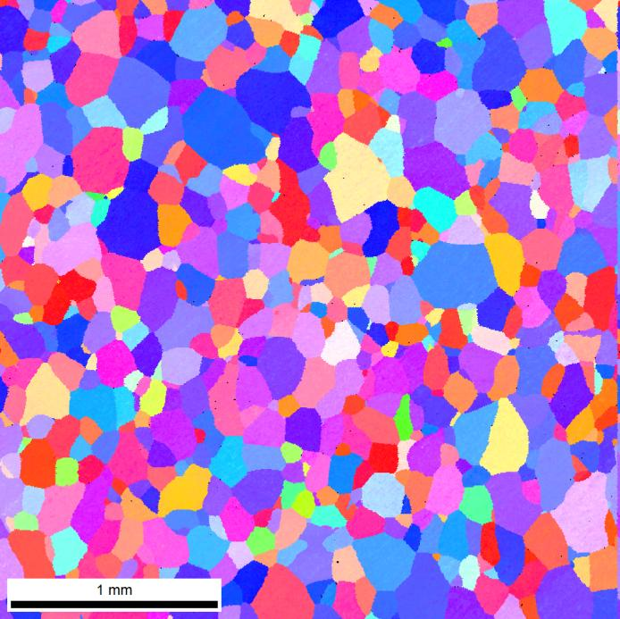
Crystalline uniformity confirmation
Weak process power
Strong process power
1㎜
1㎜
RD
1㎜
1㎜
1㎜
TD
ND
We should apply more strong process for seamless tube

Slide 14
Summary
ULVAC can supply high purity Nb products satisfy ASTM 5 and ILC spec.
In welding type 1-cell cavity, good accelerating performance was obtained.
(E_{acc} max = 41 MV/m, Q₀ =1.0 x 10¹⁰ @32MV/m (@2K))
We succeed in forming of seamless 1-cell cavity.
In seamless type 1-cell cavity, E_{acc} max = 37 MV/m @2K.
However, accelerating performance should be improved.
Future plan
seamless tube for 3-cell
<Scale up study>
Trial manufacturing of seamless tube for 3-cell
was already finished.
Necking and Hydoroforming process will be performed near future.
<Improvement of accelerating performance for seamless cavity>
We will optimize forging, deforming and annealing condition,
so as to be uniform grain size.
φ138 x φ131 x 830mm

Slide 15
Thank you for your attention !

