Slide 1
TTC meeting 2015 WG4a FPC
SLAC, 01-04 December 2015
Walid KAAbi, Eric Montesinos, on behalf of wg4a speakers

Slide 2
Preparation of the session
Agenda to Indico
Fundamental Power Couplers
Fabrication issues – plating, EBW, cleaning, checking
Cooling
Integration
Testing CW coupler
Processing
3rd Call for abstract
2nd Call for abstract
1st Call for abstract
2 x Funding reasons
2 x Visa
1 x too late

Slide 3
Preparation of the session
Short talks requested
60 % presentation / 40 % disucssion
10 minutes + 4 minutes + 1 minute
Focused on ‘provocative’ topics
In real life
15-20 minutes + 5-10 minutes
A lot of interesting discussions
14:15 (computer crash) to 18:00 with no break – intensive session
Warmest thanks to All Speakers !

Slide 4
Preparation of the session
Thales-RI (vendor)
CPI (vendor)
Toshiba (vendor)

Slide 5
Outcome of talks
Simulations provide a good idea of the results, but keep margin
Quite some discrepancies
simulation vs true life
unit to unit
Some parameters still to be understood even with operating couplers
Is outgassing a problem ? Even some leaky couplers have not stopped operation at SNS, lead into manageable degraded operation

Slide 6
Outcome of talks
Moving to series production
ramp up is long, multiplied by number of actors
Ramp down, suspicious pieces that have previously been rejected will be recovered/repaired for the last FPC, take a longer time to qualify them
Difficult to keep the knowledge (knowhow) in companies on long term basis
Good enough vs perfect
set up objective criteria !
Do not ask what is not needed !
Even with the same sample, quite a lot of dispersion on results
Correctly adapt the Quality Control program as this will have a direct impact on cost and delivery delays

Slide 7
Outcome of talks
Dark ceramics are rejected (up to now)
5 % rejected couplers
Is it really a matter ?
Is it really only on outer side of cold ceramics ?
Would be nice to have a dedicated program in order to find out what is the reason of this phenomena, volunteer(s) ?
Stain in copper coating :
Discovered at earlier stage: Which treatment? Chemical Vs. mechanical treatment
Discovered after RF conditioning: Could we live with it?
Surface treatment after copper plating:
Really needed?
Which treatment? Mo Wool polishing? Ceramic wool burnishing? Glass bead blasting?
Impact on RF processing?

Slide 8
Outcome of talks
R&D on couplers:
Make R&D in step in order to separate troubles to be able to identify what impacts what (time consuming but well invested)
Add additional sensors on a prototype, simplify the needs for the series production
Report on all R&D to the community, redundant results (not necessarily linked to the project itself, like copper plating for example)

Slide 9
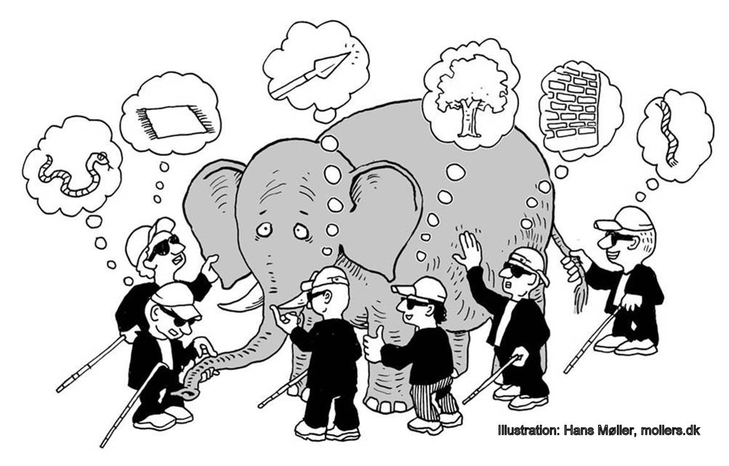
Still not all understood ABOUT FPC
The elephant is still not fully visible, but could it be one day ?
Or are we moving to production before we can completely see it ?
Beauty of our job

