Slide 1
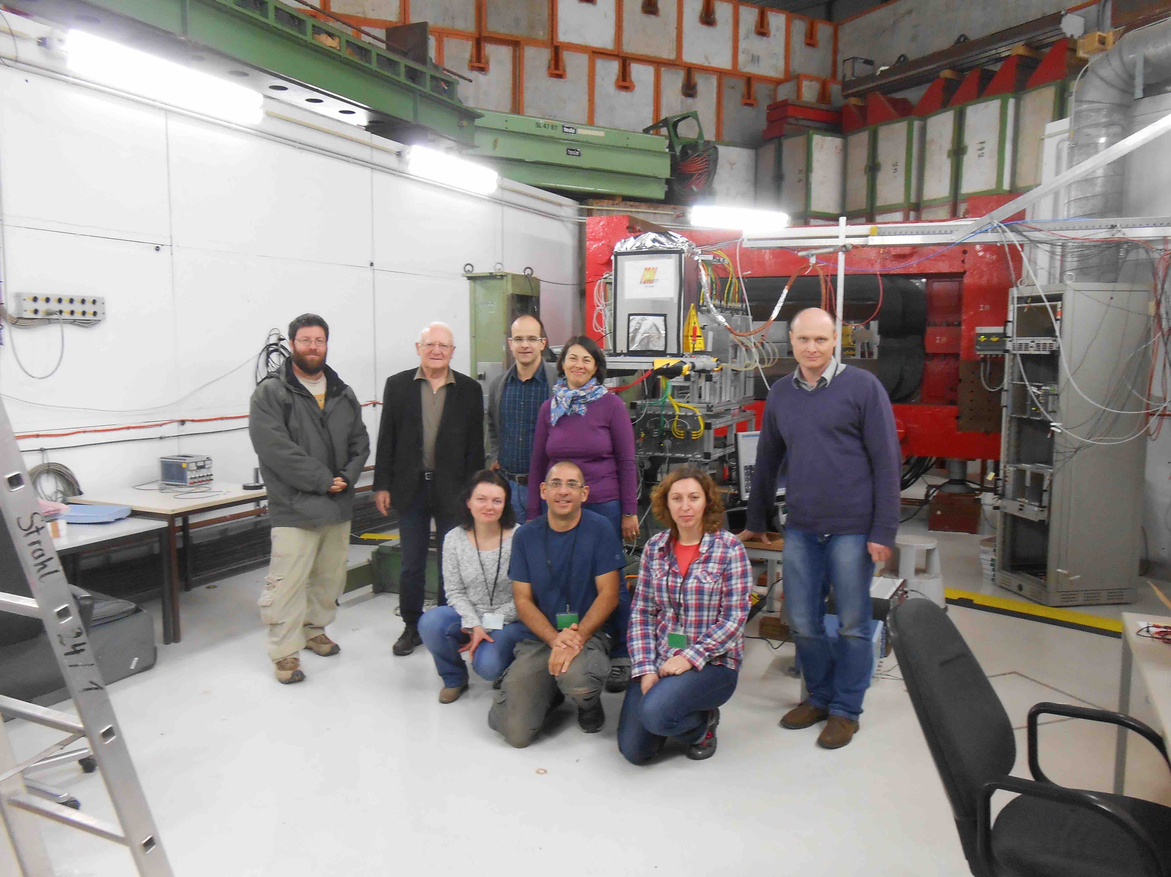
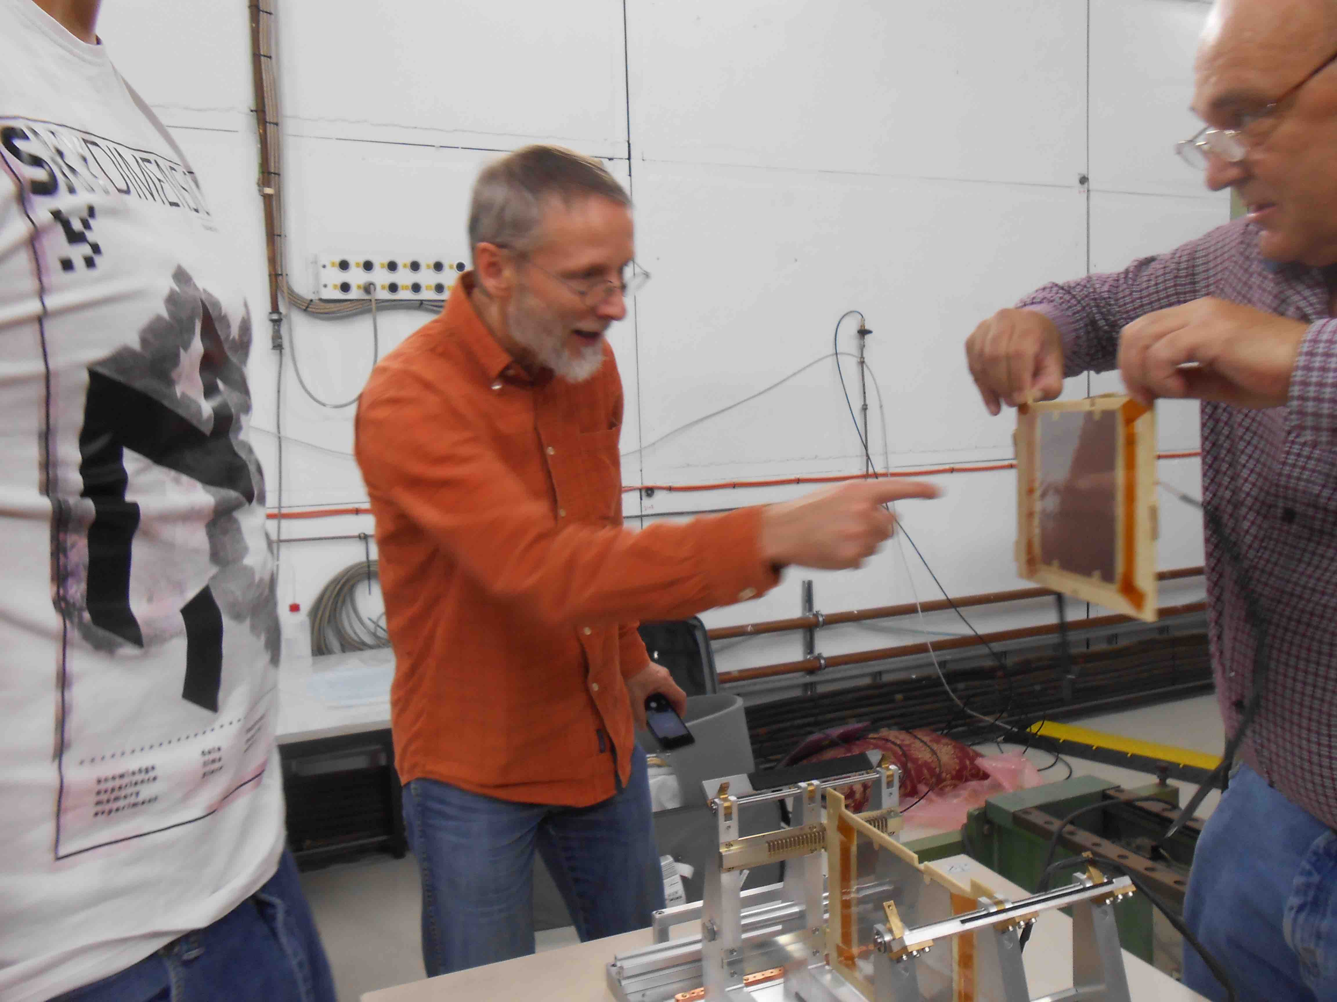

2015 test beam 12/10-19/10

Slide 2
setup
4 planes with thin sensor scotched on tungsten
FEB : pre amplifier shaper charge, 192-cell analog pipeline and an analog pulse shape processor per channel. 128 channels (2 per plane). HDMI cable to the SRS
DAQ : SRS system, designed by RD51 collaboration.
Silicon telescope : 6 planes with MIMOSA chip
Synchronization using TLU and fake SRS busy signal (generated by dual timer)
Online and “light” offline

Slide 3
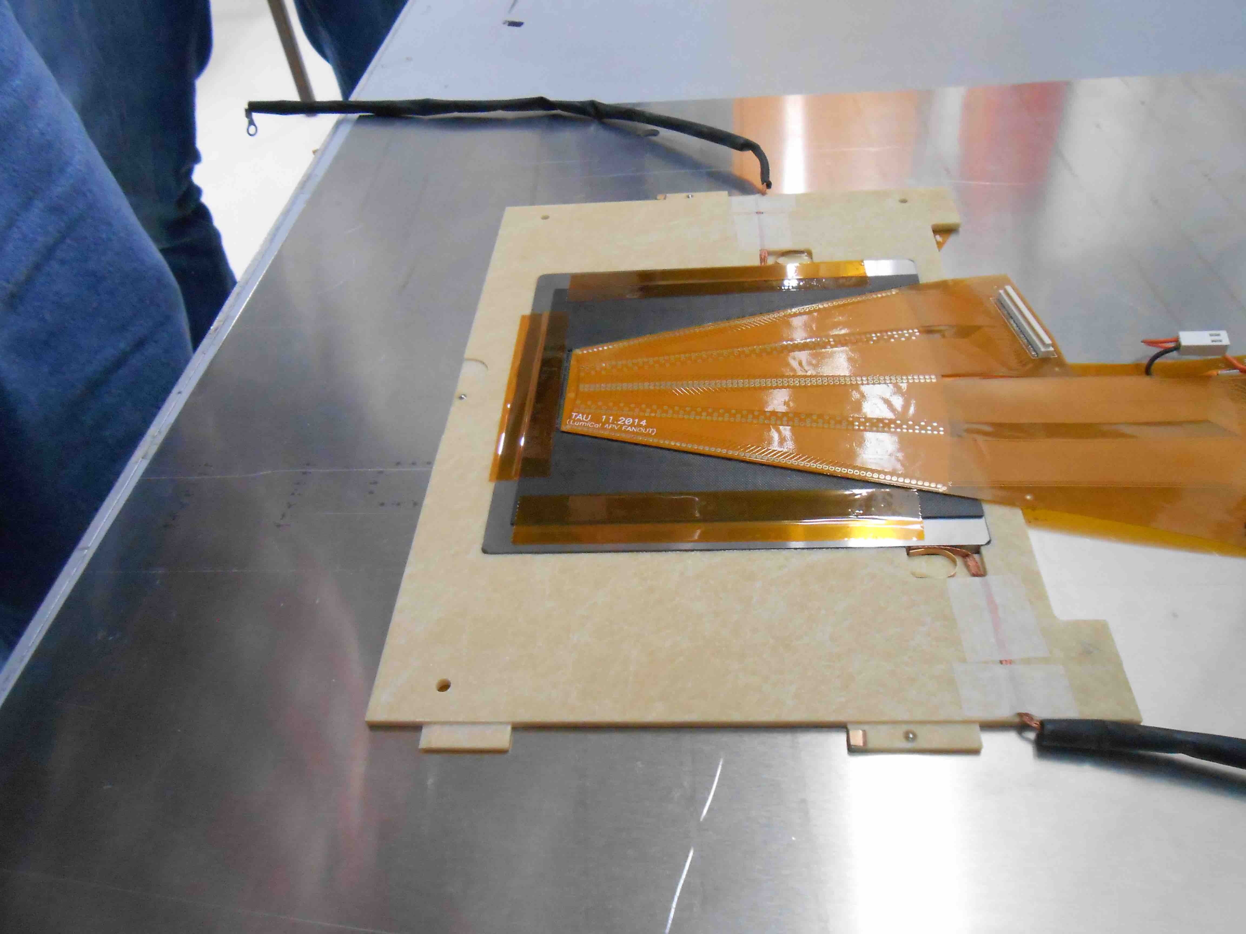
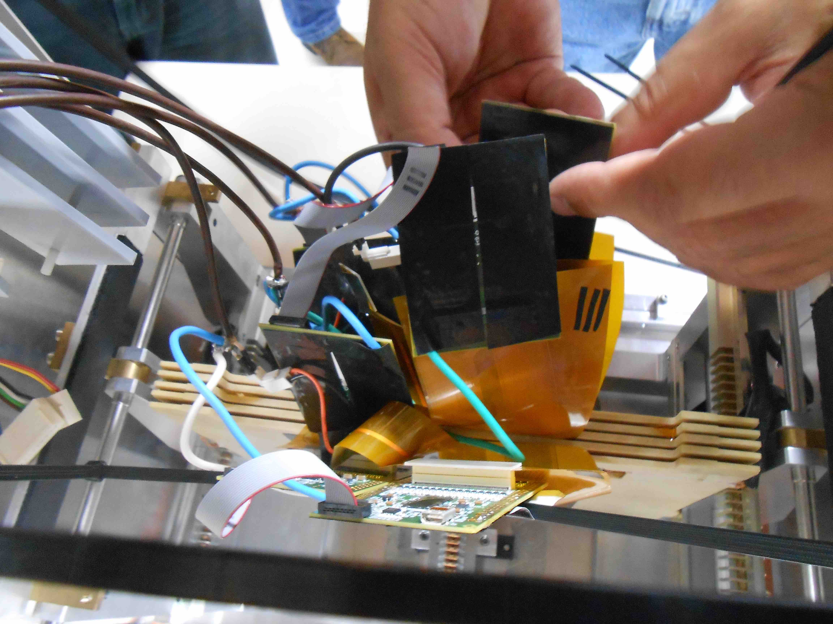
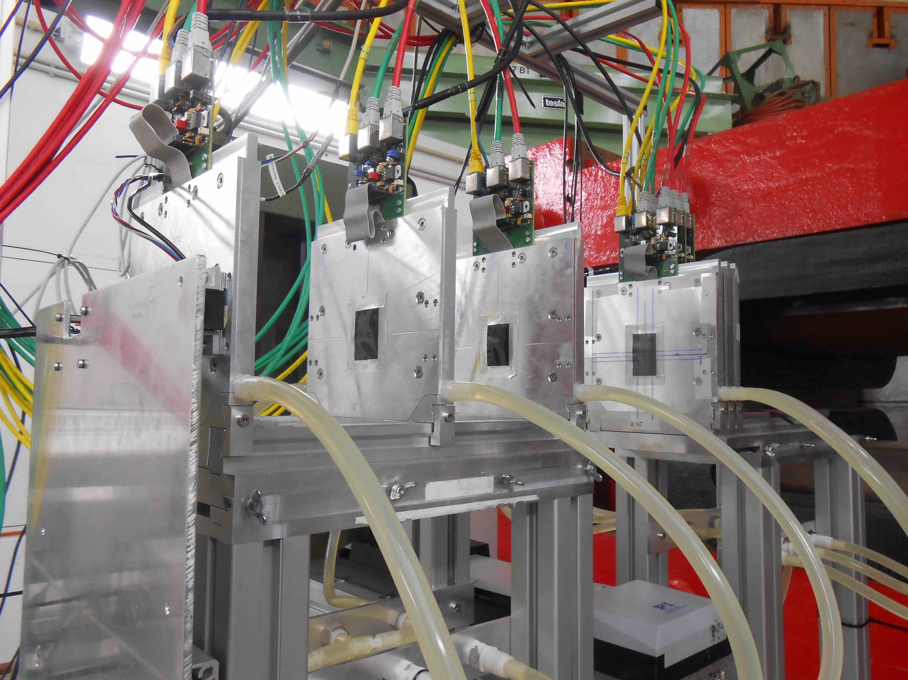
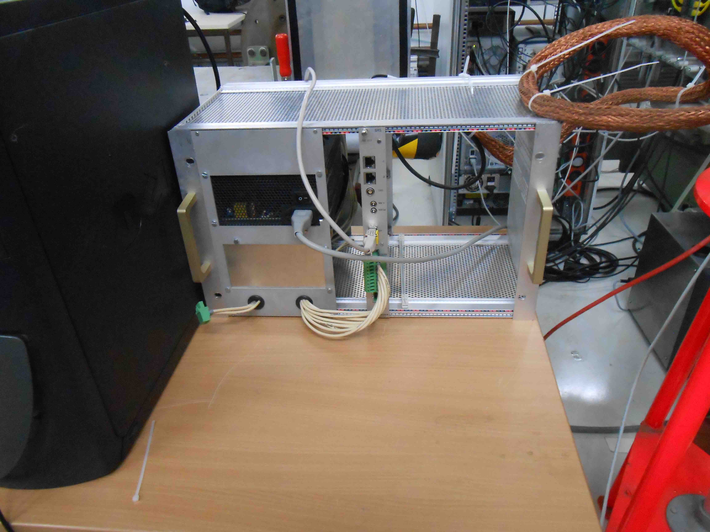

Slide 4
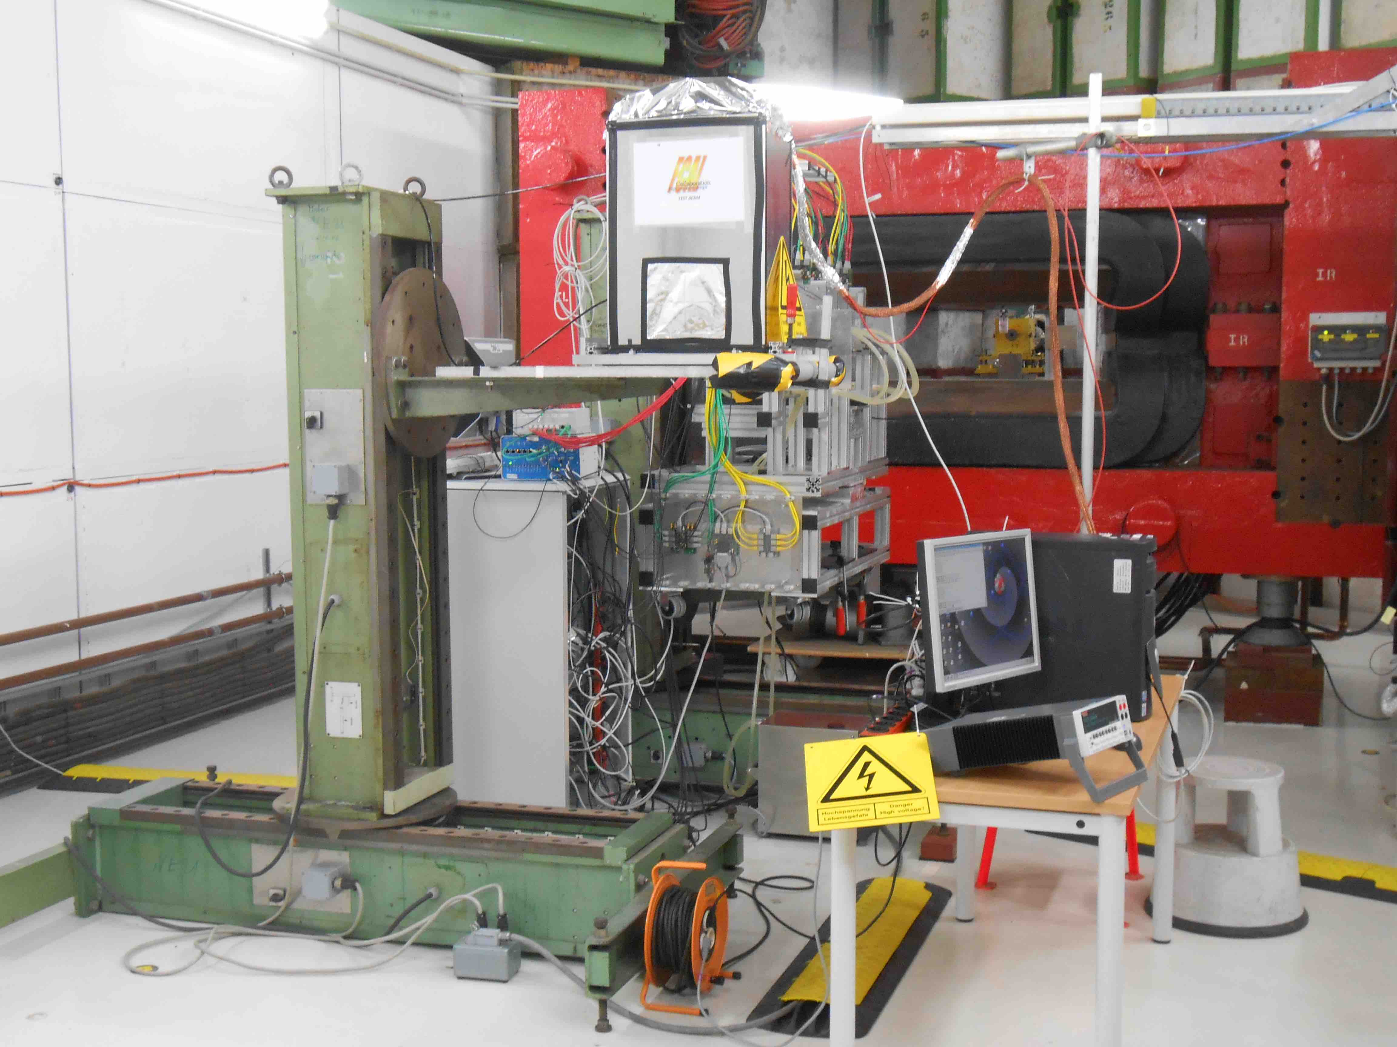
beam
xy table
Grounding cables
Telescope DAQ
Silicon HV

Slide 5
DAQ NUMBERING
APV 1 (slave)
APV 0 (master)
129
256
1
128
130
255
2
127
131
254
3
126
132
133
134
135
136
189
196
61
68
190
195
62
67
191
194
63
66
192
193
64
65

Slide 6
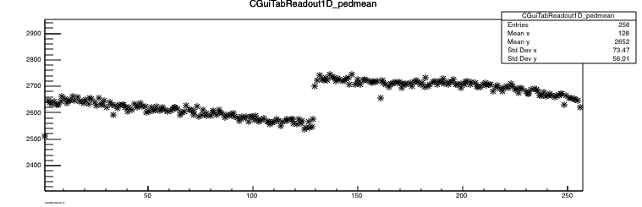

Slide 7
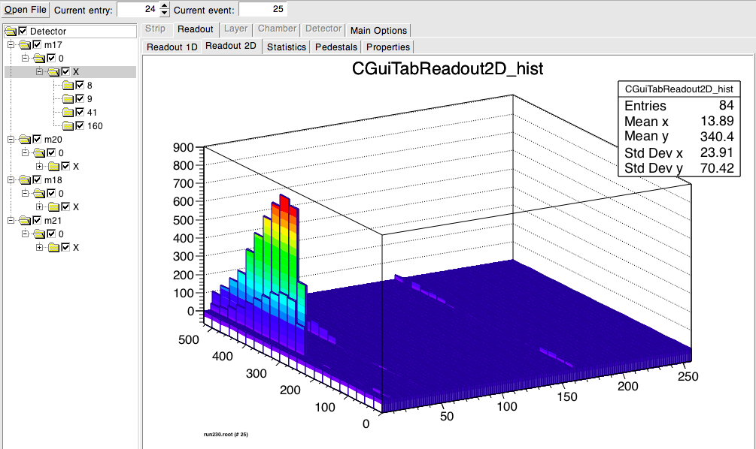
LIGHT OFFLINE : browser

Slide 8
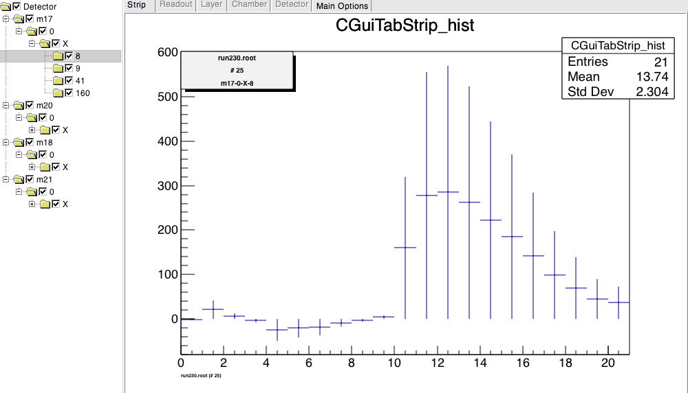
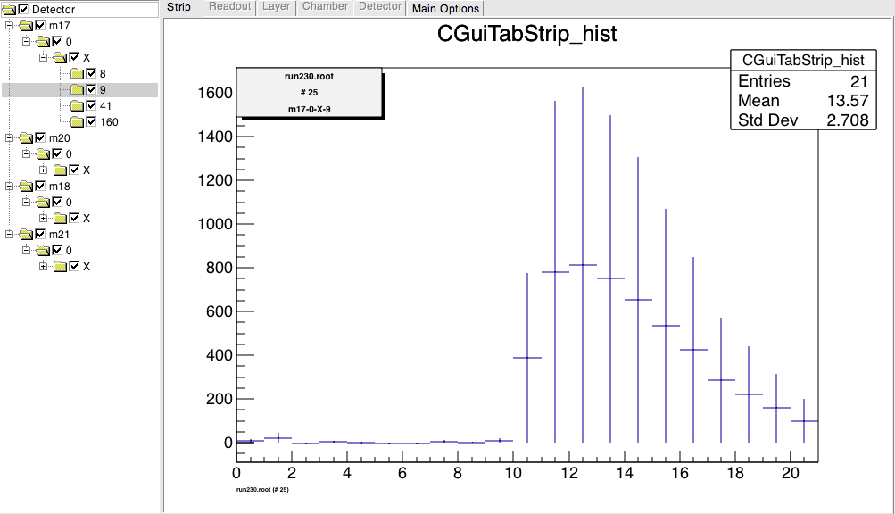
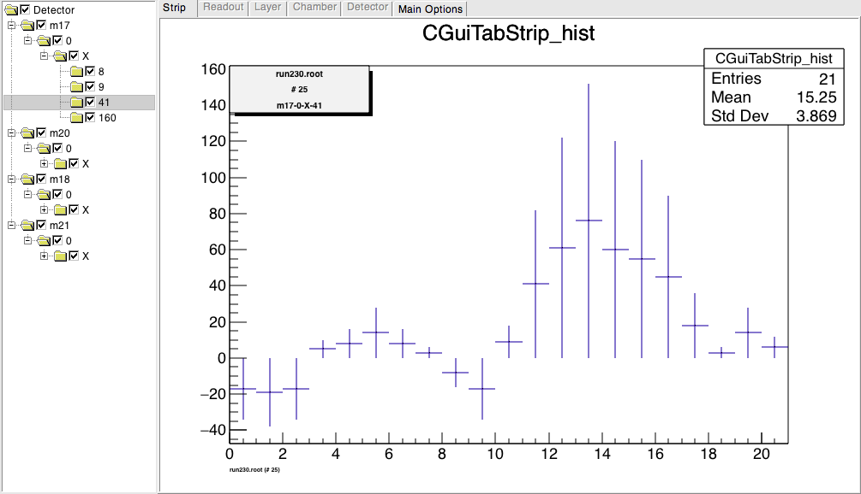
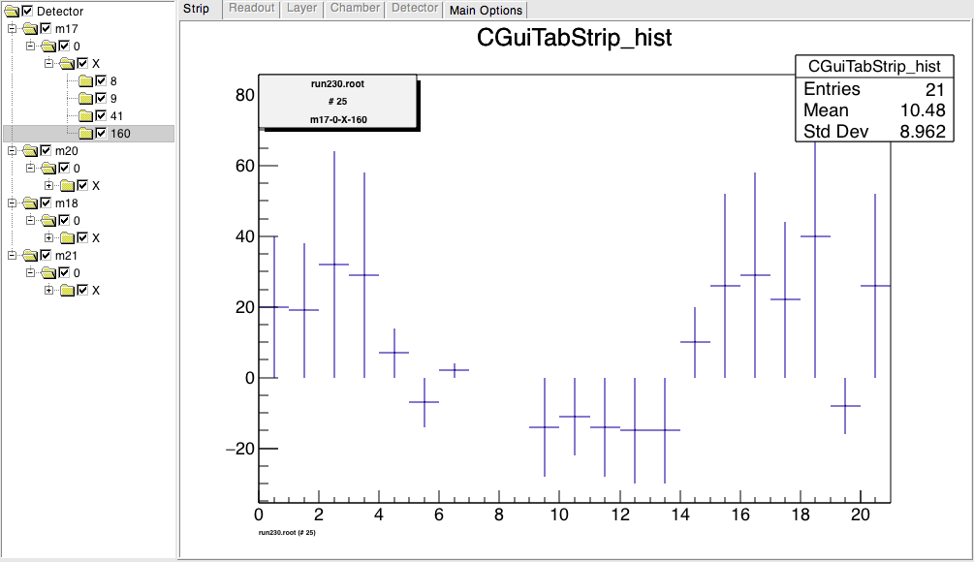
ADC count
ADC count
Time (sample#)
Time (sample#)
Cut : Qmax>200
Cut in time : Qmax with t ~ sample #12
rejected
rejected
ADC count
ADC count
Time (sample#)
Time (sample#)

Slide 9
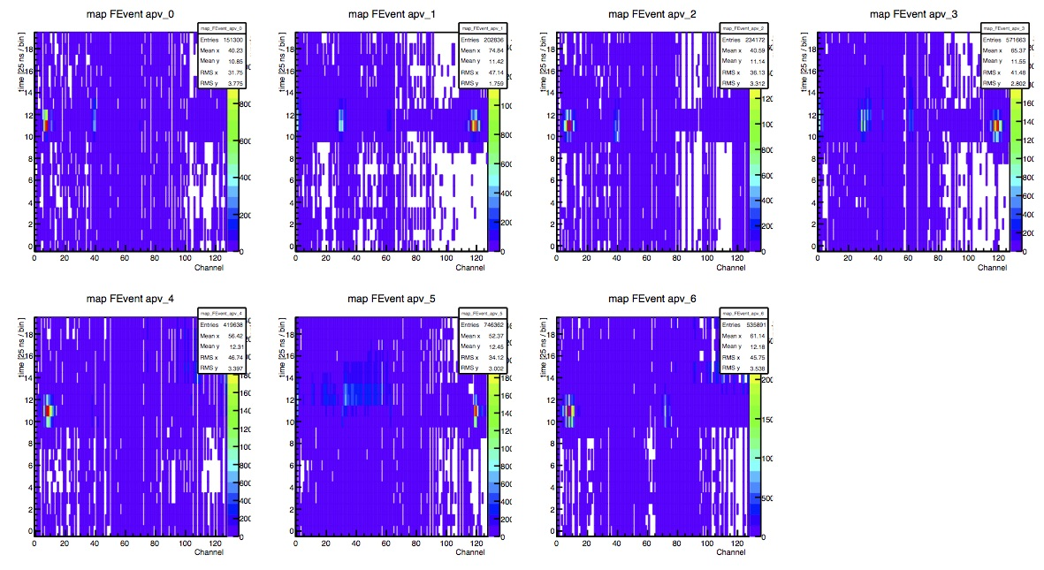
Time (sample number)
Run 221
Channel #

Slide 10
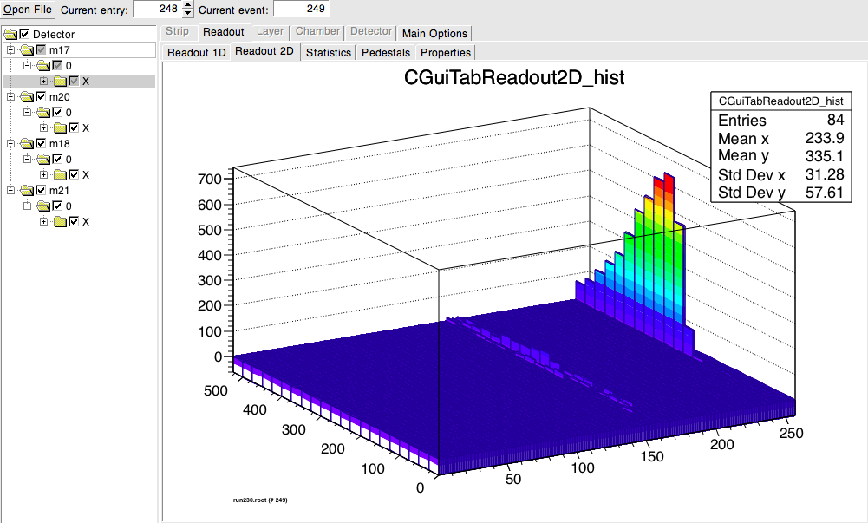
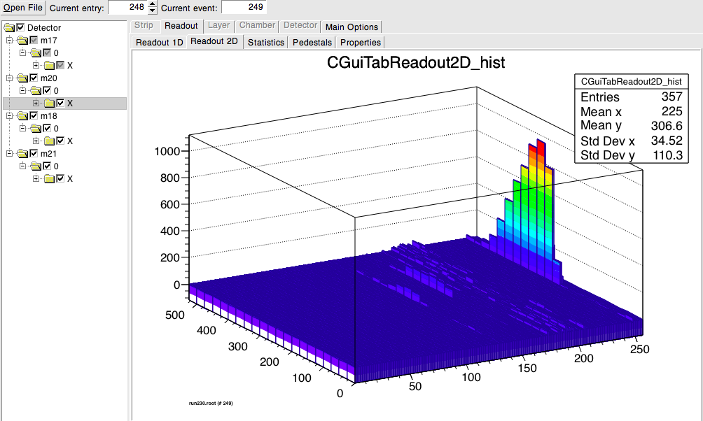
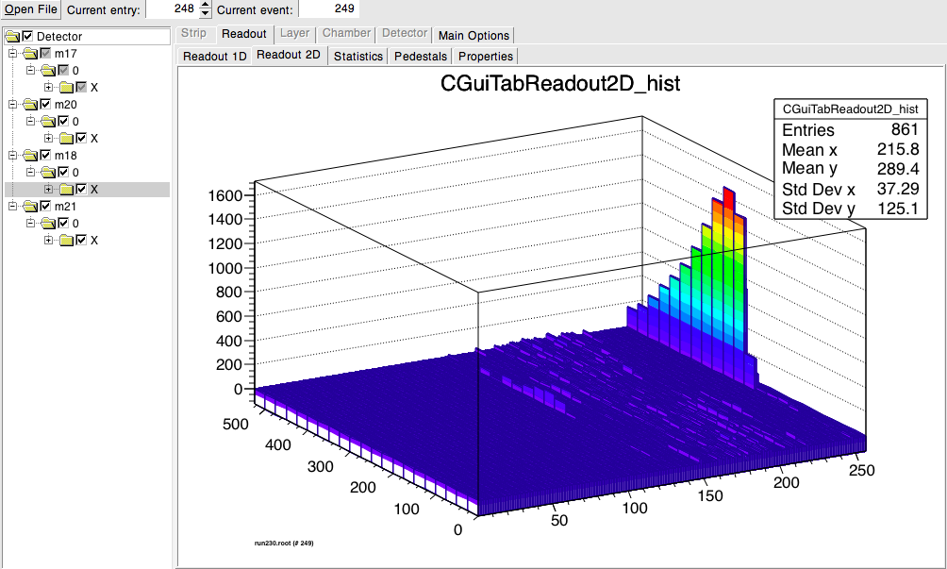
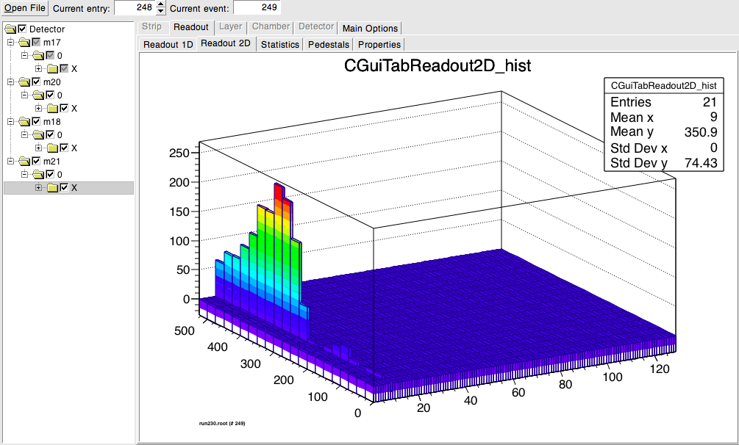
1st plane
2nd plane
Channel 247 (700)
Channel 247(1100),248(400)
Shower development
Alignment ? Channel 10 ?
3rd plane
4th plane
Channel 247(1500),248(1000)
Channel 9 (250)

Slide 11
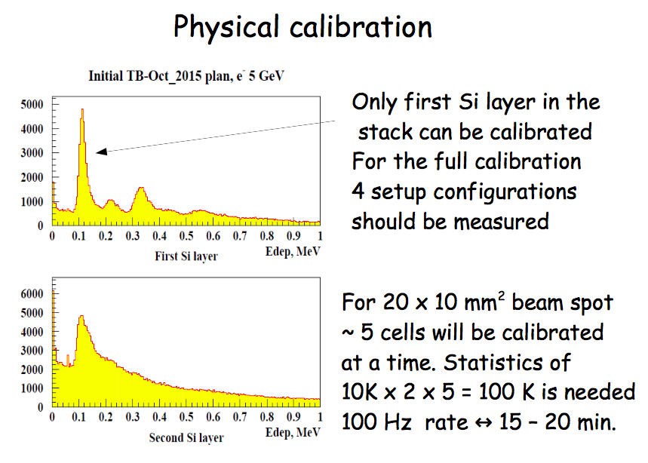
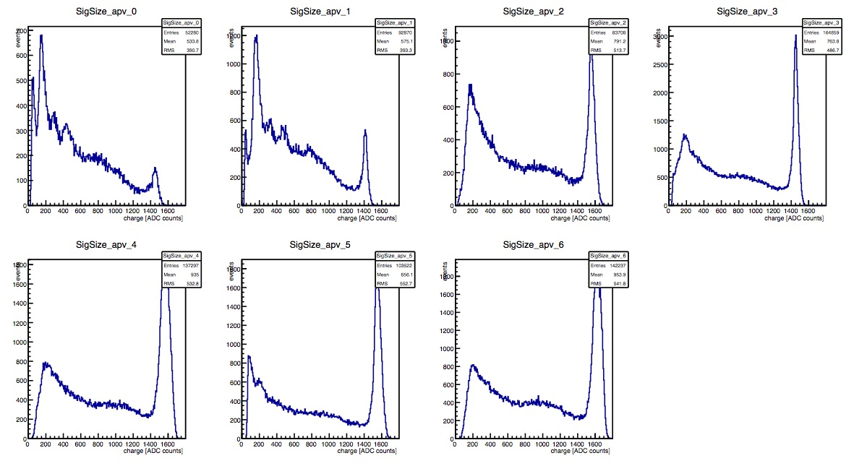
RUN 221

Slide 12
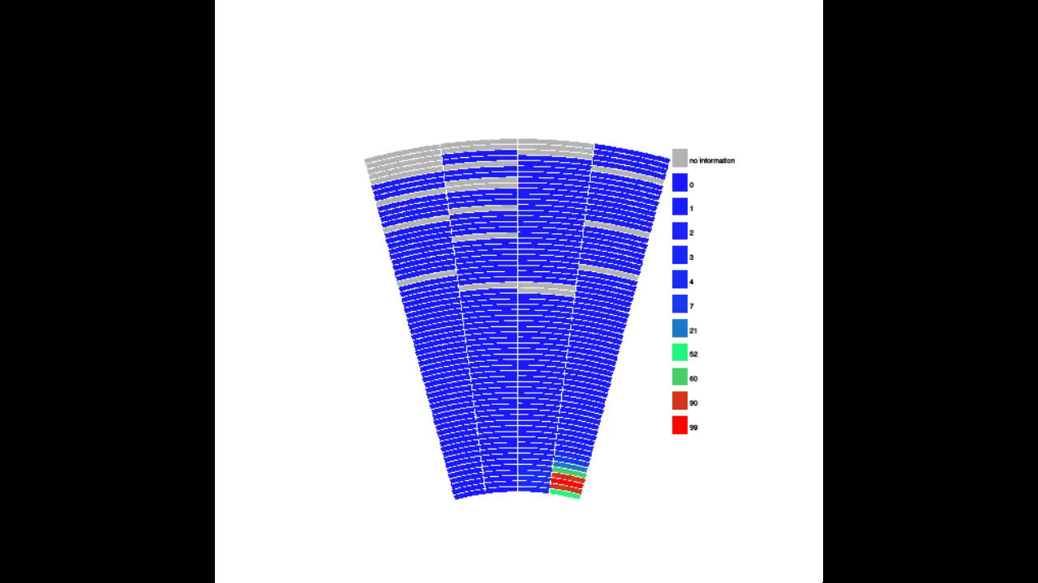
Xy scan

Slide 13
To summarize
More than 200 files, a bit less than 30Gb of data from the sensors
200 silicon telescope data files
Scan in (x,y), long statistic, HV scan, measurement with 4, 6 and 8 tungsten
Everything is web accessible :
  Data (and pictures) : http://alzt.tau.ac.il/~itamar/TB15-data/
  Logbook : same as last year but 2015

Slide 14
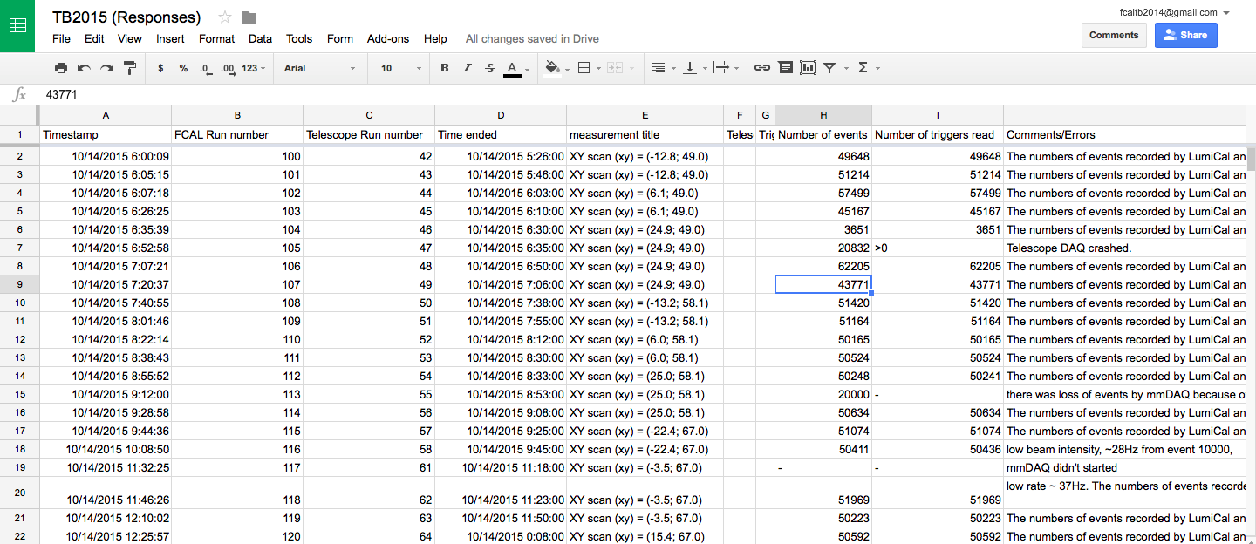

Slide 15
To do
Calibration of the system with muons (MIP)
Calibration of the APVs (pulser)
Analyze the data :
  Synchronization between the telescope and the sensors
  Charge, saturation
  Cross talk
  Shower study
  …

Slide 16
thanks

Slide 17
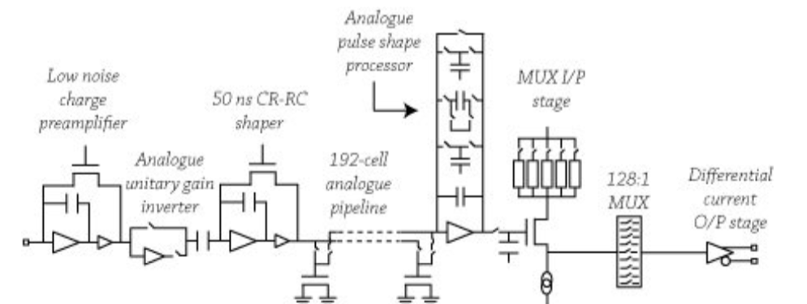
APV

Slide 18
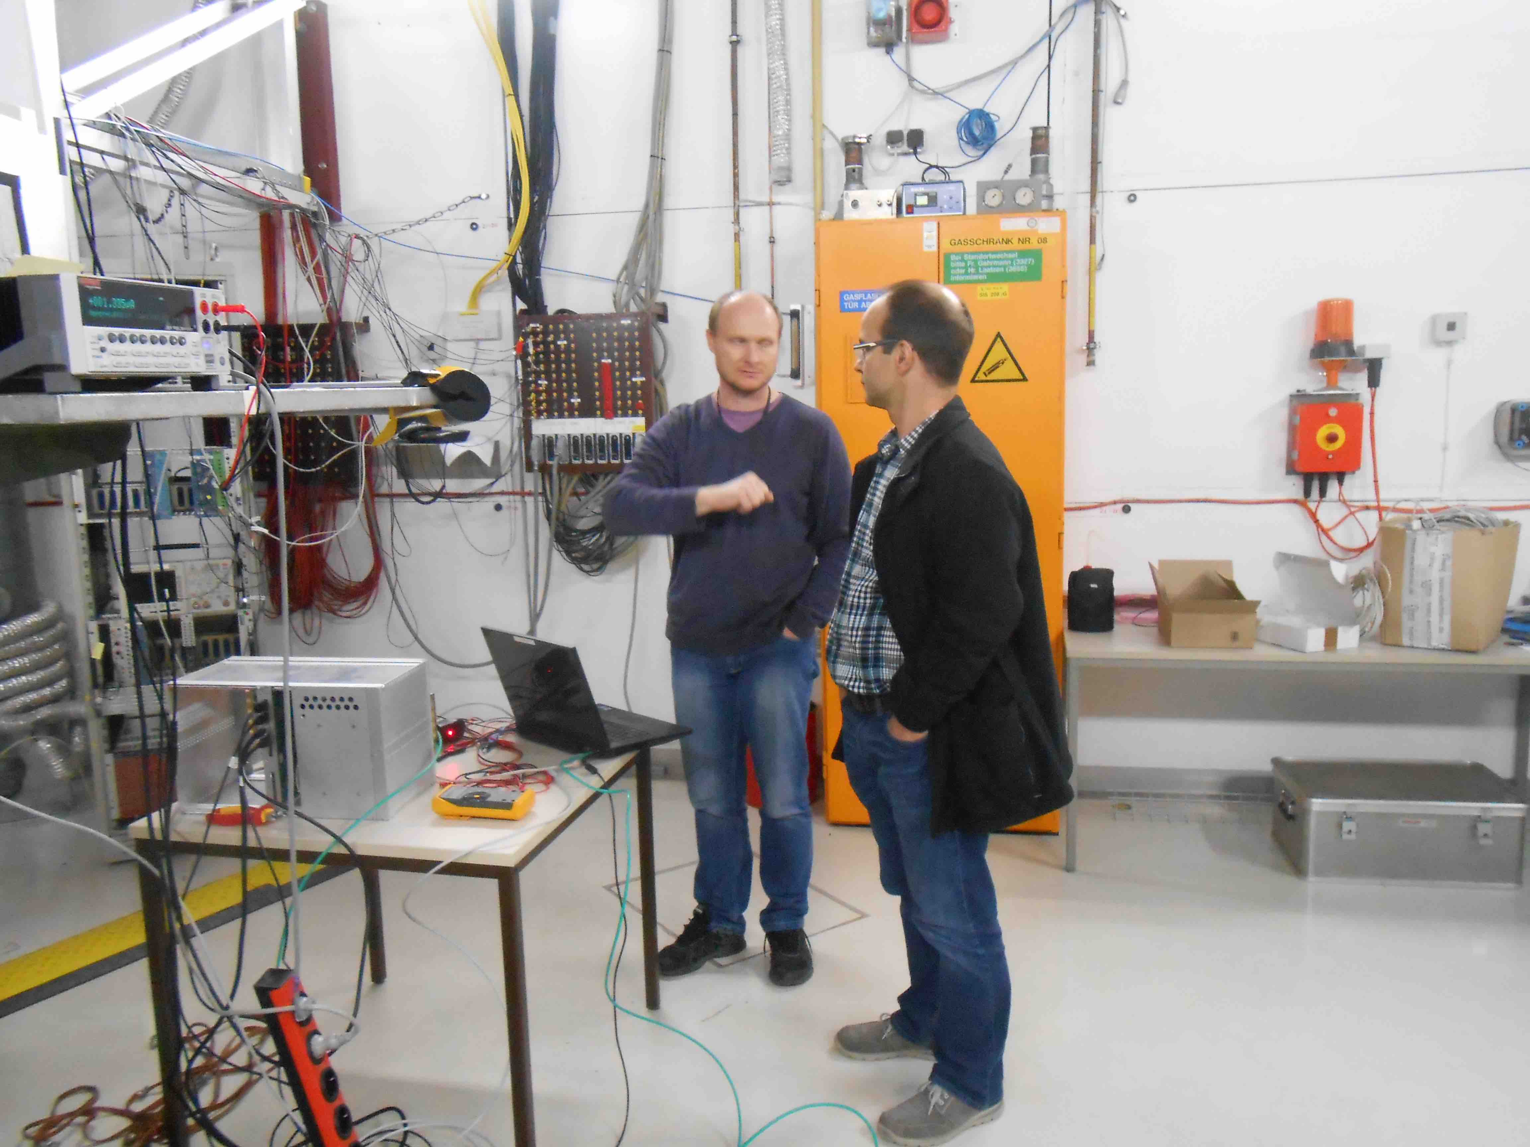

Slide 19
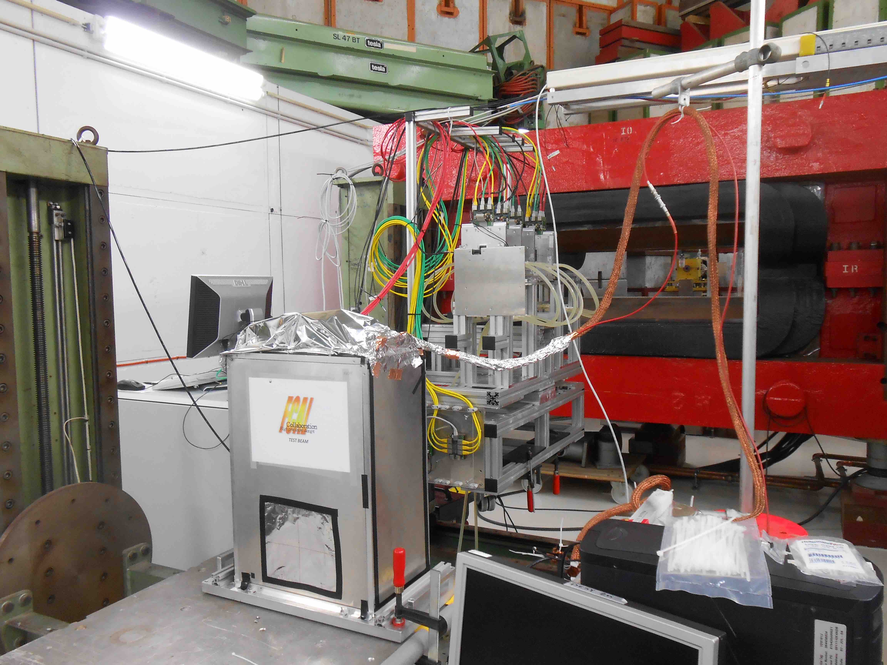

Slide 20
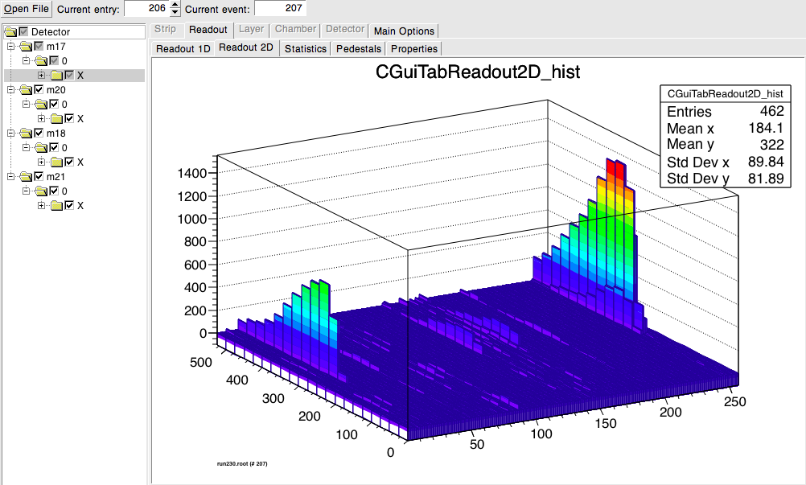
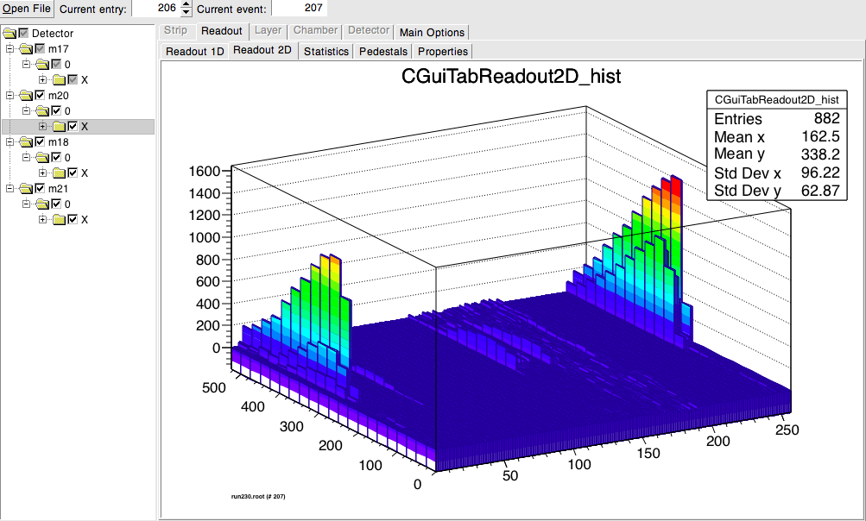
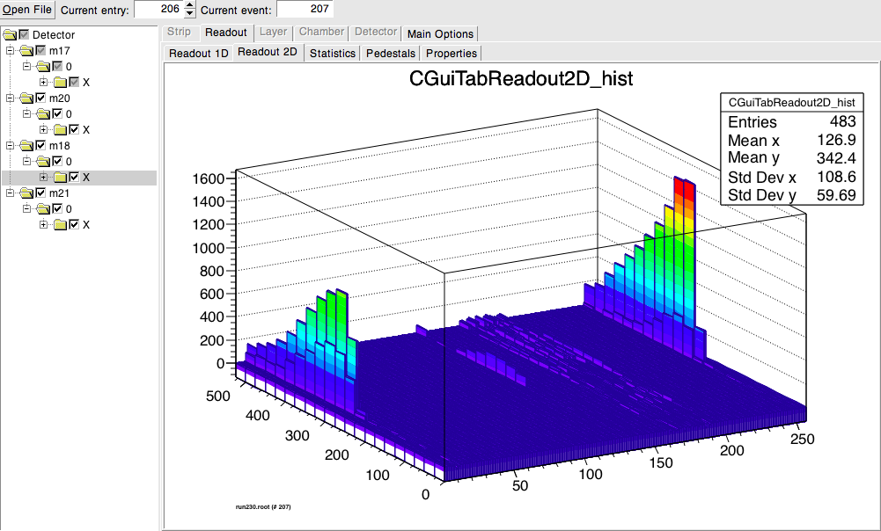
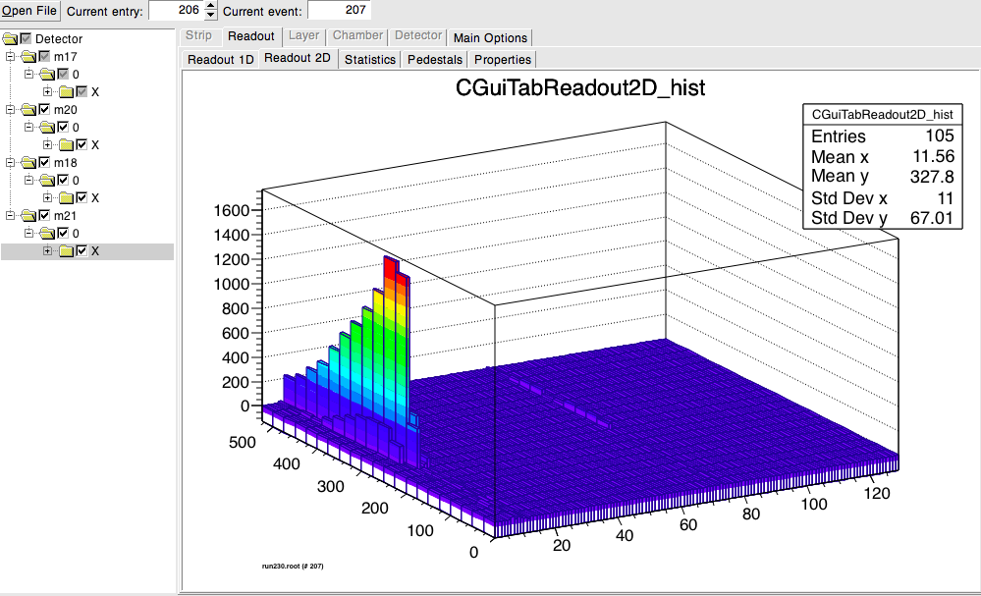
Shower development
1st plane
2nd plane
3rd plane
4th plane

Slide 21
DAQ NUMBERING
APV 1 (slave)
APV 0 (master)
129
256
1
128
130
255
2
127
131
254
3
126
132
133
134
135
136
189
196
61
68
190
195
62
67
191
194
63
66
192
193
64
65

