Slide 1
Chess2 Review Hit Encoding and Readout Blocks
July 1st 2015
P. Caragiulo, C. Tamma, A. Dragone, C. Kenney, P. Grenier, Su Dong
(* pietroc@slac.stanford.edu)
AIR Integrated Circuit

Slide 2
Hit Encoding and Read Out blocks
INPUTS
for each row the hit encoder has:
column address (5b) + double hit (1b)
hit
every 25ns
HIT ENCODER
detect the pixel address of the first 8 hits
OUTPUTS
It returns:
8x
every 25ns
INPUTS
It receives:
column address (5b) + double hit (1b) + row address (7b)
LVDS TX
Parallel transmission of the 13b lines
every 3.25ns
OUTPUTS
It returns:
column address (5b) + double hit (1b) + row address (7b)
every 3.25ns

Slide 3
Hit Encoding - Inputs
column address (5b) + double hit (1b)
hit
row0
x
x
x
x
1
row1
x
x
x
x
0
row2
x
x
x
x
0
row3
x
x
x
x
0
row4
x
x
x
x
1
row5
x
x
x
x
1
row6
x
x
x
x
0
row7
x
x
x
x
0
row8
x
x
x
x
0
row9
x
x
x
x
1

Slide 4
Hit Encoding – Processing the Strip Encoding
0
8xbit0 lines
row0
x
x
x
x
1
+
row1
x
x
x
x
0
+
row2
x
x
x
x
0
+
row3
x
x
x
x
0
+
closed switch
row4
x
x
x
x
1
+
open switch
row5
x
x
x
x
1
+
Control lines
row6
x
x
x
x
0
+
row7
x
x
x
x
0
+
row8
x
x
x
x
0
+
row9
x
x
x
x
1
+

Slide 5
Hit Encoding – Processing the Strip Encoding
0
8xbit0 lines
8xbit1 lines
8xbit2 lines
…
row0
x
x
x
x
1
+
row1
x
x
x
x
0
+
row2
x
x
x
x
0
+
row3
x
x
x
x
0
+
row4
x
x
x
x
1
+
row5
x
x
x
x
1
+
row6
x
x
x
x
0
+
row7
x
x
x
x
0
+
row8
x
x
x
x
0
+
row9
x
x
x
x
1
+
8b Memory
8b Memory
8b Memory
Write Memory

Slide 6
Hit Encoding – Processing the Strip Encoding
0
row0
x
x
x
x
1
+
row1
x
x
x
x
0
+
row2
x
x
x
x
0
+
row3
x
x
x
x
0
+
row4
x
x
x
x
1
+
row5
x
x
x
x
1
+
row6
x
x
x
x
0
+
row7
x
x
x
x
0
+
row8
x
x
x
x
0
+
row9
x
x
x
x
1
+

Slide 7
Hit Encoding – Processing the Strip Encoding
0
row0
x
x
x
x
1
+
Adder are slow (up to 1ns in worst case speed)
Huge load on the bit lines (127 switch off-capacitance + 5mm line capacitance)
row1
x
x
x
x
0
+
row2
x
x
x
x
0
+
row3
x
x
x
x
0
+
row4
x
x
x
x
1
+
Change of architecture in order to match the 25ns
row5
x
x
x
x
1
+
row6
x
x
x
x
0
+
row7
x
x
x
x
0
+
row8
x
x
x
x
0
+
row9
x
x
x
x
1
+

Slide 8
Hit Encoding – Processing the Strip Encoding
0
row0
x
x
x
x
1
+1
SKIP
row1
x
x
x
x
0
+1
SKIP
row2
x
x
x
x
0
+1
SKIP
row3
x
x
x
x
0
+1
SKIP
row4
x
x
x
x
1
+1
SKIP
row5
x
x
x
x
1
+1
SKIP
row6
x
x
x
x
0
+1
SKIP
row7
x
x
x
x
0
+1
SKIP
row8
x
x
x
x
0
+1
SKIP
row9
x
x
x
x
1
+1
SKIP

Slide 9
Hit Encoding – Processing the Strip Encoding
0
row0
x
x
x
x
1
+1
SKIP
row1
x
x
x
x
0
+1
SKIP
row2
x
x
x
x
0
+1
SKIP
row3
x
x
x
x
0
+1
SKIP
row4
x
x
x
x
1
+1
SKIP
typical case speed
row5
x
x
x
x
1
+1
SKIP
+1
SKIP
row6
x
x
x
x
0
+1
SKIP
row7
x
x
x
x
0
+1
SKIP
row8
x
x
x
x
0
300ps
110ps
+1
SKIP
row9
x
x
x
x
1
+1
SKIP
Worst case speed
+1
SKIP
500ps
150ps

Slide 10
Hit Encoding – Processing the Strip Encoding
0
row0
x
x
x
x
1
+1
SKIP
row1
x
x
x
x
0
+1
SKIP
row2
x
x
x
x
0
+1
SKIP
row3
x
x
x
x
0
+1
SKIP
row4
x
x
x
x
1
+1
SKIP
row5
x
x
x
x
1
+1
SKIP
row6
x
x
x
x
0
+1
SKIP
row7
x
x
x
x
0
+1
SKIP
row8
x
x
x
x
0
+1
SKIP
row9
x
x
x
x
1
+1
SKIP
Worst case speed
+1
SKIP
500ps
150ps

Slide 11
Hit Encoding – Processing the Strip Encoding
Write Memory
+1
SKIP
25ns
Bit line settling
time
Write Bit

Slide 12
Hit Encoding – Processing the Strip Encoding
Write Memory
+1
500ps
SKIP
25ns
150ps
Bit line settling
4ns
time
Write Bit
300ps
Time to get the bit lines ready is based on number of hits
Can be as high as 64ns if are all hits.
We are interested in the first 8 hits so the worst case using this architecture is when we have no hit on the first 120 rows and hit on the last 8 rows -> 22ns

Slide 13
Hit Encoding – Processing the Strip Encoding
reset
Write Memory
+1
500ps
SKIP
25ns
150ps
Bit line settling
4ns
time
Write Bit
300ps
Time to get the bit lines ready is based on number of hits
Can be as high as 64ns if are all hits.
We are interested in the first 8 hits so the worst case using this architecture is when we have no hit on the first 120 rows and hit on the last 8 rows -> 22ns
Avoid ghost from previous cycle
introducing a reset phase

Slide 14
Hit Encoding – Processing the Strip Encoding
Find first 8 hits in 128 rows
2x Find first 8 hits in 32 rows
13 x 8b Memory
13 x 8b Memory

Slide 15
Hit Encoding – Processing the Strip Encoding
+1
+1
500ps
500ps
SKIP
SKIP
150ps
150ps
Bit line settling
Bit line settling
4ns
0.8ns
Write Bit
Write Bit
300ps
300ps
Worst case scenario:
22ns
7.6ns

Slide 16
Hit Encoding – ReadOut interface
2x Find first 8 hits in 32 rows
13
13
13 x 8b Memory
13x LVDS Driver
13

Slide 17
LVDS TX/RX and Sync
2x Find first 8 hits in 32 rows
Sync pad
13
13
13 x 8b Memory
13x LVDS Driver
13
320MHz Clock
1 LVDS Receiver

Slide 18
LVDS Driver – Simulated Performance
Schematic simulated at all condition (wo,wz,ws,wp) at room temperature.
Specs | Typical | Min | Max
Differential Output Voltage (@ R_{LOAD} =100Ω) | 600mV
Output Common Mode | 1.2V | 0.5 | 2.8
Current | 3mA | 0.2mA | 3.5mA*
Speed | 320MHz |  | 500MHz
Supply | 3.3V
* Can meet standard LVDS requirements.

Slide 19
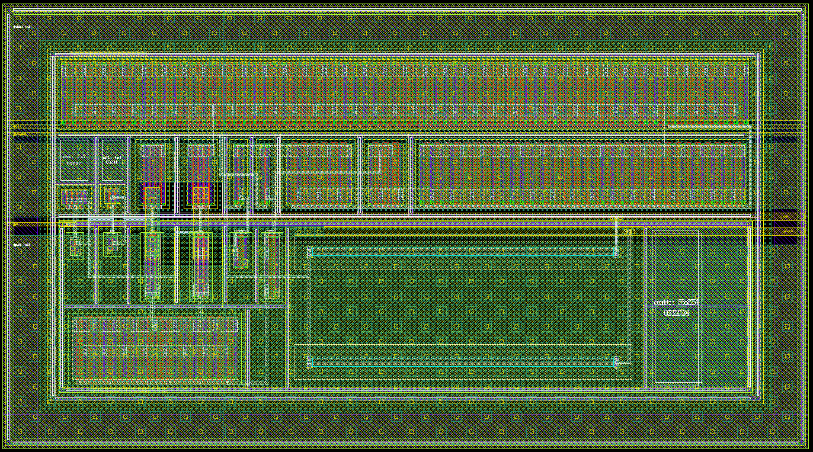
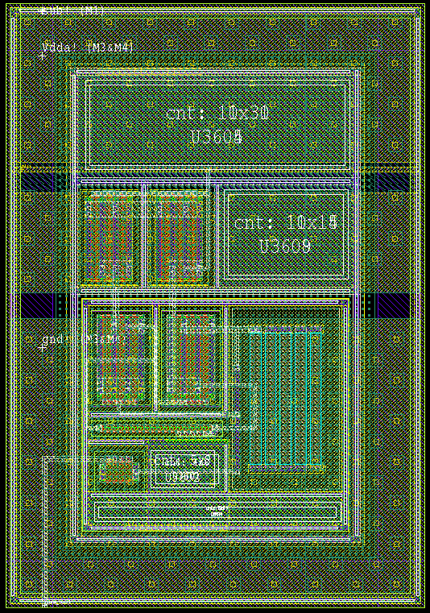
LVDS Driver - Layout
200µm
100µm
110µm
Out
Negative
Out
Positve
Bias Control
Common Mode Control
Pads Pitch
100µm
Shared Circuitry

Slide 20
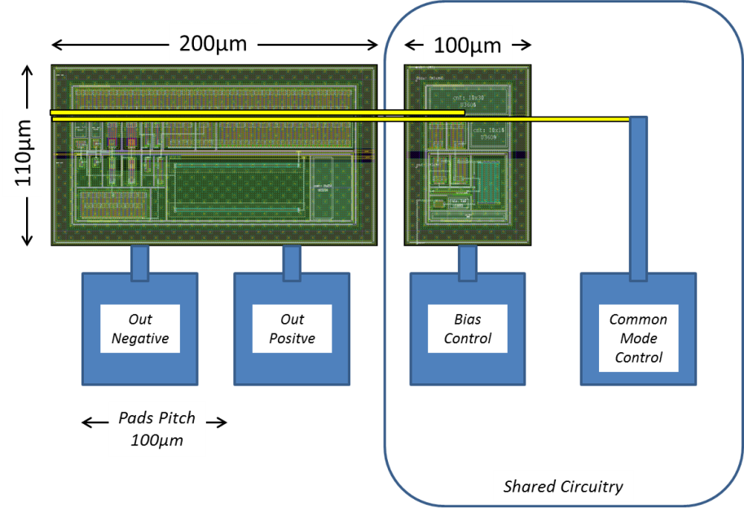
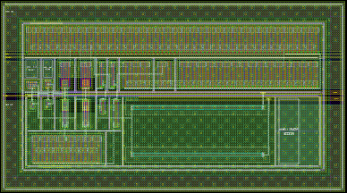
LVDS Driver - Layout

Slide 21
LVDS Receiver - Performance
Schematic simulated at all condition (wo,wz,ws,wp) at room temperature.
Specs | Typical | Min | Max
Differential Input Voltage (@ R_{LOAD} =100Ω) | 600mV
Output Common Mode | 1.2V
Input Current | 3mA*
Speed | 320MHz |  | 500MHz
Supply | 3.3V
* Can meet standard LVDS requirements.

