Slide 1
CHESS2 Pixels
Design SLAC – UCSC – KIT

Slide 2
CHESS2 pixels
Injection
IFB
RowENB
RAMWrEn
ColENB
3.3
1.8
Th
1/2
Load
Casc
1/2/4/8
Comp
InSF
In

Slide 3
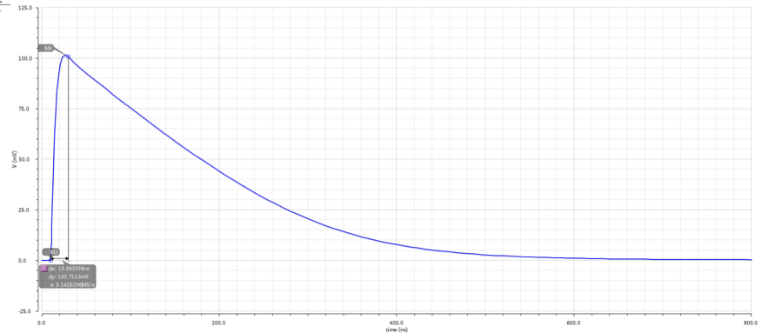
Simulation results
Fast: ~10ns risetime
SNR = 10 for 700e
Power 30µW/pixel, 0.5W per sensor.

Slide 4
RAM cell
PMOS added to RAM cell to allow configuration from 1 up 128 cells in parallel.
Disconnects the inverter from driving the DataIn line during configuration.
Simulation OK: with the additional PMOS we can configure a full row or a full column with a single SACI command (see SLAC presentations).
Load
DataIn

Slide 5
Pixel geometry
Amplifier.
Half comparator.
RAM controlled -
- charge injection
Row/Col selection
Trim RAM
Trim DAC
8 connected NWELLs
50% diode fraction
P-contact around each NWELL
120V rules
Size to be adjusted to strip length

Slide 6
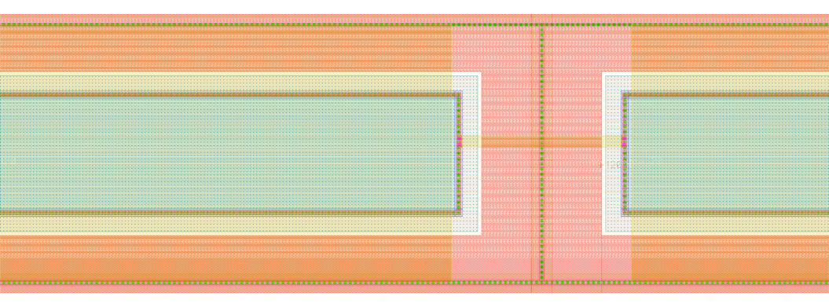
Pixel M3 lines
Metal 3
32 Signal
+
1 Row select
+
1 Injection
7.5µm space
for connectivity

Slide 7
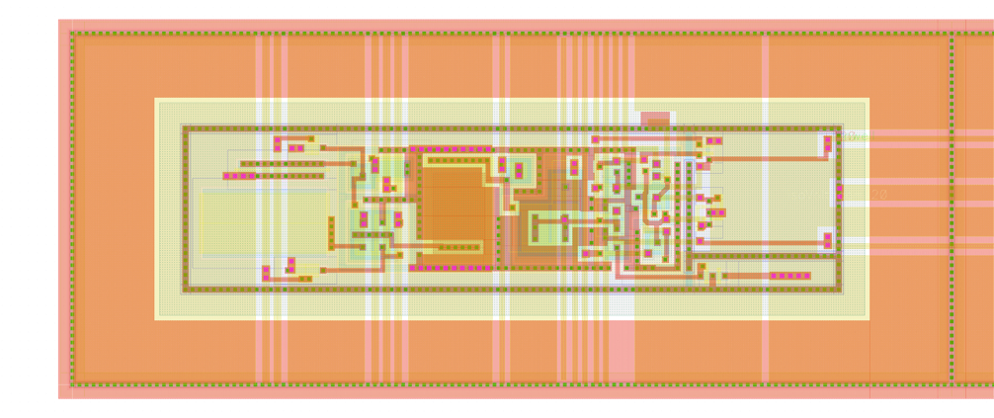
Amplifier & ½ comparator
Amplifier
AC
coupling
½ Comp.
Inj. RAM
Row/Col sel.
Amplifier & Comp. bias analog lines
Digital RAM & Inj. lines

Slide 8
Amplifier & ½ comparator control signals
Supply
Col sel.
Row sel.
Injection
Amplifier
AC
coupling
½ Comp.
Inj. RAM
Row/Col sel.
Bias from DACs - periphery

Slide 9
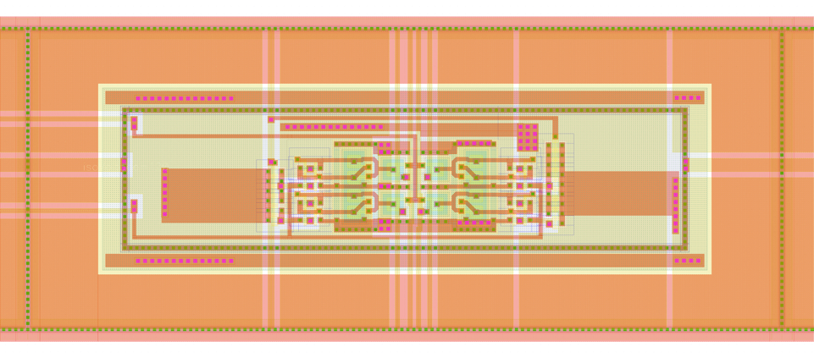
Trim RAM & Trim DAC
x2 & x4
current sources
x1 & x8
current sources
Trim current
to ½ comp.
4bit TRIM RAM

Slide 10
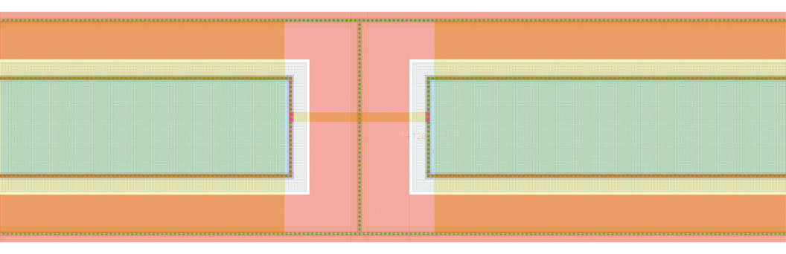
NWELLs interconnect
M2 NWELL shield (gnd/vdd)

Slide 11
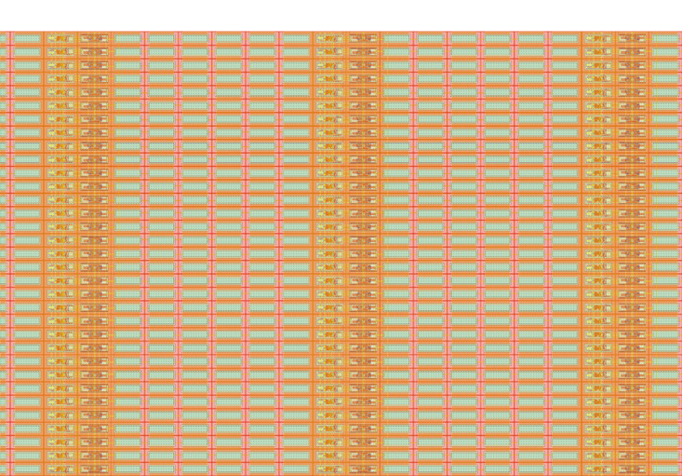
CHESS assembly - detail
40x800µm pixel

