Slide 1
Chess2 Review
ASIC Configuration
July 1st 2015
P. Caragiulo, C. Tamma, A. Dragone, C. Kenney, P. Grenier, Su Dong
(* pietroc@slac.stanford.edu)
AIR Integrated Circuit

Slide 2

Outline
SACI
Command Logic
Global Register
Row and Column register for pixel selection
Row and Column decoders
Digital control signal distribution

Slide 3
Floor Plan
Trim DAC (4b) + Calibration (1b) + Masking (1b)
Column Decoder (5 bits Input– 1 Hot Output)
Column Decoder (5 bits Input– 1 Hot Output)
128 x 32
5bit
Half Comparator
1bit
Hit Encoder
colReg
5bits
SACI
Control Logic
Row Decoder (7 bits Input– 1 Hot Output)
rowReg
7bits
rowSel
clk
and
x128

Slide 4
SLAC ASIC Control Interface (SACI)
Serial Interface with handshake protocol
5 Signals
  3 shared: saciClk, saciCmd, saciRsp.
  1 dedicated select line per slave: saciSelL.
  1 Reset Line (RstL) can be shared with the ASIC Global Reset.
Operated between 0V and 3.3V
Allows multiple SACI on same bus (parallel mode).
16 bit Data Bus
Row Pointer
Column Pointer
Global Registers
PIPO with
Read back
12 bit Address Bus
CMD Unit
Ack
CClk
EXEC
R/W
7 bit Command
12 bit Address
32 bit Data Bus
SLAC ASIC Control Interface (SACI)
RstL
saciSelL
saciClk
saciCmd
saciRsp

Slide 5
SACI - Signals
SACIclk
SACIselL
SACIcmd
SACIrsp
SACIrstL
SACIcmd (serial signal):
SET (1bit)
1
RW (1bit)
R/W
CMD (7bit)
CMD
ADDR (12bit)
ADDR
DATA (32bit)
DATA
SACIrsp (serial signal):
SET (1bit)
1
RW (1bit)
1
CMD (7bit)
CMD
ADDR (12bit)
ADDR
Write Mode
SET (1bit)
1
RW (1bit)
0
CMD (7bit)
CMD
ADDR (12bit)
ADDR
DATA (32bit)
DATA
Read Mode

Slide 6
SACI – Multiple ASIC connection
SACI Response<0:3>
SACI-0
SACI-1
SACI-2
SACI-3
RSP
RSP
RSP
RSP
CLK
CMD
SEL
CLK
CMD
SEL
CLK
CMD
SEL
CLK
CMD
SEL
Shared Clock
Shared Command
Sel0
Sel1
Sel2
Sel3
Response line can be shared if only 1 SACI is selected when the command arrives.

Slide 7
SACI - Commands
SET (1bit)
1
RW (1bit)
RW
CMD (7bit)
CMD
ADDR (12bit)
ADDR
DATA (32bit)
DATA
RW | CMD | ADDR | DATA | Function
0/1 | 1 | Register Address | Data | Read/Write Global Register
1 | 4 | 0 | Data | Write Matrix
0/1 | 5 | 0 | Data | Read/Write Pixel
1 | 8 | 0 | 0 | START Matrix Configuration
0 | 0 | 0 | 0 | END Matrix Configuration
1 | 2 | 0 | 0 | Write all Columns (used to configure a single row)
1 | 3 | 0 | 0 | Write all Row (used to configure a single column)
The ASIC decodes the command last 4 bits. Any given command longer than 4 bits will be interpreted as a 4 bit command.

Slide 8
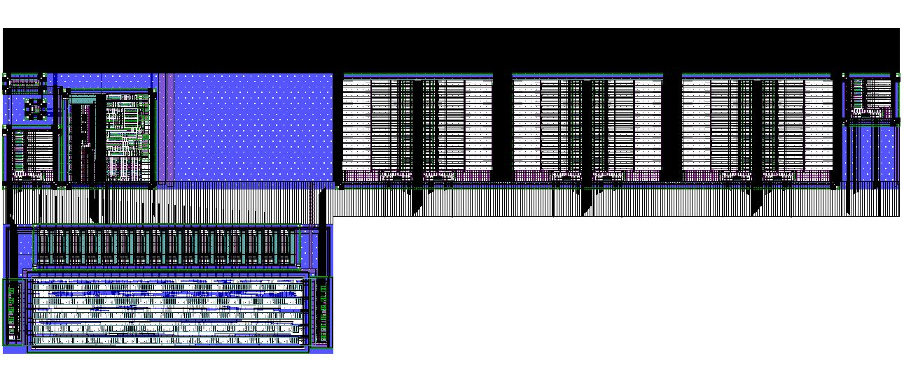
Control Unit
2000 µm
Global Register
Row and Column register for pixel selection
SACI
Command Logic
Digital control signal distribution
LVDS TX/RX
700 µm

Slide 9

Control Unit
+
+
Rad Hard Register
Bus to ASIC
+
Command Decoder
Command Logic
Rad Hard Bits
DataBus to Matrix
Buffers
Col
Reg
Command Logic
Pixel Write
Row Reg
SACI System
Bits
Bits
Logic
Logic
DATABUS Buffer
Logic
Internal Bus
CMD, CLK Buffer
SACI Core
ADDRESS Buffer

Slide 10
Address and Databus buffer
Address and Command Buffer
Sending address and command to the command logic only when the EXEC signal is HIGH in order to save power.
Databus Buffer
Guarantees that SACI is writing the data bus only in WRITE mode and it is reading the data bus in READ mode.
Writing and reading of the data bus are permitted only when the EXEC signal is HIGH in order to save power
SACI is reading the data bus only when the ACK signal is HIGH in order to avoid buffer high current consumption when the bus is floating.

Slide 11
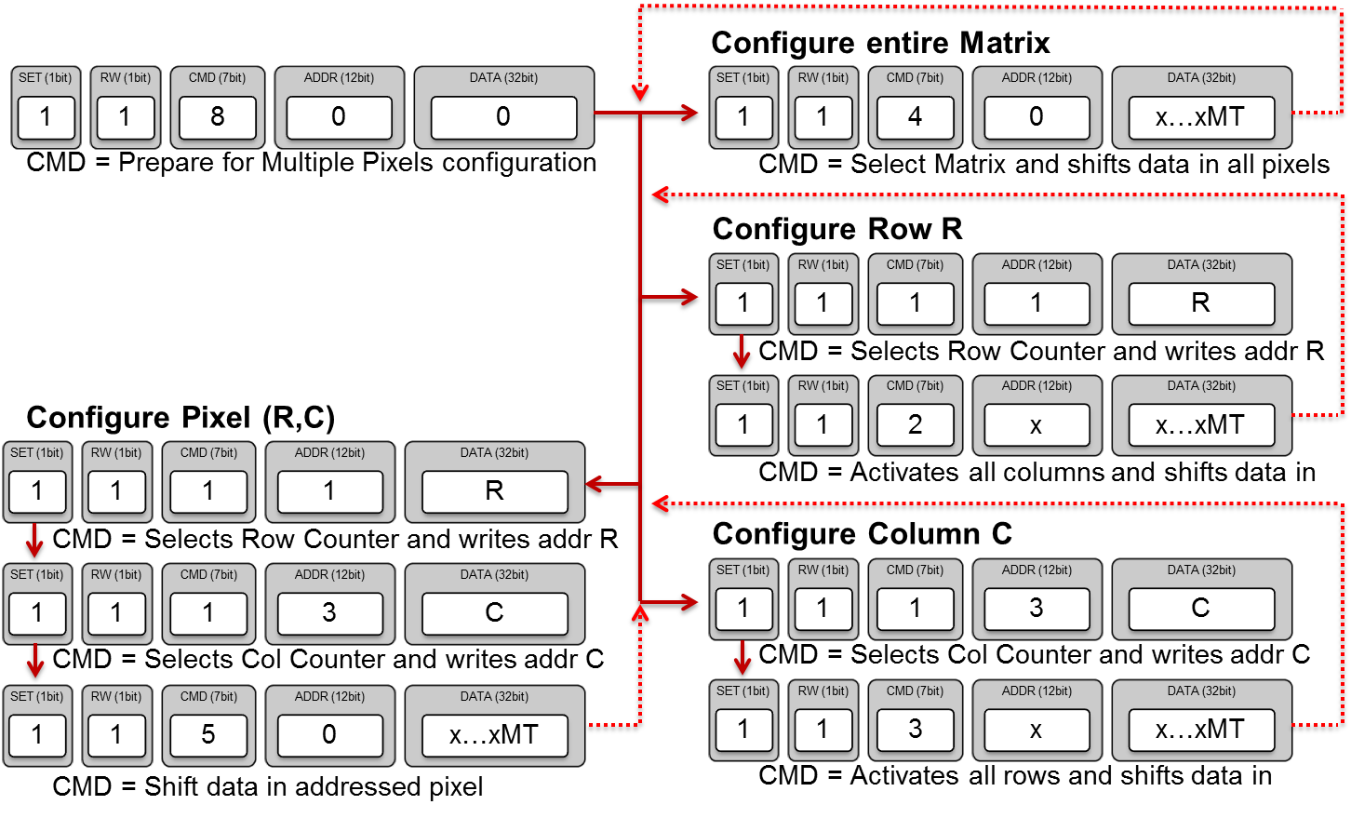
Pixels Configuration
Matrix configuration time pixel by pixel is: 110ms
SET (1bit)
1
RW (1bit)
0
CMD (7bit)
8
ADDR (12bit)
0
DATA (32bit)
0
CMD = End Configuration

Slide 12
Global Register Map
The registry store the ASIC configuration settings needed for the DACs and the control unit.
Radiation tolerant register.
Set the initial condition to guarantee correct DACs and control unit settings using the global reset signal (GR).

Slide 13
Global Registers Configuration
- WRITE Configuration Registers:
SET (1bit)
1
RW (1bit)
1
CMD (7bit)
1
ADDR (12bit)
ADDR
DATA (32bit)
DATA
- READ Configuration Registers:
SET (1bit)
1
RW (1bit)
0
CMD (7bit)
1
ADDR (12bit)
ADDR
DATA (32bit)
x

Slide 14
Column and Row Selection Register
Row Selection Register
Column Selection Register
7 bits row register and 5 bits column register that store row and column pointers.

Slide 15
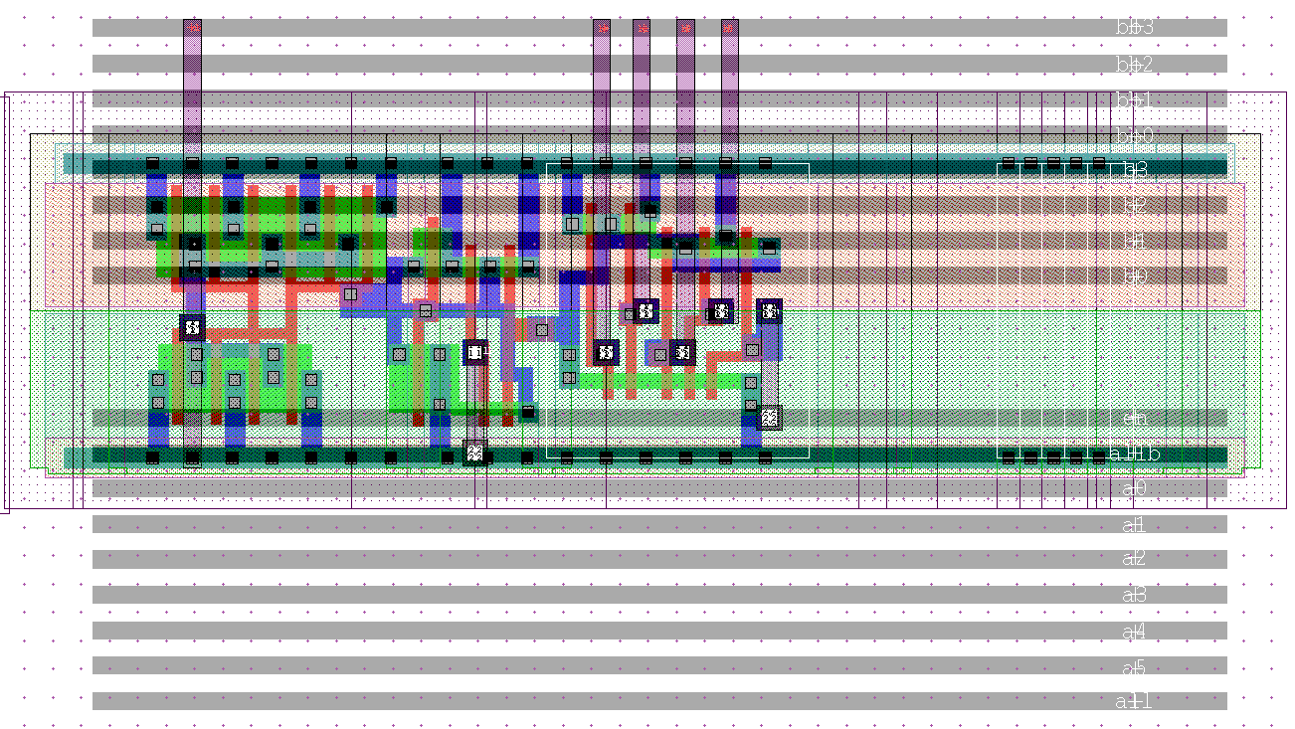
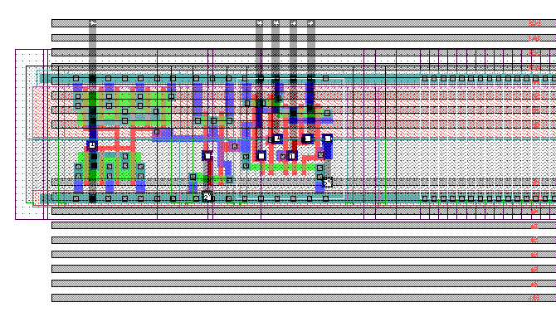
Column and Row decoders
Row decoders
Column decoders
Decode the digital word coming from the row and column selection register in 1 hot digital output.
Allow single row, single column or matrix configuration.
Row decoder is synchronous with the CCKpix clock.

Slide 16
Databus buffer chain
Trim DAC (4b) + Calibration (1b) + Masking (1b)
Column Decoder (5 bits Input– 1 Hot Output)
Column Decoder (5 bits Input– 1 Hot Output)
128 x 32
5bit
Half Comparator
1bit
Hit Encoder
colReg
5bits
SACI
Control Logic
Row Decoder (7 bits Input– 1 Hot Output)
rowReg
7bits
rowSel
clk
and
x128

