Slide 1
CHESS2 architecture

Slide 2
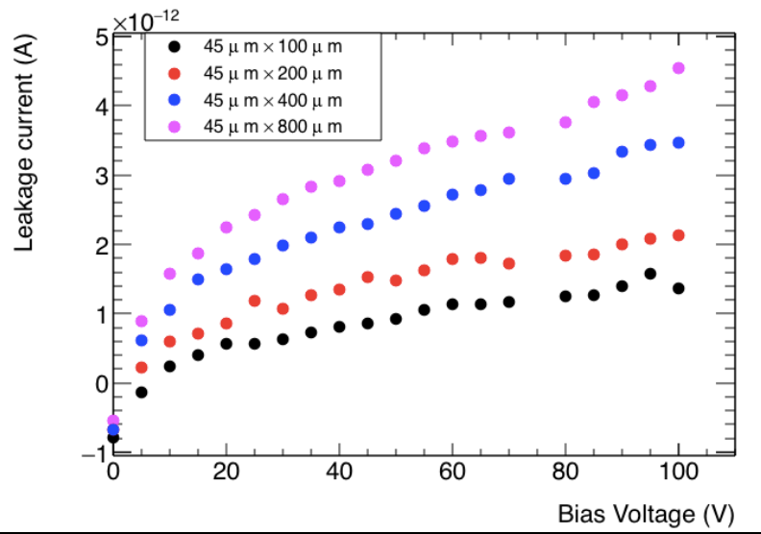
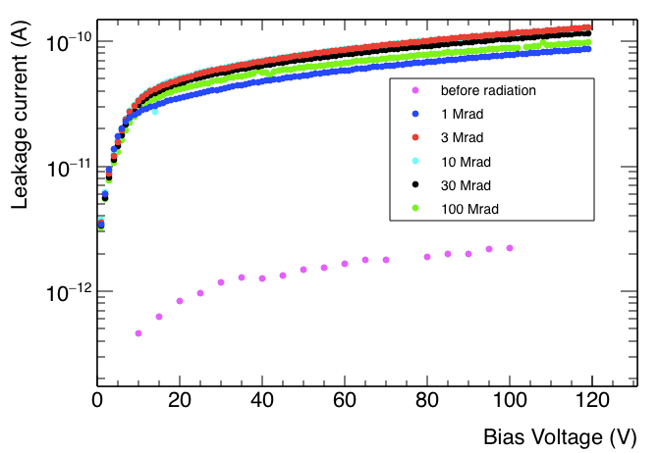
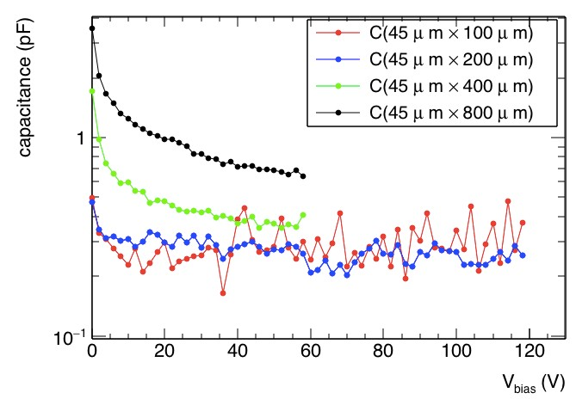
From CHESS1
Leakage current and detector capacitance has been measured [UCSC] using probe stations.
Isolated amplifiers have been measured [UCSC] using a DIY board.

Slide 3
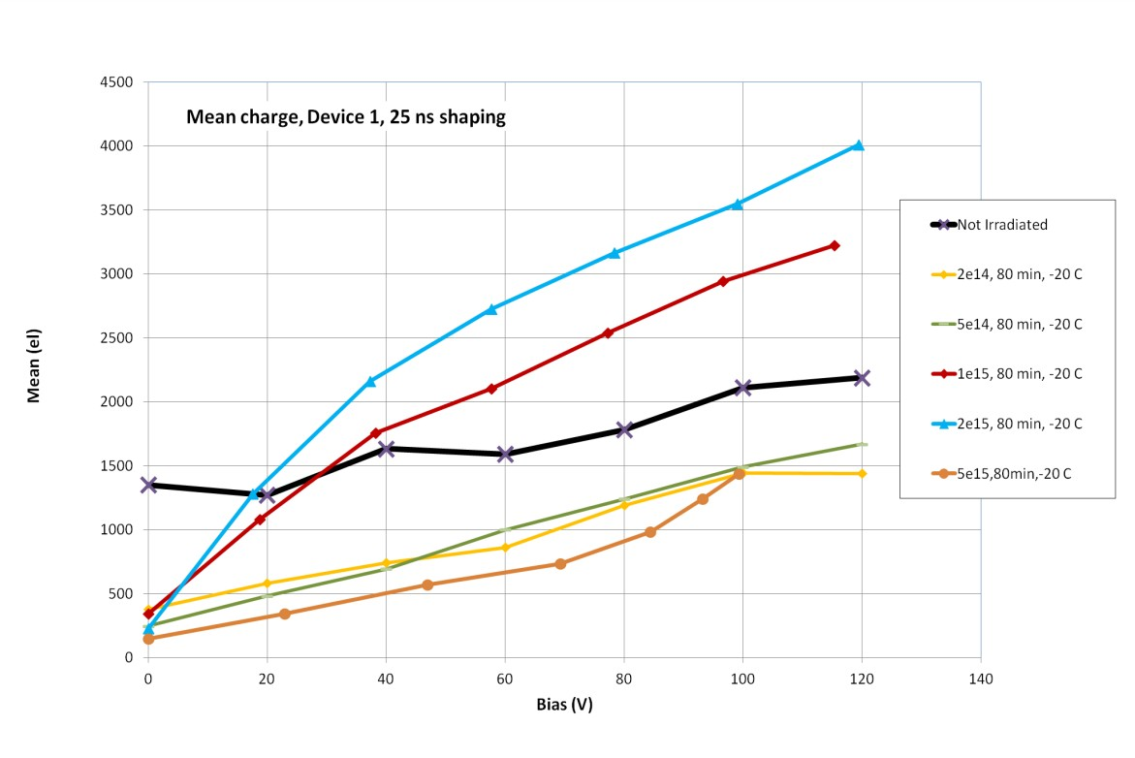
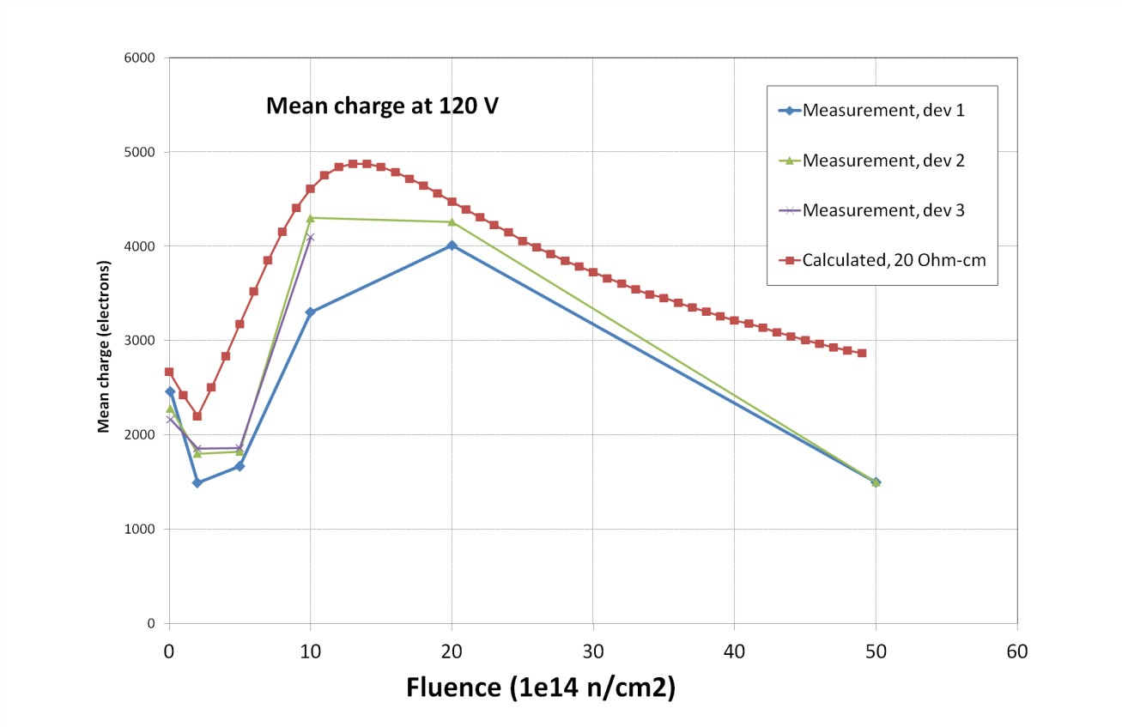
From CHESS1
Charge collection efficiency has been measured under irradiation [Igor Mandić Ljubljana]
Sr-90 electrons, mean charge, 25 ns shaping

Slide 4
Objective of CHESS2
Demonstrate HVCMOS as a viable solution for ATLAS strip detector.
Record hits on full reticle sensor
Amplify and discriminate signal
Encode hit position in sensor and send to external readout electronics
Further investigate performances of HVCMOS MAPS sensors
Evaluate sensors performances with different substrate resistivity 20, 100, 1000 Ohms.
Verify radiation hardness using test structures.
Characterize the detector with edge-TCT structure and passive pixels arrays.

Slide 5
HV-CMOS Monolithic Active Sensors
-HV
External amplifier
Drift
-
+
Full depletion
-
+
+
-
-
+
+
-
-
+
STRIP Baseline
-HV
Drift
In strip amplifier
Deep nwell
-
+
-
+
+
-
depletion
-
+
+
-
STRIP HVCMOS
-
+

Slide 6
Strip sensor dimensions
800µm
128
strip
40µm
32 pixels in a strip

Slide 7
Specifications
Substrate resistivity | 20Ohms to 1000Ohms
Substrate high voltage bias | 120V
Pixel size | 40µm x ~800µm
Number of pixel per strip | 32
Number of strips | 128
Timing resolution | 25ns
Maximum number of hits per strip | 1 + flag
Maximum number of hits per 128 strips | 8
Readout speed | 320MHz
Additional contraint | Radhard design

Slide 8
CHESS2 architecture
6b
Trim DAC (4b) + Calibration (1b) + Masking (1b)
Column Decoder (5 bits Input– 1 Hot Output)
Column Decoder (5 bits Input– 1 Hot Output)
128 x 32
pixels
Half Comparator,
Latch & Hit encoding
Strip Encoder
colReg
5bits
Global DACs
LVDS
SACI
…
Control Logic
Row Decoder (7 bits Input– 1 Hot Output)
LVDS
rowReg
7bits
PADS
PADS
rowSel
clk
Doesn’t reflect actual size or placement

Slide 9
List of programmable possibilities
In pixel:
Configure a single pixel – configure all pixel in a row – configure all pixel in a column
Configure signal injection for each pixel [RAM]
Adjust threshold for each pixel [RAM]
Periphery
Mask the comparator output for each pixel [RAM]
External Reset signal to all comparators
SACI global control
Adjust the amplifier bias
Adjust the comparator bias
Adjust the threshold level
Adjust the LVDS power consumption
Adjust the LVDS levels and common mode
Adjust parameters in the encoding and readout blocks.

