Slide 1
CHESS2 Hit Encoding
Design SLAC – UCSC – KIT

Slide 2
CHESS2 pixels
Injection
IFB
RowENB
RAMWrEn
ColENB
3.3
1.8
Th
1/2
Load
Casc
1/2/4/8
Comp
InSF
In

Slide 3
CHESS periphery
Kill sig.
HitPrev
HitNext
Hard coded pixel address
Reset
1/2
5 bit hit address
Sel
1 bit hit to encoding
Hit Latch
Ck
Hit Flag Logic
1 bit hit flag
RowENB
RAMWrEn
ColENB
x32
Comparator latching
Hit encoding

Slide 4
Periphery floor plan
32 lines
32 lines
5 lines
5 lines
pixels
latch
encoding
Data synch.
To Strip
encoding
Latching and encoding can’t be done physically at the same location or we would need 32 + 5 line across 40µm which is not feasible.
The comparator latching/masking is done separately from the hit encoding in the strip.
The encoding cell can accommodate for 5 more lines to the periphery.
At the end of the encoding the data is resynchronized to the strip encoding block.

Slide 5
Dynamic Hit Latching
Dynamic comparator output resynchronization on the 25ns clock.
25ns clock pumping: no high Z node for more than 12.5ns.
Comp
Ck
Ck
Ck
Comp
Comp synch
with Ck
½ Ck
delay
NAND

Slide 6
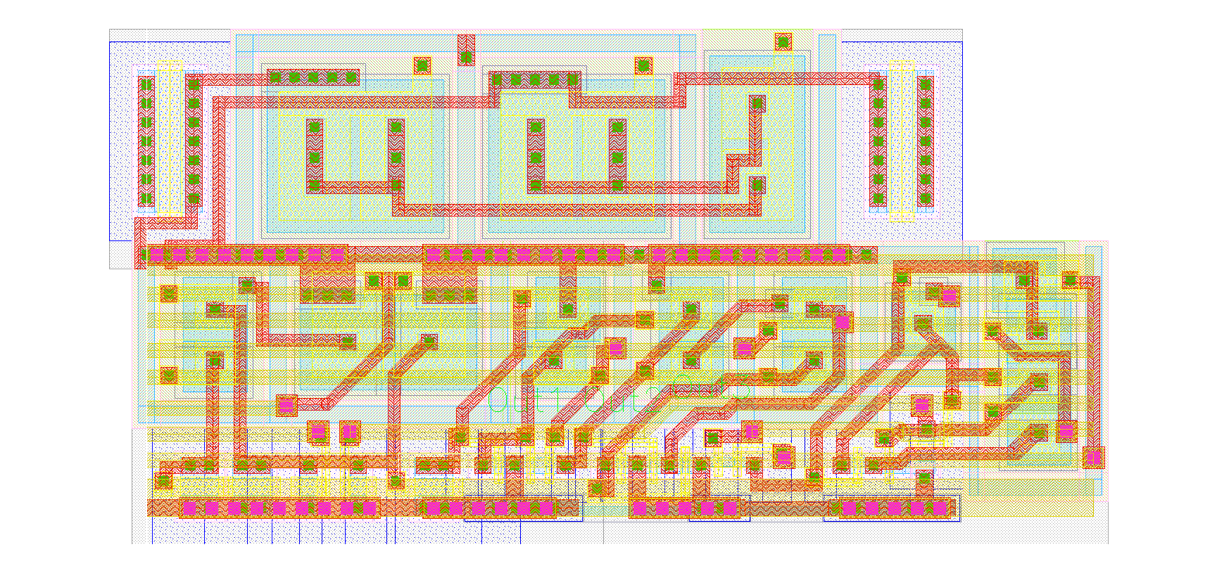
Comparator latch layout
Completely RadHard design.
10.7µm pitch: 32x10.7 ~340µm for comparator latching and masking.
8.95µm pitch for the half comparator.
Layout as compact as possible: no additional Metal for connection can be used.
Without the ½ comparator can be directly re-use for the pixel with full comparator.
Comparator 2nd stage
Hit latching
RAM
½ Comparator

Slide 7
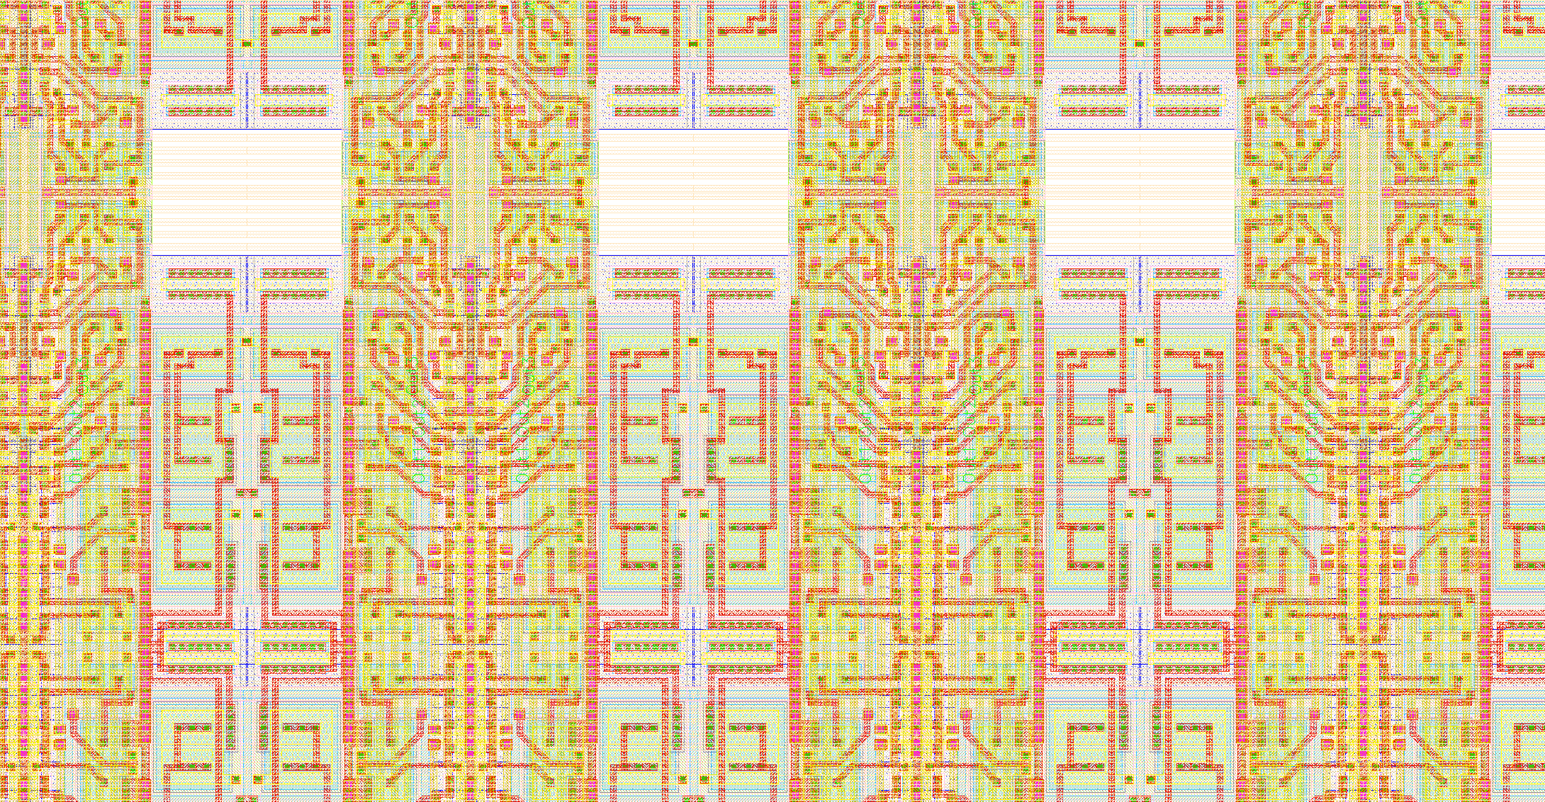
Complexity of the latching layout
Metal 1 use for interconnection
Metal 2 vertical for biasing
Metal 3 fully occupied by 32 lines
Metal 4 power supplies.

Slide 8
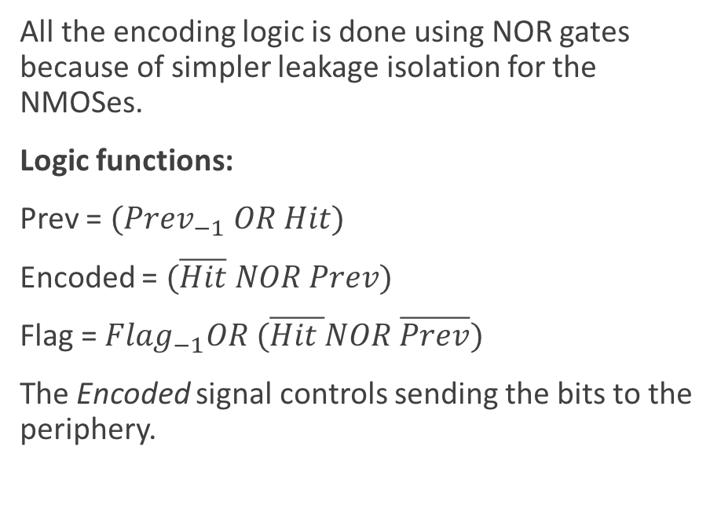
Principle behind Hit encoding in the strip
Hit | Prev | Encoded | Flag
0 | 0 | 0 | 0
0 | 0 | 0 | 0
0 | 0 | 0 | 0
0 | 0 | 0 | 0
1 | 0 | 1 | 0
0 | 1 | 0 | 0
0 | 1 | 0 | 0
0 | 1 | 0 | 0
1 | 1 | 0 | 1
1 | 1 | 0 | 1
0 | 1 | 0 | 1
All the encoding logic is done using NOR gates because of simpler leakage isolation for the NMOSes.
Logic functions:
Prev = $({Prev}_{−1} OR Hit)$
Encoded = $(\overline{Hit} NOR Prev)$
Flag = ${Flag}_{−1}OR (\overline{Hit }NOR \overline{Prev})$
The Encoded signal controls sending the bits to the periphery.

Slide 9
CHESS periphery
Kill sig.
HitPrev
HitNext
Hard coded pixel address
Reset
1/2
5 bit hit address
Sel
1 bit hit to encoding
Hit Latch
Ck
Hit Flag Logic
1 bit hit flag
RowENB
RAMWrEn
ColENB
x32

Slide 10
Hit Flag Logic
Simple asynchronous propagating logic to raise the Flag in case of additional hit in the strip.
Schematic has been optimized to use a minimum of NMOS as they require more space.
Not a dynamic cell: no high Z nodes.
Both encoding and flag raising is completed in less than 6ns.
FlagPrev
HitPrevN
CompN
FlagPrev
FlagNext
HitPrevN
Flag raising logic
Flag propagation

Slide 11
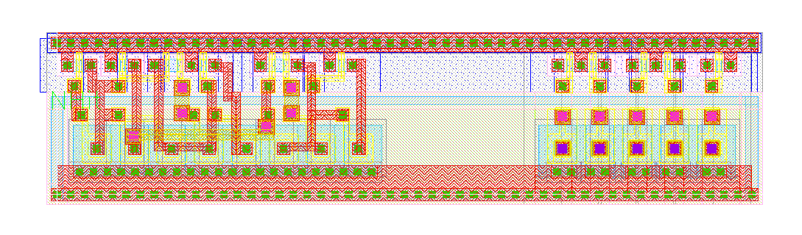
Hit encoding layout
Free space for routing
Of encoded values
RadHard Encoding logic
Hard coded pixel address

