Slide 1
Test structures in CHESS2

Slide 2
List of the test structures
Passsive pixel array 800µm 50%.
one without guardring.
Passive pixel array 200µm.
Edge TCT 800µm.
Large passive array.
7 stand alone amplifier.
Isolated transistor, cap, res
Latchup test strcuture (TO BE DEFINED)
HV switch
3*128strip on edge - no spacing between the 2 arrays. + dicing street one the isolated one.
LVDS small swing receiver connected to transmitter. on opposite ends.
Huge NWELL

Slide 3
Pixel 800µm 50 %
Pixel with contact
Pixel without contact

Slide 4
Pixel 800µm Edge TCT

Slide 5
Passive pixel array 2x2mm

Slide 6
Standalone Amplifier
Cell to be done with new amplifier

Slide 7
Isolated CMOS, Res, Cap

Slide 8
120 MOSFET for HV switch

Slide 9
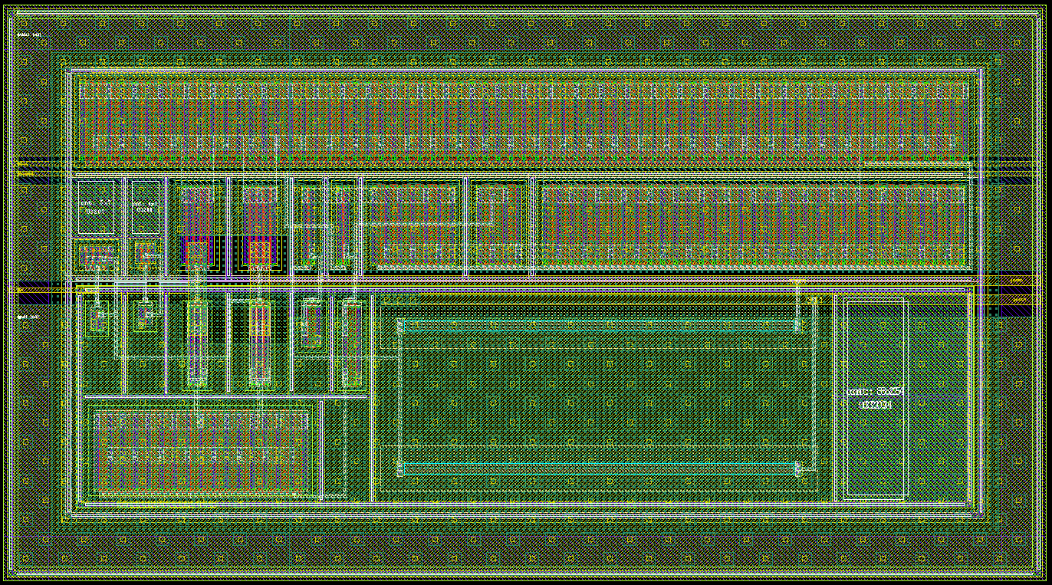
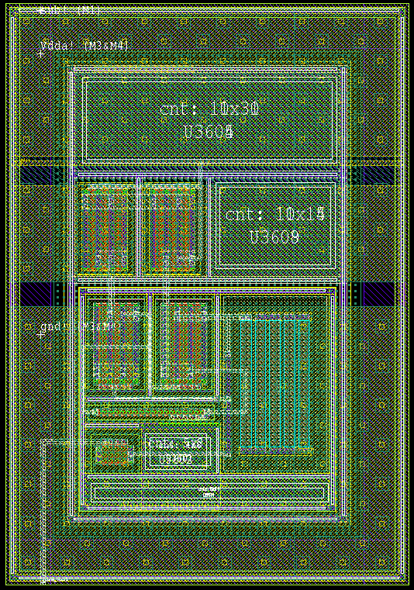
LVDS RX – TX
200µm
100µm
110µm
Out
Negative
Out
Positve
Bias Control
Common Mode Control
Pads Pitch
100µm
Shared Circuitry

Slide 10
Floorplan
Test structures here

