Slide 1
30 Juni 2015
L1 Inbetriebnahme. Aktueller Status.
BC1 Installation
Notes:
Before you start editing the slides of your talk change to the Master Slide view:
Menu button “View”, Master, Slide Master:
Edit the following 2 items in the 1st slide:
1) 1st row in the violet header:
Delete the existent text and write the title of your talk into this text field
2) The 2 rows in the footer area: Delete the text and write the information
regarding your talk (same as on the Title Slide) into this text field.
If you want to use more partner logos position them left
beside the DESY logo in the footer area
Close Master View

Slide 2
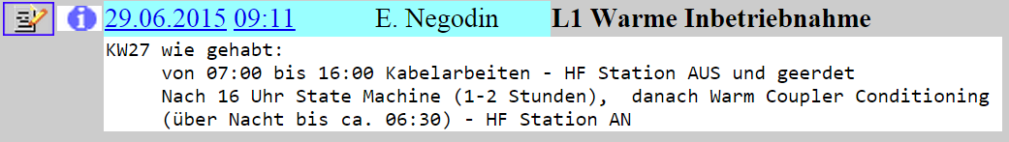
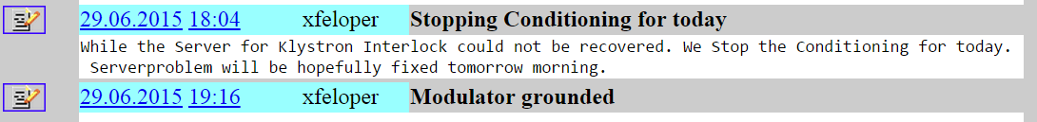
30 Juni 2015
L1 Inbetriebnahme
Notes:
Before you start editing the slides of your talk change to the Master Slide view:
Menu button “View”, Master, Slide Master:
Edit the following 2 items in the 1st slide:
1) 1st row in the violet header:
Delete the existent text and write the title of your talk into this text field
2) The 2 rows in the footer area: Delete the text and write the information
regarding your talk (same as on the Title Slide) into this text field.
If you want to use more partner logos position them left
beside the DESY logo in the footer area
Close Master View

Slide 3
30 Juni 2015
BC1 Installation
Steine
Racks
LWL
Wasser
Strom
Beleuchtung, Steckdosen, Klemmkasten, Schienen, …
Ethernet
Verkabelung
Notes:
Before you start editing the slides of your talk change to the Master Slide view:
Menu button “View”, Master, Slide Master:
Edit the following 2 items in the 1st slide:
1) 1st row in the violet header:
Delete the existent text and write the title of your talk into this text field
2) The 2 rows in the footer area: Delete the text and write the information
regarding your talk (same as on the Title Slide) into this text field.
If you want to use more partner logos position them left
beside the DESY logo in the footer area
Close Master View

Slide 4
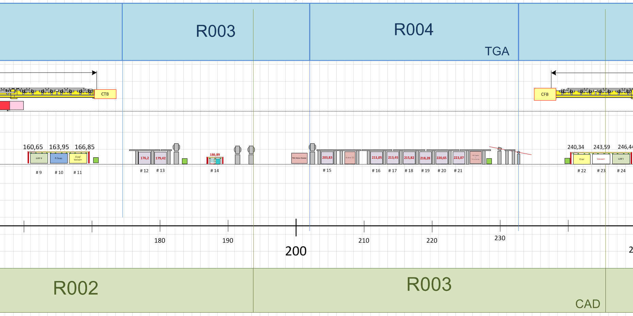
BC1
Bodenplatte ohne Mannloch
Bodenplatte mit Kernbohrung
Pumpstand

Slide 5
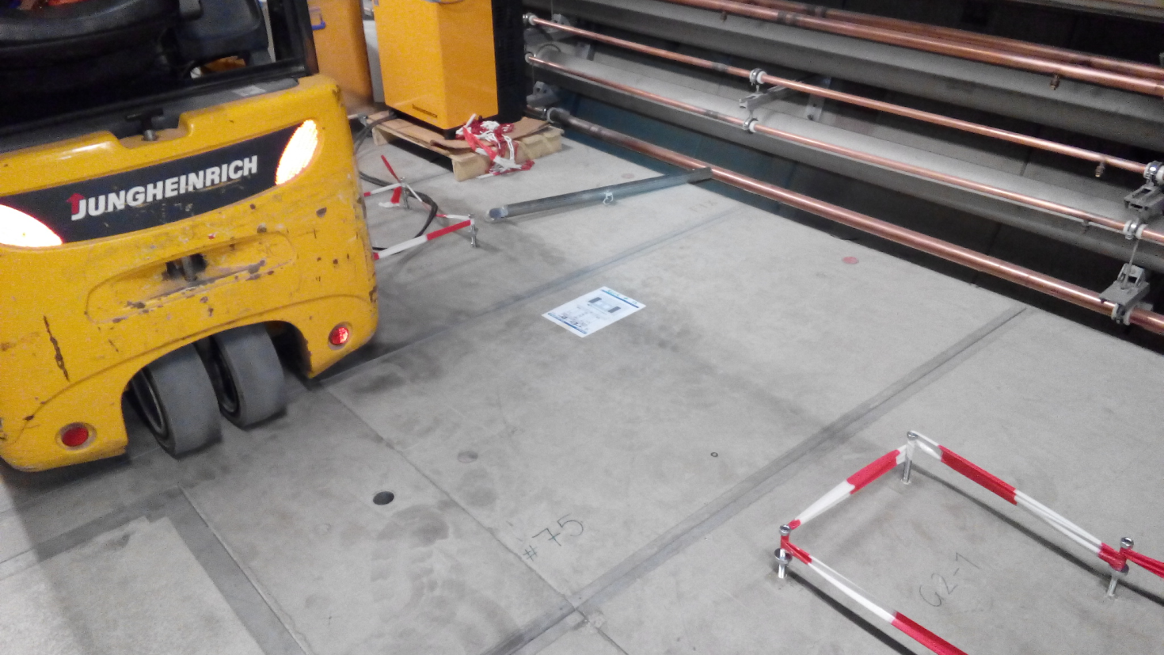
BC1

Slide 6
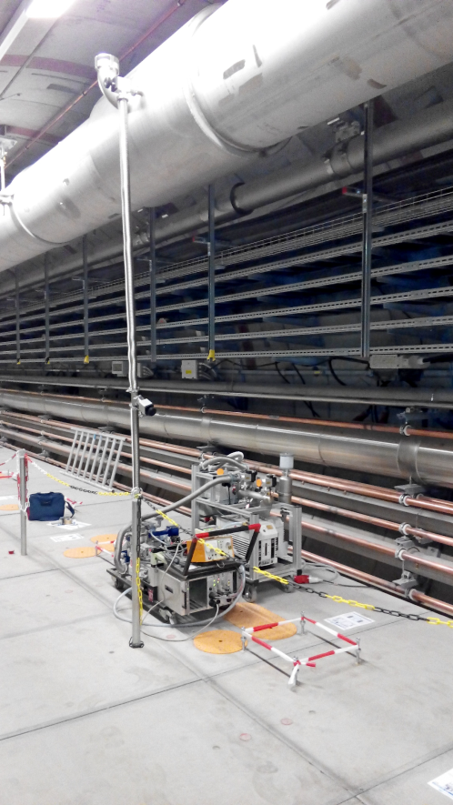
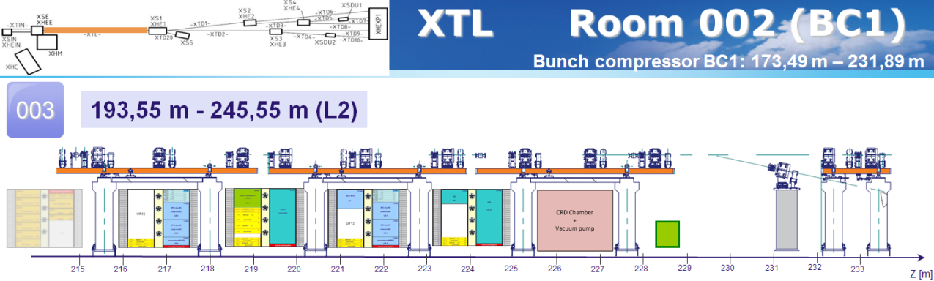
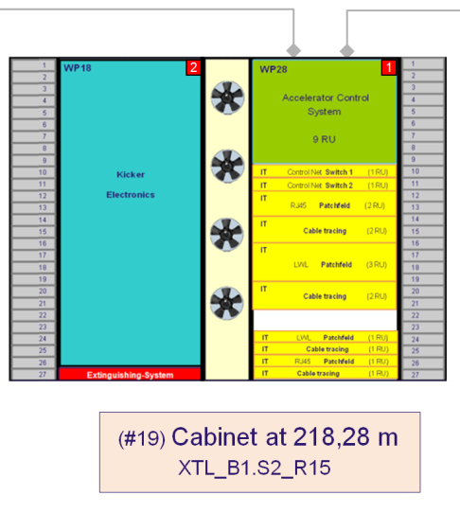
BC1

Slide 7

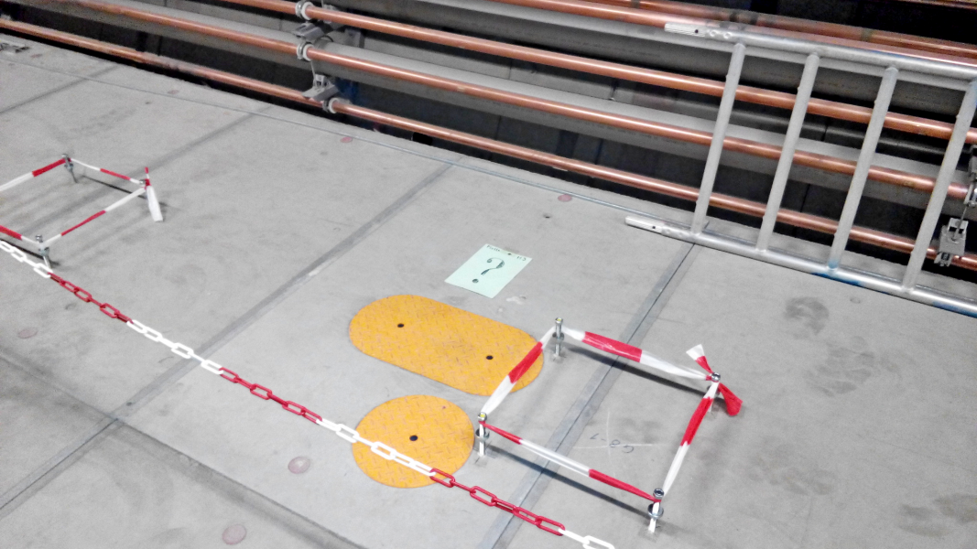
BC1

Slide 8
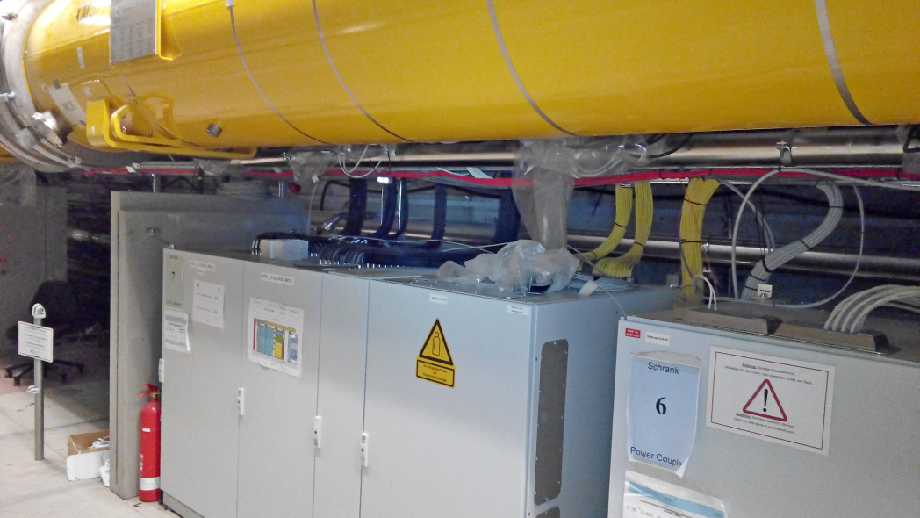
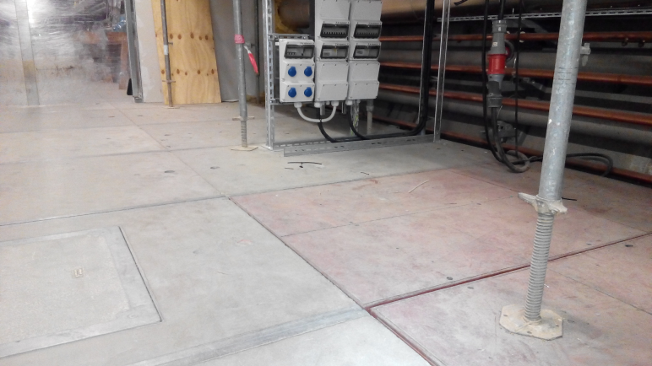
L1
Aufräumen / Fegen / Absaugen
Abschirmsteine
Abstandhaltern

Slide 9
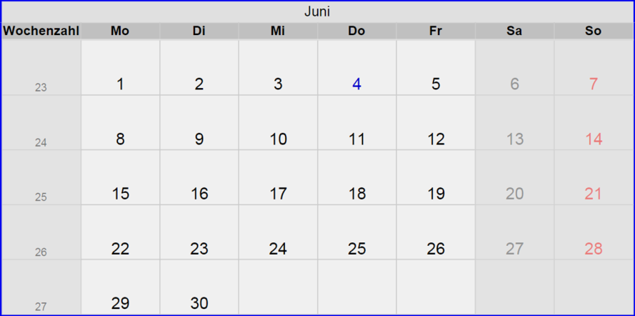
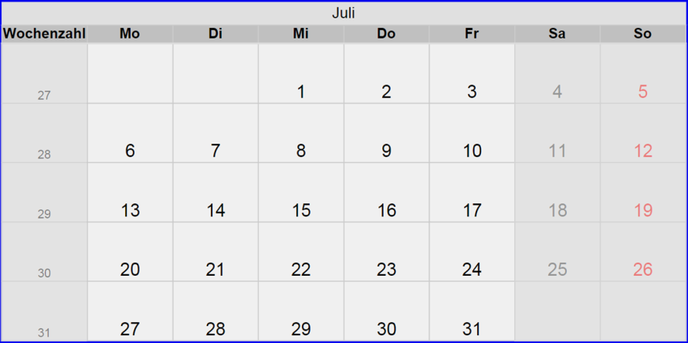

Slide 10
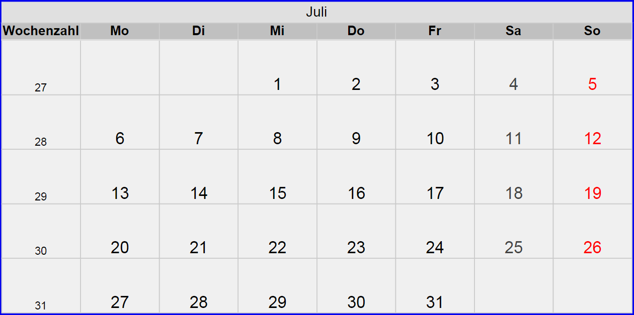

Slide 11
Status Montage: Modul- und RF-Stationen

Slide 12
BC1

Slide 13
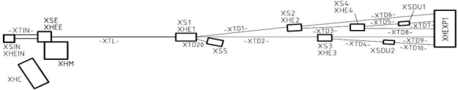
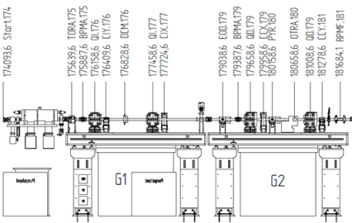

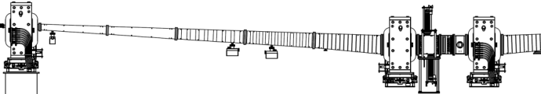




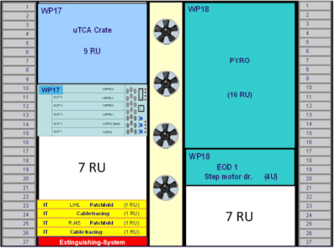
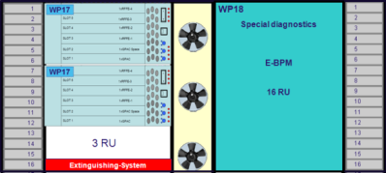
XTL Room 002 (BC1)
Bunch compressor BC1: 173,49 m – 231,89 m
002
141,55 m - 193,55 m (L1)
G1
G2
170
171
172
173
174
175
176
177
178
179
180
181
182
183
184
185
186
187
188
189
190
191
192
193
194
195
Z [m]
2
1
2
1
2
1
Elektrant 1
184,00 m
(#12) Cabinet at 176,2m
XTL_B1.S1_R02
(#13) Cabinet at 179,42 m
XTL_B1.S1_R05
(#14) Cabinet at 186,89 m
XTL_B1.S1_R12

Slide 14



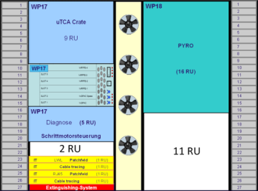
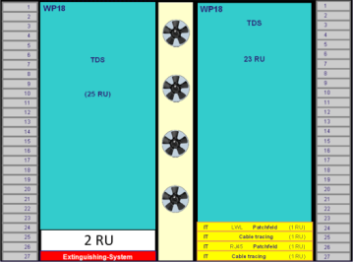
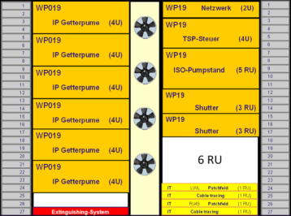




XTL Room 002 (BC1)
Bunch compressor BC1: 173,49 m – 231,89 m
003
193,55 m - 245,55 m (L2)
G3
G4
G5
196
197
198
199
200
201
202
203
204
205
206
207
208
209
210
211
212
213
214
215
Z [m]
2
1
2
1
2
1
(#15) Cabinet at 203,83 m
XTL_B1.S2_R01
(#16) Cabinet at 211,05 m
XTL_B1.S2_R08
(#17) Cabinet at 213,45 m
XTL_B1.S2_R10

Slide 15
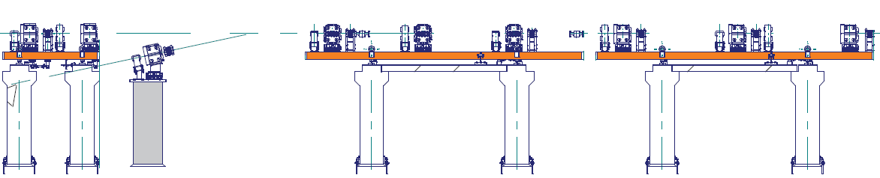
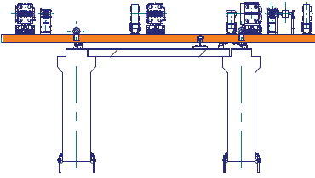





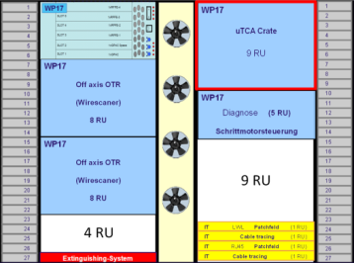
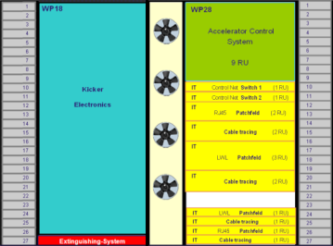
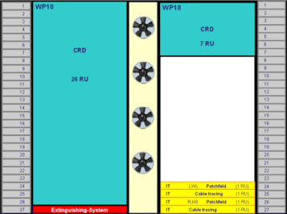
XTL Room 002 (BC1)
Bunch compressor BC1: 173,49 m – 231,89 m
003
193,55 m - 245,55 m (L2)
215
216
217
218
219
220
221
222
223
224
225
226
227
228
229
230
231
232
233
Z [m]
2
1
2
1
2
1
2
1
7 RU
(#18) Cabinet at 215,82 m
XTL_B1.S2_R12
(#19) Cabinet at 218,28 m
XTL_B1.S2_R15
(#20) Cabinet at 220,65m
XTL_B1.S2_R17
(#21) Cabinet at 223,07 m
XTL_B1.S2_R20
Elektrant 2
228 m

Slide 16

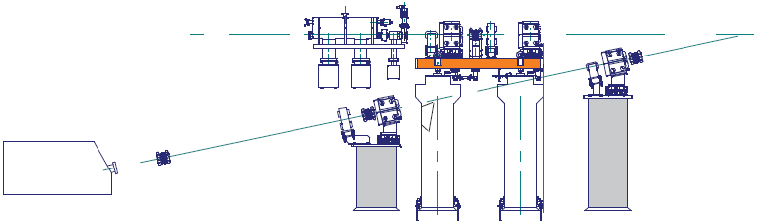
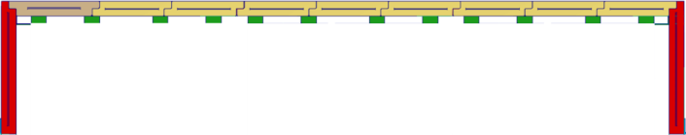
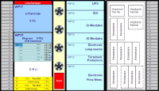
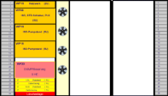
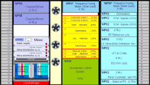
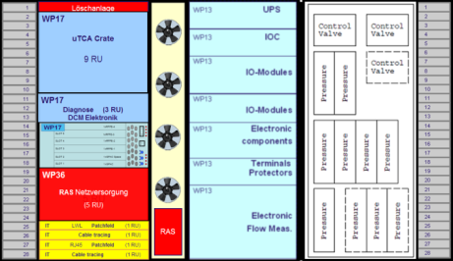
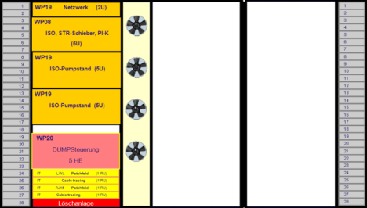
XTL Room 003
003
193,55 m - 245,55 m (L2)
CFB
A3
229
230
231
232
233
234
235
236
237
238
239
240
241
242
243
244
245
246
247
248
Z [m]
240,339
243,589
249,339
3
2
1
3
2
1
Elektrant 1
242,7 m
(#22) Cryo at 240,339 m
XTL_L2.A3_R02
(#23) Vacuum at 243,589 m
XTL_L2.A3_R05

