Slide 1
Optimizing the built-in amplifier in HV-CMOS CHESS1
Vitaliy Fadeyev, Zach Galloway , Herve Grabas
Alexander Grillo , Zhijun Liang , Abe Seiden
Jennifer Volk, Forest Martinez-Mckinney
University of California, Santa Cruz

Slide 2
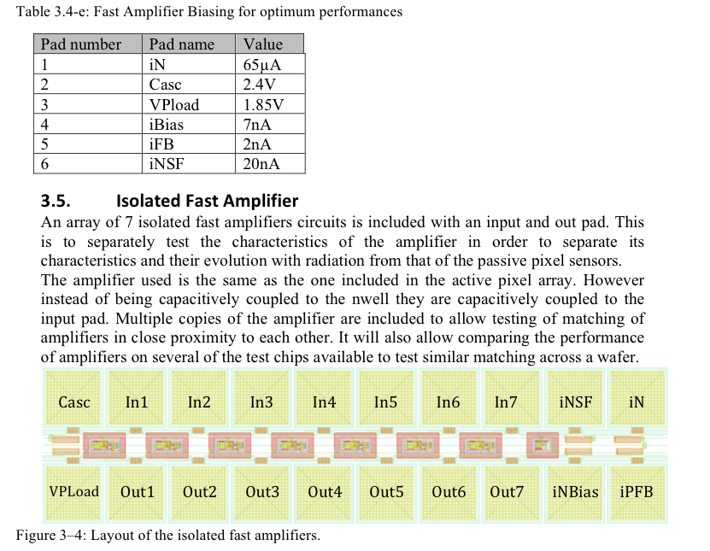
Isolated amplifier in CHESS1 chip
HV-CMOS CHESS1 chip has built-in isolated amplifiers
designed to optimize amplifier performance
Six amplifier biasing control
Optimization can be done with pulser, without using laser injection or beta source.
Change its gain and output signal shape by changing biasing control
Try to study the amplifier performance as input to CHESS2 design

Slide 3
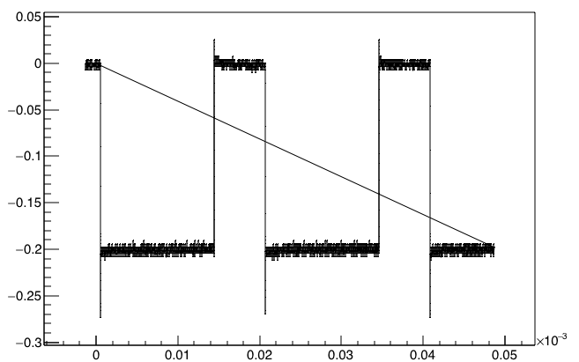
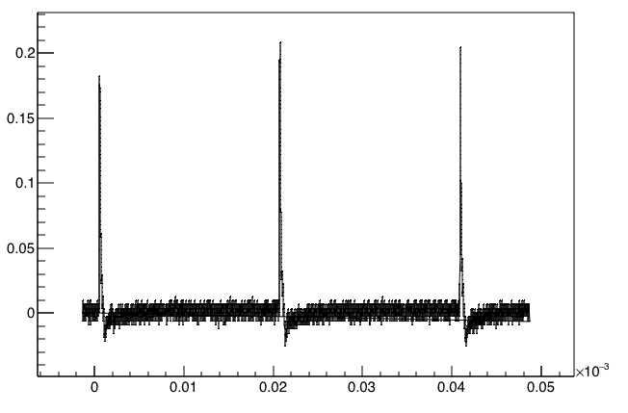
Setup to test amplifier performance
Voltage (V)
Pulser
Voltage source
Input pulse
50fF coupling capacitance
Isolated Amplifier on CHESS1 chip
3.3V bias for amplifier
Amplifier output
Falling edge
Voltage (V)
Source follower
Scope
Time (s)

Slide 4
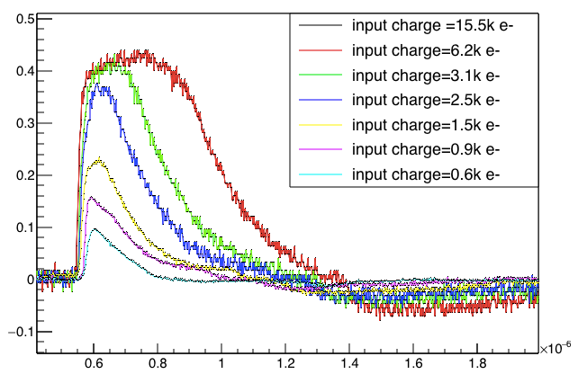
Reminder of the output from CMOS amplifier (from last update)

Slide 5
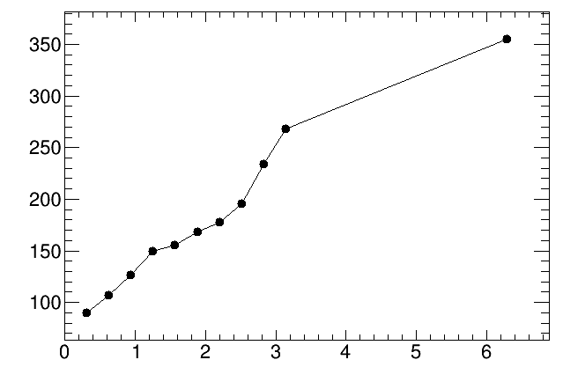
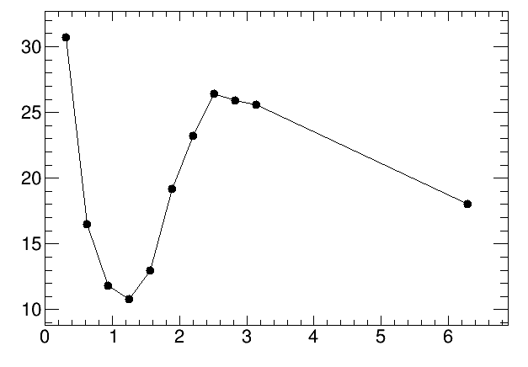
Amplifier output signal rise time (from last update)
Rise time : 10~30 ns depending on signal size
Full width at half maximum is from 80ns ~360ns depending on signal size.
Jitter dominated region ?
Significant background contribution
Rise time (ns)
FWHM(ns)
Signal Time walk ?
Input charge (k e-)
Input charge (k e-)

Slide 6
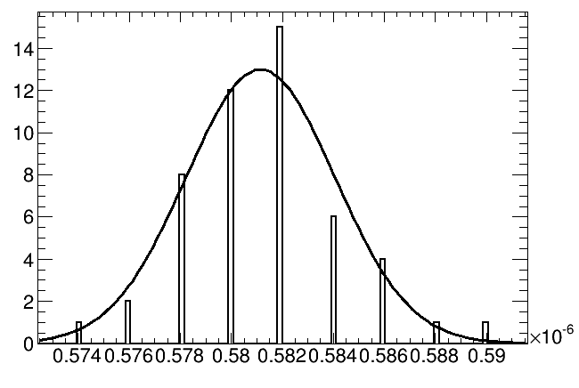
Timing distribution at a fixed threshold example 1:
Output Threshold =0.05V
Input charge =0.6 k e-
Number of events
Threshold
Time (ns)

Slide 7
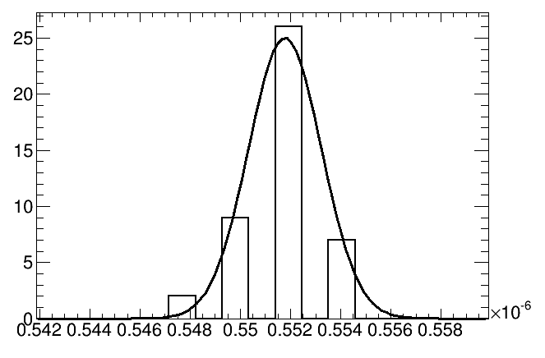
Timing distribution at a fixed threshold example 2:
Output Threshold =0.05V
Input charge =3.1 k e-
Threshold
Number of events
Time (ns)

Slide 8
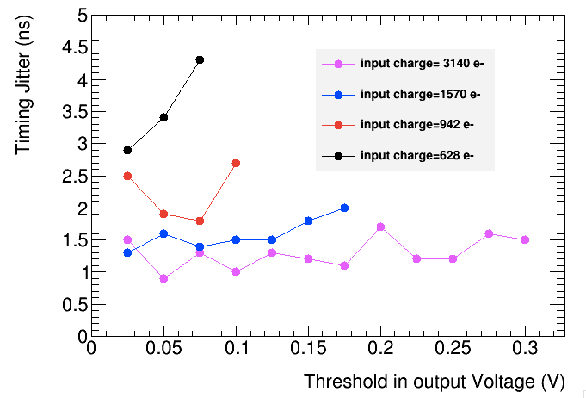
Timing jitter Vs output threshold
Larger jitter for smaller input charge (as expected )

Slide 9
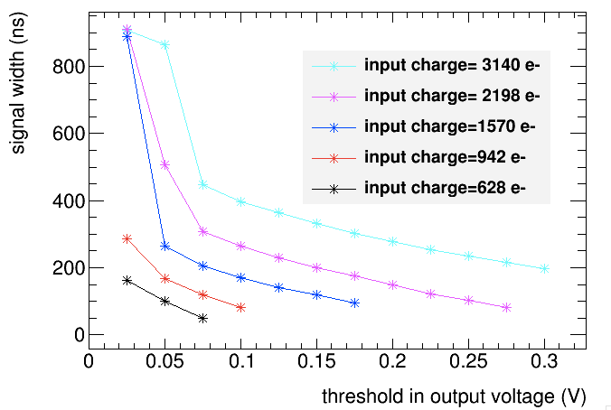
Signal width Vs Threshold

Slide 10
summary
Timing Jitter of the amplifier has been measured.
Less than 5ns
Larger jitter for smaller input charge (as expected )

