Slide 1
Integration of CMOS sensors into the detector
Sensors are one element of the tacker, the other components also require years of R and D to optimise.
This cannot be undertaken, so vital to understand that any alternative sensor can be used with the already planned supporting systems.
There is some interaction between sensor/ASIC design and the module/stave/petal into which they are integrated. Electrical stability of system is not assured by stability of sensor.
Rely very heavily on lessons from planar work.

Slide 2
First year of the programme called for
“Furthermore, the impact on the physics is to be evaluated and the integration in the baseline design needs to be studied.”
The main effort on understanding integration into the mechanics comes in year-2
However it is important to ensure that the direction taken is consistent with being able to use the sensor in the detector
Layout
Modules
Mechanics
Services
Data
Power
Cooling
Peripheral Electronics
DC-DC
HCT
(ABCn’)
HV Switches
Physics impact has not been evaluated
explicitly.
CMOS sensor system has better
parameters and this is taken to mean
that the physics is not degraded, and
may be improved.
(X0, point sigma, …)

Slide 3
Parameter | Planar Sensor | StripCMOS Sensor
r-φ resolution | 20 µm – 23 µm | 11 µm
z-resolution | 850 µm | 280 µm
Two hit resolution in r-φ | 160 µm-240 µm | 80 µm
z-element length | 2.5 cm | 720 µm (2.4 cm / strip)
Fraction of two hit clusters | 15% - 20% | 2%-3%
Geometry inefficiency on stave | ~0.7% | ~1%
Radiation Lengths per stave | 1.8% | 1%
Insensitive crossings after a hit | 1 BC | 0.3 BC (1/32 of strip is dead for 10 bunch crossings)
Number of Signal Wire bonds | O(5100) | O(1100)
Planar values are mostly measured or engineering values
StripCMOS values are estimates. Assumptions are listed in the ‘layout document’.
Note that recent study showed a fifth pixel layer improved fake rate by 25%
These strip sensors are close to being pixel-like in resolution at 40x720μm.

Slide 4
Not altered significantly or at all
Layout
Modules
Mechanics
Services
Data
Power
Cooling
Peripheral Electronics
DC-DC
HCC
(ABCn’)
Switches
Concept consistent with existing mechanics
mounting etc.. different
Basically Unaltered [* fwd maybe]
Total volume reduced – format similar
Possible issue with cables – some increase in power
Probably higher, but consistent with
existing cooling system.
FEAST-2 suitable
Redesign for routing and packets
‘under consideration’
Unaltered
(assumes ganging)
Changed to all digital, but needs to be done
By construction, major issues of layout, support mechanics and peripheral electronics are rendered tractable by designing to use existing planar systems

Slide 5
Module Concept - Barrel
Barrel module
10cm x (2 x 2.1) active area
Sensors in ‘blocks’ of reticules
Single hybrid
10 ABCn’
HCC
DC/DC convertor
Mechanical support
Sensors possibly with duplicate pad sets

Slide 6
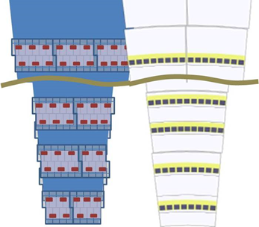
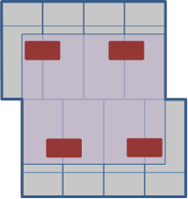
Module Concept - Forward
Barrel module is a special
case of a forward module (10-10)
A 4-4 module
2 x 4 reticule blocks
Final Details of sensor dimensions,
Strip pitch, dicing blocks
fixed by overall mechanical considerations forward+barrel in year-2 of programme

Slide 7
DC-DC convertors
Engineer suggested that re-laying out the geometry would be the design task and that FEAST2 is already capable of supplying the current and voltage needed for the electronics in a CMOS sensor + ABCn’. [but maybe multiple voltages, not evaluated]
HCC
This is being redesigned to allow L1 trigger. FA is aware of the possible different data payload with the CMOS system and is bearing it in mind during the redesign for the planar system.
Data
The data packets should be the same, but the payload different. An additional six bits per hit is required. However the total number of hits is reduced by about a factor of two. This because the probability of two hit clusters is higher in the planar design but clustering is employed to reduce the extra hit effect on data rates. Clustering is not planned for the stripCMOS system as two hit clusters are improbable. A net reduction in data rate is expected despite increased resolutions.
HV Switches
Largely unaltered, though wider range of materials could be used.

Slide 8
Major Mechanical/System Challenges
these are often schedule driven
Demonstrating large-scale electrical system stability
Detailed analysis of forward region mechanical implications
Total power consumption and power cables
Mechanical/System Challenges
Redesign of ASICs
Redesign of stave/petal tapes/EoS cards

Slide 9
First year goal was not to solve all the mechanical/system issues, but to consider if the design direction was at least consistent with a minimum impact scenario.
Claim is that this is the case.
Improbable that there is a design direction which could have less impact whilst retaining the potential advantages of stripCMOS

