Slide 1
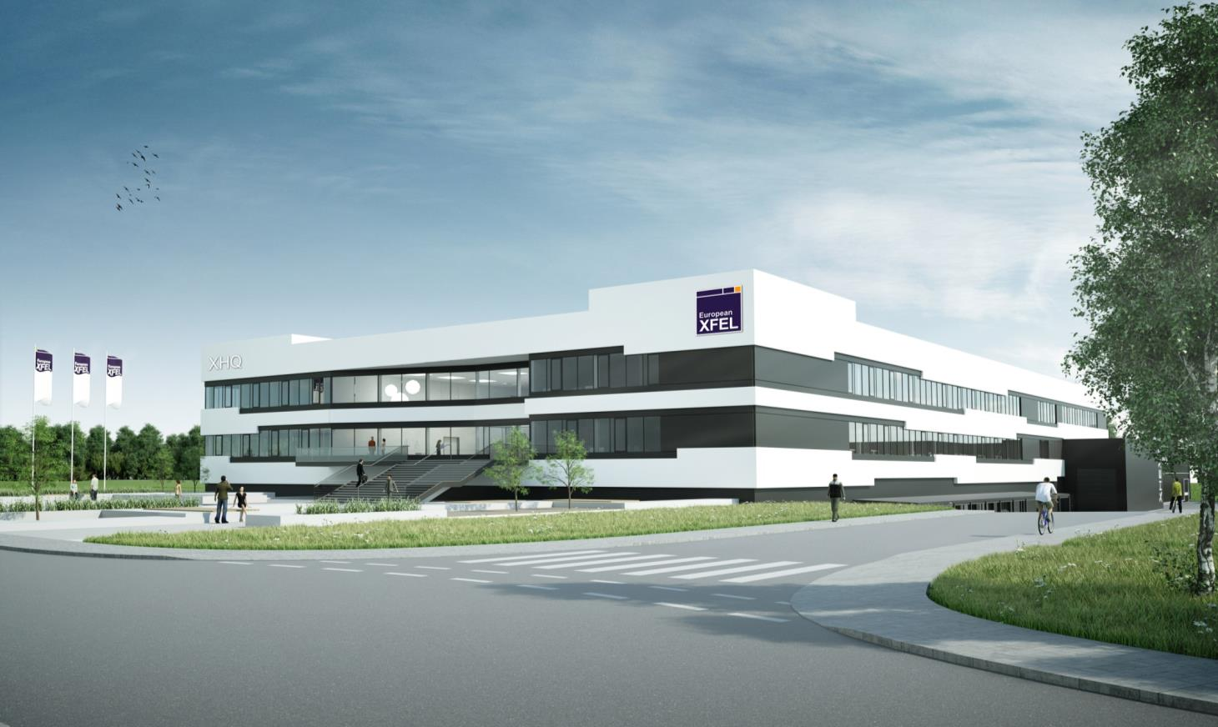
Detector Commissioning and Calibration
Markus Kuster
for WP75
XFEL Commissioning Meeting
DESY, Hamburg
July, 15 2015

Slide 2
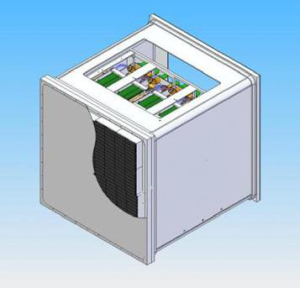
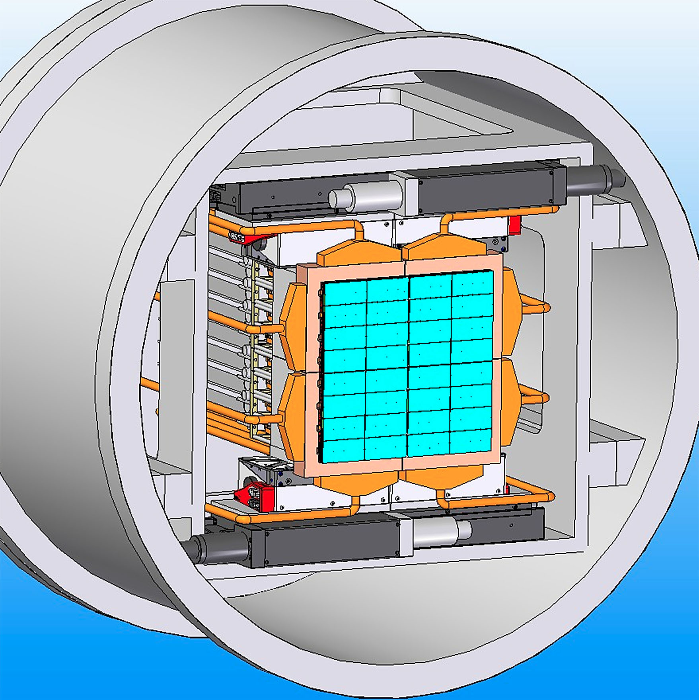
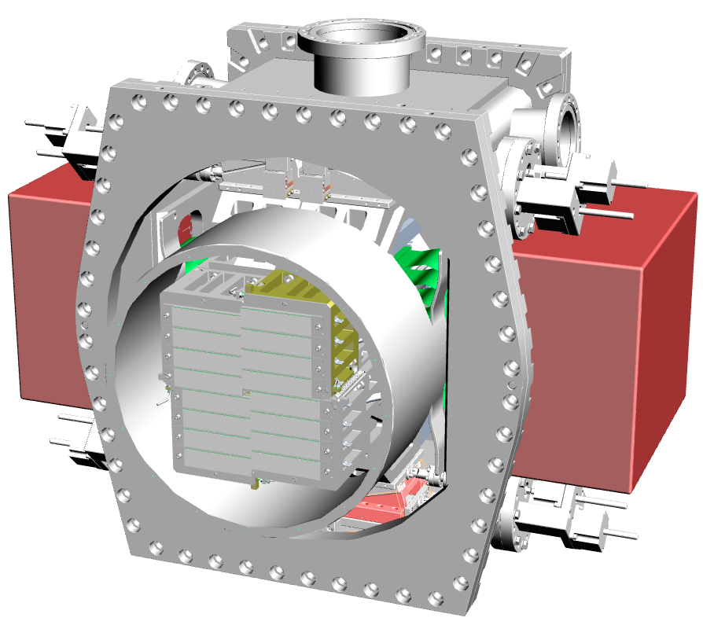
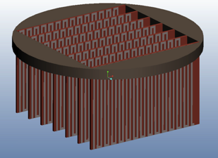
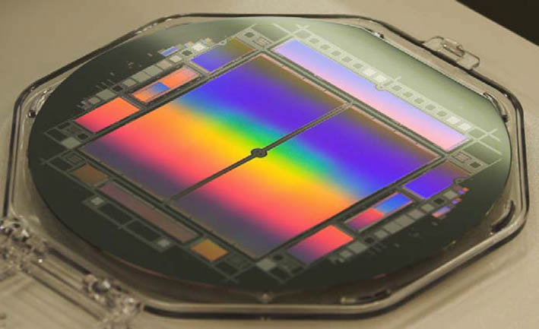
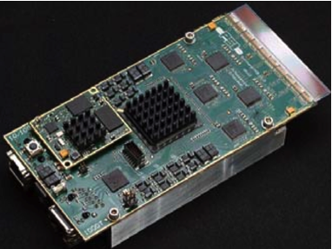
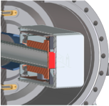
Detectors for the European XFEL
Pixel
Size
LPD
4.5 MHz
4.5 MHz
500 μm
DSSC
4.5 MHz
AGIPD
4.5 MHz
200 μm
pnCCD
MCP
Gotthard V2
FastCCD
4.5 MHz
4.5 MHz
75 μm
50 μm
30 μm
SASE 3 (0.25 – 3 keV)
SASE 1/2 (2.3 – 25 keV)
0.2
1.0
10
20
30
Energy [keV]
Notes:
Before you start editing the slides of your talk change to the Master Slide view: Menu button “View”, Master, Slide Master:
Edit the following 2 items in the 1st slide: 1) 1st row in the violet header: Delete the existent text and write the title of your talk into this text field 2) The 2 rows in the footer area: Delete the text and write the information regarding your talk (same as on the Title Slide) into this text field.
If you want to use more partner logos position them left beside the DESY logo in the footer area Close Master View

Slide 3
Detector Mapping to the Scientific Instruments at the European XFEL – “Primary Customer”
AGIPD
Single Particles,
Clusters and
Biomolecules (SPB)
Gotthard V2
Fast CCD
4.5 MHz
4.5 MHz
SASE 1
Gotthard V2
Materials Imaging &
Dynamics (MID)
AGIPD
4.5 MHz
4.5 MHz
High E
LPD
Gotthard V2
Gotthard V1
Femto Second X-ray
Experiments (FXE)
4.5 MHz
4.5 MHz
SASE 2
High Energy Density
Matter (HED)
Gotthard V2
4.5 MHz
DSSC
Fast CCD
Small Quantum Systems (SQS)
4.5 MHz
MCP
4.5 MHz
SASE 3
Low E
Fast CCD
Small pnCCD
Spectroscopy and Coherent
Scattering (SCS)
DSSC
MCP
4.5 MHz
4.5 MHz
Notes:
FXE:
will permit ultrafast pump-probe studies of solid and liquid samples, using different structural tools: X-ray absorption spectroscopies, requiring tunability of the incident monochromatic (E/E down to a few 10-5) radiation, X-ray emission spectroscopies (XES, RIXS, etc.), and X-ray diffraction (XRD) capabilities (WAXS, SAXS, Bragg) requiring both large (1 Mpx) and small (< 128 kpx) area detectors.
ultrafast studies of nuclear, charge, and spin dynamics; dynamics of solids and phase transitions, surface studies via X-ray reflectivity; dynamics of photoactive proteins; chemical dynamics in the solution phase including solvation dynamics
SQS:
The instrument will be suitable primarily for high-field applications, non-linear processes, and time-resolved pump-probe investigations. The instrument will be suitable primarily for high-field applications, non-linear processes, and time-resolved pump-probe investigations. For the investigation of multiple ionization and multiple-photon excitations, the fast relaxation of these core holes through Auger decay, which takes place on the femtosecond time scale, results in complex dynamics governing the sequential and direct ionization processes. Dynamics of atomic processes (e.g. inner shell dynamics).

Slide 4
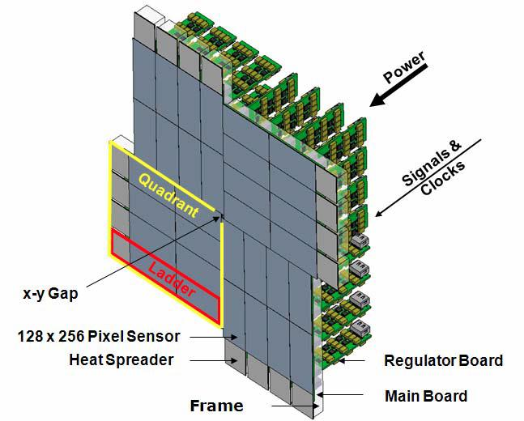
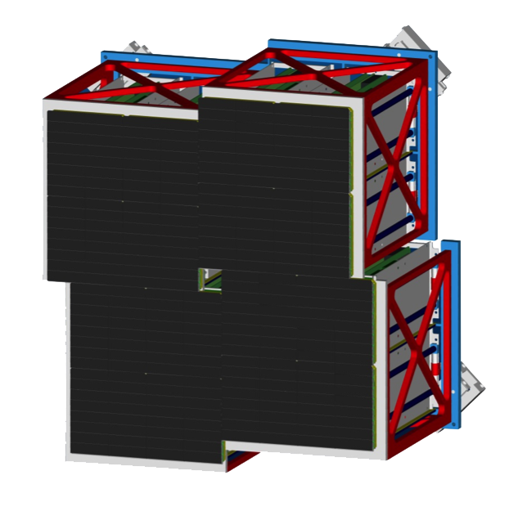
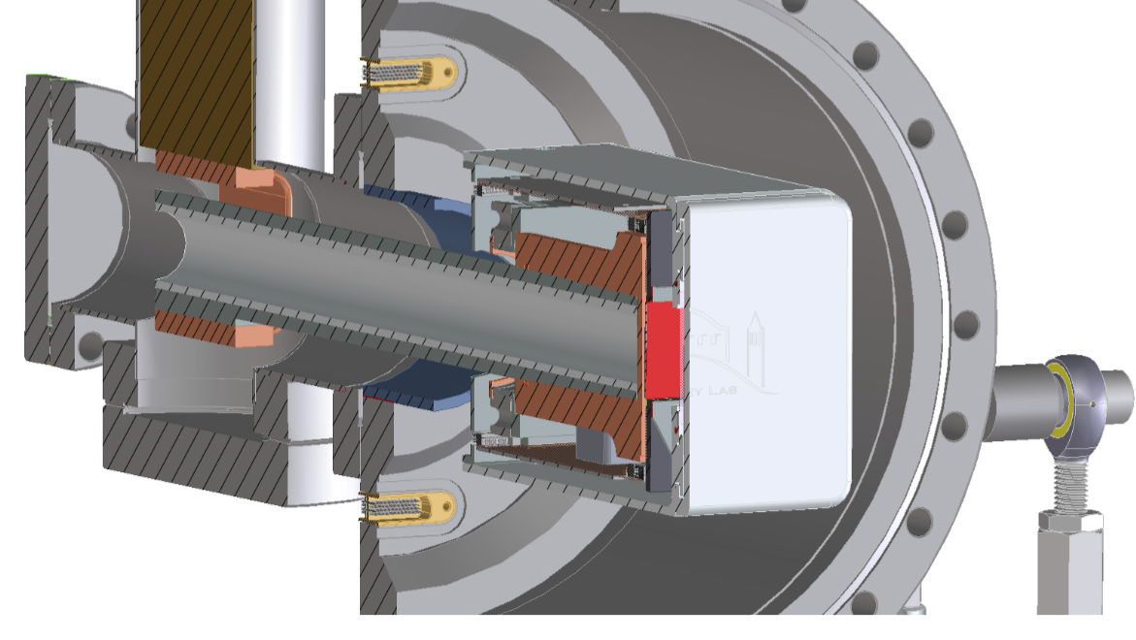
Detectors for Day One Operation at XFEL.EU
Adaptive Gain Integrating Pixel De-tector (AGIPD)
DePFET Sensor with Signal Compres-sion (DSSC)
4.5 MHz
4.5 MHz
Energy Range
3 – 13 (25) keV
Dynamic Range
10⁴ ph/px/pulse@12 keV
Single Photon Sens.
Yes
Memory ≈380 images
Pixel Size 200×200 μm²
Energy Range
0.5 – 6 (25) keV
Dynamic Range
6000 ph/px/pulse@1 keV
Single Photon Sens.
Yes
Memory ≈800 images
Pixel Size 236×236 μm²
Large Pixel Detector (LPD)
FastCCD
4.5 MHz
Energy Range
3 – 13 (25) keV
Dynamic Range
10⁵ ph/px/pulse@12 keV
Single Photon Sens.
Yes
Memory ≈512 images
Pixel Size 500×500 μm²
Energy Range
0.25 – 6 keV
Dynamic Range
≈360 ph/px/pulse@1 keV
Single Photon Sens.
Yes
Memory No
Pixel Size 30×30 μm²
Notes:
Before you start editing the slides of your talk change to the Master Slide view: Menu button “View”, Master, Slide Master:
Edit the following 2 items in the 1st slide: 1) 1st row in the violet header: Delete the existent text and write the title of your talk into this text field 2) The 2 rows in the footer area: Delete the text and write the information regarding your talk (same as on the Title Slide) into this text field.
If you want to use more partner logos position them left beside the DESY logo in the footer area Close Master View

Slide 5
Detectors for Day One Operation at XFEL.EU
5
Adaptive Gain Integrating Pixel De-tector (AGIPD)
DePFET Sensor with Signal Compres-sion (DSSC)
4.5 MHz
4.5 MHz
Energy Range
3 – 13 (25) keV
Dynamic Range
10⁴ ph/px/pulse@12 keV
Single Photon Sens.
Yes
Memory ≈380 images
Pixel Size 200×200 μm²
Energy Range
0.5 – 6 (25) keV
Dynamic Range
6000 ph/px/pulse@1 keV
Single Photon Sens.
Yes
Memory ≈800 images
Pixel Size 236×236 μm²
Large Pixel Detector (LPD)
Other Detectors
4.5 MHz
Energy Range
3 – 13 (25) keV
Dynamic Range
10⁵ ph/px/pulse@12 keV
Single Photon Sens.
Yes
Memory ≈512 images
Pixel Size 500×500 μm²
1D detectors for high repetition rate applications
Small area, low repetition rate, low energy 2D detectors
CCDs for low speed imaging
Point like detectors for veto applications
Notes:
Before you start editing the slides of your talk change to the Master Slide view: Menu button “View”, Master, Slide Master:
Edit the following 2 items in the 1st slide: 1) 1st row in the violet header: Delete the existent text and write the title of your talk into this text field 2) The 2 rows in the footer area: Delete the text and write the information regarding your talk (same as on the Title Slide) into this text field.
If you want to use more partner logos position them left beside the DESY logo in the footer area Close Master View

Slide 6
Steps Towards First Day of Operation
Before delivery of the detector to XFEL
Early performance testing and commissioning of prototype systems (single modules/quadrants) together with developer groups with in-house and external sources
Control and DAQ integration as early as possible
Participate in and perform performance optimization and calibration together with development groups
LPD
DSSC
XFEL
AGIPD
Delivery of the detector to XFEL
Verification of detector performance, control system and DAQ/data management system “end-to-end” test in the XFEL detector laboratories at HERA South without XFEL beam
Commissioning and initial calibration of the detector at HERA South before integration of the system into the beam line experiment
Detector Integration into and Commissioning at Beam Line
DAQ and control system installation will take place before the detector will be installed
Installation of the detector system and functional tests (vacuum, mechanics, control system, DAQ system, data management system) → repeat end-to-end test at beam line
Commissioning and alignment with XFEL beam in-situ
Detector ready for first day user operation

Slide 7
Steps Towards First Day of Operation
Before delivery of the detector to XFEL
Early performance testing and commissioning of prototype systems (single modules/quadrants) together with developer groups with in-house and external sources
Control and DAQ integration as early as possible
Participate in and perform performance optimization and calibration together with development groups
LPD
DSSC
XFEL
AGIPD
Delivery of the detector to XFEL
Verification of detector performance, control system and DAQ/data management system “end-to-end” test in the XFEL detector laboratories at HERA South without XFEL beam
Commissioning and initial calibration of the detector at HERA South before integration of the system into the beam line experiment
Detector Integration into and Commissioning at Beam Line
DAQ and control system installation will take place before the detector will be installed
Installation of the detector system and functional tests (vacuum, mechanics, control system, DAQ system, data management system) → repeat end-to-end test at beam line
Commissioning and alignment with XFEL beam in-situ
Detector ready for first day user operation

Slide 8
Calibration and Commissioning Strategy
XFEL.EU Project Phase | Detector Laboratory | FELs/Synchrotrons/ Particle Accelerators
 |  | External Sources | XFEL. EU
 |  |  | Instr. Hutches | Dedicated beam
Start-up (before delivery) | Initial detailed calibration and characterization of detector modules | Response of the detector depending on repetition rate and intensity.
Commissioning | Initial detailed calibration and characterization of full systems | Calibration of large area 1MPix 2D cameras is NOT feasible due to infrastructure constraints | Validate laboratory calibration Characterization of detector response under XFEL.EU conditions (repetition rate and intensity)
User Operation | Calibration of full systems only if necessary (accident, detailed detector response investigation, etc.) |  | Scientific Experiments Part of regular data taking procedure (shall take a few minutes) Calibration/tests using in-hutch sources | Detailed detector response investigation under realistic conditions (repetition rate and intensity)

Slide 9
Detector Calibration & Characterization Parameters
Parameter | AGIPD | DSSC | LPD | CCDs (10 Hz) | Strip Detectors | Point Detectors
Conversion gain G(cell nr, x,y)
Dark signal O(cell nr,x,y)
Noise N(cell nr, x,y)
Bad pixel B(cell nr,x,y)
Quantum efficiency QE(x,y)
Detective quantum efficiency DQE
Dynamic range DR(x,y)
Pile-up
Memory cell droop (signal losses) MD(cell nr, x,y) |  |  |  |  | Depends on the detector
Charge transfer inefficiency CTI(x,y)
Point spread function PSF(x,y)
Line spread function LSF(x,y)
Spectral response |  |  |  |  |  | Depends on the detector
Flat field corrections
Common mode
Event splitting
Alignment

Slide 10
What is needed to calibrate and commission our detectors?
Infrastructure to run detector
DAQ and Control system, data storage, data base, cooling, cabling etc.
Data analysis tools
Different kind of stimulus (X-rays, charged particles, etc..)
Required | Parameter | Comments
Internal charge injection | Gain conversion, memory cell droop | Internal source needs to be cross calibrated to real X-rays
Laboratory X-ray sources (isotopes, X-ray tubes) | Gain conversion, Detector Response Function, Flat-field, Charge Transfer Inefficiency, Quantum Efficiency Flat-field, Splitting Events – Crosstalk | Measurements which do not require high intensity and XFEL timing structure at the same time
Beam from FELs/Synchrotrons/ Particle Accelerators |  | All measurements which require high intensity and appropriated XFEL timing
XFEL Experiment Environment | Background, noise, EMC, com-patibility with other components | Tests must be performed in-situ.

Slide 11
Detector Calibration – Priorities
Parameter | Priority | Target Accuracy
Conversion gain G(x, y) | High | < Poisson statistic
Dark signal O(cell nr, x, y) | High | < detector noise
Noise N(x, y) | High | < 1%
Bad pixel B(cell nr, x, y) | High
Quantum efficiency QE | High | 5-10 % (simulation uncertainty)
Dynamic range DR(x, y) | High | < Poisson statistic
Memory cell droop (signal losses) MD(cell nr, x, y) | High | < detector noise
Charge transfer inefficiency CTI(x, y) | High | < 1%
Point spread function PSF(x, y) | Low | to be defined
Line spread function LSF(x, y) | Low | to be defined
Spectral response | Medium | < 10%
Flat field corrections | High | < 10%
Common mode | High | to be defined
Event splitting | High | to be defined, for low rate applications
Alignment (position calibration) | High | < pixel size
Measurement
Physics Model

Slide 12
Laboratory X-ray Sources vs. Requirements
Requirements | Radioactive Isotopes | X-ray Source in DC mode | Pulsed X-ray source
Energy range 0.25 – 25 keV | Different isotopes/filters | Anode with different target materials/ filters
Pulse Duration Pulse length < 50 ns Δt = 220 ns (4.5 MHz repetition rate) |  |  | Pulsed electron source
Intensity Adjustable 1- 10³ photons/ pixel/frame Stability better than 1% |  | High-power micro-focusing X-ray tube
Illumination Point-like d<= 20-50μm Line-like Flat field (homogeneity > 10%) | Optics, pinholes, collimators

Slide 13
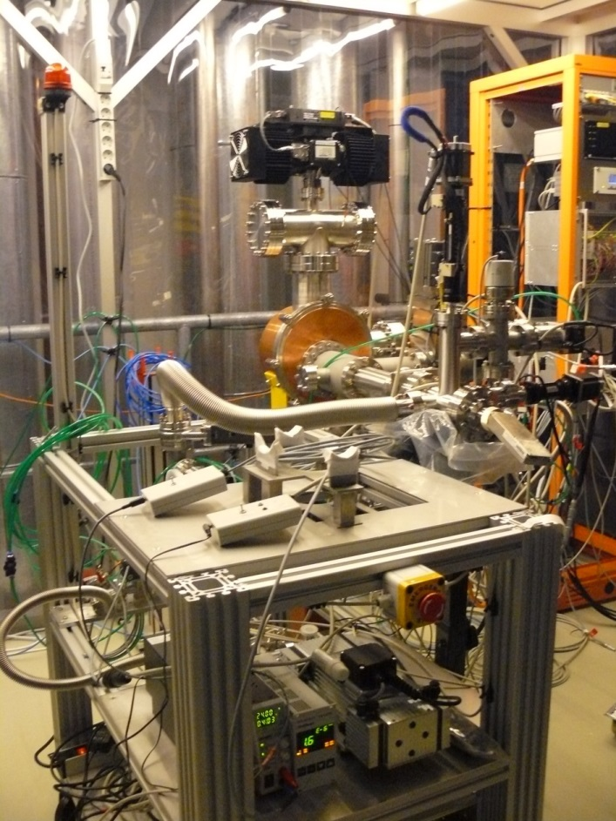
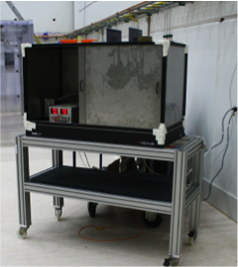
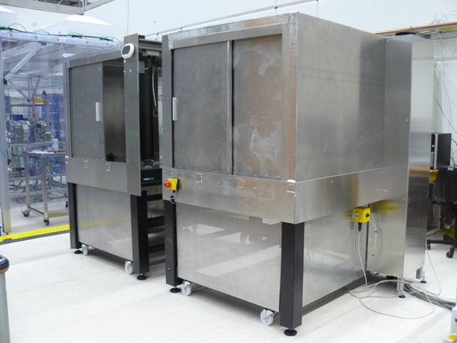
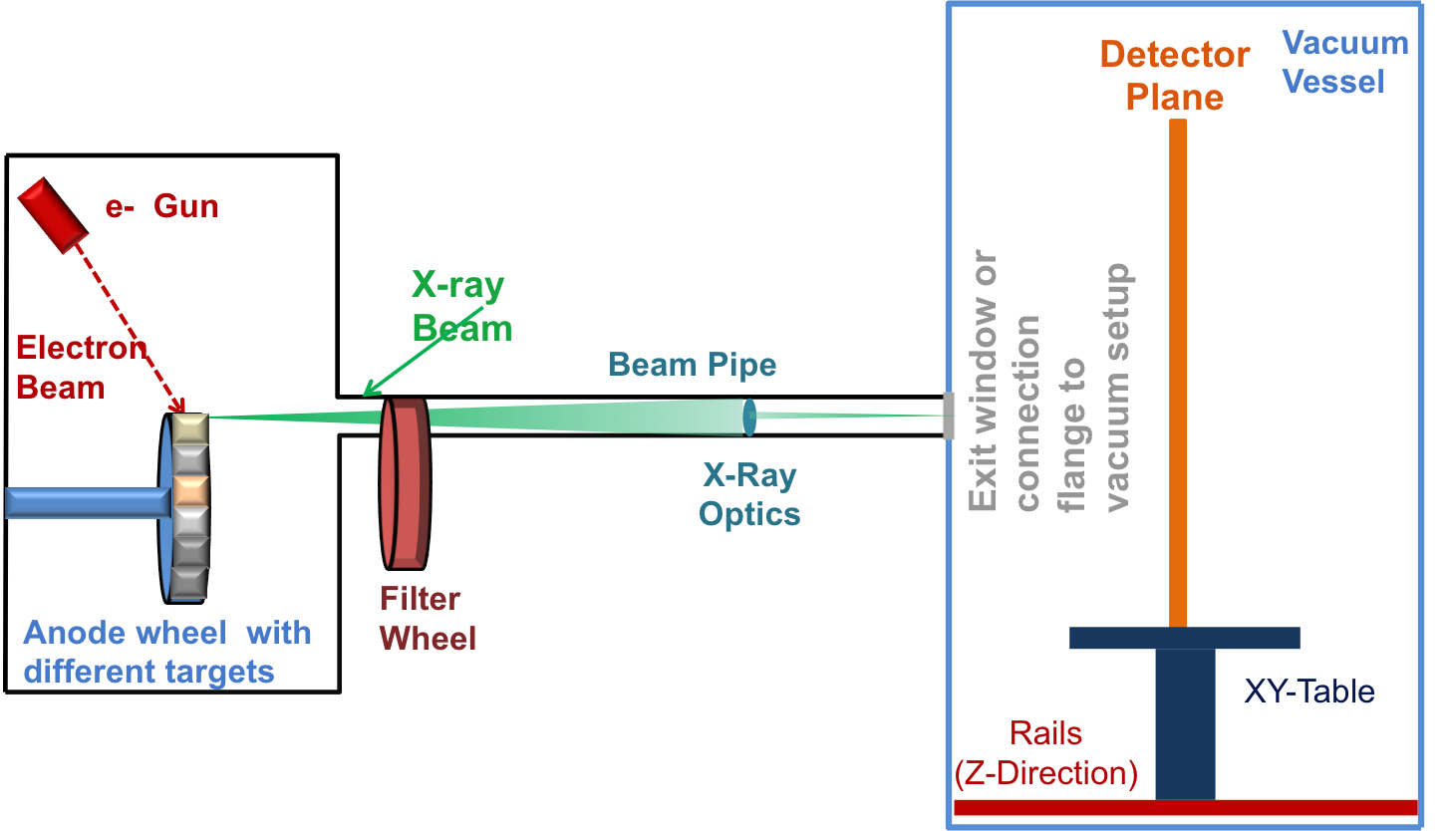
In-House Calibration and Commissioning Tools
Phoebe
Test of small detectors and detector tiles
Radioactive isotopes e.g. ⁵⁵Fe up to a few GBq
Flexible system for vacuum operation
Little/Big Amber
Operation of single detector tiles and detector modules up to ¼ Mpix
Detector operation under controlled and dry
atmosphere conditions
In combination with X-ray optics point like or parallel beam illumination is possible
¼ Mpix DAQ and control backend
PulXar
Operation of detector modules and full detec-tors up to 1 Mpix (XHQ) ¼ Mpix (HERA South)
XFEL timing and pulse structure
Full 1 Mpix DAQ and control backend
Phoebe
Little Amber
Big Amber
PulXar
Notes:
The concept is to built up infrastructure for XFEL in several steps.
Problem is …
→ go through right part of the slide
What are the specifications, requirements → next slide

Slide 14
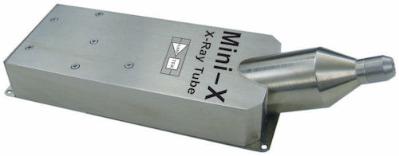
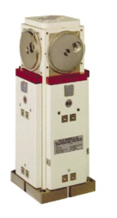
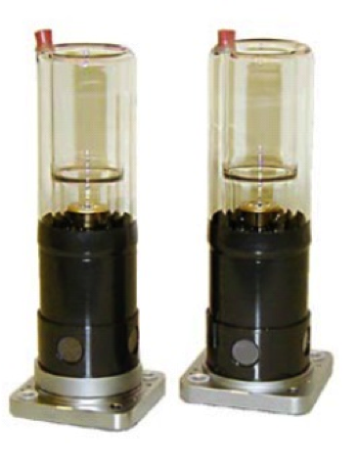
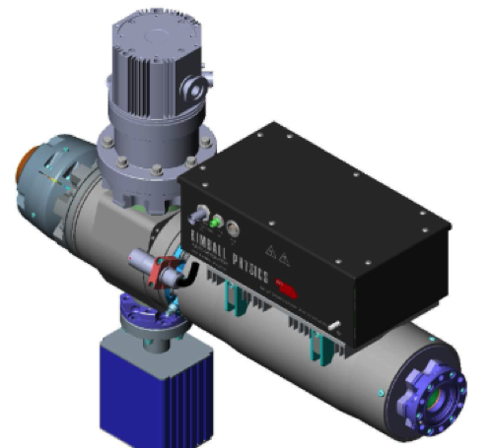
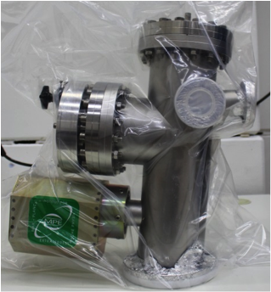
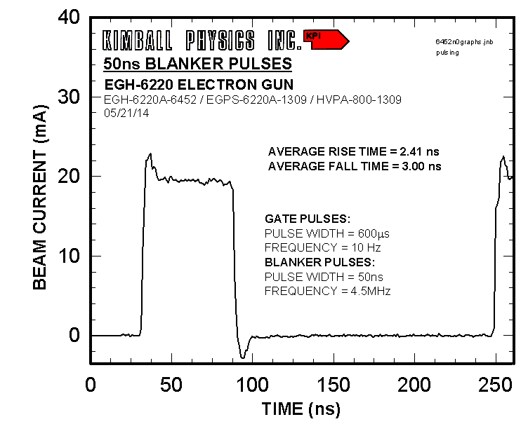
In-House Calibration and Commissioning Tools
Standard Sources
Radioactive isotopes e.g. ⁵⁵Fe up to a few GBq
Low power commercial X-ray tubes
“High Intensity” Sources
Different target materials
→ different photon energies 0.2 to 16 keV
In combination with X-ray optics point like or parallel beam illumination
Up to 10⁶ photons/s/pixel continuous
Pulsed Electron/X-ray Source
XFEL timing and pulse structure and
continuous operation
e⁻ current up to 20 mA
Point like and small area illumination
e⁻ and X-ray generation
Up to 1000 photons/pixel/pulse @ 4.5 MHz
Low Power
X-ray Tube
Single-Target
X-ray Tubes
Pulsed e⁻ Gun
Multi-Target X-ray Tube
Notes:
The concept is to built up infrastructure for XFEL in several steps.
Problem is …
→ go through right part of the slide
What are the specifications, requirements → next slide

Slide 15
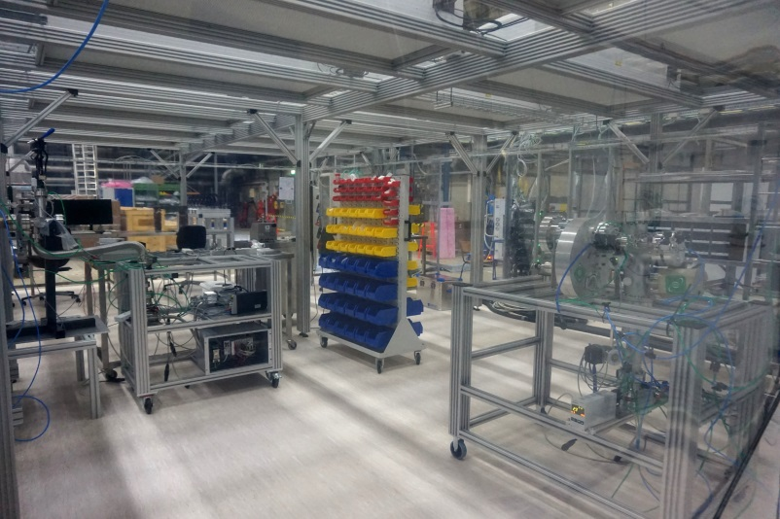
Detector Laboratory in HERA South
Notes:
The concept is to built up infrastructure for XFEL in several steps.
Problem is …
→ go through right part of the slide
What are the specifications, requirements → next slide

Slide 16
Size of Detector Parameter Space
LPD 1 Mpix Detector
Example LPD
x 512 memory cells
x 1 million pixel
= 5 x 10⁸ parameters
and
3 Gain Stages
x 2 Gain Settings
16 Super Modules
256 Detector Tiles
2048 ASICs
Parameter Dependence
Temperature
Integration time/sampling speed
Irradiated dose
Conclusions
Impossible to calibrate and commis-sion many (>3 - 4) combinations for first day of operation (finite time)
Focus on most important operating conditions!

Slide 17
Scientific Requirements for Day-1 Operation
Non Linear System Response
 | DSSC | AGIPD | LPD
Beam structure | Accelerator freq: ~100 kHz, 60 pulses per bunch, 600 pulses/sec, 10 μs pulse separation
Photon energy | 0.5, 0.7, 1, 1.5 keV | 7, 8.3, 9, (15) keV | 12, 15, 20 keV
Expected max. nr of ph/pulse/pixel | 3 x 10³ @1keV (maximum achievable) | 10⁴ @ 12keV(SPB) | >10⁴ @12 keV
Dynamic range as a function of the radial detector position | YES, sensor by sensor (ASIC unit)
Single photon detection | Not requested | Yes (MID) | Yes, at 20keV (minimum requirements)
Alignment precision | Alignment on quadrant level needs to be stable and known on level of 1/10 of the pixel size
Veto capability | Yes | Yes | Yes
Simulation data (typical patterns) | Simulations of FeRh LCLS experimental data to see performance to be provided | Simulated data, initially to investigate interoperation of detector-sim with SPB s2e-sim | FXE provided simulated data to compare updated LPD specs with requirements
Other requirements | Calibration with filters

Slide 18
Detector Operation Modes – First Day
Non Linear System Response
DSSC
AGIPD
LPD
 | Mode I | Mode II | Mode III
Read Out Frequency | 4.5 MHz
Photon Energy | 1 keV | 1.5 keV | 0.7 keV
Max # of ph/pulse/pixel | 3 x 10³ @1keV (maximum achievable)
Read Out Geometry | Full Frame
Single Photon Sensitivity | No
Alignment Precision | 1/10 of the pixel size (quadrant level)
Veto Capability | Yes&
Memory | 800 Cells (full memory)
Mode I | Mode II | Mode III
4.5 MHz
8.3 keV# | 15 keV | 7 keV
10⁴ @12.4 keV (maximum achievable)
Full Frame
Yes 0.15 ph RMS Noise |  | No
1/10 of the pixel size
Yes&
352 Cells (full memory)
Mode I | Mode II | Mode III
4.5 MHz |  | < 4.5 MHz
12 keV* | 20 keV | 12 keV*
> 10⁴ @12.4 keV (maximum achievable)
Full Frame
Yes 0.35 ph RMS Noise | Yes 0.21 ph RMS Noise | Yes$ < 0.21 ph RMS Noise
1/10 of the pixel size
Yes&
512 Cells (full memory)
&Remove empty frames for different bunch patterns
#Same performance is expected for 7 – 12 keV
*Same performance is expected for 7 – 9 keV
$Feasibility to be confirmed
Notes:
LPD
Operation mode 1
E=12 keV (the same performance is expected at 7-9 keV)
RMS noise = 1200 e- (0.35 ph@12 keV)
Single photon sensitivity at 7-9 keV is not required
Max. nr of ph/pulse/pixel before saturation > 10⁴ photons
Full frame readout
4.5MHz repetition rate (full memory, i.e. 512 memory cells)
Veto/data reduction capability to adjust to the pulse rate
Alignment precision – according to WP-75 definition (see “Detector Alignment at European XFEL: Concepts & Responsibilities” on Alfresco)
Operation mode 2:
E= 20 keV
0.21 ph noise @ 20 keV
Rest stays the same as in the mode 1
Operation mode 3:
E= 12 keV (the same performance expected at 7-9 keV)
Longer readout circle (no 4.5MHz speed) mainly for longer reset (noise reduction) if the feasibility study will show improvement in the detector performance (i.e. lower noise)
Rest stays the same as in the mode 1

Slide 19
Detector Operation Modes – First Day
Non Linear System Response
DSSC
AGIPD
FastCCD
 | Mode I | Mode II | Mode III
Read Out Frequency | 4.5 MHz
Photon Energy | 1 keV | 1.5 keV | 0.7 keV
Max # of ph/pulse/pixel | 3 x 10³ @1keV (maximum achievable)
Read Out Geometry | Full Frame
Single Photon Sensitivity | No
Alignment Precision | 1/10 of the pixel size (quadrant level)
Veto Capability | Yes&
Memory | 800 Cells (full memory)
Mode I | Mode II | Mode III
4.5 MHz
8.3 keV# | 15 keV | 7 keV
10⁴ @12.4 keV (maximum achievable)
Full Frame
Yes 0.15 ph RMS Noise |  | No
1/10 of the pixel size
Yes&
352 Cells (full memory)
Mode I | Mode II | Mode III
10 Hz
1 keV | 1.5 keV | 0.7 keV
3.6 x 10² @1 keV (maximum achievable)
Full Frame
Yes
1/10 of the pixel size
Not available
Not available
&Remove empty frames for different bunch patterns
#Same performance is expected for 7 – 12 keV
Notes:
LPD
Operation mode 1
E=12 keV (the same performance is expected at 7-9 keV)
RMS noise = 1200 e- (0.35 ph@12 keV)
Single photon sensitivity at 7-9 keV is not required
Max. nr of ph/pulse/pixel before saturation > 10⁴ photons
Full frame readout
4.5MHz repetition rate (full memory, i.e. 512 memory cells)
Veto/data reduction capability to adjust to the pulse rate
Alignment precision – according to WP-75 definition (see “Detector Alignment at European XFEL: Concepts & Responsibilities” on Alfresco)
Operation mode 2:
E= 20 keV
0.21 ph noise @ 20 keV
Rest stays the same as in the mode 1
Operation mode 3:
E= 12 keV (the same performance expected at 7-9 keV)
Longer readout circle (no 4.5MHz speed) mainly for longer reset (noise reduction) if the feasibility study will show improvement in the detector performance (i.e. lower noise)
Rest stays the same as in the mode 1

Slide 20
Calibration Plan & Schedule – Example DSSC
+1 year
+1 year
+1 year
XFEL
Munich
+1 year
XFEL
Munich
+1 year
+1 year

Slide 21
Steps Towards First Day of Operation
Before delivery of the detector to XFEL
Early performance testing and commissioning of prototype systems (single modules/quadrants) together with developer groups with in-house and external sources
Control and DAQ integration as early as possible
Participate in and perform performance optimization and calibration together with development groups
LPD
DSSC
XFEL
AGIPD
Delivery of the detector to XFEL
Verification of detector performance, control system and DAQ/data management system “end-to-end” test in the XFEL detector laboratories at HERA South without XFEL beam
Commissioning and initial calibration of the detector at HERA South before integration of the system into the beam line experiment
Detector Integration into and Commissioning at Beam Line
DAQ and control system installation will take place before the detector will be installed
Installation of the detector system and functional tests (vacuum, mechanics, control system, DAQ system, data management system) → repeat end-to-end test at beam line
Commissioning and alignment with XFEL beam in-situ
Detector ready for first day user operation

Slide 22
Detector Tests and Commissioning – HERA South
End-To-End Test
Goal of the Test
Demonstrate the functionality of the detector system including all subcomponents and identify potential problems before system acceptance and integration at beam line.
What will be Tested?
Vacuum, cooling and movement system
Detector control system
C&C and veto system
DAQ and data management system including calibration data base
Data processing pipeline and calibration pipeline
Detector operation modes I-III for first day operation (priority)
Data and calibration data quality checks
Where and How will be Tested?
HERA South: BigAmber or PulXar depending on tests to be performed
Data taking with and without X-rays
Sequentially all four quadrants of a detector at full speed 4.5 MHz
Notes:
Before you start editing the slides of your talk change to the Master Slide view: Menu button “View”, Master, Slide Master:
Edit the following 2 items in the 1st slide: 1) 1st row in the violet header: Delete the existent text and write the title of your talk into this text field 2) The 2 rows in the footer area: Delete the text and write the information regarding your talk (same as on the Title Slide) into this text field.
If you want to use more partner logos position them left beside the DESY logo in the footer area Close Master View

Slide 23
Steps Towards First Day of Operation
Before delivery of the detector to XFEL
Early performance testing and commissioning of prototype systems (single modules/quadrants) together with developer groups with in-house and external sources
Control and DAQ integration as early as possible
Participate in and perform performance optimization and calibration together with development groups
LPD
DSSC
XFEL
AGIPD
Delivery of the detector to XFEL
Verification of detector performance, control system and DAQ/data management system “end-to-end” test in the XFEL detector laboratories at HERA South without XFEL beam
Commissioning and initial calibration of the detector at HERA South before integration of the system into the beam line experiment
Detector Integration into and Commissioning at Beam Line
DAQ and control system installation will take place before the detector will be installed
Installation of the detector system and functional tests (vacuum, mechanics, control system, DAQ system, data management system) → repeat end-to-end test at beam line
Commissioning and alignment with XFEL beam in-situ
Detector ready for first day user operation

Slide 24
Detector Tests and Commissioning – at Experiment (First Steps)
Without XFEL Beam
Requirements
Same conditions as for End-To-End test this time at experiment
Calibration source installed and operational
Detector installed and safety interlocks fully operational
No direct and not attenuated beam can hit the detector
Tests to be done
Detector performance verification measurements of Operating Mode I-III with and without calibration source under nominal operation conditions (pressure, temperature, sampling speed)
Analysis of performance data and update of CalDB
With XFEL Beam
Requirements
Same conditions as for End-To-End test this time at experiment
Calibration source installed and operational
Detector installed and safety interlocks fully operational
No direct and not attenuated beam can hit the detector
Tests to be done
Alignment measurement with diffraction sample
Detector performance verification measure-ments of Operating Mode I-III with XFEL beam
Analysis of performance data and update of CalDB
Final operation tests with up-to-date CalDB and alignment data
Notes:
Before you start editing the slides of your talk change to the Master Slide view: Menu button “View”, Master, Slide Master:
Edit the following 2 items in the 1st slide: 1) 1st row in the violet header: Delete the existent text and write the title of your talk into this text field 2) The 2 rows in the footer area: Delete the text and write the information regarding your talk (same as on the Title Slide) into this text field.
If you want to use more partner logos position them left beside the DESY logo in the footer area Close Master View

Slide 25
Commissioning – Base Line Operating Modes
Required Pulse Patterns
Nominal Pulse Pattern
Single Pulse per Train
2700 Pulses
Pulse Train
Pulse Train
Pulse Train
Pulse Train
Time
100 ms (10 Hz)
Time
100 ms (10 Hz)
220 ns
600 μs
Two or More Pulses per Train
One Pulse Every Second Train
(10 Hz Detectors)
Pulse Train
Pulse Train
Pulse Train
Pulse Train
Pulse Train
100 ms (10 Hz)
Time
100 ms (10 Hz)
Time
220 ns or n x 220 ns
Notes:
Before you start editing the slides of your talk change to the Master Slide view: Menu button “View”, Master, Slide Master:
Edit the following 2 items in the 1st slide: 1) 1st row in the violet header: Delete the existent text and write the title of your talk into this text field 2) The 2 rows in the footer area: Delete the text and write the information regarding your talk (same as on the Title Slide) into this text field.
If you want to use more partner logos position them left beside the DESY logo in the footer area Close Master View

Slide 26
Commissioning – Base Line Operating Modes
Nominal Pulse Pattern
Further Requirements
Most important photon energies 0.7, 1, 1.5,
7, 8.3, 12, 20 keV more are welcome
Beam monitor accuracy for I₀ measurement
Beam intensity up to 10⁵ ph/pixel/pulse
Beam profile characterized
Beam attenuators for intensity scans
(gain and dynamic range validation)
Unfocussed beam (d ≈ few centimeters or more) and focused beam (d ≈ 20 μm)
Fluorescent target for e.g. flat field measurements and ⁵⁵Fe source installed in experiment chamber
2700 Pulses
Pulse Train
Pulse Train
100 ms (10 Hz)
Time
600 μs
Stable Experiment Infrastructure
Vacuum, cooling and movement system
Detector control, C&C and veto system
DAQ/data management system including calibration data base
Data processing pipeline and calibration pipeline
Reference sample for alignment measurements
Assumption
Infrastructure is operational and tested up to the level that is possible without a detector.
Notes:
Before you start editing the slides of your talk change to the Master Slide view: Menu button “View”, Master, Slide Master:
Edit the following 2 items in the 1st slide: 1) 1st row in the violet header: Delete the existent text and write the title of your talk into this text field 2) The 2 rows in the footer area: Delete the text and write the information regarding your talk (same as on the Title Slide) into this text field.
If you want to use more partner logos position them left beside the DESY logo in the footer area Close Master View

Slide 27
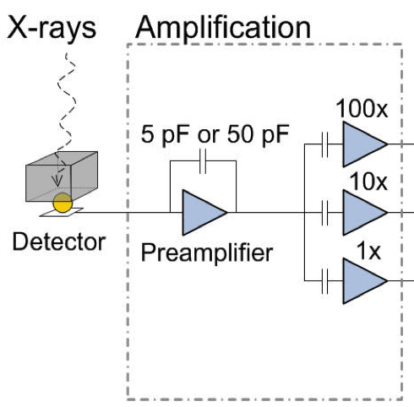
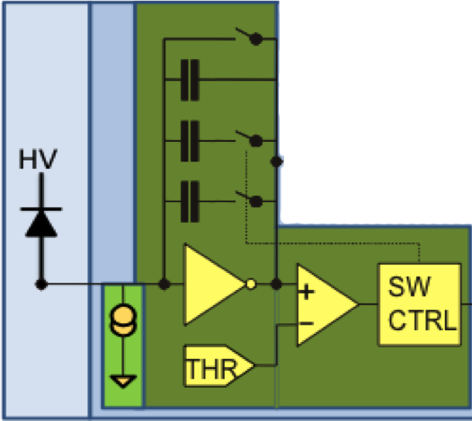
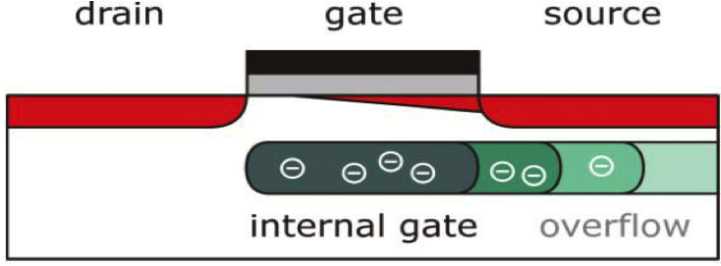
Dynamic Range Scan and Gain Validation
Mult. Linear Amplifiers + ADC
Implementations
Multiple
parallel amplification
stages
Gain switching or charge resetting mechanism
Non linear component on front-end or sensor level (sensor, preamplifier)
High
Medium
Low
Digital Output
Number of Incident Photons
Gain Switching Amplifier + ADC
Image:RAL
Digital Output
Number of Incident Photons
None Linear System + ADC
Image: AGIPD Collaboration
Digital Output
Number of Incident Photons
Image: DSSC Collaboration

Slide 28
Dynamic Range Scan and Gain Validation
Mult. Linear Amplifiers + ADC
Gain | Source | Detector
High | PulXar/Panter | AGIPD, DSSC, LPD prototypes, FastCCD, SDD
 | Big Amber | AGIPD, DSSC, LPD prototypes and1 Mpixel, Gotthard V1/2
 | Little Amber | Gotthard V1 and II, LPD 2-tile system
 | Phoebe | DSSC prototype and 1 Mpix, FastCDD, pnCDD
Medium to Low | PulXar/Panter | DSSC prototype and 1 Mpix
 | LED Array | DSSC prototype and 1 Mpix LPD
 | Internal Calibration Circuit | AGIPD/LPD
 | Synchrotrons | AGIPD/DSSC/LPD prototypes
 | LCLS | AGIPD/DSSC/LPD prototypes
All | XFEL | Validation for all detectors
High
Medium
Low
Digital Output
Number of Incident Photons
Gain Switching Amplifier + ADC
Digital Output
Number of Incident Photons
None Linear System + ADC
Digital Output
Number of Incident Photons

Slide 29
Dynamic Range Scan and Gain Validation
Mult. Linear Amplifiers + ADC
Beam Time Estimate for Gain Scan
Required data points per gain and per detector
≈10
x3 gain stages
x3 photon energies
approx. 5h x 3 x 3 = 45 h ≈ 2 days
Breaks possible, instrument team available
Additional planned tests and measurements:
EM compatibility and noise tests
Systematic background studies (beam jet, stray light etc.)
and more depending on requirements …
These studies are presently only partially included in the installation schedule!
High
Medium
Low
Digital Output
Number of Incident Photons
Gain Switching Amplifier + ADC
Digital Output
Number of Incident Photons
None Linear System + ADC
Digital Output
Number of Incident Photons

Slide 30
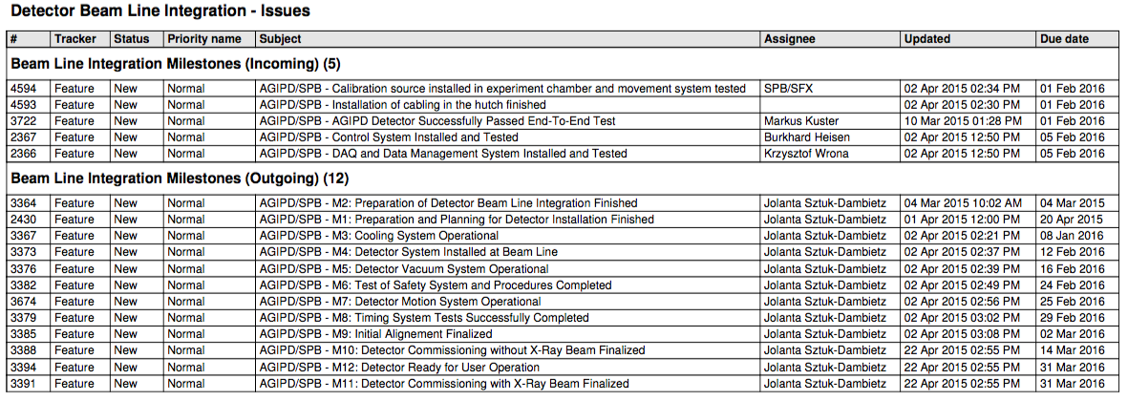
Example: AGIPD 1 Mpx Integration at SPB
Status of Planning
Template resource loaded detector integration schedule exists for vacuum and non-vacuum detectors.
Detailed schedule and approach has been discussed with FXE, SPB and MID.
Milestones have partially been synchronized with scientific groups up to the level presently known.
Responsibilities are agreed with FXE, SPB, MID, CAS, ITDM and AE.
Definition of planning interface to PSPO and TC.

Slide 31
Example: AGIPD 1 Mpx Integration at SPB
Open Issues
Agreement on responsibilities with CIE.
Establish planning interface to PSPO and TC.
Integration of the detector installation schedule into the XFEL “master plan” and resolve collisions.
Fix dates for incoming milestones with instrument groups, AE, ITDM and CAS.
Prepare planning for SQS, SCS, and HED and synchronize milestones.
So far no contingency is foreseen to be consistent with the global XFEL “master plan”.

Slide 32
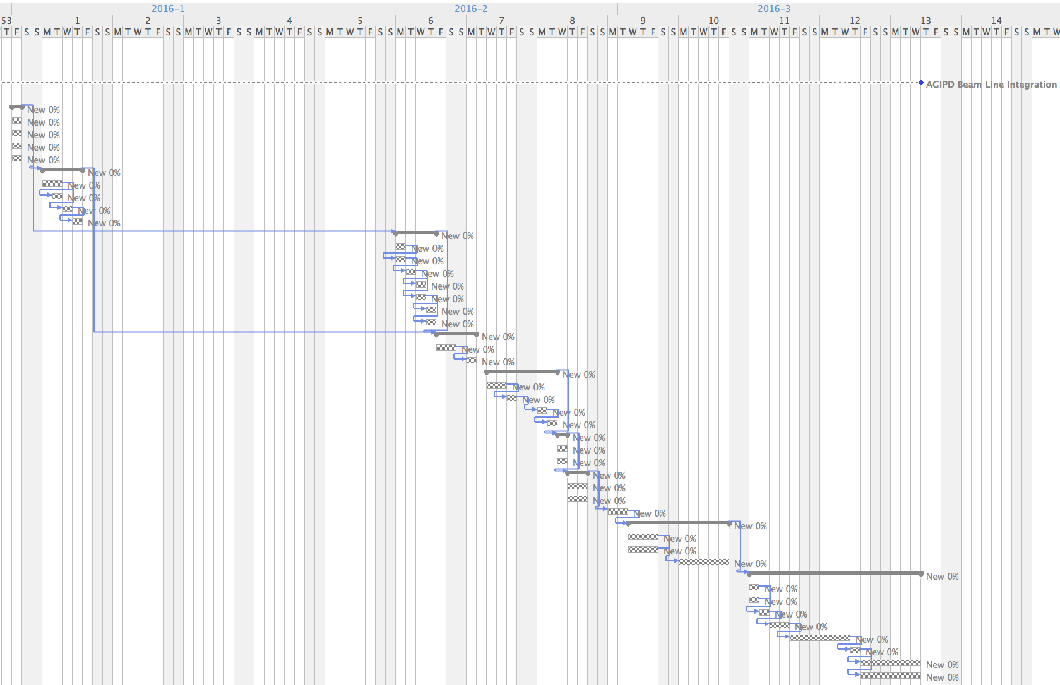
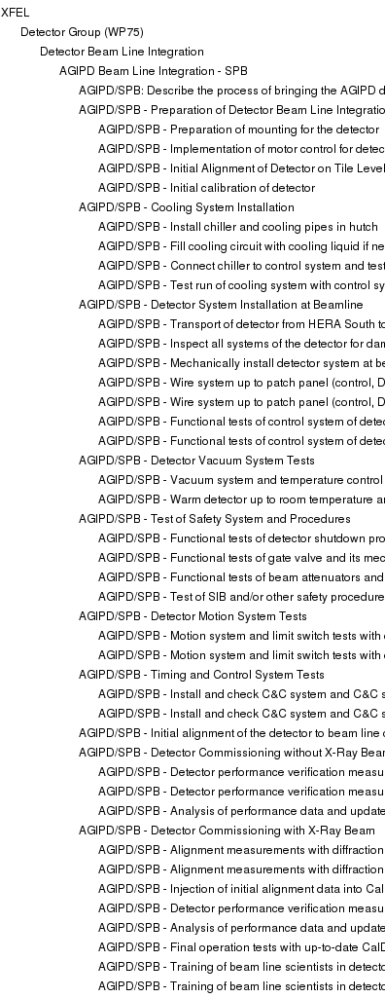
Example: AGIPD 1 Mpx Integration at SPB
Total Duration 8 Weeks
Commissioning without Beam
Commissioning with Beam

Slide 33
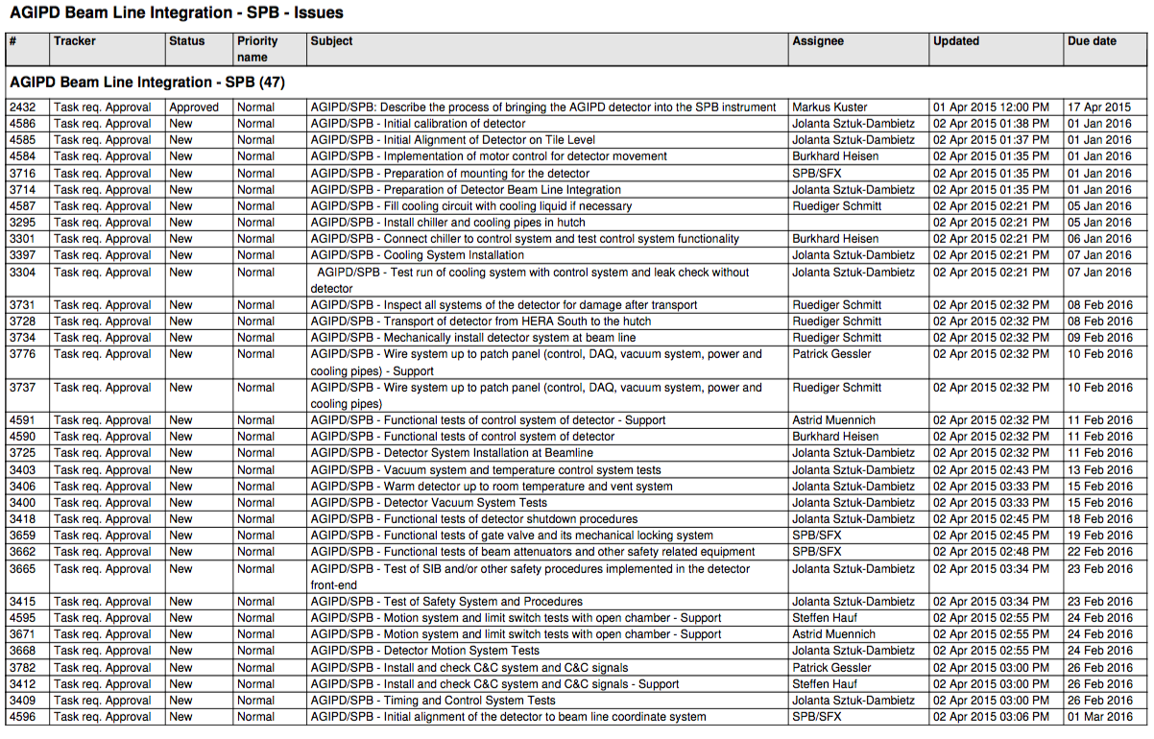
AGIPD 1 Mpx Integration at SPB – Tasks

Slide 34
AGIPD 1 Mpx Integration at SPB – Tasks

Slide 35
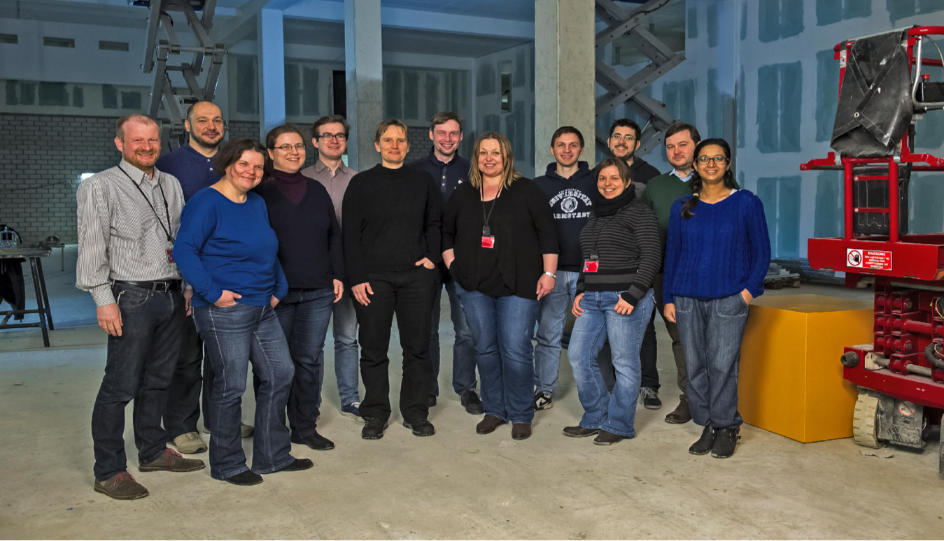
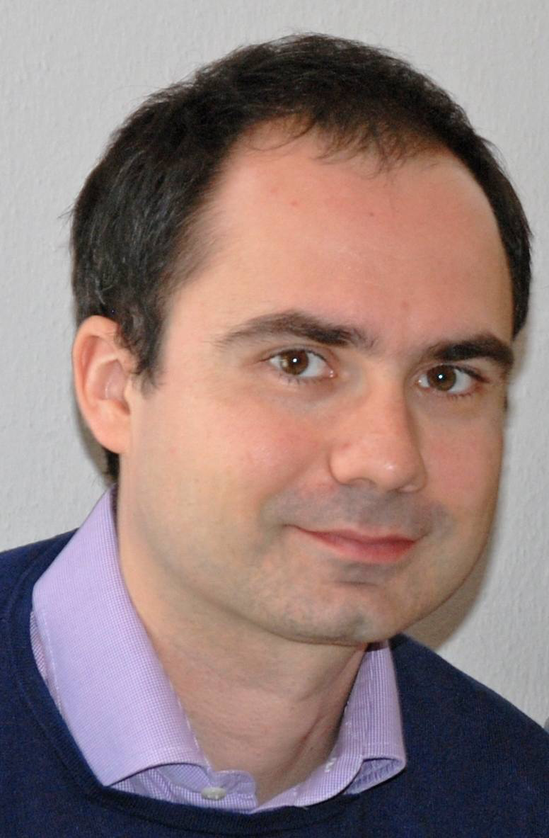
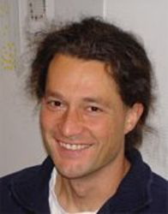
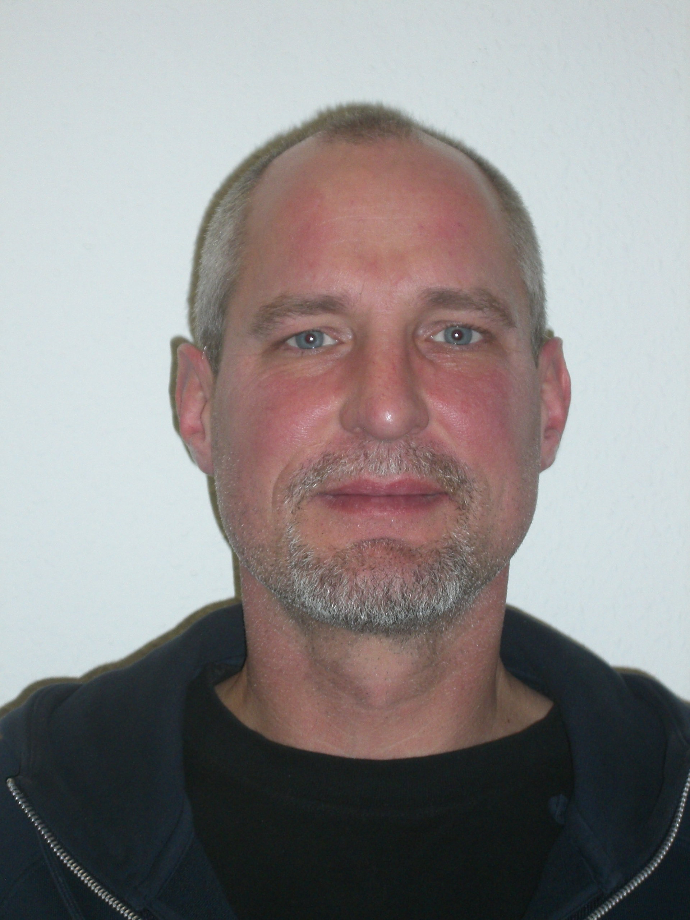
Thank you for your Attention

Slide 36
Bunch Trains
60 to 2700 bunches per train at a 10Hz repetition rate
78 to 3510 W beam power at 130MeV and 1nC (10-472kW at 17.5GeV)
Expected dark current of up to about 30 W at 130MeV and 600 μs
Orbit/energy stability along train (intra-train feedbacks)
Bunches from each train can be used for destructive semi-parasitic diagnostics (emittance, …)
B. Beutner & W. Decking XFEL Commissioning Meeting, 25.02.2015

Slide 37
Injector Commissioning: Goal(s)
Achieve all XFEL parameters
Reduced/relaxed parameter set:
beam charge around 0.5 nC good for diagnostics and LLRF
Linac operation with several tens of bunches
single bunch operation is useless for LLRF diagnostics and studies
many bunch operation is more demanding for machine protection
Quantity | TDR goal | initial goal
macro pulse repetition rate | 10 Hz | 10 Hz
RF pulse length (useable flat top) | 600 μs | 600 μs
bunch repetition frequency within pulse | 4.5 MHz | 100 kHz
bunch charge | 0.02 – 1 nC | 0.5 nC
Slice emittance | 0.4 - 1.0 mm mrad | 1.0 mm mrad
Gun gradient | 60 MV/m | 50 MV/m
B. Beutner & W. Decking XFEL Commissioning Meeting, 25.02.2015

Slide 38
Initial e⁻ Beam Parameters – Bunch Repetition
Linac will be operated with several tens of bunches (not single bunch) as fast as possible
RF pulse length can be varied (gun performance and dark current losses might be limiting factors)
Initially possible repetition rates (injector laser)
Many bunches make European XFEL unique
Should be established as soon as possible
n | bunch repetition frequency [MHz] (=1.3GHz/(n*144) with n>=2 and even) | bunch spacing [ns] | max # of bunches in 600 μs train
2 | 4.514 | 222 | 2700
3 | 3.009 | 333 | 1800
8 | 1.128 | 886 | 670
90 | 0.1003 | 10000 | 60
- | - | - | 1
B. Beutner & W. Decking XFEL Commissioning Meeting, 25.02.2015

Slide 39
Overview of e⁻-Beam & FEL Operation Modes
Bunch charge/compression -> X-ray pulse length
20-1000pC -> 2-100 fs
Long. Bunch shape
Electron energy
8.5, 12, 14, 17.5 GeV
±1.5 % fast scanning
Bunch repetition –
X-ray delivery pattern
From pulse-on-demand to 4.5 MHz
Properties on demand – within bunch train
Simultaneous operation
of 3 (5) experiments
Special
Seeding
Tapering
Variable Polarization
Mulit-color
Instrument can determine
Exact photon energy
Focus size
Bandwidth

