Slide 1
Predicting the Neutrino Flux from the Brightest Gamma-Ray Burst 130427A
Presented by: Amy Joyce
Supervisor: Shan Gao
Group: THAT

Slide 2
A Little Bit of Revision
Intense γ-ray emission from jets
Lorentz factor > 100 → v > 0.9999c
Apparent L_{iso} of 10⁵⁰ to 10⁵⁴ erg/s
Average redshift of z = 2
GRB130427A had a prompt emission of 276 ± 5s.
L_{iso} = 3x10⁵³ erg/s and redshift of z = 0.34.

Slide 3
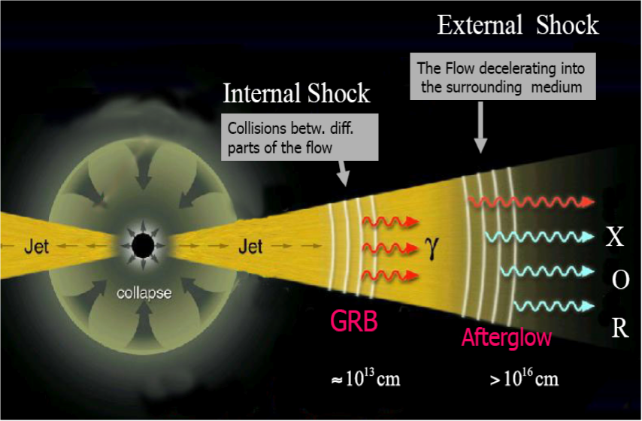
Fireball Internal-External Shocks Model
Internal shocks occur when two shells in the jet collide, producing prompt emission.
External shocks occur when the jet hits the surrounding medium, producing afterglow.
The nature of the inner engine is unknown, but the properties of the GRB give some clues.

Slide 4
Fermi Acceleration and Photon Radiation
Particles are accelerated via Fermi-acceleration mechanism.
After gaining enough energy, they emit photons via synchrotron radiation.
Photons gain energy via inverse Compton and Synchrotron Self Compton.

Slide 5
Photon and Proton Energy
A broken power law is used to describe photon spectrum:
ε^{-α} for ε^{min} < ε < ε^{b}
ε^{-β} for ε^{b} < ε < ε^{max}
Hillas Criterion places an upper limit on the maximum allowable proton energy .
The next step is to consider timescales and cooling rates for the protons.

Slide 6
Timescale and Cooling Rates
Need to consider acceleration timescale, t_{acc}, synchrotron cooling timescale, t_{syn}, adiabatic cooling timescale, t_{ad} and the photomeson cooling rate, .
The total proton loss rate is calculated by:
And the pion production efficiency is expressed as:

Slide 7
Pion and Neutrino Production in GRBs
Pions are produced via photohadronic interactions:
n + π⁺
p + π⁰
And neutrinos are produced via pion decay:
It is assumed that all products of π⁺ and π⁻ decay receive same energy, therefore neutrinos receive 3/8 of charged pion energy.

Slide 8
Calculating Photomeson Cooling Rate
The photomeson cooling rate is:
Analytical approach:
Numerical approach gives a more accurate result.
Assume proton energy spectrum is a power law:

Slide 9
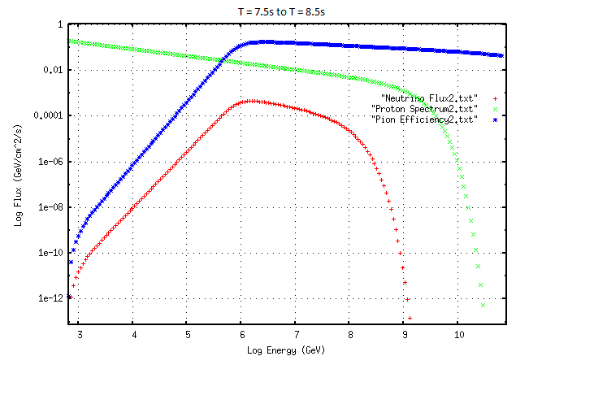
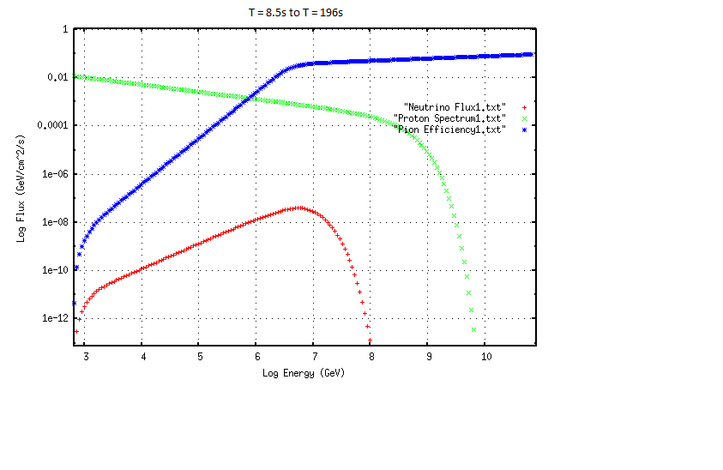
Calculated Neutrino Fluxes from GRB130427A Prompt Emission

Slide 10
Neutrino Fluxes Continued
Second stage has highest peak neutrino flux of 0.00045 GeV/cm²/s.
Diffuse astrophysical neutrino flux detected by IceCube per year in the TeV to PeV energy range is 1.2x10⁻⁸ GeV/cm²/s/sr, roughly 1 event per month.
To compare, the second stage corresponds to 9.5x10-4 events per year, and all three stages correspond to 10⁻³ events per year.
Therefore, the non-detection of neutrinos by IceCube of GRB130427A is an expected result.

Slide 11
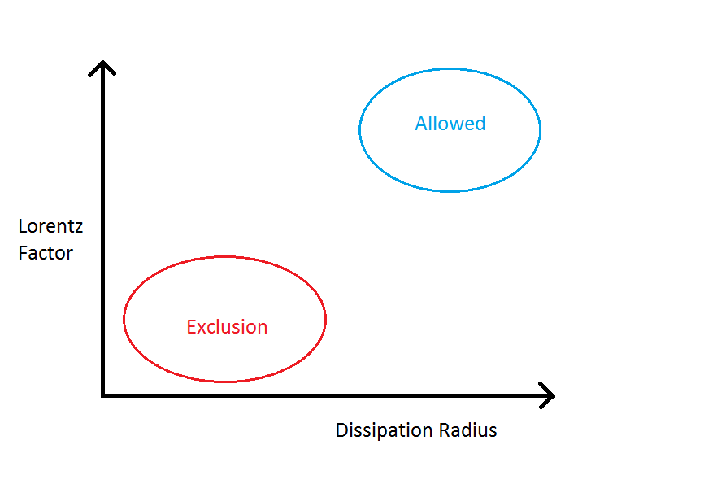
Future Work
Use neutrino constraints to study the allowed parameter space of this GRB, as a supplement to photon messengers, for example:
Study the correlation between the neutrino messengers and photon messengers from this GRB

Slide 12
Acknowledgements
DESY, of course, for this amazing opportunity!
My supervisor, Shan Gao, for his beyond endless patience in explaining everything.
Gernot and Katrin in particular for organising everything.
All of you summer students, just for being fantastic people!

