Slide 1
Beam dynamics study of RF and solenoid fields for PITZ gun without space charge
OUTLINE
PITZ photoinjector
SETUP
Motivation
Simulation and Experiment
Next steps
Niki Vitoratou
Summer Student Project
Zeuthen, 9/8/2015

Slide 2
PITZ beamline
PITZ (Photo Injector Test Facility at DESY, Location Zeuthen )
was built in order to test and to optimize sources of high brightness electron beams for future free electron lasers (FELs) and linear colliders.
Screen 1
Screen 2
Screen 3

Slide 3
SETUP
GRID
Screen1
Screen2
Electron charge 20pC
Screen3

Slide 4
MOTIVATION
Beam dynamics study of RF and solenoids fields for PITZ gun.
Verification of the calibration of solenoids magnetic fields.

Slide 5
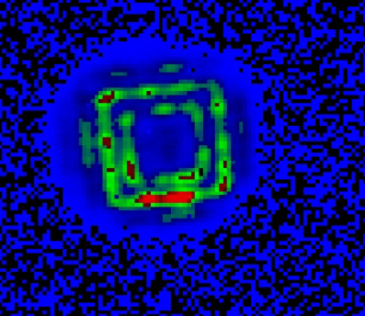
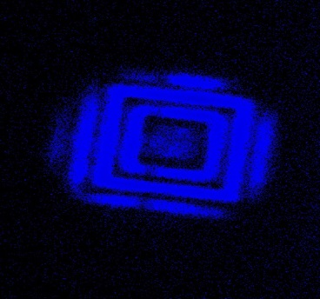
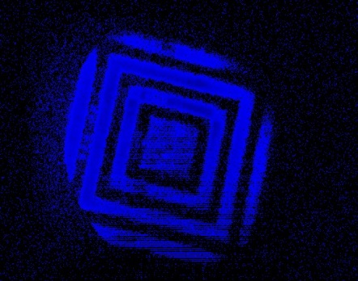
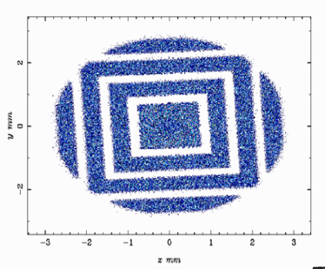
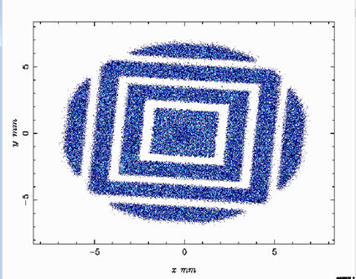
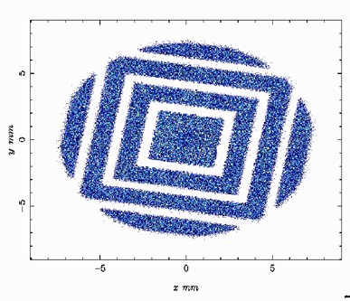
SIMULATION AND EXPERIMENT
Experiment: tranverse plane of beam in the screens with RF gun power 5MW and 20pC beam charge.
ASTRA ( A Space Charge Tracking Algorithm)
beam dynamics simulations
Screen 1
B = 0.272
Screen 2
B = 0.249
Screen 3
B = 0.234
Screen 1
Screen 2
Screen 3

Slide 6
Next steps
Correlation of the experimental data with the simulation.
Acquisition of more data with less RF power in the gun (3MW) .
New simulation of the acquired data.

Slide 7
THANK YOU FOR YOUR ATTENTION!

