Slide 1
Path integrals and the Metropolis method
Marco Di Bella (University of Roma)
Alkistis Zervou (University of Athens)
NIC group
Supervisor: Stefan Schaefer

Slide 2
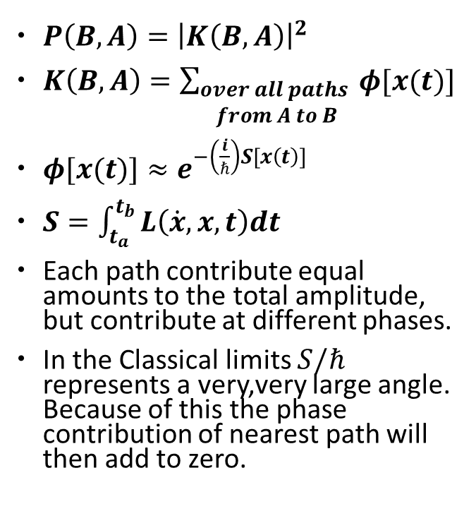
The path integrals introduction I
[1]
$P\left(B,A\right)={\left|K\left(B,A\right)\right|}^{2}$
$K\left(B,A\right)=\sum_{\begin{aligned}over all paths \\ from A to B\end{aligned}}{ φ[x(t)]}$
$φ[x(t)]≈e^{−\left(\frac{i}{ℏ}\right)S[x\left(t\right)]}$
$S=\int_{t_{a}}^{t_{b}}{L\left(\dot{x},x,t\right)dt }$
Each path contribute equal amounts to the total amplitude, but contribute at different phases.
In the Classical limits $S/ℏ$ represents a very,very large angle. Because of this the phase contribution of nearest path will then add to zero.
[1]
The result of any experiment in which
all of the holes are open requires the
addition of all the amplitudes for each
possible path.

Slide 3
The path integrals introduction II
Analogy with the Riemann Integral
Through an analogous procedure we can define the sum over all paths in this manner by taking a multiple integral over all values of $x_{i}$ for $i$ between 1 and $N−1.$The resulting equation is:
$$K\left(B,A\right)\sim \iint{…\int{φ\left[x\left(t\right)\right]}dx_{1}…dx_{N−1}=}\int_{A}^{B}{e^{\left(−\frac{i}{ℏ}\right)S\left[B,A\right]}Dx(t)}$$
Where: $\int{Dx(t)}=\int_{− ∞}^{∞}{\prod_{i=1}^{N−1}{dx_{i}}}$
Now if we define the action on the coordinates of the lattice then we can write the ampitude of a single step through the lattice in this way:
$$K\left(i+1,i\right)=\frac{1}{A}exp\left[\frac{iε}{ℏ}L\left(\frac{{x_{i+1}−x}_{i}}{ε},\frac{{x_{i+1}+x}_{i}}{2},\frac{{t_{i+1}+t}_{i}}{2},\right)\right]$$
[1]

Slide 4

The Monte-Carlo Method
${x_{k}}_{ }^{}$= ${({x^{\left(k\right)}}_{1, }^{}{x^{\left(k\right)}}_{2,}^{},….,{x^{(k)}}_{N }^{})}^{T}$
< A> = $\int{.. \int{A(}}x_{k}$) P($x_{k}$) d${x^{(k)}}_{1}$ ..d${x^{(k)}}_{N}$
$P^{eq}=\frac{e^{−S(x_{k})}}{\int{.. \int{e^{−S(x_{k})}}}\text{d}{x^{(k)}}_{1}\text{ ..}\text{d}{x^{(k)}}_{N} }$ based on Boltzmann in the Euclidean time t= iτ.
We need a method to estimate such quantities. Then by using Monte-Carlo, we take the average over all the paths:
<A> = $\frac{1}{M} \sum_{k=1}^{M}{A(x_{k})}$
M is the number of the paths we want to generate .

Slide 5
Markov Process
Εnsures the “importance sampling”. It is used to:
a)generate M configurations (paths)
b)when M >> 0 the probability of the $k^{th}$ configuration to occur is P(eq)
(exactly what we wanted !! )
Wij
$x_{i}{ x}_{j}$
Probing successively ( one coordinate at a time) all coordinates many times.

Slide 6
Metropolis Algorithm
Peaks a form of W ( transitional operator ).
It is a 2 steps procedure so as to update each coordinate:
1)We propose a new value ${{x′}^{(k)}}_{i}$.
2) acceptance/ rejection method to ensure that ${{x′}^{(k)}}_{i}$ has the right distribution.
Now the path has changed !!
For every new path we measure the observable A.
We repeat for as many times as the number M of the paths we want to generate. Then we take the Monte- Carlo average over all the paths <A> = $\frac{1}{M} \sum_{k=1}^{M}{A(x_{k})}$

Slide 7
Application in lattice QCD
Properties:
a) Asymptotic freedom for E >> 0 perturbation theory
b) Confinement (for low E no free quarks & gluons exist)
lattice QCD (non perturbative theory)
4d lattice (we discretize space-time )
128 x ${64}^{3}$x 4 x SU(3) variables !!!!
Monte Carlo

Slide 8
Goal of our project
We are going to apply Monte Carlo methods to the study of simple quantum systems as free particles, harmonic oscillator and (maybe) anharmonic oscillator.
The main object is to calculate values of different observables at the ground state of a particle in arbitrary potential.
We will try to mesure different kinds of observables from the low-lying energy eigenvalues to the ${\left|ψ_{0}(x)\right|}^{2}$.
This project is based on acquiring the base of how to work on the Lattice QCD and how to evaluate values of N-dimensional integral through computing.
GOOD LUCK TO US ALL!!!!
Alkistis &
Marco

