Slide 1
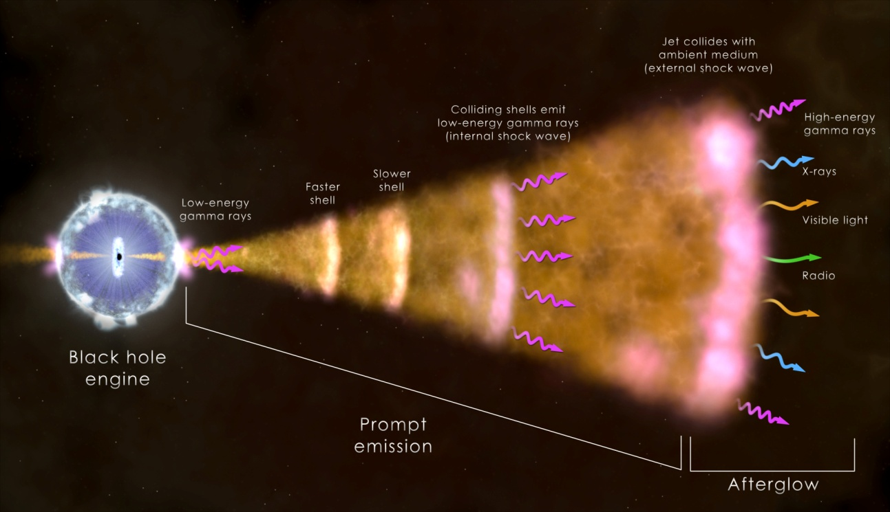
Constraints from the Neutrino Channel on the Brightest GRB
Presented by Amy Joyce
Supervisor Shan Gao
THAT

Slide 2
Gamma Ray Bursts (GRBs)
Intense gamma ray emission (L_{iso}~10⁵⁰ -10⁵⁴erg/s from relativistic jets (Γ > 100)
Short GRBs (prompt emission < 2s) thought to result from “mergers” and long GRBs (prompt emission > 2s) thought to come from collapse of massive star.
Detected ~ once per day with average redshift of <z> ~ 2 from γ-ray to radio.

Slide 3
Neutrino Production in GRBs
Neutrinos are the smoking-gun signature for proton interactions.
Mesons are produced by pγ or pp collisions.
Pions (π⁺, π⁰, π⁻ ) decay to neutrinos via:
π⁺ → ν_{μ} + μ⁺
π⁰ → γ + γ
π⁻ → ν_{μ} + μ⁻
Then:
μ⁺ → e⁺ + ν_{μ} + ν_{e}
μ⁻ → e⁻ + ν_{μ} + ν_{e}

Slide 4
Multi-Wavelength and Multi-Messenger Era for Astronomy
Multi-wavelength: expansion from optical to entire EM spectrum detection.
Multi-messenger: cosmic rays, gravitational waves and neutrinos.
Neutrinos affected only by weak force and gravity.
GRBs, Active Galactic Nuclei, hypernovae and dark matter decay have been proposed as sources.

Slide 5
GRB 130427A
Began early April 27th, 2013
Detected by Fermi-LAT, Swift and numerous other space and ground-based telescopes.
One of the brightest GRBs ever detected
Relatively close, only 3.6 billion light years away (redshift of z = 0.34).
No neutrinos detected by IceCube

